Slide 1
Routing in an Interplanetary Internet
Scott Burleigh
IPNSIG
28 July 2021

Slide 2
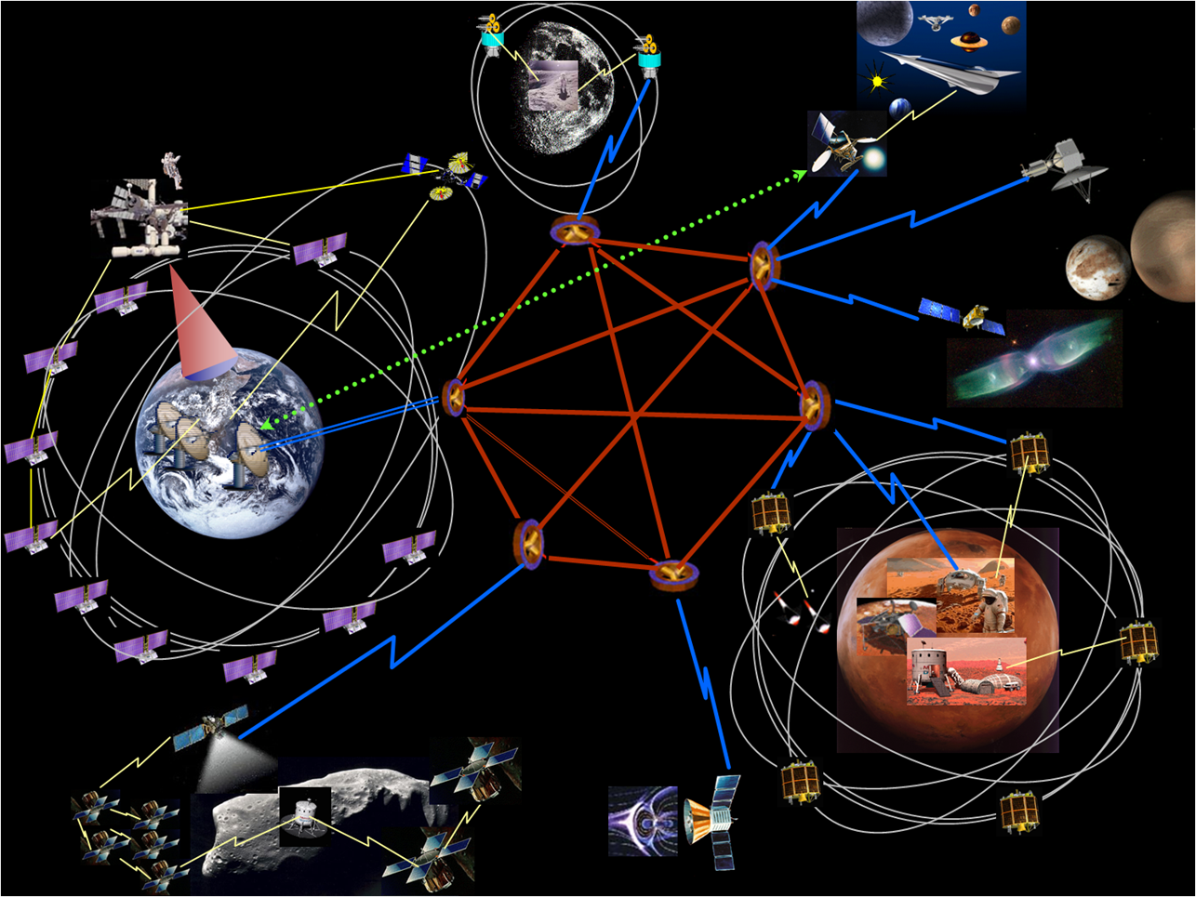
Overview
Evolving toward interplanetary Internet (IPN)
Routing in IPN
How to test it

Slide 3
Motivation
An Internet that extended into interplanetary space would be hugely valuable for space exploration and eventual habitation and industry.
But the Internet as we know it is not suitable for interplanetary communications, because message propagation latencies may be on the order of minutes, hours, or days rather than milliseconds.
Distances are large, measured in light seconds, light minutes, etc.
Network partitions are not anomalous, but may be frequent and/or lengthy.
The evolution that is needed in this case is evolution toward an Internet technology whose operation is tolerant of large message propagation latencies – “delay-tolerant networking” (DTN).

Slide 4
Design notes (1 of 2)
Lengthy propagation times result in lengthy round-trip times.
Communication parameters must be asserted, rather than negotiated: convergence might not occur until the communication opportunity (“contact”) has ended.
Client/server is the wrong model. If you need information right now and don’t have it, you’ve already lost; it’s too late to ask for it. Publish/subscribe works better.
End-to-end retransmission of lost data degrades performance. Retransmission between forwarding points within the network (“custody transfer”) works better.
Change in a node’s topological location while messages are in transit to it may be common.
So the destination of a message should be a node’s ID (name), not its address. Map the name to the final address at the last possible moment (“late binding”).

Slide 5
Design notes (2 of 2)
Network partitioning must result in retention of data at the edge of the partition, awaiting restoration of contact, rather than failure.
This retention may be lengthy. Ample, ideally non-volatile storage is needed.
Since data may commonly be at rest for prolonged periods, the network protocol data units must be kept secure while at rest, not only while in transit. So security should be integrated directly into the network protocol, rather than left to other layers of the stack.
Routing errors may result in data being retained at a single node forever, rather than transiting a closed loop forever. Recovery requires dropping data upon expiration of time-to-live as expressed in seconds rather than in hops.
So accurate clock alignment is desirable.

Slide 6
Evolution or revolution?
The DTN architecture is a generalization of Internet architecture: it works even when message propagation latencies are very short.
But Internet is already extensively optimized for the low-latency environment. Reinventing its capabilities within DTN would be dumb.
Instead, DTN relies on leveraging the specific capabilities of protocols in the underlying “convergence layer”. That is, DTN is an overlay network that interconnects heterogeneous networks (space links, planetary Internets) just as Internet is an overlay network that interconnects heterogeneous subnets (FDDI, Ethernet).

Slide 7
What about routing?
Not surprisingly, long latencies affect routing as well:
You can’t infer a route from the destination address, because there isn’t one.
You can’t rely on message exchange to give you timely notification of changes in the current topology of the network.
Even if you could, the topology of the network might routinely change while messages are in transit.

Slide 8
So how do we route a DTN “bundle”?
When routing through interplanetary space, we can compute a route from the “contact plan” – a standard product of flight mission operations – as it applies to nodes on the end-to-end path to the destination. We know in advance about all changes in connectivity, because they are planned and scheduled.
Absent a contact plan (e.g., where forwarding among free-ranging planetary rovers is opportunistic), we take our best guess based on contact discovery and prior contact history.

Slide 9
Implementations
Contact plans are the basis for “contact graph routing” (CGR), standardized by CCSDS as “schedule-aware bundle routing.” An alternate contact-plan-based algorithm, Spanning-Tree CGR, has been proposed by Olivier de Jonckere.
A wide variety of opportunistic routing systems for DTN have been proposed: Epidemic, PRoPHET, Spray and Wait, Maxprop, many others. Opportunistic CGR has been prototyped.
No final answer. Additional research is needed.

Slide 10
A further wrinkle
While the precise topological location (specific connectivity) of a given node may be highly mutable, perhaps a node’s membership in a single homogeneous collective (“region”) – unified by administrative authority, technology base, routing strategy – may be more stable.
If so, routing across a network comprising a large number of variously configured regions might be enabled by an inter-regional routing mechanism roughly analogous to BGP.

Slide 11
How do we test it?
Space flight missions are expensive. Interplanetary networking is tested almost exclusively in simulation environments.
JPL’s Protocol Technology Laboratory has been testing DTN implementations for many years.
IPNSIG is assembling a large distributed testbed including nodes running on cloud services.
Testing in interplanetary space has occurred just once, during the Deep Impact Network Experiment (DINET) in 2008. For DINET, DTN was exercised over a network that included a node running on the EPOXI spacecraft, between 49 and 61 light seconds from Earth.

Slide 12
Questions?

