Slide 1
Algebraic Analysis and Design of Routing Protocols
João Luís Sobrinho
Instituto Superior Técnico, Universidade de Lisboa
Instituto de Telecomunicações
IETF-111

Slide 2
Outline
Algebraic approach to routing
Analysis: from routing protocols to routing problems
Design: from routing problems to routing protocols
Final remarks

Slide 3
Early networks: shortest paths
1. Algebraic approach to routing
Shortest path routing
Distance-vector
& link-state routing protocols
[Schwartz & Stern 1980]
Notes:
Dijkstra and Bellman-Ford algorithms were well-known by the time shortest-path routing protocols were invented.
In the case of non-restarting distance vector protocols, there the problem of count-to-infinity had to be dealt with.

Slide 4
A variety of networks: non-shortest paths
1. Algebraic approach to routing
Context | Routing | Protocol | Behavior
Quality-of-service | Delay and bandwidth | EIGRP | Sub-optimal paths
Internet | Decentralized policies | BGP | Oscillations
Interconnection | Distinct routing instances | AD & RR | Forwarding loops
Wireless | Generic metrics | old Babel | Black holes
[Varadhan et al. 2000, Griffin et al. 2002, Gouda & Schneider 2003, Le et al. 2008, Sobrinho 2019]
Notes:
Old Babel is RF 6126 from 2011; recent babel is RFC 8966 from 2021. The difference is in section 3.6 “Route selection”.
New protocols are not shortest-path routing protocols.

Slide 5
Routing problems or routing protocols?
1. Algebraic approach to routing
Shortest path routing
What is the routing problem being solved?
What guarantees correct behavior?
Distance-vector
& link-state routing protocols
Non-shortest path routing protocol
(BGP, EIGRP, AD & RR, old Babel, etc.)
Notes:
The development of non-shortest path routing protocols was somewhat ad hoc by adaptation of operation rules of distance vector protocols oftentimes without full comprehension of the global behaviors induced by those adaptations
Sweeping away undesirable behaviors, what is the problem that a non-shortest-path routing protocol is attempting to solve?

Slide 6









Routing algebras
1. Algebraic approach to routing
Attributes $(a, b, c, …)$: context-specific metrics and/or policy decisions
$$a$$
$$a$$
Total order $(≼)$:
$a≺b$
$$b$$
$$a$$
$$b$$
$a⊕b$
Extension operation $(⊕)$:
Algebraic entwinement of total order and extension operation determines behaviors of a routing protocol
Notes:
Difficulty may be recognizing the attributes, total order, and extension operation underlying a non-shortest path routing protocol.
Most routing protocols are generalizations of distance-vector protocols rather than of link-state protocols.

Slide 7







Shortest paths
1. Algebraic approach to routing
Attributes: length, $ℝ_{0}^{+}∪\left\{+∞\right\}$
$$l$$
$$l$$
Total order:
$l<m$
$$m$$
$$l$$
$$m$$
$l+m$
Extension operation:
Notes:
1. Description in common terms with a mathematical substance

Slide 8







Widest paths
1. Algebraic approach to routing
Attributes: width, $ℝ_{0}^{+}∪\left\{+∞\right\}$
$$w$$
$$w$$
Total order:
$w>x$
$$x$$
$$x$$
$$min⁡(w,x)$$
Extension operation:
$$w$$

Slide 9







Shortest-widest paths
1. Algebraic approach to routing
Attributes: (width, length), ${{(ℝ}^{+}∪\{+∞\})×ℝ}_{0}^{+}∪\left\{(0,+∞)\right\}$
$$(w,l)$$
$$(w,l)$$
Total order:
$$w>x ∨ (w=x ∧l<m)$$
$$(x,m)$$
$$(\min\left(w,x\right),l+m)$$
$$(w,l)$$
$$(x,m)$$
Extension operation:
The composite metric of EIGRP generalizes this total order
[Wang & Crowcroft 1996]
Notes:
1. Description in common terms with a mathematical substance

Slide 10






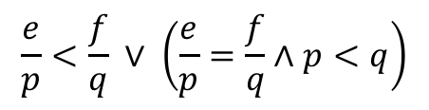
Minimum energy paths
1. Algebraic approach to routing
Attributes: (energy, success probability):${ ℝ}_{0}^{+}×(0,1]∪\left\{(+∞,0)\right\}$
$$(e,p)$$
$$(e,p)$$
Total order:
$$\frac{e}{p}<\frac{f}{q} ∨ \left(\frac{e}{p}=\frac{f}{q}∧p<q\right)$$
$$(f,q)$$
$$(e,p)$$
$$(f,q)$$
$$(e+fp,pq)$$
Extension operation:
End-to-end rather than hop-by-hop retransmissions
[Dong et al. 2005]
Notes:
1. Description in common terms with a mathematical substance

Slide 11
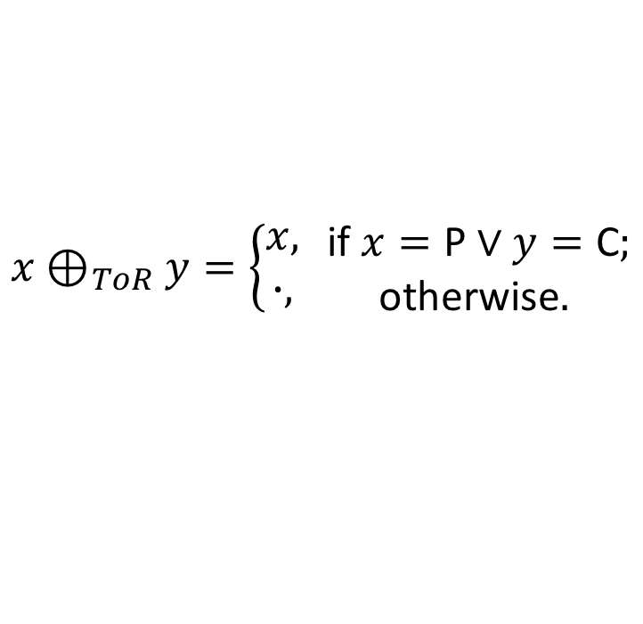

Best type-of-relationship paths
1. Algebraic approach to routing
Attributes: Type-of-Relationship (ToR), $\{\text{C}\text{, }\text{R}\text{, }\text{P}\text{,∙}\}$
Total order:
$$\text{C}≺_{ToR}\text{R}{≺_{ToR}\text{P}≺}_{ToR} ∙$$
Extension operation:
$$x⊕_{ToR}y=\left\{\begin{aligned}x, \\ ∙, \end{aligned}\right.\begin{matrix} \text{if} x=\text{P}∨y=\text{C}; \\ \text{otherwise}.\end{matrix}$$
Every intermediate node along a path must profit from transiting traffic
[Gao & Rexford, 2001]
Notes:
Algebraic formulation of policies at least as they are implemented with BGP. No exportation or importation leads to invalid paths; ranking leads to total order.
Peer routes do not have to be preferred to peer routes

Slide 12
Outline
Algebraic approach to routing
Analysis: from routing protocols to routing problems
Design: from routing problems to routing protocols
Final remarks

Slide 13








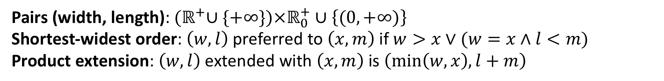













Example: shortest-widest paths
2. Analysis: from protocols to problems
Pairs (width, length): ${{(ℝ}^{+}∪\{+∞\})×ℝ}_{0}^{+}∪\left\{(0,+∞)\right\}$
Shortest-widest order: $\left(w,l\right)$ preferred to $\left(x,m\right)$ if $w>x∨(w=x∧$ $l<m)$
Product extension: $\left(w,l\right)$ extended with $\left(x,m\right)$is $\left(min\left(w,x\right),l+m\right)$
$$v$$
$$u$$
$$w$$
$$(5,2)$$
$$uwx$$
$$\left(5,1\right)$$
$$\left(20,1\right)$$
$$\left(10,8\right)$$
$$uvwx$$
$$u$$
$$\left(20,4\right)$$
$$x$$
$$\left(10,5\right)$$
$$uvx$$
$$vx$$
$$\left(10,2\right)$$
$$\left(10,3\right)$$
$$\left(10,2\right)$$
$$v$$
$$vwx$$
$$\left(20,5\right)$$
Preference
Preference

Slide 14











Vectoring protocol I
2. Analysis: from protocols to problems
$$w$$
$$\left(20,1\right):x$$
$$\left(5,1\right)$$
$$\left(20,1\right)$$
$$\left(+∞,0\right):−$$
$$u$$
$$\left(20,4\right)$$
$$x$$
(width, length): next.hop
$$\left(10,3\right)$$
$$\left(10,2\right)$$
$$v$$
Elected (width, length) in bold

Slide 15
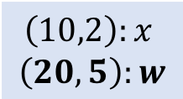
Vectoring protocol II
2. Analysis: from protocols to problems
$$w$$
$$\left(20,1\right):x$$
$$\left(5,1\right)$$
$$\left(20,1\right)$$
$$\left(+∞,0\right):−$$
$$u$$
$$\left(20,4\right)$$
$$x$$
(width, length): next.hop
$$\left(10,3\right)$$
$$\left(10,2\right)$$
$$v$$
Elected (width, length) in bold
$$\left(10,2\right):x$$
$$\left(20,5\right):w$$

Slide 16
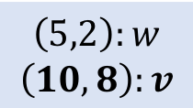
Vectoring protocol III
2. Analysis: from protocols to problems
$$w$$
$$\left(20,1\right):x$$
$$\left(5,2\right):w$$
$$\left(10,8\right):v$$
$$\left(5,1\right)$$
$$\left(20,1\right)$$
$$\left(+∞,0\right):−$$
$$u$$
$$\left(20,4\right)$$
$$x$$
(width, length): next.hop
$$\left(10,3\right)$$
$$\left(10,2\right)$$
$$v$$
Elected (width, length) in bold
$$\left(10,2\right):x$$
$$\left(20,5\right):w$$

Slide 17
Sub-shortest-widest path routing
2. Analysis: from protocols to problems
$$w$$
$$\left(20,1\right):x$$
$$\left(5,2\right):w$$
$$\left(10,8\right):v$$
$$\left(5,1\right)$$
$$\left(20,1\right)$$
$$\left(+∞,0\right):−$$
$$u$$
$$\left(20,4\right)$$
$$x$$
(width, length): next.hop
$$\left(10,3\right)$$
$$\left(10,2\right)$$
$$v$$
Elected (width, length) in bold
$$\left(10,2\right):x$$
$$\left(20,5\right):w$$
data-packets
Data-packets are not forwarded along shortest-widest paths

Slide 18




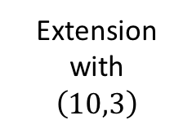










Understanding sub-optimality
2. Analysis: from protocols to problems
$$v$$
$$u$$
$$w$$
$$(5,2)$$
Extension
with
$\left(10,3\right)$
$$\left(5,1\right)$$
$$\left(20,1\right)$$
$$\left(10,8\right)$$
Elected
$$u$$
$$\left(20,4\right)$$
$$x$$
$$\left(10,5\right)$$
Not visible
Hidden
$$\left(10,2\right)$$
$$\left(10,3\right)$$
$$\left(10,2\right)$$
$$v$$
Elected
$$\left(20,5\right)$$
Preference
Preference
Extension inverts the relative preference between two pairs (width, length)

Slide 19
Left-isotonicity
2. Analysis: from protocols to problems
Left-isotonicity
$b≼c ⇒ a⊕b≼a⊕c,$for all attributes$a,b,c$
Extension preserves the relative preference between two attributes
Notes:
1. In the case of vectoring protocols, left-isotonicity implies the na atribute that a node hides from a neighbor is of no interest to the neighbor.

Slide 20
Vectoring protocols under left-isotonicity
2. Analysis: from protocols to problems
Optimal path routing
left-isotonicity,
strictly left-inflationary cycles
Vectoring protocols
(BGP, EIGRP, AD & RR, etc.)
But: left-isotonicity does not hold in many practical cases

Slide 21
The problem solved by vectoring protocols
2. Analysis: from protocols to problems
Optimal destination-based routing
strictly left-absorbent cycles
Vectoring protocols
(BGP, EIGRP, AD & RR, etc.)
Strict left-absorbency is stronger than strict left-inflation but weaker than the combination of strict left-inflation and left-isotonicity [Sobrinho 2016]

Slide 22
Outline
Algebraic approach to routing
Analysis: from routing protocols to routing problems
Design: from routing problems to routing protocols
Final remarks

Slide 23
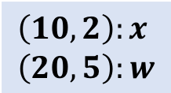
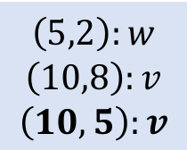
Overcoming sub-optimality
3. Design: from problems to protocols
What is the smallest set of attributes that must be elected to contain the optimal attributes?
$$w$$
$$\left(20,1\right):x$$
$$\left(5,2\right):w$$
$$\left(10,8\right):v$$
$$\left(10,5\right):v$$
$$\left(5,1\right)$$
$$\left(20,1\right)$$
$$\left(+∞,0\right):−$$
$$u$$
$$\left(20,4\right)$$
$$x$$
$$\left(10,3\right)$$
$$\left(10,2\right)$$
$$v$$
(width, length): next.hop
$$\left(10,2\right):x$$
$$\left(20,5\right):w$$
Elected (width, length) in bold
If $v$ elects both $\left(20,5\right)$ and $\left(10,2\right)$, then $u$ does learn $\left(10,5\right)$

Slide 24

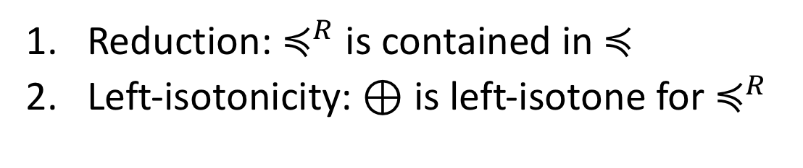
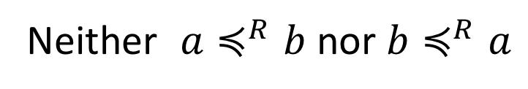

Left-isotonic reduction
3. Design: from problems to protocols
Partial order $≼^{R}$ is a left-isotonic reduction of $≼$
Reduction: $≼^{R}$ is contained in $≼$
Left-isotonicity: $⊕$ is left-isotone for $≼^{R}$
Attributes $a$ and $b$ are incomparable in $≼^{R}$
Neither $a≼^{R}b$ nor $b≼^{R}a$
Every order has a largest left-isotonic reduction
[Lengauer & Theune 1991, Sobrinho & Ferreira 2020]

Slide 25
Example: shortest-widest order
3. Design: from problems to protocols
Shortest-widest order
Product order on pairs (width, length)
Length
Length
Less preferred
Largest
left-isotonic
reduction
Less preferred
Incomparable
Preferred
Incomparable
Preferred
Width
Width

Slide 26









Partial-order vectoring protocol I
3. Design: from problems to protocols
$$w$$
$$\left(20,1\right):x$$
$$\left(5,1\right)$$
$$\left(20,1\right)$$
$$\left(+∞,0\right):−$$
$$u$$
$$\left(20,4\right)$$
$$x$$
$$\left(10,3\right)$$
$$\left(10,2\right)$$
$$v$$

Slide 27
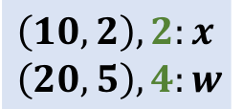
Partial-order vectoring protocol II
3. Design: from problems to protocols
$$w$$
$$\left(20,1\right):x$$
$$\left(5,1\right)$$
$$\left(20,1\right)$$
$$\left(+∞,0\right):−$$
$$u$$
$$\left(20,4\right)$$
$$x$$
(width, length), label: next.hop
$$\left(10,3\right)$$
$$\left(10,2\right)$$
Elected (width, length) in bold
$$v$$
$$\left(10,2\right),2:x$$
$$\left(20,5\right),4:w$$
Locally unique labels distinguish elected pairs (width, length)

Slide 28
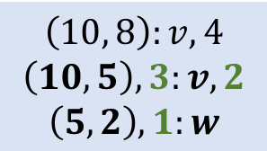
Partial-order vectoring protocol III
3. Design: from problems to protocols
$$w$$
$$\left(20,1\right):x$$
$$\left(10, 8\right):v,4$$
$$\left(10,5\right),3:v,2$$
$$\left(5,2\right),1:w$$
$$\left(5,1\right)$$
$$\left(20,1\right)$$
$$\left(+∞,0\right):−$$
$$u$$
$$\left(20,4\right)$$
$$x$$
(width, length), label: next.hop; next.label
$$\left(10,3\right)$$
$$\left(10,2\right)$$
Elected (width, length) in bold
$$v$$
$$\left(10,2\right),2:x$$
$$\left(20,5\right),4:w$$
Labels propagated alongside pairs (width, length)

Slide 29
Shortest-widest-path routing
3. Design: from problems to protocols
$$w$$
$$\left(20,1\right):x$$
$$\left(10, 8\right):v,4$$
$$\left(10,5\right),3:v,2$$
$$\left(5,2\right),1:w$$
$$\left(5,1\right)$$
$$\left(20,1\right)$$
$$\left(+∞,0\right):−$$
$$u$$
$$\left(20,4\right)$$
$$x$$
2
(width, length), label: next.hop; next.label
$$\left(10,3\right)$$
$$\left(10,2\right)$$
Elected (width, length) in bold
$$v$$
$$\left(10,2\right),2:x$$
$$\left(20,5\right),4:w$$
2
labeled data-packets
Data-packets are forwarded along shortest-widest paths

Slide 30
Future networks: specification of routing paths?
3. Design: from problems to protocols
Optimal path routing
strictly left-inflationary cycles
Partial-order vectoring protocol
Partial-order is the largest left-isotonic reduction of the total order
[Sobrinho & Ferreira 2020]
Notes:
Although I presented a running example concerning shortest-widest paths, the implications of isotonicity to inter-AS routing has additional insights concerning the relationship between individual incentives and social welfare. Left-isotonicity implies that what is best for me is best for may neighbor. When we want to upgrade the inter-AS routing system from a global state A to a global state B in the presence of left-isotonicity AS have local incentives to do their part in the direction of B

Slide 31
Final remarks
Insight into the operation of routing protocols
Unified analysis of routing protocols; not just vectoring protocols
Principled design of routing protocols; not just optimality problems
Notes:
Other protocols: restarting vectoring protocols.
Multiple optimality criteria; constraints on paths such as going through a chain of services; optimal path with na approximation tolerance.
BGP policies can be formulated an optimal path problema.

Slide 32




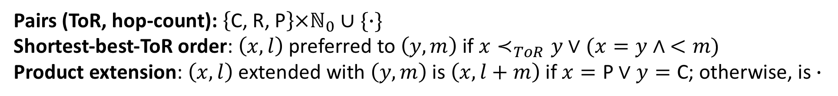




















Example: shortest-best-ToR paths
Pairs (ToR, hop-count): $\left\{\text{C}\text{, }\text{R}\text{, }\text{P}\right\}×ℕ_{0}∪\{∙\}$
Shortest-best-ToR order: $\left(x,l\right)$ preferred to $\left(y,m\right)$ if $x≺_{ToR}y∨(x=y∧$ $<m)$
Product extension: $\left(x,l\right)$ extended with $\left(y,m\right)$is $\left(x,l+m\right)$ if $x=\text{P}∨y=\text{C}$; otherwise, is $∙$
$$w$$
$$v$$
$$(\text{P},4)$$
$$vwu_{1}u_{2}x$$
$$y$$
$$R$$
$$w$$
$$\text{R}$$
$$C$$
$$\left(\text{P},3\right)$$
$${vu}_{3}u_{4}x$$
$$u_{1}$$
$$u_{2}$$
$$\left(\text{P},2\right)$$
$$vwx$$
$$P$$
$$x$$
$$wx$$
$$\left(\text{R},1\right)$$
$$u_{4}$$
$$v$$
$$u_{3}$$
$$P$$
$$wu_{1}u_{2}x$$
$$\left(\text{C},3\right)$$
Preference
Preference

Slide 33








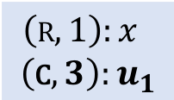


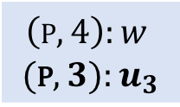



BGP
$$\left(R,1\right):x$$
$$\left(\text{C},3\right):u_{1}$$
$$y$$
$$R$$
$$w$$
$$R$$
$$C$$
$$u_{1}$$
$$\left(R,4\right):w$$
$$u_{2}$$
$$P$$
$$x$$
$$u_{4}$$
$$u_{3}$$
$$\left(\text{C},0\right):−$$
(ToR, hop-count): next.hop
$$v$$
$$P$$
$$\left(\text{P},4\right):w$$
$$(\text{P},3):u_{3}$$
Elected (ToR, hop-count) in bold
data-packets
Data-packets are not forwarded along shortest-best-ToR paths

Slide 34

















No left-isotonicity
$$w$$
$$v$$
Extension
with
$\left(\text{P},1\right)$
$$(\text{P},4)$$
$$y$$
$$R$$
$$w$$
$$R$$
$$C$$
$$\left(\text{P},3\right)$$
Elected
$$u_{1}$$
$$u_{2}$$
$$P$$
$$\left(\text{P},2\right)$$
Not visible
$$x$$
$$u_{4}$$
Hidden
$$\left(\text{R},1\right)$$
$$v$$
$$u_{3}$$
$$P$$
Elected
$$\left(\text{C},3\right)$$
Preference
Preference

Slide 35






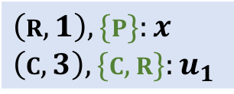


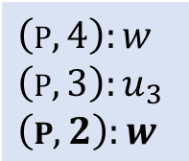



Partial-order BGP
$$\left(R,1\right), \{P\}:x$$
$$\left(C,3\right), \{C,R\}:u_{1}$$
Forwarding as a function of incoming links; labels not required
$$y$$
$$R$$
$$w$$
$$R$$
$$C$$
$$\left(R,4\right):w$$
$$u_{1}$$
$$u_{2}$$
$$P$$
$$x$$
$$u_{4}$$
(ToR, hop-count), in_links: next.hop
$$\left(P,4\right):w$$
$$\left(P,3\right):u_{3}$$
$$\left(P,2\right):w$$
$$u_{3}$$
$$\left(C ,0\right):−$$
$$v$$
$$P$$
Elected (ToR, hop-count) in bold
data-packets
Data-packets are forwarded along shortest-best-ToR paths

Slide 36
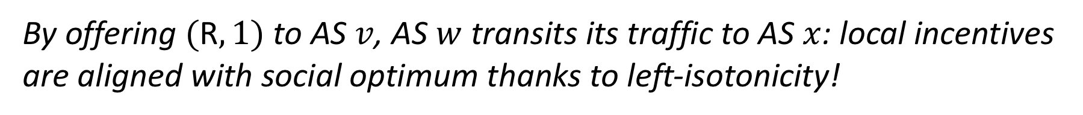
Deployment and incentives
$$\left(R,1\right), \{P\}:x$$
$$\left(C,3\right), \{C,R\}:u_{1}$$
Stub ASes run BGP
ISPs have local incentives to adopt partial-order BGP
$$y$$
$$R$$
$$w$$
$$R$$
$$C$$
$$\left(R,4\right):w$$
$$u_{1}$$
$$u_{2}$$
$$P$$
$$x$$
$$u_{4}$$
$$\left(P,4\right):w$$
$$\left(P,3\right):u_{3}$$
$$\left(P,2\right):w$$
$$u_{3}$$
$$\left(C ,0\right):−$$
$$v$$
$$P$$
By offering $(\text{R},1)$to AS $v$, AS $w$ transits its traffic to AS $x$: local incentives are aligned with social optimum thanks to left-isotonicity!

