Slide 1
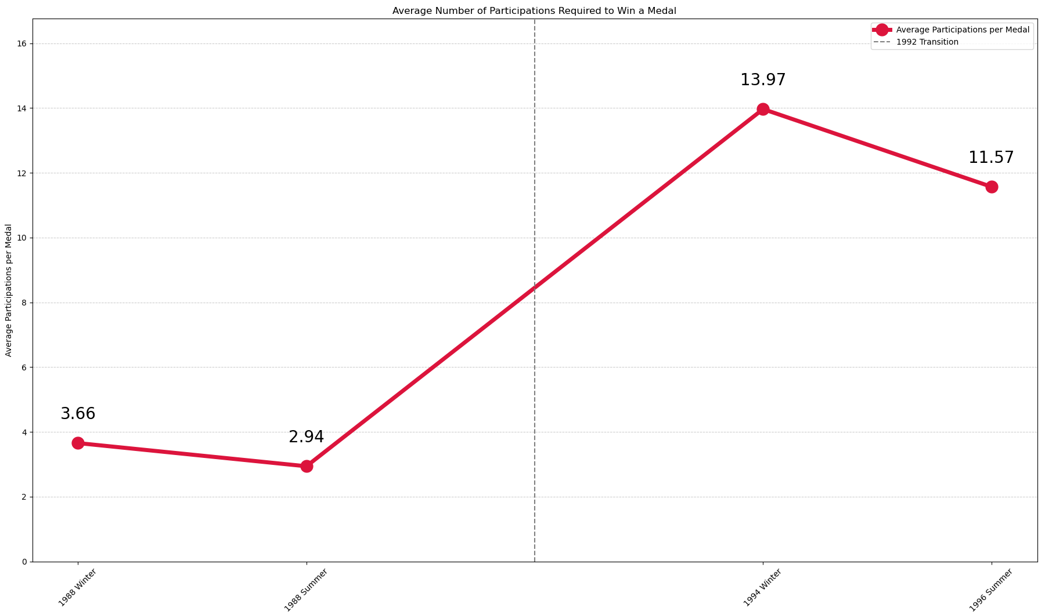
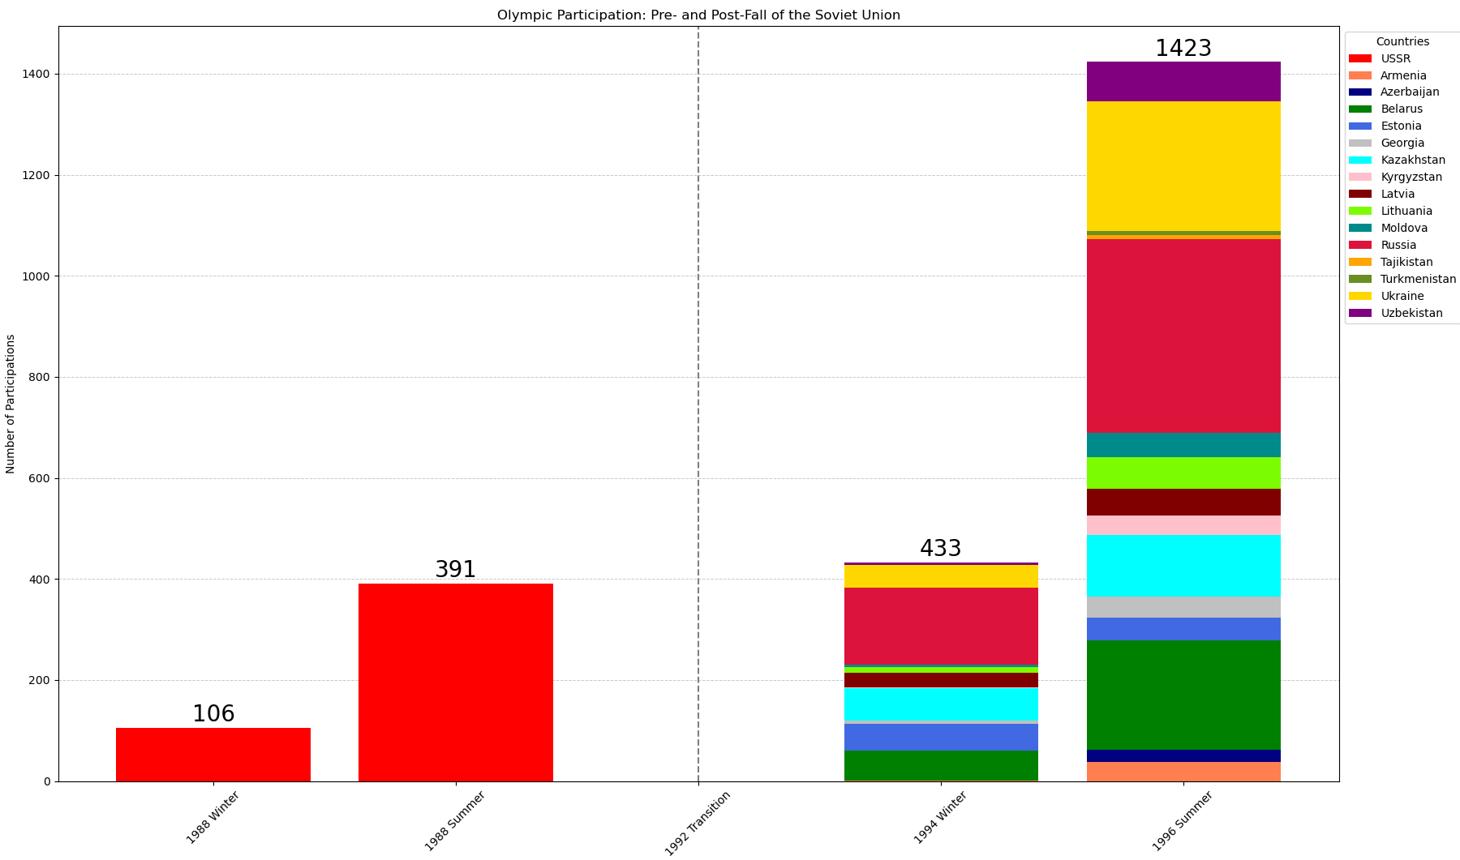
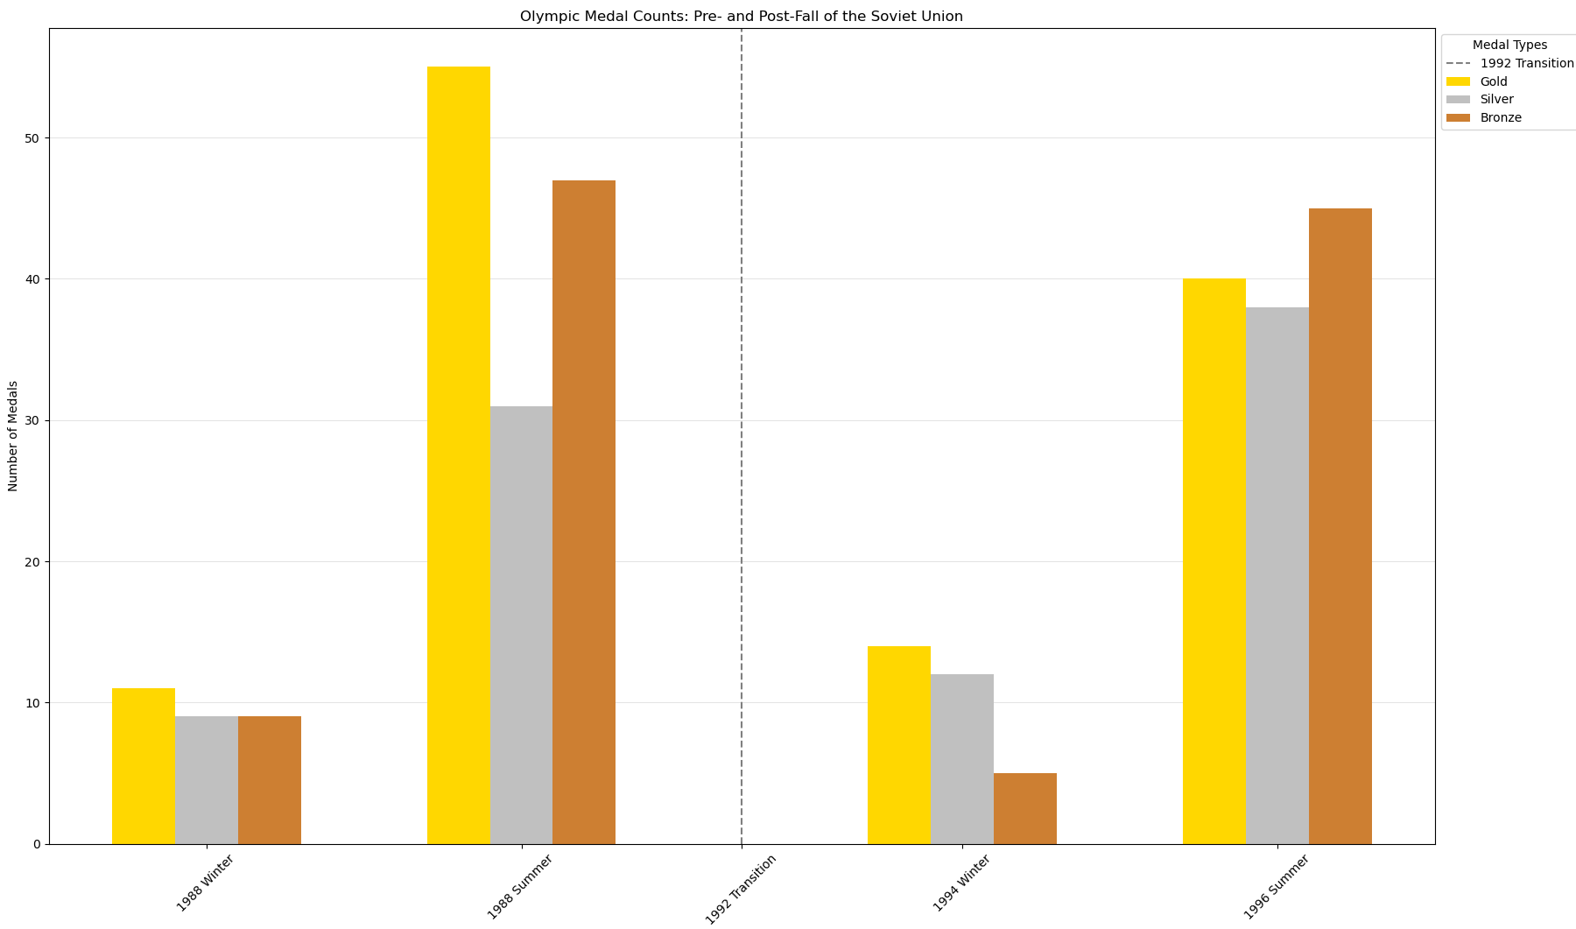
UV Applied AI in Python – Daniel Krall
How did the Fall of the Soviet Union impact their Performance at the Olympics?
In 1991, the Soviet Union, one of the most successful countries in the history of the Olympic Games, collapsed. In my research I tried to find differences between the Soviet Union and its successor states, regarding participation and medals won. Due to the Eastern Bloc’s boycott of the 1984 Winter Olympics, I decided to focus on two Olympics Games (1988 Winter and Summer) before and two Olympic Games (1994 Winter and 1996 Summer) after the fall of the Soviet Union. Data from the 1992 Games is not included and marked as “Transition Period”, as most of the former Soviet states competed within a unified team, with some exceptions (i.e. the Baltic states). For the medal data, I used the combined values of the successor states and compared them with pre-fall results to get a better comparison. Furthermore, the resulting graphs show whether the Soviet Union and its successor states were more successful in Winter or Summer Games.
Comparison of Participations per Medal
The dataset included all members of a team etc. and was changed so only one athlete
represented each team, to not distort the number of participations or medals.
Key Findings:
Increased Participation
This can be seen in the first graph. The most likely explanation is that quotas now allowed all the newly formed nations to send their own athletes, even ones that wouldn’t have made it into a Soviet team. Sports can also be a political tool and in this case a team can showcase a country’s newly won independency and represent it on an international stage.
Difference in Medals won
The second graph shows that there is a change in their success. When we involve the number of participations and show the connection between them and the number of medals won, we get a clearer picture of the pre- and post-fall results in the third graph. While in the 1988 Winter Games the Soviet Union only needed 2.94 participations on average to win a medal, this rose to 11.57 in 1996 for their successor states. There are most likely several reasons, like the before-mentioned athletes that wouldn’t have made it into the Soviet team, the centralized support for all Soviet athletes ceasing to exist, state-sanctioned doping programs not being continued due to their costs, and many more.
Success in Summer Games
From the third graph we can also tell that not only the Soviet Union but also its successor states were more successful in Summer Games compared to Winter Games.
Number of Participations – Divided into successor states for post-fall Games
Medals Won – Combined Results for post-fall Games
Sources: “120 years of Olympic history: athletes and results“ on kaggle.com and olympics.com

