Slide 1
How and Why Electrons Move
Description for Mr. Kuncik’s Physics Class

Slide 2
1: Expectations
What you need to know

Slide 3
Questions to know how to answer:
What particle moves around the circuit?
How fast do electrons move around a circuit?
How many electrons move at a time around a circuit?
Where do they come from? How did electrons get into the electric circuit at all?
Why do the electrons move around the circuit?
How do they know where do go? Why do they move only through a wire, and not anything else?
Also: know how to draw a diagram showing what happens at a subatomic level in an electric circuit.

Slide 4
Expectation
For each question, you need to know the right answer
But you also (and much more importantly) need to be able to explain why a wrong answer is wrong.

Slide 5
2: Inside the wire
What is happening in the wire form a subatomic view?

Slide 6
First Question: What particle moves around the circuit?
A. only electrons move around the circuit
B. electrons and protons move around the circuit

Slide 7
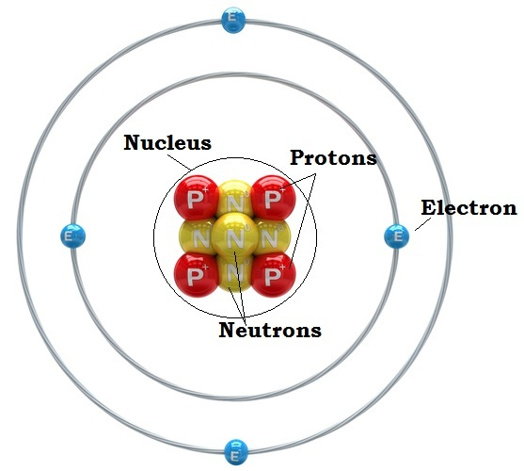
Protons are contained in the nucleus, and are not able to move.
Only electrons, outside the nucleus, are able to move.

Slide 8
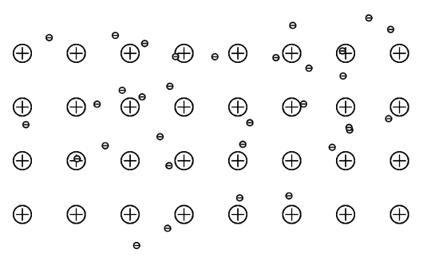
Why does electric current exist only in a wire?
The structure of atoms within a metal is different than other substances:

Slide 9
Atomic Structure of a metal (conductor)
Protons are arranged into a grid structure
Valence electrons are able to move freely between the protons.
Electric current can flow only where electrons can move freely.

Slide 10
3: Electron Motion
Describing how electrons move around the circuit.

Slide 11
Second Question: How fast does an electron move around the circuit?
At the speed of light (300,000,000 m/s)
Maybe not that fast, but very very fast
A normal walking speed
Slower than a lazy tortoise

Slide 12

This fast:
A typical speed of an electron in a wire is approximately 1 inch per hour!
How can that be???? And why do the light bulbs turn on instantly if the electron is moving so slow???

Slide 13

NOT WHAT ELECTRONS DO:
When we say “electrons move through the circuit,”
That doesn’t mean they move through in a straight line like a parade.

Slide 14
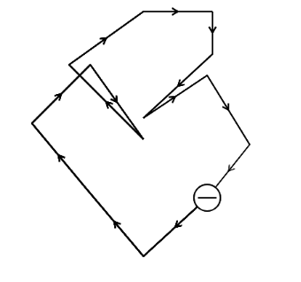
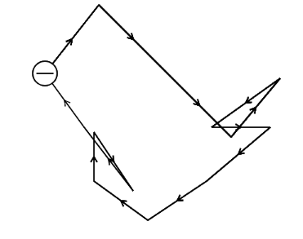
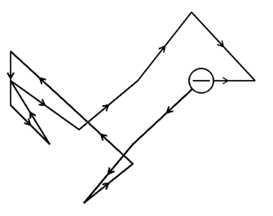
Electrons are always in random motion around the wire.
A wire, with three electrons in it:
The electrons are moving all the time, in all directions,
but they never actually end up going anywhere!

Slide 15
The electrons are moving all the time, in all directions, but they never actually end up going anywhere!

Slide 16
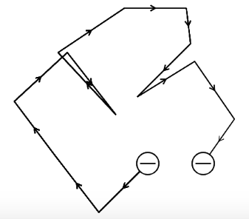
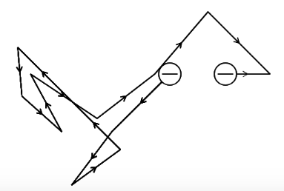
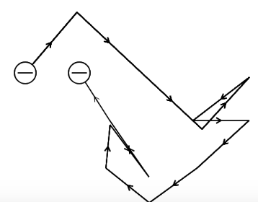
Force pushing electrons
When the wire is connected to a battery, the electrons continue to move completely randomly, but each time they move they go a little bit to the right.
Each electron ends up drifting a little bit to the right!

Slide 17
A wire, not connected to a battery:
The same wire, connected to a battery:
Force pushing electrons
Notice in the bottom wire, the electrons always end up a little bit to the right!

Slide 18
This is called the electron drift.
Instead of saying that electrons move around a circuit, its actually somewhat more correct to say they drift around the circuit!
The “drift velocity” the speed at which they drift, is only about 1 inch per minute!

Slide 19
4: How Batteries Work
Describing what pushes and pulls electrons as they move around the circuit

Slide 20
Where do the electrons in the current come from?
A. on the negative side of the battery is a big chunk of electrons that are being sent out of the battery
B. on the negative side of the battery is a chemical that is releasing electrons as part of a chemical reaction

Slide 21
Why are electrons pulled towards the positive end of the battery?
A. on the positive end of the battery is a big chunk of protons that attracts the electrons.
B. on the positive end of the battery is a chemical that receives electrons as part of a chemical reaction

Slide 22
A misconceptions….
Many high school students, when asked how batteries work, say that there is a big chunk of positive charges on one side and a big chunk of electrons on the other side…and the electrons come out of one side and then go all the way to the other side:

Slide 23
How many students say a battery works:
Lots of protons over here
Lots of electrons over here
+
+
+
DURACEL
-
-
+
+
-
-
+
+
-
-
-
-
+
+
-
+
NOT TRUE!
-
+
-
-
+
+
+
-
-
The electrons want to get to the protons on the other end!

Slide 24
How a battery actually works:
A chemical that accepts electrons in a reaction
A chemical that gives up electrons in a chemical reaction
+
-
DURACEL
Cu
Zn
Cu
Zn
Zn
Cu
Cu
Zn
Cu
Zn

Slide 25
Some vocabulary
Cathode: The chemical that accepts electrons (on the positive end)
Anode: the chemical that gives up electrons (on the negative end)
Electrodes: The anode and cathode
Oxidation: Losing electrons in a chemical reaction (at the anode)
Reduction: Gaining electrons in a chemical reaction (at the cathode)

Slide 26
The expectation
On a test, it will not be enough to say what the right answer is
You also need to say why the wrong answer couldn’t possibly be true!

Slide 27
Explain: why could this not possibly work:
Lots of protons over here
Lots of electrons over here
+
+
+
DURACEL
-
-
+
+
-
-
+
+
-
-
-
-
+
+
-
+
-
+
-
-
+
+
+
-
-

Slide 28
True or False:
Every electron that leaves the anode travels all the way to the cathode.
FALSE!
Why?
Electrons move far to slow for this to be true! (see above!)

Slide 29
What actually happens
An electron leaves the anode and goes into the wire.
Another electron comes out of the wire and goes into the cathode.
Meanwhile, positive ions move across the battery, completing the chemical reaction!

Slide 30
WIRE
An electron moves out of the wire and into the cathode.
-
An electron moves out of the anode into the wire
-
+
-
DURACEL
Cu
Zn
Cu
Zn
Zn
Cu
A positive ion moves across the battery to complete the reaction.
Zn
Cu
Cu
Zn

Slide 31
WARNING!
This is a very simplified version of how a battery works.
The actual chemical reactions involved are far more complex.
For this class, we need only enough knowledge to explain why electrons move so we can analyze the circuitry mathematically.
For a more detailed description of the chemical reactions within a battery, look in any chemistry textbook on oxidation-reduction reactions and electrochemistry.

Slide 32
5: Why Electrons Drift in the Wire
What pushes and pulls electrons around the circuit.

Slide 33
6: Where electric current comes from

Slide 34
Electrons alter their behavior by a tiny tiny bit, and drift at the speed of a tortoise in slow motion….
But, the billions upon billions of electrons inside of the wire all drift slowly together, they create an extremely powerful motion of charge
- that motion of cahrge is called an electric current

Slide 35
7: Conventional Current and Electric Field
Concepts required to mathematically analyze an electric circuit.

Slide 36
Two really annoying things you need to worry about:
Electric field: an arrow showing the direction that positive charges move.
Conventional Current: the direction that positive charges move?

Slide 37
Electric Field: This is an arrow indicating the direction that a positive charge will move.
Negative charge (electrons) move in the direction opposite the electric field arrows.
But, positive charges don’t move (they are trapped in the nuclei), and negative charges move in the dire

Slide 38
Force pushing electrons
Electric field

Slide 39
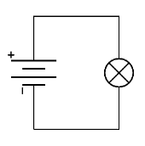
Conventional Current
We always say that electric current moves from the positive side of the battery to the negative side.

Slide 40
Electrons have a negative charge, and they move this way!
But, we pretend that current has a positive charge, and moves this way! Sorry.

Slide 41
But how can you get away with being wrong like that?
They are mathematically equivalent!
Something positive moving the the left, and something negative moving to the right are mathematically equivalent!
+++++++++++
---------------

Slide 42
Why this obnoxiousness?
Electric current was discovered before electrons (or protons) were.
The early scientists who created models of electric current didn’t know that it was the negative charges that moved.
So, when studying electric current, everything is backwards.
Sorry!

Slide 43
In all my college classes, my professors would just blame Ben Franklin.
I never really understood why.
Probably because he first posited that lightning bolts are caused by tiny moving particles.

Slide 44
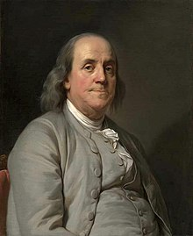

Slide 45
8: Expectations Revisited
What do you need to know about this slideshow

