Slide 1
CG3201 Lab 1 Briefing
<TA_name>

Slide 2


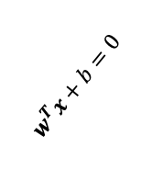

Support Vector Machine (SVM)
$$x_{2}$$
$$x_{2}$$
$$w^{T}x+b=0$$
$$w^{T}x+b=0$$
$$x_{1}$$
$$x_{1}$$

Slide 3
Support Vector Machine (SVM)
$$x_{2}$$
Margin
$$x_{2}$$
Margin
$$w^{T}x+b=0$$
$$w^{T}x+b=0$$
Decision boundary
$$x_{1}$$
Decision boundary
$$x_{1}$$

Slide 4

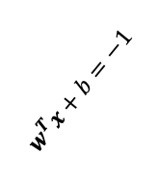
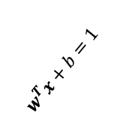
Support Vector Machine (SVM)
$$\frac{2}{\left\|w\right\|}$$
Margin
Find a decision boundary s.t. the margin is max and data points are classified correctly.
$$x_{2}$$
Support vectors
$$w^{T}x+b=1$$
$$w^{T}x+b=0$$
$$w^{T}x+b=−1$$
Decision boundary
$$x_{1}$$

Slide 5
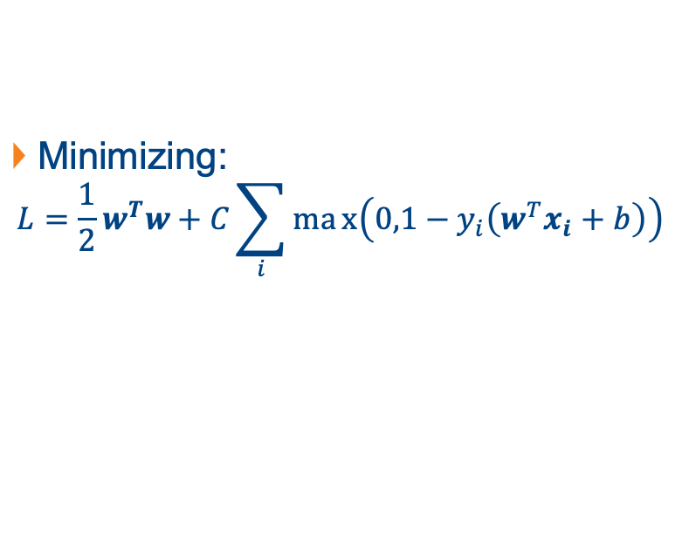

Support Vector Machine (SVM)
$$\frac{2}{\left\|w\right\|}$$
Margin
Minimizing:
$$L=\frac{1}{2}w^{T}w+C\sum_{i}{max\left(0,1−y_{i}\left(w^{T}x_{i}+b\right)\right)}$$
$$x_{2}$$
Support vectors
$$w^{T}x+b=1$$
$$w^{T}x+b=0$$
$$w^{T}x+b=−1$$
Reciprocal of margin
Penalty if $x_{i}$ violates margin
Decision boundary
$$x_{1}$$

Slide 6
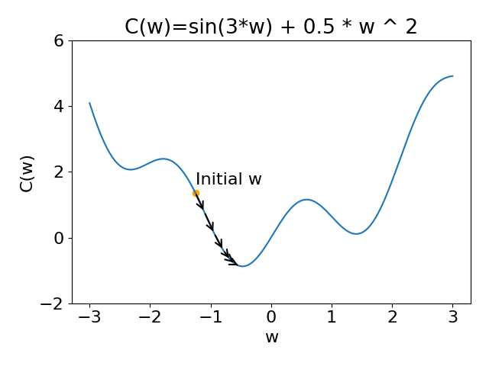
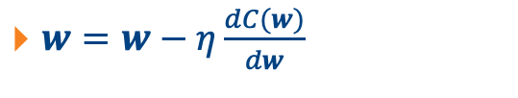
Stochastic Gradient Descend (SGD)
$w=w−η\frac{dC(w)}{dw}$

Slide 7
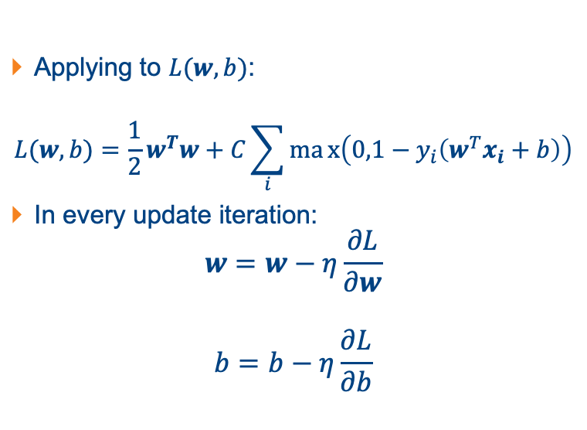
Stochastic Gradient Descend (SGD)
Applying to $L(w, b)$:
$$L(w, b)=\frac{1}{2}w^{T}w+C\sum_{i}{max\left(0,1−y_{i}\left(w^{T}x_{i}+b\right)\right)}$$
In every update iteration:
$$w=w−η\frac{∂L}{∂w}$$
$$b=b−η\frac{∂L}{∂b}$$

Slide 8
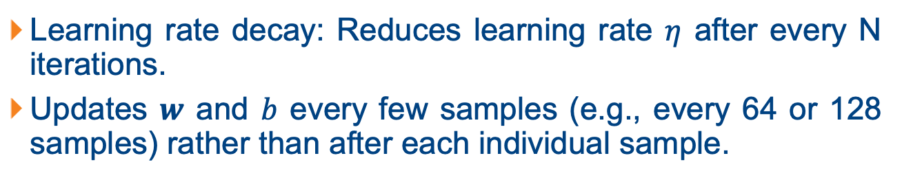
Implementation
Learning rate decay: Reduces learning rate $η$ after every N iterations.
Updates $w$ and $b$ every few samples (e.g., every 64 or 128 samples) rather than after each individual sample.

Slide 9
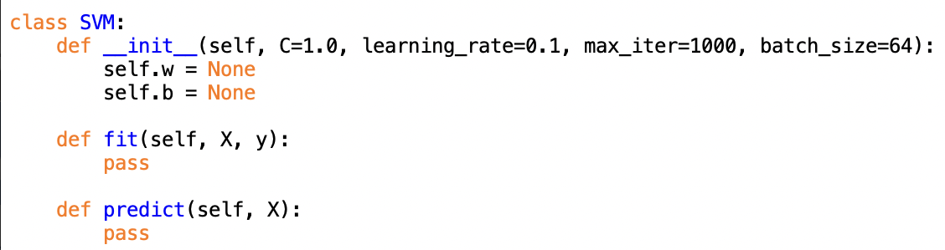
Template

Slide 10





Multi-Class SVM
$$x_{2}$$
One-vs-All approach: Train a binary classifier to separate each class vs. the rest.
$$B$$
$$A$$
$$C$$
$$x_{1}$$

