Slide 1

CREDIT CARD PORTFOLIO OPTIMIZATION
Strategic Insights & Growth Roadmap
DANIEL LATIF | BUSINESS ANALYST & DATA STRATEGIST

Slide 2

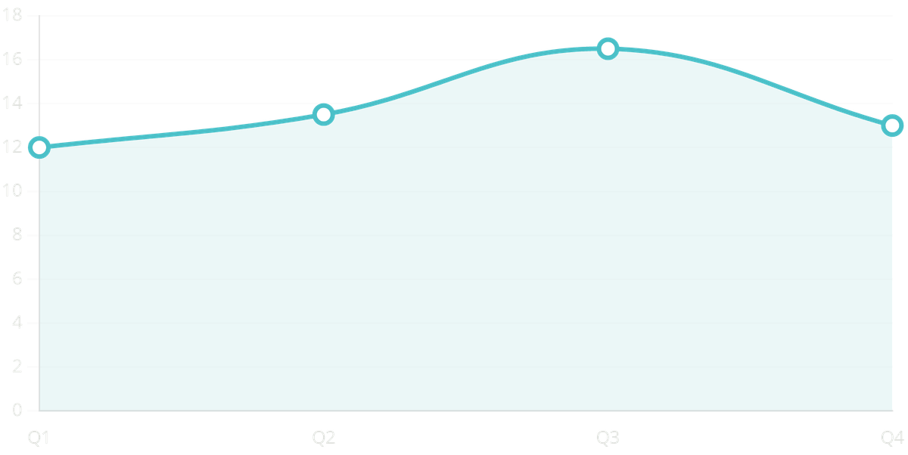


EXECUTIVE SUMMARY: $55M REVENUE PORTFOLIO
$55M
$45M
$7.84M
Q3 Peak
TOTAL REVENUE
TRANSACTION VOLUME
INTEREST INCOME
REVENUE SEASONALITY
Performance Trend: Stable revenue growth with a significant seasonal peak in Q3, suggesting strong consumer spending during that period.
Product Dominance: The "Blue" card tier remains the primary revenue engine, though it presents a concentration risk.
Behavioral Insight: Traditional "Swipe" transactions account for 64% of volume, indicating a major opportunity for digital migration.

Slide 3



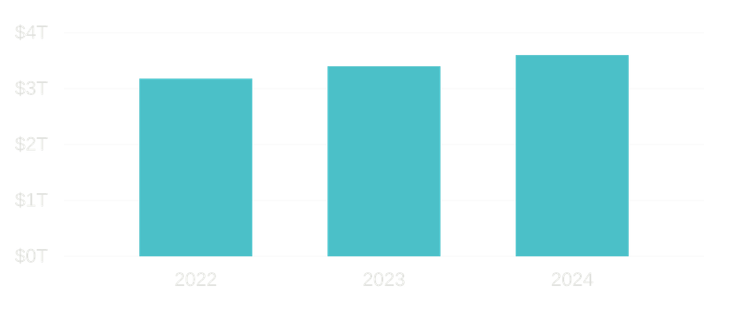


MARKET CONTEXT: NAVIGATING THE 2025 CREDIT LANDSCAPE
Industry Growth
Profitability Pressures
Global credit card purchase volume has seen a 13% increase since 2022, reaching $3.6 trillion among top issuers.
Rising fraud and operational costs are squeezing margins, making portfolio efficiency and digital adoption critical.
Consumer Resilience
Despite economic shifts, mid-income segments show the highest growth potential for revolving credit products.
Digital Shift
Contactless and mobile wallet adoption is accelerating, with leaders seeing 20%+ higher retention in digitally active users.

Slide 4

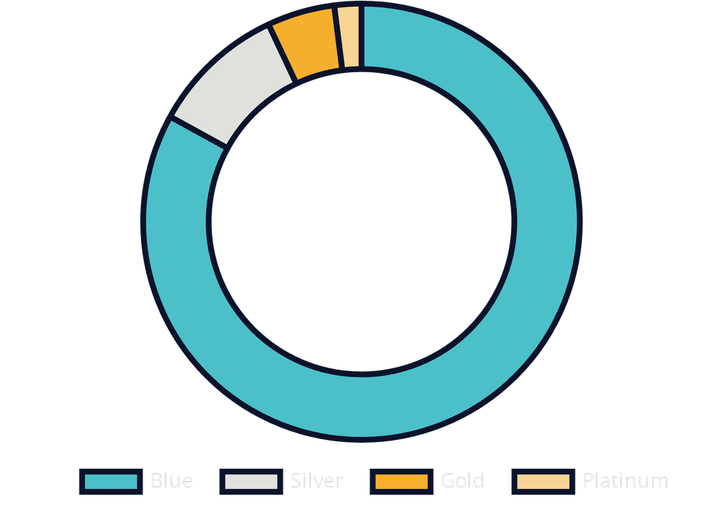
PORTFOLIO COMPOSITION & CONCENTRATION RISK
BLUE CARD DOMINANCE
The Blue card tier remains the primary revenue engine, contributing 83% of total revenue. This creates a significant vulnerability to entry-level market shifts and competitive pressure.
PREMIUM TIER GAP
Gold, Silver, and Platinum tiers contribute less than 17% combined. This highlights a major under-penetration in high-value segments and a clear opportunity for upselling.
REVENUE MIX STABILITY
83% Revenue Concentration
Interest income represents ~14% of total revenue, indicating a healthy balance between transaction fees and revolving credit, providing a stable foundation for growth.

Slide 5




TRANSACTION DYNAMICS: THE DIGITAL TRANSFORMATION OPPORTUNITY
THE DIGITAL LAG
Heavy reliance on physical swipe transactions indicates a customer base not yet integrated into the digital ecosystem, leading to higher processing costs and lower engagement.
RETENTION & VALUE LINK
64%
Data confirms that customers utilizing digital wallets exhibit significantly higher engagement metrics compared to swipe-only users.
SWIPE VOLUME
+15%
Higher Lifetime Value (LTV)
20%
Lower Churn Rate for Digital Users
Physical Swipe
Digital/Contactless
ACTIONABLE INSIGHT
Incentivizing "Tap-to-Pay" and mobile integration is the fastest lever to modernize the brand and reduce operational overhead.

Slide 6


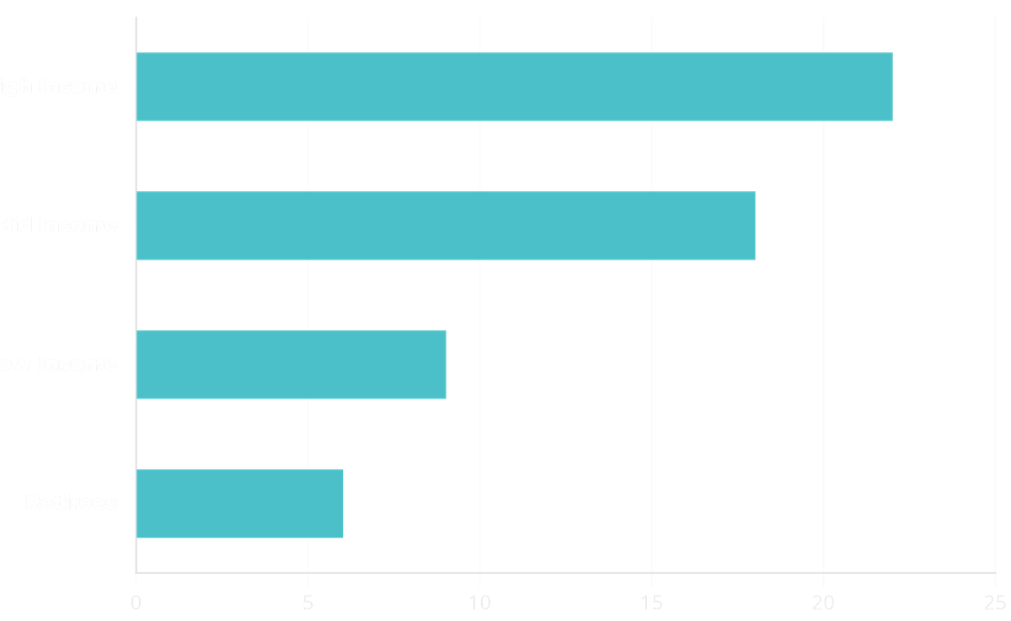


CUSTOMER SEGMENTATION: HIGH-VALUE VS. SCALABLE GROWTH
REVENUE ANCHORS
High-income users drive the highest per-capita revenue but have reached a saturation point within the current Blue tier offerings.
THE "MID-INCOME" OPPORTUNITY
This segment represents the most scalable growth engine, showing high engagement with everyday spending and credit utilization.
ENGAGEMENT GAP
Low-income and retiree segments show minimal engagement, suggesting these groups require specialized product features or lower entry barriers.
STRATEGIC FOCUS: TRANSITIONING "BLUE" CARDHOLDERS TO "SILVER/GOLD"

Slide 7





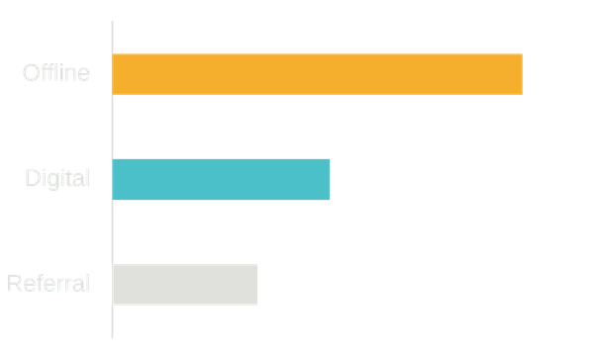
REVENUE DRIVERS: BEHAVIORAL & PRODUCT ANALYSIS
HABIT-DRIVEN SPEND
PRODUCT STICKINESS
CHANNEL EFFICIENCY
GROWTH LEVER
Everyday spending on groceries and utilities forms the bedrock of the $55M revenue, providing high portfolio stability.
Offline channels lead in acquisition volume but carry significantly higher operational and service costs.
Enhancing the digital value proposition is the primary catalyst for increasing transaction frequency.
Blue cards exhibit high retention rates but suffer from low cross-sell penetration into premium tiers.
CORE STABILITY
TARGET METRIC
Low volatility in monthly transaction counts.
+15% Frequency via Mobile Integration.
RETENTION RATE
92% Annual Retention for Blue cardholders.

Slide 8



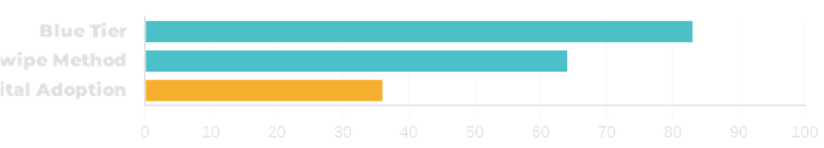


RISK ASSESSMENT: IDENTIFYING PORTFOLIO VULNERABILITIES
CONCENTRATION RISK
GEOGRAPHIC DEPENDENCY
Heavy reliance on the "Blue" product tier (83% revenue) and traditional "Swipe" methods (64%) creates a fragile revenue base.
Revenue is concentrated in a few regions, exposing the portfolio to localized economic or regulatory shocks.
DIGITAL OBSOLESCENCE
MITIGATION STRATEGY
Slow migration to digital channels risks losing share to agile fintech and digital-native platforms.
Strategic Diversification:
Expand geographically and encourage product-tier migration for
resilience.
Digital Integration:
Modernize transaction flows to cut costs and boost retention.

Slide 9




STRATEGIC RECOMMENDATIONS: A THREE-PILLAR GROWTH PLAN
PREMIUM MIGRATION
DIGITAL ACCELERATION
SEGMENT EXPANSION
Launch a targeted "Upsell" campaign for high-usage Blue cardholders. Focus on transitioning them to Silver and Gold tiers to diversify revenue and increase per-capita value.
Develop tailored marketing for the mid-income segment, emphasizing credit-building features and lifestyle rewards that resonate with everyday spending habits.
Implement "Digital-First" incentives, such as bonus points for mobile wallet transactions and paperless billing, to modernize the transaction ecosystem.
KEY ACTION
KEY ACTION
KEY ACTION
Automated eligibility triggers based on
Integrate seamless "Tap-to-Pay"
Expand acquisition efforts into under-
spending thresholds and credit history.
onboarding within the mobile
represented geographic markets to
application.
balance risk.

Slide 10


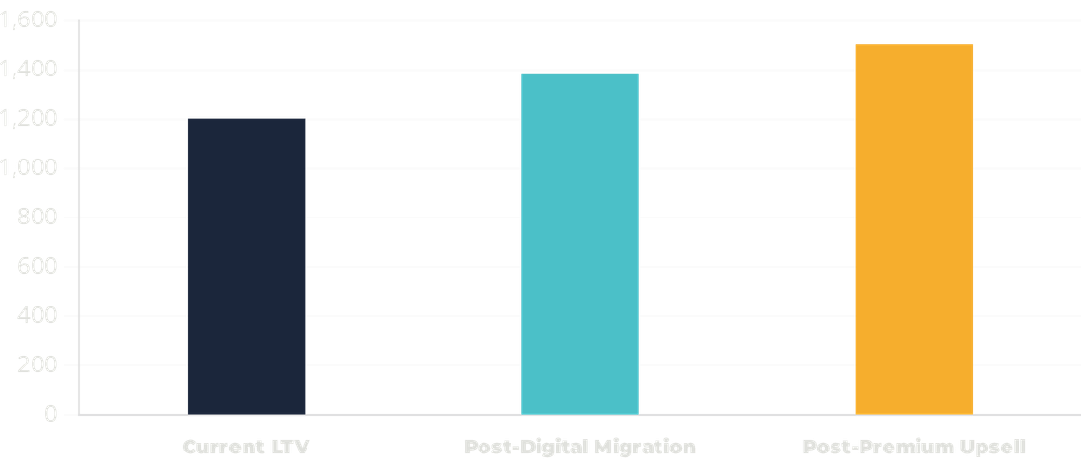

BUSINESS IMPACT: PROJECTING LONG-TERM VALUE
-20%
+25%
30%
High
RISK EXPOSURE
LIFETIME VALUE
DIGITAL SHIFT
MARKET POSITION
RISK REDUCTION
PROJECTED LTV GROWTH ($)
Diversifying the revenue base will decrease concentration risk by an estimated 20% over 18 months through product tier expansion.
OPERATIONAL EFFICIENCY
Shifting 30% of swipe volume to digital can significantly reduce transaction processing and physical card replacement costs.
MARKET POSITION
Modernizing the portfolio strengthens the brand's competitive stance against digital-native competitors and fintech disruptors.

Slide 11

IMPLEMENTATION ROADMAP: Q2 2026 - Q1 2027
Q2 2026
Q3 2026
Q4 2026
Q1 2027
DIGITAL FOUNDATION
PREMIUM MIGRATION
SEGMENT EXPANSION
OPTIMIZATION & SCALE
Launch Digital Wallet integration campaign.
Roll out "Premium Tier Upsell" for high-value Blue cardholders.
Expand geographic marketing to under-represented regions.
Evaluate portfolio performance vs. digital adoption targets.
Update mobile app UI for enhanced transaction engagement.
Introduce mid-income specific credit-building rewards.
Refine AI-driven cross-sell modeling based on Q3 data.
Launch Gold/Platinum exclusive lifestyle rewards.
Launch localized community engagement programs.
Scale successful regional pilots to national level.
Deploy "Tap-to-Pay" incentive structures.
Implement automated credit limit increase triggers.
PHASE 3: GROWTH
PHASE 4: EVALUATION
PHASE 1: INFRASTRUCTURE
PHASE 2: UPSELL

Slide 12

CONCLUSION: BUILDING A FUTURE-READY PORTFOLIO
The $55M portfolio demonstrates strong foundational stability but faces critical concentration and digital adoption risks. By executing the three-pillar growth plan, the organization can transition from a traditional credit model to a high-growth, digital-first ecosystem.
DEMONSTRATED EXPERTISE
ADVANCED DATA MODELING
STRATEGIC STORYTELLING
Translating raw KPIs into a compelling and persuasive growth narrative.
Structuring complex financial datasets into actionable business intelligence.
FINAL VERDICT
DAX & POWER BI
RISK MANAGEMENT
Focusing on digital adoption and premium migration will unlock an estimated 25% increase in Lifetime Value while significantly reducing operational risk exposure.
Leveraging technical tools to uncover deep-seated revenue drivers and trends.
Identifying and planning for long-term portfolio vulnerabilities and shocks.
MARKET ANALYSIS
BUSINESS STRATEGY
Benchmarking internal performance against 2025 industry credit trends.
Developing multi-phase roadmaps for digital transformation and growth.

