Slide 1

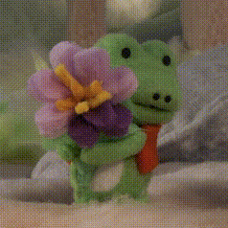
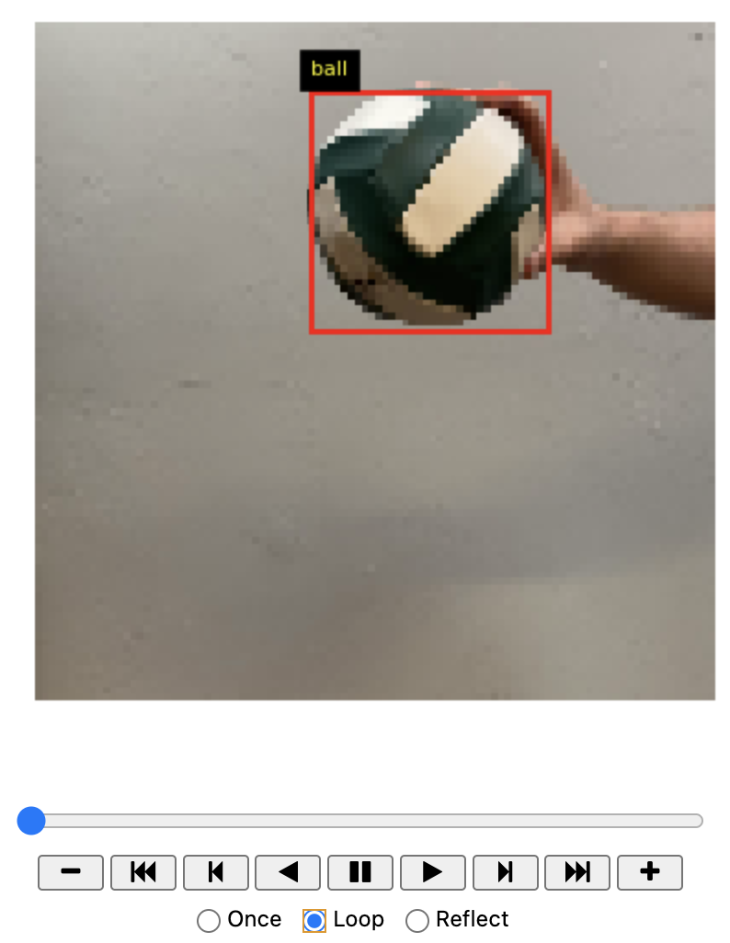
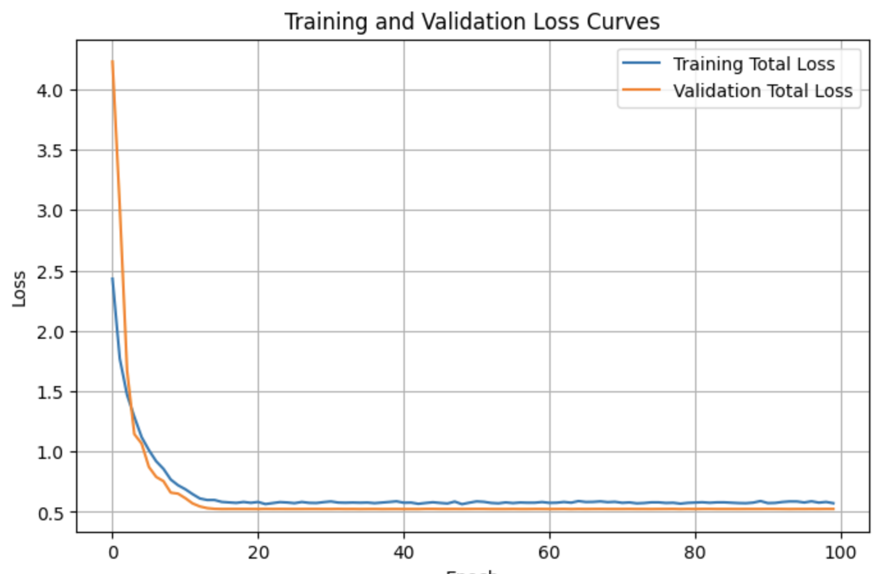
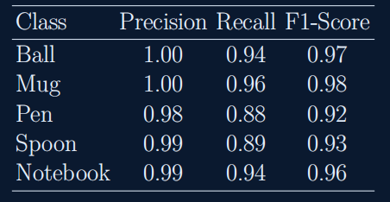
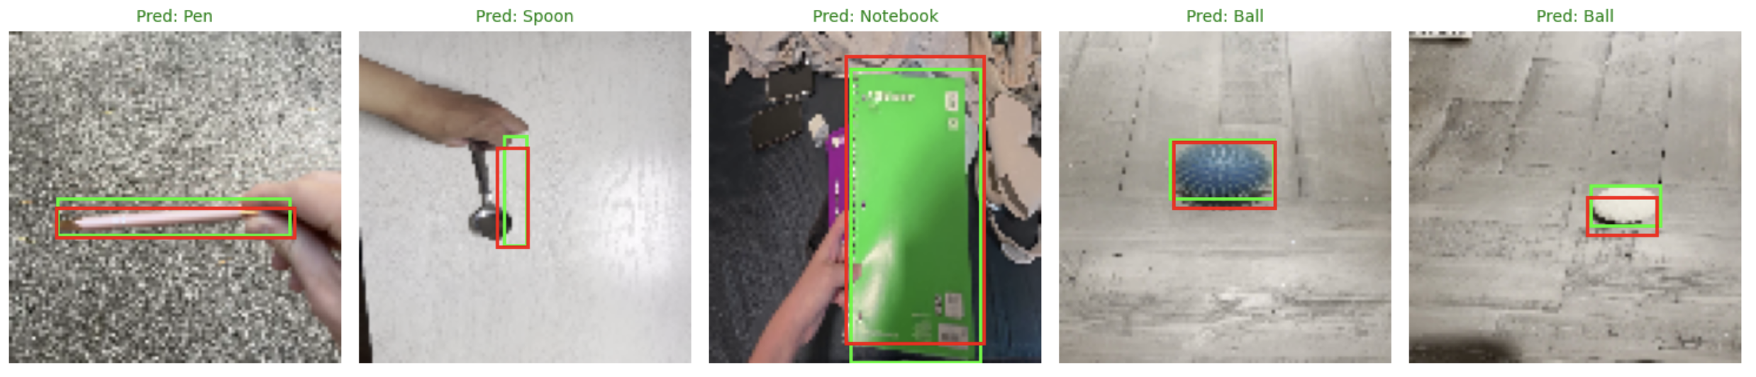
Project E: CoordConv CNN for Object Classification and Bounding Box Regression
Author: Sihan A, Daniel David
Dual-task learning using U-Net style Encoder-Decoder with Residual Blocks
1. Abstract & Objective
2. Data Pipeline
We propose a multi-task Convolutional Neural Network (CNN) designed to
simultaneously classify objects and regress their spatial bounding boxes.
Dataset:
1.Custom video dataset flattened to frames.
2.5 Classes: Ball, Mug, Pen, Spoon, Notebook.
3.Labels: Class ID + Bounding Box [x, y, w, h].
Key Challenges:
1.Standard convolutions are translation-equivariant, making absolute coordinate prediction difficult.
2.Small objects (e.g., Pen, Spoon) require precise localization
To ensure robust generalization, we implemented an efficient tf.data pipeline:
1.Preprocessing:
1.1Normalize pixel values to [0, 1].
1.2Normalize bounding box coordinates relative to image size (100 × 100).
2.Augmentation:
2.1Random Brightness (δ = 0.1) & Contrast (0.8 − 1.2).
2.2Horizontal Flip: Crucially, bounding box coordinates are mirrored
(x new = 1.0 − (x + w)) when the image is flipped.
3. Methodology: CoordConv Architecture
We utilize a U-Net-style Encoder-Decoder enhanced with Residual Blocks and
the CoordConv mechanism.
The CoordConv Layer (AddCoords):
1. Standard CNNs fail at coordinate transform tasks.
2.We inject explicit spatial information by concatenating two extra channels:
1.i-coordinate channel (normalized row indices).
2.j-coordinate channel (normalized column indices)
Input (100 × 100 × 3)
4. Results & Evaluation
ResNet Encoder
(Downsampling)
Metrics on Validation Set:
1. Classification Accuracy: ≈ 92%
2. Mean IoU (Correct Classes): ≈ 0.67 − 0.83
BottleNeck
U-Net Decoder
(Upsampling + Skips)
Global Avg Pool
+
Softmax (5 Classes)
Multi-Task Learning
CoordConv Layer
+
Sigmoid (x, y, w, h)
5. Conclusion
1. The CoordConv layer significantly improves the network’s ability to map
spatial coordinates to pixel space.
2. U-Net skip connections preserve fine-grained features essential for small
object detection.
3. The system runs efficiently on frame-level data with robust accuracy

