Slide 1
Colorado Covid-19
Predicting County Outbreak via Supervised Machine Learning

Slide 2
Overview
Introduction
Data Sourcing & Preliminary Questions
Exploration Phase
Analysis Phase
A Technology Overview
Summary and Future Analysis

Slide 3
INTRODUCTION
The Covid-19 Vaccines have had a measurable impact on the spread of the coronavirus. While there is evidence that the use of a vaccine can reduce outbreaks, we sought to examine if other factors such as population density and social vulnerabilities could be used to predict the likelihood of a covid infection rate above the average for surrounding areas.
Notes:
SVI Index (https://svi.cdc.gov/Documents/Publications/CDC_ATSDR_SVI_Materials/SVI_Poster_07032014_FINAL.pdf)

Slide 4
Data Sources
CDC - County Vaccination Data
NY Times Covid Data Tracker
Colorado Department of Public Health and Environment
Our World In Data
Notes:
Colorado Department of Public Health Positive Cases Data - https://hub.arcgis.com/datasets/CDPHE::colorado-covid-19-positive-cases-and-rates-of-infection-by-county-of-identification/about
Colorado Health Maps and Index on Community Health Assessment https://www.cohealthmaps.dphe.state.co.us/colorado_community_inclusion/downloads/CICO_ROI_2016_Nichole_Rex.pdf
CDC SVI Index Graphic - https://svi.cdc.gov/Documents/Publications/CDC_ATSDR_SVI_Materials/SVI_Poster_07032014_FINAL.pdf
Overview of SVI - https://www.atsdr.cdc.gov/placeandhealth/svi/documentation/SVI_documentation_2018.html and At-A-Glance - https://www.atsdr.cdc.gov/placeandhealth/svi/at-a-glance_svi.html
Vaccine Reporting Documentation from CDC - https://www.cdc.gov/coronavirus/2019-ncov/vaccines/reporting-vaccinations.html
CDC County Data on Vaccination - https://data.cdc.gov/Vaccinations/COVID-19-Vaccinations-in-the-United-States-County/8xkx-amqh
Our World in Data Covid-19 Repo - https://github.com/owid/covid-19-data/tree/master/public/data
Confirmed Case Data from OWID - https://ourworldindata.org/explorers/coronavirus-data-explorer?facet=none&Interval=Cumulative&Relative+to+Population=true&Color+by+test+positivity=false&country=USA~ITA~CAN~DEU~GBR~FRA~JPN&Metric=Confirmed+cases

Slide 5
Preliminary Questions
What impact does vaccination rate have on the likelihood of a COVID rate above the state average?
What is the impact of population density on on county COVID rates?
What is the role of the Social Vulnerability Index in county COVID rates?
What other features are necessary to produce an accurate model?

Slide 6
Exploration Phase
POPULATION
VACCINATION
SVI
To show whether population correlates to a higher risk of outbreak.
To show the relationship vaccination rates and population density.
To show whether SVI is an indicator for vaccination rate/outbreak risk.

Slide 7
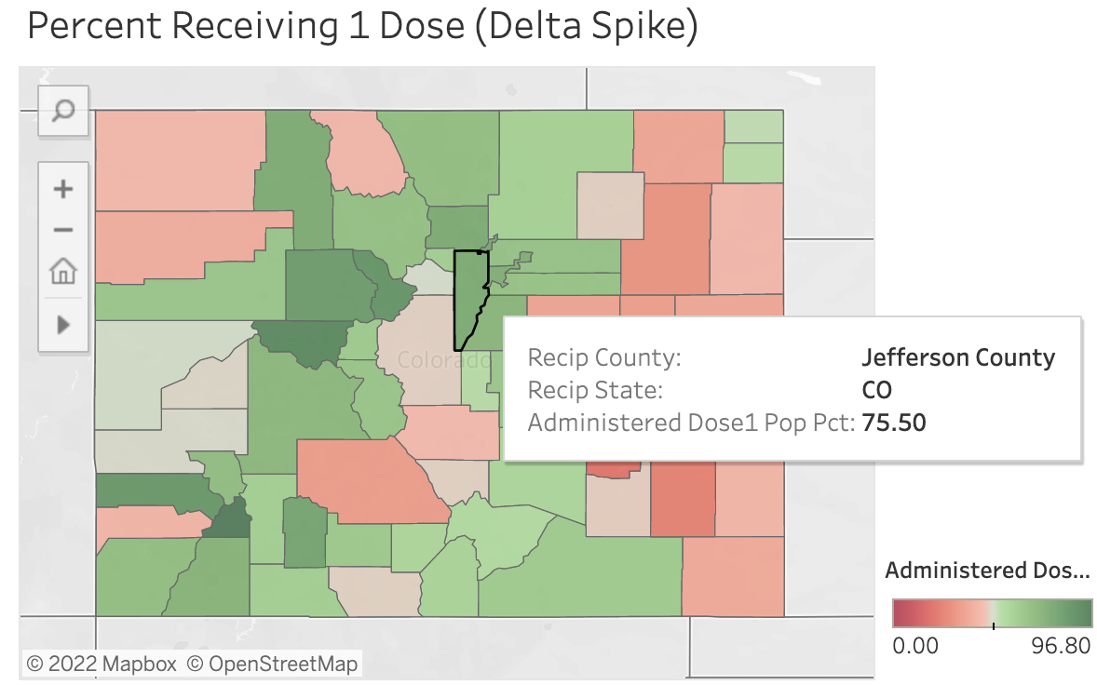
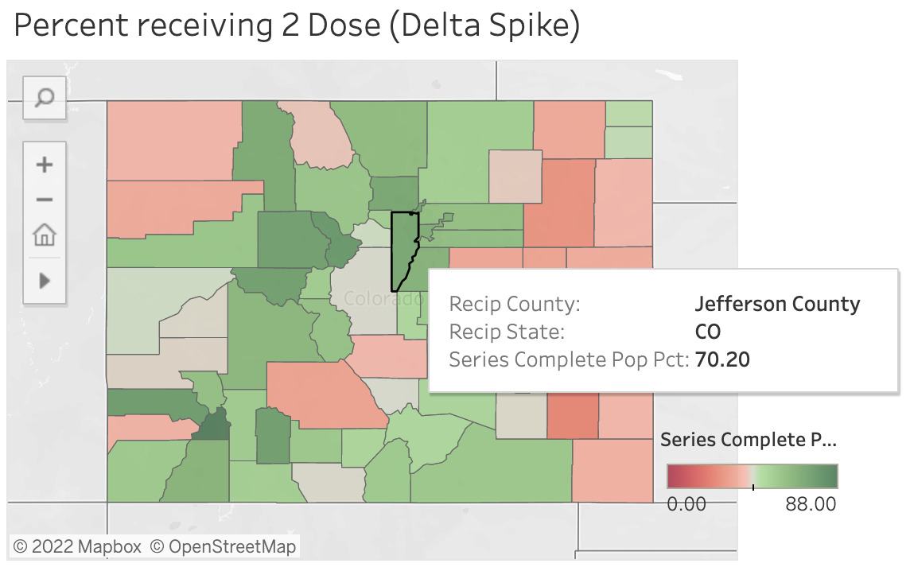
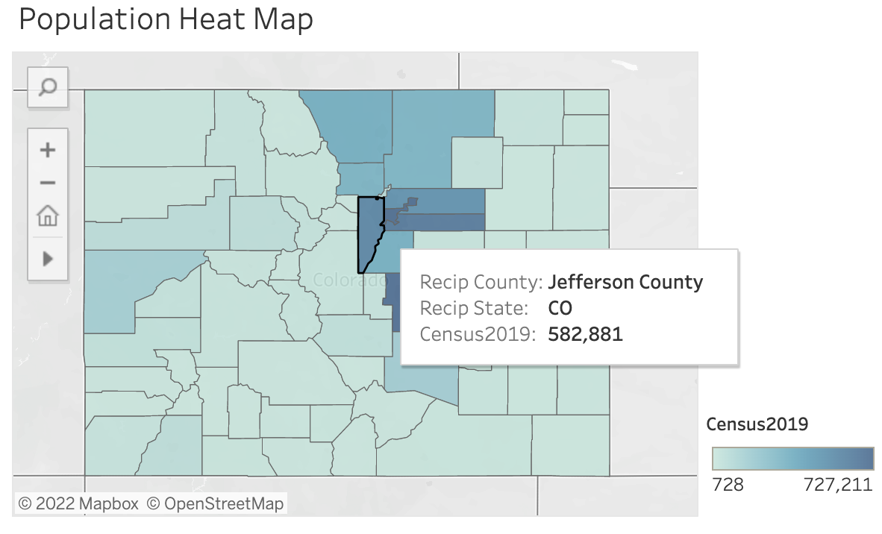
Data Exploration Using Tableau
Percentage of County Population with One-Dose
Percentage of County Population: Complete Series
Population by County

Slide 8
Technology
Data was collected and preprocessed in Jupyter Notebook using Pandas with Python and SQL
Preprocessed data is connected and imported into Postgres using pgAdmin and AWS.
The database is then connected to the Machine Learning model that has been created using Python, Pandas, and Jupyter Notebook
The presentation will be displayed via Google Slides, as well as, an interactive webpage hosted via Tableau Public using HTML, CSS and Javascript.

Slide 9
Analysis Phase and Results
Accuracy: Our models showed different levels of accuracy.in our undersampling piece we received an accuracy of 78.5% and 81.25% in the Logistic Regression. Our Supervised Machine Learning dataset contained binary outcomes, the accuracy of the predictions can be further analyzed by viewing the Confusion Matrices for the two models.
Precision: Precision, also known as positive predictive value (PPV), is a measure of how likely that a Predicted Positive is a True Positive. Precision is obtained by dividing the number of true positives (TP) by the number of all positives (i.e., the sum of true positives and false positives, or TP + FP). For our models below, both the Decision Tree and Random Forest achieved a Precision score of .67. This means that out of 100 predicted positives, 67 were True Positives.

Slide 10
Results of Analysis
Sensitivity/Recall: We can assess a model's performance is with sensitivity/recall. Sensitivity is a measure of how many True Positives were correctly predicted. For our models, both the Decision Tree and Random Forest achieved a Recall Score of .67.
F1 Score - Tradeoff Between Precision and Sensitivity: The F1 score is a pronounced imbalance between sensitivity and precision. For our models below, both models achieved a high F1 Score of .67.

Slide 11
Future Analysis
Applying the model to data sets in other states and/or countries
Applying the model to the peak of the Delta Wave

