Slide 1
Data Analytics
Storyboard for Dashboard

Slide 2
Table of Contents
Introduction
Hypothesis
Data Exploration
Tool Overview:
Tableau
Google Presentation
Interactive Element: Tableau
Summary

Slide 3
INTRODUCTION
The following storyboard will be utilized as the blueprint for the final dashboard. The final dashboard will display images from the initial analysis, a report from the machine learning task, and an interactive element via Tableau.

Slide 4
Hypothesis
Whether a specific county is likely to have a COVID Outbreak that exceeds the State or National Average.

Slide 5
areas of the data to explore
SVI
To show whether SVI is an indicator for vaccination rate/outbreak risk.
POPULATION
To show whether population correlates to a higher risk of outbreak.
VACCINATION
To show the relationship vaccination rates and population density.
To compare within the state as well as against other state and national averages.
Compare Data

Slide 6
Presentation Tools: Overview
Dashboard
Google Presentation
Will be used to display the results of our data collection, as well as discuss finer points discovered in our analysis.
Tableau
Will enable us to present comparative data through visualization. Using this platform, we can present a general overview, as well as specific data for each county.

Slide 7
County Vaccination rate
We will utilize Vaccination Rate data in graphs and charts to compare the following:
Vaccination rate in three counties with similar population density.
Vaccination rate in three counties with varying population density.
Vaccination rate in three counties with similar SVI.
Vaccination rate in three counties with varying SVI.

Slide 8
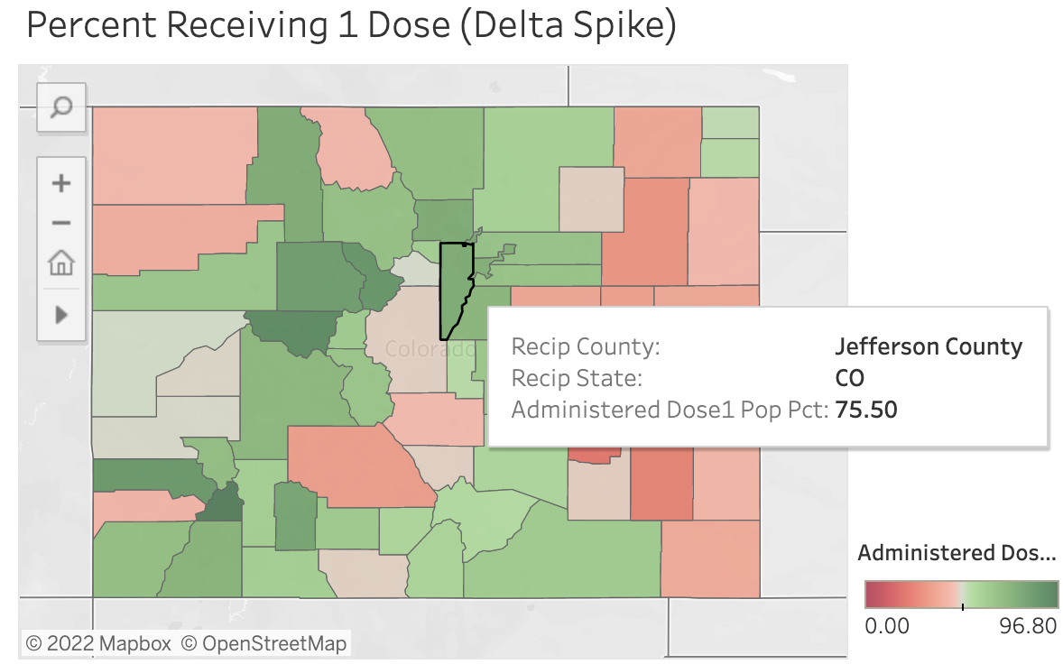
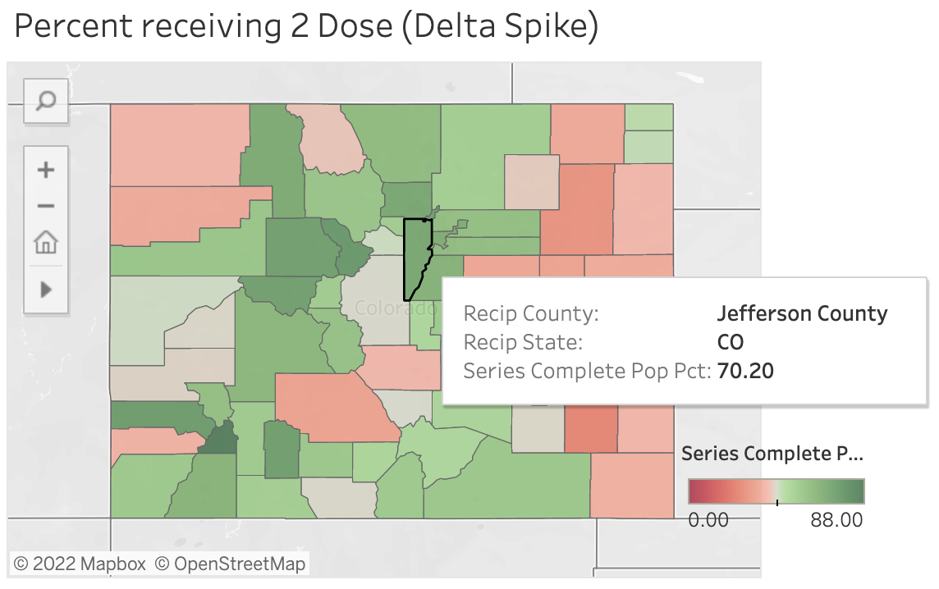
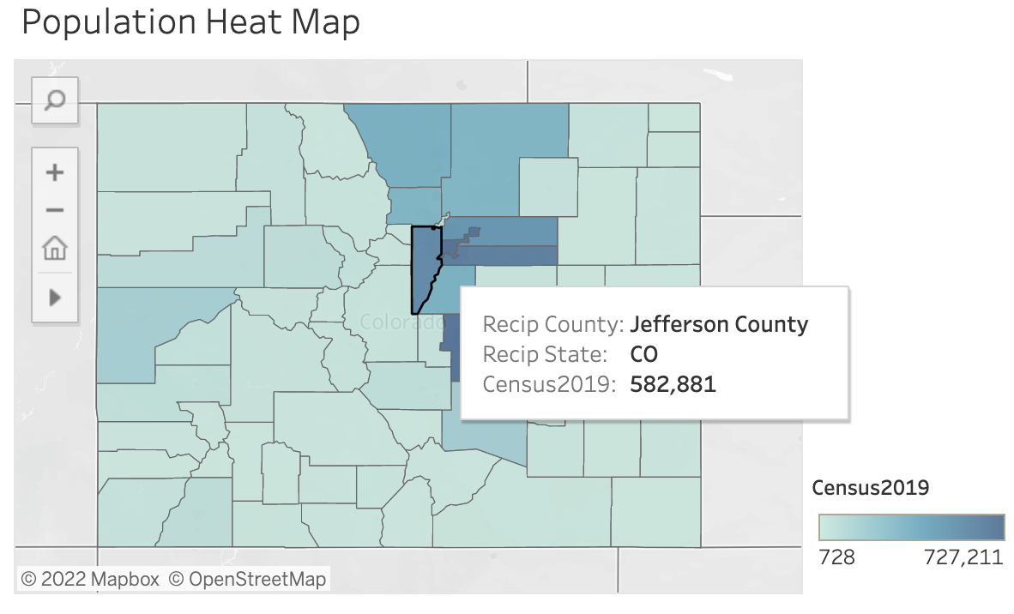
Interactive element: Tableau
Percentage of County Population: One-Dose
Percentage of County Population: Complete Series
Population by County

Slide 9
SUMMARY
The final dashboard will include:
Selected topic
Reason for selected topic
Description of the source of data
Questions to answer with the data
Description of the data exploration phase of the project
Description of the analysis phase of the project
Technologies, languages, tools, and algorithms used throughout the project
Result of analysis
Recommendation for future analysis
Anything the team would have done differently

Slide 10
THANK YOU

