Slide 1
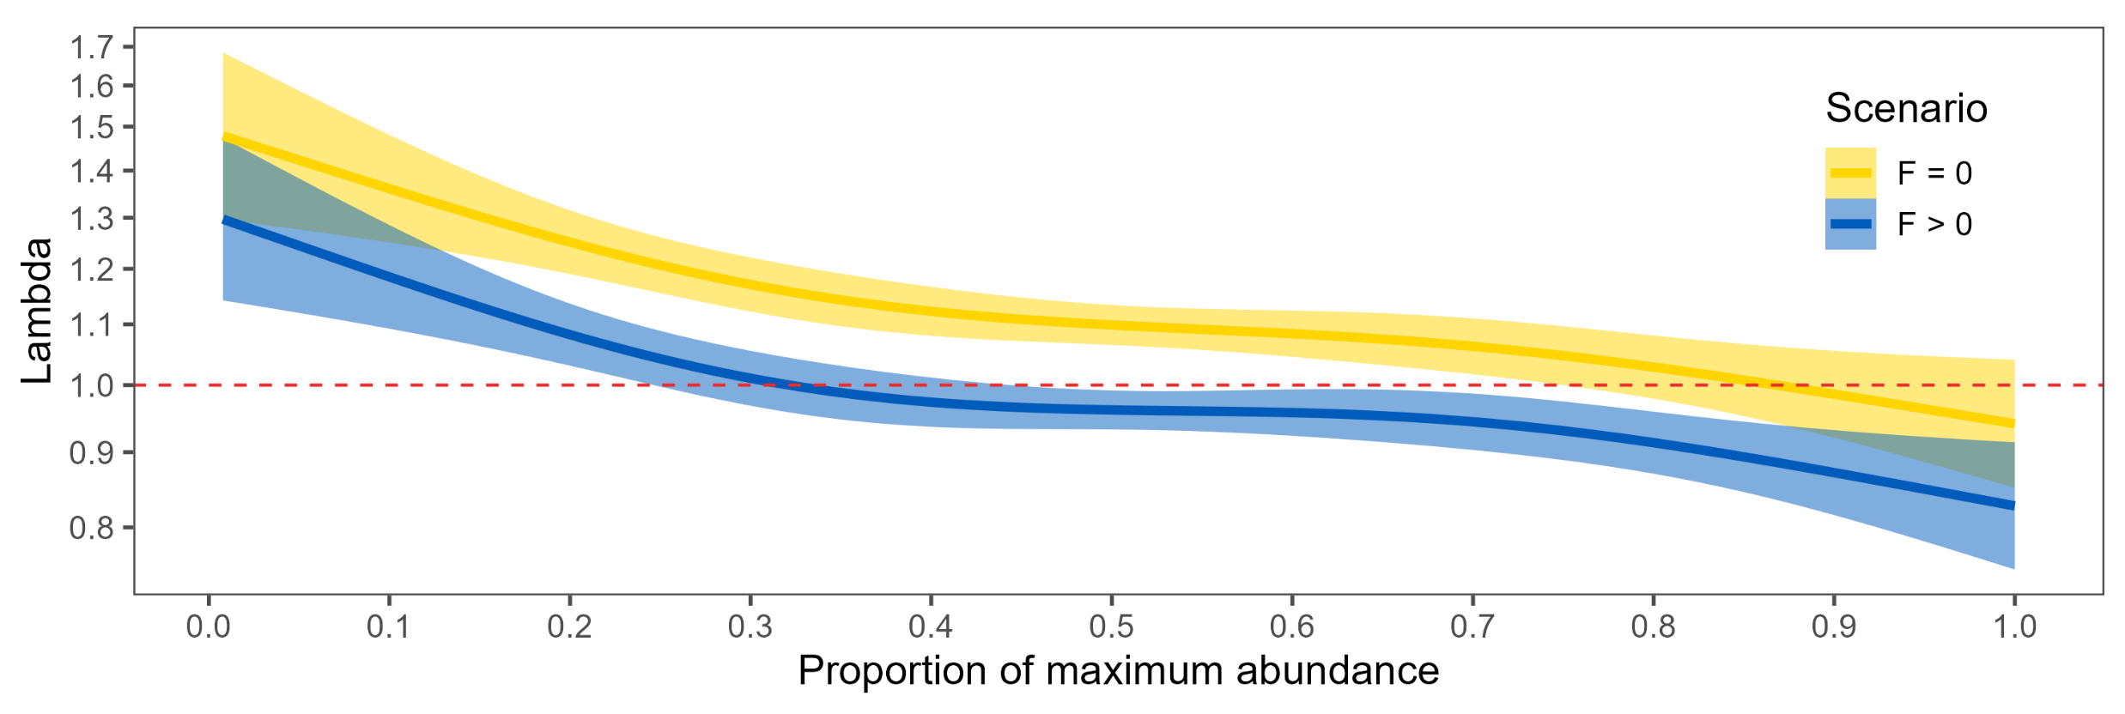
Population Demographics
Quantified realized population dynamics of 77 exploited stocks
Population dynamics not related to life-history characteristics
Results are foundation for parameterizing multispecies model

Slide 2
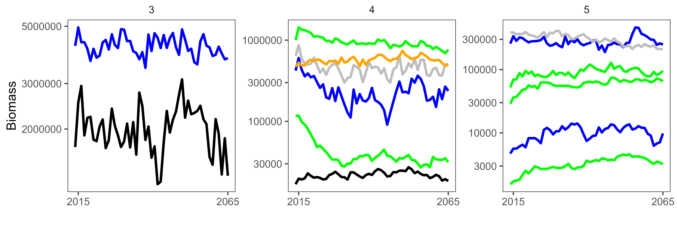
Multispecies Model of North Sea
Initial projection simulations model developed for 14 North Sea stocks
Incorporates historic population demographics and relationships
Developing scenarios to quantify impact of fishing on functional diversity
Shiny App interface developed and in testing

