Slide 1
FG model development
February 20, 2026

Slide 2
K simulation
Now runs for just larges (no piscivore or benthivore partitioning)
Community K ARIMA based on median and is log-transformed
Proportion ARIMAs are logit-transformed
2000-2017
Includes all larges (cod, haddock, silver hake, pollock, American plaice, wolffish, thorny skate and monkfish)
100 years, 10 iterations

Slide 3
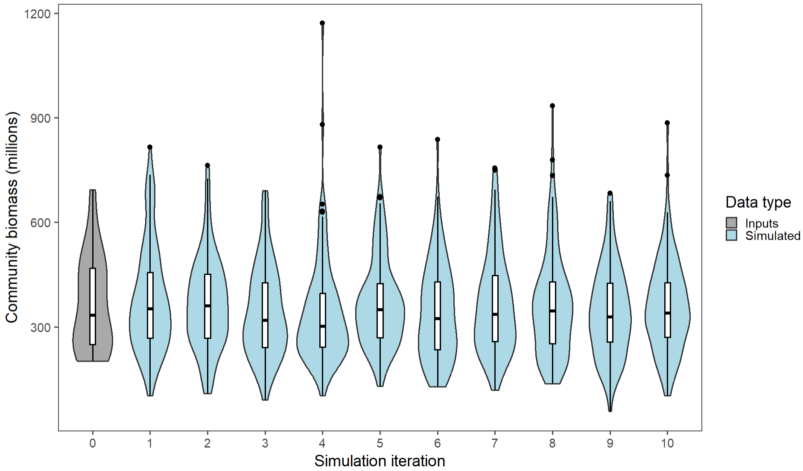

Slide 4
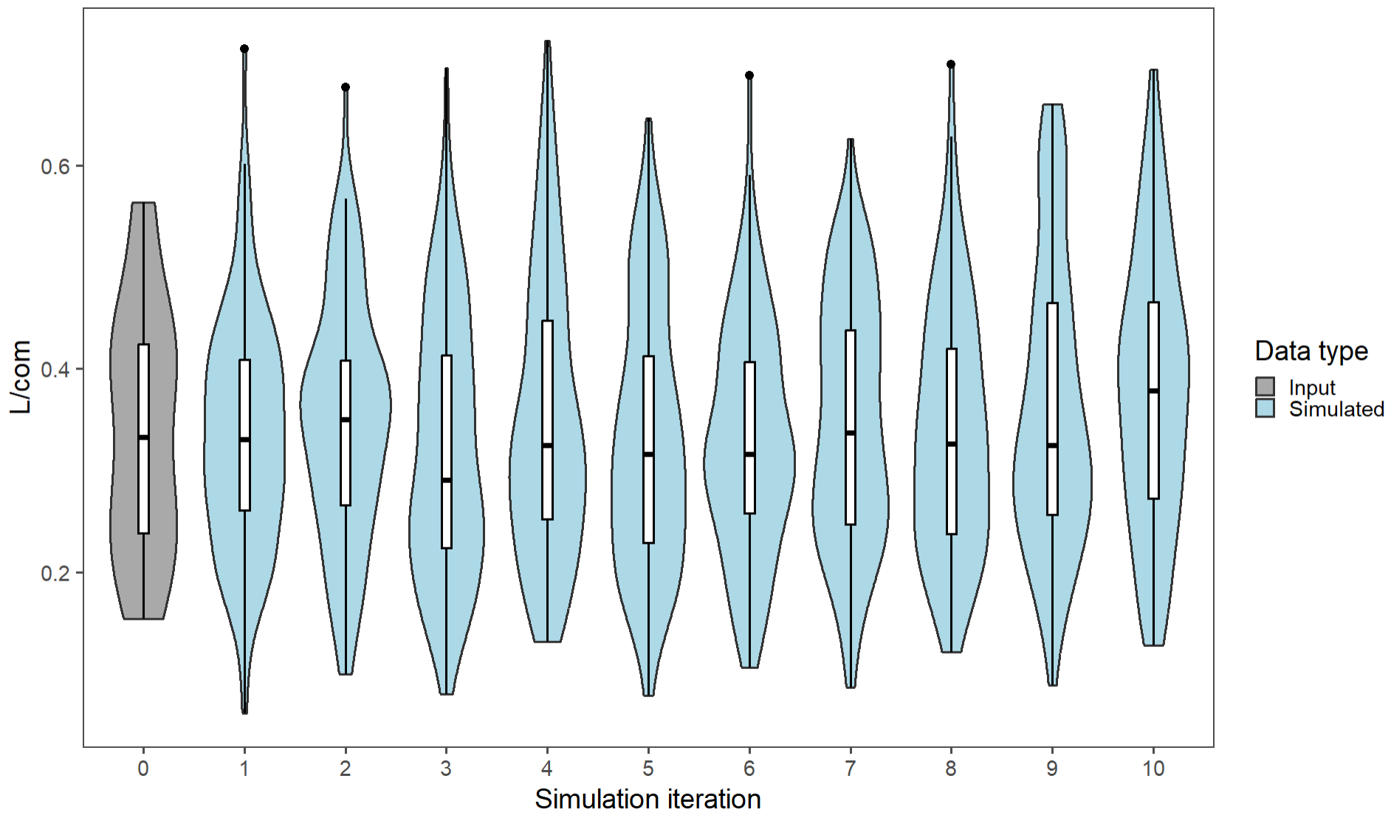

Slide 5
Variable | Time series mean | ARIMA mean
Community K | 367.1362 million | 357.3373 million
Proportion of L in community | 0.3393786 | 0.3431758

Slide 6
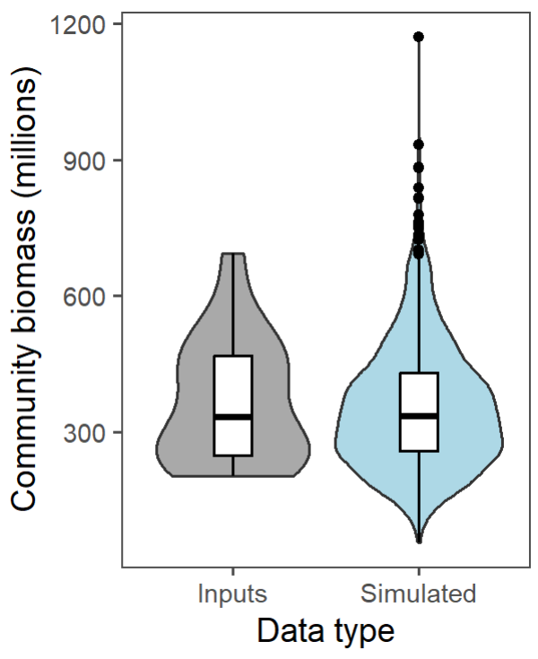
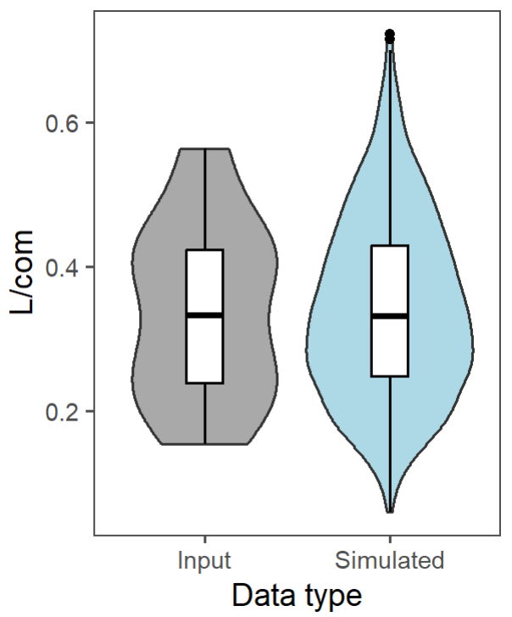

Slide 7
Stock-specific (see PDFs)
Overprojecting haddock and underprojecting other species
Notes:
Proportions don’t add up to 1 when using lags 1 and 2 (over 1)
Proportions also don’t add up properly when only using lag 1 (0.35)
Input data adds up to 1
Switching mean to be starting value for projections helped some, but not enough (0.46)

