Slide 1
MPM Test Run – ESS Functional Groups
January – February 2026

Slide 2
Functional Groups
DIFFERENT SCALES

Slide 3
LARGE
P (6)
B (3)
Med
P (3)
B (2)
Z (2)

Slide 4
Large piscivores (LP):
Atl cod*
White hake
American plaice
Pollock
Large benthivores (LB):
Haddock*
Atl wolffish
Thorny skate
Medium benthivores/
zoopiscivores (MBZ):
Redfish (Z)
Witch flounder (B)
Longfin hake (Z)
Smooth skate (B)
Medium piscivores (MP):
Silver hake
Longhorn sculpin
Sea raven
Notes:
Could test by moving haddock to LP and see what’s different

Slide 5
Rationale behind classification (Bundy et al. 2017)
Fs97-6-3186-eng.pdf
Maximum adult length: small is < 31 cm, medium is 30-80 cm and large is >80 cm
Habitat (benthic includes infauna, bottom-dwelling and bentho-pelagic species)
Feeding guild (predominate prey type) – piscivore, benthivore, planktivore, zoopiscivore

Slide 6
“Functional groups (FGs)”
Large piscivores (LP)
Large benthivores (LB)
Larges
“Medium functional groups (MFGs)”
Medium benthivores/
zoopiscivores (MBZ)
Medium piscivores (MP)
Mediums
“Broad functional groups (MFGs)”

Slide 7
Describing the ecosystem
SECTION 1

Slide 8
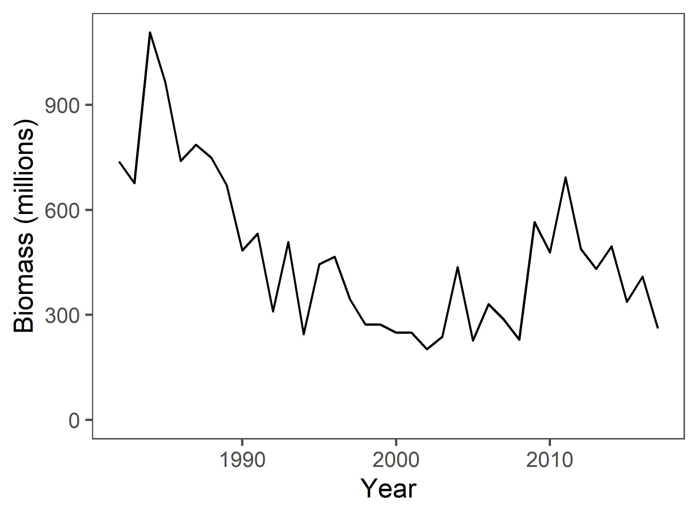
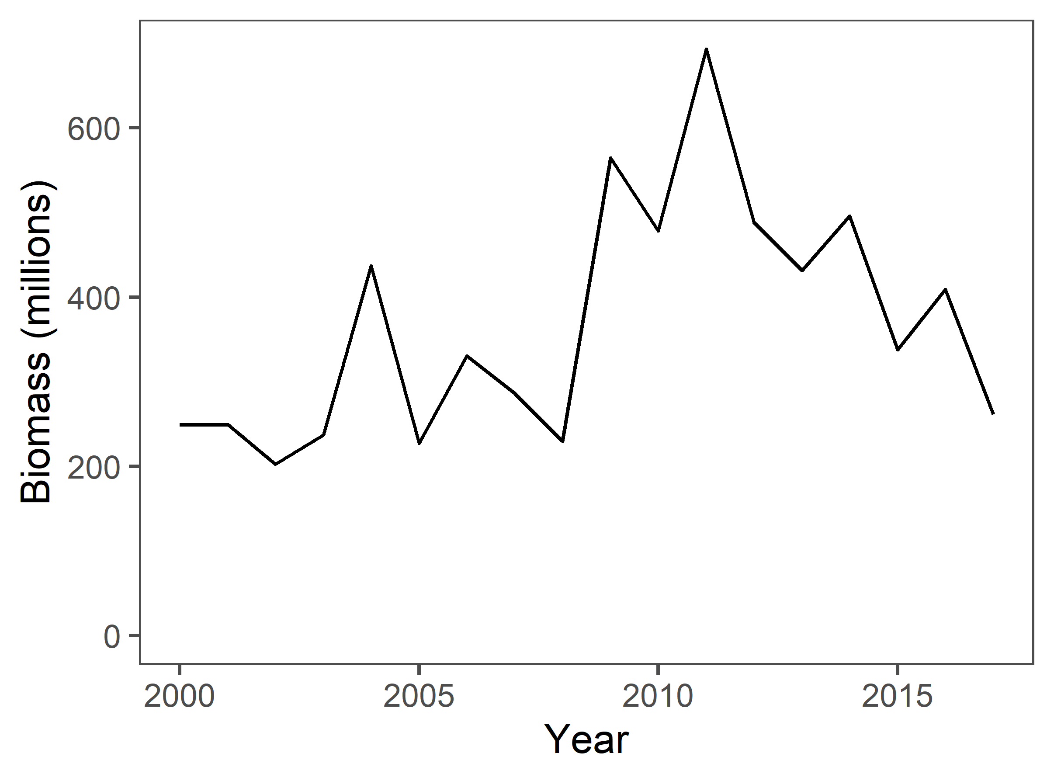
Ecosystem biomass
(detrending on all the years – fit a smooth GAM and run pacf on residuals)
Notes:
Makes sense with literature – ecosystem biomass reaches its lowest in late 1990s (groundfish moratorium); showing some increase since then
Decline post-2010 – why could this be? Is this decline significant? Can you check this with a glm? No, ending where starting
Better to call this community > ecosystem

Slide 9
Notes:
Makes sense with literature – ecosystem biomass reaches its lowest in late 1990s (groundfish moratorium); showing some increase since then
Decline post-2010 – why could this be? Is this decline significant? Can you check this with a glm?

Slide 10
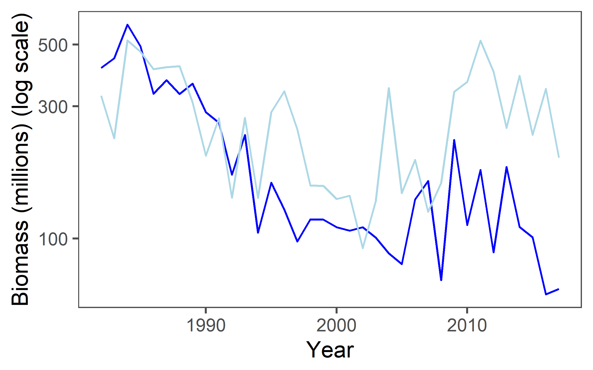
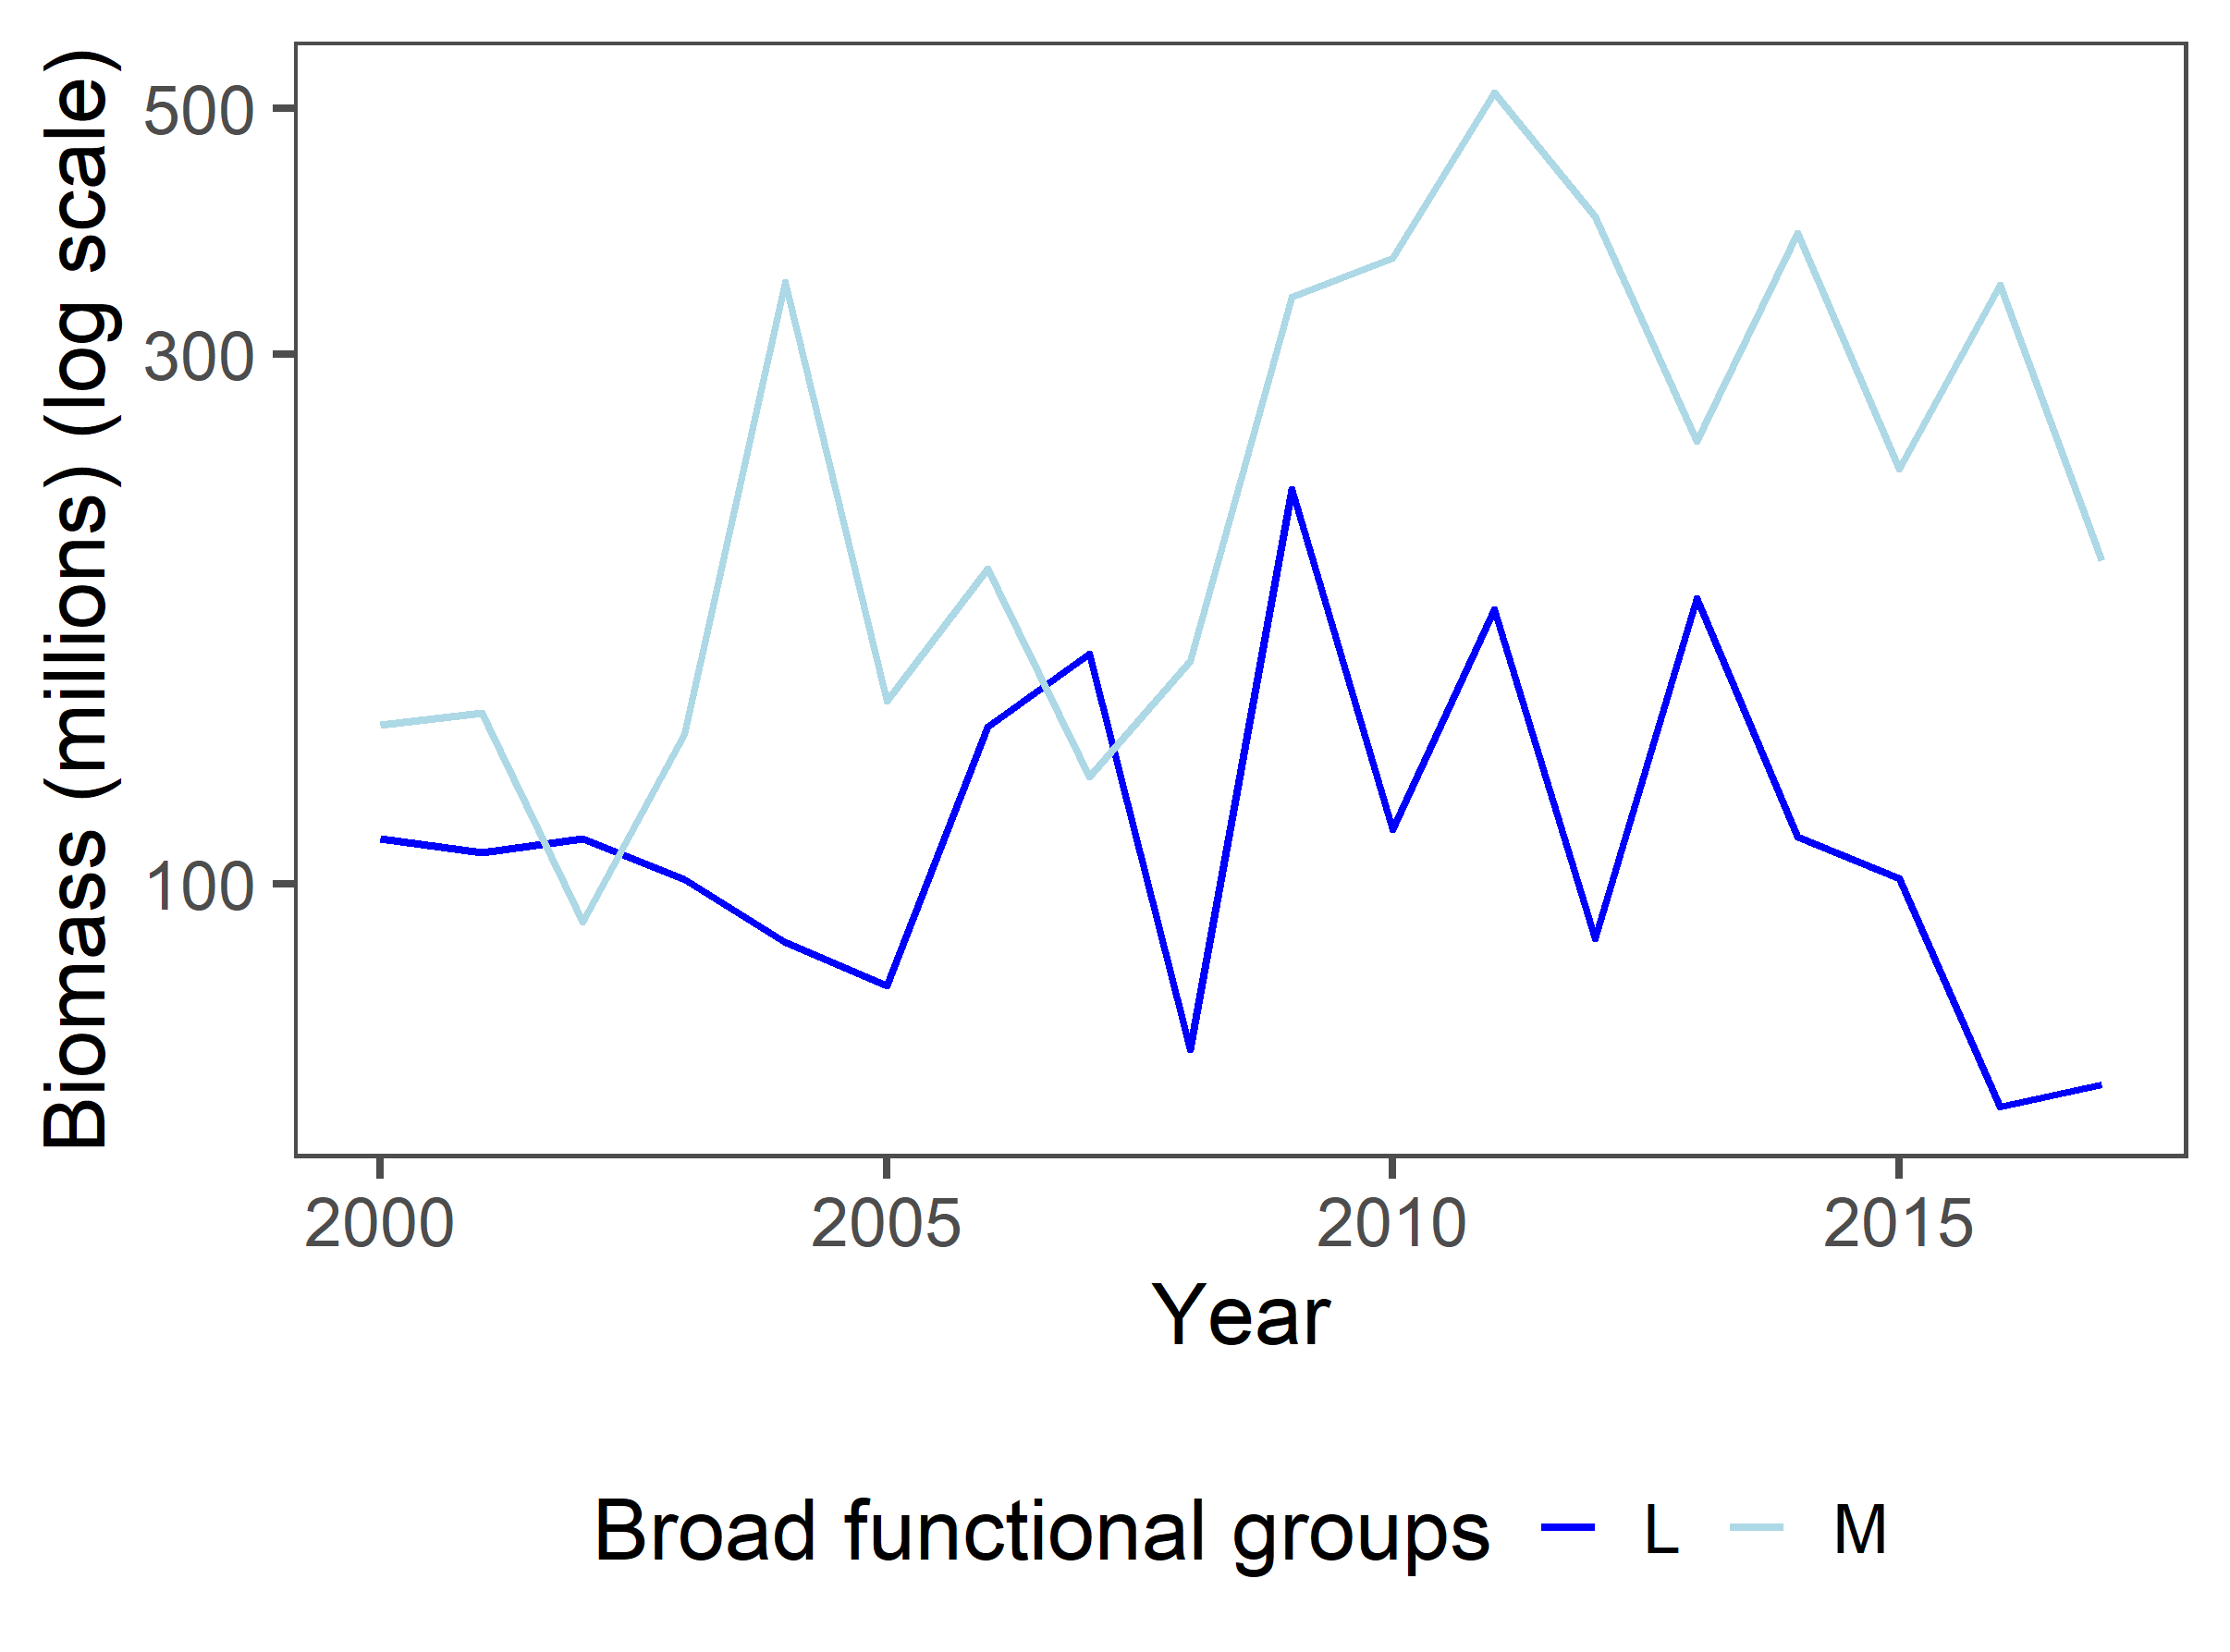
BFG biomass
Notes:
Makes ecological sense – Ms are becoming more abundant post-1990s – ecosystem restructuring?
Not completely in line with TL concepts
Ms staying relatively stable while L declines

Slide 11
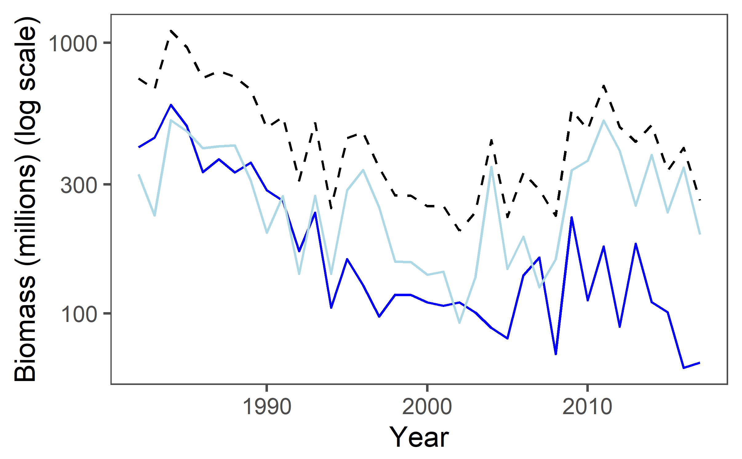
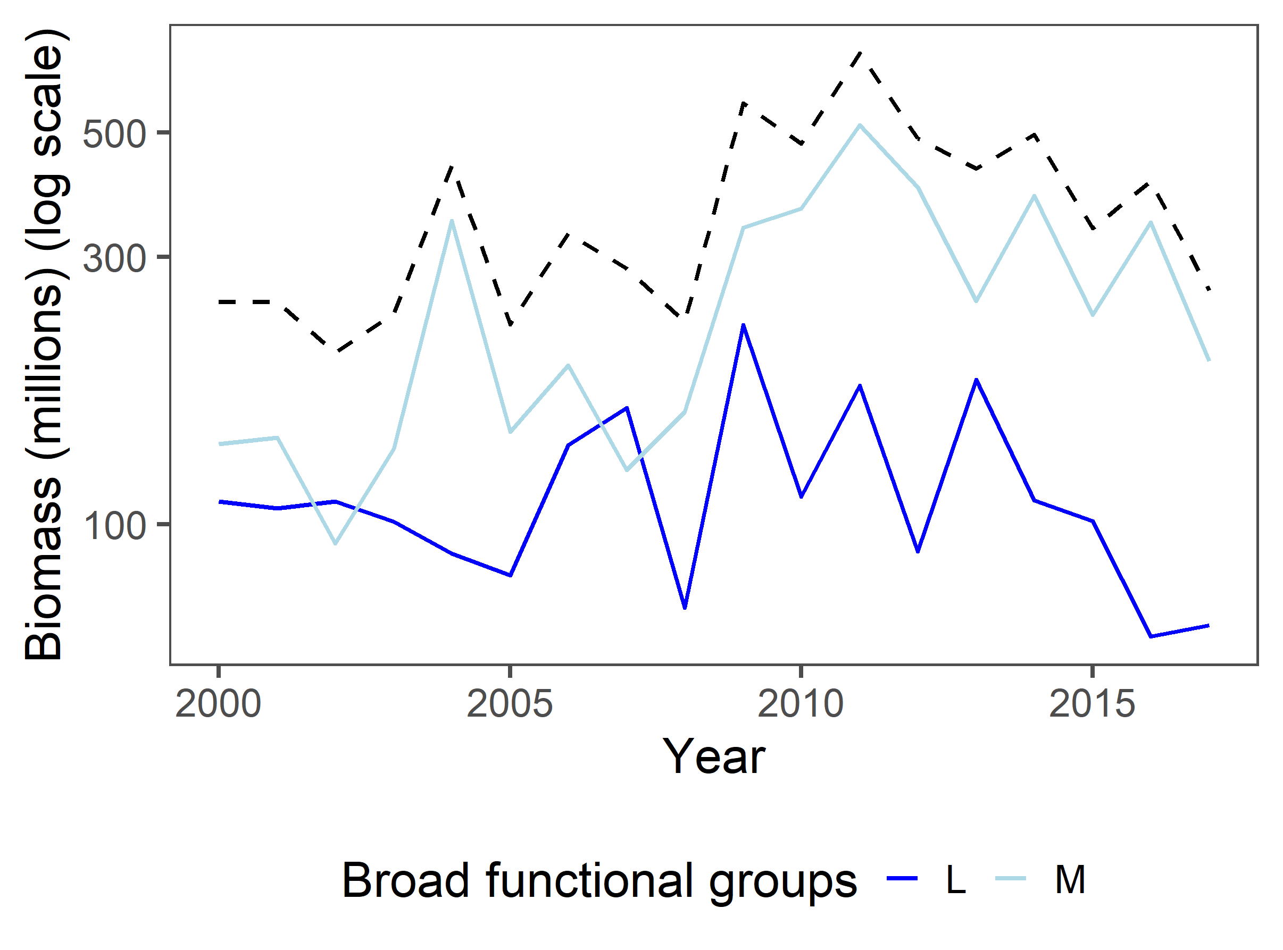
BFG + ecosystem biomass
*Dotted line = ecosystem biomass
Notes:
Decline in Ls is driving overall ecosystem declines
Maybe some survey signals – triangles
Don’t need to detrend mediums, larges in full time series has more risk
Since 2000, very consistent – full time series = fairly consistent community, but structure has changed
Keep dotted ecosystem line – helps with scaling

Slide 12
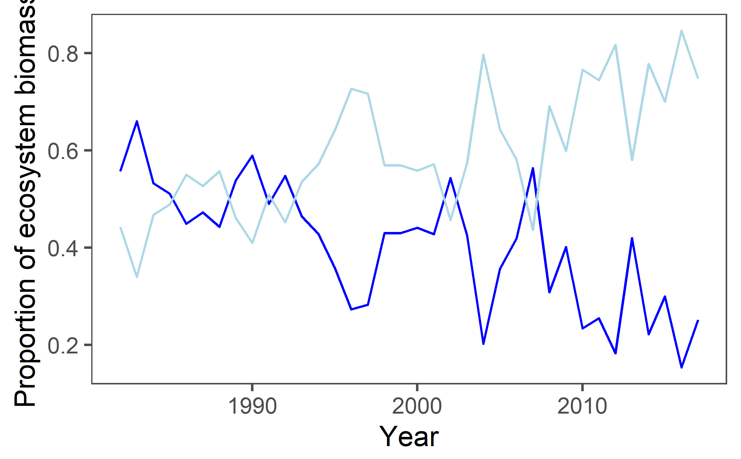
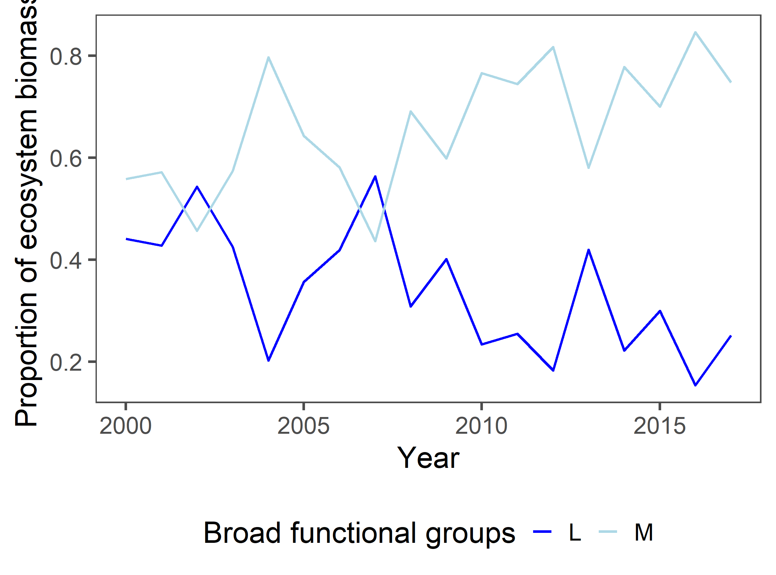

$\frac{BFG}{eco}$ biomass
Notes:
Is the divergence of M and L post-1990s evidence of ecosystem restructuring? Interesting that they were more or less equal proportions before early 1990s.

Slide 13
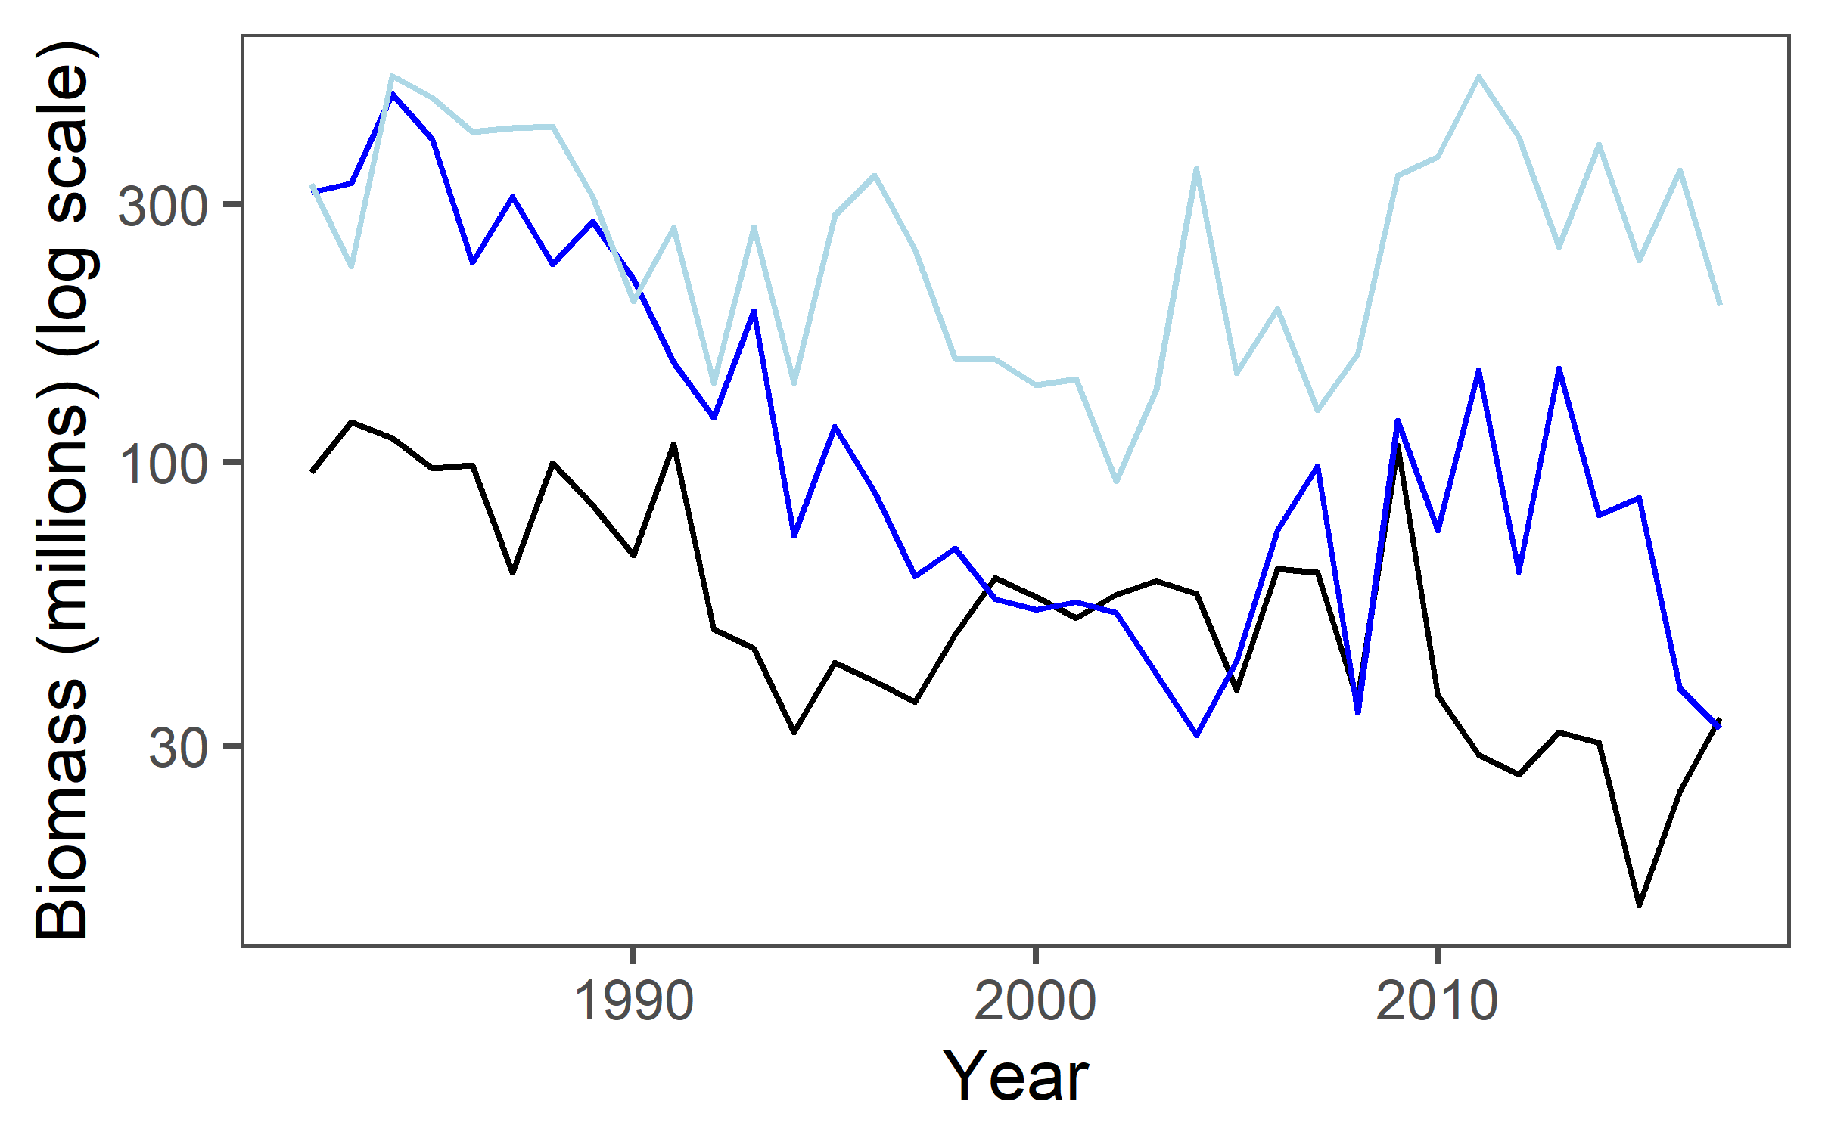
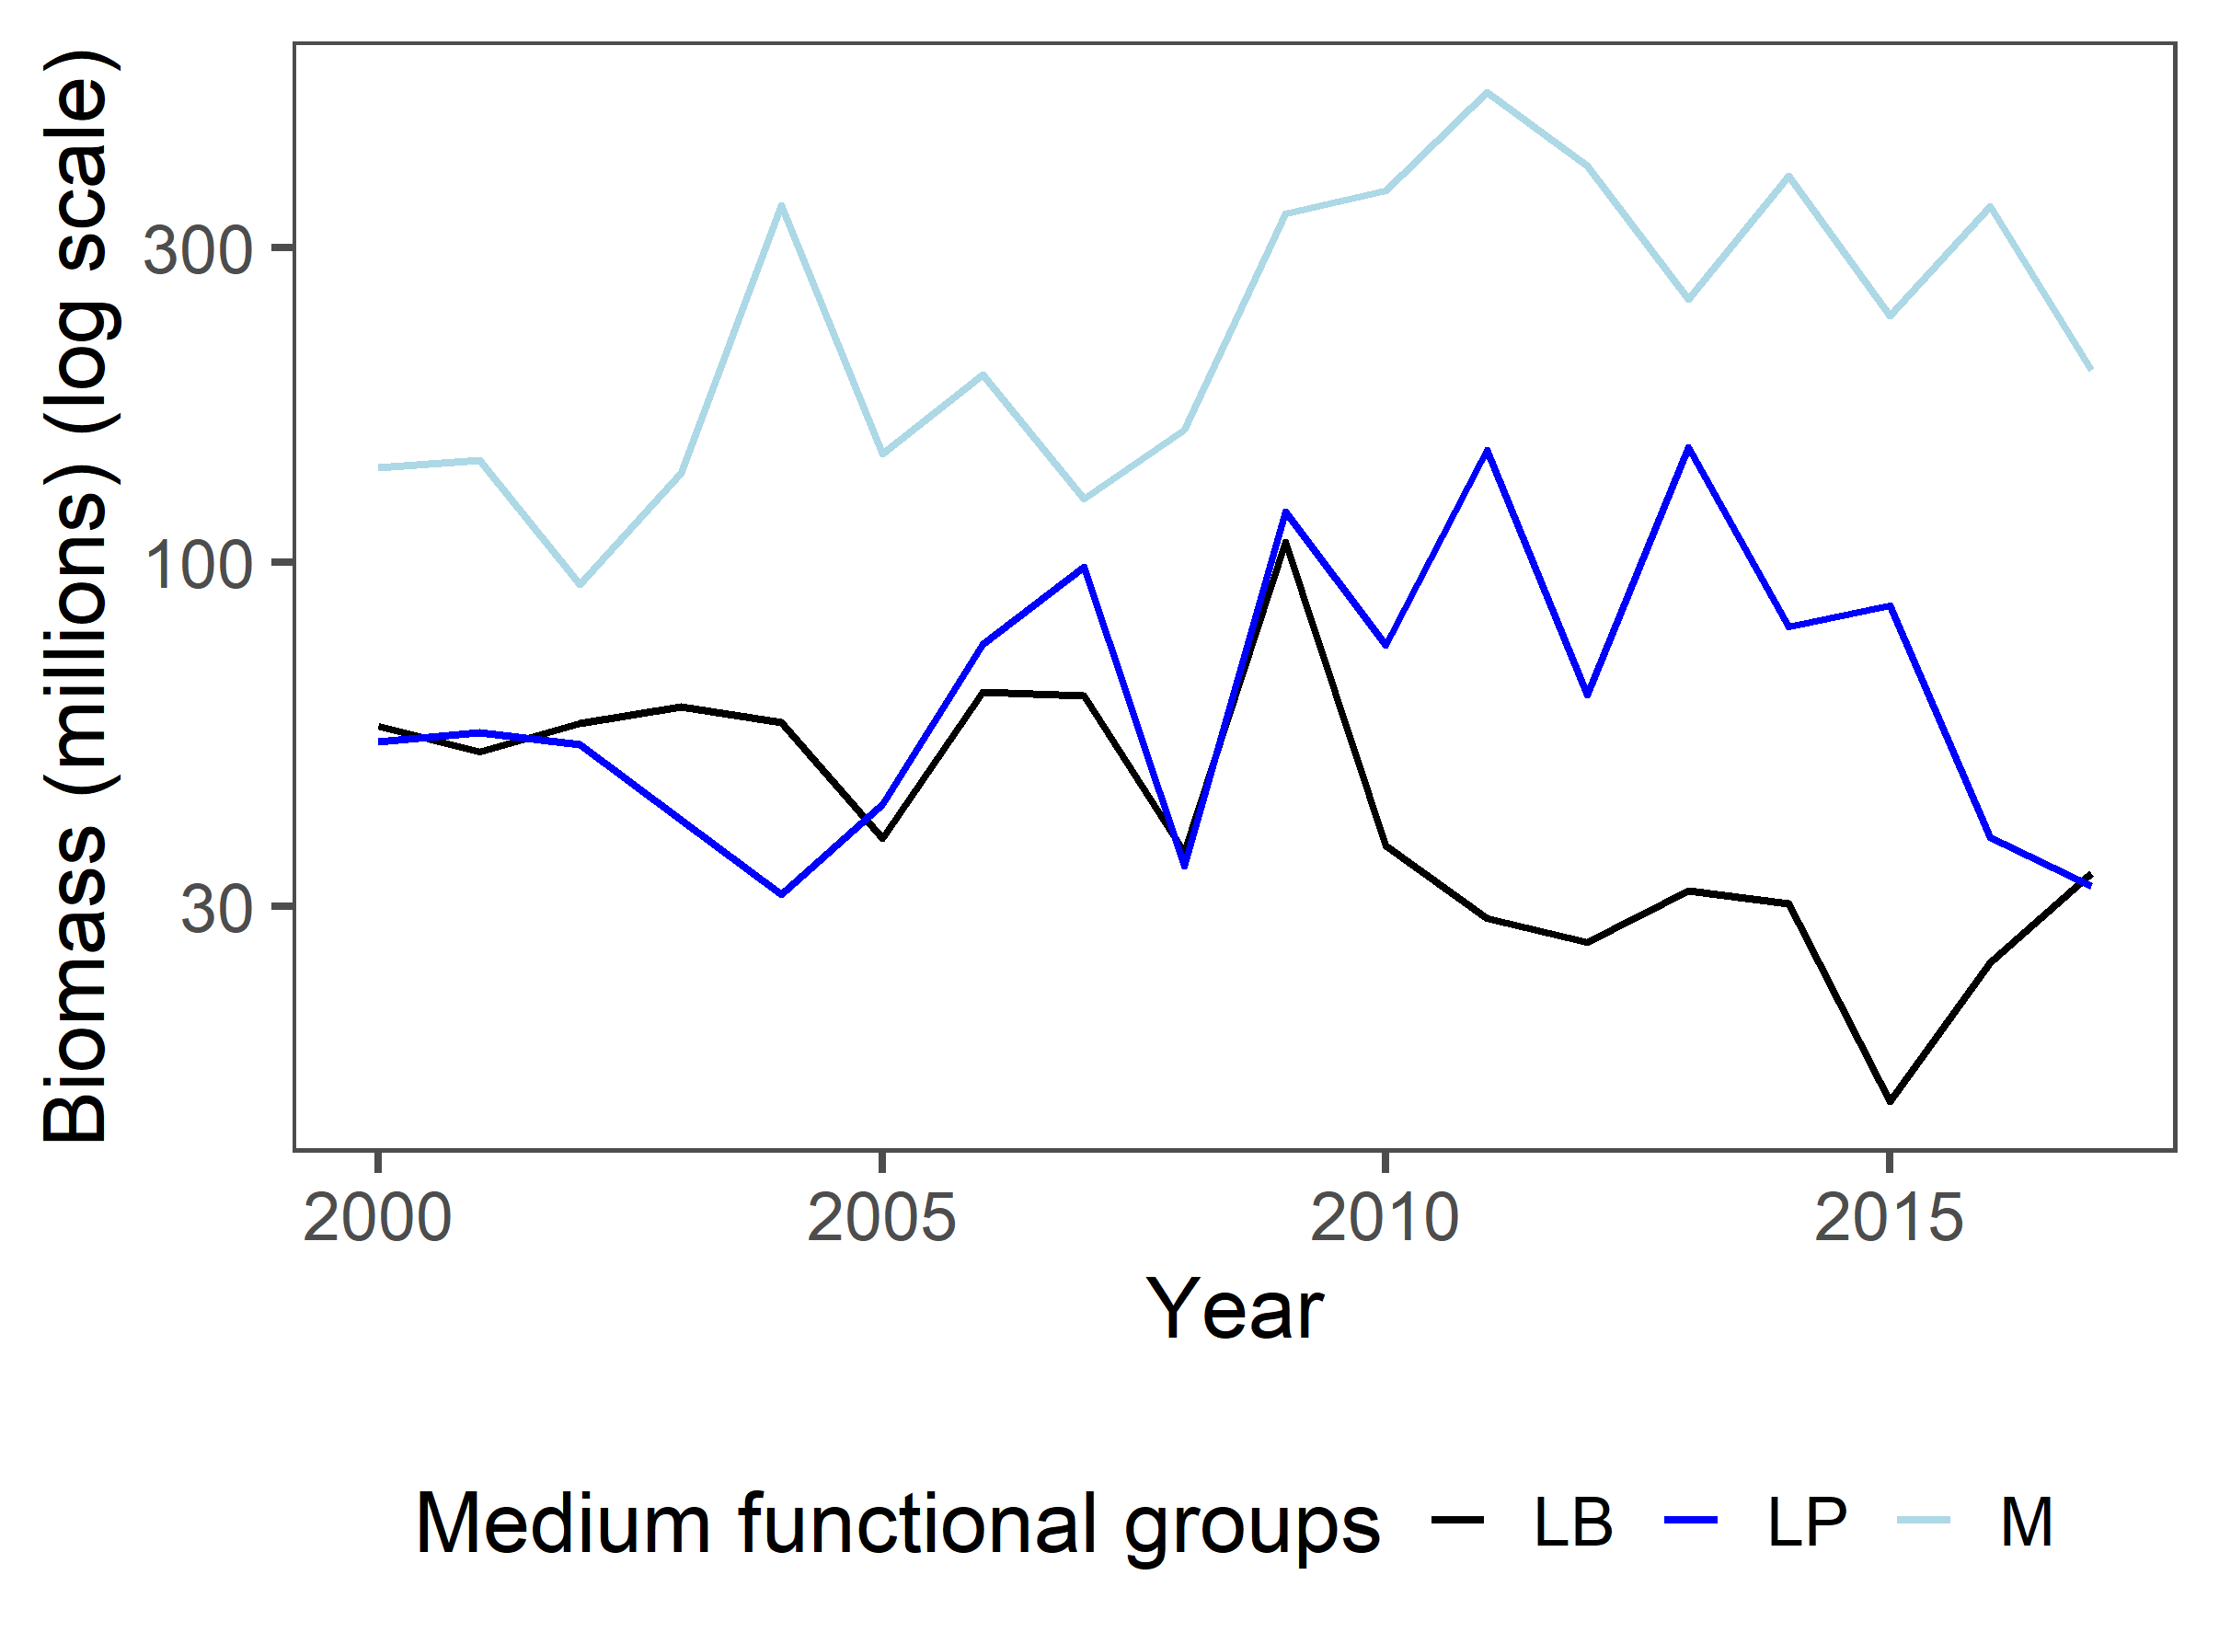
MFG Biomass
Notes:
Good that M are on top; would expect LBs to be on top of LPs (could be because wolffish is in LB compared to cod/hake in LP)?
LB drops weirdly around 2009 – which species is driving this? 2008 and 2010 are similar biomasses; combo of haddock soaring and other two tanking in 2009
Wolffish and skate stay low into 2012 while haddock returns to 2008-level sizes
2015 tank could just be survey noise – weird tank/boom in GB haddock around this time; unassessed species, so we don’t know

Slide 14
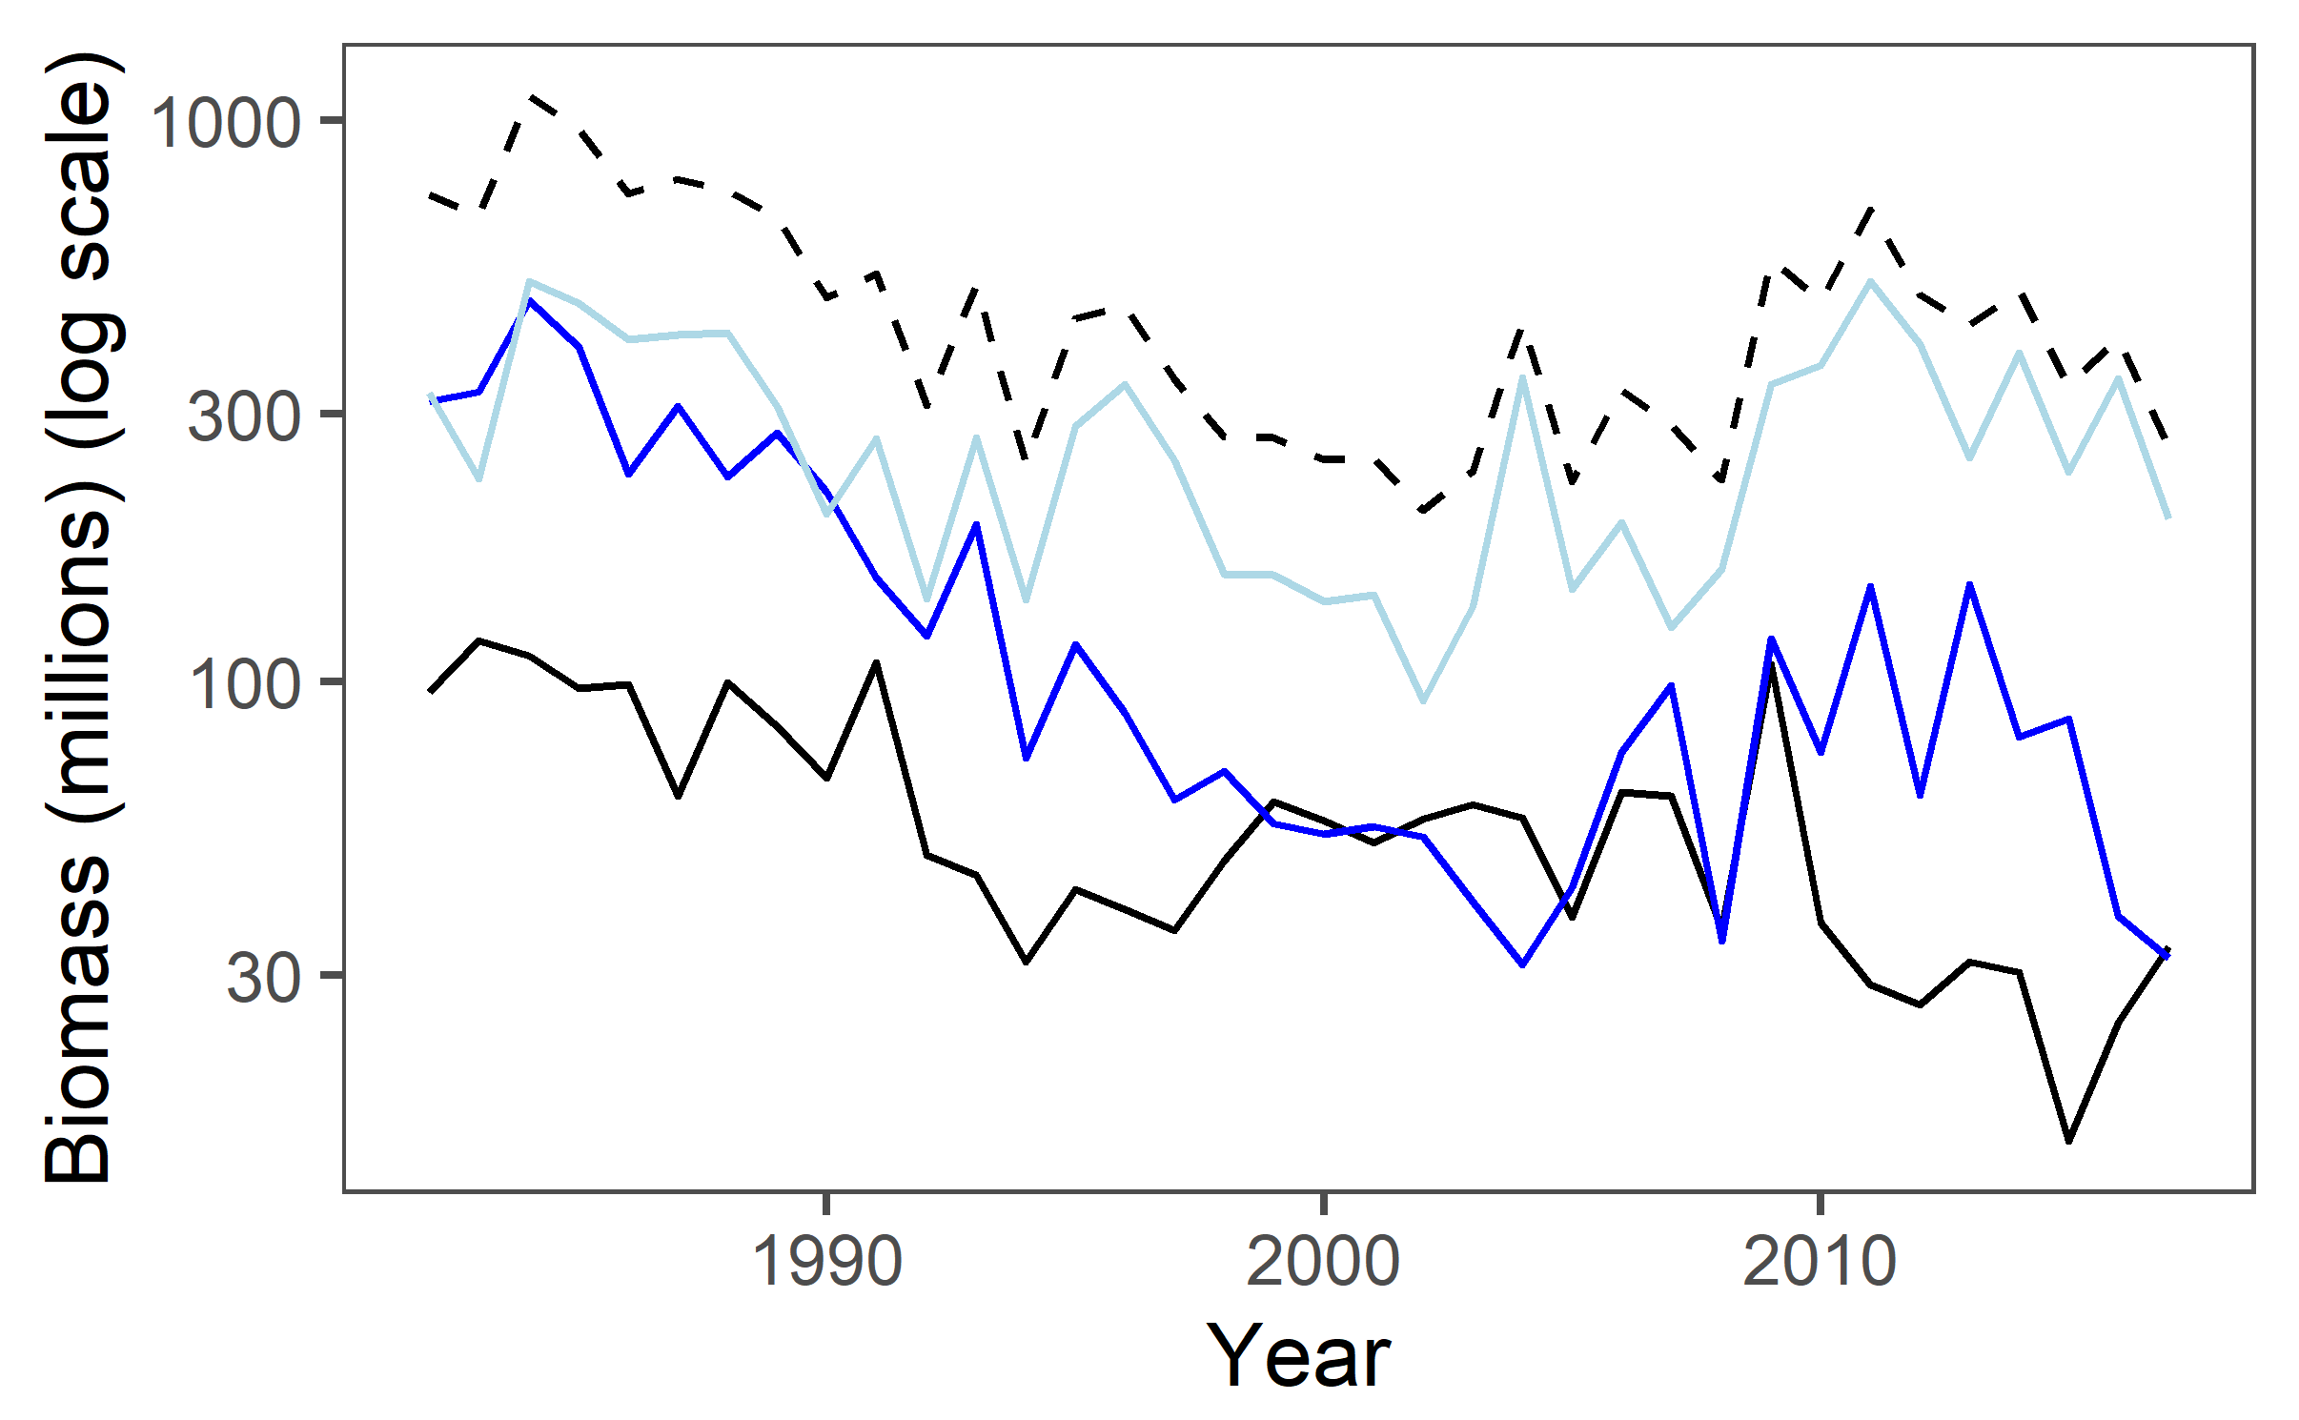
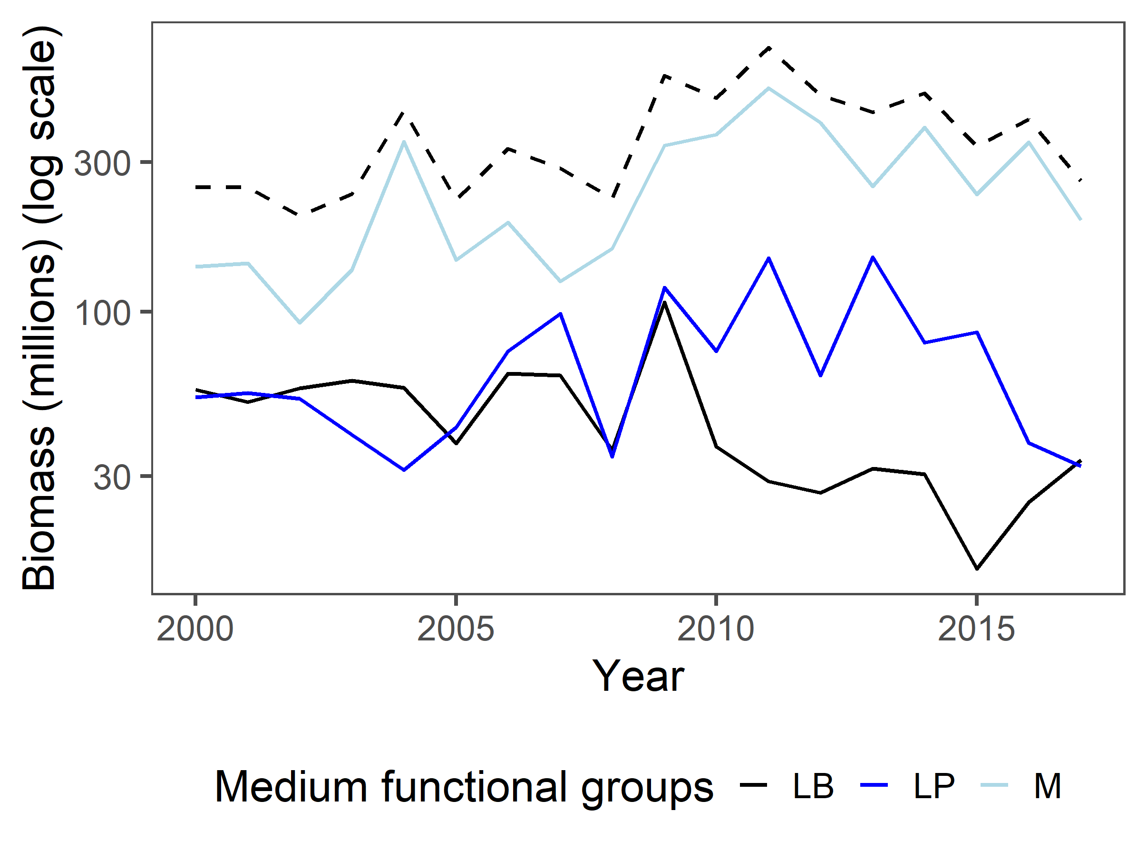
MFG + ecosystem biomass
*Dotted line = ecosystem biomass
Notes:
Ecosystem biomass seems to most closely follow LPs in full time series, but from 2000-2017 looks closest to Ms

Slide 15
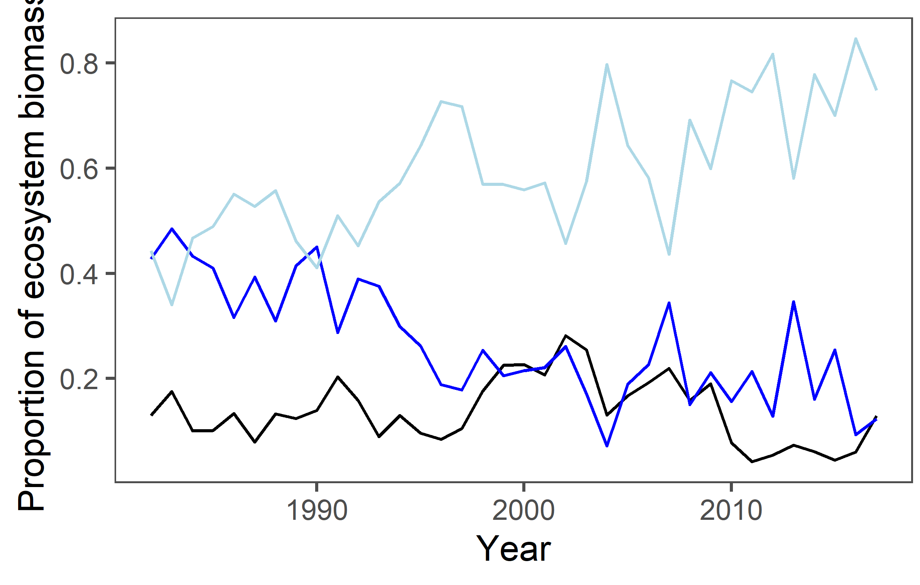
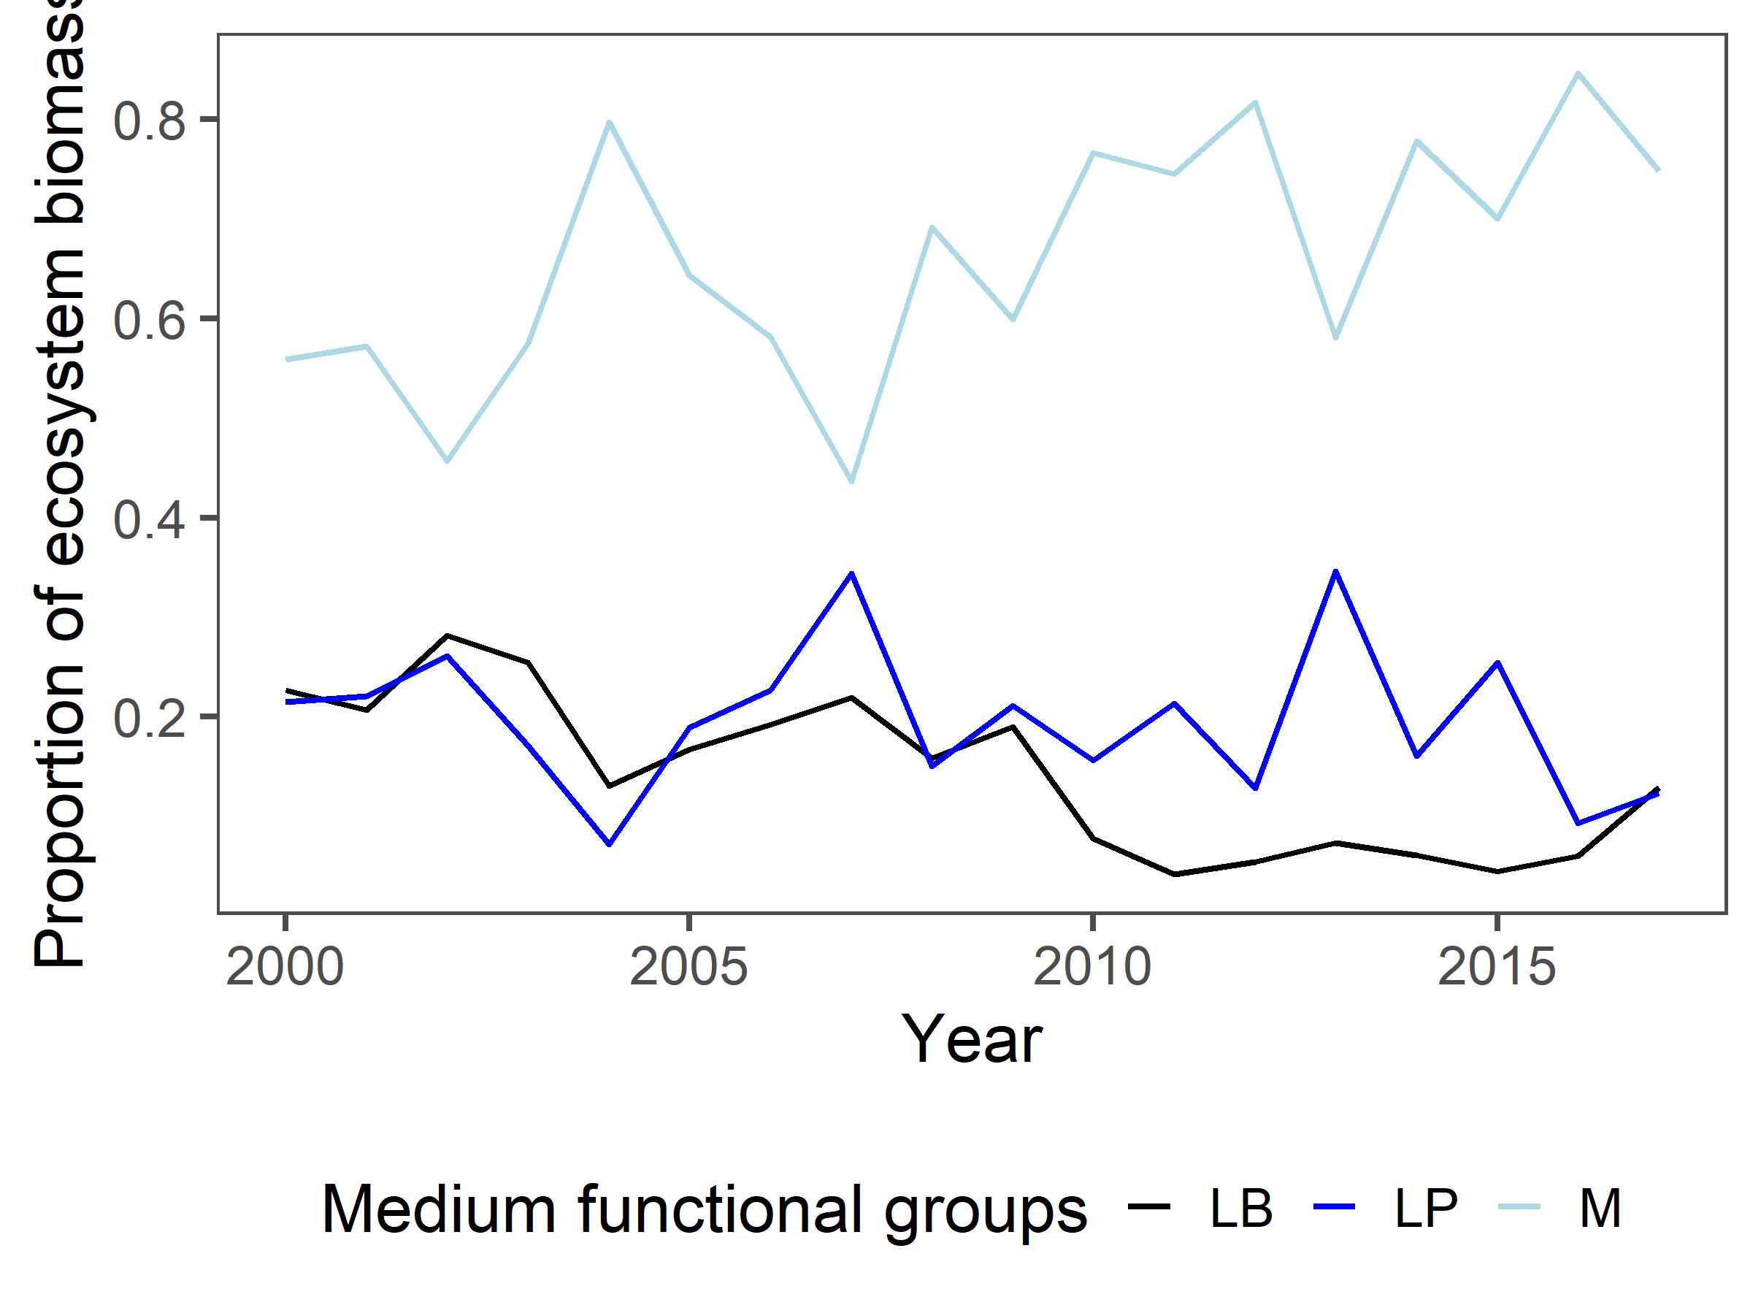

$\frac{MFG}{eco}$ biomass
Notes:
Interesting how LB/eco stays fairly stable over time (wolffish versus cod/hake influence again?)

Slide 16
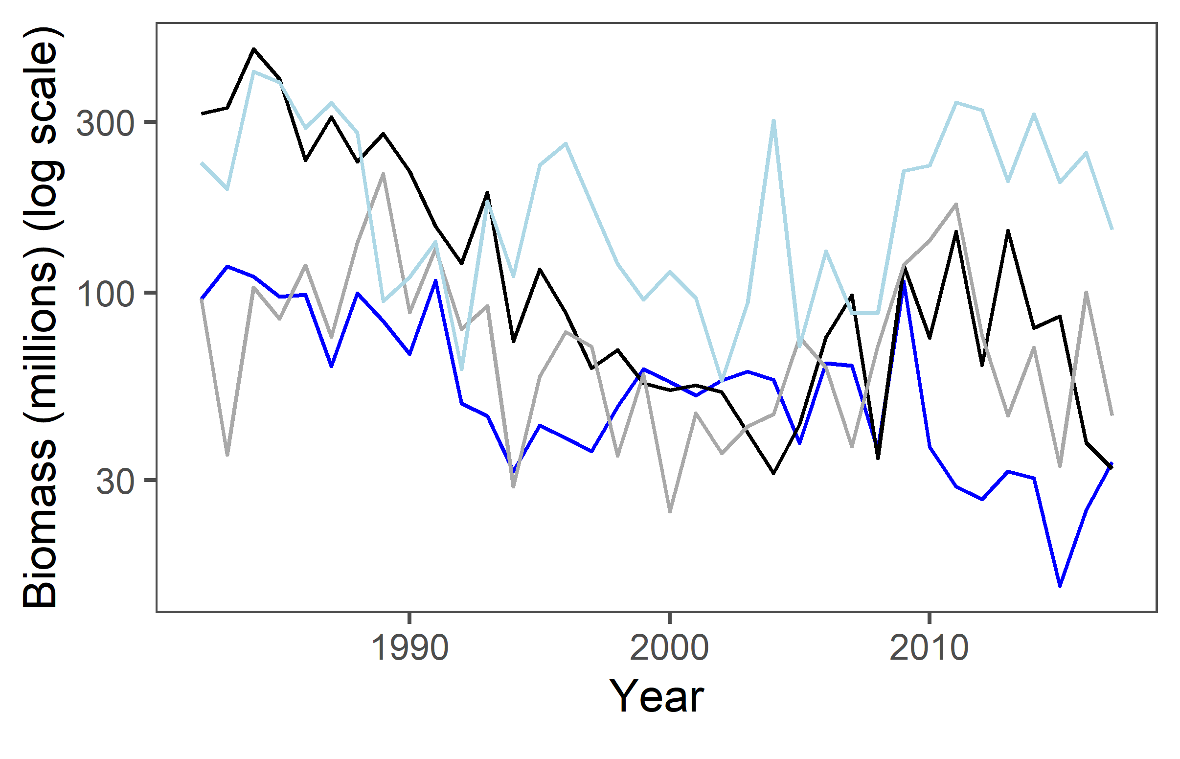
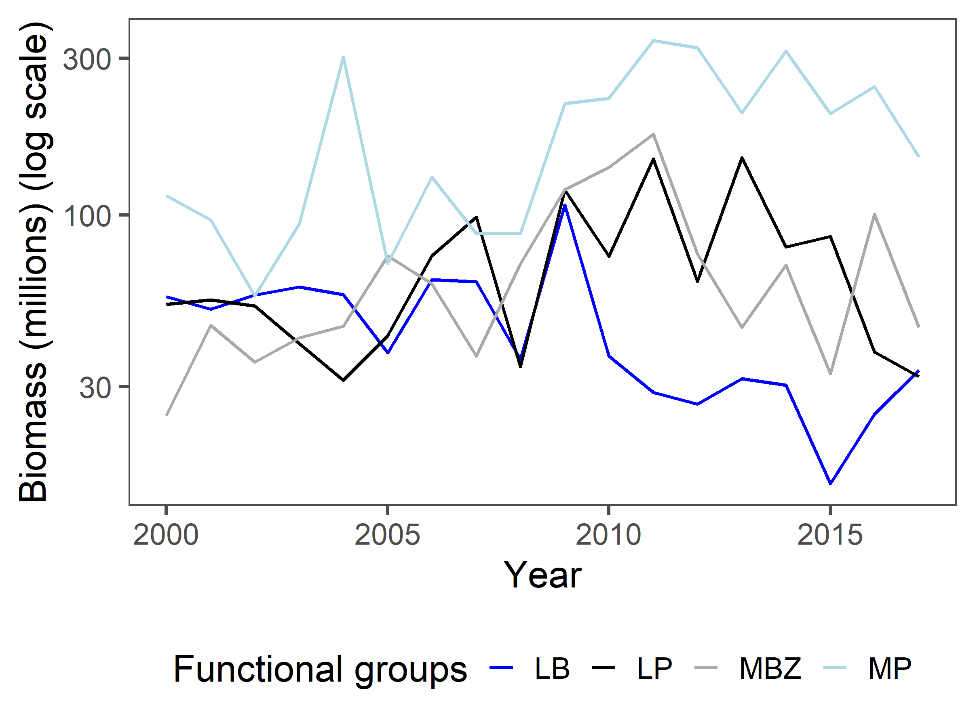
FG Biomass
Notes:
Makes some ecological sense – mediums are greater than larges – however, would expect the LPs to be the smallest, not the LBs (same with MPs and MBZs)
Is this just because of the nature of the survey?
Is this OK, since we are looking at FGs and not TLs?
2015 LB drop is driven by haddock and wolffish – why could this be?
Abundance of each FG is likely driven by how the groupings are done – check lit for relative abundances of these different groups

Slide 17
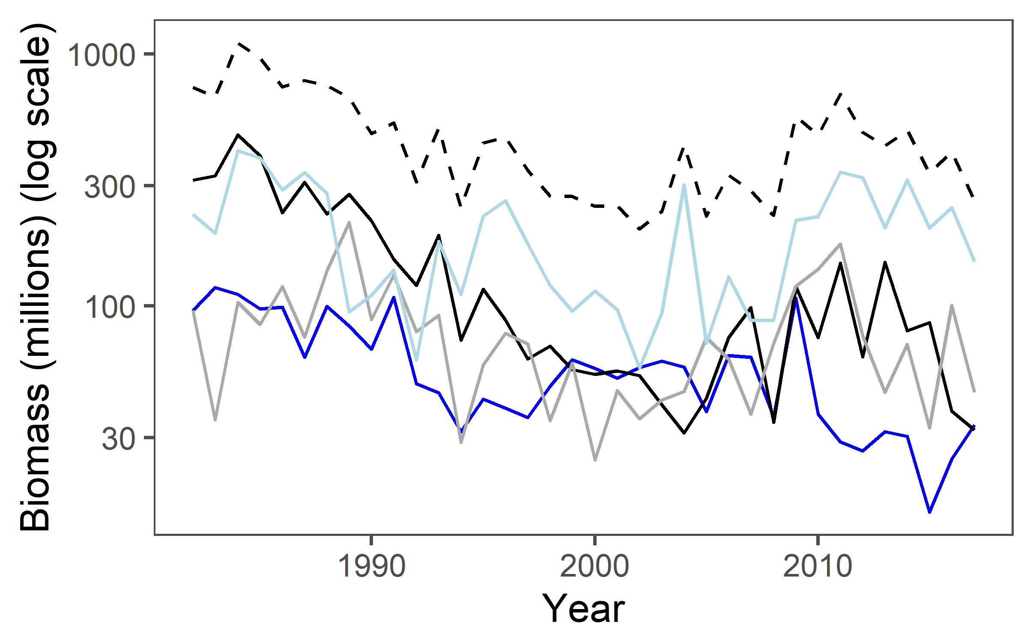
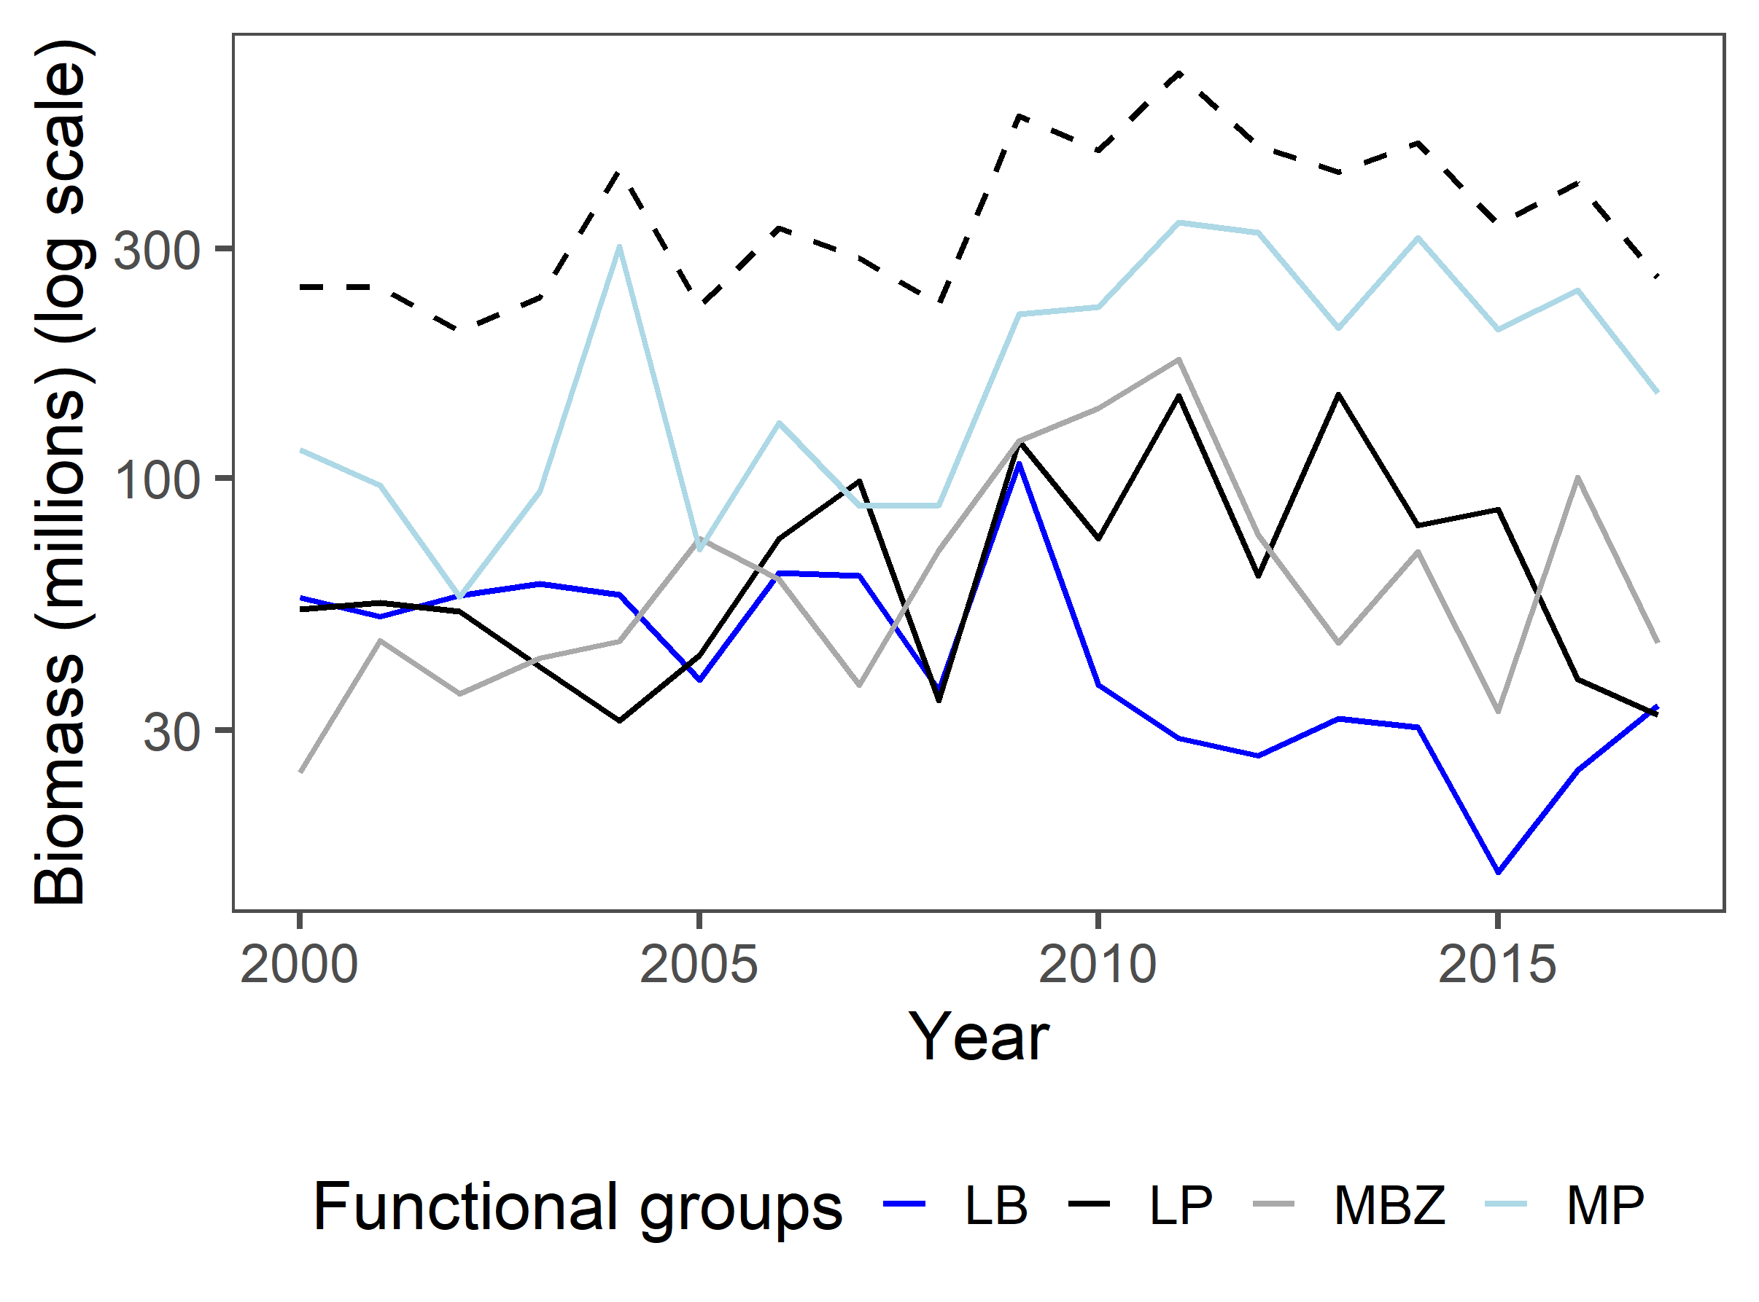
Ecosystem + FG biomass
*Dotted line = ecosystem biomass
Notes:
Ecosystem biomass seems to most closely follow the MPs, but LPs are also pretty close – evidence of TD?
Changes in size of ecosystem seems to be driven mostly by decline in LPs

Slide 18
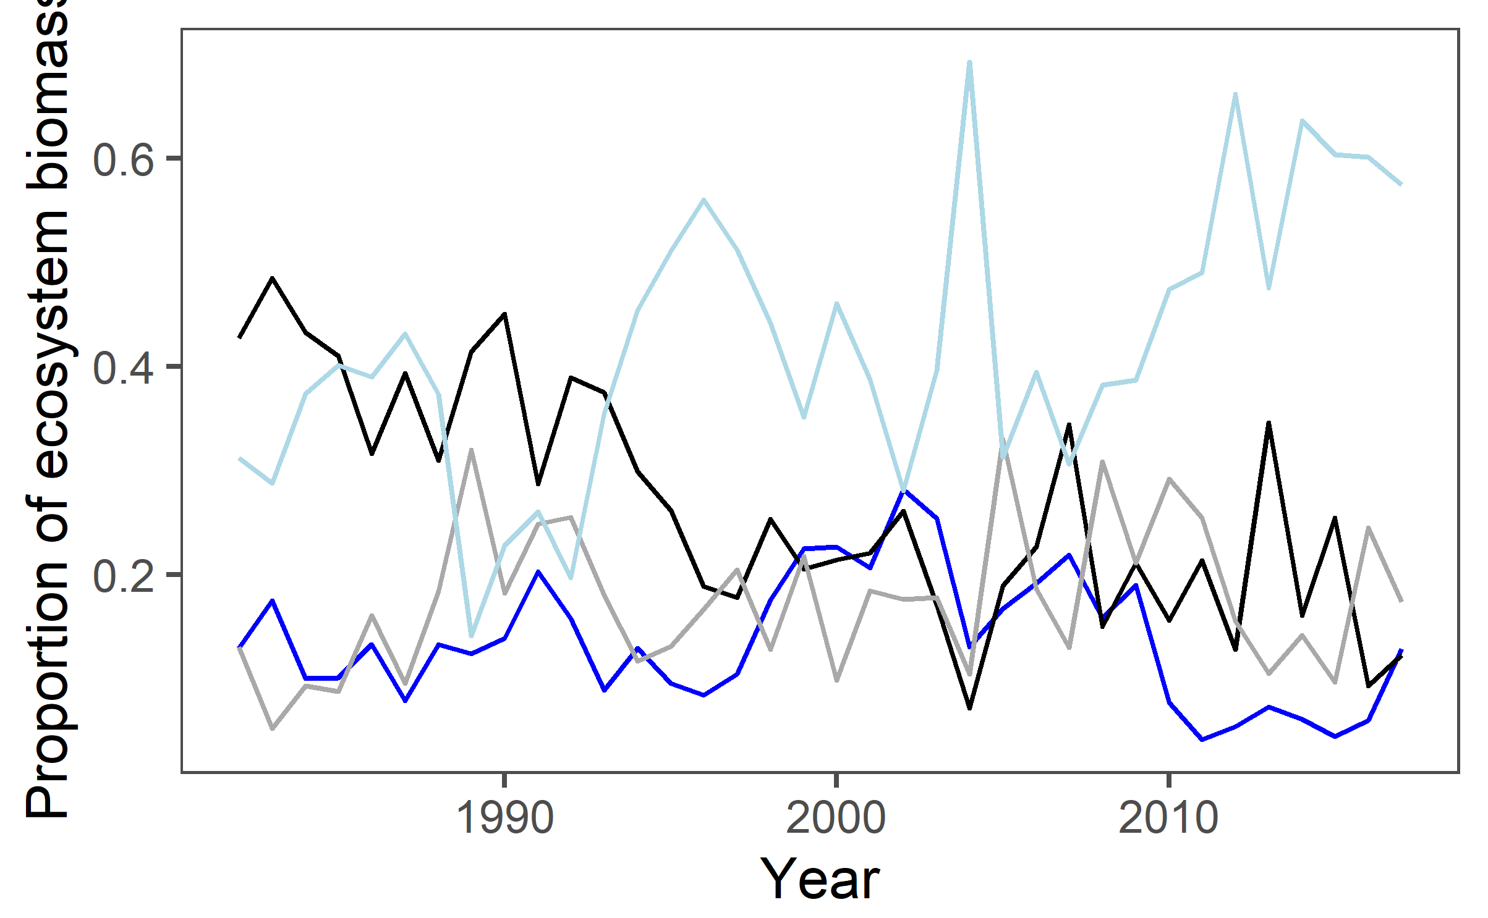
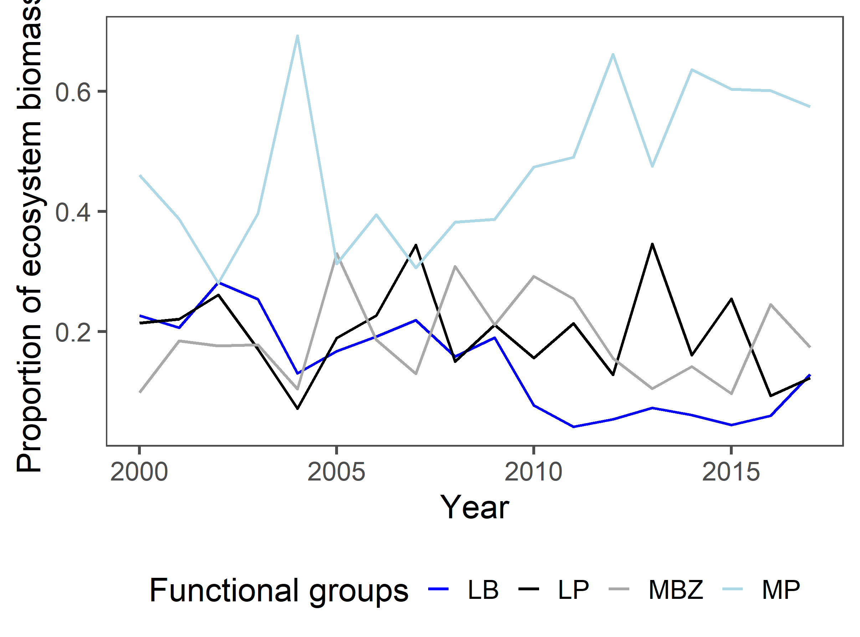
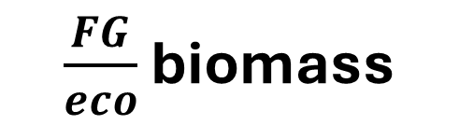
$\frac{FG}{eco}$ biomass
Notes:
Interesting to see how LP/eco declined pre-2000 and MP filled the gap
MBZ pretty close to LB

Slide 19
K simulations
SECTION 2 – WHERE THINGS Kind of FELL APART

Slide 20
Eco K
LP/eco
LP K (eco * LP/eco)
LBM (eco – LP)
LB/LBM
LB K (LBM * LB/LBM)
M K (LBM – LB)
MP/M
MP K (M * MP/M)
MBZ K (M – MP)

Slide 21
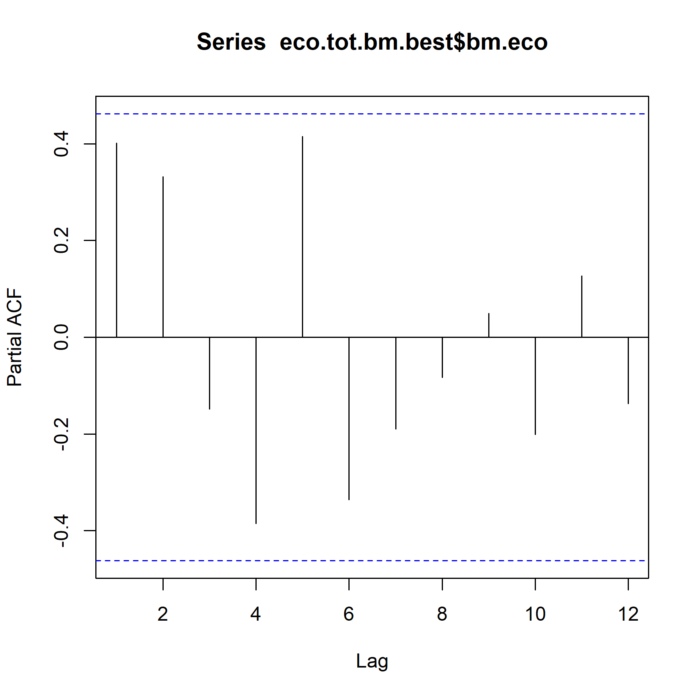
ecosystem PACF
2000-2017
*PACF plots look more normal with more years

Slide 22
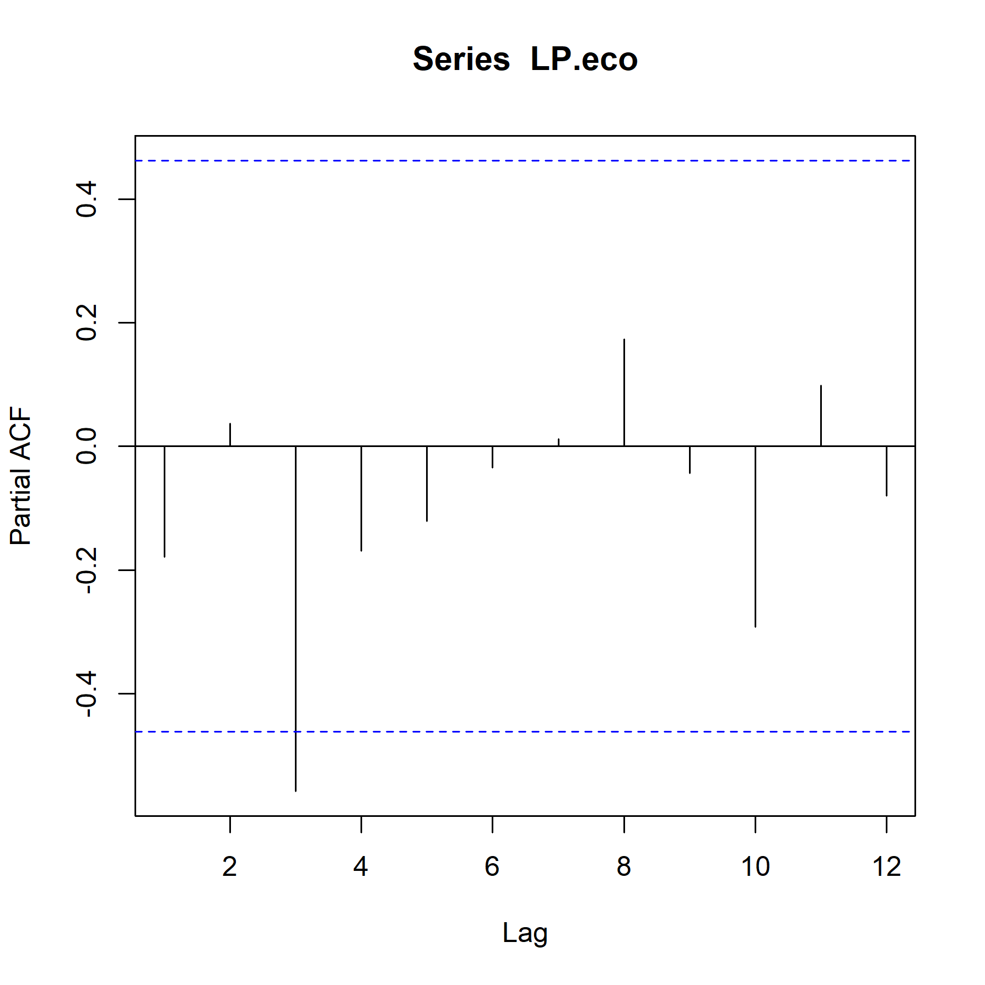
LP/eco PACF
2000-2017

Slide 23
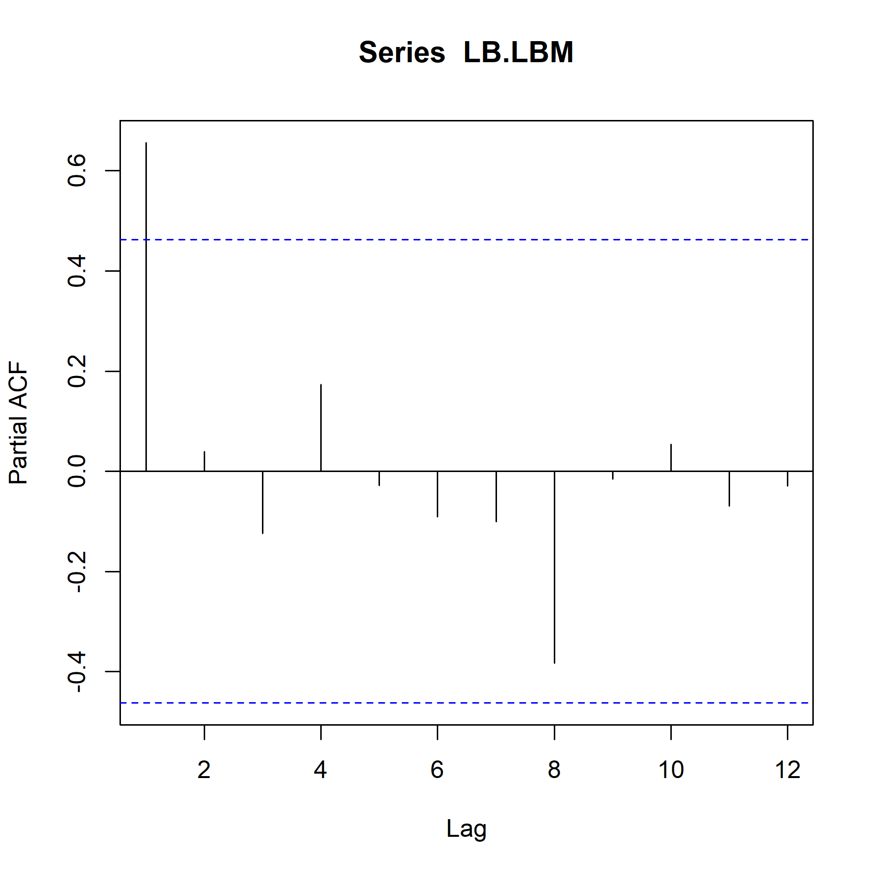
LB/LBM PACF
2000-2017

Slide 24
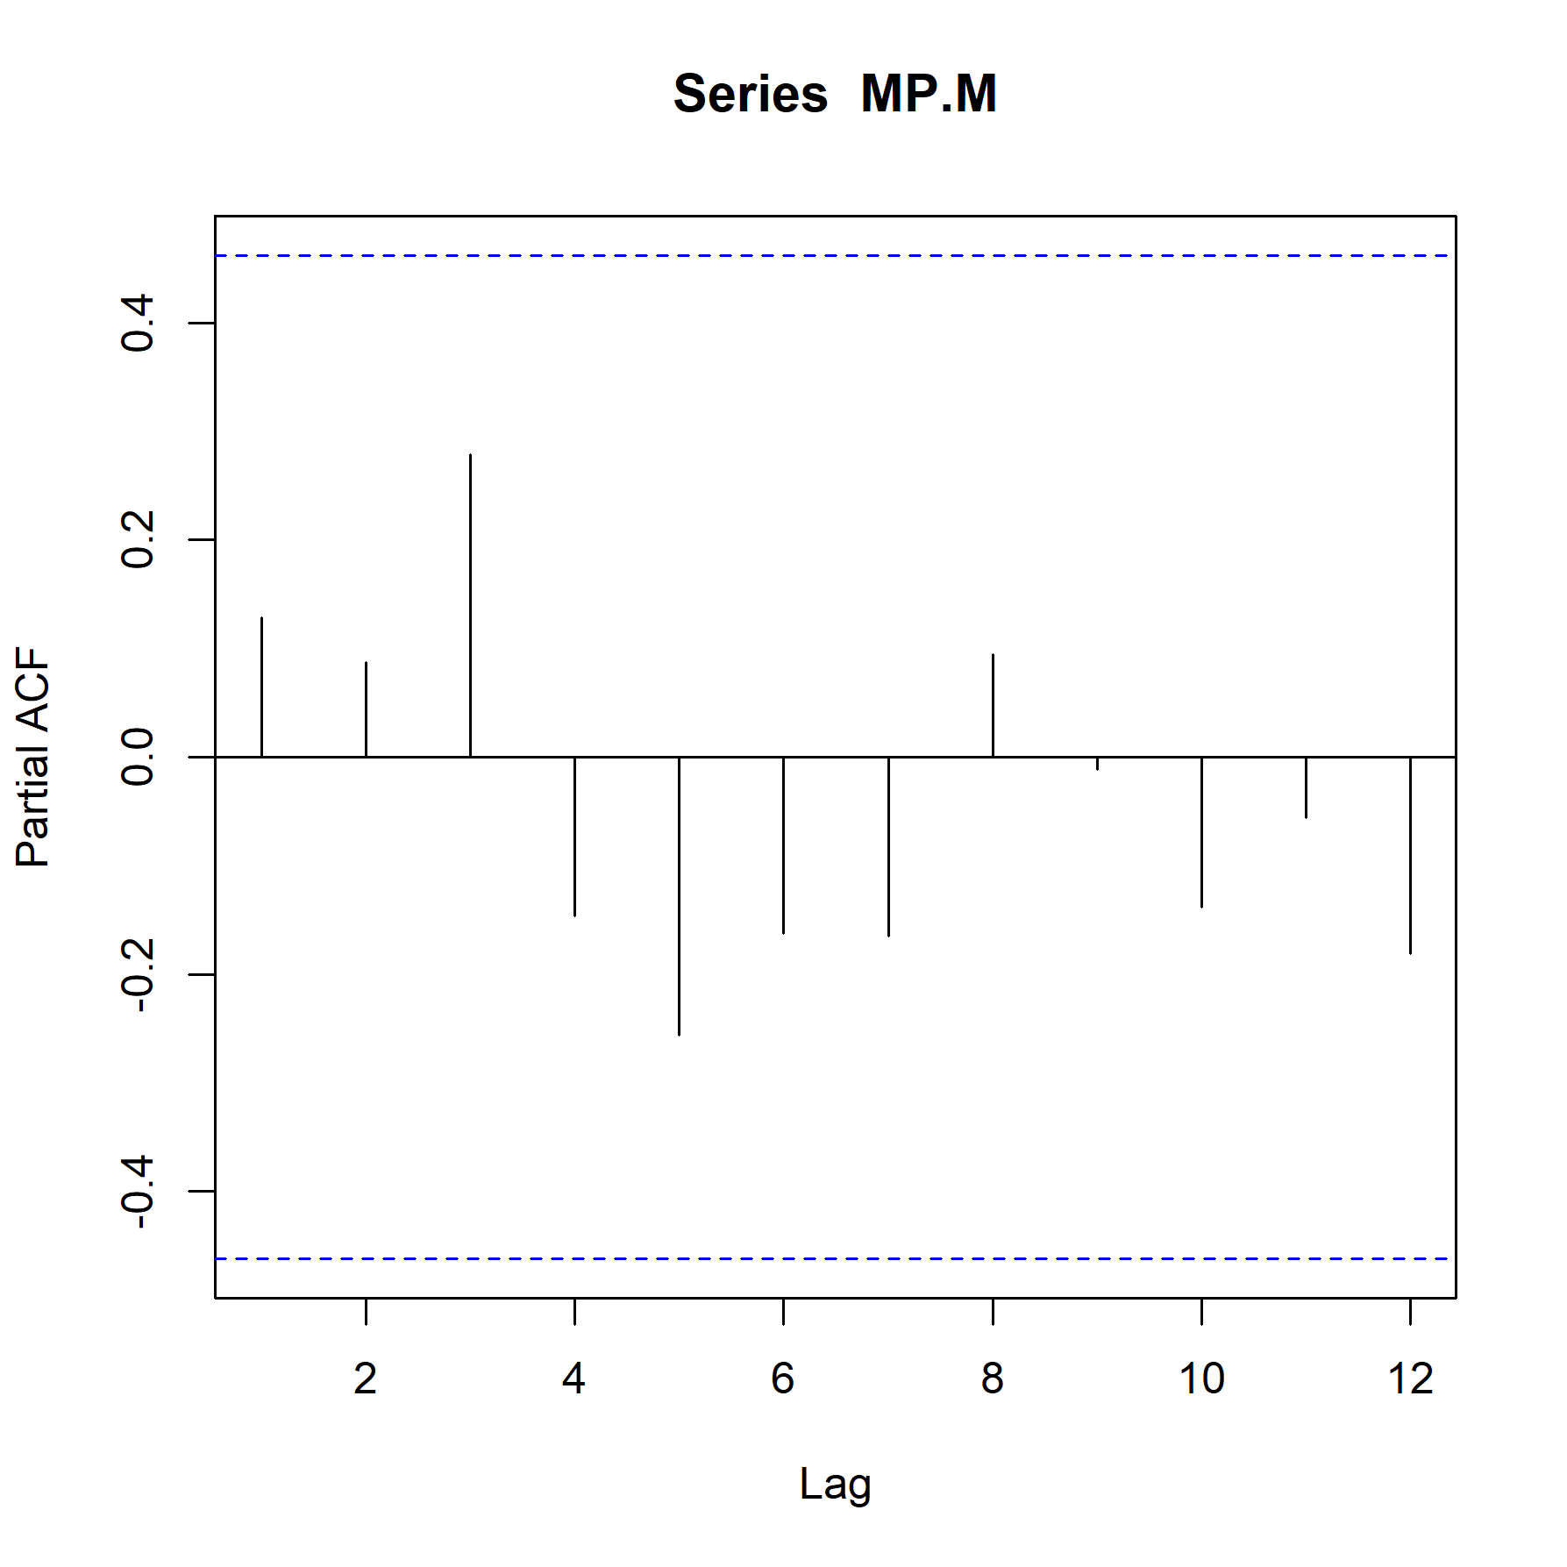
MP/M PACF
2000-2017

Slide 25
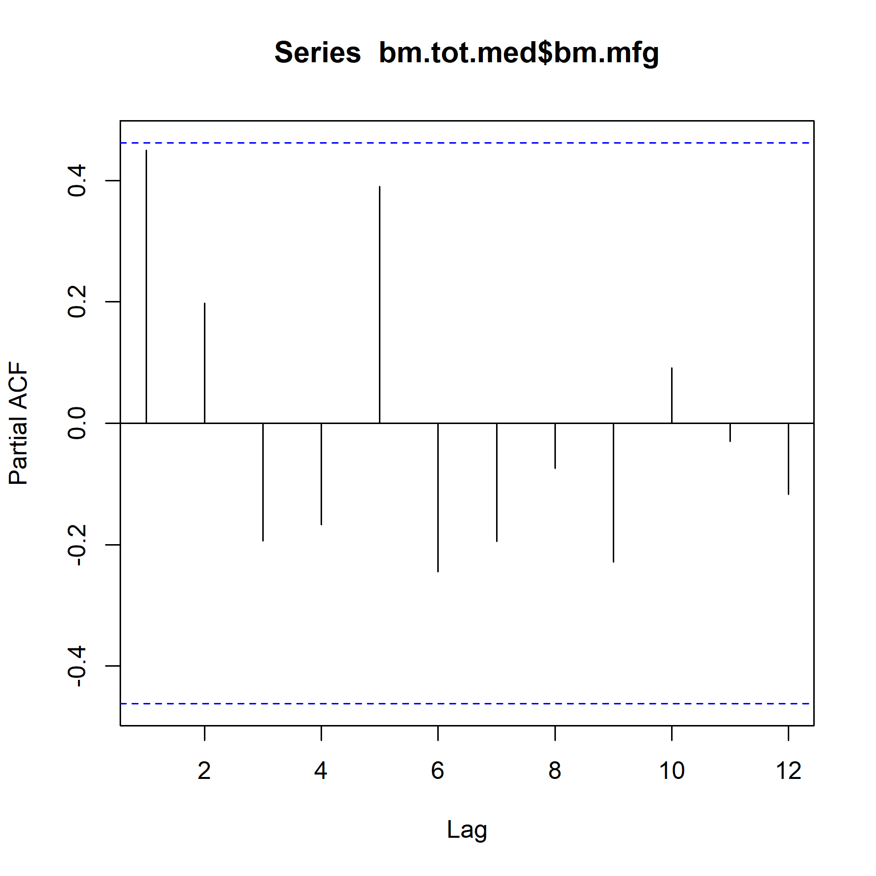
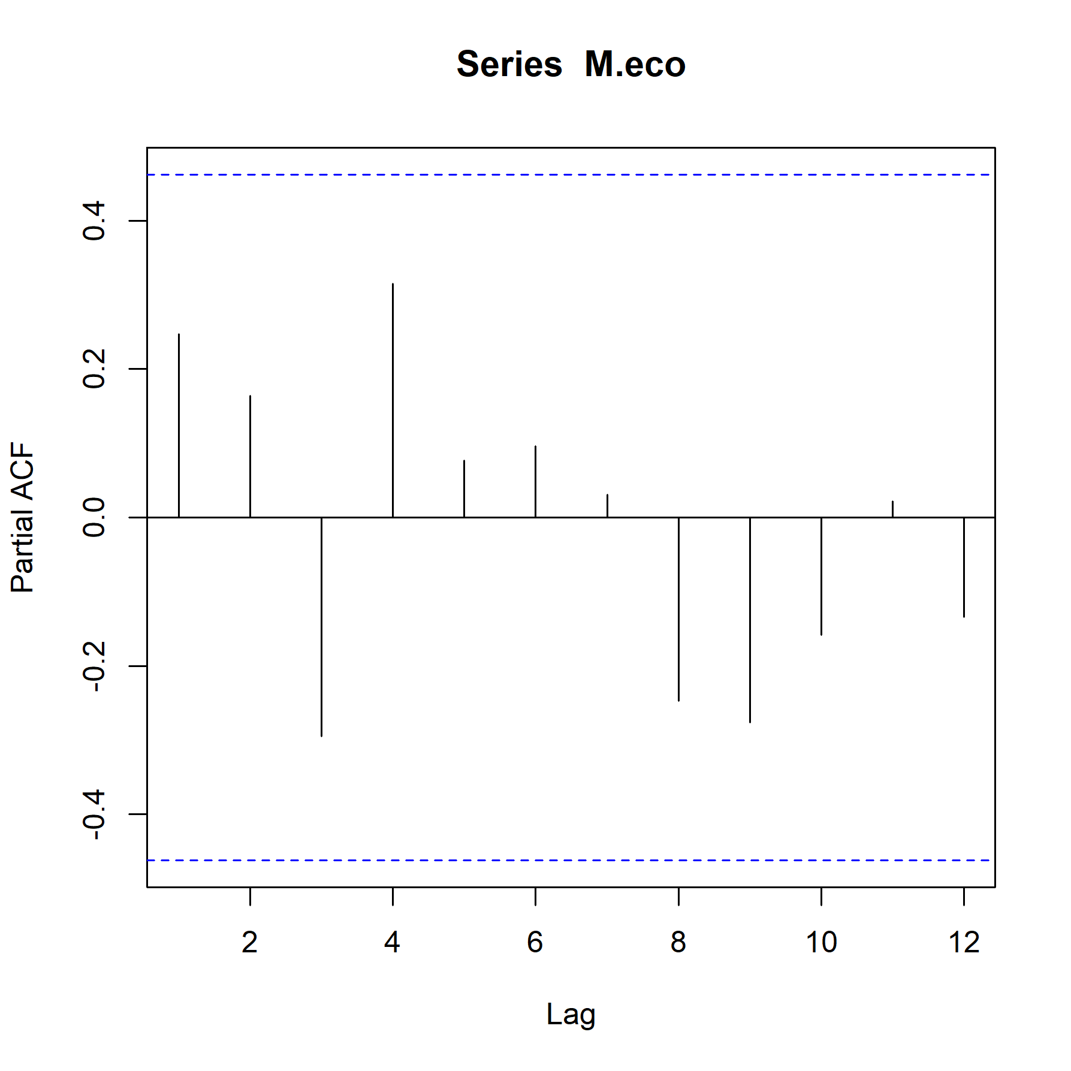
Other M
2000-2017

Slide 26
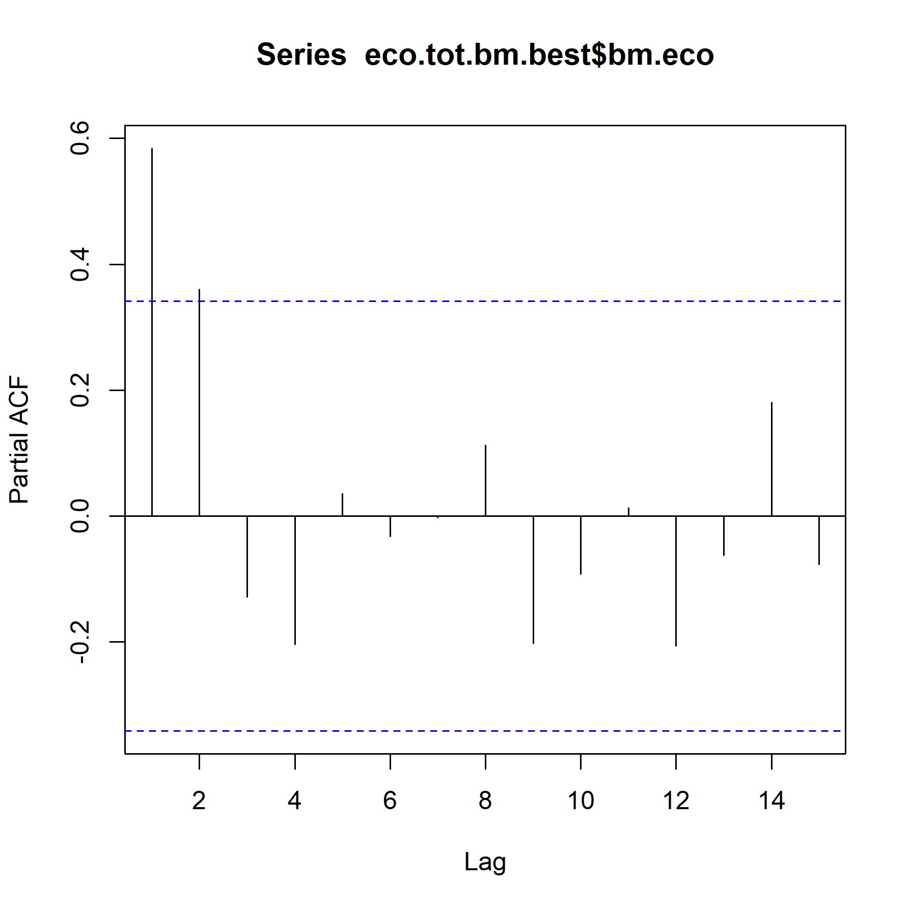
ecosystem PACF
1985-2017

Slide 27
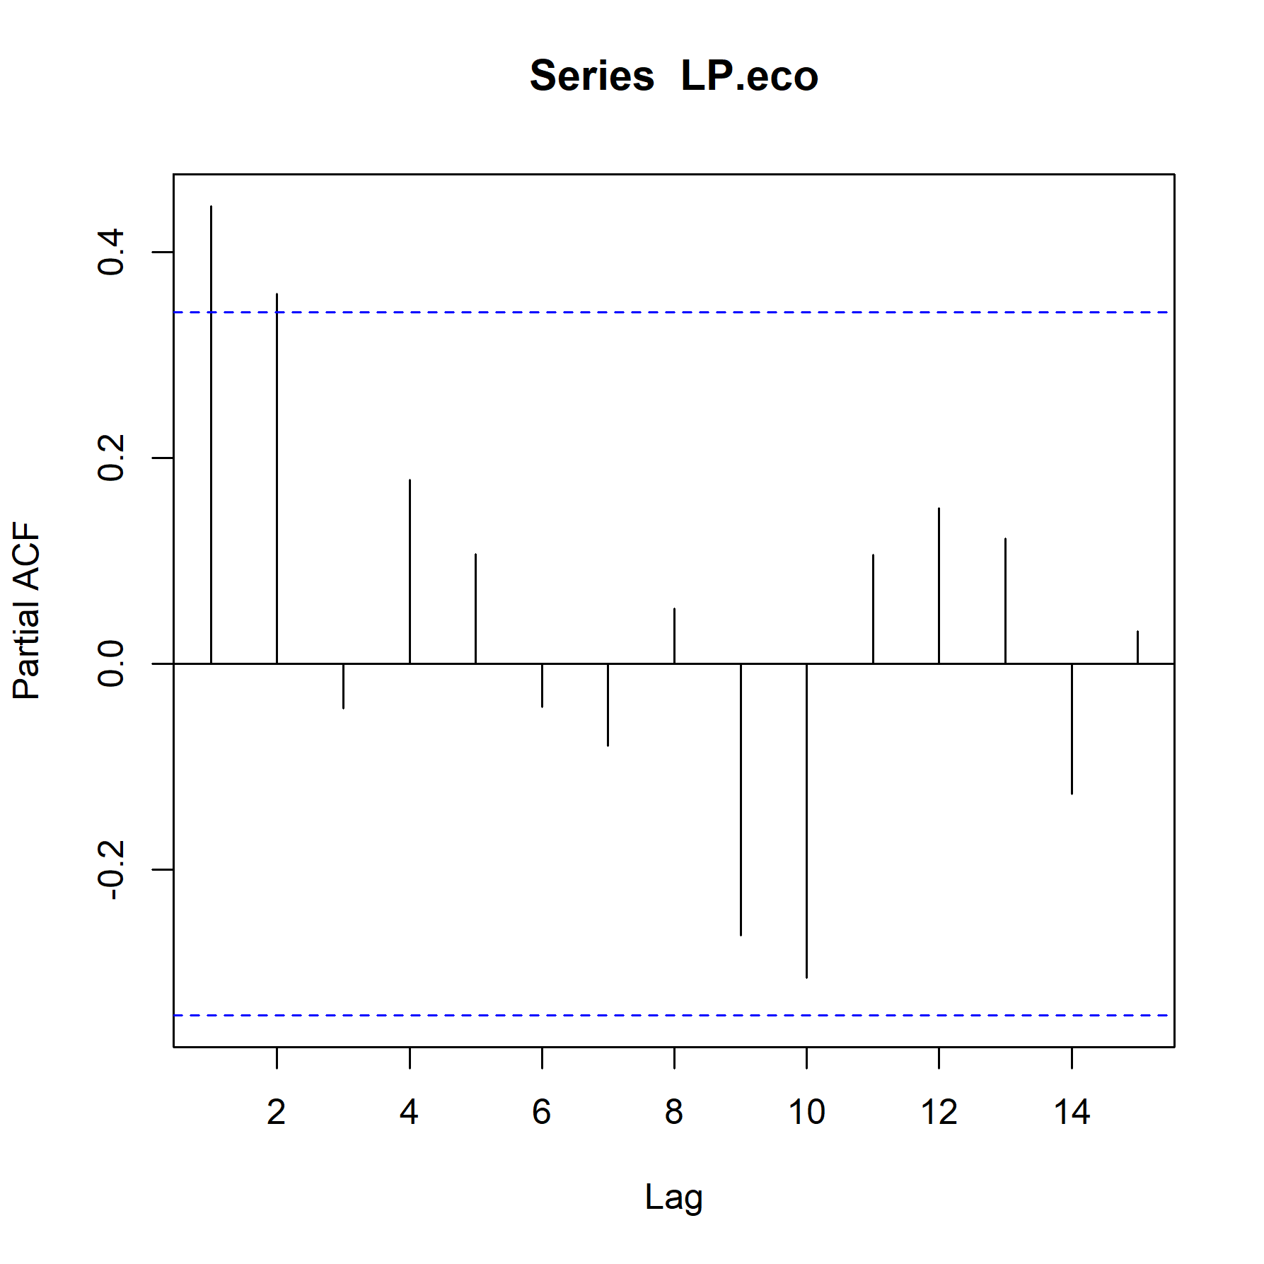
LP/eco PACF
1985-2017

Slide 28
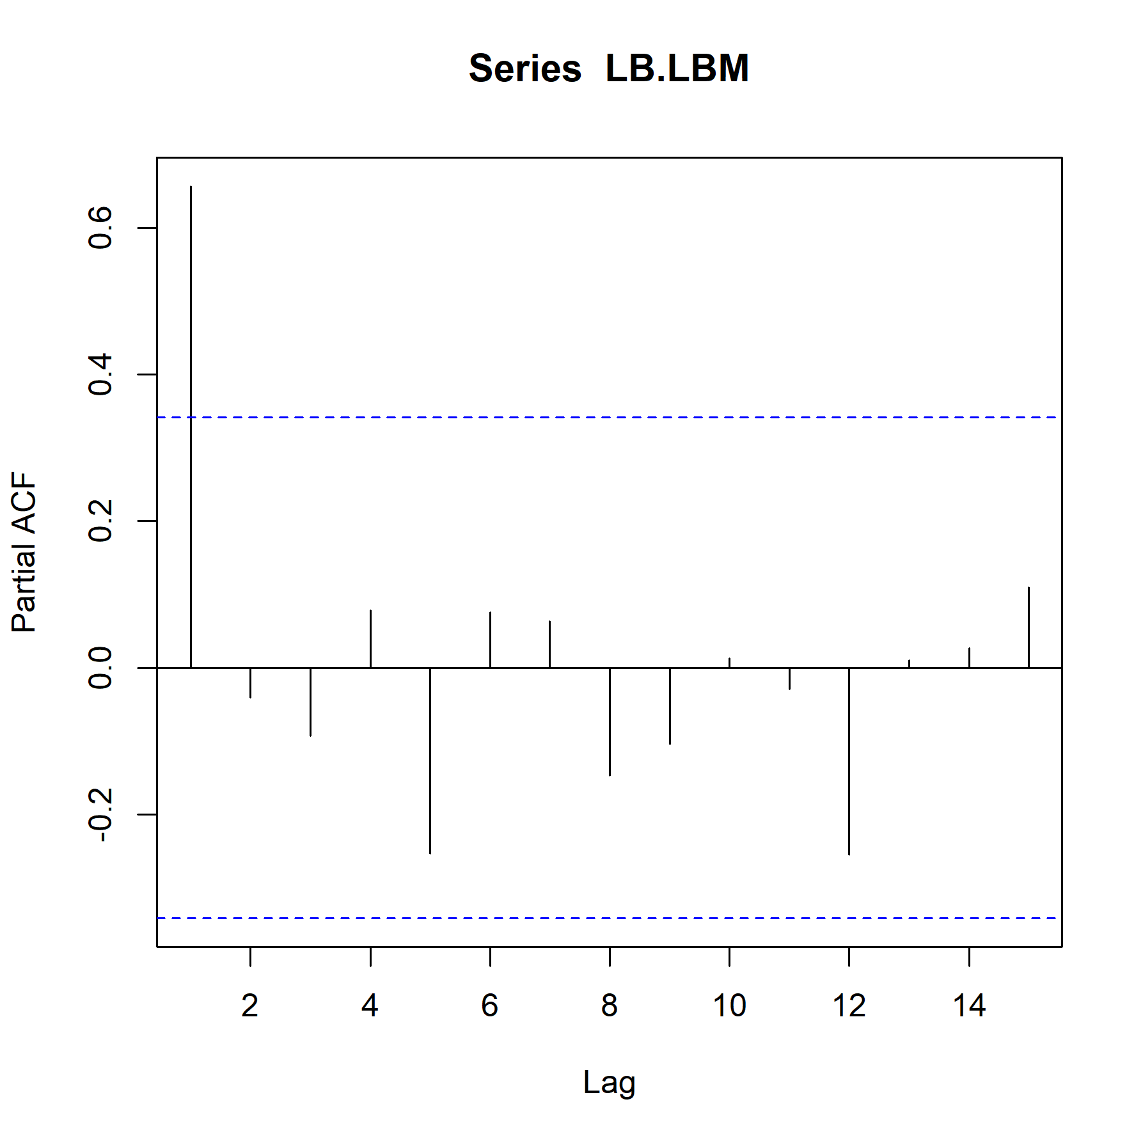
LB/LBM PACF
1985-2017

Slide 29
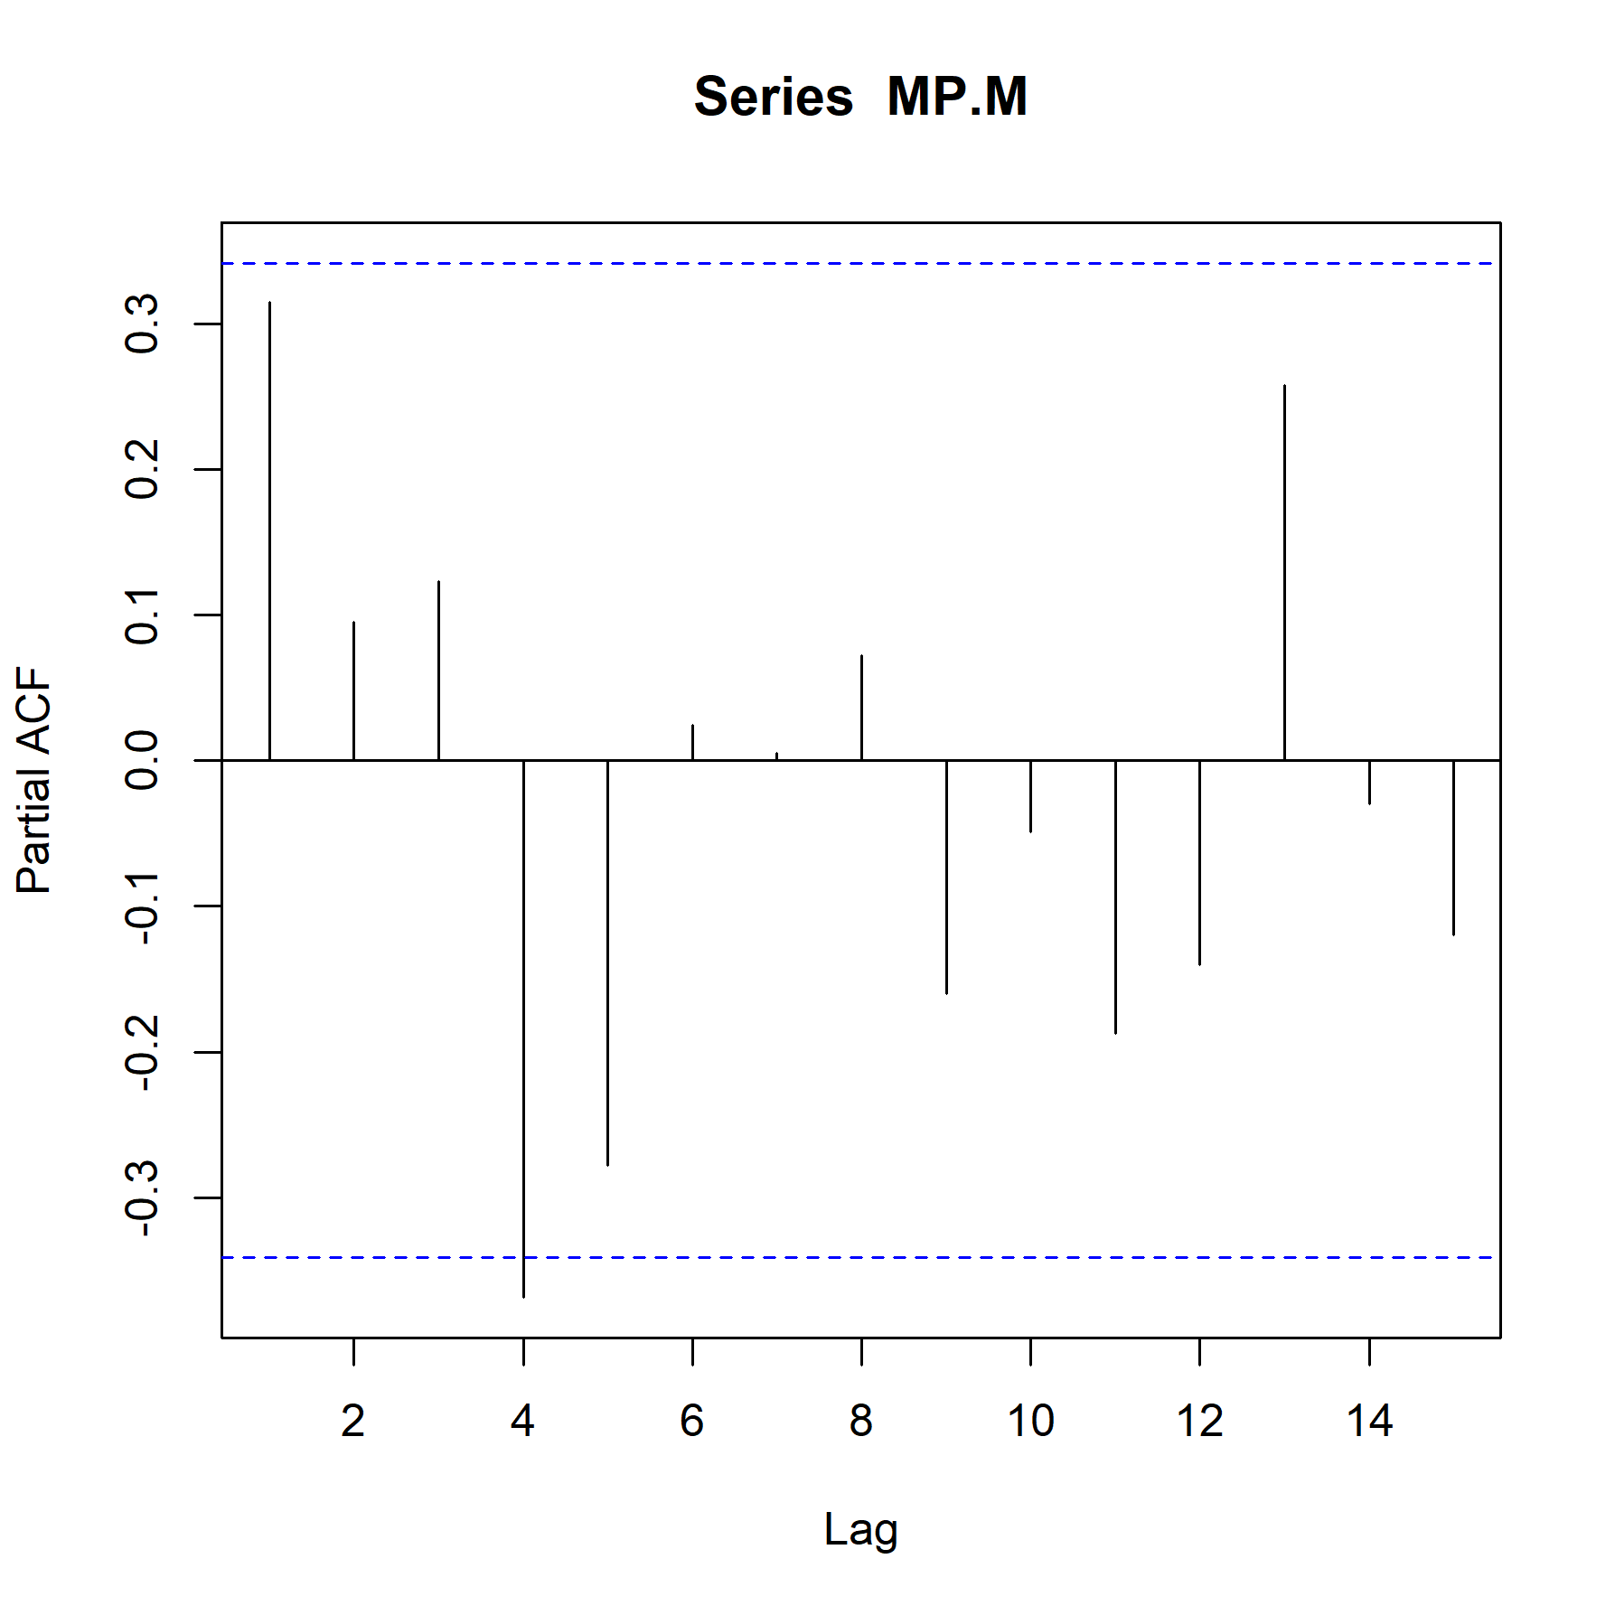
MP/M PACF
1985-2017

Slide 30
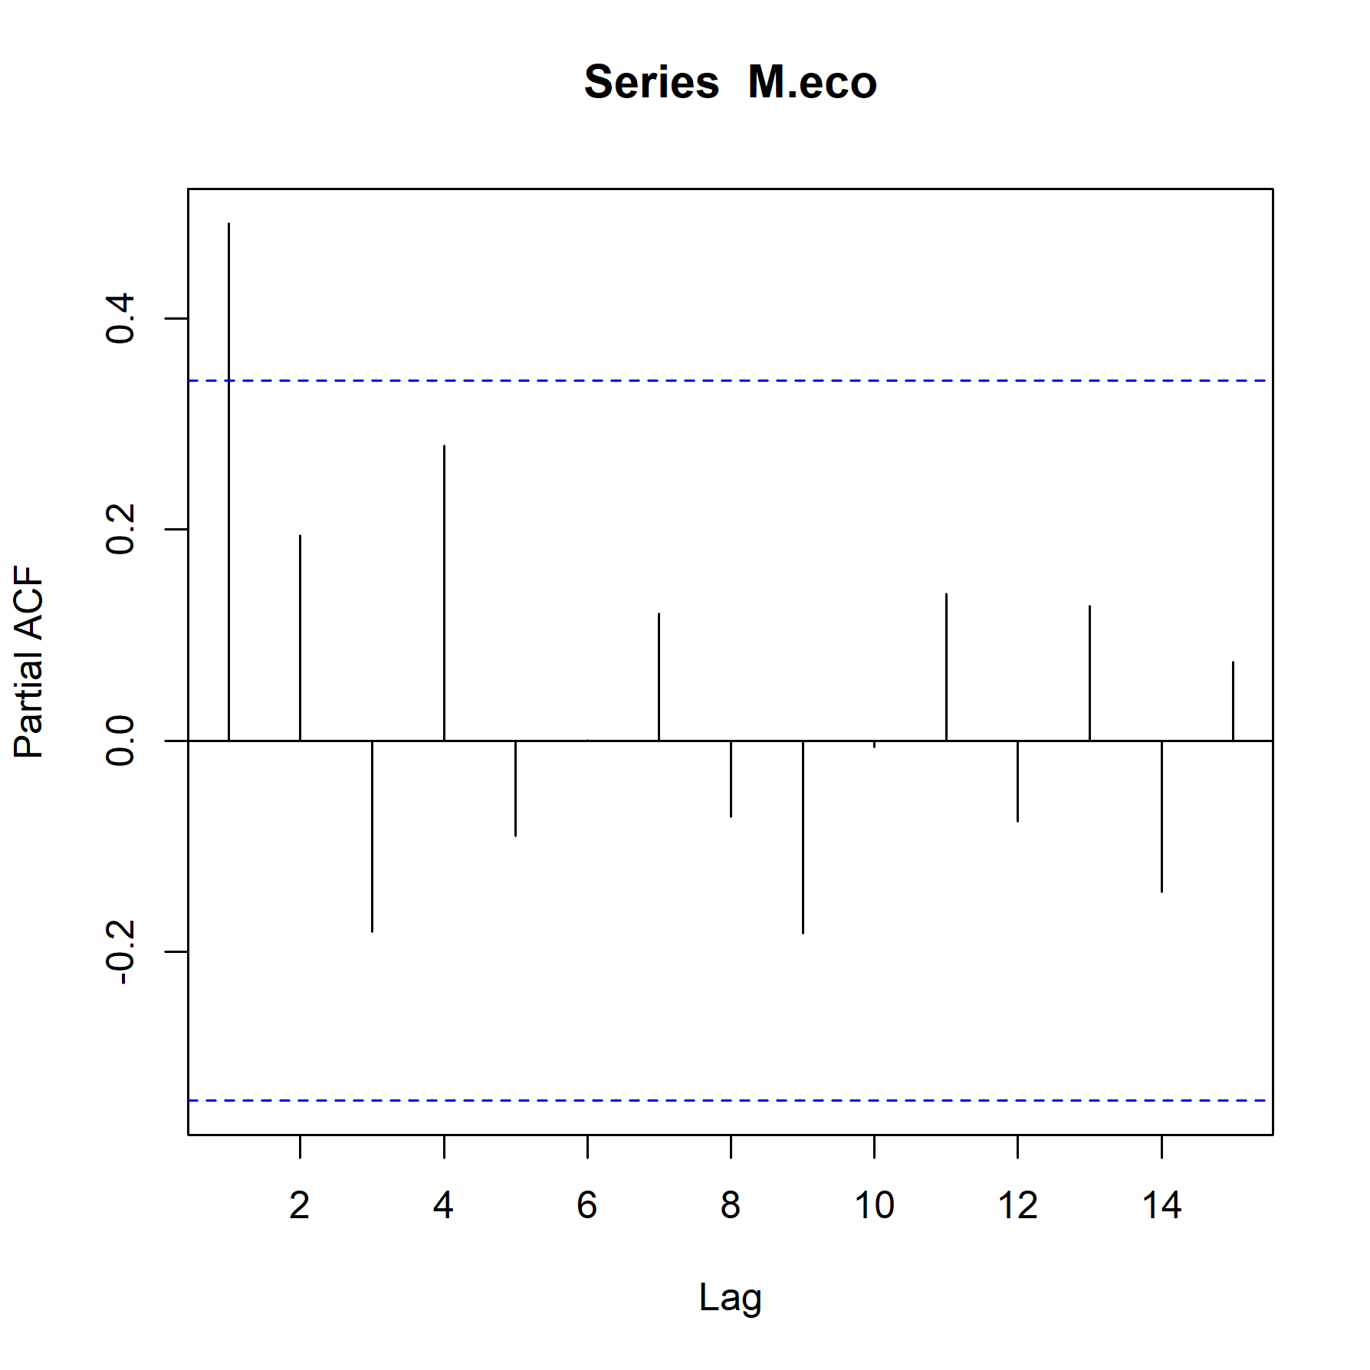
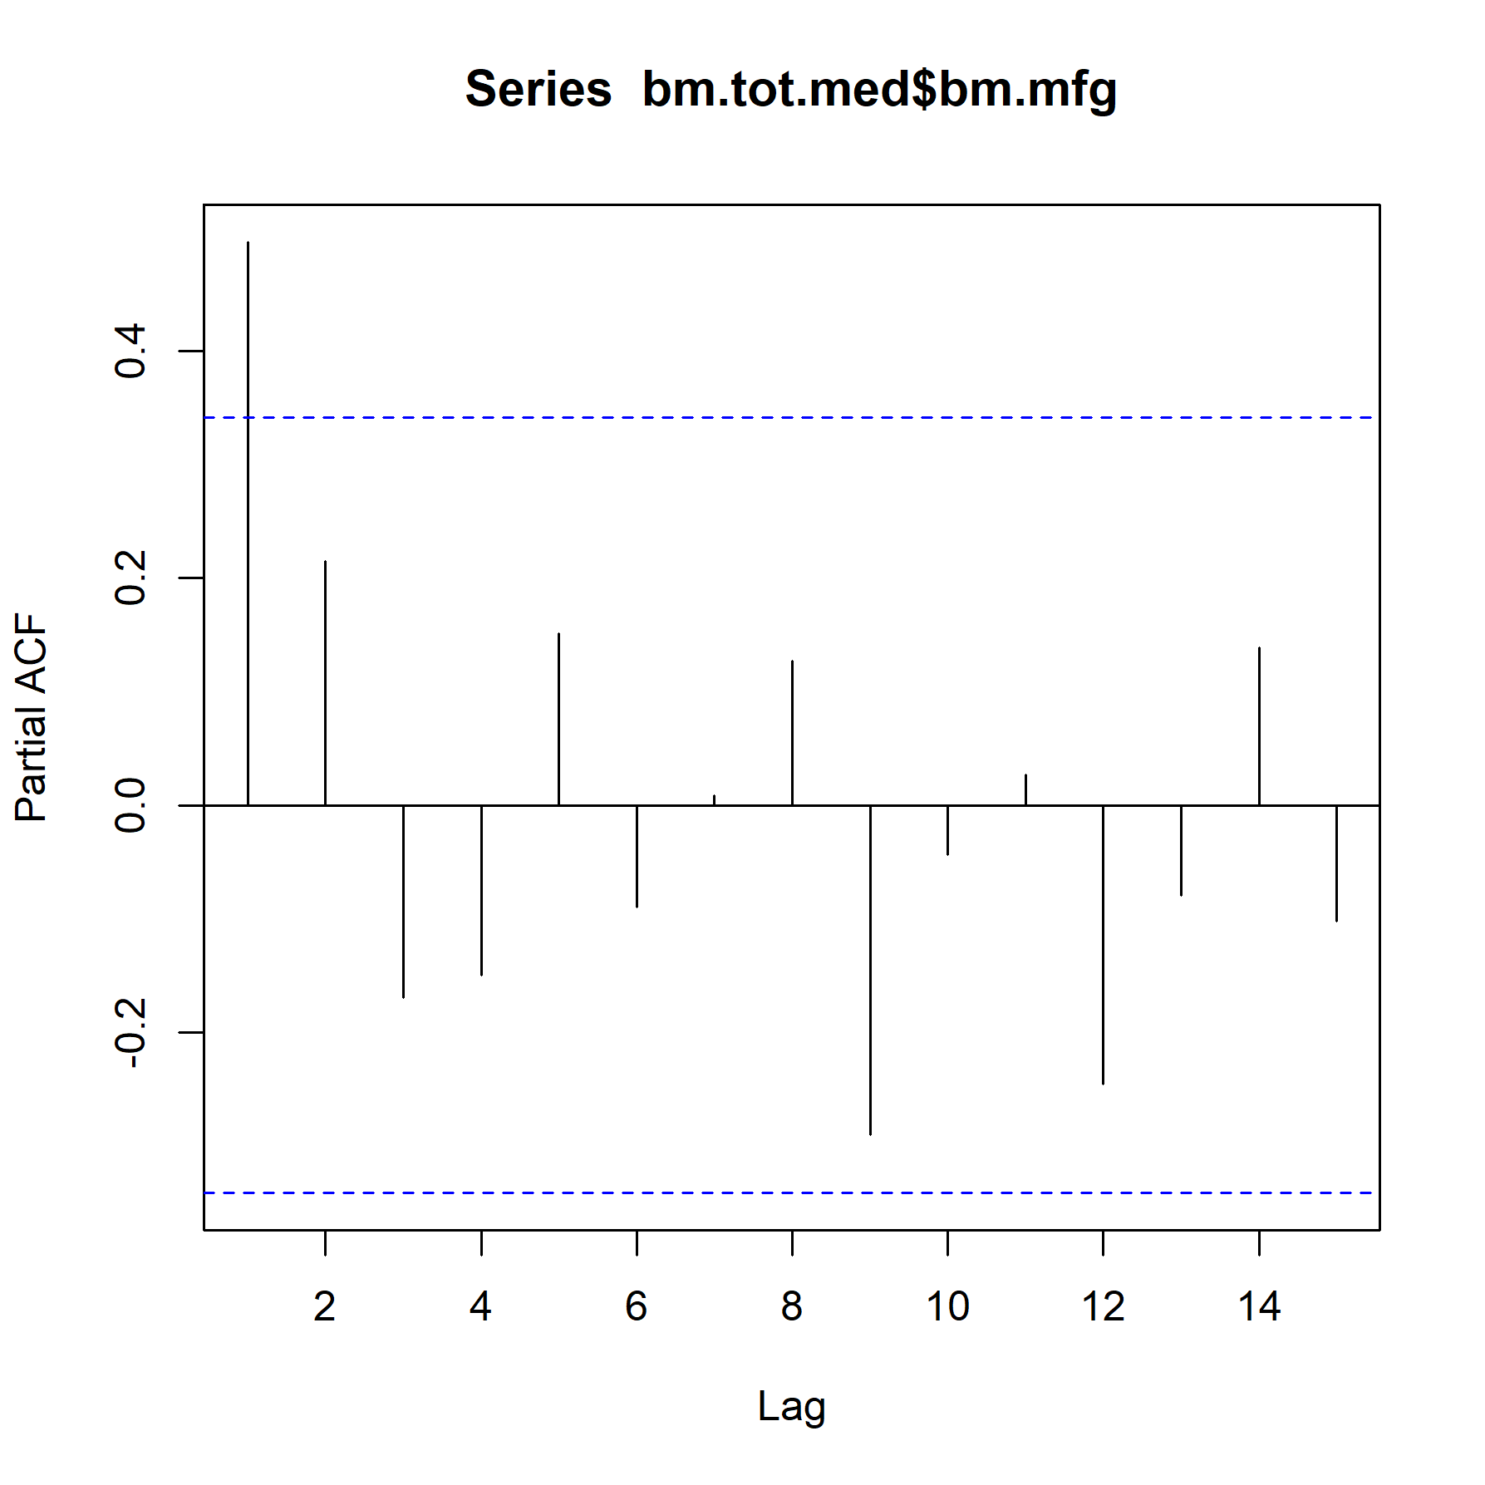
Other M
1985-2017

Slide 31
First attempt
Input time series of 2000-2017
10 iterations
Lags 1 and 2 included in all ARIMAs
Innovation – lognormal distribution around 1; offset by mean of input time series (used lognormal to prevent model from giving us negatives)
Qs
Log-transform non-logit transformed SDs only: is this correct?
Start innovations are both based on lag 1: is this correct?

Slide 32
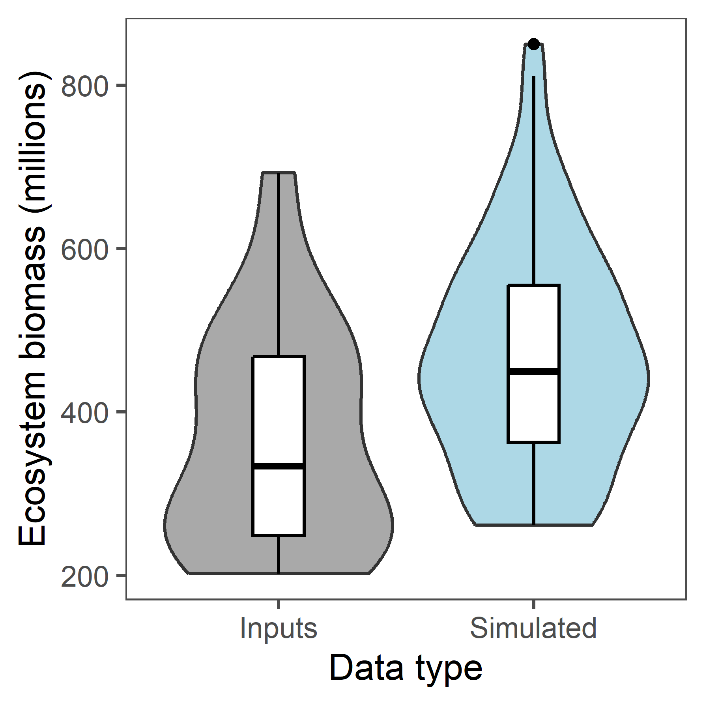
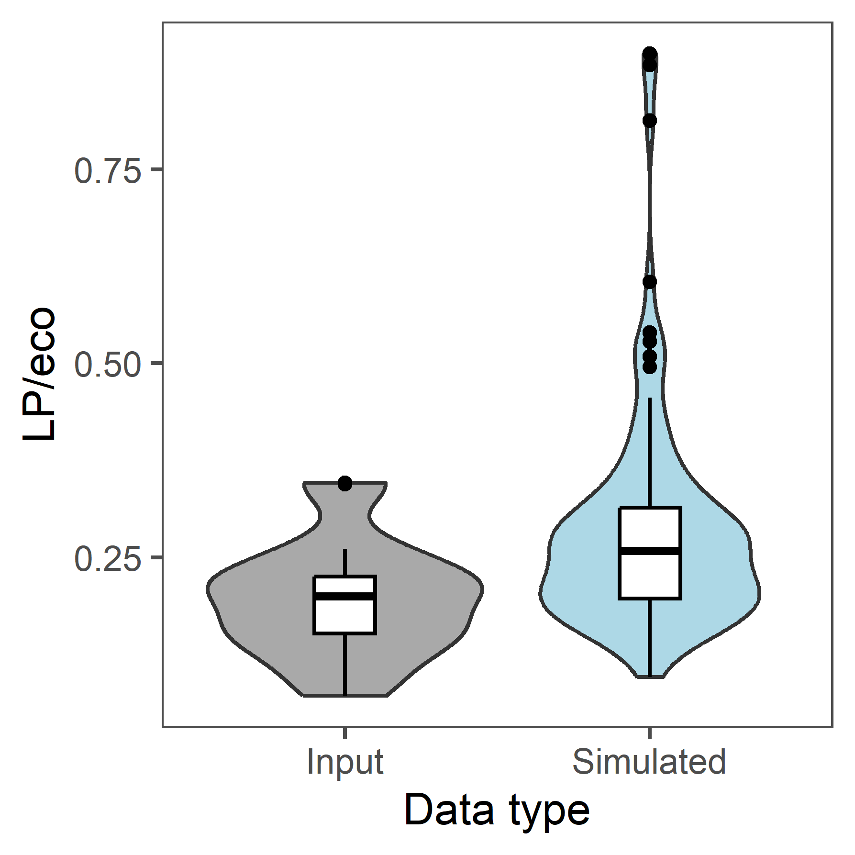
Compare ARIMAs to inputs
Notes:
Ecosystem looks really good! Outliers for LP/eco are a bit odd.

Slide 33
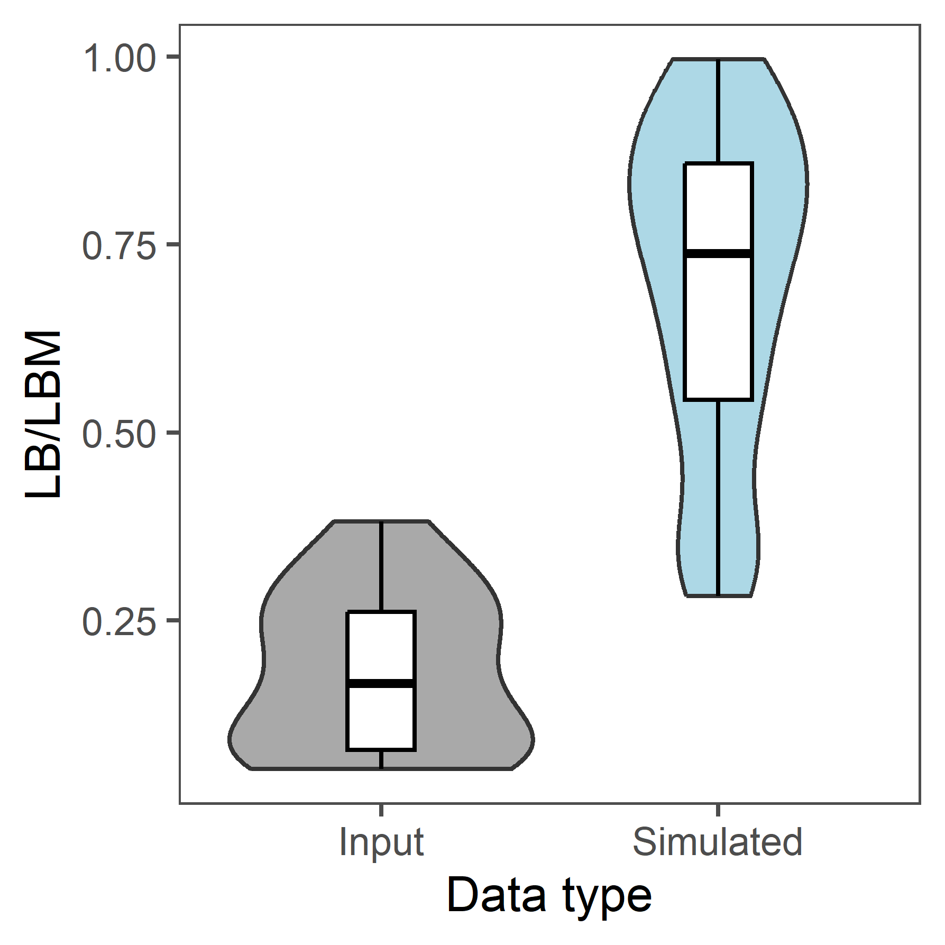
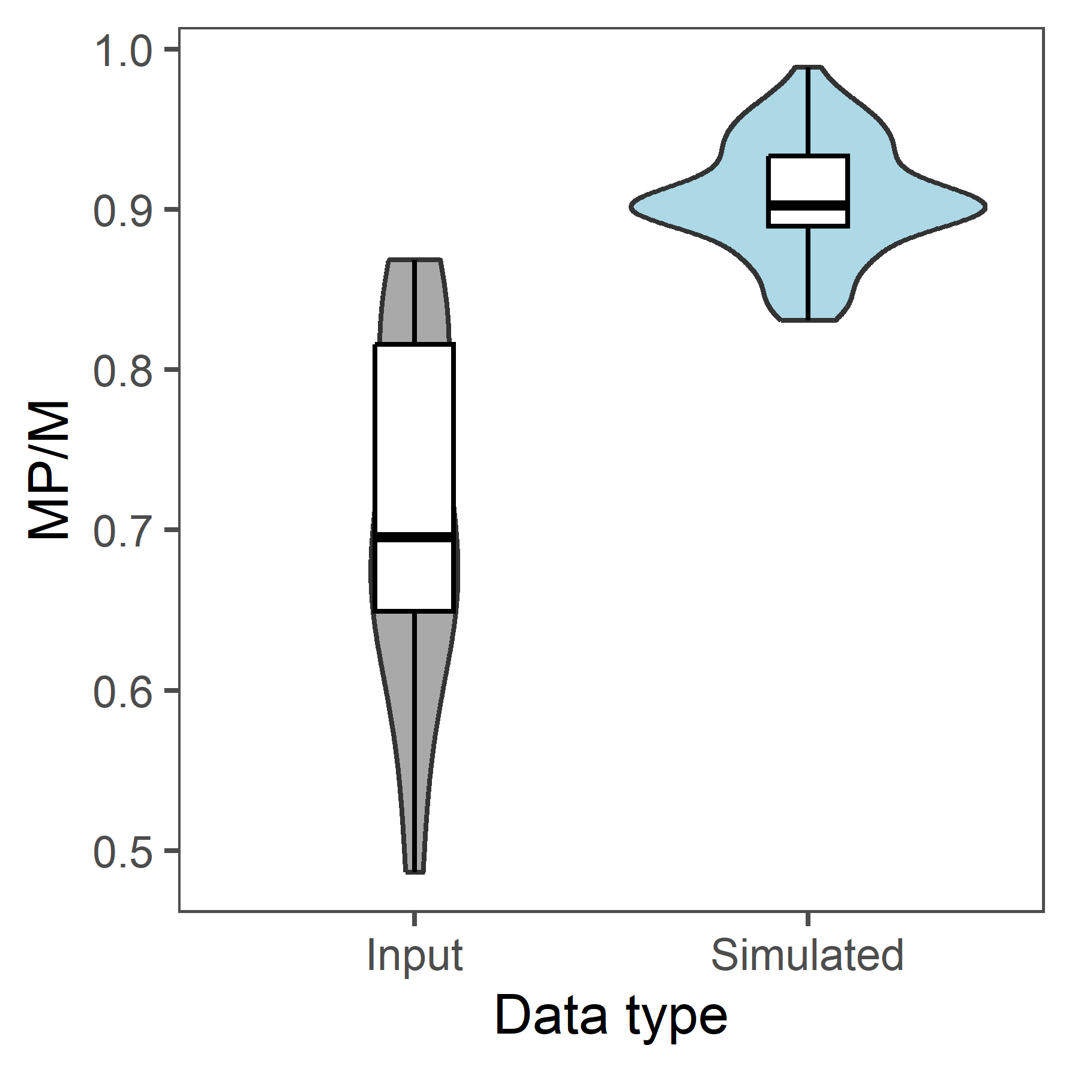
Compare ARIMAs to inputs
Notes:
This does not look so good – MP should be largest group in LBM. Super wide range of input data for MP/M is likely what is causing MP/M to be so much higher. Also problem with lognormal distribution

Slide 34
Comparing ARIMAs to inputs - means
Variable | ARIMA mean | Input time series mean
Ecosystem biomass | 465.9033 million | 367.1362 million
LP/eco | 0.28513 | 0.196588
LB/LBM | 0.6945 | 0.1814795
MP/M | 0.9071 | 0.7112051

Slide 35
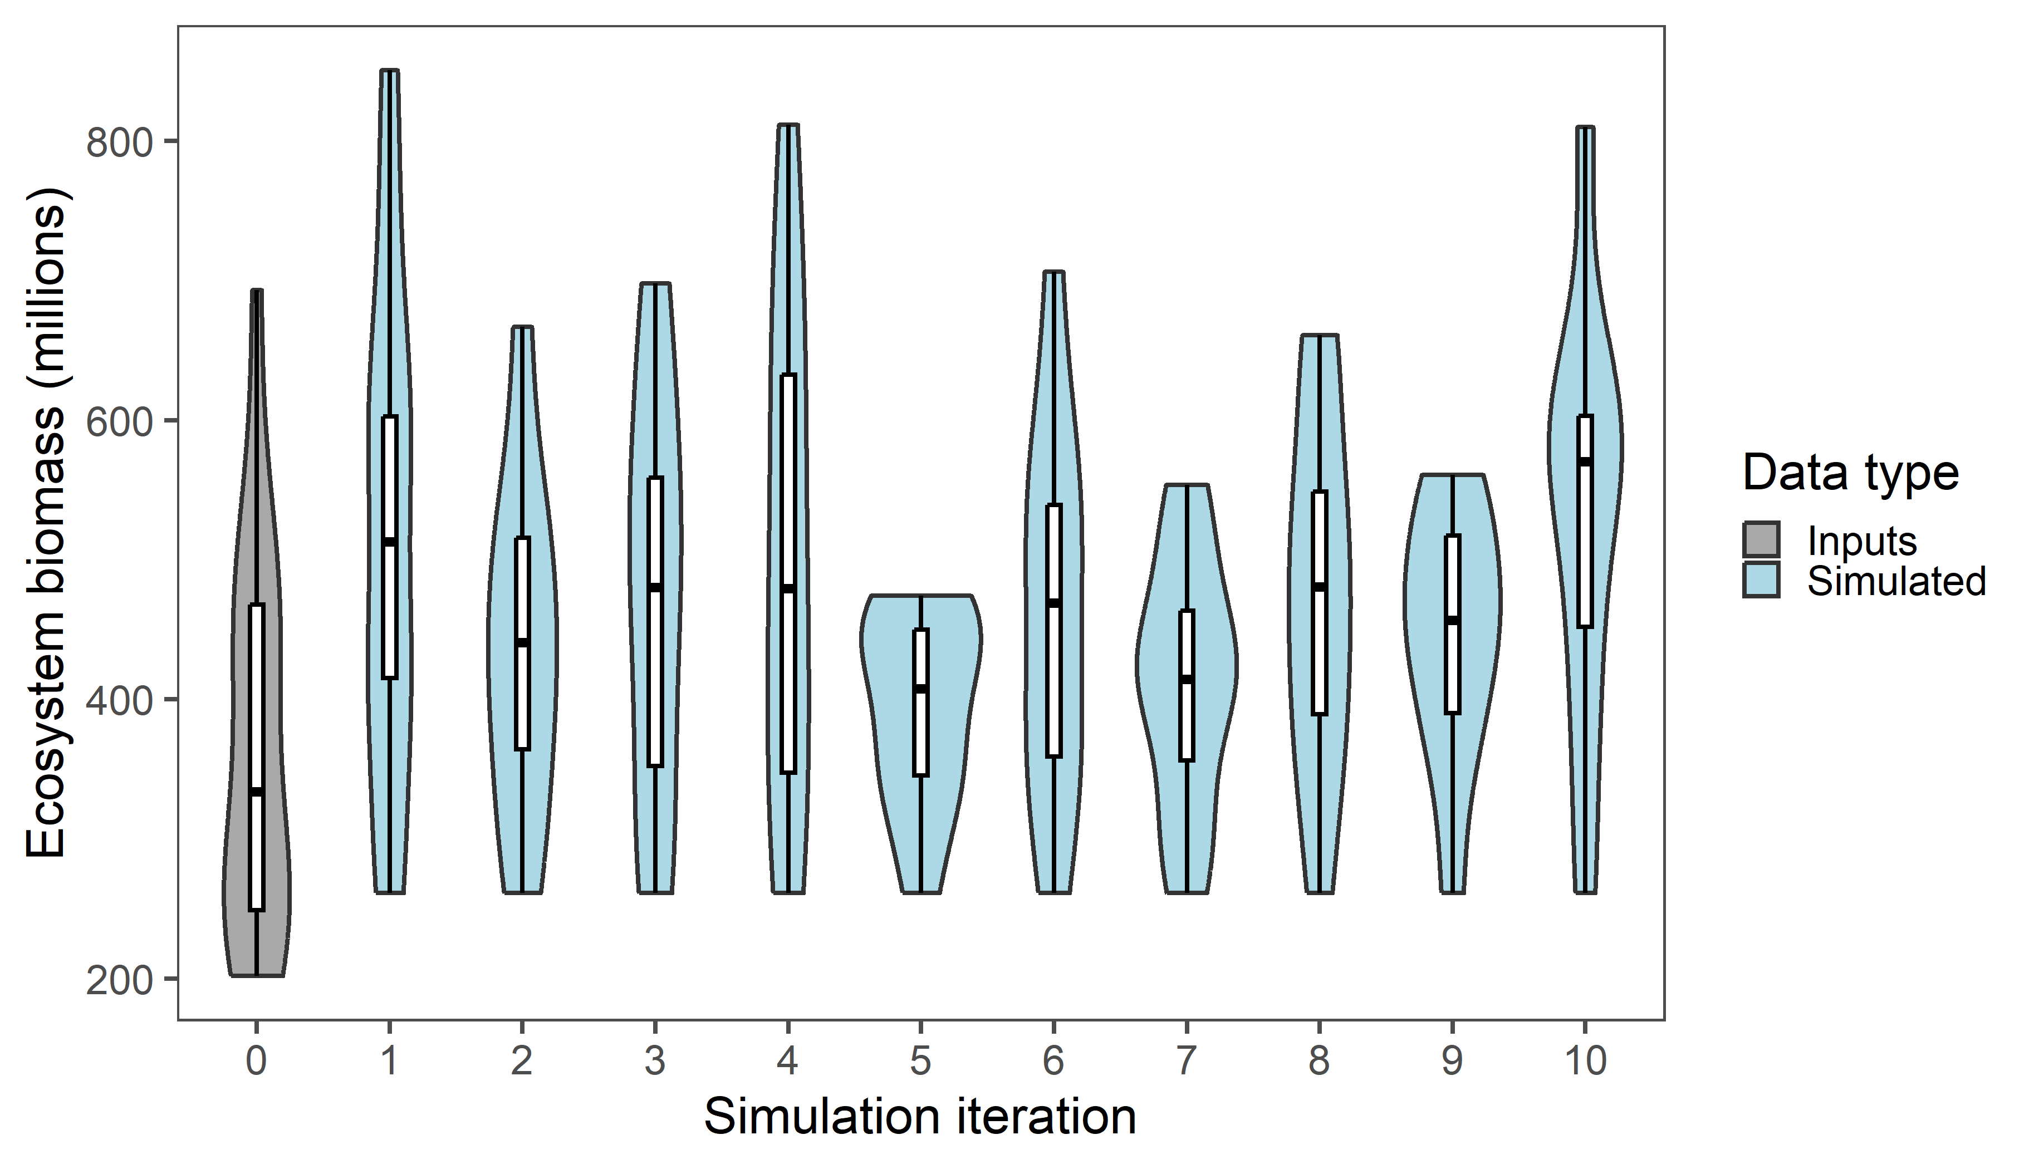
Notes:
Simulation is quite consistent.

Slide 36
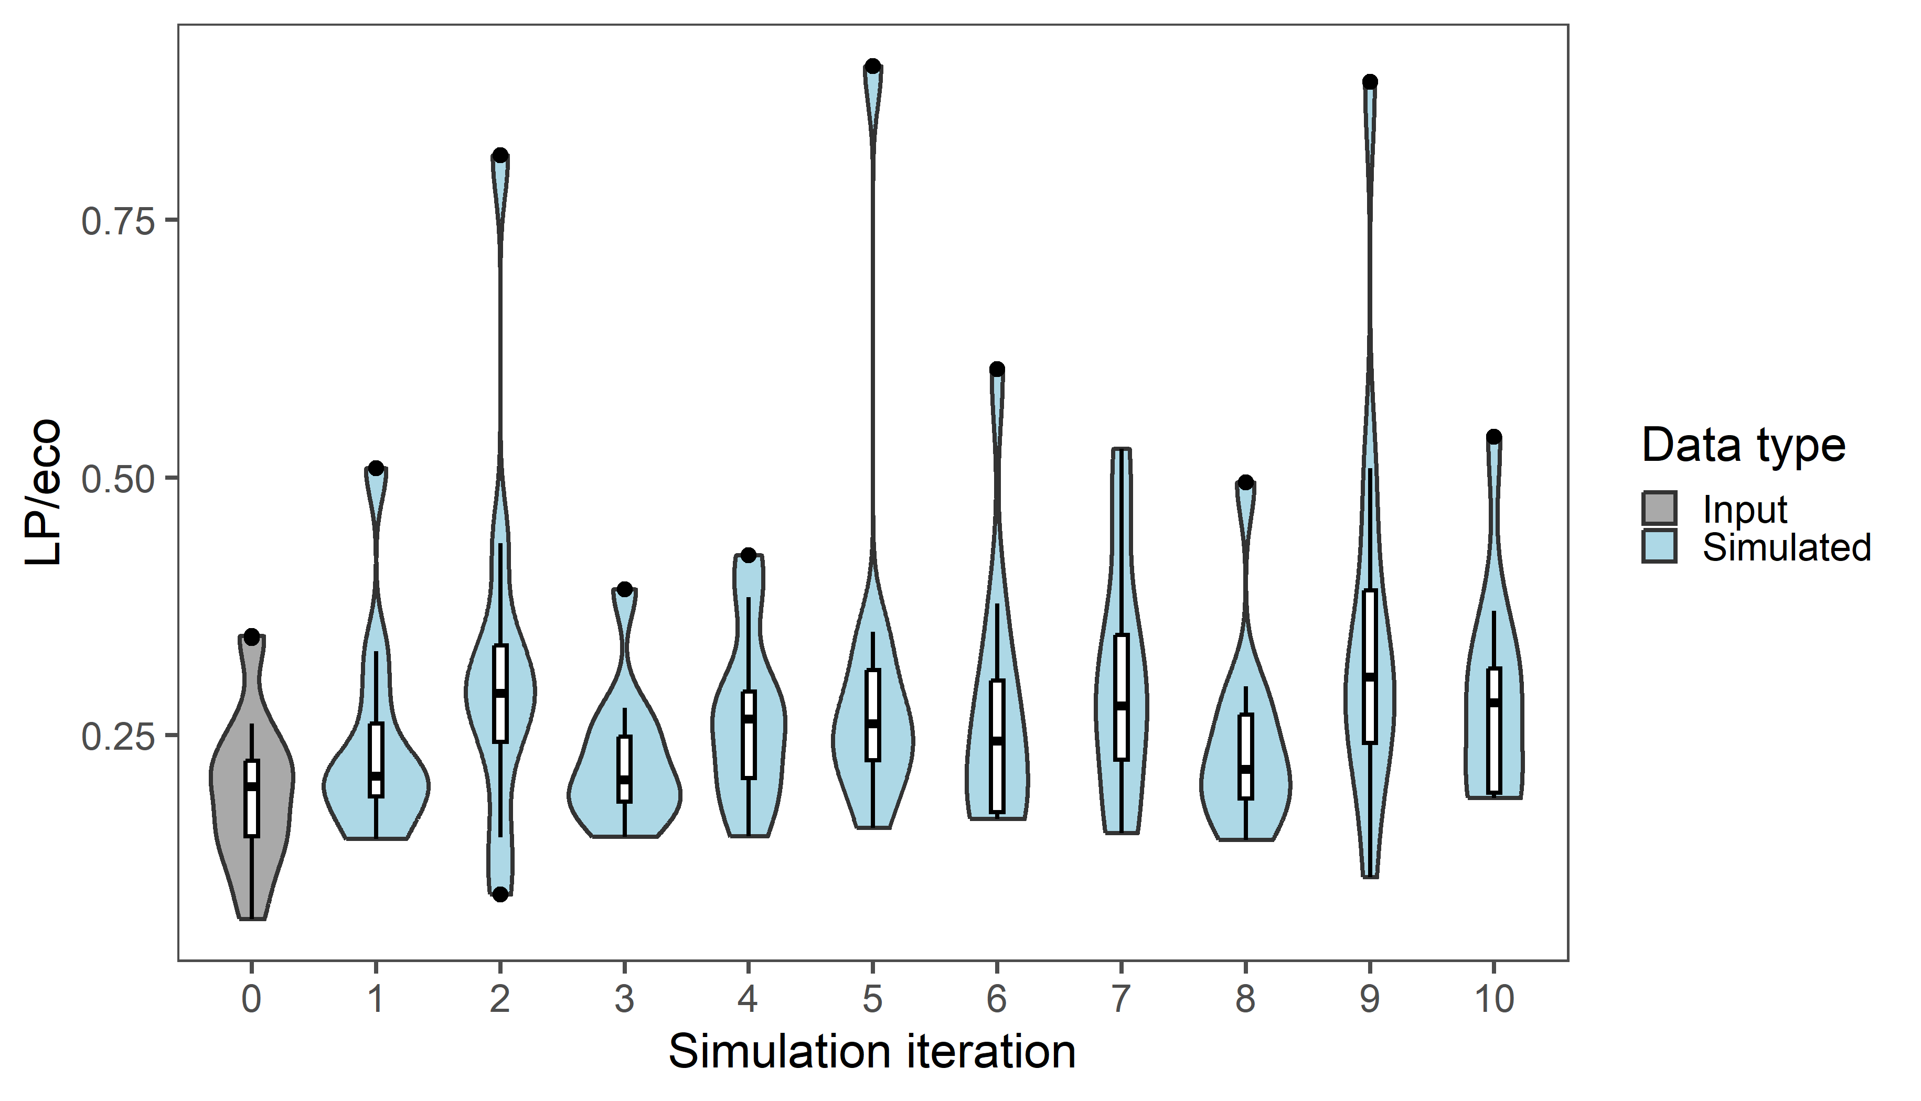
Notes:
Weird outliers are driven by three iterations

Slide 37
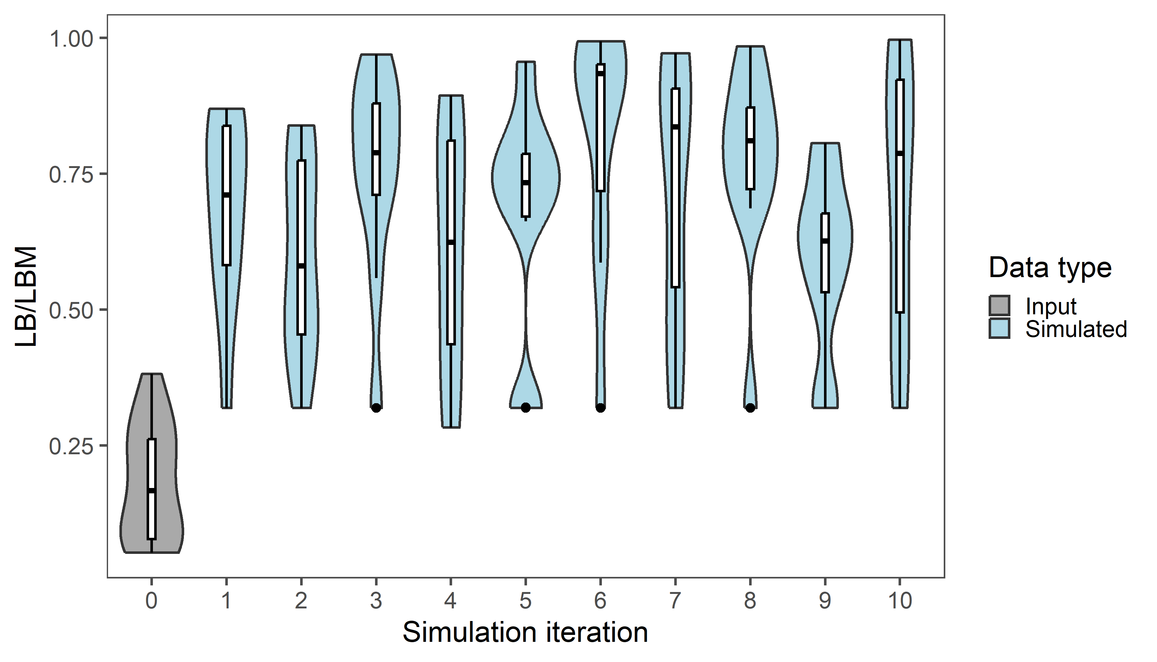
Notes:
Simulation is pretty consistent here, too

Slide 38
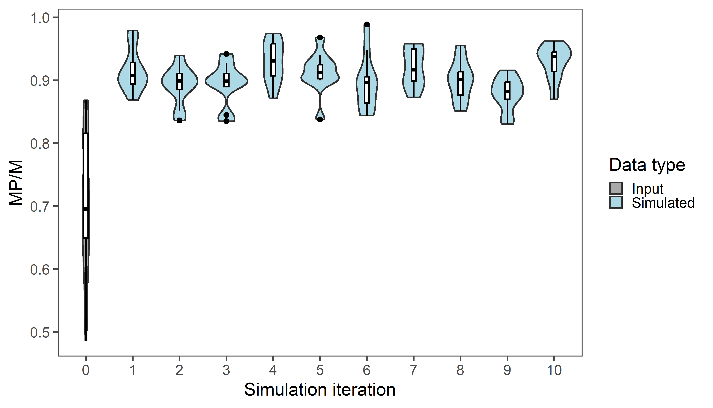
Notes:
Simulation also being consistent here

Slide 39
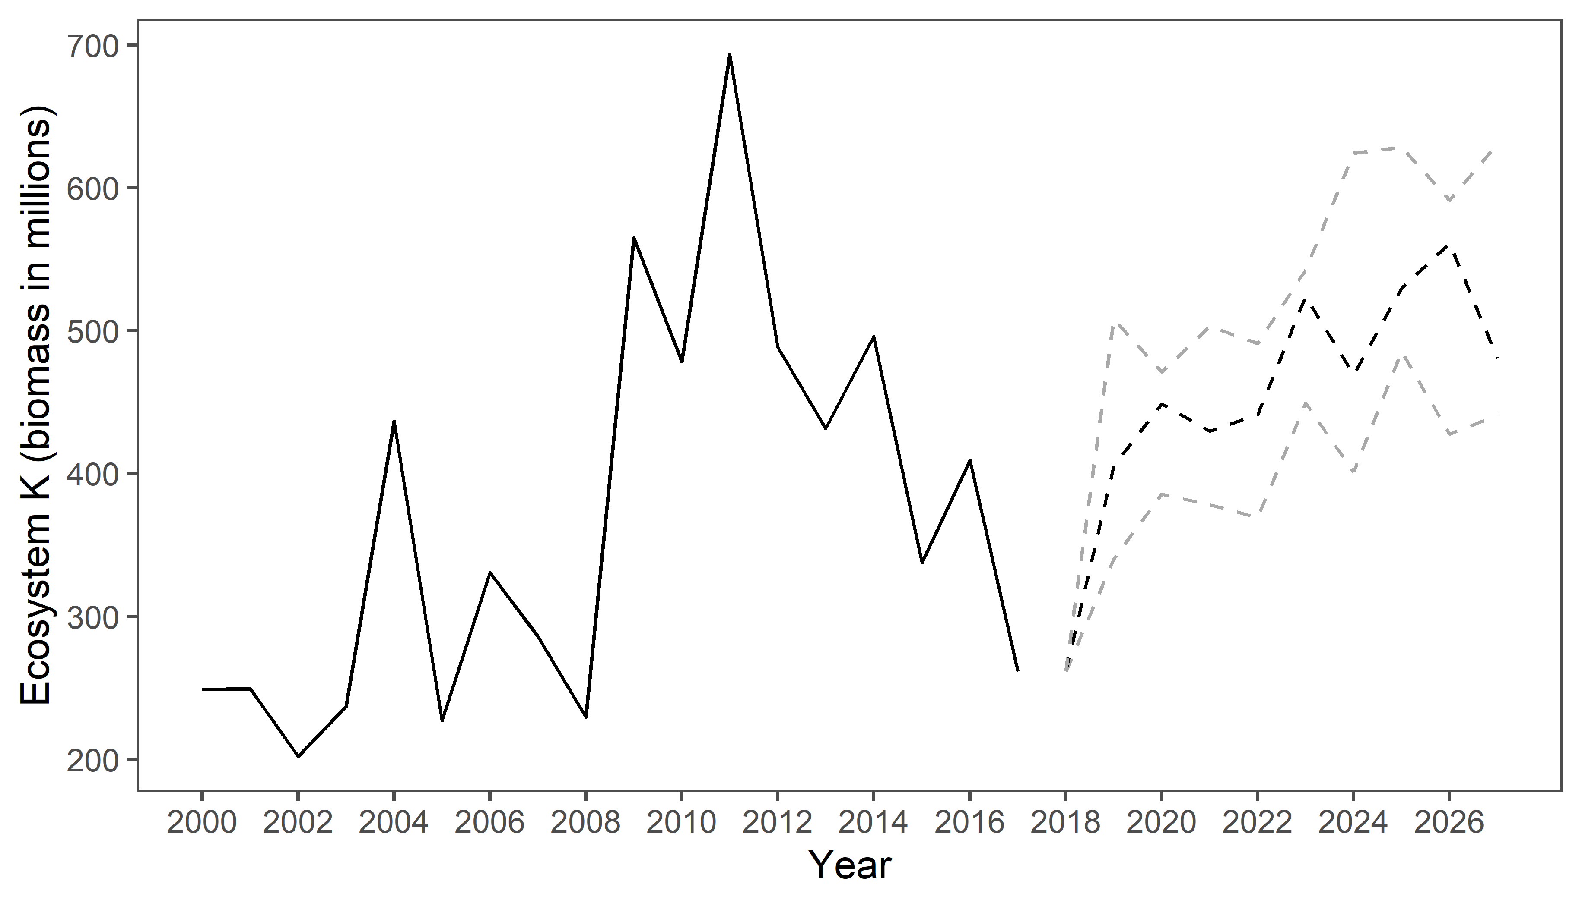

Slide 40
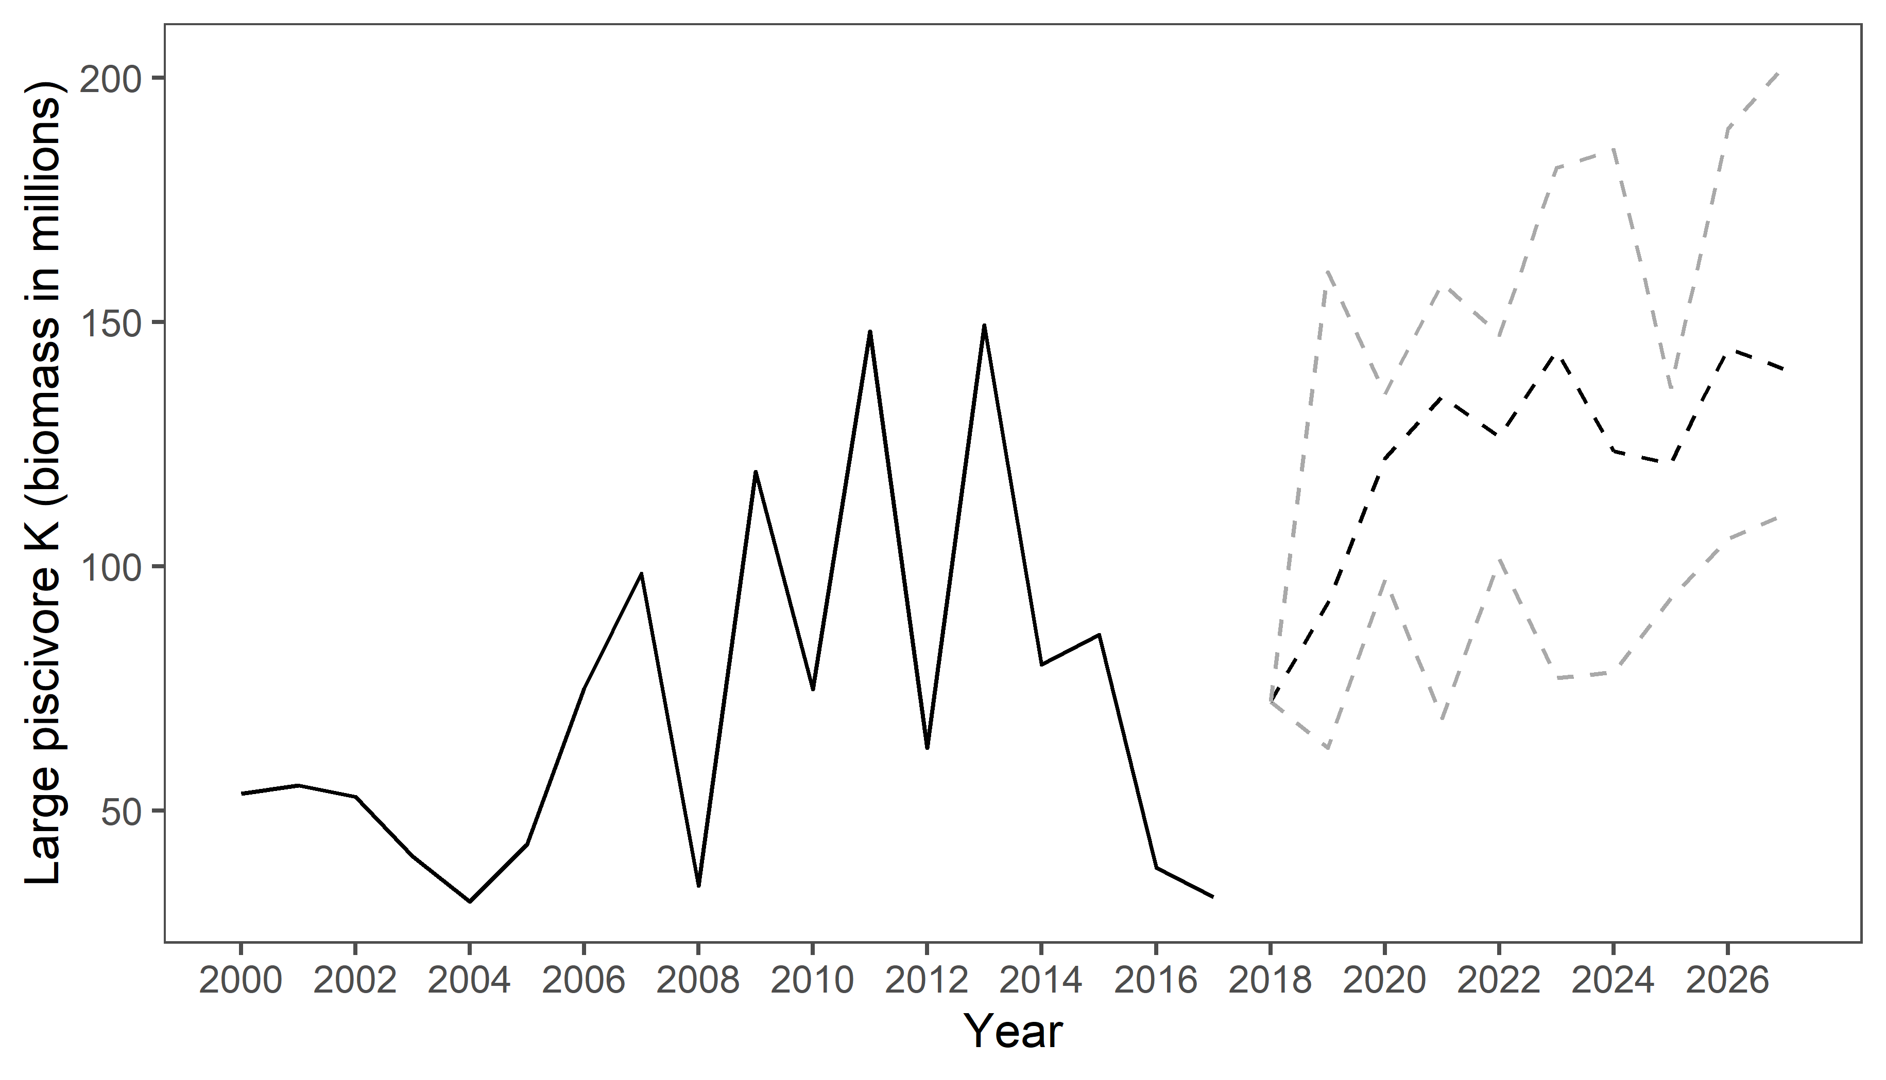

Slide 41
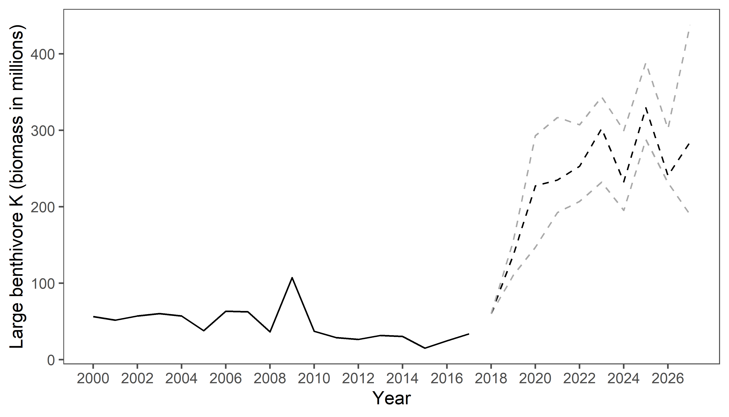

Slide 42
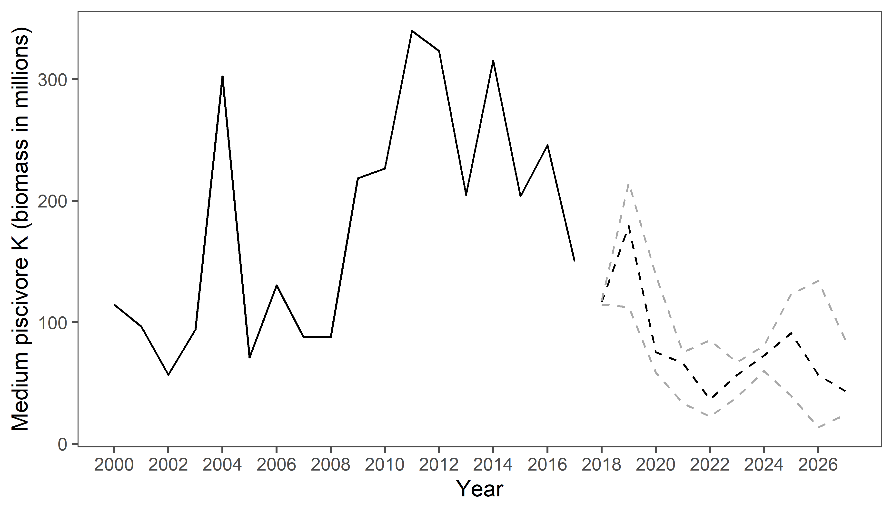

Slide 43
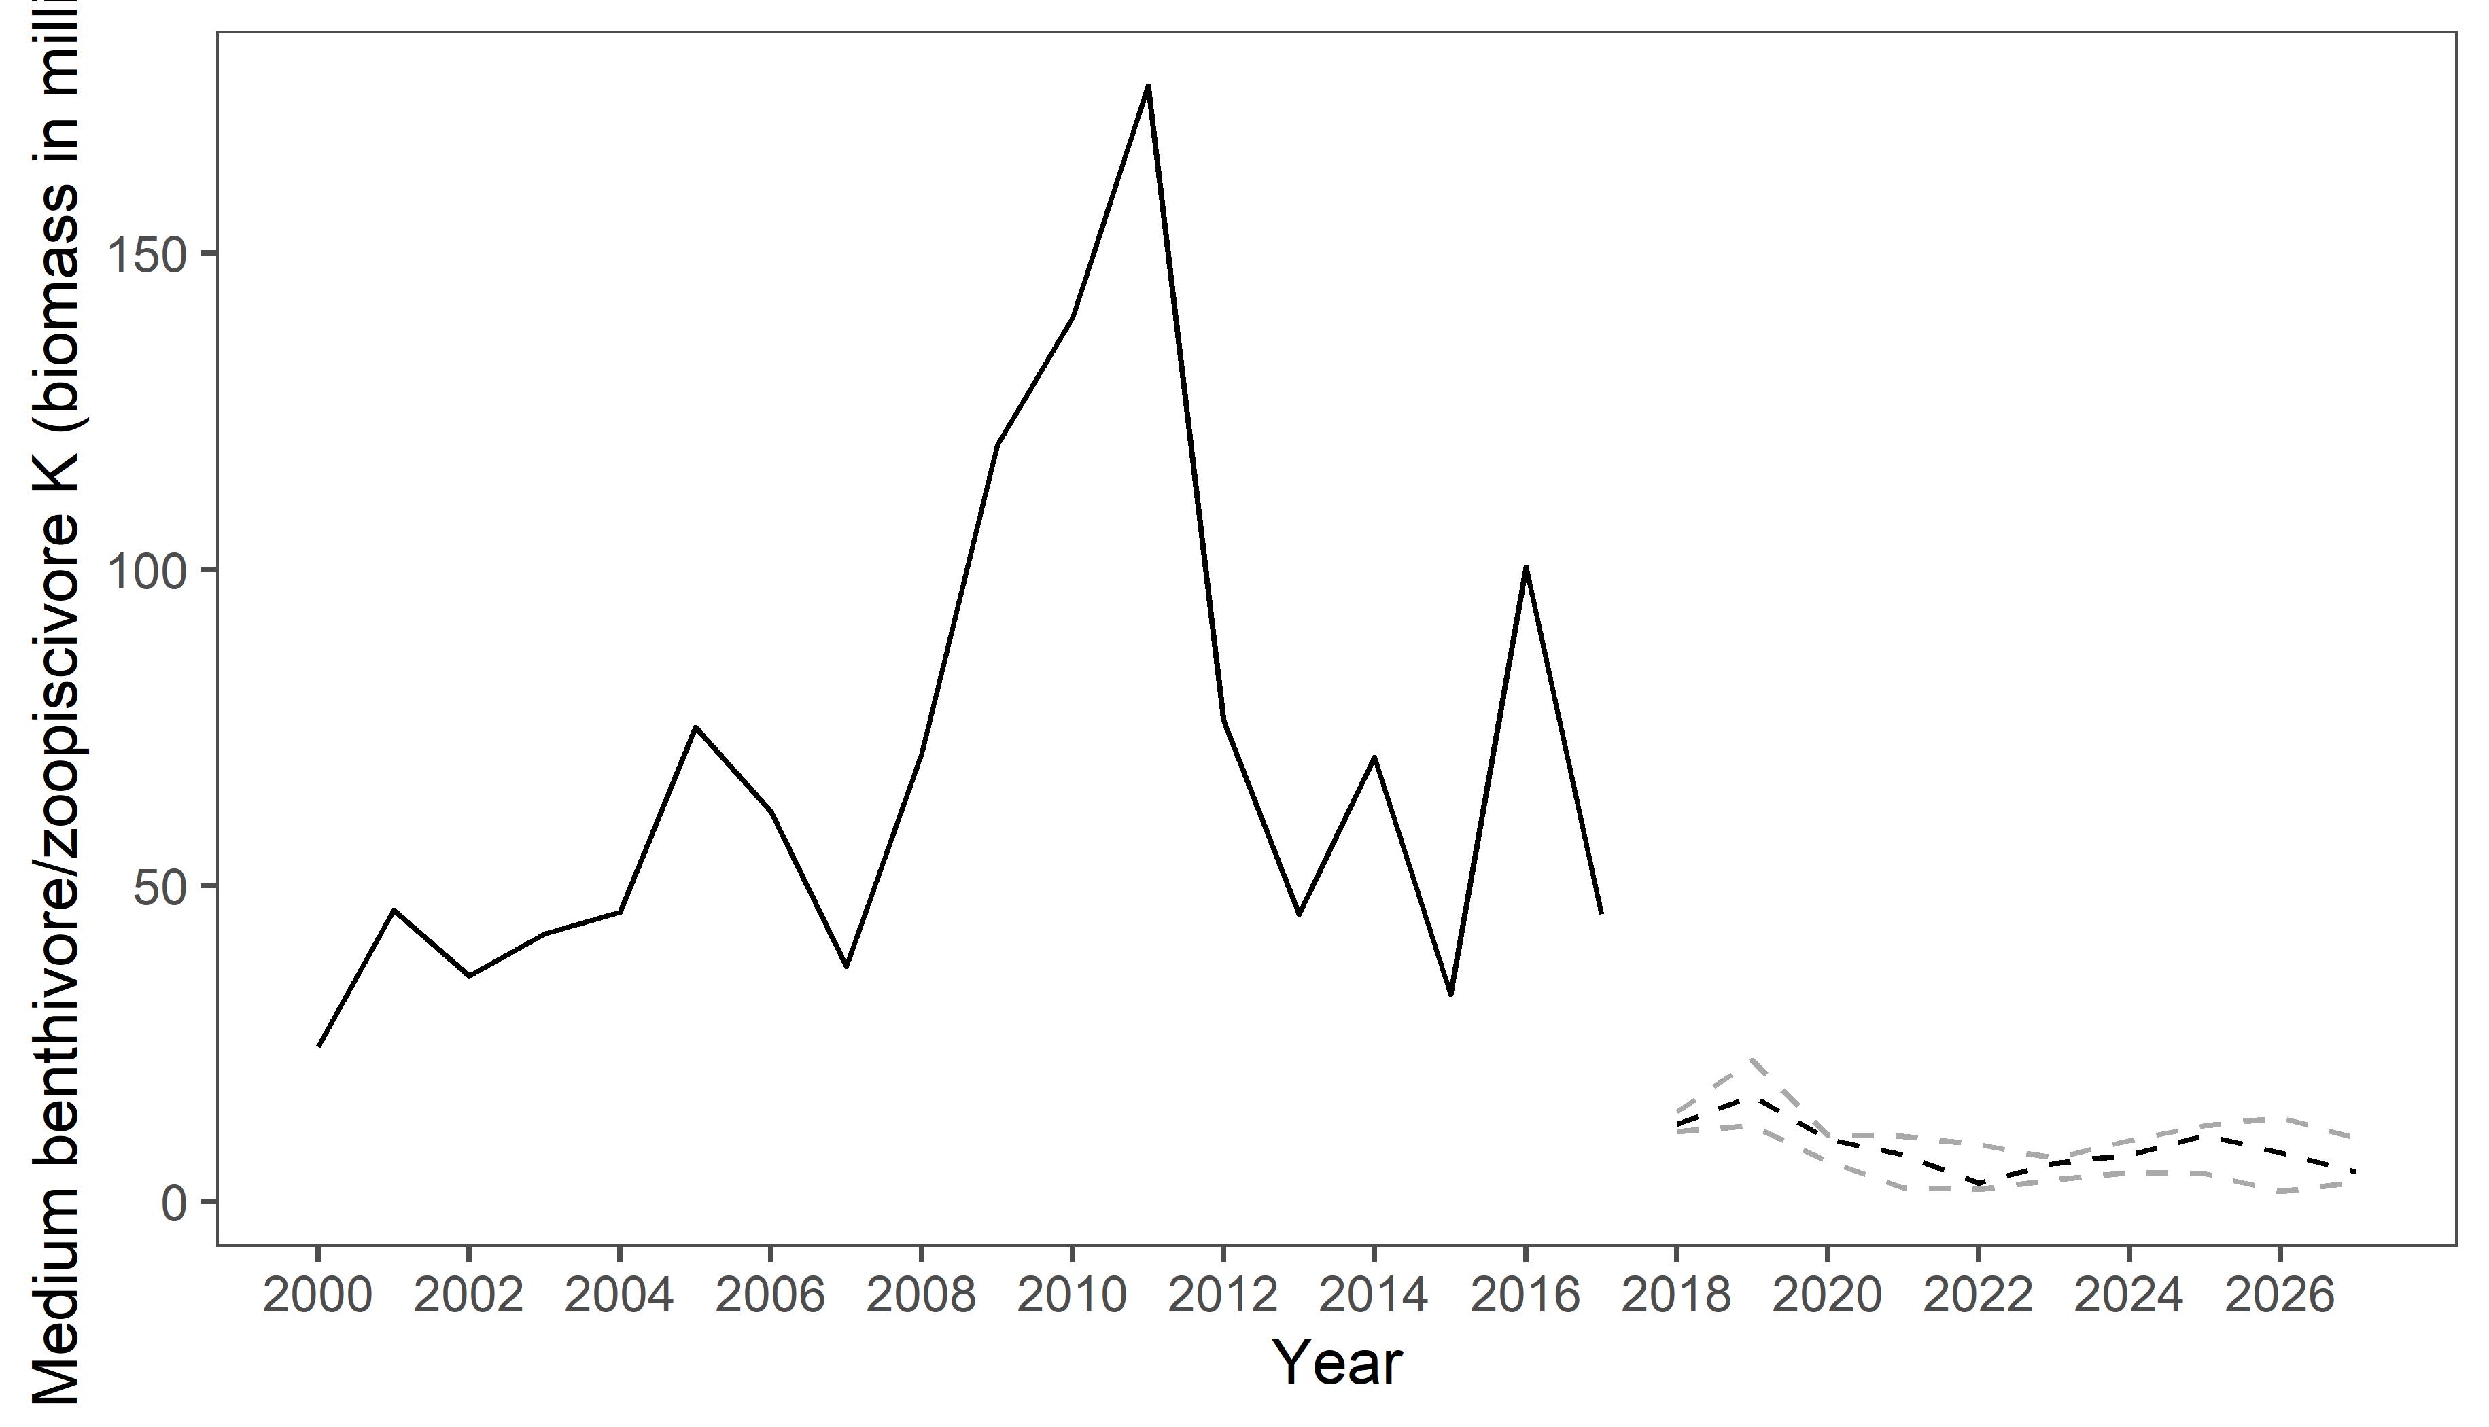
Notes:
From all these, it looks like overprediction in larges made mediums too small

Slide 44
Second attempt
Input time series of 2000-2017
10 iterations
Lags 1 and 2 included in all ARIMAs
Innovation – lognormal distribution around 1 only for ecosystem; offset by mean of input time series (used lognormal to prevent model from giving us negatives)
Innovations for proportions are from a normal distribution instead

Slide 45
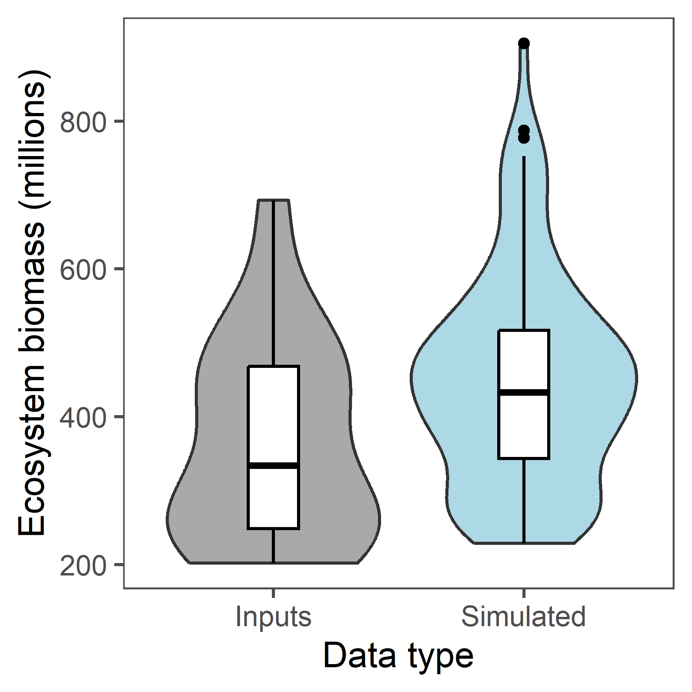
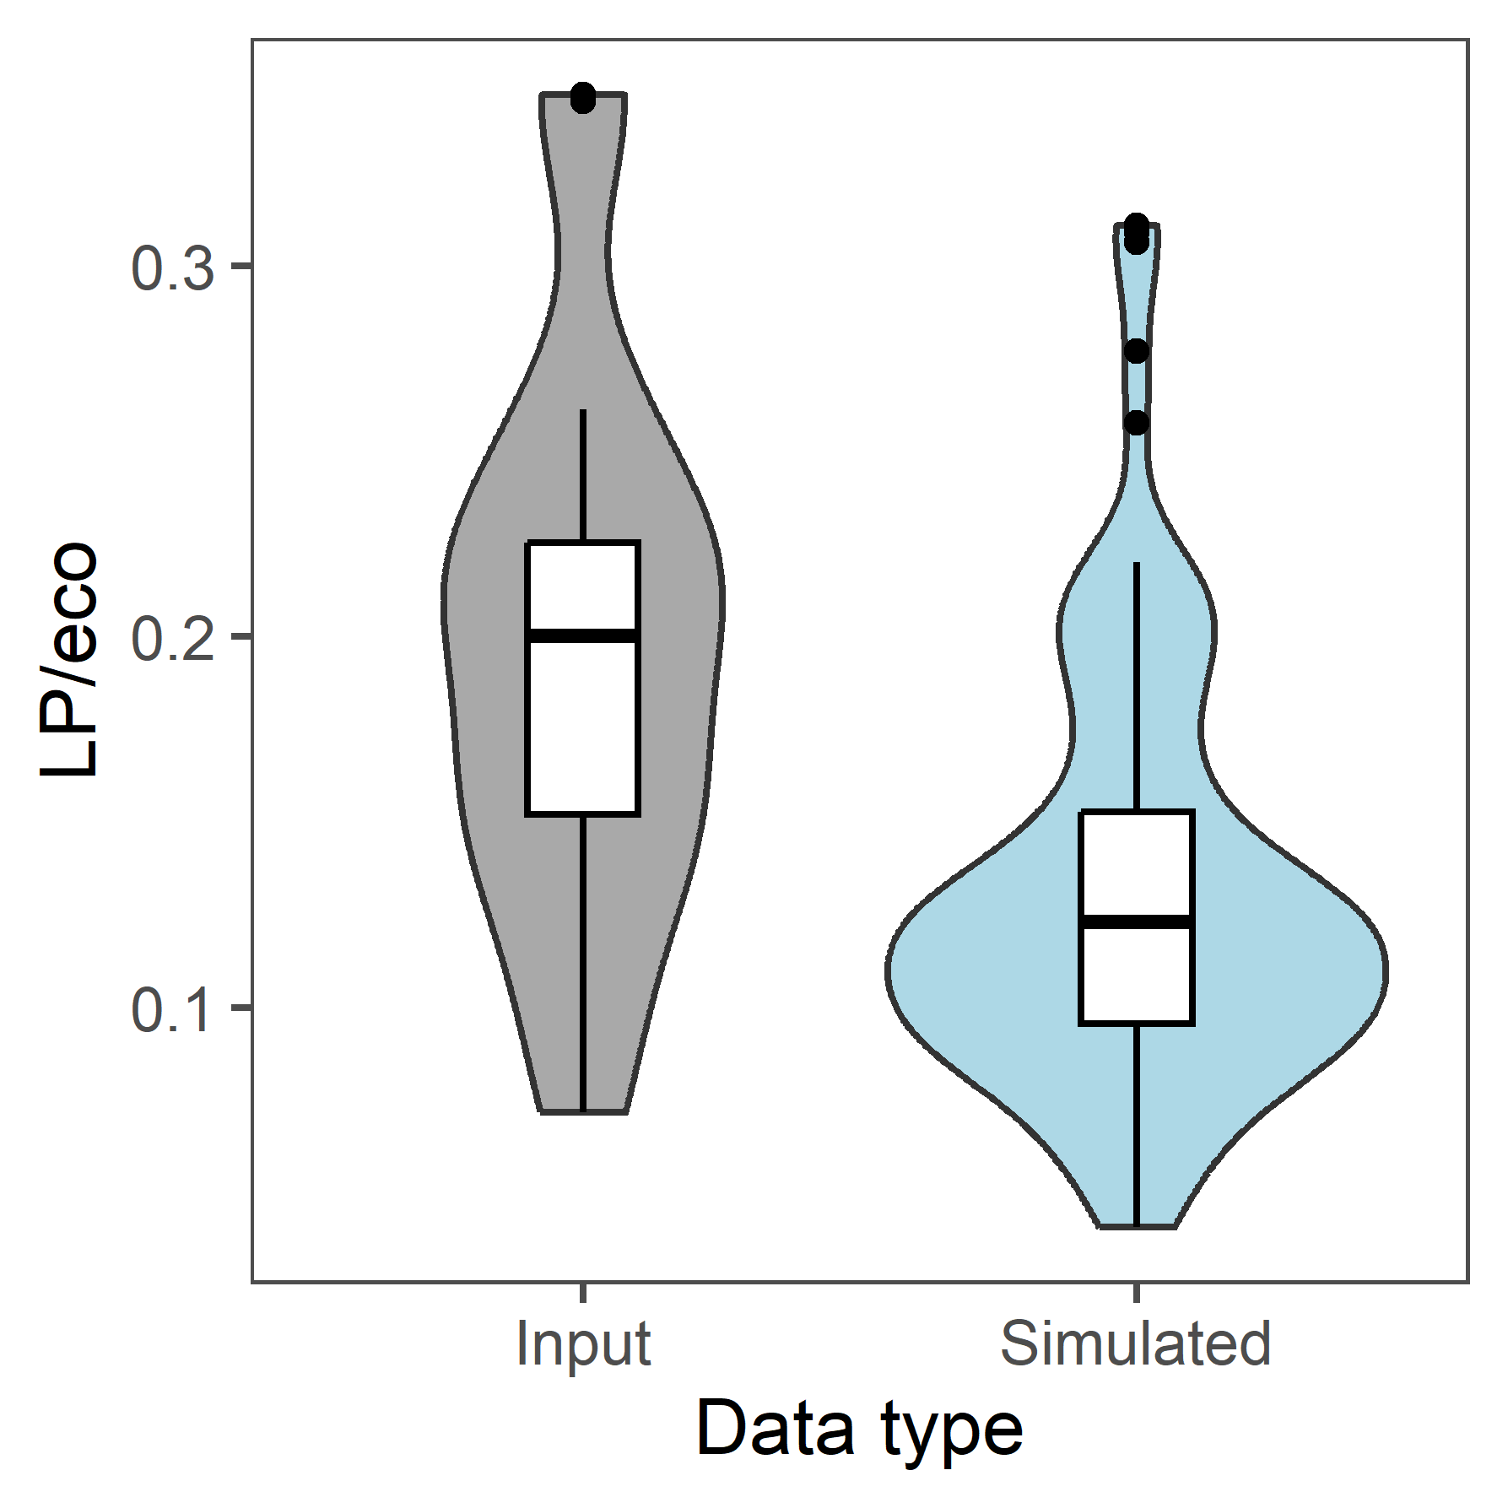
Compare ARIMAs to inputs
Notes:
This looks a lot better! Ecosystem arima is also closer to median than in previous run, so shows that more iterations would likely improve ecosystem estimates.

Slide 46
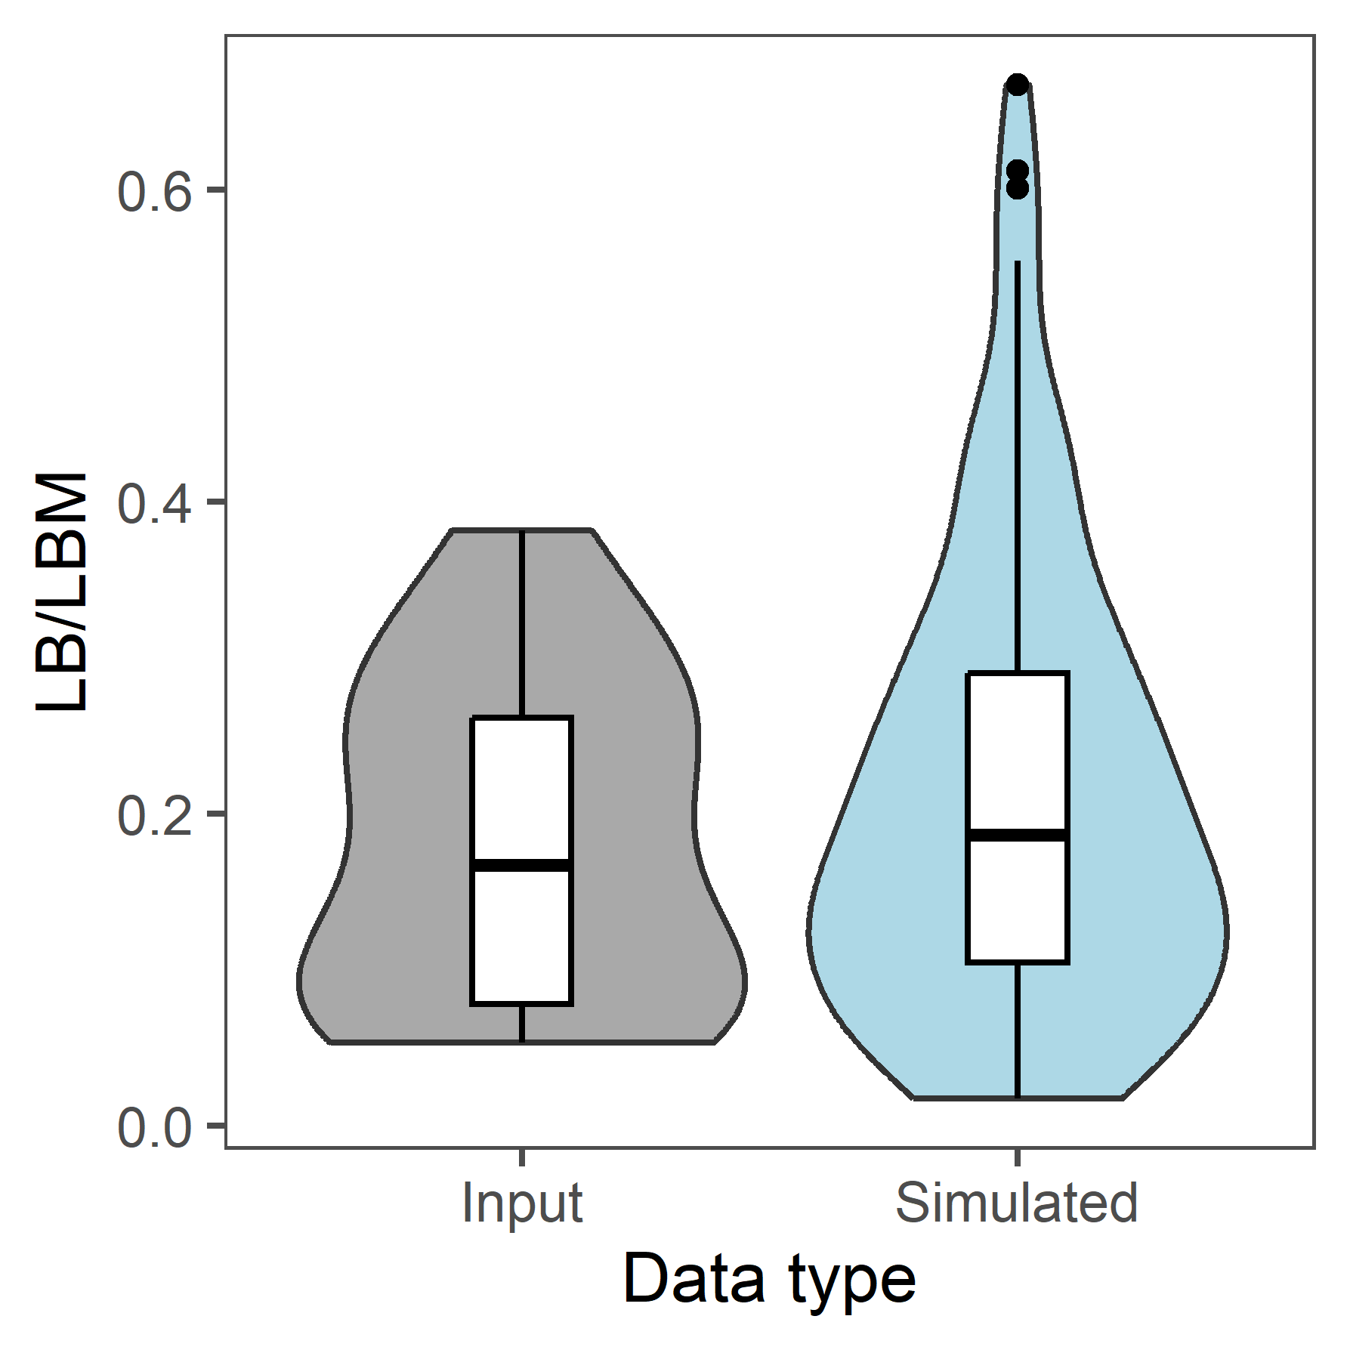
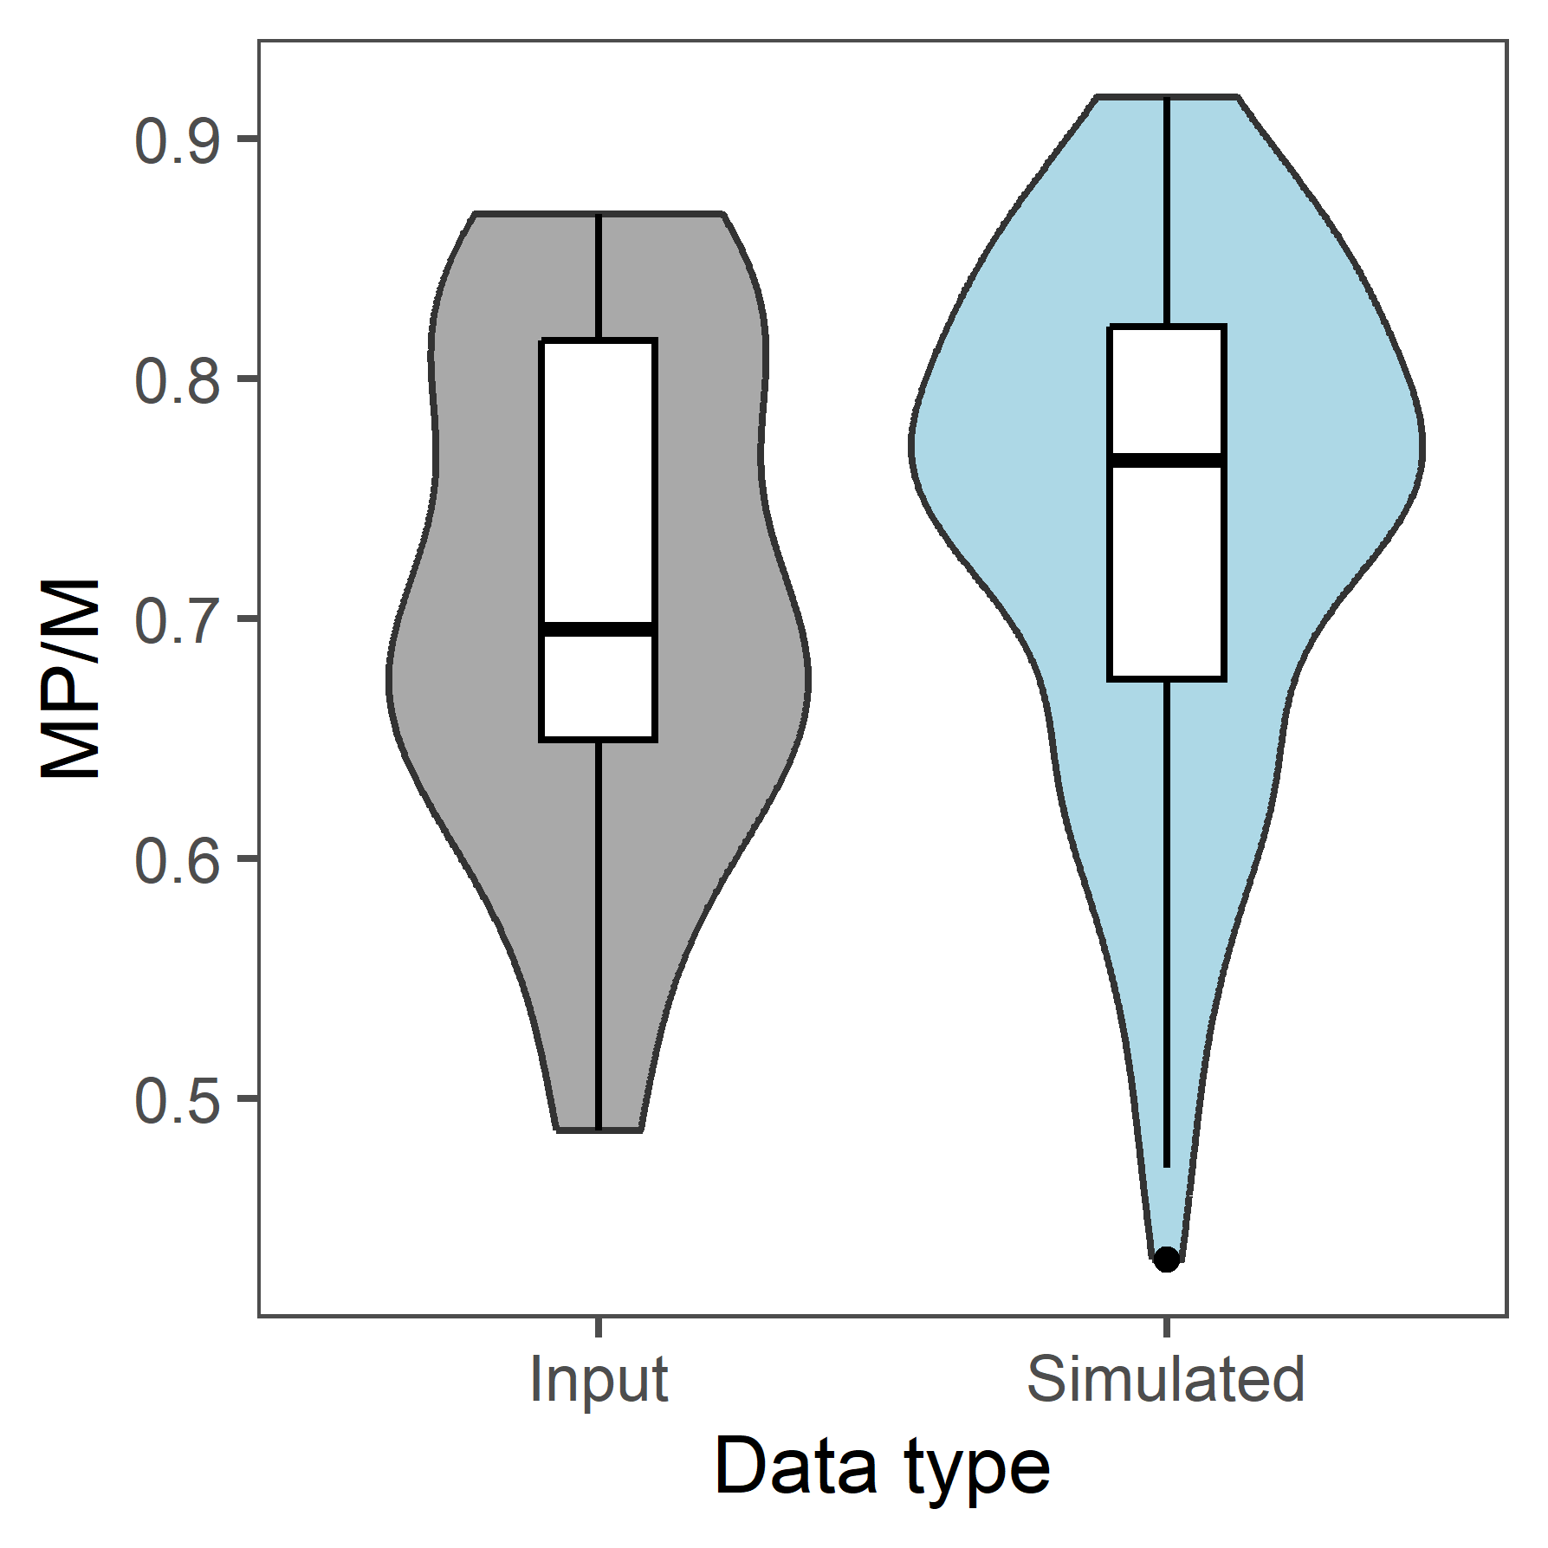
Compare ARIMAs to inputs
Notes:
Much better here too – shape of distributions even looks pretty close!

Slide 47
Comparing ARIMAs to inputs - means
Variable | ARIMA mean | Input time series mean
Ecosystem biomass | 448.5536 million | 367.1362 million
LP/eco | 0.1311101 | 0.196588
LB/LBM | 0.2110537 | 0.1814795
MP/M | 0.74285 | 0.7112051

Slide 48

Notes:
Simulation is more variable.

Slide 49


Slide 50


Slide 51


Slide 52

Notes:
Similar shape to previous run – not too bad!

Slide 53

Notes:
Still not starting in right spot

Slide 54


Slide 55


Slide 56


Slide 57
Third attempt
Input time series of 2000-2017
10 iterations
Lags 1 and 2 included in all ARIMAs
Innovation – lognormal distribution around 1 only for ecosystem; offset by mean of input time series (used lognormal to prevent model from giving us negatives)
Innovations for proportions are from a normal distribution instead
Switch placement of mean in proportion ARIMAs (in innovation instead of out front)
Notes:
Spoiler alert – this fixed the larges, but not the mediums

Slide 58


Compare ARIMAs to inputs
Notes:
This looks a lot better! Ecosystem arima is also closer to median than in previous run, so shows that more iterations would likely improve ecosystem estimates.

Slide 59


Compare ARIMAs to inputs
Notes:
Much better here too – shape of distributions even looks pretty close!

Slide 60
Comparing ARIMAs to inputs - means
Variable | ARIMA mean | Input time series mean
Ecosystem biomass | 448.5536 million | 433.8898 million
LP/eco | 0.1311101 | 0.13643
LB/LBM | 0.2110537 | 0.16029
MP/M | 0.74285 | 0.7646

Slide 61

Notes:
Simulation is more variable.

Slide 62


Slide 63


Slide 64


Slide 65

Notes:
Similar shape to previous run – not too bad!

Slide 66

Notes:
Still not starting in right spot

Slide 67


Slide 68

Notes:
Projections start in wrong spot

Slide 69

Notes:
Projections start in wrong spot

Slide 70


Slide 71


Slide 72


Slide 73
LP K
LP/eco
eco K ( LP/(LP/eco) )
LBM (eco – LP)
LB/LBM
LB K (LBM * LB/LBM)
M K (LBM – LB)
MP/M
MP K (M * MP/M)
MBZ K (M – MP)

Slide 74
M K
M/eco
eco K ( M/(M/eco) )
L (eco – M)
MBZ/M
MBZ K (M * MBZ/M)
LB/L
MP K (M – MBZ)
LB K (L * LB/L)
LP K (L – LB)

Slide 75
Qs
Is non-significant pacf actually a problem? No
High CIs?
What are ccfs doing in model? Just for description? Yes
Thoughts on how to get around the partitioning within M issue? N/A
Started K simulation – getting negative biomasses for first ARIMA. How to avoid this (non-stationary, not enough years)? Fixed
Details on ARIMA – is this actually an AR(n), why no MA, what are innovations, what is arima.sim() doing? Explained

Slide 76

Fishing function problem?

Slide 77
Next steps
Why are MP and MBZ not starting in the right place?
Fishing function problem
Converting rest of MPM to be based on FG
Trying to run K sims with entire input time series (detrend by fitting a GAM and doing PACF on residuals to parameterize the ARIMAs)
Try different K sim formats

