Slide 1
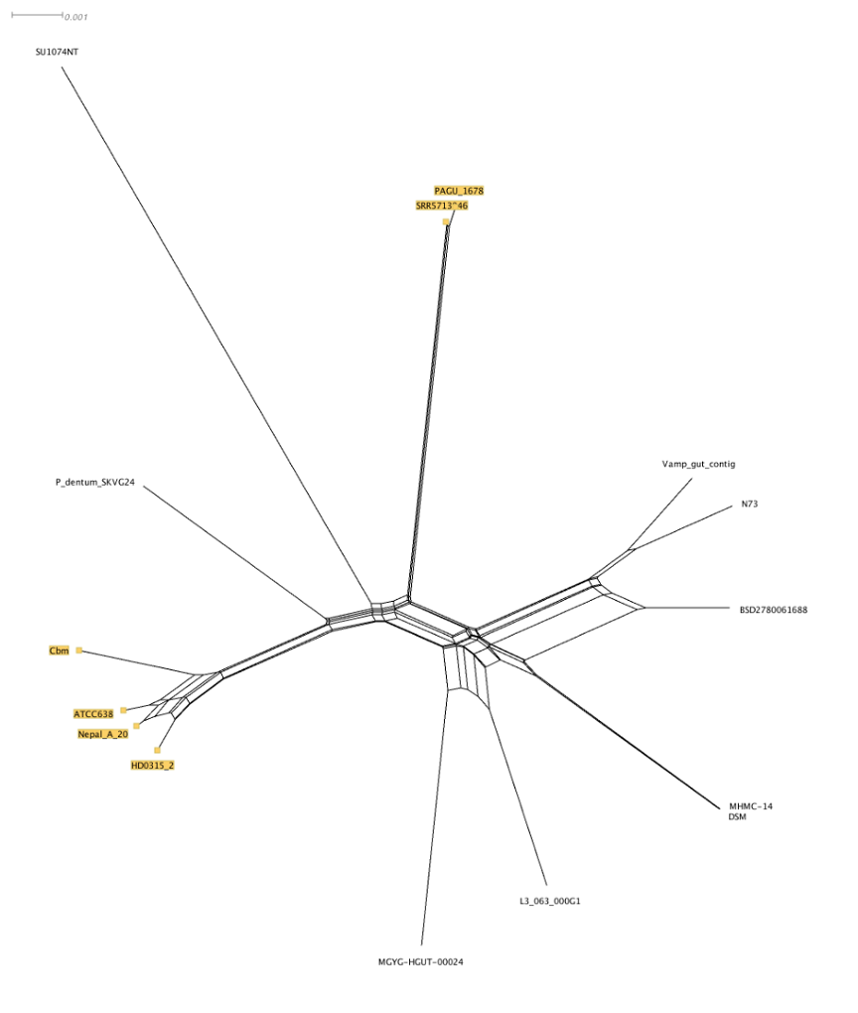
0.001
SU1074NT
PAGU_1678
SRRS5713946
Vamp_gut_contig
P_dentum_SKVG24
N73
BSD2780061688
CBM
ATCC638
Nepal_A_20
HD0315_2
MHMC-14
DSM
L3_063_00DG1
MGYG_HGUT-00024

