Slide 1
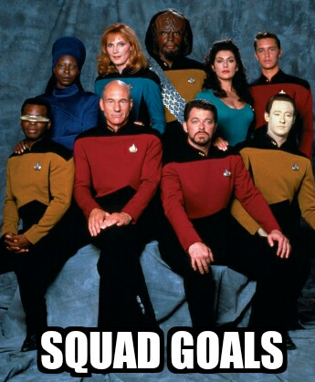

FUTURE-PROOFING UR DATA WITH
Danielle Robinson, PhD @daniellecrobins

Slide 2
FUTURE-PROOFING UR DATA WITH
Structured!
Quantitative!
Universal Access to!
Data!
Full credit to Max Ogden @denormalize for SQUAD Goals

Slide 3
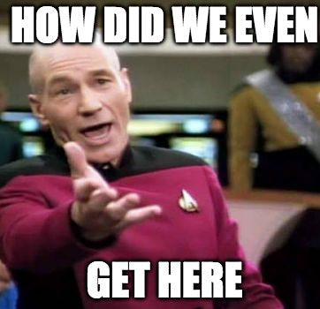
Piecemeal data infrastructure
Lack of standards
Functional as long as nothing changes
Ummmm
…but then something changed

Slide 4
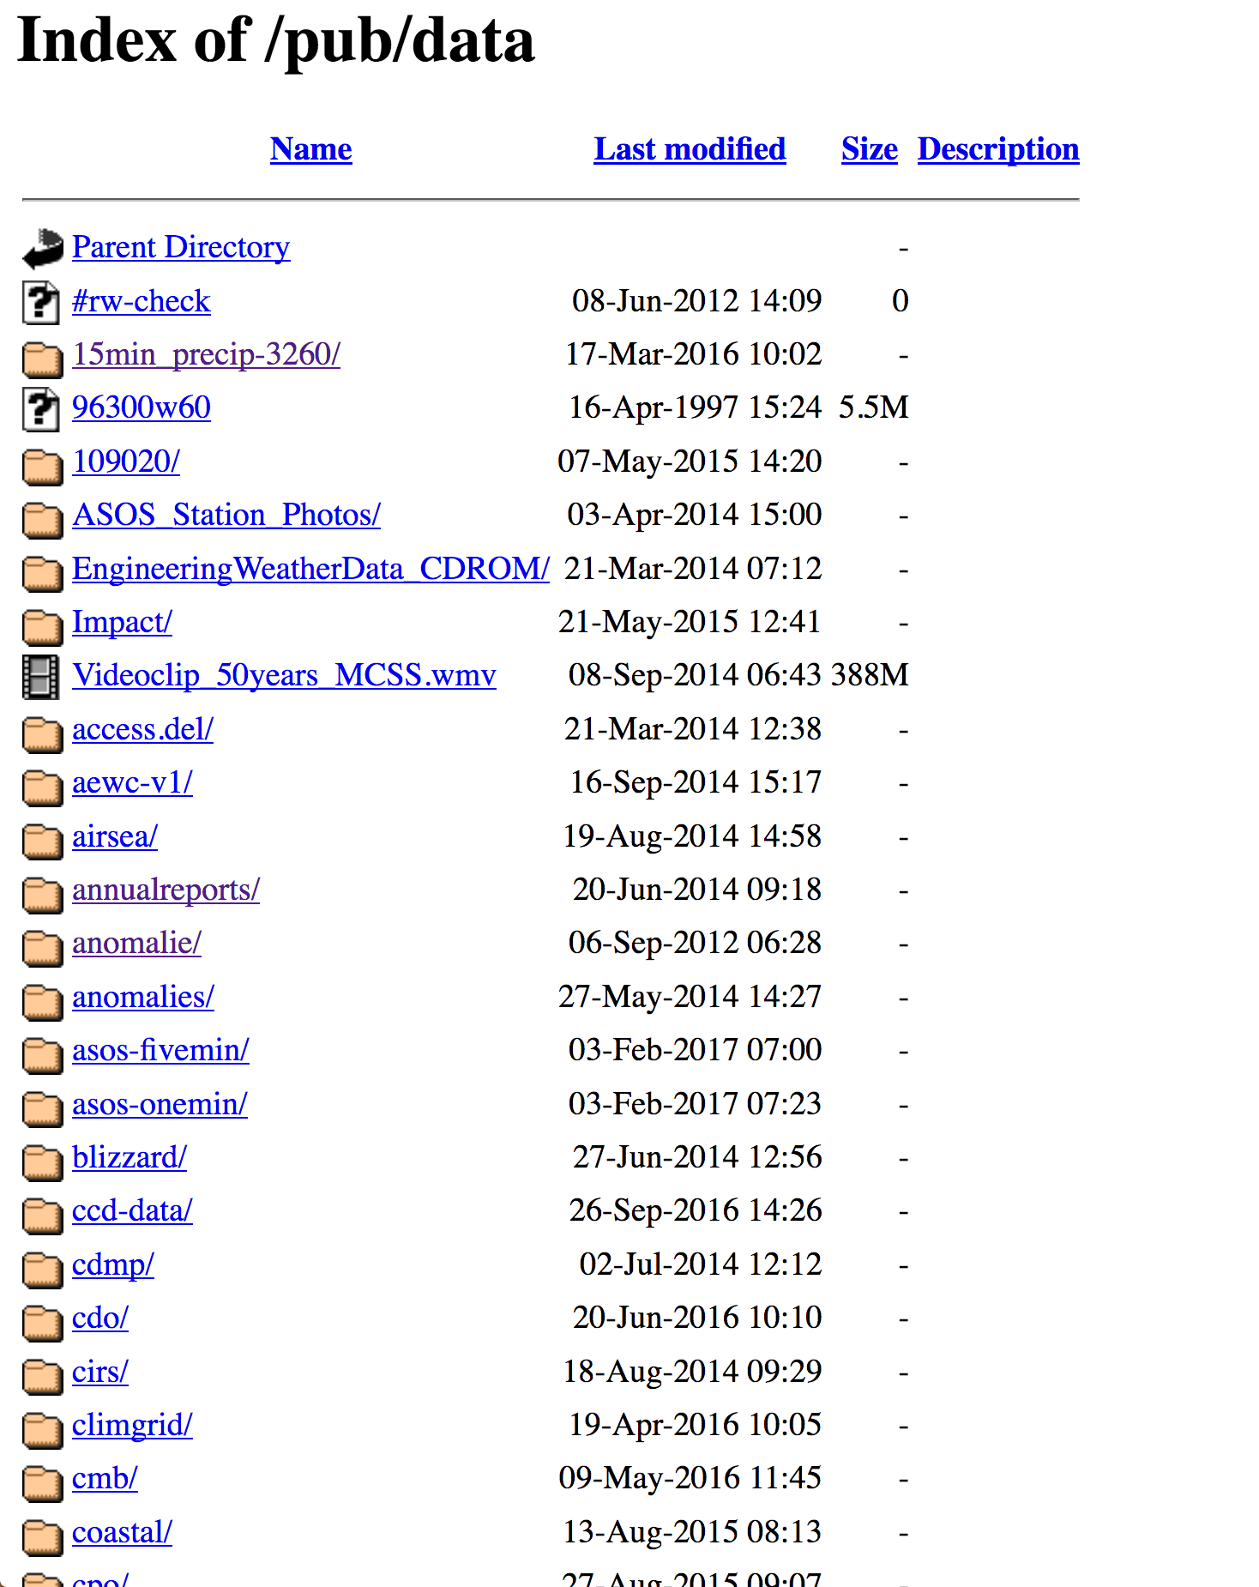
No machine readable metadata anywhere in this file structure
No agency pages link to this site
Only users know what/where
It’s functional as long as nothing changes
https://www1.ncdc.noaa.gov/pub/data/

Slide 5
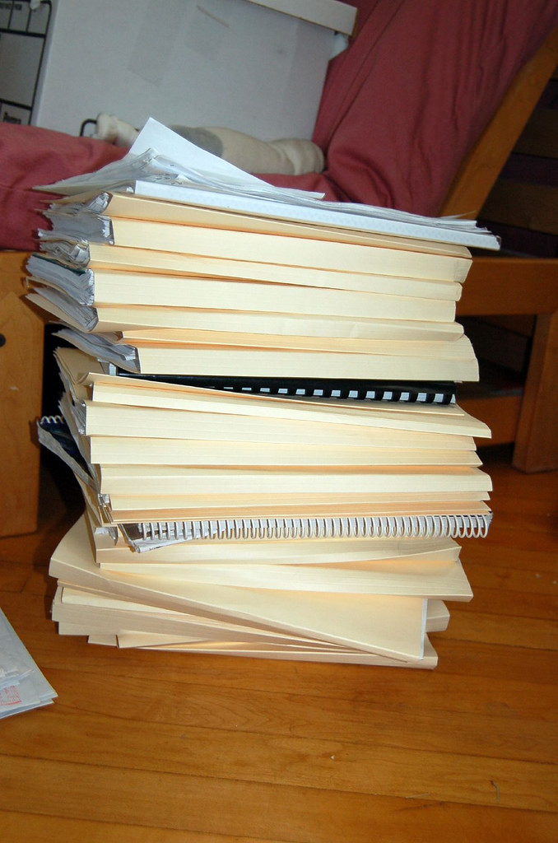
Data on Internet
be like
No complete list of data, dataset locations, data volume
No guarantee of datset backup
No way to assess changes over time
No way to ask questions of the national or global volume of data
Flickr user: Ilovebutter

Slide 6
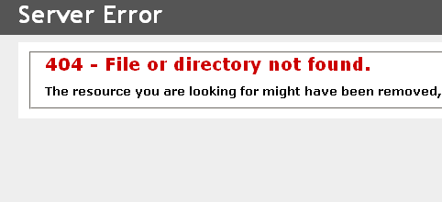
Avoiding data disaster
“The internet is a terribly unstable way to keep information available”
– Laurie Allen
Assistant Director for Digital Scholarship PENN Libraries DataRefuge
Need wide adoption of METADATA standards
… and documentation/mirroring of data now

Slide 7
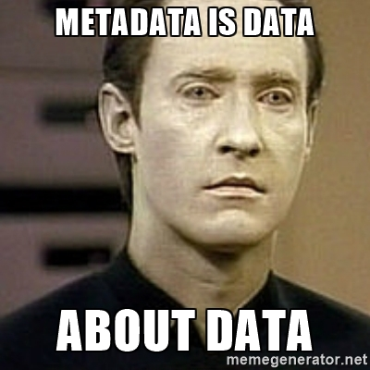
What do we want?
/ When do we want it?

Slide 8
What do we want?
/ When do we want it?
Wide adoption of MACHINE-READABLE METADATA standards
DOCUMENTATION AND MIRRORING of datasets
DECENTRALIZED archiving infrastructure

Slide 9
Think data, think METADATA, then think
Structured!
Quantitative!
Universal Access to!
Data!

Slide 10
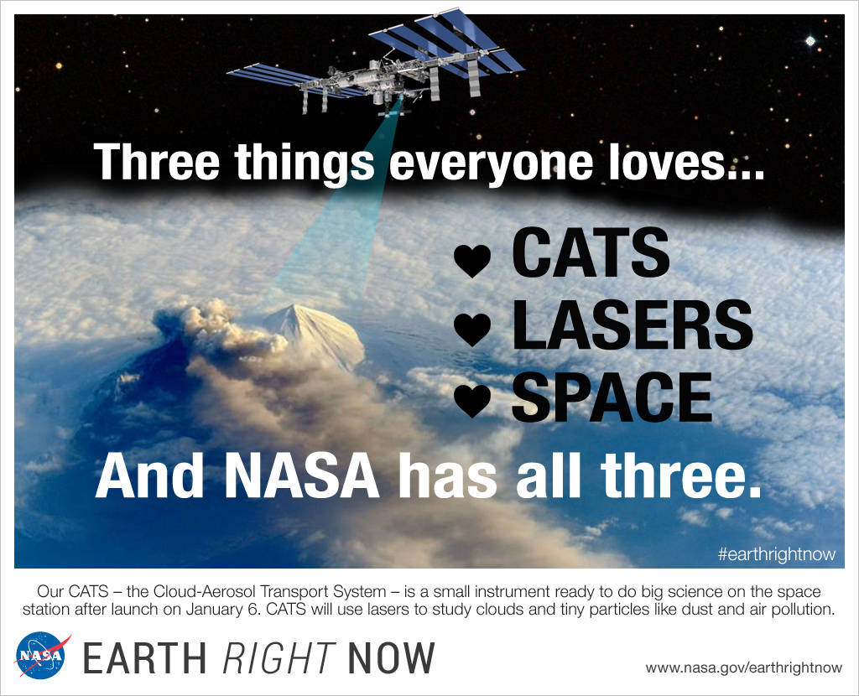

Come to Data Reuse session tomorrow to learn more about METADATA and the CATS dataset!

