Slide 1
snaps v s. humanity
Vasu Agrawal Fletcher Woodruff
Atulya Ravishankar Danielle Hu
Notes:
Snaps vs. Humanity – TartanHacks 2015
If you want to follow our project, an actual demonstration of it would be a bit difficult (since the server is down),
But instead I can tell you all about Snaps Vs. Humanity here in the comments!
Note: I, Danielle of August 12, 2015, do not approve of this PowerPoint’s graphics.

Slide 2

INSPRATION
Notes:
Inspiration – what is the idea behind this project? Why did we decide to spend 24 hours on making this project?
Well think of four second semester college freshmen, quickly brainstorming about hackathon ideas.
We mainly wanted to have FUN! (hence the cool Snapchat ghost with cool shades)
Our idea consisted of making something that may require various fields of computer science, and yet
Would be a deliverable that we would all personally find applicable or useful in some way.
In our case, we thought it would be fun to make a game that many college students played and adapt it
To a popular platform that was easily accessible—Snapchat.

Slide 3
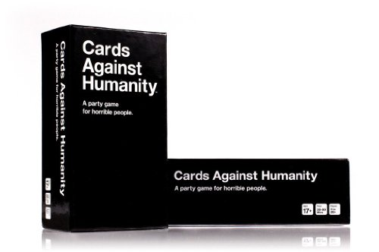
IDEA
Notes:
The idea was to be able to deliver Cards Against Humanity topic/prompt cards (black cards)
To anyone with a Snapchat account. The prompt would be delivered to users, who would then
Be able to respond to the prompt with a snap. Imagine the possibilities with your response!
You can take a picture of what you want to respond with, or you can simply type out a funny
Comment in the chat section.

Slide 4

Notes:
Since Snapchat is already a well-established social application, the need to develop
A platform such as itself was eliminated. Instead, we wouldn’t have to worry about
The many bugs and issues that could arise with a camera/social application.
Best part of this idea was being able to find a Snapchat API (albeit unofficial and sketch)
Within the first few minutes of trying to research this project.
Snapchat API link - https://github.com/mgp25/SC-API

Slide 5




HOW DID WE DO IT?
Multiplatform
Large database of users
Semi-accessible
Notes:
Again, sorry for the graphics of this PP.
The general steps to accomplishing this project were:
Set up a server that would allow users to input their Snapchat account and the
Snapchat accounts of their friends who want to play.
Send out to each player (using our official snapsvhumanity account) a snap that would ask players if they accepted the invitation to play
(achieved using Python and the Snapchat API)
Once we received the images back from every user, we would verify if they wanted to play
with OpenCV (computer visual graphics recognition library through Python).
Send out a randomized prompt to each user
Once each user has responded to the snapsvhumanity account, snapsvhumanity would send all of the responses
to the host player (player who entered the names on the server website), who would receive the responses
in an anonymous manner
Host will reply to snapsvhumanity and notify the account, which ‘card’ was the best
All users receive the winner’s snap
Game restarts and new host is picked randomly

Slide 6
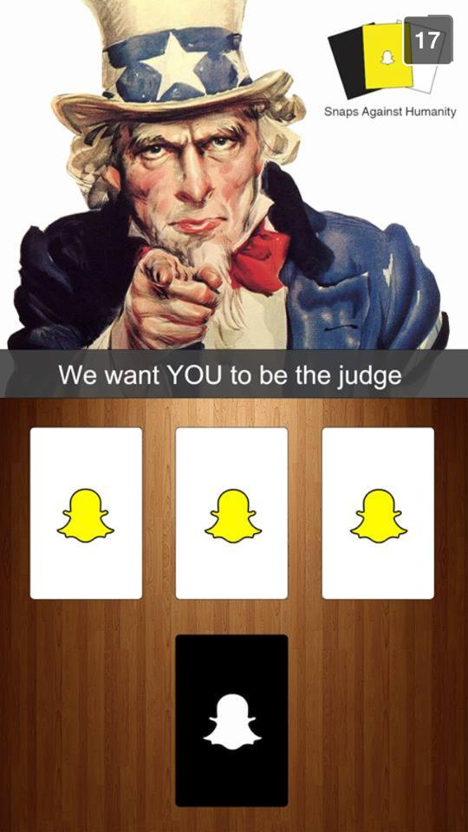
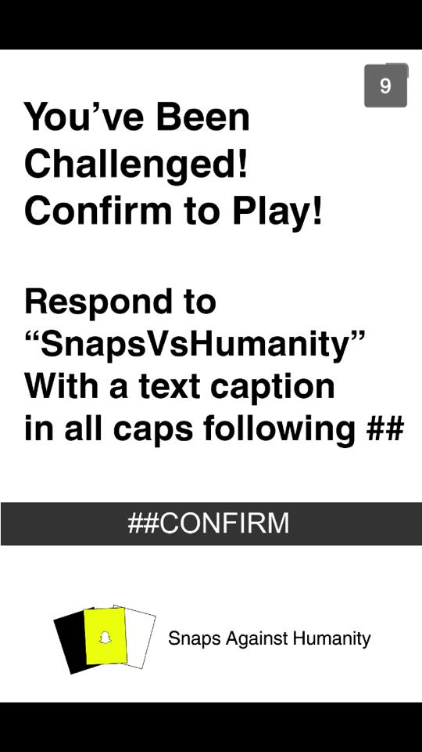
Notes:
Here are some of the actual images from SnapsvHumanity
Left: The judge receives this snap to notify him/her of their position
Right: Players are sent this snap to see if they want to play or not, a ‘##CONFIRM’ is needed from
each player in order for the round to start. OpenCV would recognize the comment
from players and process their responses.

Slide 7
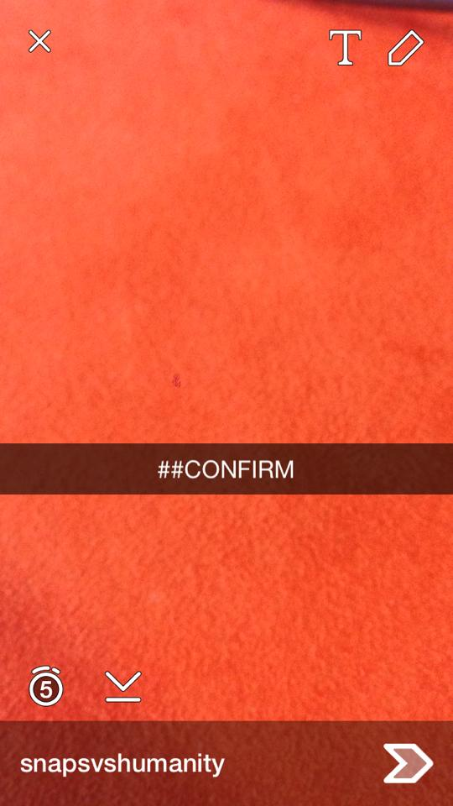

Notes:
Left: example of someone confirming to a round
Right: example of a Cards Against Humanity card that a player would receive once the round starts.

Slide 8
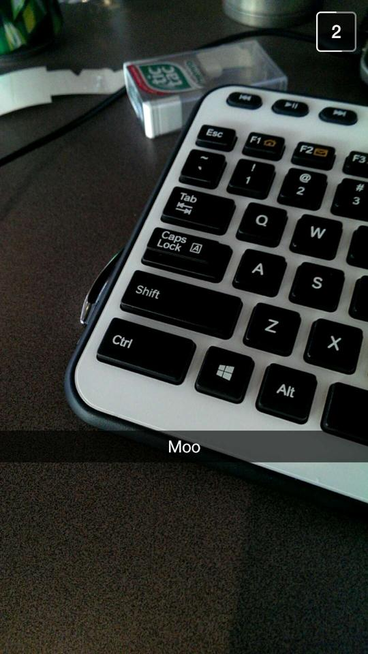
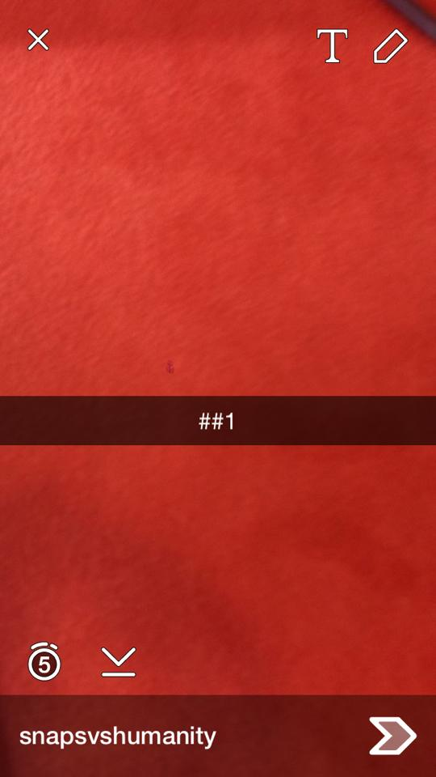
Notes:
Left: a sample response from a player (it’s not a very good response)
Right: once all of the responses are returned, a winner is chosen by the host, who responds with
the winning number according to the snaps he/she receives in order

