Slide 1
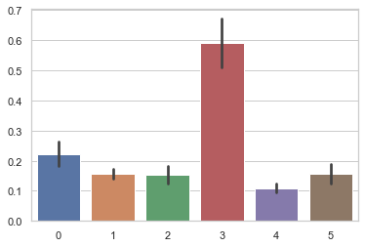
Proportion Green-Only Cells of All Labeled Cells
Proportion
50mg/kg x 2
100mg/kg x 1
Mouse

