Slide 1
IMDB CATALOG, 2010–2019
Ratings tell a different story than audiences do
A first look at what the IMDB movie tables reveal, where the gaps are, and what's worth chasing next.
Danielle Shokrian — Part 2 Exploratory Analysis
1

Slide 2
WHAT THE DATA SHOWS
Genre tags are crowded, and engagement isn't evenly spread
30,788 / 17,753 / 17,290
Drama, Documentary, and Comedy dominate the catalog by title count — nearly half of every rated movie carries one of these three tags.
Most titles carry 2–3 genre tags at once
"Comedy,Drama,Romance" and similar combinations are common, so a movie tagged this way needs to be split and counted under each genre, not treated as its own category.
7,620 missing runtimes · 804 missing genre tags
Both fields have real gaps in the movie_basics table that had to be excluded outright — no filling in, per the assignment's instructions.
Reach and acclaim move independently
Documentary titles average a 7.3 rating but draw only ~270 votes per title; Adventure titles average a lower 6.2 rating but draw over 22,000 votes.
2

Slide 3
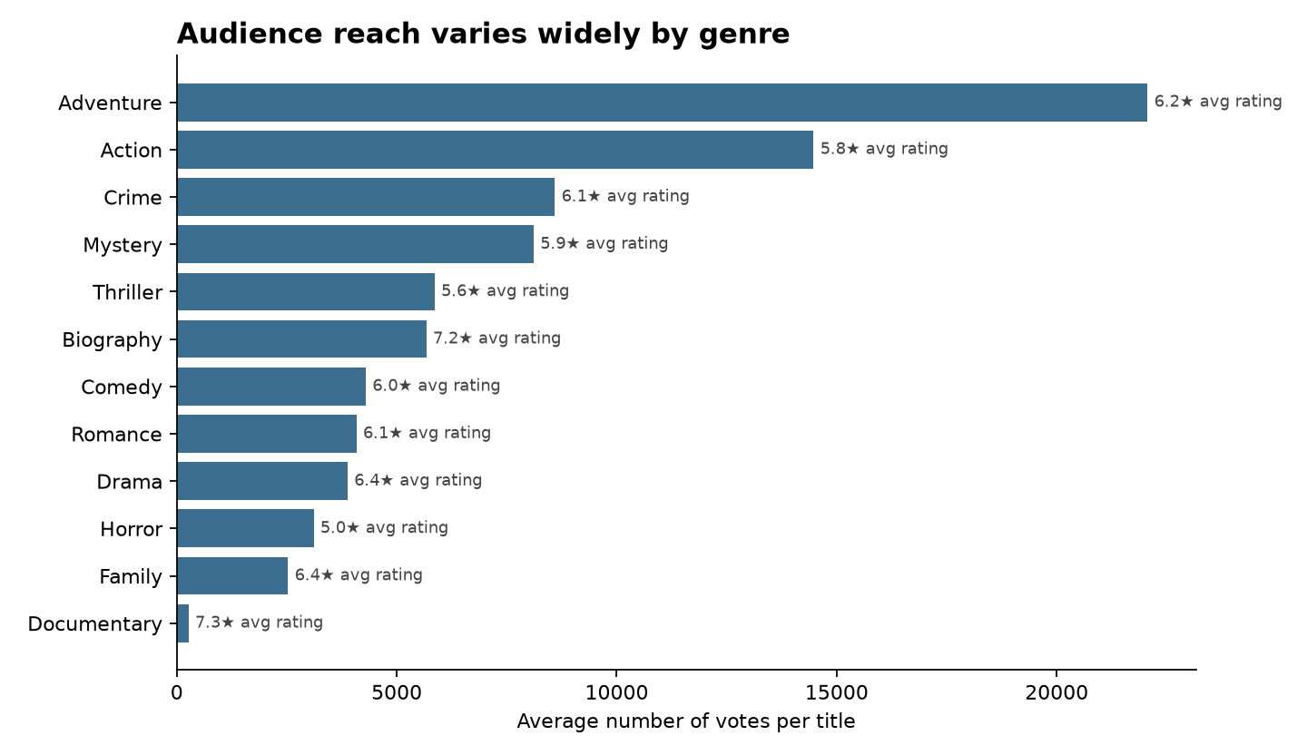
ENGAGEMENT VS. ACCLAIM
Action and Adventure pull crowds; Documentary pulls praise
Average vote count per title, by genre (2010–2019). Labels show each genre's average rating for comparison. Adventure titles draw roughly 80x more votes on average than Documentary titles, despite rating over a full point lower.
3

Slide 4
WHERE THIS LEADS
If a studio could only chase one of these, which genre bet pays off — reach or reputation?
Specifically: do high-vote, average-rated genres like Action and Adventure convert into stronger long-run financial outcomes than high-rated, low-vote genres like Documentary and Biography — and does that tradeoff hold once runtime and release year are controlled for?
4

Slide 5
BEFORE ANY OF THAT ANALYSIS HAPPENS
Four cleanup tasks come first
01
02
Split combined genre tags
Drop, don't fill, missing values
Explode the comma-separated genres column into one row per genre before grouping, so multi-genre titles aren't miscounted.
runtime_minutes and genres both have real nulls; exclude those rows from the relevant analysis rather than imputing a value.
03
04
Enforce the 2019 cutoff
Watch for join fan-out
start_year contains values past 2019; every query needs an explicit filter since the dataset is only validated through that year.
principals, directors, and writers are many-to-many tables — joining them onto movie_basics can multiply rows per movie if not deduplicated first.
5

