Slide 1


Kmart.com | Live Your Christmas Story

Slide 2


kmart.com | Live Your Christmas Story
The Blue Family Holiday Adventure
1 Game/Sweepstakes - Holiday Adventure
2 Holiday Adventure Experiance / Family Engagement
3 Christmas Stories – Image based scrapbook. Share via email or text. See all Christmas stories.
4 Mobile Text Message game and DOD alerts.
ARS | Our Results
Confidential & Proprietary Information

Slide 3
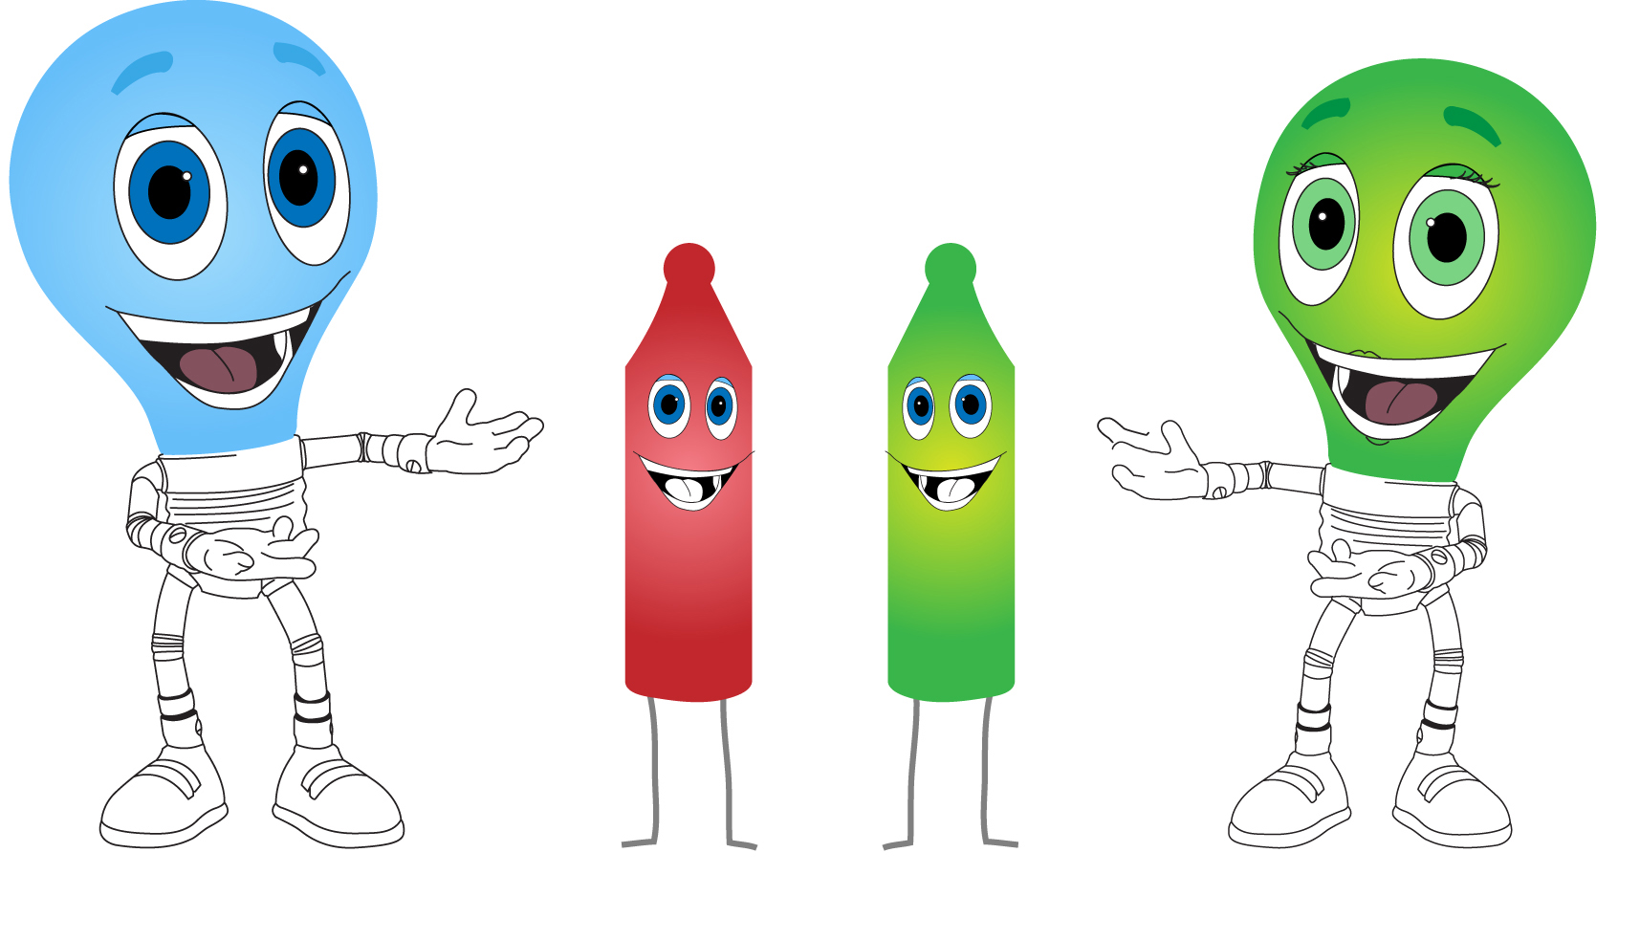
kmart.com | The Blue Family Holiday Adventure
Holiday Adventure Game/Sweepstakes
Game Engagement Points
1. Register Receipts = 1
2. Shop My Way = 2
3. Write a review = 1
4. Share Christmas Story
Prizes
1. Holiday Adventure Trip & Money
2. Randomized deal based prize
Sharable:
Facebook, Twitter, Text Msg – 5people be the first to claim
Example:
49.00 JS Sweater
What’s your prize?
ARS | Project Overview
Confidential & Proprietary Information

Slide 4
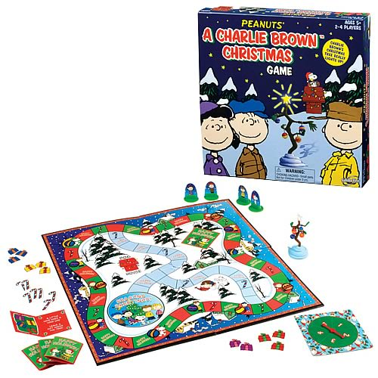
kmart.com | The Blue Family Holiday Adventure
Holiday Adventure
Experiance
As time goes on new games are unlocked.
Keep people coming back to site.
Mad libs
Coloring Ornaments
Join the Blue Family
Memory
ARS | Project Overview
Confidential & Proprietary Information

Slide 5
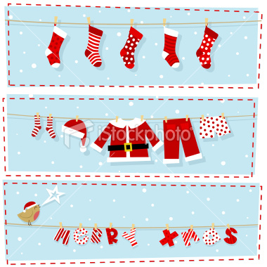
kmart.com | The Blue Family Holiday Adventure
Christmas Stories Virtual Scrapbook
Share via email or text with your family and friends.
See all Christmas stories.
ARS | Project Overview
Confidential & Proprietary Information

Slide 6
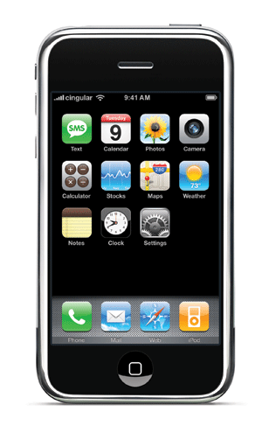
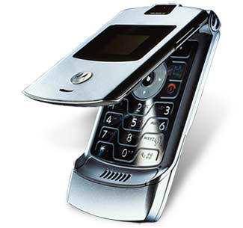
kmart.com | The Blue Family Holiday Adventure
Mobile DOD Alerts
Customized offers based on Geolocation if in Wal-mart send alert.
Possibly a text message based choose-your-own-adventure game
ARS | Project Overview
Confidential & Proprietary Information

