Slide 1
Ray Tracing

Slide 2
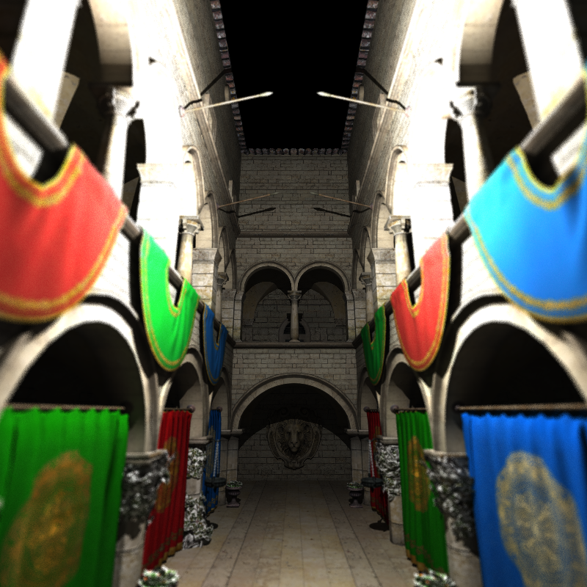
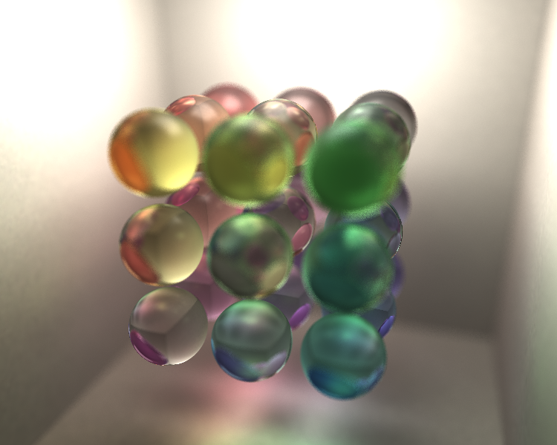
What is ray tracing?

Slide 3
What is ray tracing?
A English blog http://www.flipcode.com/archives/Raytracing_Topics_Techniques-Part_1_Introduction.shtml
Wiki
https://en.wikipedia.org/wiki/Ray_tracing_(graphics)

Slide 4
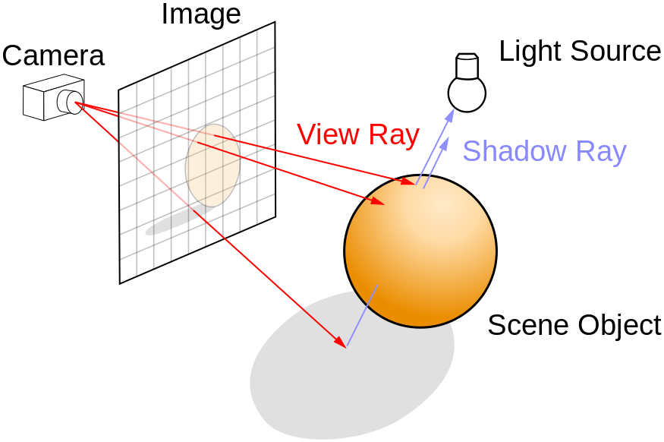
What is ray tracing?
Ray tracing is an algorithm for generating an image as real as possible by tracing the path of light as pixels in an image plane and simulating the effects of its encounters with virtual objects.
The primary problem is the collision between light and primitive.

Slide 5
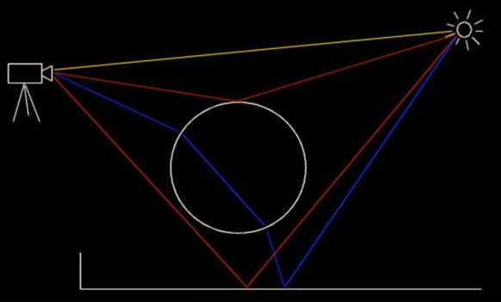
What is ray tracing?
When a light collide a primitive, there are many cases such as diffuse reflection, specular reflection and refraction. The case depends on the material quality of the collision surface.

Slide 6
Environment
Only depend on C++
Windows
Visual studio 2012 or more advanced
Or you can copy the code to the other C++ environment
A ray tracing framework can work and you should implement something new

Slide 7
Framework
There are some classes in the framework and you should pay attention to a few classes
Bmp
Camera
Scene
Ray tracer
Primitive
Light
……

Slide 8
Framework
Ray tracer
Primitive
Light
The three classes are used to find which primitive is collided with the light.
There are many kinds of primitives and light sources.
You should implement at least one kind of collision.
//NEED TO IMPLEMENT is an annotation in the place where you should add your code.

Slide 9
Framework
The framework can generate some simple image with simple scenes. You can generate your image by writing a configuration file. The file’s name is scene.txt
The format is
Class type
Property1 value1
Property2 value2
……
end

Slide 10
Framework
Primitive
Sphere
Plane
Square
Cylinder (Need to be implemented)
Bezier spinar (Need to be implemented)

Slide 11
Framework
Light source
Point light
Square light
Sphere light (Need to be implemented)

Slide 12
Framework
You can implement something new such as a new method of how a light collide a primitive.
In raytracer.cpp, Color Raytracer::CalnReflection(……)
You can implement a new reflection way
We encourage you to customize your own scene.txt file to utilize more lights/primitives/backgrounds/textures to demonstrate more fancy visual effects!

