Slide 1


http://www.comp.nus.edu.sg/~cs1010/
UNIT 13
Separate Compilation

Slide 2
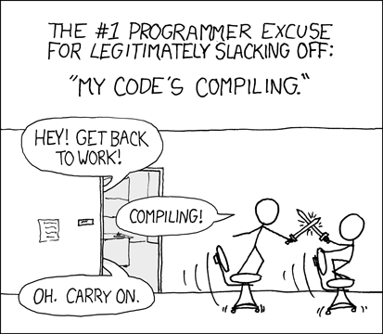
Unit 13: Separate Compilation
Objective:
Learn how to use separate compilation for program development

Slide 3
Unit 13: Separate Compilation
Introduction
Separate Compilation
Notes

Slide 4
1. Introduction (1/4)
So far we have compiled our programs directly from the source into an executable:
For the development of large programs with teams of programmers the following is practised
“Break” the program into multiple modules (files)
Compile the modules separately into object files (in C)
Link all object files into an executable file
Executable code
Compiler
produces
a.out
e.g.: gcc welcome.c

Slide 5
1. Introduction (2/4)
Header Files and Separate Compilation
Problem is broken into sub-problems and each sub-problem is tackled separately – divide-and-conquer
Such a process is called modularization
The modules are possibly implemented by different programmers, hence the need for well-defined interfaces
The function prototype constitutes the interface (header file). The function body (implementation) is hidden – abstraction
Good documentation (example: comment to describe what the method does) aids in understanding

Slide 6
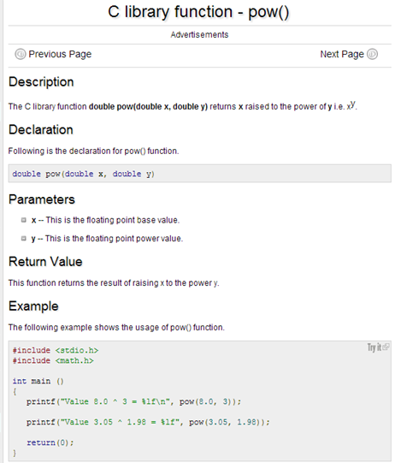
1. Introduction (3/4)
Example of documentation
The function header is given
A description of what the function does is given
How the function is implemented is not shown
double pow(double x, double y);
// Returns the result of raising
// x to the power of y.

Slide 7
1. Introduction (4/4)
Reason for Modular Programming
Divide problems into manageable parts
Reduce compilation time
Unchanges modules do not eed to be re-compiled
Facilitate debugging
The modules can be debugged separately
Small test programs can be written to test the functions in a module
Build libraries of useful functions
Faster development
Do not need to know how some functionality is implemented, e.g., image processing routines
Example: OpenCV – a computer vision library.

Slide 8
2. Separate Compilation (1/2)
From http://encyclopedia2.thefreedictionary.com/
Separate Compilation:
A feature of most modern programming languages that allows each program module to be compiled on its own to produce an object file which the linker can later combine with other object files and libraries to produce the final executable file.
Advantages
Separate compilation avoids processing all the source code every time the program is built, thus saving development time. The object files are designed to require minimal processing at link time. The can also be collected together into libraries and distributed commercially without giving away source code (through they can be disassembled).
Examples of output of separate compilation:
C object files (.o files) and Java .class files.

Slide 9
2. Separate Compilation (2/2)
In most cases, a module contains functions that are related, e.g., math functions.
A module consists of
A header file (e.g. f1.h) which contains:
Constant definitions, e.g.:
#define MAX 100
Function prototypes, e.g.:
double mean(double, double);
A source file (e.g. f1.c) which contains:
The functions that implement the function prototypes in the header file (e.g., the code for the function mean(…)).
Other functions, variables, and constants that are only used within the module (i.e., they are module-local).
f1.h
f1.c

Slide 10
2.1 Separate Compilation: Case 1
Source files .c & .h
Case 1:
All the source files are compiled and linked in one step.
f1.h
math.h
libm.a
Library file(s)
f1.c
f2.h
-lm
f2.c
gcc
a.out
f3.h
f3.c
Compilation
and Linking
Executable file
main.c

Slide 11
2.1 Case 1 Demo
Let’s re-visit the Freezer version 2 program in Unit 4 Exercise 6. We will create a module that contains a function to calculate the freezer temperature:
Module header file:
Module source file:
Unit13_FreezerTemp.h
// Compute new temperature in freezer
float calc_temperature(float);
Unit13_FreezerTemp.c
#include <math.h>
// Compute new temperature in freezer
float calc_temperature(float hr) {
return ((4.0 * pow(hr, 10.0))/(pow(hr, 9.0) + 2.0)) - 20.0;
}

Slide 12
2.1 Case 1 Demo: Main Module
Unit13_FreezerMain.c
#include <stdio.h>
#include "Unit13_FreezerTemp.h"
int main(void) {
int hours, minutes;
float hours_float; // Convert hours and minutes into hours_float
float temperature; // Temperature in freezer
// Get the hours and minutes
printf("Enter hours and minutes since power failure: ");
scanf("%d %d", &hours, &minutes);
// Convert hours and minutes into hours_float
hours_float = hours + minutes/60.0;
// Compute new temperature in freezer
temperature = calc_temperature(hours_float);
// Print new temperature
printf("Temperature in freezer = %.2f\n", temperature);
return 0;
}
Include the header file (Note "..." instead of <…>).
Header file should be in the same directory as this program.
Now we can write a program which uses
the new external function

Slide 13
2.1 Case 1 Demo: Compile and Link
How do we run Unit13_FreezerMain.c, since it doesn’t contain the function definition of calc_temperature()?
Need to compile and link the programs
$ gcc Unit13_FreezerMain.c Unit13_FreezerTemp.c -lm
Here, the compiler creates temporary object files (which are immediately removed after linking) and directly creates a.out
Hence, you don’t get the chance to see the object files (files with extension .o)
(Note: The option –Wall is omitted above due to space constraint. Please add the option yourself.)

Slide 14
2.2 Separate Compilation: Case 2
Source files .c & .h
Case 2:
Source files are compiled separately and then linked.
Object files
math.h
f1.h
Compilation
Library file(s)
f1.c
f1.o
Libm.a
gcc -c
f2.h
-lm
f2.c
gcc -c
f2.o
gcc
a.out
f3.h
Linking
Executable file
f3.c
gcc -c
f3.o
main.c
gcc -c
main.o
The compiler creates separate
object files (files with extension .o)

Slide 15
2.2 Case 2 Demo: Compile and Link
For our Freezer program:
$ gcc –c Unit13_FreezerMain.c
$ gcc –c Unit13_FreezerTemp.c
$ gcc Unit13_FreezerMain.o Unit13_FreezerTemp.o -lm
Here, we first create the Unit13_FreezerMain.o and Unit13_FreezerTemp.o object files, using the –c option in gcc.
Then, we link both object files into the a.out executable
(Note: The option –Wall is omitted above due to space constraint. Please add the option yourself.)

Slide 16
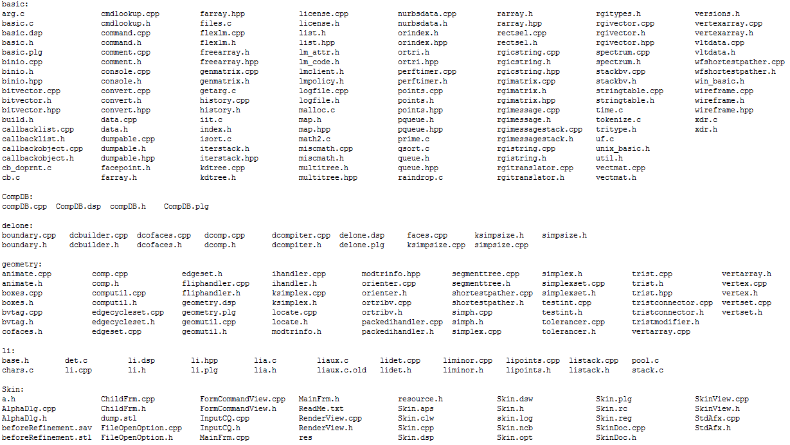

Slide 17
2.2 Separate Compilation: Case 2
Source files .c & .h
Case 2:
Source files are compiled separately and then linked.
Object files
math.h
f1.h
Compilation
Library file(s)
f1.c
f1.o
Libm.a
gcc -c
f2.h
-lm
f2.c
gcc -c
f2.o
And Link
gcc
a.out
Modified
f3.h
Only need to compile this
Linking
f3.c
gcc -c
f3.o
Executable file
main.c
gcc -c
main.o
The compiler creates separate
object files (files with extension .o)

Slide 18
2.2 Case 2 Demo: Compile and Link
For our Freezer program:
$ gcc –c Unit13_FreezerMain.c
$ gcc –c Unit13_FreezerTemp.c
$ gcc Unit13_FreezerMain.o Unit13_FreezerTemp.o -lm
Let’s say if you only modified Unit13_FreezerTemp.c but NOT Unit13_FreezerMain.c, you can skip the first compilation
Speed of a lot if you have tons of files
$ gcc –c Unit13_FreezerMain.c
$ gcc –c Unit13_FreezerTemp.c
$ gcc Unit13_FreezerMain.o Unit13_FreezerTemp.o -lm

Slide 19
3. Notes (1/2)
Difference between
#include < … > and #include " … "
Use " … " to include your own header files and < … > to include system header files. The compiler uses different directory paths to find < … > files.
Inclusion of header files
Include *.h files only in *.c files, otherwise duplicate inclusions may happen and later may create problems:
Example: Unit13_FreezerTemp.h includes <math.h> Unit13_FreezerMain.c includes <math.h> and “Unit13_FreezerTemp.h” Therefore, Unit13_FreezerMain.c includes <math.h> twice.

Slide 20
3. Notes (2/2)
‘Undefined symbol’ error
ld: fatal: Symbol referencing errors.
The linker was not able to find a certain function, etc., and could not create a complete executable file.
Note: A library can have missing functions → it is not a complete executable.
Usually this means you forgot to link with a certain library or object file. This also happens if you mistyped a function name.

Slide 21
Summary
In this unit, you have learned about
How to split a program into separate modules, each module containing some functions
How to separately compile these modules
How to link the object files of the modules to obtain the single executable file

Slide 22
End of File

