Slide 1


http://www.comp.nus.edu.sg/~cs1010/
UNIT 4
Overview of C Programming

Slide 2
Unit 4: Overview of C Programming
A Simple C Program
Variables and Data Types
Program Structure
Preprocessor directives
Input
Compute
Output
Math Functions
Programming Style
Common Mistakes

Slide 3
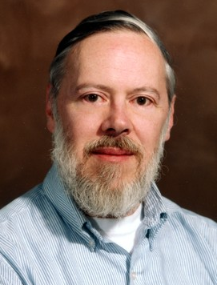
Introduction
C: A general-purpose computer programming language developed in 1972 by Dennis Ritchie (1941 – 2011) at Bell Telephone Lab for use with the UNIX operation System
We will follow the ANSI C (C99) standard
https://en.wikipedia.org/wiki/ANSI_C#C99

Slide 4
Quick Review: Edit, Compile, Execute
Compile
Execute
Edit
Test, test, and test!
Source code
Edit
produces
first.c
eg: vim first.c
Executable code
Compile
produces
a.out
Cannot compile?
eg: gcc first.c
Program output
Incorrect result?
Execute
produces
eg: a.out
The value of c is 3.

Slide 5
A Simple C Program (1/3)
General form of a simple C program
preprocessor directives
main function header
{
declaration of variables
executable statements
}
“Executable statements” usually consists of 3 parts:
Input data
Computation
Output results

Slide 6
A Super Simple C Program
Compile
Execute
Edit
Use vim to create this C program first.c
preprocessor directives
#include <stdio.h>
int main(void) {
printf(“ @..@\n”);
return 0;
}
main function header
declaration of variables
executable statements

Slide 7
The Less Simple C Program
Compile
Execute
Edit
#include <stdio.h>
int main(void) {
int a,b,c;
a = 2001;
b = 4002;
c = a + b;
printf(“ The value of %d + %d = %d\n”,a,b,c);
return 0;
}

Slide 8
A Simple C Program (1/3)
General form of a simple C program
preprocessor directives
main function header
{
declaration of variables
executable statements
}
“Executable statements” usually consists of 3 parts:
Input data
Computation
Output results

Slide 9
The Less Simple C Program
Compile
Execute
Edit
Use vim to create this C program first.c
preprocessor directives
#include <stdio.h>
int main(void) {
int a,b,c;
a = 2001;
b = 4002;
c = a + b;
printf(“ The value of %d + %d = %d\n”,a,b,c);
return 0;
}
main function header
declaration of variables
executable statements

Slide 10
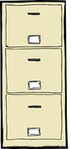
The Less Simple C Program
Compile
Execute
Edit
Declared 3 variables, their names are a,b and c
#include <stdio.h>
int main(void) {
int a,b,c;
a = 2001;
b = 4002;
c = a + b;
printf(“ The value of %d + %d = %d\n”,a,b,c);
return 0;
}
put the value 2001 into a
a
2001
b
4002
Read the data in a and b, add them and put the sum in c
c
6003

Slide 11
A Simple C Program (2/3)
Unit4_MileToKm.c
// Converts distance in miles to kilometres.
#include <stdio.h> /* printf, scanf definitions */
#define KMS_PER_MILE 1.609 /* conversion constant */
int main(void) {
float miles, // input – distance in miles
kms; // output – distance in kilometres
/* Get the distance in miles */
printf("Enter distance in miles: ");
scanf("%f", &miles);
// Convert the distance to kilometres
kms = KMS_PER_MILE * miles;
// Display the distance in kilometres
printf("That equals %9.2f km.\n", kms);
return 0;
}
Sample run
$ gcc –Wall Unit4_MileToKm.c
$ a.out
Enter distance in miles: 10.5
That equals 16.89 km.

Slide 12
A Simple C Program (3/3)
// Converts distance in miles to kilometres.
#include <stdio.h> /* printf, scanf definitions */
#define KMS_PER_MILE 1.609 /* conversion constant */
int main(void) {
float miles, // input – distance in miles
kms; // output – distance in kilometres
/* Get the distance in miles */
printf("Enter distance in miles: ");
scanf("%f", &miles);
// Convert the distance to kilometres
kms = KMS_PER_MILE * miles;
// Display the distance in kilometres
printf("That equals %9.2f km.\n", kms);
return 0;
}
standard header file
preprocessor directives
constant
reserved words
variables
comments
functions
special symbols
punctuations

Slide 13
What Happens in the Computer Memory
memory
memory
memory
Executable code of Unit4_MileToKm.c
Executable code of Unit4_MileToKm.c
Executable code of Unit4_MileToKm.c
miles
miles
miles
?
10.5
10.5
kms
kms
kms
?
?
16.89
At the beginning
After user enters: 10.5 to
scanf("%f", &miles);
After this line is executed:
kms = KMS_PER_MILE * miles;
Do not assume that uninitialised variables contain zero! (Very common mistake.)

Slide 14
Variables
Data used in a program are stored in variables
Every variable is identified by a name (identifier), has a data type, and contains a value which could be modified
(Each variable actually has an address too, but for the moment we will skip this, until we discuss pointers.)
A variable is declared with a data type
Eg: int count; // variable ‘count’ of type ‘int’
Variables may be initialized during declaration:
Eg: int count = 3; // count is initialized to 3
Without initialization, the variable contains an unknown value (Cannot assume that it is zero!)

Slide 15
What if
Compile
Execute
Edit
#include <stdio.h>
int main(void) {
int a,b,c;
b = 4002;
c = a + b;
printf(“ The value of %d + %d = %d\n”,a,b,c);
return 0;
}
a
b
4002
Read the data in a and b, add them and put the sum in c
c
?

Slide 16
Variables: Mistakes in Initialization
No initialization
int count;
count = count + 12;
Does ‘count’ contain 12 after this statement?
Redundant initialization
int count = 0;
count = 123;
Initialization here is redundant.

Slide 17
The Less Simple C Program
Compile
Execute
Edit
Declared 3 variables, their names are a,b and c
#include <stdio.h>
int main(void) {
int a,b,c;
a = 2001;
b = 4002;
c = a + b;
printf(“ The value of %d + %d = %d\n”,a,b,c);
return 0;
}
put the value 2001 into a
a
2001
b
And the variable a, b, c are storing integers
Can we do a = 0.1?
c

Slide 18
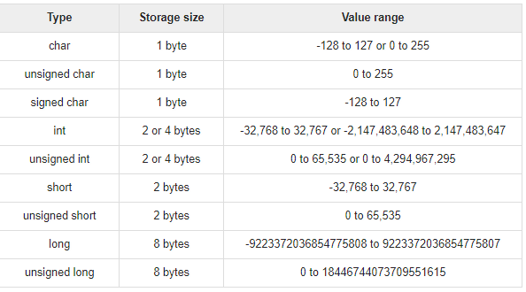
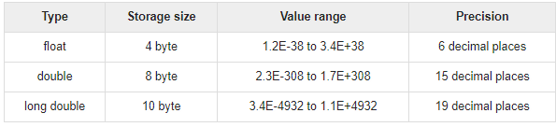
Data Types
To determine the type of data a variable may hold
Integer and Char
Float
http://www.tutorialspoint.com/cprogramming/c_data_types.htm

Slide 19

Notes (1/2)
Basic steps of a simple program
Read inputs (scanf)
Compute
Print outputs (printf)
For now we will use interactive inputs
Standard input stream (stdin) – default is keyboard
Use the scanf() function
Assume input data always follow specification
Hence no need to validate input data (for now)
Outputs
Standard output stream (stdout) – default is monitor
Use the printf() function

Slide 20
Notes (2/2)
Include header file <stdio.h> to use scanf() and printf()
Include the header file (for portability sake) even though some systems do no require this to be done
Important! (CodeCrunch issue)
Make sure you have a newline character (‘\n’) at the end of your last line of output, or CodeCrunch may mark your output as incorrect.
printf("That equals %9.2f km.\n", kms);

Slide 21
Type of Errors
Easiest to spot – the compiler helps you!
Syntax errors (and warnings)
Program violates syntax rules
Warning happens, for example, incomparable use of types for output
Advise to use gcc –Wall to compile your programs
Run-time errors
Program terminates unexpectedly due to illegal operations, such as dividing a number by zero, or user enters a real number for an integer data type
Logic errors
Program produces incorrect result
Undetected errors
Exist if we do not test the program thoroughly enough
Moderately easy to spot
Hard to spot
May never be spotted!
The process of correcting errors in programs is called debugging.
This process can be very time-consuming!

Slide 22
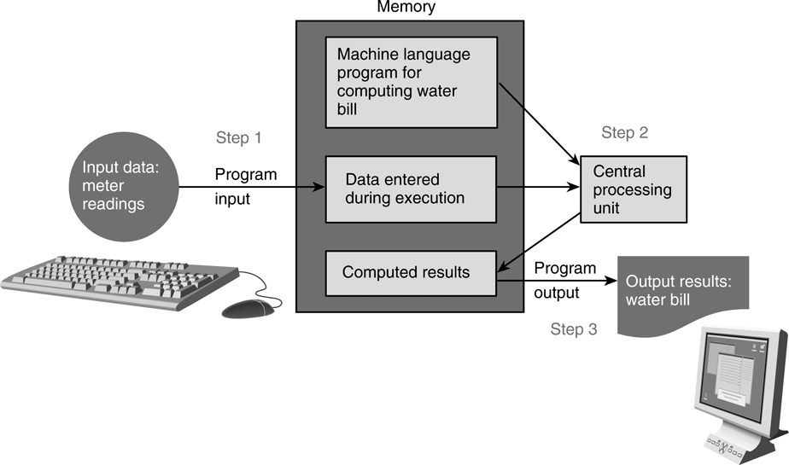
Program Structure
A basic C program has 4 main parts:
Preprocessor directives:
eg: #include <stdio.h>, #include <math.h>, #define PI 3.142
Input: through stdin (using scanf), or file input
Compute: through arithmetic operations
Output: through stdout (using printf), or file output
We will learn file input/output later.

Slide 23
Program Structure: Preprocessor Directives (1/2)
Preprocessor
Input
Compute
Output
The C preprocessor provides the following
Inclusion of header files
Macro expansions
Conditional compilation
For now, we will focus on inclusion of header files and simple application of macro expansions
Inclusion of header files
To use input/output functions such as scanf() and printf(), you need to include <stdio.h>: #include <stdio.h>
To use mathematical functions, you need to include <math.h>: #include <math.h>

Slide 24
Program Structure: Preprocessor Directives (2/2)
Preprocessor
Input
Compute
Output
Macro expansions
One of the uses is to define a macro for a constant value
Eg: #define PI 3.142 // use all CAP for macro
#define PI 3.142
int main(void) {
...
areaCircle = PI * radius * radius;
volCone = PI * radius * radius * height / 3.0;
}
Preprocessor replaces all instances of PI with 3.142 before passing the program to the compiler.
What the compiler sees:
int main(void) {
...
areaCircle = 3.142 * radius * radius;
volCone = 3.142 * radius * radius * height / 3.0;
}

Slide 25
Program Structure: Input/Output (1/3)
Preprocessor
Input
Compute
Output
Input/output statements:
printf ( format string, print list );
printf ( format string );
scanf( format string, input list );
age
Address of variable ‘age’ varies each time a program is run.
20
One version:
“age” refers to value in the variable age.
“&age” refers to (address of) the memory cell where the value of age is stored.
int age;
double cap; // cumulative average point
printf("What is your age? ");
scanf("%d", &age);
printf("What is your CAP? ");
scanf("%lf", &cap);
printf("You are %d years old, and your CAP is %f\n", age, cap);
Unit4_InputOutput.c
Another version:
int age;
double cap; // cumulative average point
printf("What are your age and CAP? ");
scanf("%d %lf", &age, &cap);
printf("You are %d years old, and your CAP is %f\n", age, cap);
Unit4_InputOutputV2.c

Slide 26
Program Structure: Input/Output (2/3)
Preprocessor
Input
Compute
Output
%d and %lf are examples of format specifiers; they are placeholders for values to be displayed or read
Placeholder | Variable Type | Function Use
%c | char | printf / scanf
%d | int | printf / scanf
%f | float or double | printf
%f | float | scanf
%lf | double | scanf
%e | float or double | printf (for scientific notation)
Examples of format specifiers used in printf():
%5d: to display an integer in a width of 5, right justified
%8.3f: to display a real number (float or double) in a width of 8, with 3 decimal places, right justified
Note: For scanf(), just use the format specifier without indicating width, decimal places, etc.

Slide 27
Program Structure: Input/Output (3/3)
Preprocessor
Input
Compute
Output
\n is an example of escape sequence
Escape sequences are used in printf() function for certain special effects or to display certain characters properly
See Table 1.4 (pages 32 – 33)
These are the more commonly used escape sequences:
Escape sequence | Meaning | Result
\n | New line | Subsequent output will appear on the next line
\t | Horizontal tab | Move to the next tab position on the current line
\" | Double quote | Display a double quote "
%% | Percent | Display a percent character %

Slide 28
Exercise #2: Testing scanf() and printf()
We will do an exercise in class to explore scanf() and printf() functions
Unit4_TestIO.c
Copy the above program into your current directory cp ~cs1010/lect/prog/unit4/Unit4_TestIO.c .

Slide 29
Exercise #3: Distance Conversion (1/2)
Convert distance from miles to kilometres
Unit4_MileToKm.c
The program is given (which you can copy to your directory as earlier instructed), but for this exercise we want you to type in the program yourself as a practice in using vim
The program is shown in the next slide

Slide 30
Exercise #3: Distance Conversion (2/2)
Unit4_MileToKm.c
// Unit4_MileToKm.c
// Converts distance in miles to kilometers.
#include <stdio.h>
#define KMS_PER_MILE 1.609
int main(void) {
float miles, // input - distance in miles.
kms; // output - distance in kilometers
/* Get the distance in miles */
printf("Enter distance in miles: ");
scanf("%f", &miles);
// Convert the distance to kilometres
kms = KMS_PER_MILE * miles;
// Display the distance in kilometres
printf("That equals %9.2f km.\n", kms);
return 0;
}

Slide 31
Program Structure: Compute (1/9)
Preprocessor
Input
Compute
Output
Computation is through function
So far, we have used one function: int main(void)
main() function: where execution of program begins
A function body has two parts
Declarations statements: tell compiler what type of memory cells needed
Executable statements: describe the processing on the memory cells
int main(void) {
/* declaration statements */
/* executable statements */
return 0;
}

Slide 32
Program Structure: Compute (2/9)
Preprocessor
Input
Compute
Output
Declaration Statements: To declare use of variables
int count, value;
Data type
Names of variables
User-defined Identifier
Name of a variable or function
May consist of letters (a-z, A-Z), digits (0-9) and underscores (_), but MUST NOT begin with a digit
Case sensitive, i.e. count and Count are two distinct identifiers
Guideline: Usually should begin with lowercase letter
Must not be reserved words (next slide)
Should avoid standard identifiers (next slide)
Eg: Valid identifiers: maxEntries, _X123, this_IS_a_long_name Invalid: 1Letter, double, return, joe’s, ice cream, T*S

Slide 33
Program Structure: Compute (3/9)
Preprocessor
Input
Compute
Output
Reserved words (or keywords)
Have special meaning in C
Eg: int, void, double, return
Complete list: http://c.ihypress.ca/reserved.html
Cannot be used for user-defined identifiers (names of variables or functions)
Standard identifiers
Names of common functions, such as printf, scanf
Avoid naming your variables/functions with the same name of built-in functions you intend to use

Slide 34
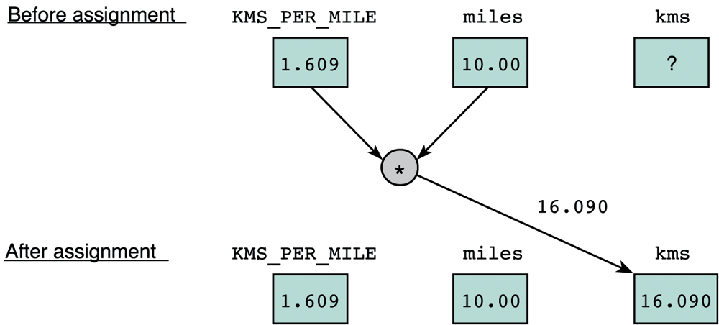
Program Structure: Compute (4/9)
Preprocessor
Input
Compute
Output
Executable statements
I/O statements (eg: printf, scanf)
Computational and assignment statements
Assignment statements
Store a value or a computational result in a variable
(Note: ‘=’ means ‘assign value on its right to the variable on its left’; it does NOT mean equality)
Left side of ‘=’ is called lvalue
Eg: kms = KMS_PER_MILE * miles;

Slide 35
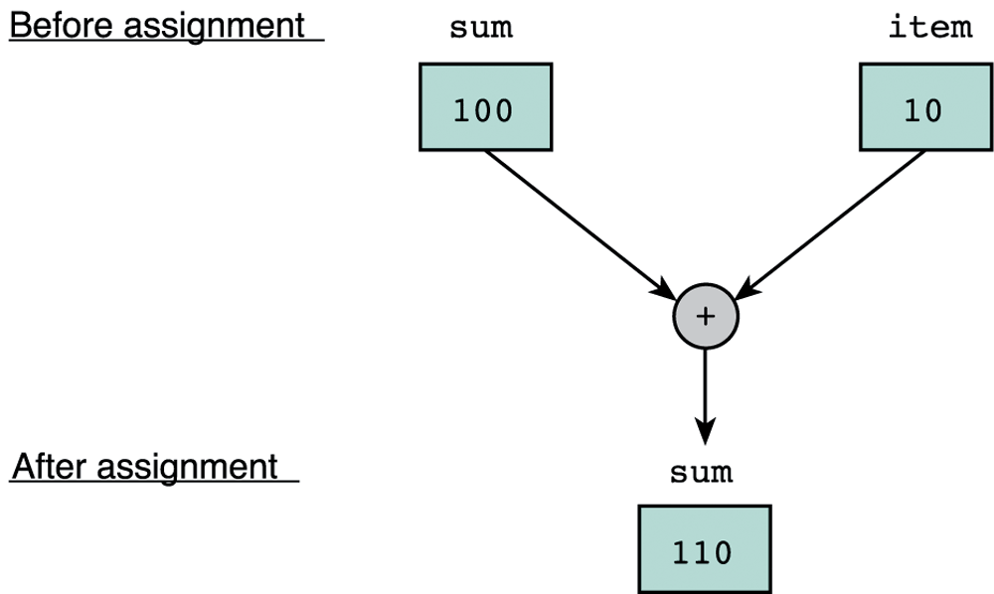
Program Structure: Compute (5/9)
Preprocessor
Input
Compute
Output
Eg: sum = sum + item;
Note: lvalue must be assignable
Examples of invalid assignment (result in compilation error “lvalue required as left operand of assignment”):
32 = a; // ’32’ is not a variable
a + b = c; // ‘a + b’ is an expression, not variable
Assignment can be cascaded, with associativity from right to left:
a = b = c = 3 + 6; // 9 assigned to variables c, b and a
The above is equivalent to: a = (b = (c = 3 + 6));
which is also equivalent to:
c = 3 + 6; b = c;
a = b;

Slide 36
Program Structure: Compute (6/9)
Preprocessor
Input
Compute
Output
Side Effect:
An assignment statement does not just assigns, it also has the side effect of returning the value of its right-hand side expression
Hence a = 12; has the side effect of returning the value of 12, besides assigning 12 to a
Usually we don’t make use of its side effect, but sometimes we do, eg:
z = a = 12; // or z = (a = 12);
The above makes use of the side effect of the assignment statement a = 12; (which returns 12) and assigns it to z
Side effects have their use, but avoid convoluted codes:
a = 5 + (b = 10); // assign 10 to b, and 15 to a
Side effects also apply to expressions involving other operators (eg: logical operators). We will see more of this later.

Slide 37
Program Structure: Compute (7/9)
Preprocessor
Input
Compute
Output
Arithmetic operations
Binary Operators: +, –, *, /, % (modulo or remainder)
Left Associative (from left to right)
46 / 15 / 2 → 3 / 2 → 1
19 % 7 % 3 → 5 % 3 → 2
Unary operators: +, –
Right Associative
x = – 23 p = +4 * 10
Execution from left to right, respecting parentheses rule, and then precedence rule, and then associative rule (next page)
addition, subtraction are lower in precedence than multiplication, division, and remainder
Truncated result if result can’t be stored (the page after next)
int n; n = 9 * 0.5; results in 4 being stored in n.
Try out Unit4_ArithOps.c

Slide 38
Program Structure: Compute (8/9)
Preprocessor
Input
Compute
Output
Arithmetic operators: Associativity & Precedence
Operator Type | Operator | Associativity
Primary expression operators | ( ) expr++ expr-- | Left to right
Unary operators | * & + - ++expr --expr (typecast) | Right to left
Binary operators | * / % | Left to right
 | + -
Assignment operators | = += -= *= /= %= | Right to left

Slide 39
Program Structure: Compute (9/9)
Preprocessor
Input
Compute
Output
Mixed-Type Arithmetic Operations
int m = 10/4; means
float p = 10/4; means
int n = 10/4.0; means
float q = 10/4.0; means
int r = -10/4.0; means
m = 2;
p = 2.0;
n = 2;
q = 2.5;
r = -2;
Caution!
Type Casting
Use a cast operator to change the type of an expression
syntax: (type) expression
int aa = 6; float ff = 15.8;
float pp = (float) aa / 4; means
int nn = (int) ff / aa; means
float qq = (float) (aa / 4); means
pp = 1.5;
nn = 2;
qq = 1.0;
Try out Unit4_MixedTypes.c and Unit4_TypeCast.c

Slide 40
Exercise #5: Freezer (1/2)
Write a program freezer.c that estimates the temperature in a freezer (in ºC) given the elapsed time (hours) since a power failure. Assume this temperature (T) is given by
where t is the time since the power failure.
Your program should prompt the user to enter how long it has been since the start of the power failure in hours and minutes, both values in integers.
Note that you need to convert the elapsed time into hours in real number (use type float)
For example, if the user entered 2 30 (2 hours 30 minutes), you need to convert this to 2.5 hours before applying the above formula.

Slide 41
Exercise #5: Freezer (2/2)
Refer to the sample run below. Follow the output format.
Enter hours and minutes since power failure: 2 45
Temperature in freezer = -13.63
How long does it take the freezer to get to zero degree? Which of the following is the closest answer?
3 hours
4 hours 10 minutes
6 hours 30 minutes
8 hours
This exercise is mounted on CodeCrunch as a practice exercise.
Please work on it on your own and discuss it on the IVLE forum if you have any queries.

Slide 42
Math Functions (1/2)
In C, there are many libraries offering functions for you to use.
Eg: scanf() and printf() – requires to include <stdio.h>
In Exercise #5, for t² you may use t*t, or the pow() function in the math library: pow(t, 2)
pow(x, y) // computes x raised to the power of y
To use math functions, you need to
Include <math.h> AND
Compile your program with –lm option (i.e. gcc –lm …)
See Table 3.1 (page 141) for some math functions

Slide 43
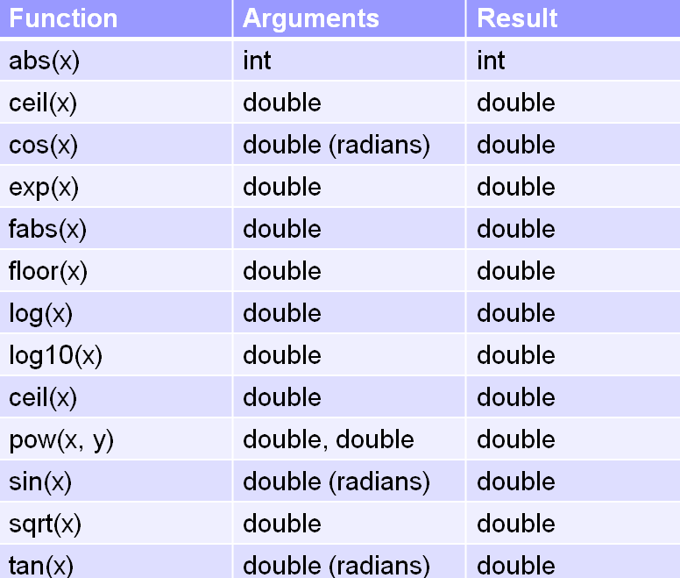
Math Functions (2/2)
Some useful math functions
Function abs(x) from <stdlib.h>; the rest from <math.h>
Function prototype:
double pow(double x, double y)
function return type
Q: Since the parameters x and y in pow() function are of double type, why can we call the function with pow(t, 2)?
A: Integer value can be assigned to a double variable/parameter.

Slide 44
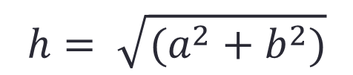
Math Functions: Example (1/2)
Program Unit4_Hypotenuse.c computes the hypotenuse of a right-angled triangle given the lengths of its two perpendicular sides
h
$$h= \sqrt{(a^{2}+b^{2})}$$
a
b

Slide 45
Math Functions: Example (2/2)
Unit4_Hypotenuse.c
// Unit4_Hypotenuse.c
// Compute the hypotenuse of a right-angled triangle.
#include <stdio.h>
#include <math.h>
int main(void) {
float hypot, side1, side2;
printf("Enter lengths of the 2 perpendicular sides: ");
scanf("%f %f", &side1, &side2);
hypot = sqrt(side1*side1 + side2*side2);
// or hypot = sqrt(pow(side1, 2) + pow(side2, 2));
printf("Hypotenuse = %6.2f\n", hypot);
return 0;
}
Remember to compile with –lm option!

Slide 46
Exercise #6: Freezer (version 2)
This exercise is mounted on CodeCrunch as a practice exercise.
Please work on it on your own and discuss it on the LumiNUS or Telegram group forum if you have any queries.

Slide 47
Programming Style (1/2)
Programming style is just as important as writing a correct program
Refer to some C Style Guides on the CS1010 website
http://www.comp.nus.edu.sg/~cs1010/2_resources/online.html
In your lab assignments, marks will be awarded to style besides program correctness
Correctness: 60%
Style: 20%
Design: 20%

Slide 48

Programming Style (2/2)
Identifier naming for variables and functions
Use lower-case with underscore or capitalise first character of every subsequent word (Eg: celsius, sum, second_max, secondMax; NOT Celsius, SUM, SecondMax)
Must be descriptive (Eg: numYears instead of ny, abc, xbrt)
User-defined constants
Use upper-case with underscore (Eg: KMS_PER_MILE, DAYS_IN_YEAR)
Consistent indentation
Appropriate comments
Spacing and blank lines
And many others
In vim, typing
gg=G
would auto-indent your program nicely!

Slide 49


Very Common Mistakes (1/2)
Not initialising variables
Program may work on some machine but not on another!
PAINFUL MISTAKE!
Cannot assume that the initial value of b is zero!
int a, b;
a = b + 3; // but what is the value of b?
Unnecessary initialisation of variables
int x = 0;
x = 531;
int x = 0;
scanf("%d", &x);
Forgetting & in a scanf() statement
int x;
scanf("%d", x);
int x;
scanf("%d", &x);

Slide 50
Very Common Mistakes (2/2)
Forgetting to compile with –lm option when the program uses math functions.
Forgetting to recompile after modifying the source code.
Sometimes when your program crashes, a “core dump” may happen. Remove the file “core” (UNIX command: rm core) from your directory as it takes up a lot of space.

Slide 51
FAQs
Why is there a ‘return 0;’ at the end of every program?
Our program is a function (the ‘main’ function), and it is defined as ‘int main(void)’ – it has no parameters and it returns an integer value. Hence we add ‘return 0;’ at the end of the function to return 0. Return to where? Return to the operation system in which the program is run. In our case it is UNIX. UNIX takes the return value of 0 to mean a successful run.
There are so many ways to format outputs in printf(), do I have to know them all?
You will use the basic ones like %d for integers, %f for float and double, and %c for characters for now, and simple formatting such as the number of decimal places to be displayed.
We will focus more on the problem solving aspects in this module than on complex output formatting.

Slide 52


Knowing the basic C constructs, interactive input, output, and arithmetic operations
Knowing some data types and the use of variables to hold data
Be aware of some basic common mistakes
Using some math functions
Understanding good programming style

Slide 53
