Slide 1


http://www.comp.nus.edu.sg/~cs1010/
UNIT 7
Pointers

Slide 2
Unit 7: Pointers
Objective:
Learning about pointers and how to use them to access other variables
Reference:
Section 6.1 Pointers and the Indirection Operator

Slide 3
Unit 7: Pointers
Variable and Its Address
Pointer Variable
Declaring a Pointer
Assigning Value to a Pointer
Accessing Variable Through Pointer
Examples
Common Mistake
Why Do We Use Pointers?

Slide 4
How do you tell others where your home is?

Slide 5
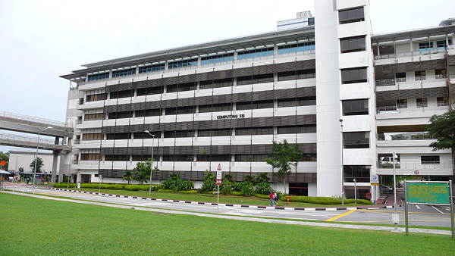
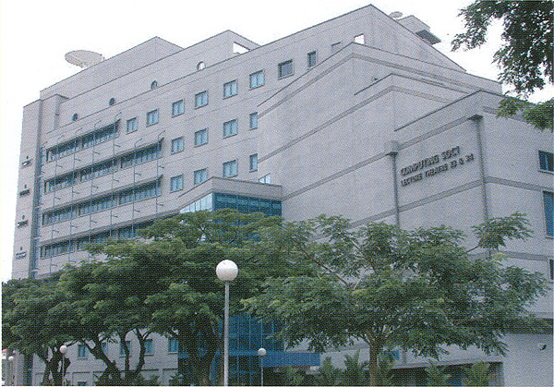
Real Life Address Example
Back in 2002, School of Computing is in another corner of NUS

Slide 6
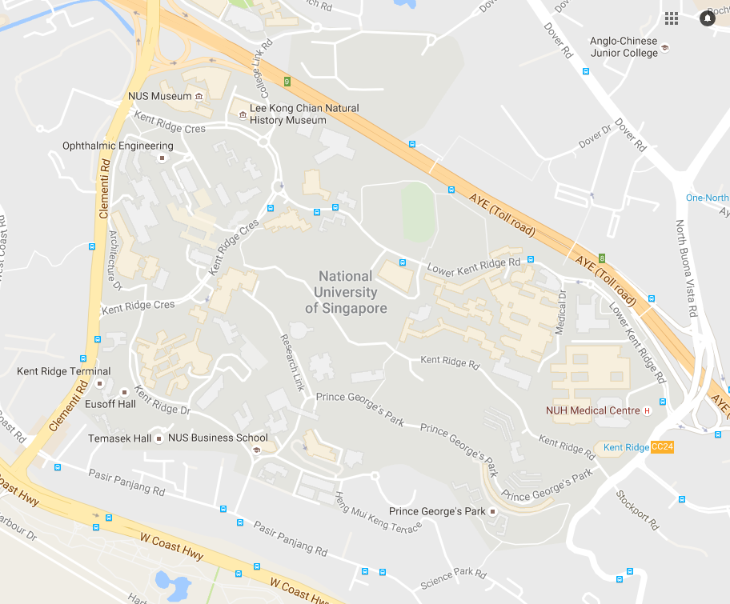

Slide 7
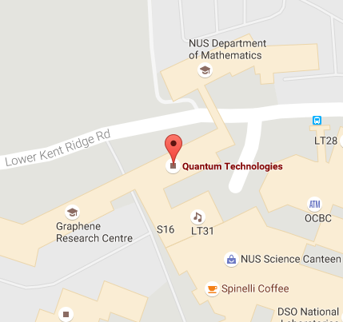
Real Life Address Example
The address of SOC at that time
3 Science Drive 2, 117543
6 Science Drive 2, 117546
But now, no more SOC but
Quantum Tech
Graphene Research Centre
NUS Dept of Math
Addresses
“Contents”

Slide 8
Real Life Address Example
Addresses
Contents
In the past
3 Science Drive 2, 117543
6 Science Drive 2, 117546
Now
3 Science Drive 2, 117543
6 Science Drive 2, 117546
In the past
SOC
SOC
Now
Quantum Tech
Graphene Research Centre

Slide 9
1. Variable and Its Address (1/2)
Data type
Name
A variable has a unique name (identifier) in the function it is declared in, it belongs to some data type, and it contains a value of that type
int a;
a = 123;
May only contain integer value
A variable occupies some space in the memory, and hence it has an address
The programmer usually does not need to know the address of the variable (she simply refers to the variable by its name), but the system keeps track of the variable’s address
a
123
Where is variable a located in the memory?

Slide 10
1. Variable and Its Address (2/2)
You may refer to the address of a variable by using the address operator: & (ampersand)
int a = 123;
printf("a = %d\n", a);
printf("&a = %p\n", &a);
a = 123
&a = ffbff7dc
%p is used as the format specifier for addresses
Addresses are printed out in hexadecimal (base 16) format
The address of a variable varies from run to run, as the system allocates any free memory to the variable
Test out Unit7_Address.c

Slide 11
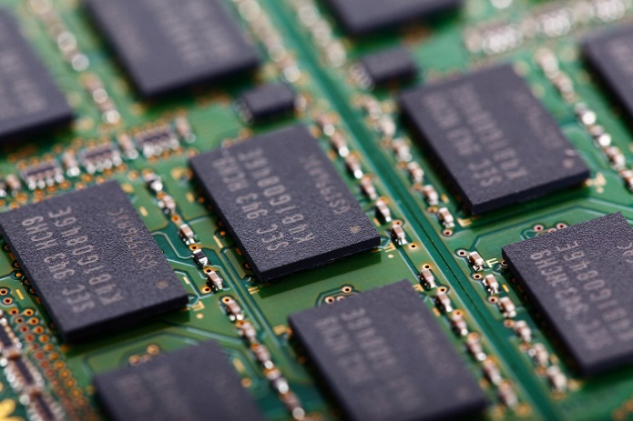
Computer Memory
Address | Content
ffbff7d8
ffbff7d9 | 3.1415
ffbff7da
ffbff7db
ffbff7dc | 123
ffbff7dd
ffbff7de
Some others maybe float, double, etc.
The address of the variable a
The content is an integer

Slide 12
How about?
Address | Content
ffbff7d8
ffbff7d9 | 3.1415
ffbff7da | ffbff7dc
ffbff7db
ffbff7dc | 123
ffbff7dd
ffbff7de
The address of the variable a_ptr
The content of the address is an address

Slide 13
2. Pointer Variable
A variable that contains the address of another variable is called a pointer variable, or simply, a pointer.
Example: a pointer variable a_ptr is shown as a blue box below. It contains the address of variable a.
a_ptr
a
Assuming that variable a is located at address ffbff7dc.
ffbff7dc
123
Variable a_ptr is said to be pointing to variable a.
If the address of a is immaterial, we simply draw an arrow from the blue box to the variable it points to.
a_ptr
a
123

Slide 14
3. Declaring a Pointer
Syntax:
type *pointer_name;
pointer_name is the name (identifier) of the pointer
type is the data type of the variable this pointer may point to
Example: The following statement declares a pointer variable a_ptr which may point to any int variable
Good practice to name a pointer with suffix _ptr or _p
int *a_ptr;

Slide 15
4. Assigning Value to a Pointer
Since a pointer contains an address, only addresses may be assigned to a pointer
Example: Assigning address of a to a_ptr
int a = 123;
int *a_ptr; // declaring an int pointer
a_ptr = &a;
a_ptr
a
123
We may initialise a pointer during its declaration:
int a = 123;
int *a_ptr = &a; // initialising a_ptr

Slide 16
5. Accessing Variable Through Pointer
a_ptr
a
123
Once we make a_ptr points to a (as shown above), we can now access a directly as usual, or indirectly through a_ptr by using the indirection operator (also called dereferencing operator): *
printf("a = %d\n", *a_ptr);
=
printf("a = %d\n", a);
*a_ptr = 456;
=
a = 456;
Hence, *a_ptr is synonymous with a

Slide 17
6. Example #1
i
12
j
12
int i = 10, j = 20;
int *p; // p is a pointer to some int variable
10
20
p
p = &i; // p now stores the address of variable i
printf("value of i is %d\n", *p);
Important!
Now *p is equivalent to i
value of i is 10
// *p accesses the value of pointed/referred variable
*p = *p + 2; // increment *p (which is i) by 2
// same effect as: i = i + 2;
p = &j; // p now stores the address of variable j
Important!
Now *p is equivalent to j
*p = i; // value of *p (which is j now) becomes 12
// same effect as: j = i;

Slide 18
6. Example #2 (1/2)
a
Unit7_Pointer.c
#include <stdio.h>
int main(void) {
double a, *b;
b = &a;
*b = 12.34;
printf("%f\n", a);
return 0;
}
b
Can you draw the picture?
What is the output?
12.340000
What is the output if the printf() statement is changed to the following?
printf("%f\n", *b);
12.340000
printf("%f\n", b);
Compile with warning
printf("%f\n", *a);
Error
What is the proper way to print a pointer? (Seldom need to do this.)
Value in hexadecimal; varies from run to run.
printf("%p\n", b);
ffbff6a0

Slide 19

6. Example #2 (2/2)
How do we interpret the declaration?
double a, *b;
The above is equivalent to
double a; // this is straight-forward: a is a double variable
double *b;
We can read the second declaration as
*b is a double variable, so this implies that ...
b is a pointer to some double variable
The following are equivalent:
double a;
double *b;
b = &a;
double a;
double *b = &a;
But this is not the same as above (and it is not legal):
double a;
double b = &a;

Slide 20
Exercise #1: Tracing Pointers (1/2)
Trace the code below manually to obtain the outputs.
Compare your outputs with your neighbours.
Unit7_TracePointers.c
int a = 8, b = 15, c = 23;
int *p1, *p2, *p3;
p1 = &b;
p2 = &c;
p3 = p2;
printf("1: %d %d %d\n", *p1, *p2, *p3);
*p1 *= a;
while (*p2 > 0) {
*p2 -= a;
(*p1)++;
}
printf("2: %d %d %d\n", *p1, *p2, *p3);
printf("3: %d %d %d\n", a, b, c);

Slide 21
Exercise #2: Choose the Correct Codes
Pick the correct codes to read a value into the float variable var.
(A)
(B)
float var;
scanf("%f", var)
float var;
scanf("%f", &var)
(C)
(D)
float var;
float *p;
p = &var;
scanf("%f", p)
float var;
float *p;
p = &var;
scanf("%f", &p)

Slide 22
Exercise #3: Incrementing a Pointer
If p is a pointer variable, what does it mean by p = p + 1 (or p++)?
Unit 4 Exercise #1:
int takes up 4 bytes
float takes up 4 bytes
char takes up 1 byte
double takes up 8 bytes
int a, *ap;
float b, *bp;
char c, *cp;
double d, *dp;
ap = &a; bp = &b; cp = &c; dp = &d;
printf("%p %p %p %p\n", ap, bp, cp, dp);
ap++; bp++; cp++; dp++;
printf("%p %p %p %p\n", ap, bp, cp, dp);
ap += 3;
printf("%p\n", ap);
Unit7_IncrementPointers.c

Slide 23

7. Common Mistake
Unit7_Common_Mistake.c
#include <stdio.h>
int main(void) {
int *n;
*n = 123;
printf("%d\n", *n);
return 0;
}
What’s wrong with this?
Can you draw the picture?
?
n
Where is the pointer n pointing to?
Where is the value 123 assigned to?
Result: Segmentation Fault (core dumped)
Remove the file “core” from your directory. It takes up a lot of space!

Slide 24
8. Why Do We Use Pointers?
It might appear that having a pointer to point to a variable is redundant since we can access the variable directly
The purpose of pointers is apparent later when we pass the address of a variable into a function, in the following scenarios:
To pass the address of the first element of an array to a function so that the function can access all elements in the array (Unit 8 Arrays, and Unit 9 Multidimensional Arrays)
To pass the addresses of two or more variables to a function so that the function can pass back to its caller new values for the variables (Unit 14 Functions with Pointer Parameters)

Slide 25
Summary
In this unit, you have learned about
Declaring a pointer variable
Using a pointer variable to point to a variable
Hence, assessing a variable through the pointer variable that points to it

Slide 26
End of File

