Slide 1


http://www.comp.nus.edu.sg/~cs1010/
Computational Thinking
Problem Formulation

Slide 2


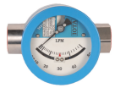
Quick recap…
The Hungry Bear
Bargain buy
Leaking flowmeter
Tourist | Places of Interest
Aaron | SZG, BG, JB
Betty | CG, JG, BG
Cathy | VC, SI, OR
David | JG, CG, OR
Evans | CG, JG, SZG
Frances | BG, SZG, JB
Gary | CG, OR
Harry | JG, CG
Tourist problem
Verifying your problem definition
Is a solution possible?
Is a solution desirable?
Is there a trivial undesirable solution?
Do the constraints conflict?
Anything missing?
Anything extraneous?

Slide 3
Lessons learned
Computational problem has inputs, outputs, constraints; identify them.
Use concrete problem instances to help you understand the problem.
Problem statements can be vague, make them clear.
Constraints may be implicit, make them explicit.
Without constraint, may get trivial undesirable solution.
With sufficient constraints, can get desirable solution.
When constraints conflict, no solution.
Verify whether problem definition is good enough; revise if needed.
Use Polya’s questions to guide your reasoning.

Slide 4
Tourist Problem
Given a list of tourists, each with a list of places to visit, schedule bus trips so that each tourist gets to visit all the places in his/her list.
Tourist | Places of Interest
Aaron | SZG, BG, JB
Betty | CG, JG, BG
Cathy | VC, SI, OR
David | JG, CG, OR
Evans | CG, JG, SZG
Frances | BG, SZG, JB
Gary | CG, OR
Harry | JG, CG
Real-life problems are much more complex!

Slide 5
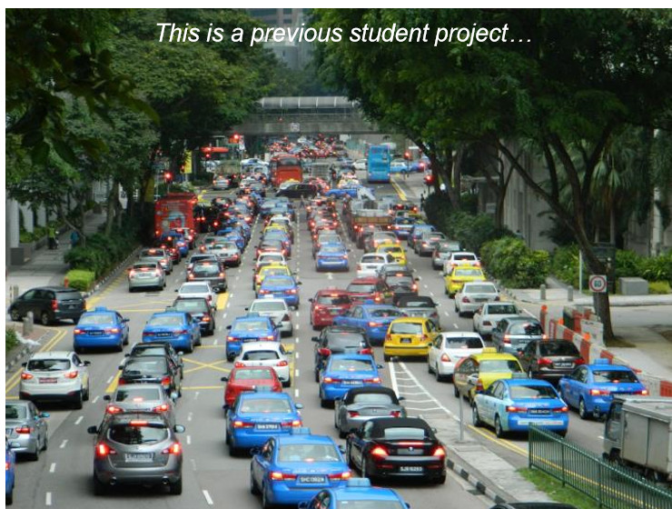
Traffic Congestion

Slide 6
Traffic Congestion
Initial problem statements:
Traffic congestion contributes to inefficiency in commuters.
Traffic conditions are not available at real time.
Drivers are unaware of less congested alternative routes.
These are real-world situations.
But these concepts are not computational: “traffic congestion”, “traffic conditions”, “less congested routes”.
To disambiguate, we call them real-world issues.

Slide 7
Identify Computational Factors
Need to turn non-computational concepts into computational factors
Idea #1 (I want to go home quickly)
Measure average speed of cars on road.
Faster speed means less congestion.
Slower speed means more congestion.
Difficulties
Different roads have different speed limits: (normal roads 50km/h, expressways 90km/h)
Average speed of 40km/h on normal roads is not slow.
Average speed of 60km/h on expressways is not fast.
No car at all: 0km/h, but completely no congestion.

Slide 8
Identify Computational Factors
Need to turn non-computational concepts into computational factors
Idea #2 (Crowdedness)
Measure average distance between cars on road.
Large distance means less congestion.
Small distance means more congestion.
Difficulties
Different roads have different speed limits: (normal roads 50km/h, expressways 90km/h)
For safe travel, average distance on expressways is larger than that on normal roads.

Slide 9
Identify Computational Factors
Need to turn non-computational concepts into computational factors
Possible Idea #1 (Relative Speed)
Measure average relative speed (average speed/speed limit)
Smaller than 1 means more congestion.
Close to 1 means less congestion.
Works for both normal roads and expressways.

Slide 10
Identify Computational Factors
Need to turn non-computational concepts into computational factors
Possible Idea #2 (Relative Distance)
Calculate minimum safe distance on road.
3-second rule (dry weather): takes 3 seconds to respond and brake.
Measure average relative distance (average distance/minimum safe distance)
Larger than 1 means less congestion.
Close to 1 means more congestion.
Works for both normal roads and expressways.

Slide 11
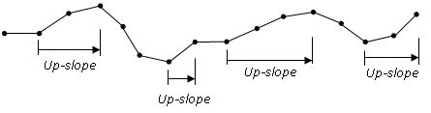
Up-slopes
You are an avid runner. Given a running route consisting of heights of points at regular interval on the route, you want to find the number of up-slopes in the route. An up-slope is a contiguous group of heights of increasing values.
Enter data:
3
3
4
:
2.9
3.65
-1
Number of up-slopes = 4

Slide 12
Up-slopes
3
3
4
4.3
3.3
2
1.8
2.7
2.7
3.2
3.9
4
3.4
2
2.9
3.65
-1
3
0
1
0.3
-1
-1.3
-0.2
0.9
0
0.5
0.7
0.1
-0.6
-1.4
0.5
0.75
-1
0
1
1
-1
-1
-1
1
0
1
1
1
-1
-1
1
1
-9
To find:
Number of up-slopes?
Longest up-slope?
Steepest up-slope?

Slide 13
End of File

