Slide 1


http://www.comp.nus.edu.sg/~cs1010/
UNIT 1
Computational Thinking

Slide 2
Unit 1: Computational Thinking
Computational Thinking
Polya’s Problem Solving Process
Understanding the Problem
Problem Formulation/Definition
Acknowledgement:
We would like to thank A/P Leong Hon Wai and A/P Leow Wee Kheng for allowing us to use part of the materials from their module GET1031 Computational Thinking for this unit.

Slide 3
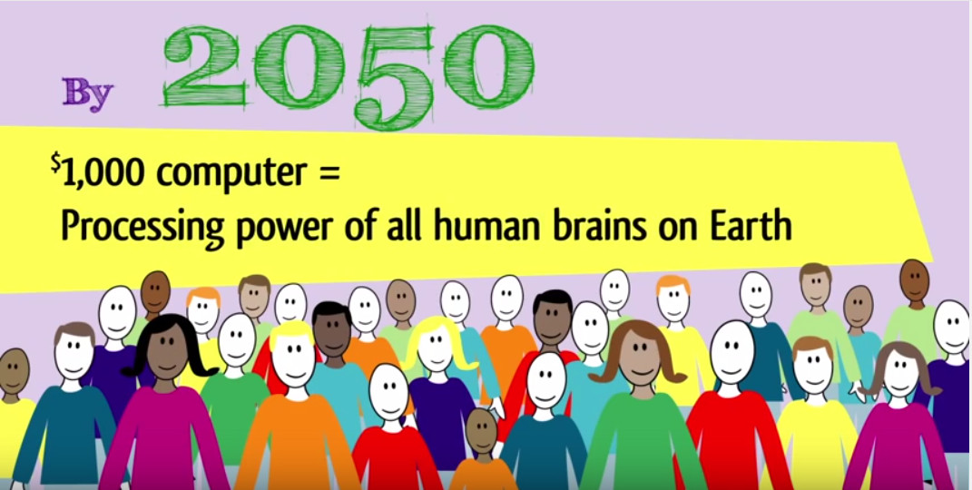
A digital age skill for everyone
A four-minute video from ISTE:
https://www.youtube.com/watch?v=VFcUgSYyRPg

Slide 4
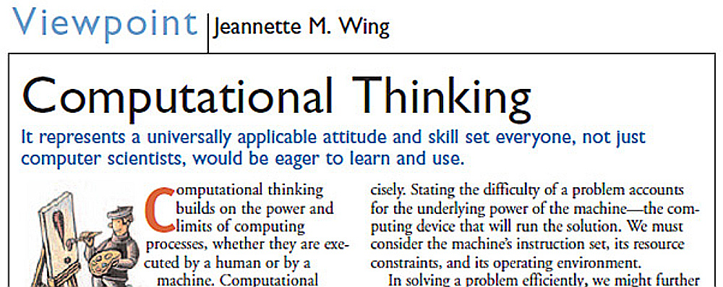

Communications of the ACM
March 2006/Vol. 49, No. 3

Slide 5

An exercise will be given out in class

Slide 6

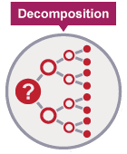
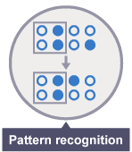
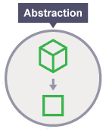
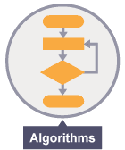
Computational Thinking
Breaking the problem into smaller, more manageable parts.
Recognising which parts are the same and the attributes that define them.
Filtering out info not needed and generalising info that is needed.
Creating solutions using a series of ordered steps.

Slide 7
CT: Decomposition
Breaking the problem into smaller, more manageable parts.
Why is this important?
To manage and overcome complexity.
Leads to pattern recognition and generalization.
Example:
Baking a cake
Video:
https://www.youtube.com/watch?v=yQVTijX437c

Slide 8
CT: Pattern Recognition
Recognising which parts are the same and the attributes that define them.
Why is this important?
Finding similarities and patterns in order to solve complex problems more efficiently.
Example:
Detecting and classifying whether an email is a spam
Video:
https://www.youtube.com/watch?v=SixLnIDV1yY

Slide 9
CT: Abstraction
Filtering out info not needed and generalising info that is needed.
Why is this important?
A means to distil what is essential.
To create models, rules, principles or theories to test predicted outcomes.
So that one solution works for multiple problems with similar nature.
Examples:
Google maps
Baking a cake
Video:
https://www.youtube.com/watch?v=RdzYOtxhuDc
Notes:
About abstraction and decomposition: often happen without us realising. We switch between the two ways of thinking.
With abstraction we bring a better understanding through reducing the complexity and focus on the essentials.
With decomposition we bring a better understanding through dividing the whole into its component parts (which in turn can be further divided).
A world map showing the countries is an abstraction. But if we want to locate a place in Singapore, a world map does not have enough detail to help us. We need a local map.

Slide 10
CT: Algorithms
Creating solutions using a series of ordered steps.
Why is this important?
Algorithms are plans/procedures that can be communicated at an abstract level and implemented on different platforms.
Can be analysed and studied.
Example:
A recipe to bake chocolate cake.
Video:
https://www.youtube.com/watch?v=N91oCQbWUvA

Slide 11
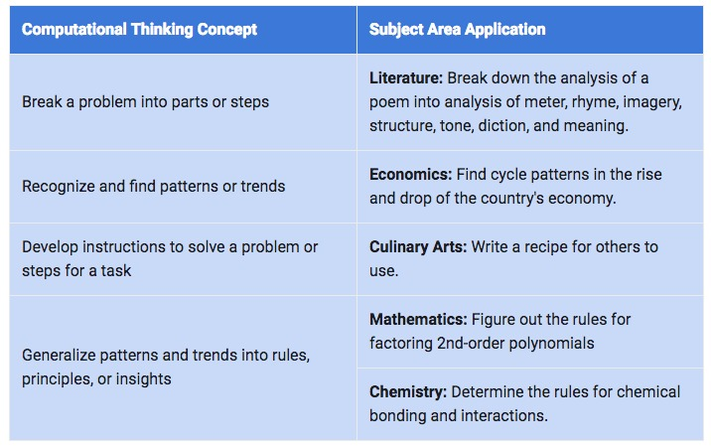
Computational Thinking (CT) is NOT restricted to Computer Science!
Notes:
Give a problem after this slide.
Example: Summing up from 1 to 200.

Slide 12

Today, you learned about Computational Thinking (CT).
But… today is NOT the only lesson on CT.
The concepts of CT will be reinforced throughout the semester.

Slide 13
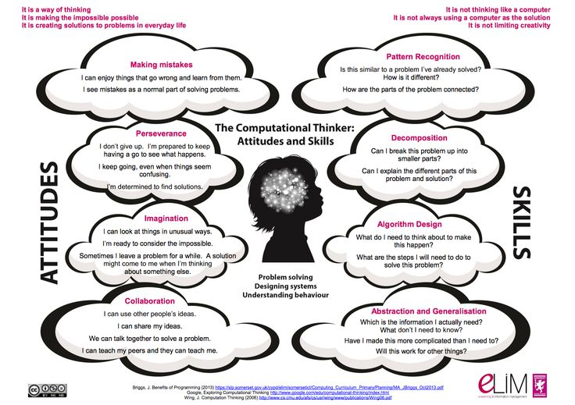
Computational Thinking
Notes:
Notes from Wee Kheng:
Real-world problems consist of computational and non-computational parts. It is necessary to identify the computational parts of a problem for computational problem solving.
Refer to Problem-Formulation-04.pptx for discussion on this issue.

Slide 14

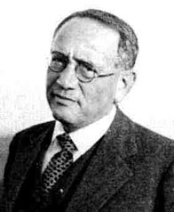


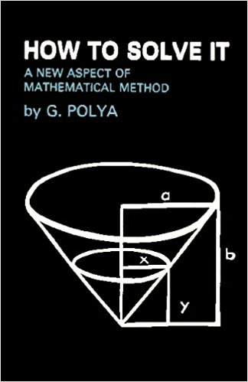
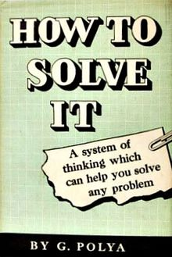
Problem Solving
The most widely cited reference for problem solving in all disciplines!
George Polya
(1887 – 1985)

Slide 15
A few Polya’s Quotes
“A great discovery solves a great problem, but there is a grain of discovery in the solution of any problem. Your problem may be modest, but if it challenges your curiosity and brings into play your inventive faculties, and if you solve it by your own means, you may experience the tension and enjoy the triumph of discovery.”
“Quite often, when an idea that could be helpful presents itself, we do not appreciate it, for it is so inconspicuous. The expert has, perhaps, no more ideas than the inexperienced, but appreciates more what he has and uses it better.”
“If you can't solve a problem, then there is an easier problem you can solve: find it.”

Slide 16
Steps to Problem Solving
1. Understand the Problem
Can you state the problem in your own words?
What are you trying to find or do?
What are the unknowns?
What info do you obtain from the problem?
What info, if any, is missing or not needed?
2. Make a Plan
Look for a pattern.
Remember related problems.
Break problem down into different parts.
Make a table, diagram or write equation.
Use guess and check.
Work backward.
Identify a subgoal.
4. Look Back
Check the results in the original problem.
Interpret the solution in terms of the original problem. Does your answer make sense? Is it reasonable?
Determine whether there is another method of finding the solution.
If possible, determine other related or more general problems for which the techniques will work.
3. Do the Plan
Implement the strategy in step 2.
Check each step of the plan as you do it.
Keep an accurate record of your work.
Organize your work into easy to understand visuals.
Double check your math work.

Slide 17


Develop habit of ASKING
1. Understand the Problem
Can you state the problem in your own words?
What are you trying to find or do?
What are the unknowns?
What info do you obtain from the problem?
What info, if any, is missing or not needed?
Do not just understand the solution;
Understand how and why of getting the solution.
Do I understand the problem?
Do I understand the solutions?
Why does the solution work?
Why did he do it like that?
How can I invent such a solution?
Can I do it differently?

Slide 18

How hard can “understanding the problem” be?
(1) The Hungry Bear Problem
Oh no!
Run!

Slide 19
How hard can “understanding the problem” be?
(1) The Hungry Bear Problem
But you can’t outrun a bear!
Let me put on my running shoes.

Slide 20
How hard can “understanding the problem” be?
(1) The Hungry Bear Problem
I only need to outrun you!
@*%$#!
Perceived problem: How to outrun the bear.
Right problem: How to outrun your companion!

Slide 21

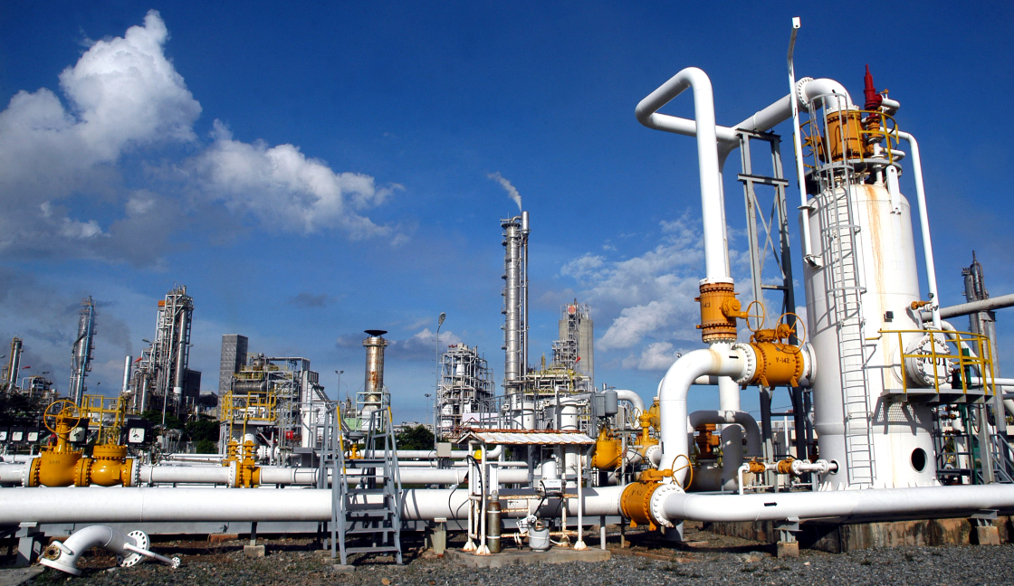
How hard can “understanding the problem” be?
(2) Leaking Flowmeter
Gasoline flow
Observation: Flowmeter leaks after 3 months.
Reason: Gasoline is corrosive.

Slide 22
How hard can “understanding the problem” be?
(2) Leaking Flowmeter
Gasoline flow
Perceived problem: How to prevent gasoline corrosion?
Solution: Build flowmeter with materials that would not be corroded by gasoline.
Reality: No such materials!

Slide 23
How hard can “understanding the problem” be?
(2) Leaking Flowmeter
Gasoline flow
Right problem: How to prevent flowmeter leakage?
Solution: Replace flowmeter regularly.

Slide 24

How hard can “understanding the problem” be?
(3) Bargain Buy
Observation: A particular brand is selling very well elsewhere but not in this store.
Perceived problem: Price not competitive.
$5.50
Solution: Reduce the price.
$5.00
Observation: Still not selling well.
$4.50
Solution: Reduce the price further.
Observation: Still not selling well!

Slide 25
How hard can “understanding the problem” be?
(3) Bargain Buy
Real problem: Item not prominently displayed!
Solution: Display item at prominent location.
$5.50
$5.00
$4.50

Slide 26
Problem Definition
Guidelines for good problem definition
Clear, concise, unambiguous.
Capture all relevant information
What are the inputs (data)?
What are the outputs (unknowns)?
What are the constraints?
Connection/relationship between inputs and outputs?

Slide 27
Problem Definition
Verifying your problem definition
Is a solution possible?
Is a solution desirable?
Is there a trivial undesirable solution?
Do the constraints conflict?
Anything missing?
Anything extraneous?

Slide 28
Example #1: Tourist Problem
Verbal statement:
Given a group of tourists, each with a list of places to visit, schedule bus trips so that each tourist gets to visit all the places in his/her list.
Tourist | Places of Interest
Aaron | SZG, BG, JB
Betty | CG, JG, BG
Cathy | VC, SI, OR
David | JG, CG, OR
Evans | CG, JG, SZG
Frances | BG, SZG, JB
Gary | CG, OR
Harry | JG, CG
An instance of the tourist problem

Slide 29
Example #1: Tourist Problem
Problem definition (first attempt):
Inputs: A list of tourists, each with a list of places to visit.
Outputs: Bus trips.
Tourist | Places of Interest
Aaron | SZG, BG, JB
Betty | CG, JG, BG
Cathy | VC, SI, OR
David | JG, CG, OR
Evans | CG, JG, SZG
Frances | BG, SZG, JB
Gary | CG, OR
Harry | JG, CG
Is this good enough?
An instance of the tourist problem

Slide 30

Example #1: Tourist Problem
Revised problem definition:
Inputs: A list of tourists, each with a list of places to visit.
Outputs: A list of bus trips, each with a list of places to visit, and the tourists visiting.
Constraints: Each tourist gets to visit all the places in his/her list.
Happy tourists

Slide 31

Example #1: Tourist Problem
Revised problem definition:
Inputs: A list of tourists, each with a list of places to visit.
Outputs: A list of bus trips, each with a list of places to visit, and the tourists visiting.
Constraints: Each tourist gets to visit all the places in his/her list.
Is a solution possible/desirable?
A no-brainer solution:
One bus for each tourist!
Unhappy boss

Slide 32

Example #1: Tourist Problem
Revised problem definition:
Inputs: A list of tourists, each with a list of places to visit.
Outputs: A list of bus trips, each with a list of places to visit, and the tourists visiting.
Constraints: Each tourist gets to visit all the places in his/her list.
Constraints:
Each tourist gets to visit all the places in his/her list.
Each tourist visits at most one place per day.
Fewest possible days.
At most one bus trip to each place.
Happy tourists
Happy boss

Slide 33
Example #1: Tourist Problem
Revised constraints:
Each tourist gets to visit all the places in his/her list.
Each tourist visits at most one place per day.
Fewest possible days.
At most one bus trip to each place.
Each bus takes at most 4 tourists.
Tourist | Places of Interest
Aaron | SZG, BG, JB
Betty | CG, JG, BG
Cathy | VC, SI, OR
David | JG, CG, OR
Evans | CG, JG, SZG
Frances | BG, SZG, JB
Gary | CG, OR
Harry | JG, CG
Do the constraints conflict?

Slide 34
Lessons Learned
Verbal statements can be vague.
Constraints may be implicit.
Without constraints, may get trivial but undesirable solution.
When constraints conflict, no solution.
Use Polya’s questions to guide your reasoning.

Slide 35
Example #2: Cube in Pyramid
Verbal statement:
What is the largest cubical space in a square-base pyramid?
(Or, what is the largest cubical box we can put inside a square-base pyramid?)

Slide 36

Example #2: Cube in Pyramid
Problem definition:
Inputs (data):
Square-base pyramid with base width b and height h.
Outputs (unknowns):
Cube of width w.
Constraints (conditions):
Base of cube rests on base of pyramid.
Top 4 corners of cube touch some surfaces of the pyramid.
Too hard!
What do you do when a problem looks too hard?

Slide 37
Example #2: Cube in Pyramid
Simplified problem definition in 2D:
Inputs (data):
Triangle with base width b and height h.
Outputs (unknowns):
Square of width w.
Constraints (conditions):
Base of square rests on base of triangle.
Top 2 corners of square touch some edges of the triangle.
Still too hard!

Slide 38
Example #2: Cube in Pyramid
More simplified problem definition in 2D:
Inputs (data):
Triangle with base width b and height h.
Outputs (unknowns):
Square of width w.
Constraints (conditions):
Base of square rests on base of triangle.
Top 1 corner of square touches an edge of the triangle.

Slide 39
Example #2: Cube in Pyramid
The more simplified problem is so simple it has many simple solutions!
Can you see the solution of the original problem now?

Slide 40
Example #2: Cube in Pyramid
Polya heuristic:
After solving simpler problem, generalize.
Generalized problem:
What is the largest rectangular block in a rectangular-base pyramid?

Slide 41
Lesson Learned
Generalized problem
Generalize
Simplify, if too hard
Simplified problem
Solve it

Slide 42


Slide 43
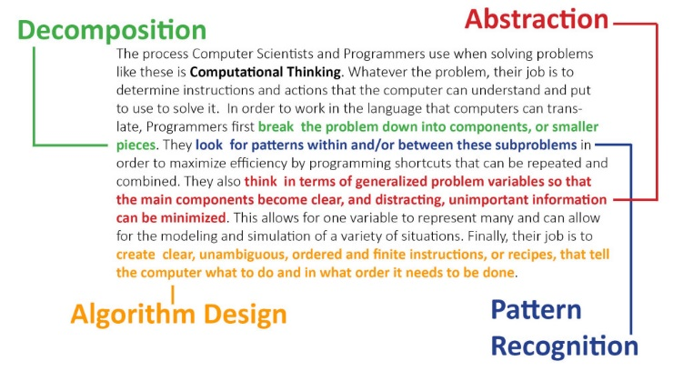
Computational Thinking

Slide 44
Computational Thinking
ATTITUDES
SKILLS
Making mistakes
Decomposition
Perseverance
Pattern Recognition
Imagination
Abstraction
Collaboration
Algorithm Design

Slide 45
Steps to Problem Solving
1. Understand the Problem
2. Make a Plan
3. Do the Plan
4. Look Back

Slide 46

Formulate problems for computer solutions.
Logically organize and analyse data.
Represent data through abstraction.
Develop algorithmic solution.
Identify most efficient solution.
Generalize problem solving process to other areas.
Communicate above processes.

Slide 47


End of File

