Slide 1


http://www.comp.nus.edu.sg/~cs1010/
UNIT 3
Algorithmic Problem Solving

Slide 2
Unit 3: Algorithmic Problem Solving
Computational Thinking: Coin Change
Euclid’s Algorithm
Algorithmic Problem Solving Process
Algorithm
Control Structures
Examples of Pseudocodes

Slide 3
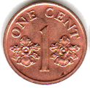
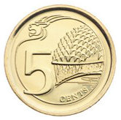


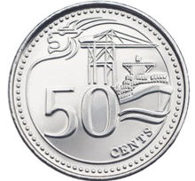
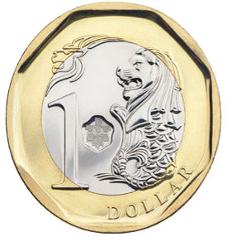

Coin Change
Problem statement
Given the above coin denominations: 1¢, 5¢, 10¢, 20¢, 50¢, and $1, assuming that you have unlimited supply of them, find the minimum number of coins needed for a given amount.
This is called optimisation problem in CS – finding the best among all possible solutions.
Examples:
375¢ → ? coins
543¢ → ? coins
Question you may ask:
Do I need to report how many coins of each denomination in my solution?
No, you don’t have to. (But in the process of computing the solution you will somehow get to know how many coins of each denomination you need.)
❖

Slide 4


Contract of a Task
The Task Giver
The Task Solver
The amount (in ¢)
The min. no. of coins
The Task Giver:
Provides the necessary inputs (arguments) to the Task Solver
Does not provides unnecessary data to the Task Solver
Does not care/need to know how the Task Solver solves the task
The Task Solver:
Accepts the necessary inputs (arguments) from the Task Giver
Returns the result to the Task Giver
Does not provides extraneous data to the Task Giver or perform extraneous work

Slide 5
Euclid’s Algorithm (1/3)
First historically documented algorithm by Greek mathematician Euclid in 300 B.C.
Also known as Euclidean Algorithm
q is not important; r is the one that matters.
1. Let A and B be integers with A > B ≥ 0.
2. If B = 0, then the GCD is A and algorithm ends.
3. Otherwise, find q and r such that
A = q.B + r where 0 ≤ r < B
4. Replace A by B, and B by r. Go to step 2.
r could be obtained by A modulo B (i.e. remainder of A / B)
Assumption on A > B unnecessary
We will rewrite the algorithm

Slide 6
Euclid’s Algorithm (2/3)
1. Let A and B be integers with A > B ≥ 0.
2. If B = 0, then the GCD is A and algorithm ends.
3. Otherwise, find q and r such that
A = q.B + r where 0 ≤ r < B
4. Replace A by B, and B by r. Go to step 2.
Rewritten in modern form
// Pre-cond: A and B are non-negative
// integers, but not both zeroes.
Algorithm GCD( A, B ) {
while (B > 0) {
r ← A modulo B
A ← B
B ← r
}
return A
}
What the Task Giver must provide to this Task Solver
Details of Task Solver unknown to Task Giver
Pre-condition: What must be true for this Task Solver to work.
What this Task Solver returns to the Task Giver.

Slide 7
Euclid’s Algorithm (3/3)
You might have guess what this algorithm does from its name but let’s trace it with some examples.
Very important skill!
// Pre-cond: A and B are non-negative
// integers, but not both zeroes.
Algorithm GCD(A, B) {
while (B > 0) {
r ← A modulo B
A ← B
B ← r
}
return A
}
Let’s trace GCD(12, 42)
(B > 0)?
r
A
B
12
42
true
12
42
12
true
6
12
6
So do you know what does the Euclid’s Algorithm do now?
true
0
6
0
false
Result returned: ?
❖

Slide 8
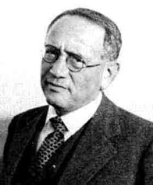
Polya’s Problem Solving Process
We (roughly)map Polya’s steps to algorithmic problem solving.
1. Understand the Problem
Analysis
Iterative process
2. Make a Plan
Design
3. Do the Plan
Implementation
4. Look back
Testing

Slide 9
Algorithmic Problem Solving
Determine problem features
Analysis
Iterative process
Write algorithm
Design
What is an algorithm?
Write code
Implementation
Check for correctness and efficiency
Testing

Slide 10
Algorithm (1/3)
An algorithm is a well-defined computational procedure consisting of a set of instructions, that takes some value or set of values as input, and produces some value or set of values as output.
Input
Algorithm
Output
‘Algorithm’ stems from ‘Algoritmi’, the Latin form of al-Khwārizmī, a Persian mathematician, astronomer and geographer.
Source: http://en.wikipedia.org/wiki/Algorithm

Slide 11
Algorithm (2/3)
An algorithm has these properties:
Exact
Terminate
Effective
General
The algorithm must terminate.
(Or no solution will be obtained.)
Each step must be exact. (Or it will not be precise.)
The algorithm must be effective.
(i.e. it must solve the problem.)
The algorithm must be general.
(Within the constraints of the system/language.)

Slide 12
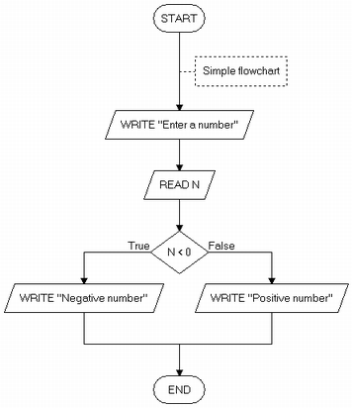
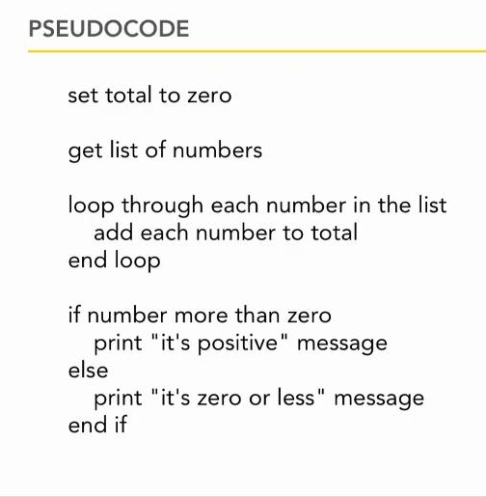
Algorithm (3/3)
Ways of representing an algorithm:
Flowchart
Pseudocode
lynda.com

Slide 13
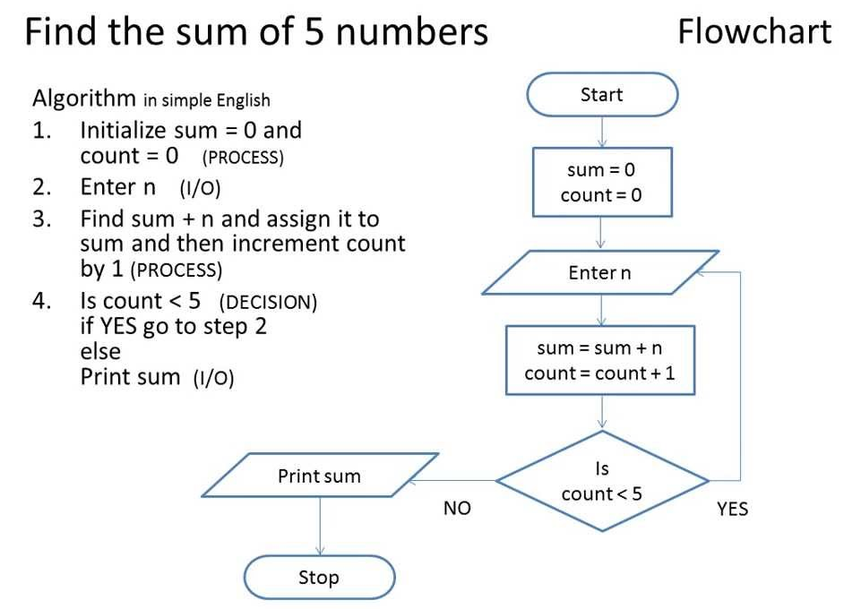
Algorithm: Example #1

Slide 14
Algorithm: Example #2 (1/2)
Find maximum and average of a list of numbers:
Terminator box
Flowchart
start
Process box
sum ← count ← 0
max ← 0
Decision box
Yes
end of input?
No
Enter num
increment count
sum ← sum + num
ave ← sum/count
print max, ave
num > max?
Yes
max ← num
No
end

Slide 15
Algorithm: Example #2 (2/2)
Find maximum and average of a list of numbers:
Pseudocode
The need to initialise variables.
sum ← count ← 0 // sum = sum of numbers
// count = how many numbers are entered?
max ← 0 // max to hold the largest value eventually
for each num entered,
count ← count + 1
sum ← sum + num
if num > max
then max ← num
ave ← sum / count
print max, ave
The need to indent.
Are there any errors in this algorithm?

Slide 16
Algorithm: Pseudocode
We will write algorithms in pseudocode instead of flowchart as the former is more succinct
However, unlike programming languages, there are no standard rules on how pseudocodes should look like
General guidelines:
Every step must be unambiguous, so that anybody is able to hand trace the pseudocode and follow the logic flow
Use a combination of English (but keep it succinct) and commonly understood notations (such as ← for assignment in our previous example)
Use indentation to show the control structures

Slide 17
Control Structures (1/2)
An algorithm is a set of instructions, which are followed sequentially by default.
However, sometimes we need to change the default sequential flow.
We study 3 control structures.

Slide 18
Control Structures (2/2)
Sequence
Default
Selection
Also called branching
Repetition
Also called loop
True
False
?
False
?
True

Slide 19

Control Structures: Sequence (1/2)
Task: Compute the average of three integers
A possible algorithm:
enter values for num1, num2, num3
ave ← ( num1 + num2 + num3 ) / 3
print ave
Variables used:
num1
num2
num3
ave
Another possible algorithm:
enter values for num1, num2, num3
total ← ( num1 + num2 + num3 )
ave ← total / 3
print ave
Variables used:
num1
num2
num3
total
ave
Each box represents a variable.
Important concepts: Each variable has a unique name and contains a value.

Slide 20
Control Structures: Sequence (2/2)
Task: Compute the average of three integers
How the program might look like
Unit3_prog1.c
// This program computes the average of 3 integers
#include <stdio.h>
int main(void) {
int num1, num2, num3;
float ave;
printf("Enter 3 integers: ");
scanf("%d %d %d", &num1, &num2, &num3);
ave = (num1 + num2 + num3) / 3.0;
printf("Average = %.2f\n", ave);
return 0;
}
Don’t worry about the C syntax; we will discuss it next week. For now, just to show you how the algorithm is translated into the code. The logic remains the same, but you need to write the code according to the rules of the programming language.

Slide 21
Control Structures: Selection (1/3)
True
False
?
Task: Arrange two integers in ascending order (sort)
Algorithm A:
enter values for num1, num2
// Assign smaller number into final1,
// and larger number into final2
if (num1 < num2)
then final1 ← num1
final2 ← num2
else final1 ← num2
final2 ← num1
// Transfer values in final1, final2 back to num1, num2
num1 ← final1
num2 ← final2
// Display sorted integers
print num1, num2
Variables used:
num1
num2
final1
final2

Slide 22
Control Structures: Selection (2/3)
True
False
?
Task: Arrange two integers in ascending order (sort)
Algorithm B:
enter values for num1, num2
// Swap the values in the variables if necessary
if (num2 < num1)
then temp ← num1
num1 ← num2
num2 ← temp
// Display sorted integers
print num1, num2
Variables used:
num1
num2
temp
Compare Algorithm A with Algorithm B.

Slide 23
Control Structures: Selection (3/3)
True
False
?
How the program might look like for Algorithm B
Unit3_prog2.c
// This program arranges 2 integers in ascending order
#include <stdio.h>
int main(void) {
int num1, num2, temp;
printf("Enter 2 integers: ");
scanf("%d %d", &num1, &num2);
if (num2 < num1) {
temp = num1; num1 = num2; num2 = temp;
}
printf("Sorted: num1 = %d, num2 = %d\n", num1, num2);
return 0;
}

Slide 24
Control Structures: Repetition (1/3)
False
?
True
Task: Find sum of positive integers up to n (assume n>0)
Algorithm:
enter value for n
// Initialise a counter count to 1, and ans to 0
count ← 1
ans ← 0
while (count ≤ n) do
ans ← ans + count // add count to ans
count ← count + 1 // increase count by 1
// Display answer
print ans
Variables used:
n
count
ans
Initialisation is very important!

Slide 25
Control Structures: Repetition (2/3)
False
?
True
Important to trace pseudocode to check its correctness
Algorithm:
enter value for n
count ← 1
ans ← 0
while (count ≤ n) do
ans ← ans + count
count ← count + 1
// Display answer
print ans
Assume user enters 3 for n.
(count <= n)?
count
ans
1
0
true
2
1
true
3
3
true
4
6
false
Output: 6

Slide 26
Control Structures: Repetition (3/3)
False
?
True
How the program might look like
Unit3_prog3.c
// Computes sum of positive integers up to n
#include <stdio.h>
int main(void) {
int n; // upper limit
int count = 1, ans = 0; // initialisation
printf("Enter n: ");
scanf("%d", &n);
while (count <= n) {
ans += count;
count++;
}
printf("Sum = %d\n", ans);
return 0;
}

Slide 27
Coin Change
Problem statement
Given the above coin denominations: 1¢, 5¢, 10¢, 20¢, 50¢, and $1, assuming that you have unlimited supply of them, find the minimum number of coins needed for a given amount.
Can you write out the pseudocode of your algorithm?
What must the Task Giver send to the Task Solver?
What must the Task Solver return to the Task Giver?
Algorithm CoinChange(amt) {
. . .
return coins
}

Slide 28


Knowing the algorithmic problem solving process
Knowing the properties of an algorithm
Knowing the three control structures
Knowing how to write algorithms in pseudocode
Knowing how to trace algorithms to verify their correctness

Slide 29
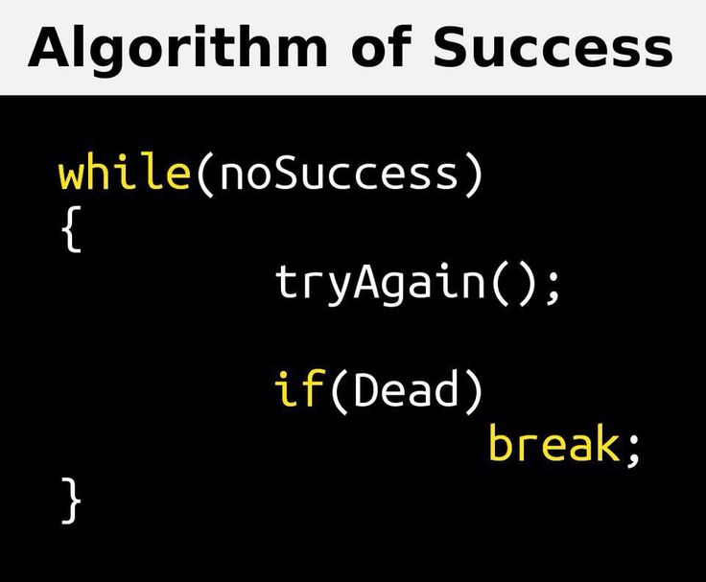
End of File

