Slide 1


http://www.comp.nus.edu.sg/~cs1010/
UNIT 21
C to JAVA

Slide 2
CS1010 Final Examination (1/2)
CS1010 Exam
29 November 2017, Wednesday, 5 – 7 pm
Venue: To be announced by Registrar’s Office
Format
MCQs section: 6 questions (18 marks)
Short questions/Problem Solving section: 6 questions ranging from 5 to 26 marks (62 marks)
Total: 80 marks
Grading of CS1010 is not based on bell curve

Slide 3
CS1010 Final Examination (2/2)
Instructions
Open book
No calculators, electronic dictionaries and devices
May use 2B pencil to write programs
Advice
Read instructions carefully and follow them!
Manage your time well!
A question may consist of several parts; the parts may be independent. If you are stuck on one part, move on to the next.

Slide 4

How to Prepare for Exams?
Try past-years’ exam papers
Answers not provided
Please discuss on IVLE forum
Preparing for Exams: A Guide for NUS Students
http://www.cdtl.nus.edu.sg/Ufm/learn/36.htm

Slide 5
Post-CS1010
For InfoSec/CEG: CS1010 → CS2040C
For CS: CS1010 → CS2030 and CS2040
CS2030 Programming Methodology II
Emphasis on object oriented and functional programming (software engineering)
Using Java, an object-oriented programming language
Website: http://www.comp.nus.edu.sg/~cs2030

Slide 6

Things-To-Do
Keep an eye on the IVLE announcements on your CA marks
Participate in IVLE forums
Try out past years’ exam papers
No solutions provided
Post on forums for clarification/discussion

Slide 8
C to Java
Objectives:
Learning about the structure of a Java program
Using selection and repetition statements in Java
Using classes such as Scanner, Math, String, DecimalFormat
Learning how to use an array in Java
With the above, able to convert some C programs written in CS1010 module to Java

Slide 9
C to Java (1/2)
Introduction
Hello World!
Java Constructs
3.1 Program Structure
3.2 Temperature Conversion
3.3 Importing Packages
3.4 Input: Using Scanner Class
3.5 Output: Using System.out Class (with DecimalFormat class)
3.6 Using Math Class
3.7 User-defined Constants
3.8 Java Naming Convention
3.9 Writing Java Methods

Slide 10
C to Java (2/2)
Java Constructs (continued…)
3.10 Boolean Data Type
3.11 Selection Statements
3.12 Repetition Statements
3.13 Arrays
API
Conclusion

Slide 11
1. Introduction (1/3)
Java is the programming language used in CS2030.
As an Object-Oriented Programming (OOP) language, Java supports OOP concepts such as encapsulation, inheritance and polymorphism. It also has exceptions handling (error handling) for better program robustness.
In this unit, we will NOT discuss such OOP features. We will focus on non-OOP features in Java and compare the syntax of Java with that of C.
However, even if we limit ourselves to non-OOP features here, certain OOP keywords such as ‘public’ and ‘static’ still creep up in our example Java programs. They require understanding of OOP concepts, which will be explained in CS2030. Here, we use them as a necessity.

Slide 12
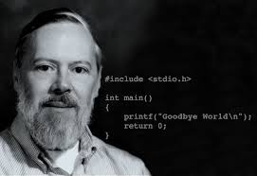
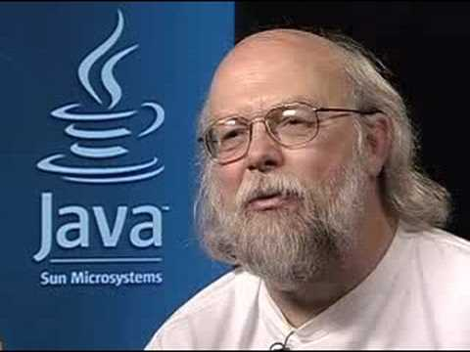
1. Introduction (2/3)
 | C | Java
When? | Created in 1972 | Created in 1995
Who? | Dennis Ritchie | James Gosling
Where? | Bell Laboratories | Sun Microsystems (now merged with Oracle)

Slide 13
1. Introduction (3/3)
 | C | Java
Type | Imperative | Imperative and object-oriented
Compilation | gcc helloworld.c → a.out (executable code) | javac HelloWorld.java → HelloWorld.class (bytecode)
Execution | a.out | java HelloWorld
Portability of compiled code | No, need to recompile for each architecture. | Yes, bytecode is “Write-Once, Run-Anywhere”.

Slide 14
2. Hello World! (1/2)
C programs: extension .c
Java programs: extension .java
hello_world.c
#include <stdio.h>
int main(void) {
printf("Hello World!\n");
return 0;
}
C: Include header file <stdio.h> to use printf().
Java: Import java.lang.* package to use System.out.print()/println().
C: Must have main() function.
Java: Must have main() method.
HelloWorld.java
import java.lang.*;
public class HelloWorld {
public static void main(String[] args) {
System.out.println("Hello World!");
}
}

Slide 15
2. Hello World! (2/2)
C
happytan$ gcc hello_world.c
happytan$ a.out
Hello World!
Executable code
Compiler
produces
gcc hello_world.c
a.out
Java
happytan$ javac HelloWorld.java
happytan$ java HelloWorld
Hello World!
Bytecode
Compiler
produces
HelloWorld.class
javac HelloWorld.java

Slide 16
3. Java
Every Java program is a class.
In OOP, a class is a template for creating objects (Analogy in C: structure definition in C is a template for creating structure variables)
Such a class defines its object attributes and methods. We call it a service class. It does not contain a main() method. (Note: What we call functions in C, we call them methods in Java.)
However, in this unit we are not writing service classes. We are writing classes that do not contain definition of any object attributes and methods. Instead, our classes are application (or client) classes that use other service classes. Such a class must contain the main() method.

Slide 17
3.1 Java: Program Structure
For the moment just stick to the following program structure:
import java.lang.*;
public class ClassName {
public static void main(String[] args) {
// Body of main() method
}
}
java.lang is a package that contains the definition of methods such as System.out.print() and System.out.println().
As java.lang is a default package, importing it is optional.
The filename must be the same as the class name. Hence, the above program must be named ClassName.java
(Assuming the file contains one class, and the class is public.)

Slide 18
3.2 Java: Temperature Conversion
temperature_convert.c
#include <stdio.h>
int main(void) {
float fah, cel; // degrees Fahrenheit and Celsius
printf("Enter temperature in Fahrenheit: ");
scanf("%f", &fah);
cel = (fah - 32) * 5/9;
printf("Temperature in Celsius = %f\n", cel);
return 0;
}
Enter ...: 123.5
... Celsius = 50.833332
import java.util.*;
public class TemperatureConvert {
public static void main(String[] args) {
Scanner sc = new Scanner(System.in);
float fah, cel; // degrees Fahrenheit and Celsius
System.out.print("Enter temperature in Fahrenheit: ");
fah = sc.nextFloat();
cel = (fah - 32) * 5/9;
System.out.println("Temperature in Celsius = " + cel);
}
}
TemperatureConvert.java

Slide 19
3.3 Importing Packages
Java comes with many built-in service classes with their methods, available for programmers to use.
To use the methods from a service class, you need to import the respective package that contains that class.
Examples:
To use System.out class → import java.lang.*; (default)
To use Scanner class → import java.util.*;
‘*’ is wildcard character, indicating all classes in that package; you may specifically import just that particular class of the package → import java.util.Scanner;
import java.util.*; // or import java.util.Scanner;
public class TemperatureConvert {
public static void main(String[] args) {
Scanner sc = new Scanner(System.in);
...

Slide 20
3.4 Input: Using Scanner Class (1/2)
Scanner class (belongs to package java.util) provides methods to read inputs
For interactive input, first, create a Scanner object to read data from System.in (keyboard)
Scanner sc = new Scanner(System.in);
Then, use the appropriate Scanner methods to read the input data. Some examples:
nextInt(): To return integer read
nextFloat(): To return float value read
nextDouble(): To return double value read
next(): To return a string (delimited by whitespace) read
nextLine(): To return a string (delimited by newline) read

Slide 21
3.4 Input: Using Scanner Class (2/2)
InputExamples.java
int, double are primitive data types (just like in C)
Scanner sc = new Scanner(System.in);
int a = sc.nextInt();
double b = sc.nextDouble();
String str1 = sc.next();
String str2 = sc.nextLine();
String is a class in Java, in java.lang package.
User’s inputs:
Values read:
123
4.56
This is a test.
a ← 123
b ← 4.56
str1 ←"This"
str2 ← " is a test."

Slide 22
3.5 Output: Using System.out Class (1/4)
System.out class (belongs to package java.lang) provides methods to print outputs
3 methods:
System.out.print()
System.out.println()
System.out.printf()
System.out.printf() is a relatively new method aiming to emulate the printf() function in C.

Slide 23
3.5 Output: Using System.out Class (2/4)
OutputExamples1.java
int a = 123, b = 456;
double x = 78.9;
String str = "Hello world!";
System.out.print("a = " + a);
System.out.println("; b = " + b);
System.out.print("x = " + x + " and ");
System.out.println("str = " + str);
System.out.printf("a = %d; b = %d\n", a, b);
System.out.printf("x = %f and ", x);
System.out.printf("str = %s\n", str);
Output:
a = 123; b = 456
x = 78.9 and str = Hello world!
a = 123; b = 456
x = 78.900000 and str = Hello world!
Note the difference in the display of x’s value.

Slide 24
3.5 Output: Using System.out Class (3/4)
What if you want to print a real number with a specific number of decimal places?
Example: 2.37609 to display as 2.38?
One way: using System.out.printf()
double y = 2.37609;
System.out.printf("y = %.2f\n", y);
How about System.out.print() or System.out.println()?
Use the DecimalFormat class (in java.text package)

Slide 25
3.5 Output: Using System.out with DecimalFormat (4/4)
OutputExamples2.java
DecimalFormat df1 = new DecimalFormat("000.00");
DecimalFormat df2 = new DecimalFormat("###.##");
DecimalFormat df3 = new DecimalFormat("0.0%");
DecimalFormat df4 = new DecimalFormat("0,000");
DecimalFormat df5 = new DecimalFormat("#,###");
double y = 2.37609, z = 36.9;
int a = 1234567, b = 89;
System.out.println("y = " + df1.format(y) + "; z = " + df1.format(z));
System.out.println("y = " + df2.format(y) + "; z = " + df2.format(z));
System.out.println("y = " + df3.format(y) + "; z = " + df3.format(z));
System.out.println("a = " + df4.format(a) + "; b = " + df4.format(b));
System.out.println("a = " + df5.format(a) + "; b = " + df5.format(b));
Many other format patterns available.
Output:
y = 002.38; z = 036.90
y = 2.38; z = 36.9
y = 237.6%; z = 3690.0%
a = 1,234,567; b = 0,089
a = 1,234,567; b = 89

Slide 26
3.6 Using Math Class (1/3)
You have written C programs that use math functions in <math.h>
Java provides the service class Math (in java.lang package)
The Math class provides many math methods, and also some constants such as PI.
Unlike in C where you need to compile a program that uses Math functions with the –lm option, no special option is required when you compile a Java program that uses Math methods.

Slide 27
3.6 Using Math Class (2/3)
area_of_circle.c
#include <stdio.h>
#include <math.h>
#define PI 3.14159
int main(void) {
double radius, area;
printf("Enter radius: ");
scanf("%lf", &radius);
area = PI * pow(radius, 2);
printf("Area = %.3f\n", area);
return 0;
}
Enter radius: 20.5
Area = 1320.253

Slide 28
3.6 Using Math Class (3/3)
AreaOfCircle.java
import java.util.*;
import java.text.*;
public class AreaOfCircle {
public static void main(String[] args) {
DecimalFormat df = new DecimalFormat("#.###");
Scanner sc = new Scanner(System.in);
double radius, area;
System.out.print("Enter radius: ");
radius = sc.nextDouble();
area = Math.PI * Math.pow(radius, 2);
System.out.println("Area = " + df.format(area));
}
}
Enter radius: 20.5
Area = 1320.254
Area is slightly different from that in area_of_circle.c due to different values of PI.
Constant PI defined in Math class.
Method pow() in Math class.

Slide 29
3.7 User-defined Constants (1/3)
currency.c
#include <stdio.h>
#define SGD_TO_MYR 3.0269
int main(void) {
double sing_dollar, ringgit;
printf("Enter currency: S$");
scanf("%lf", &sing_dollar);
ringgit = SGD_TO_MYR * sing_dollar;
printf("That's %.2f ringgit.\n", ringgit);
return 0;
}

Slide 30
3.7 User-defined Constants (2/3)
Currency.java
import java.util.*;
import java.text.*;
public class Currency {
private static final double SGD_TO_MYR = 3.0269;
public static void main(String[] args) {
DecimalFormat df = new DecimalFormat("0.00");
Scanner sc = new Scanner(System.in);
double singDollar, ringgit;
System.out.print("Enter currency: S$");
singDollar = sc.nextDouble();
ringgit = SGD_TO_MYR * singDollar;
System.out.println("That's " + df.format(ringgit)
+ " ringgit.");
}
}

Slide 31
3.7 User-defined Constants (3/3)
private static final double SGD_TO_MYR = 3.0269;
The keyword final indicates that the value assigned is final, that is, it cannot be altered.
The keyword private indicates that constant SGD_TO_MYR can only be used in this program.
If you want to allow SGD_TO_MYR to be used by other programs, declare it as public instead. (Just like the PI constant in the Math class which is a public constant)
Other programs can then use this constant by referring to it as Currency.SGD_TO_MYR, just like Math.PI
The keyword static is not within the scope of this unit.

Slide 32
3.8 Java Naming Convention (1/2)
Java has a rather comprehensive naming convention on naming of classes, objects, methods, constants, etc.
http://geosoft.no/development/javastyle.html
Some definitions: upper camel case, lower camel case
Upper camel case:
First letter of each word is capitalised, the rest are in lower case
Examples: ThisIsAnExample, AreaOfCircle, TemperatureConvert
Lower camel case:
Same as upper camel case, except that the first letter of the first word is in lower case
Examples: thisIsAnExample, singDollar, maxValue

Slide 33
3.8 Java Naming Convention (2/2)
Names of classes should be in upper camel case
Examples: AreaOfCircle, TemperatureConvert, Currency
Names of variables, methods, parameters and objects should be in lower camel case:
Examples: singDollar, studentName, printArray() , bankAcct
Names of constants should be in all upper case, with underscore (_) separating words:
Examples: PI, SGD_TO_MYR

Slide 34
3.9 Writing Java Methods (1/6)
What we call functions in C are called methods in Java.
There are two kinds of methods in Java: instance methods and class methods.
Instance methods: An instance method requires an object to apply (pass message) to.
Class methods: A class method does not require an object to apply (pass message) to.
As we are not doing OOP here, we will write only class methods here.
Class methods are distinguished from instance methods by the presence of the keyword static.

Slide 35
3.9 Writing Java Methods (2/6)
If a is the length of the square, what is the area of the circle?
Let radius of circle be r
Pythagoras’ theorem
r² = (a/2)² + (a/2)²
= a²/2
Hence, area of circle, C, is
C = π × a²/2
a
a/2
r
a/2

Slide 36
3.9 Writing Java Methods (3/6)
square_and_circle.c
#include <stdio.h>
#define PI 3.14159
double compute_area(double);
int main(void) {
double length; // length of the square
double area; // area of the circle
printf("Enter length of square: ");
scanf("%lf", &length);
area = compute_area(length);
printf("Area of circle = %.3f\n", area);
return 0;
}
double compute_area(double length) {
return PI * (length * length)/2;
}

Slide 37
3.9 Writing Java Methods (4/6)
SquareAndCircle.java
import java.util.*;
import java.text.*;
public class SquareAndCircle {
public static void main(String[] args) {
DecimalFormat df = new DecimalFormat("#.###");
Scanner sc = new Scanner(System.in);
double length; // length of the square
double area; // area of the circle
System.out.print("Enter length of square");
length = sc.nextDouble();
area = computeArea(length);
System.out.println("Area of circle "
+ df.format(area));
}
// continue on next page

Slide 38
3.9 Writing Java Methods (5/6)
SquareAndCircle.java
public class SquareAndCircle {
public static void main(String[] args) {
. . .
area = computeArea(length);
. . .
}
public static double computeArea(double length) {
return Math.PI * (length * length)/2;
}
}
Almost like function in C; function prototype not needed
Add keywords public (change to private if you don’t want to share this method) and static (not in scope here)

Slide 39
3.9 Writing Java Methods (6/6)
In C, for a function to pass back more than one value to the caller, we use pointer parameters.
There are no pointers in Java.
In Java, we create an object to hold the values, and pass the reference of the object to the method.
This is outside the scope of this unit.

Slide 40
3.10 Boolean Data Type (1/2)
Java provides the boolean data type, which is absent in ANSI C
BooleanType.java
public class BooleanType {
public static void main(String[] args) {
Scanner sc = new Scanner(System.in);
System.out.print("Enter a: ");
int a = sc.nextInt();
boolean b = (a > 0);
System.out.println("(a > 0) is " + b);
}
}
Enter a: 20
(a > 0) is true
Enter a: -3
(a > 0) is false

Slide 41


3.10 Boolean Data Type (2/2)
In ANSI C, zero represents false and any other value represents true.
C
if (a%2 == 0)
printf("a is even\n");
else
printf("a is odd\n");
if (a%2)
printf("a is odd\n");
else
printf("a is even\n");
This is not the case for Java.
Java
if (a%2 == 0) System.out.println("a is even");
else System.out.println("a is odd");
if (a%2) System.out.println("a is odd");
else System.out.println("a is even");
Compilation error!

Slide 42
3.11 Selection Statements (1/2)
Selection statements in Java – ‘if-else’ and ‘switch’ – are the same as those in C
if ((age < 1) || (age > 120))
System.out.println("Invalid age.");
else if (age >= 18)
System.out.println("Eligible for driving licence.");
System.out.println("Enter marks (0-100): ");
int marks = sc.nextInt();
char grade;
switch (marks/10) {
case 8: case 9: case 10: grade = 'A'; break;
case 7: grade = 'B'; break;
case 6: grade = 'C'; break;
case 5: grade = 'D'; break;
default: grade = 'F'; }
Grade.java

Slide 43
3.11 Selection Statements (2/2)
Short-circuit evaluation applies in Java as in C
if ((count != 0) && (sum/count > 0.5)) {
...
}
If count is zero, the second boolean expression (sum/count > 0.5) will not be evaluated.

Slide 44
3.12 Repetition Statements
Repetition statements in Java – ‘while’, ‘do-while’ and ‘for’ – are also the same as those in C
int i = 1, sum = 0;
while (sum < 1000) {
sum += i;
i++;
}
do {
age = sc.nextInt();
} while ((age<1) || (age>120));
Java allows loop variable to be declared in the ‘for’ block; however, the scope of variable i is bound within the block.
for ( int i=0; i<10; i++ ) {
System.out.println(i);
}
System.out.println(i);
Compilation error as variable i is not recognised outside the ‘for’ block.

Slide 45
3.13 Arrays (1/4)
In Java, an array is an object, and has a public attribute length which is the number of elements of the array.
Declaration:
C
int arr[8];
Java
int[] arr = new int[8];
Initialisation:
C
double arr[] = { 1.2, 3.5, 2.7 };
Java
double[] arr = { 1.2, 3.5, 2.7 };

Slide 46
3.13 Arrays (2/4)
ArrayDemo1.java
public class ArrayDemo1 {
public static void main(String[] args) {
int[] arr;
// create a new integer array with 3 elements
// arr now refers (points) to this new array
arr = new int[3];
// using the 'length' attribute
System.out.println("Length = " + arr.length);
arr[0] = 100;
arr[1] = arr[0] - 37;
arr[2] = arr[1] / 2;
for (int i=0; i<arr.length; i++) {
System.out.println("arr[" + i + "] = " + arr[i]);
}
}
}
Length = 3
arr[0] = 100
arr[1] = 63
arr[2] = 31

Slide 47
3.13 Arrays: Passing Array to a Method (3/4)
ArrayDemo2.java
public class ArrayDemo2 {
public static void main(String[] args) {
int[] arr = new int[3];
System.out.println("Length = " + arr.length);
arr[0] = 100;
arr[1] = arr[0] - 37;
arr[2] = arr[1] / 2;
printArray(arr);
}
public static void printArray(int[] a) {
for (int i=0; i<a.length; i++) {
System.out.println("a[" + i + "] = " + a[i]);
}
}
}
Length = 3
a[0] = 100
a[1] = 63
a[2] = 31

Slide 48
3.13 Arrays: Passing Array to a Method (4/4)
ArrayDemo3.java
import java.util.*;
public class ArrayDemo3 {
public static void main(String[] args) {
int[] arr = new int[3];
scanArray(arr);
System.out.println("Sum = " + sumArray(arr));
}
public static void scanArray(int[] a) {
Scanner sc = new Scanner(System.in);
System.out.print("Enter " + a.length + " values: ");
for (int i=0; i<a.length; i++)
a[i] = sc.nextInt();
}
public static int sumArray(int[] a) {
int sum = 0;
for (int i=0; i<a.length; i++)
sum += a[i];
return sum;
}
}
Enter 3 values: 16 32 8
Sum = 56

Slide 49
4. API (1/4)
The service classes we have used (Scanner, String, Math, DecimalFormat) are all parts of the Java API (Application Programming Interface)
API: an interface for other programs to interact with a program without having direct access to the internal data of the program
Documentation, SE8: http://docs.oracle.com/javase/8/docs/api/
For Java programmers, it is very important to refer to the API documentation regularly!
The API consists of many classes (hundreds of them!)

Slide 50
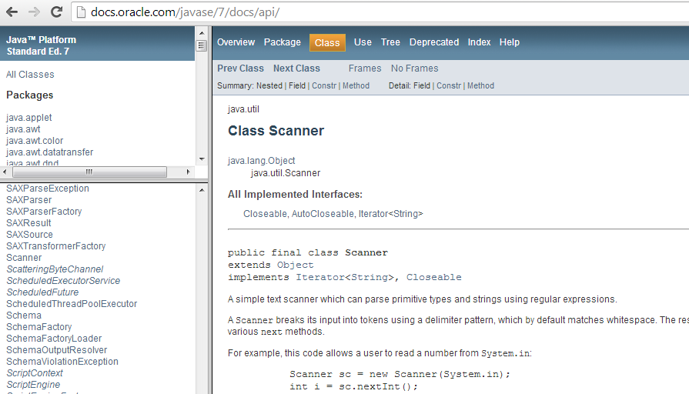
4. API: Scanner Class (2/4)
nextInt()
nextFloat()
nextDouble()
next()
nextLine()
hasNextInt()
hasNextFloat()
And many more…

Slide 51
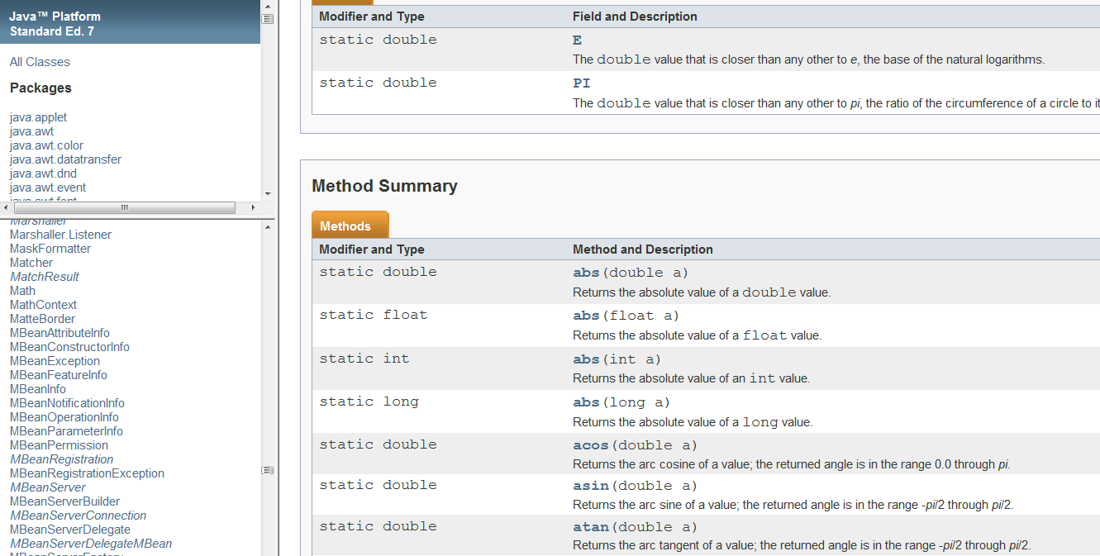
4. API: Math Class (3/4)
abs()
ceil()
floor()
hypot()
max()
min()
pow()
random()
sqrt()
And many more…

Slide 52
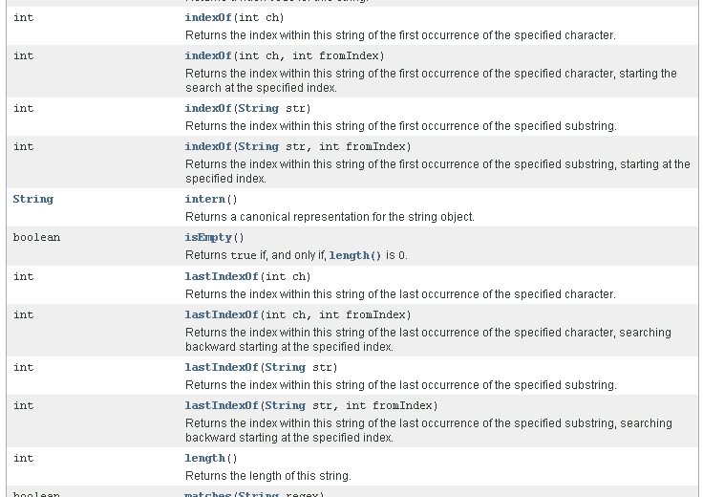
4. API: String Class (4/4)
Ubiquitous
Has a rich set of methods to manipulate strings
charAt()
concat()
equals()
indexOf()
lastIndexOf()
length()
toLowerCase()
toUpperCase()
substring()
trim()
And many more…

Slide 53
5. Conclusion
We have attempted to confine this unit to non-OOP aspects of Java
The aim is to allow you to understand the basic Java (non-OOP) constructs and…
To convert some of the C programs you have written in CS1010 to Java programs

Slide 54
Summary
In this unit, you have learned about
The program structure of Java
The non-OOP aspects of Java programming
Variables, constants, methods, selection and repetition statements
Using classes (Scanner, String, Math, DecimalFormat) and packages
Java naming convention
Declaration and use of arrays
API: The Java documentation

