Slide 1


http://www.comp.nus.edu.sg/~cs1010/
Welcome
&
Administrative Matters

Slide 2
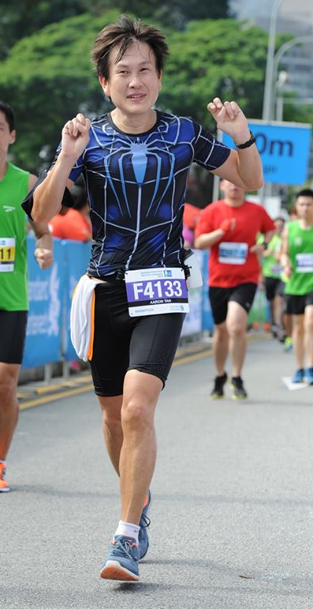
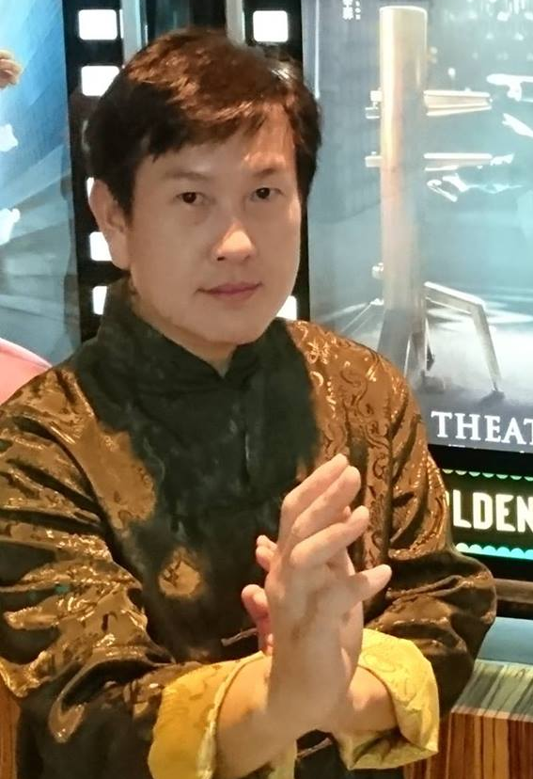
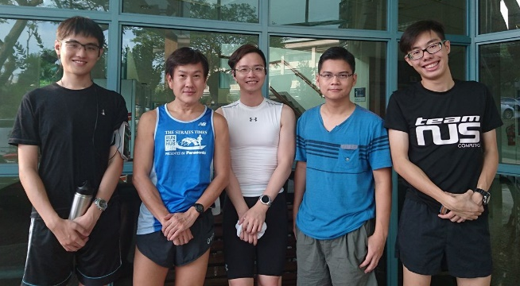
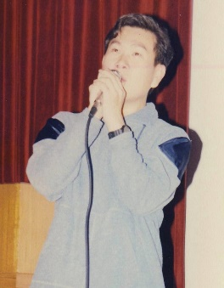
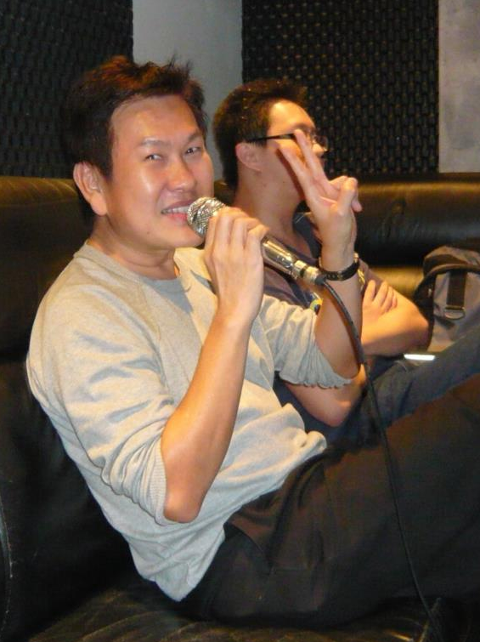
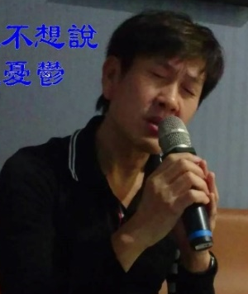
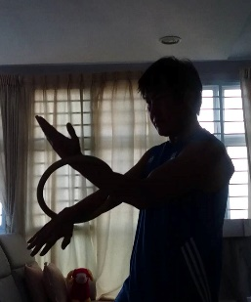
Lecturers
Hobbies:
Running
Weekly group run with students. You’re welcome to join us!
Mr Tan Tuck Choy, Aaron
CS1010 Coordinator
Office: COM1-03-12
Email: tantc@comp.nus.edu.sg
Singing
Wing Chun
Admin appointment:
Assistant Dean (Undergraduate Studies)
Karaokeing with students.

Slide 3
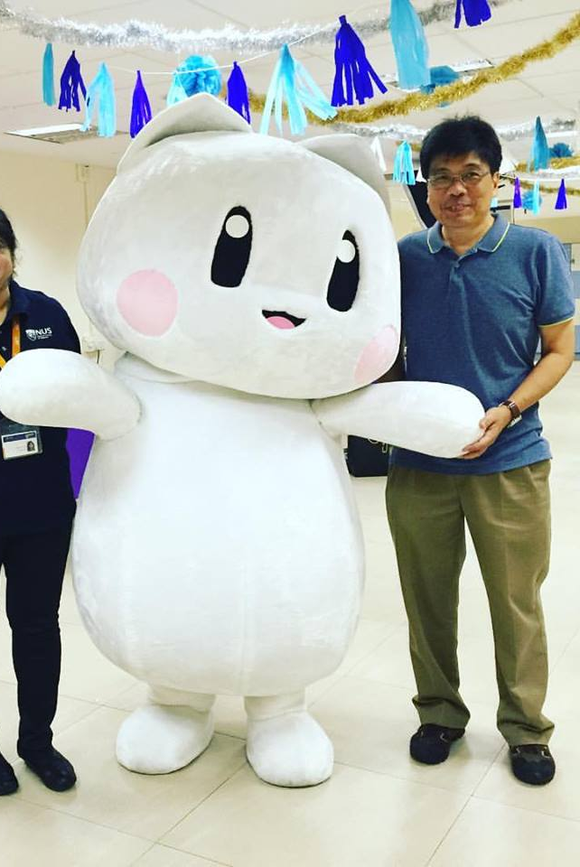
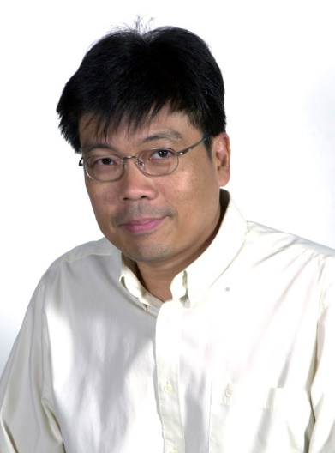
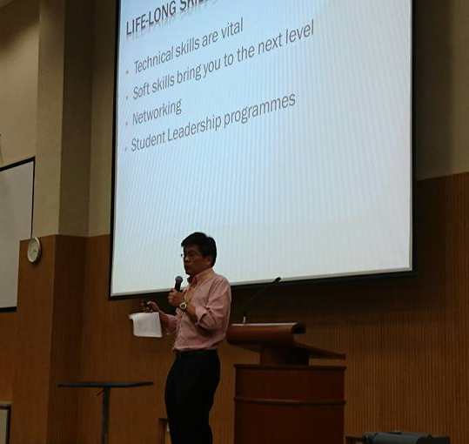
Lecturers
Admin appointment:
Vice Dean (Student Life)
A/P Tan Soon Huat, Gary
Office: COM2-03-50
Email: gtan@comp.nus.edu.sg

Slide 4
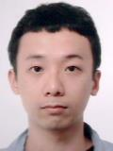
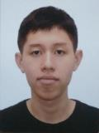
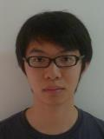
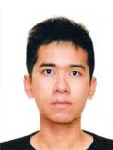
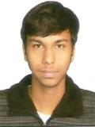
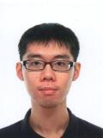
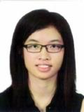
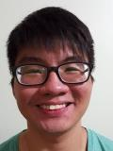
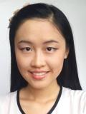
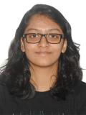
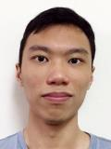
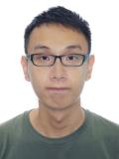
Discussion Leaders (DLs)
Cai ZhuoHong
Chia Kah Sheng, Ellery
Johannes Choo Ern Ern
Koo Chin Chye
Kushagra Goyal
Kyle Timonthy Ng Chu
Lee Yan Hwa
Lee Yong Ler
Liao Chuxin
Maddi Aadyaa
Ng Shao Hui
Ng Tzer Bin

Slide 5
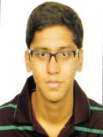
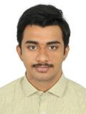
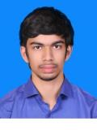
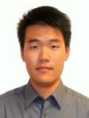
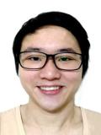
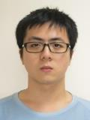
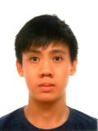
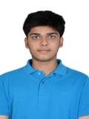
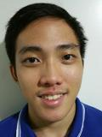
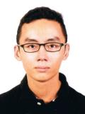
Discussion Leaders (DLs)
Ronak Lakhotia
Sashankh Chengavalli Kumar
Shradheya Thakre
Sun Lixin
Tay Wen Feng, Stanley
Wayne Neo Wei Zhe
Wong Peng Fai Shannon
Yash Chowdhary
Yim Chia Hui
Zachary Tang Tjun Chii

Slide 6
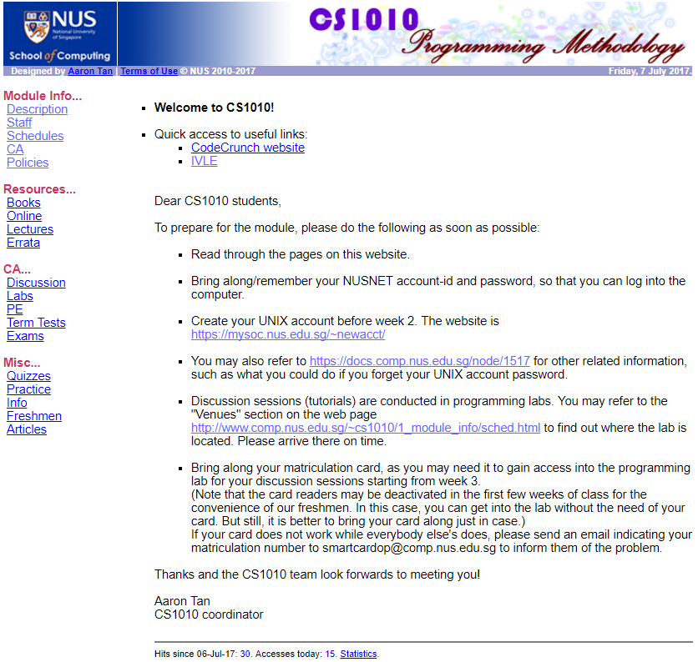

Module Website
http://www.comp.nus.edu.sg/~cs1010
Visit this website after class if you have not done so.

Slide 7
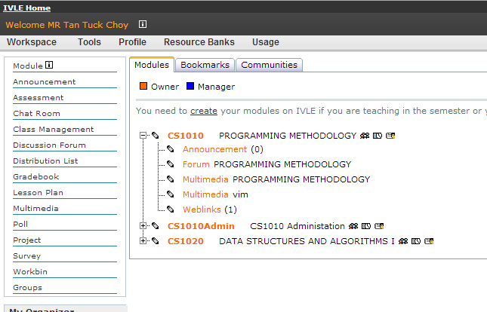
IVLE
https://ivle.nus.edu.sg
Watch out for announcements
Participate in the forums
Multimedia videos

Slide 8
Description and Objectives
Introduces the fundamental concepts of problem solving by computing and programming using an imperative programming language.
Outcomes
Solve simple algorithmic problems
Write good small programs
C as a tool
Not just about C

Slide 9






Skills
Language constructs
Problem solving
Coding

Slide 10
Schedules and Workload
Lectures:
2 hours/week.
Discussion sessions:
2 hours/week from week 3.
Continual assessments:
Take-home lab assignments
2 Practical Exams (see next slide)
Midterm Test (in week 7, TBA)
Final Exam (29 November, Wednesday)
Refer to module website http://www.comp.nus.edu.sg/~cs1010/1_module_info/sched.html
Please mark down the dates of all the tests!
Inform us of clashes in advance!

Slide 11
Practical Exams (PEs)
PE1:
22 September, Friday
Two sessions: 4 – 6pm, 6 – 8pm
Important
Email me asap, by end of week 2, if any of the sessions clashes with your other module
PE2:
4 November 2017, Saturday
Two sessions: 12:30 – 3pm, 3 – 5:30pm (note changes in time)

Slide 12

Reference Book
Problem Solving and Program Design in C 8/E, by Jeri R. Hanly, Elliot B. Koffman
See module website for more information
http://www.comp.nus.edu.sg/~cs1010/2_resources/books.html

Slide 13
Mathematics in Programming
Some common concepts encountered in programming
Prime numbers
Complex numbers
Polynomials
Matrices
Mathematical maturity desirable

Slide 14
sunfire Account
You need a UNIX account on the sunfire server
If you haven’t got one, create one at
https://mysoc.nus.edu.sg/~newacct
This account is different from your NUSNET account

Slide 15
Messages for CS1010 Students
Be prepared to work Really Really HARD!
Lots of self-practice (we will provide you with many practice exercises)
A lot of doubts can be answered by yourself, by writing programs and testing them out by yourself
Explore and ask questions, a lot of them, in class and outside class (IVLE forums)
Clear your doubts as soon as you can
Be open-minded
Do your own work, do not plagiarise

Slide 16
CS1010 Grading
CS1010 grading is NOT by bell curve
Every student who deserves an A will get it; there is no quota
On the other hand, we are also free to fail students who do not meet the standard as there is no quota too
Gradeless first year – you still need to work hard in CS1010 for 2 reasons
To get a Satisfactory grade for SU, you must attain at least a C grade (not D grade)
A solid foundation in the programming is important, as CS1010 is the pre-requisite to another module (such as CS2040) which is very much tougher and uses a different programming language (Java)

Slide 17
Quotes for CS1010 Students
Before you succeed, you must fail many times.
Don’t ask me what this code does, trace it yourself!
Think! Think! Think!
Practise! Practise! Practise!
It’s all about logic. Every step must be clear to you and whoever is reading your code.

Slide 18
Things To Note
Inform me of PE1 clash with your other module
Watch out IVLE announcement on how to register for Intro Workshop which will be conducted next week
Appeals for Tutorial Registration should be sent through CORS, not to me. Academic staff are not allowed to add students to a group or change students’ groups. CORS administrators will process your appeals.
In your appeals, give alternative slots
Check your NUSNET emails for reply from CORS

Slide 19
End of File

