Slide 1
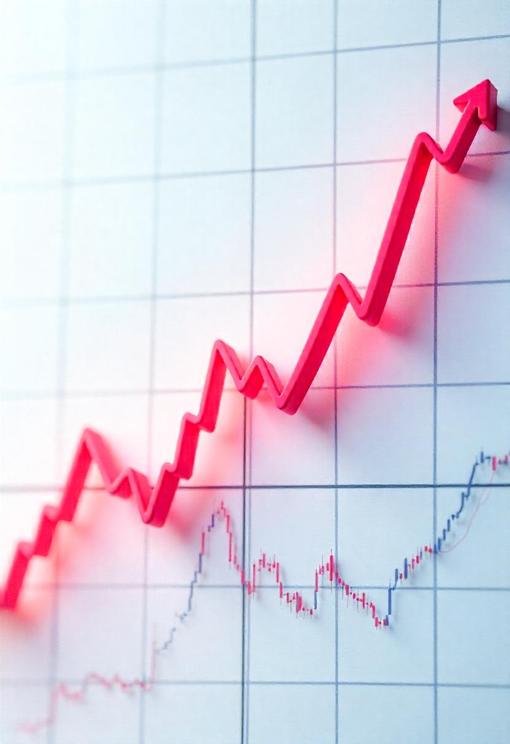

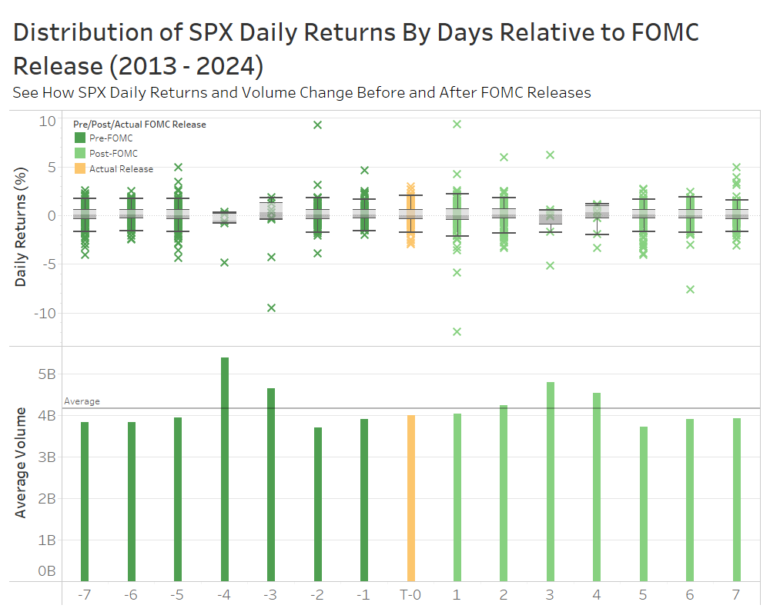
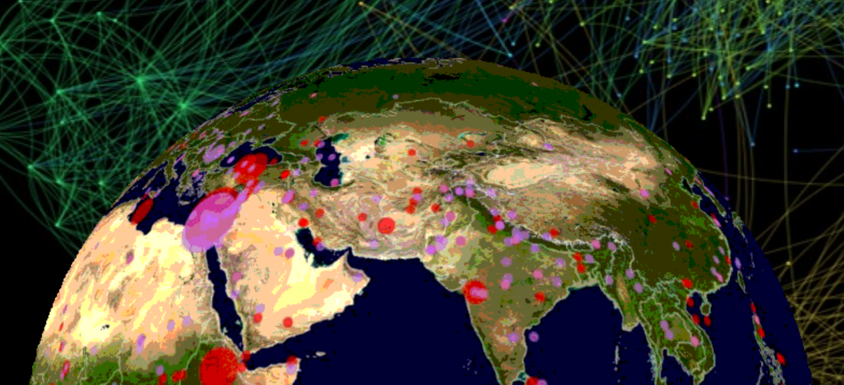
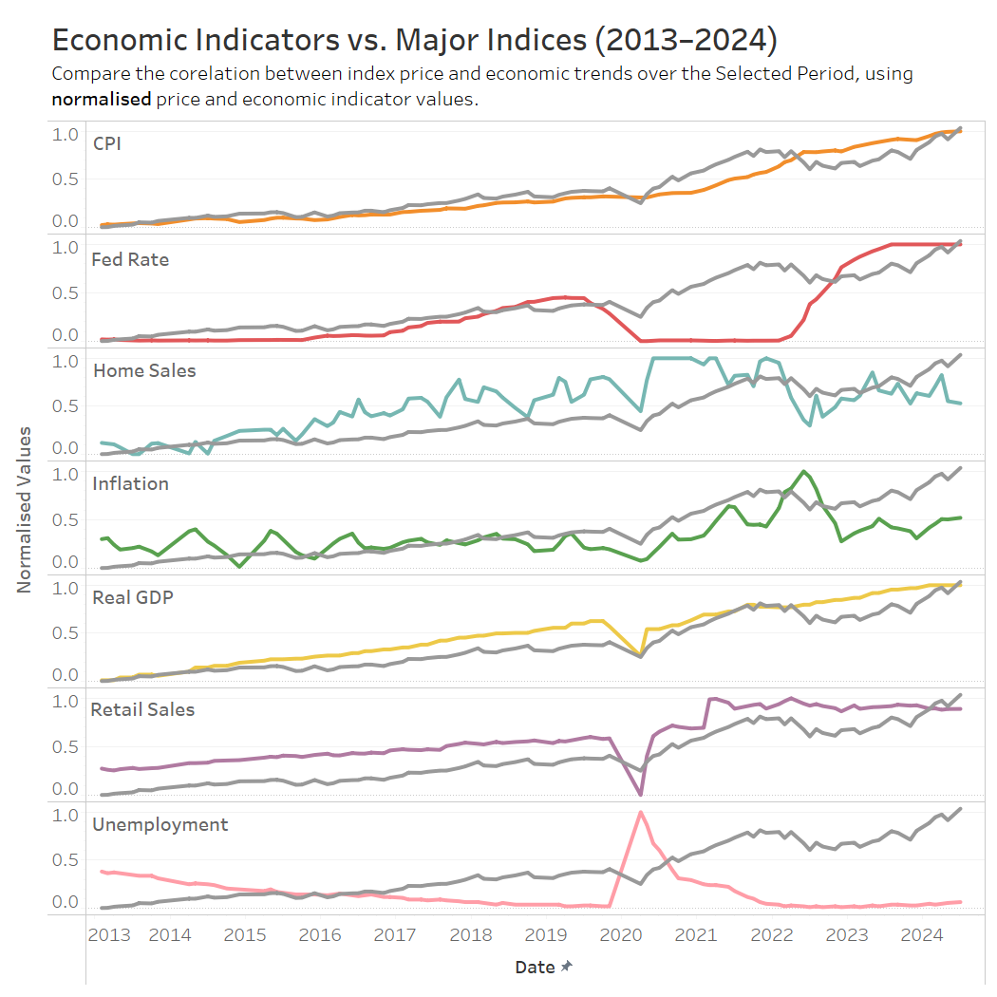
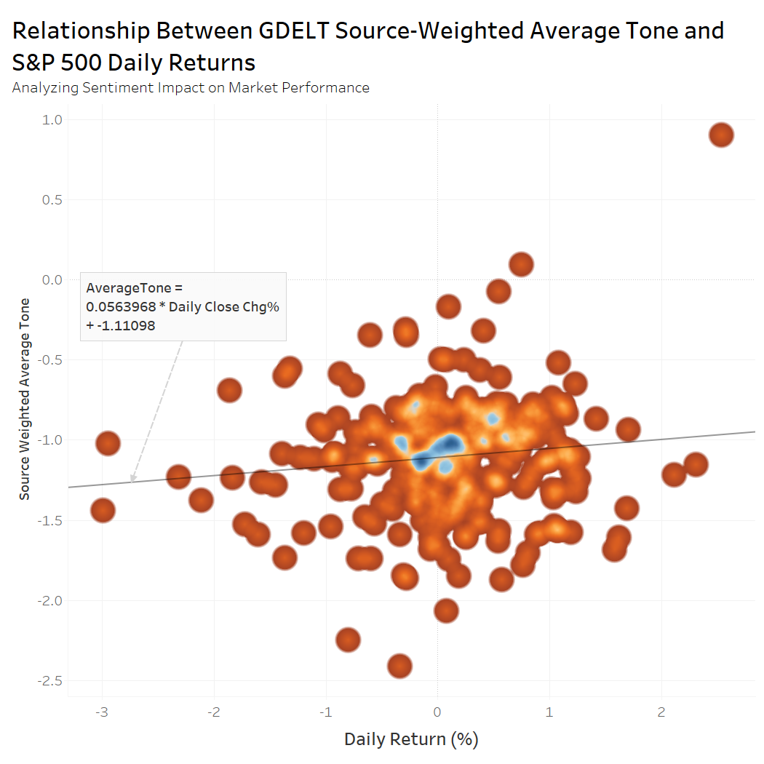
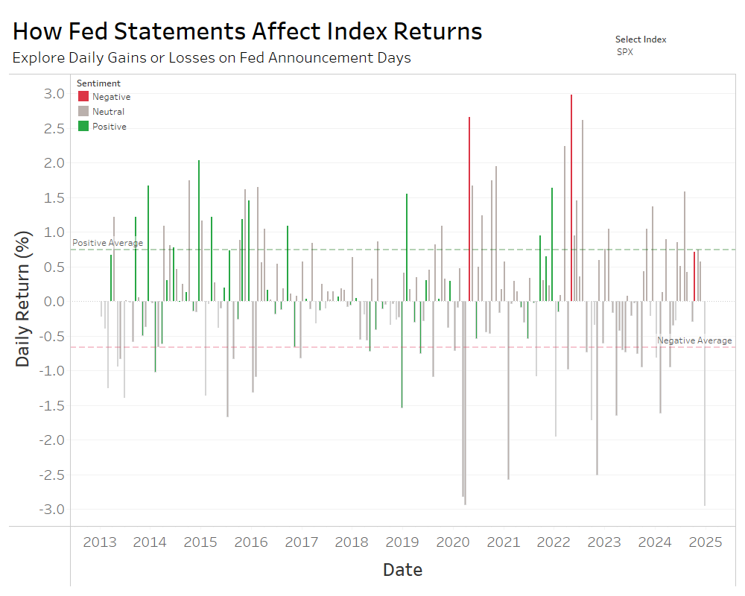
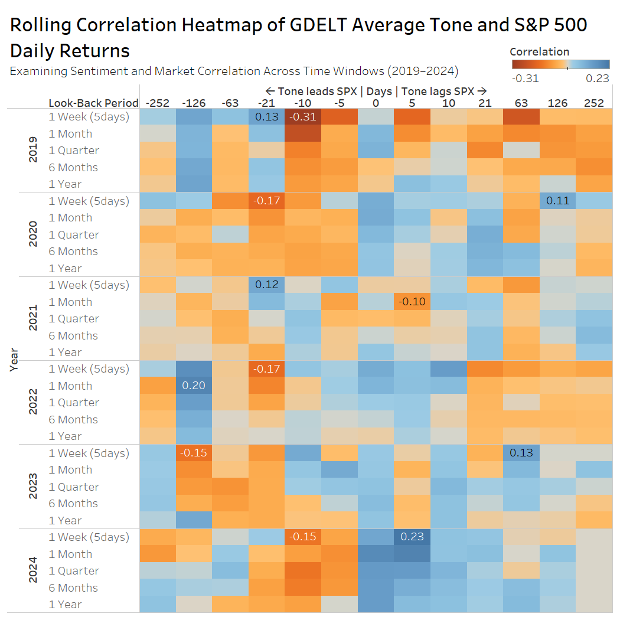
Investigating the Influence of Global Events and FOMC Sentiment on U.S. Markets
OVERVIEW
This project presents an interactive dashboard that visualizes how major U.S. market indices (S&P 500, Nasdaq-100, Dow Jones) respond to macroeconomic indicators and global events. By combining financial market data with FOMC sentiment analysis and the GDELT global events dataset—an external, event-driven source capturing worldwide media coverage and geopolitical developments—the dashboard provides a multidimensional perspective on market behavior. This integration allows retail investors to explore how news sentiment and real-world events may influence market movements, supporting more informed investment decisions.
OBJECTIVES
Analyze the correlation between global events (GDELT) and U.S. financial indices using sentiment analysis.
Investigate how FOMC announcements influence investor sentiment and stock market volatility.
Provide an interactive visualization to help retail investors understand market behavior in response to economic events.
CONCLUSION
Analyzing the interactions between U.S. market performance, macroeconomic indicators, and global events reveals crucial patterns for investors. The interactive dashboard highlights how global events, sourced from GDELT, significantly influence market movements, while FOMC sentiment plays a pivotal role in shaping short-term market reactions. Positive FOMC language tends to coincide with market rallies, while more hawkish tones are often linked to increased volatility. Moreover, geopolitical and economic disruptions clearly affect market dynamics, emphasizing the need for real-time monitoring by investors. By visualizing these relationships, the dashboard offers a powerful tool for navigating the complexities of the financial landscape and making data-driven investment decisions.

