Slide 1
Modeling of a contagious disease
Computational Astrophysics
Master in Theoretical Physics
Daniel López Cano

Slide 2
0.Index
1. Introduction
2. Implementation of a SEIRD model
2.1 Creating social interactions
2.2 Contagion
2.3 Patient's progress
2.4 Flow-chart
3. Results
4. Conclusions

Slide 3
1. Introduction
Conceptually simple problem where many C tools during this course can be applied.
C programming and parallelization → larger samples of population and multiple realizations for error estimation.
Practice creating a modular program with shared structures and I/O.
Topic whose modelization can be very useful to determine and characterize the parameters to which the social evolution of the disease is more responsive.

Slide 4










2. Implementation of a SEIRD model
$$P(S→S)$$
$$P(E→E)$$
$$P(I→I)$$
$$P(R→R)$$
$$P(D→D)$$
S – susceptible
E – infected mild
I – infected severe
R – recovered
D – dead
$$P(E→I)$$
$$P(I→R)$$
$$CONTAGION$$
$$P(E→R)$$
$$P(I→D)$$
https://nadaesgratis.es/anxo-sanchez/ni-el-pico-ni-el-final-de-una-epidemia-se-pueden-predecir-con-precision

Slide 5
2.1 Creating social interactions
N
P(1)=0.254
ID
0 1 2 3 4 5 6 7 8 9 …
P(2)=0.304
loc_sizes -> ID.h
P(3)=0.209
P(4)=0.176
h
0 1 2 3 …
.
.
.
https://www.ine.es/en/prensa/ech_2017_en.pdf
https://www.mscbs.gob.es/ciudadanos/prestaciones/centrosServiciosSNS/hospitales/home.htm

Slide 6
2.1 Creating social interactions
N
P(1)=0.254
ID
31 22 74 45 20 44 8 91 10 11 …
P(2)=0.304
loc_sizes -> ID.h
P(3)=0.209
P(4)=0.176
h
0 1 2 3 …
.
.
.
ID[i]
ID[i].h
https://www.ine.es/en/prensa/ech_2017_en.pdf
https://www.mscbs.gob.es/ciudadanos/prestaciones/centrosServiciosSNS/hospitales/home.htm

Slide 7
2.1 Creating social interactions
N
P(1)=0.254
ID
0 1 2 3 4 5 6 7 8 9 …
P(2)=0.304
loc_sizes -> ID.w
P(3)=0.209
h
0 1 2 3 …
P(4)=0.176
.
.
.
https://www.ine.es/en/prensa/ech_2017_en.pdf
https://www.mscbs.gob.es/ciudadanos/prestaciones/centrosServiciosSNS/hospitales/home.htm

Slide 8
2.1 Creating social interactions
N
P(1)=0.254
ID
46 10 75 39 88 3 9 28 19 22 …
P(2)=0.304
loc_sizes -> ID.w
P(3)=0.209
h
0 1 2 3 …
P(4)=0.176
ID[i]
.
.
.
ID[i].h
ID[i].w
https://www.ine.es/en/prensa/ech_2017_en.pdf
https://www.mscbs.gob.es/ciudadanos/prestaciones/centrosServiciosSNS/hospitales/home.htm

Slide 9

2.1 Creating social interactions
N
ID
67 83 24 6 8 93 37 47 12 61 …
$×\text{32500}$
loc_sizes -> ID.hosp
People assigned to a hospital
BUT we will assume that when a hospital has a certain percentage of occupation →… hospital collapse
h
0 …
ID[i]
ID[i].h
ID[i].hosp
ID[i].w
https://www.ine.es/en/prensa/ech_2017_en.pdf
https://www.mscbs.gob.es/ciudadanos/prestaciones/centrosServiciosSNS/hospitales/home.htm

Slide 10
2.1 Creating social interactions
P → go[alert][state].place
NO ALERT |  | 1.0 | 1.0 | 0.05 | 1.0 | 0.0
 |  | 1.0 | 0.5 | 0.0 | 1.0 | 0.0
 |  | 0.005 | 0.05 | 0.95 | 0.005 | 0.0
ALERT |  | 1.0 | 1.0 | 0.05 | 1.0 | 0.0
 |  | 0.05 | 0.025 | 0.0 | 0.05 | 0.0
 |  | 0.005 | 0.05 | 0.95 | 0.005 | 0.0

Slide 11

2.2 Contagion
h[0]
$$N_{infected}=2$$

Slide 12
2.2 Contagion
h[0]
$$N_{infected}=2$$
P -> infect.h = 0.1

Slide 13
2.2 Contagion
h[0]
$$N_{infected}=2$$
P -> infect.h = 0.1

Slide 14





2.2 Contagion
P → infect.h = 0.1 ; P → infect.w = 0.1 ; P → infect.hosp = 0.1
h[0]
$$N_{infected}=1$$
h[1]
$$N_{infected}=2$$
.
.
.
w[0]
$$N_{infected}=2$$
w[1]
.
.
.
$$N_{infected}=1$$
hosp[0]
$$N_{infected}=5$$
.
.
.

Slide 15
2.3 Patient's progress
S
E
I
R
D
P → evolve[ hospital_info ][ initial_state ][ final_state ]
[0]
[0]
[0] → hasn't gone to the hospital.
[1]
[1]
[1] → has gone to the hospital and it was not collapsed.
[2]
[2]
[3]
[3]
[2] → has gone to the hospital and it was collapsed.
[4]
[4]

Slide 16
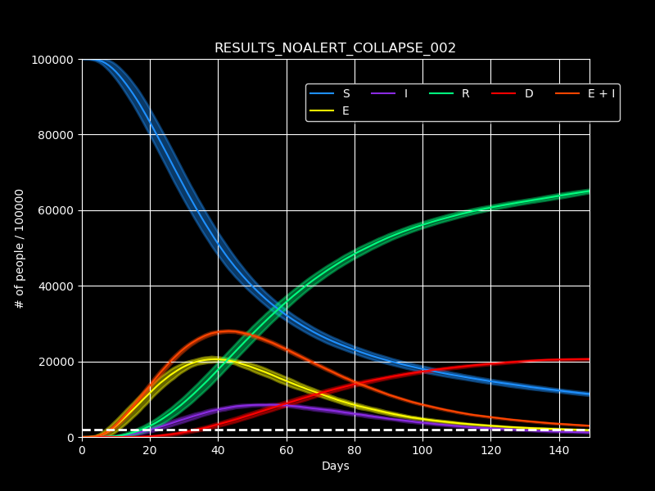
2.4 Flow-chart
iterations.c
functions.c
(Auxiliary functions)
functions.h
(Declaration of structures: P, ID, size of locations)
parameters.c/.h
(fill P structure)
declare_alert1()
initial_conditions.c/.h
people_going_places()
society_model.c
main.c
contagion()
illness_progress()
1.dat
2.dat
plot_tool.py
plot_tool1.py
…
…

Slide 17


3. Results
$$N=32500→1hosp$$
$$t=150 days$$
NO ALERT
% hospital collapse =
[0.02, 0.03, 0.04, 0.05, 0.06, 0.08, 0.1]
$$N_{realizations}=10$$

Slide 18

3. Results
$$N=32500→1hosp$$
$$t=150 days$$
ALERT $∈[25, 65]$
% hospital collapse =
[0.02, 0.03, 0.04, 0.05, 0.06, 0.08, 0.1]
$$N_{realizations}=10$$

Slide 19

3. Results
$$N=32500→1hosp$$
$$t=150 days$$
ALERT $∈[15, 80]$
% hospital collapse =
[0.02, 0.03, 0.04, 0.05, 0.06, 0.08, 0.1]
$$N_{realizations}=10$$

Slide 20
3. Results

Slide 21
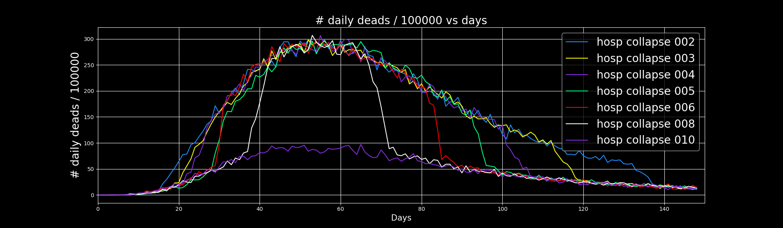
3. Results

Slide 22
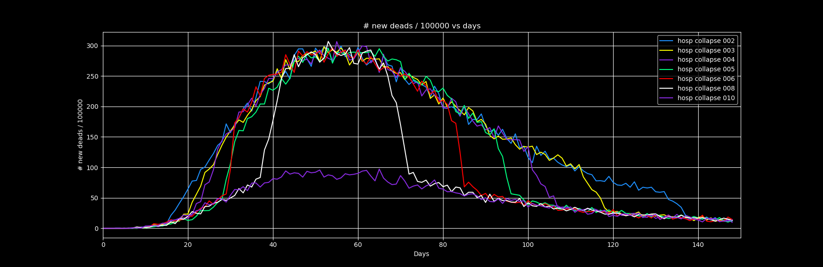
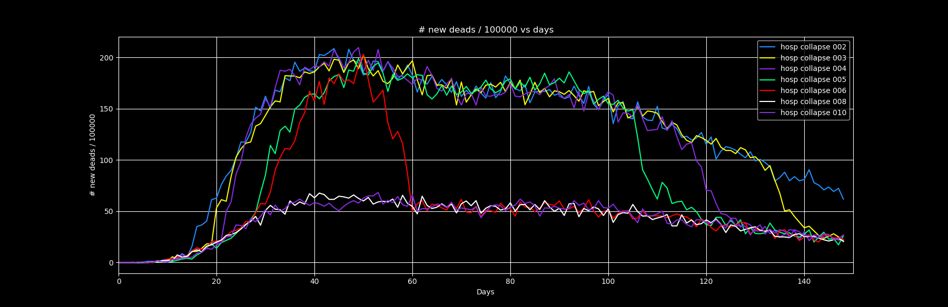
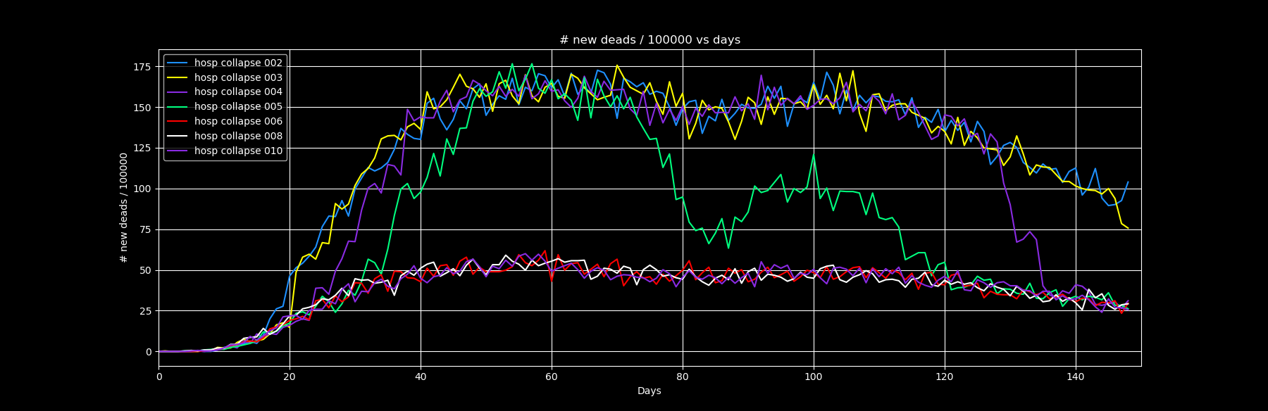


3. Results
300
No alert:
200
Alert $∈[25, 65]$
175
Alert $∈[15, 80]$

Slide 23
4. Conclusions
Two factors regulate the total number of deaths during a pandemic: the collapse threshold of hospitals and the social distancing measures regime.
No matter how much the contagion curve flattens as long as hospitals are saturated. The total number of deaths may become similar in the end.
Working with structures is indispensable when trying to model systems in which we deal with multiple elements to which we associate certain properties.

