Slide 1
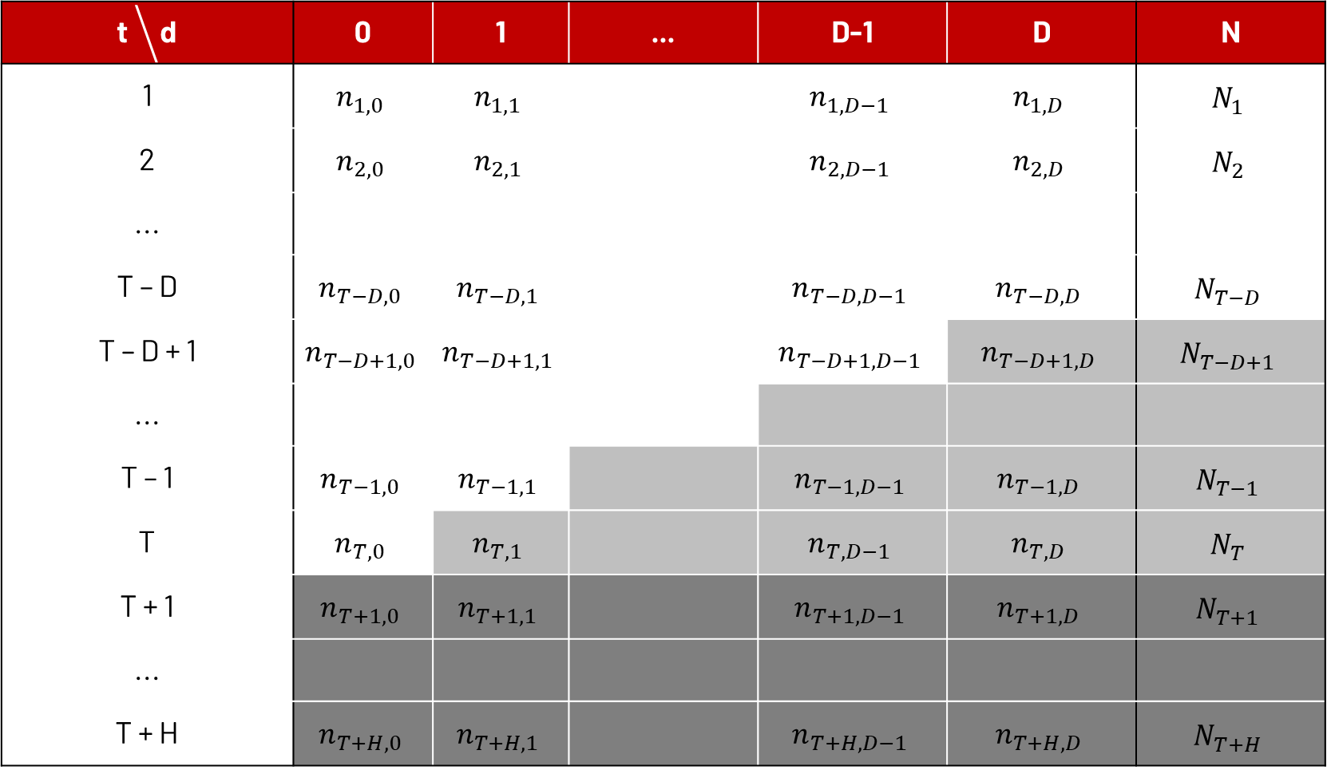
t ⧹d | 0 | 1 | ... | D-1 | D | N
1 | $$n_{1,0}$$ | $$n_{1,1}$$ |  | $$n_{1,D−1}$$ | $$n_{1,D}$$ | $$N_{1}$$
2 | $$n_{2,0}$$ | $$n_{2,1}$$ |  | $$n_{2,D−1}$$ | $$n_{2,D}$$ | $$N_{2}$$
...
T – D | $$n_{T−D,0}$$ | $$n_{T−D,1}$$ |  | $$n_{T−D,D−1}$$ | $$n_{T−D,D}$$ | $$N_{T−D}$$
T – D + 1 | $$n_{T−D+1,0}$$ | $$n_{T−D+1,1}$$ |  | $$n_{T−D+1,D−1}$$ | $$n_{T−D+1,D}$$ | $$N_{T−D+1}$$
...
T – 1 | $$n_{T−1,0}$$ | $$n_{T−1,1}$$ |  | $$n_{T−1,D−1}$$ | $$n_{T−1,D}$$ | $$N_{T−1}$$
T | $$n_{T,0}$$ | $$n_{T,1}$$ |  | $$n_{T,D−1}$$ | $$n_{T,D}$$ | $$N_{T}$$
T + 1 | $$n_{T+1,0}$$ | $$n_{T+1,1}$$ |  | $$n_{T+1,D−1}$$ | $$n_{T+1,D}$$ | $$N_{T+1}$$
...
T + H | $$n_{T+H,0}$$ | $$n_{T+H,1}$$ |  | $$n_{T+H,D−1}$$ | $$n_{T+H,D}$$ | $$N_{T+H}$$

