Slide 1
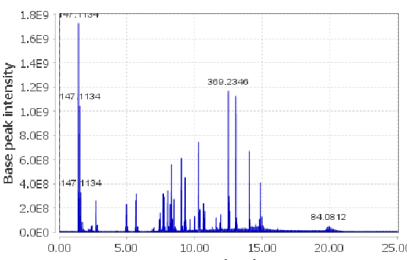
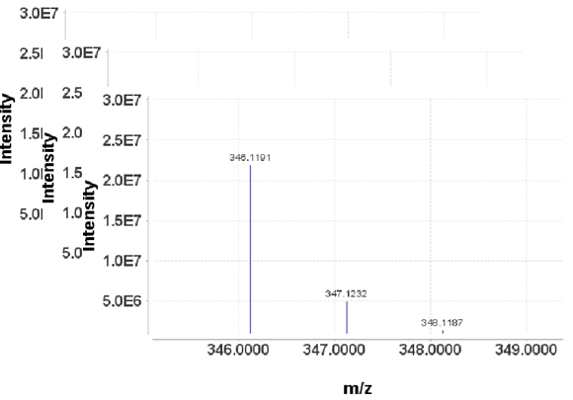
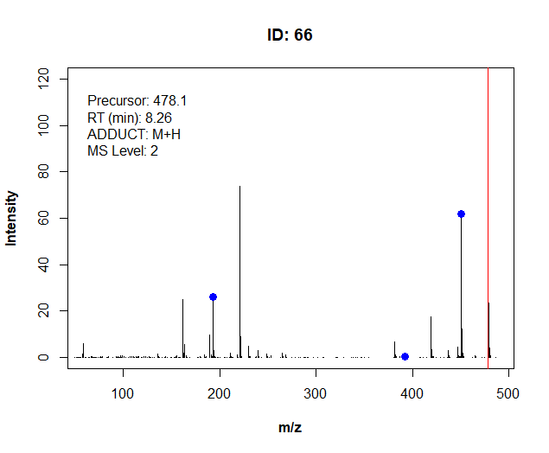
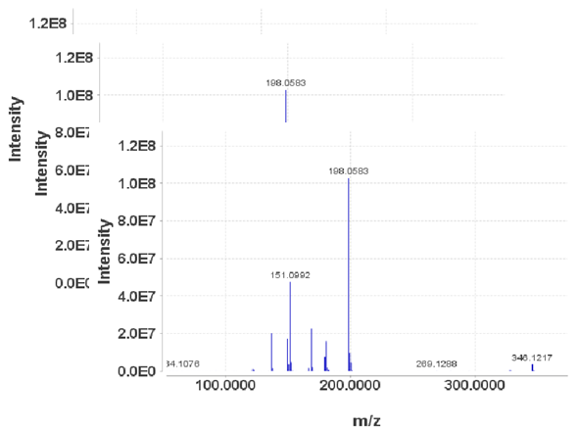
process_library()
In-house library
Search & plot
Extract MS1
LC-MS/MS Thermo
Water
Bruker
…
mzML
Centroid mode
mzML
(Centroid)
library_generator ()
Merged spectral library
MSConvertGUI
or vendor software
Extract MS2
CSI_FingerID_writer()
MSFinder_writer()
MetFrag_writer()
Targeted exact mass
Targeted retention time
Feature ID
Ion mode
Adduct type
…
Metadata
(.csv)
(Previous library .mgf)
Smart algorithms
Batch processing
Adapted formats

Slide 2

library_manager()
Query one or more metadata
simple fragment search
Search_param
Input
Remove unwanted
MSConvert ()
Docker (Ronald)
library_
generator ()
Library_visualizer()
Previous
library
LC-MS/MS Thermo
Water
Bruker
…
mzML
Centroid mode
mz(X)ML
(Centroid)
MS1+MS2
Ouput library
Updated metadata
Library_statistics()
Nb of compounds
Class prediction
Update history
Metadata_sum
Targeted mass
Targeted rt
D-NUM ID
JNJ ID
Ion mode
…
Basic metadata
(.csv)
Struc_retrieval()
Rate project (Ronald)
Smiles/INCHI
Input
Devco
* Under-development (by first release of web app)
* Developed – stable until first release

Slide 3
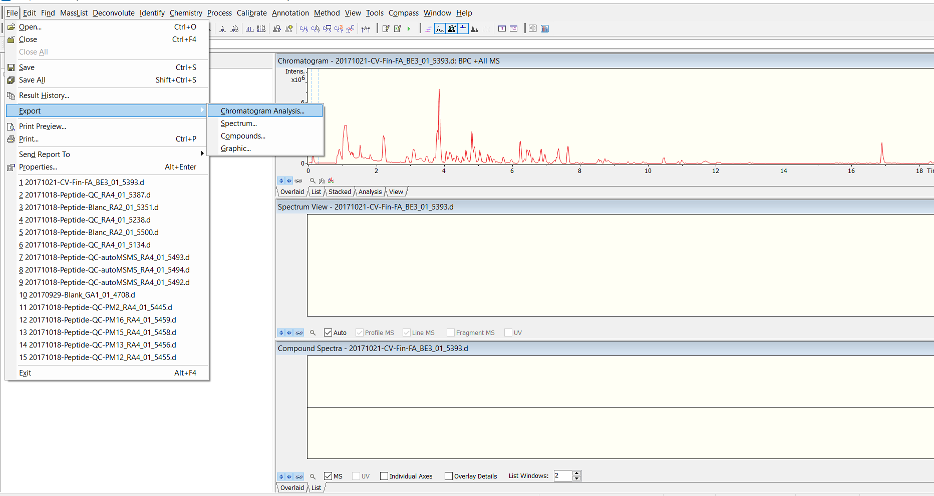
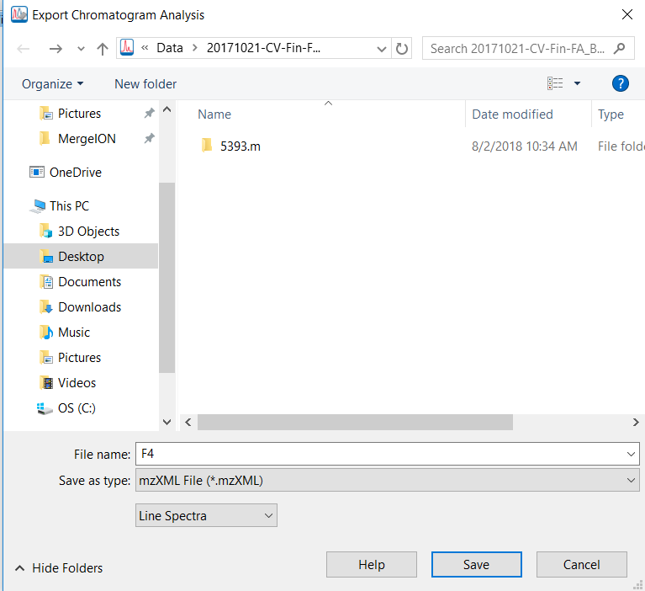
(Line spectra = Centroid-mode)

Slide 4
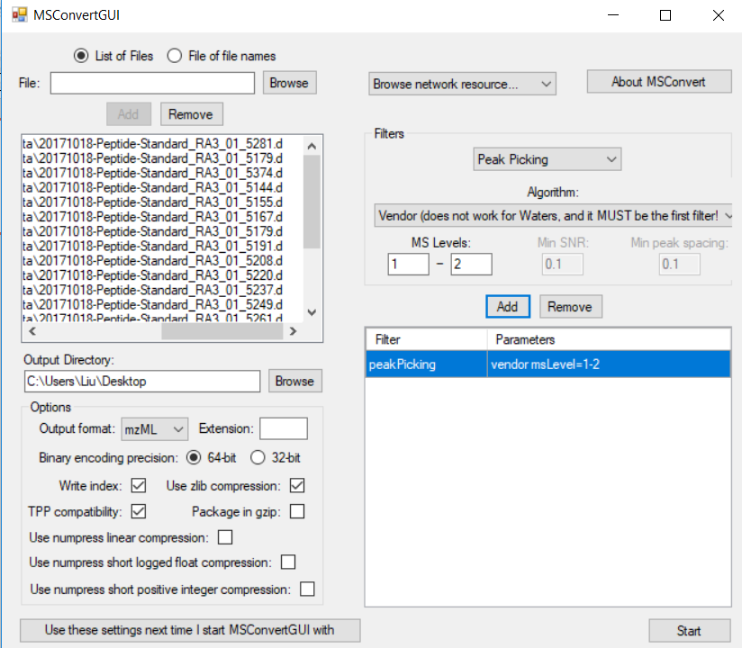
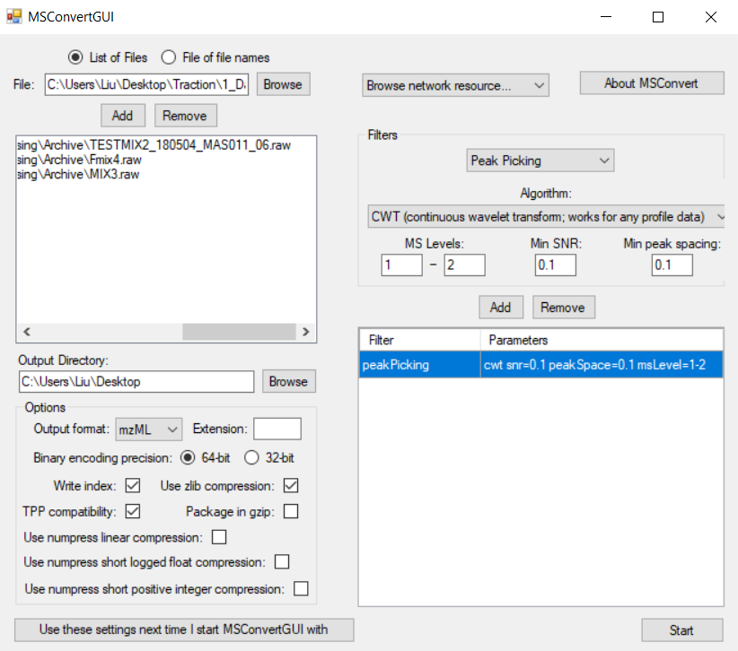
1. Browse and add raw LC-MS files.
v
v
v
v
2. If your data is in profile mode, you need to apply peak picking for both MS1 and MS2 scans. We recommend Vendor algorithms for all data formats except for Waters’.
2. Please choose CWT algorithm to centroid Waters data file. Please use default parameters.
3. Define output format and output directory.
4

Slide 5
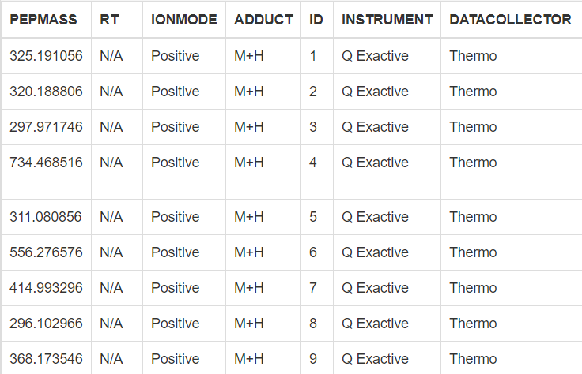
Precursor ion adduct type, one of "M+H","M+Na","M+K","M-H“, "M+Cl"
Retention time (in minute) of metabolic features to be found, please put it to N/A if unknown. Important if isomers are present in the same sample.
"Positive"
or "Negative"
A unique identifier for targeted compounds in spectral library, number or character
…
Precursor m/z to be found in chromatograms
…
The first five columns of the metadata are mandatory. Column names and order must not be changed !
The rest of columns are optional
e.g. “STRUCTURE” and “NAME” can be added for building in-house library.

Slide 6
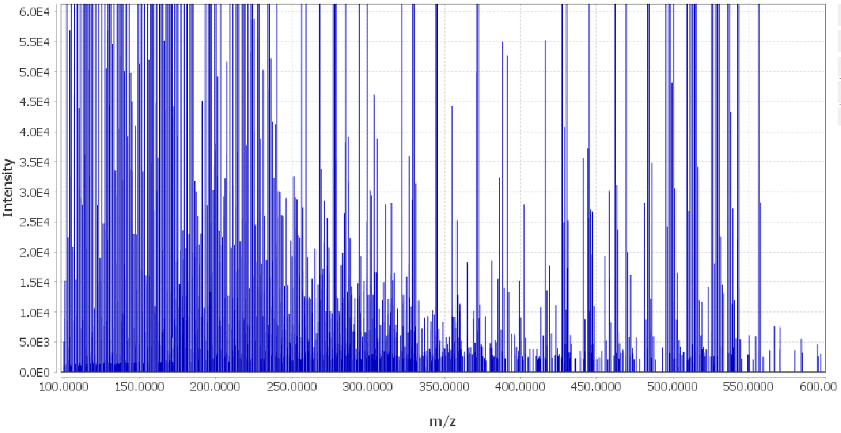
Baseline ≈ 1000

Slide 7
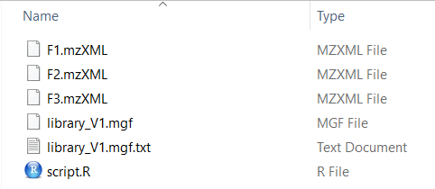
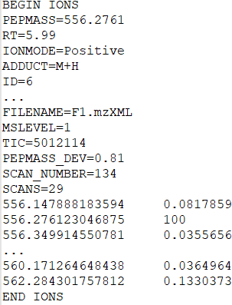
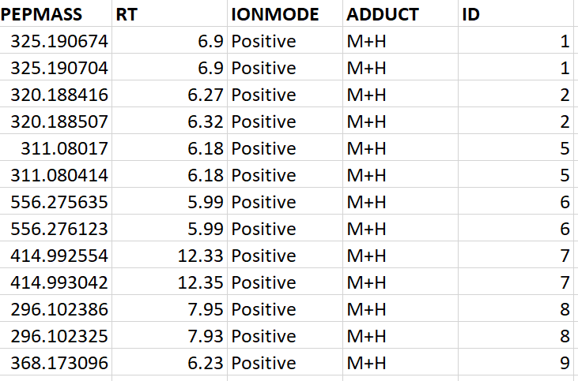
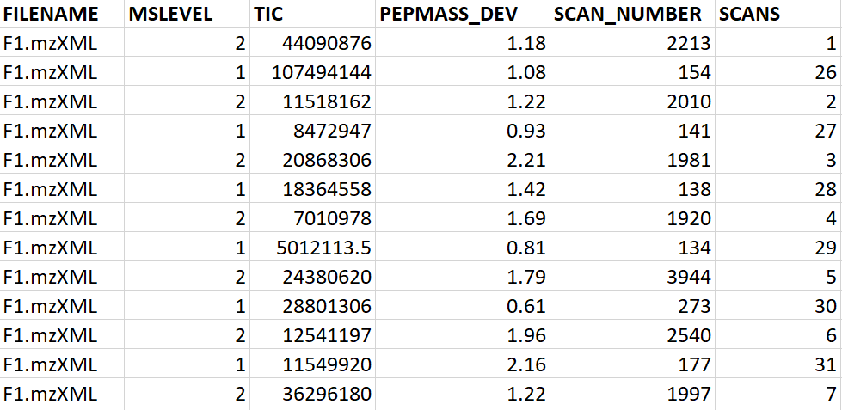
Metadata
GNPS-style spectral library file
Spectra data
Meta data
…
Example of a “scan”
…
Actual precursor m/z and RT detected
MS1 and MS2 scans are both detected for feature ID=8
Following metadata columns are added
Unique identifier for scans
FILENAME from which file the metabolic feature is detected; PEPMASS_DEV Mass deviation (ppm) of precursor m/z to what is in user-provided targeted m/z; SCAN_NUMBER scan number in original LC-MS/MS chromatogram

Slide 8
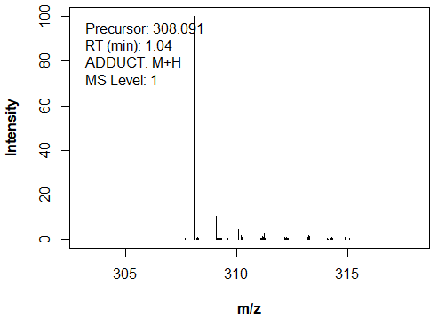
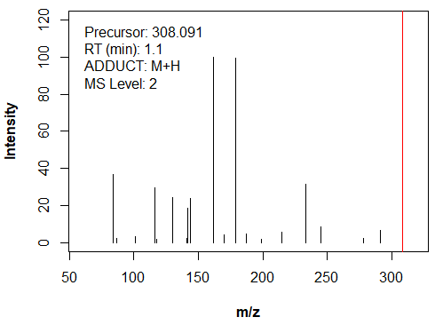
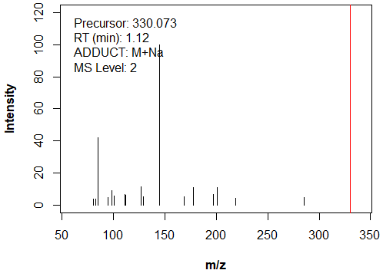

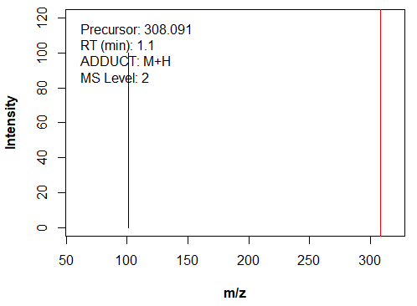
ID = 28
MS1 scan is the same in library2, library2_2 or library2_3 !
library2
library2
library2_2
library2_3

Slide 9
m/z and intensity of matched query fragments

