Slide 1
 | MergeION (Default) | compMS2Miner | RMassBank
Input Data format | mz(X)ML | mz(X)ML | mz(X)ML
Input Acquisition mode | Targeted + DDA |  | Targeted
Input Metadata (Compulsory) | ID + PEPMASS | ID + PEPMASS + RT | ID + SMILES + Filename
Input Metadata (Suggested) | RT, Filename | Filename | RT
Search Method | Highest TIC scan | Multiple scan summation | Multiple scan aggregation
Spectrum POST-processing | - | Dynamic filtering | Recalibration
Extra function | Isomer detection | Isomer detection | Fragment formula annotation
Consensus spectra

Slide 2
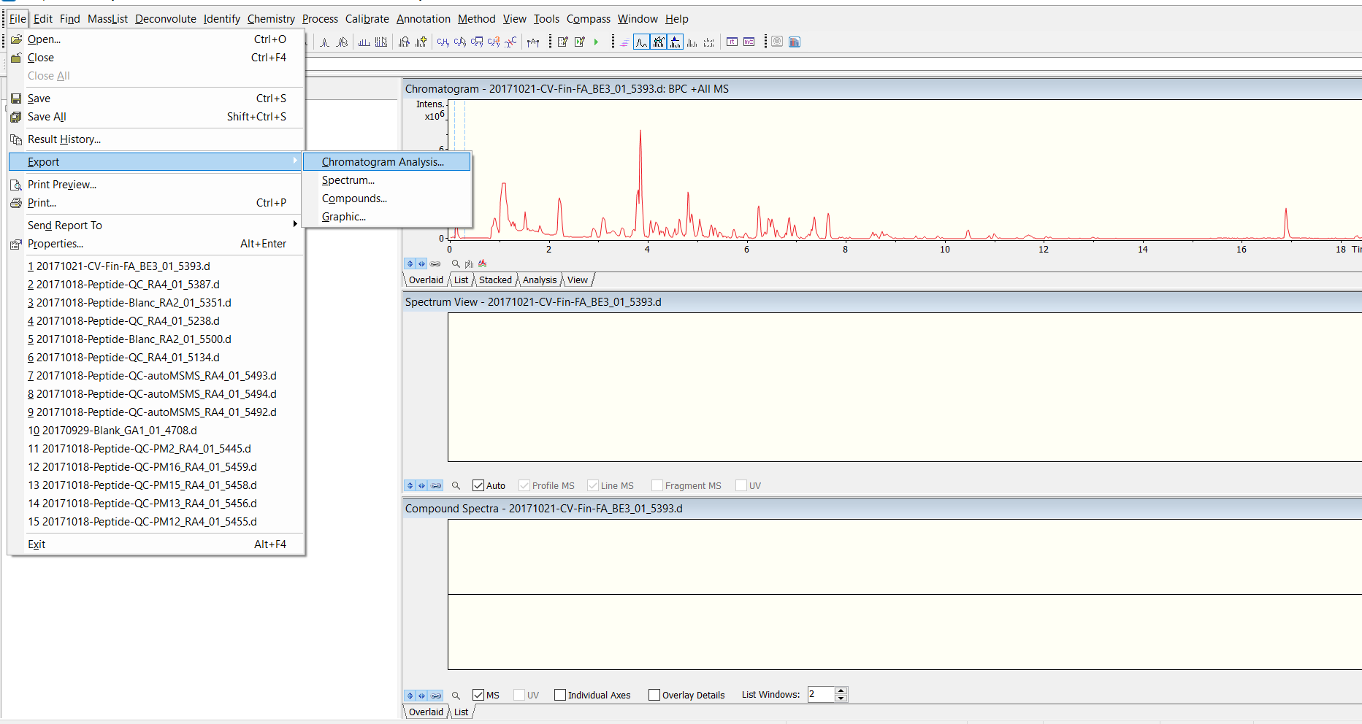
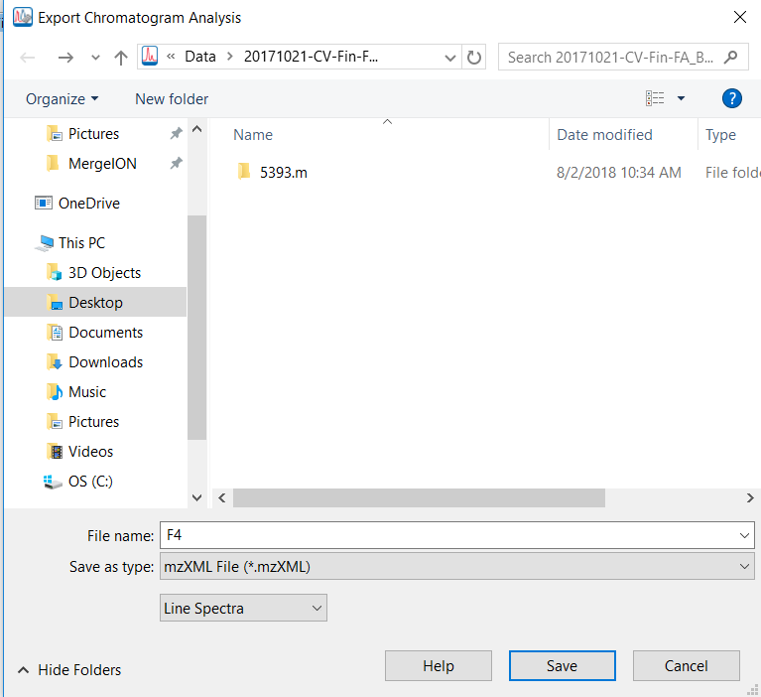
(Line spectra = Centroid-mode)

Slide 3
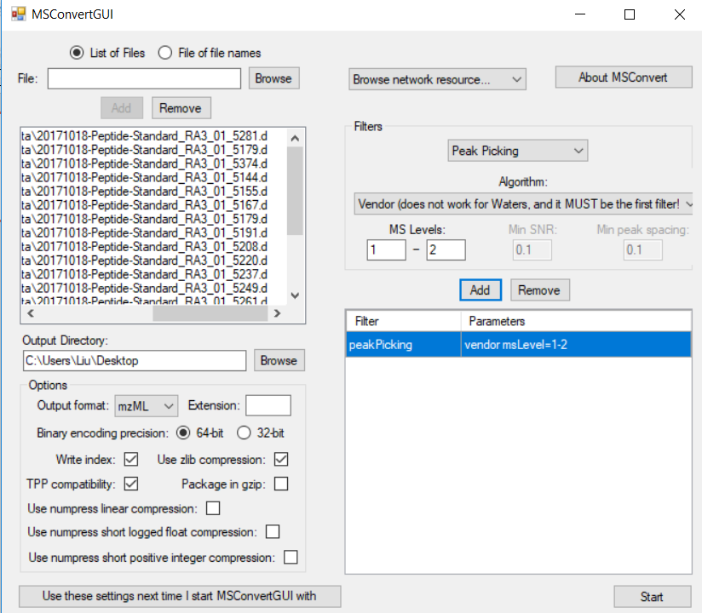
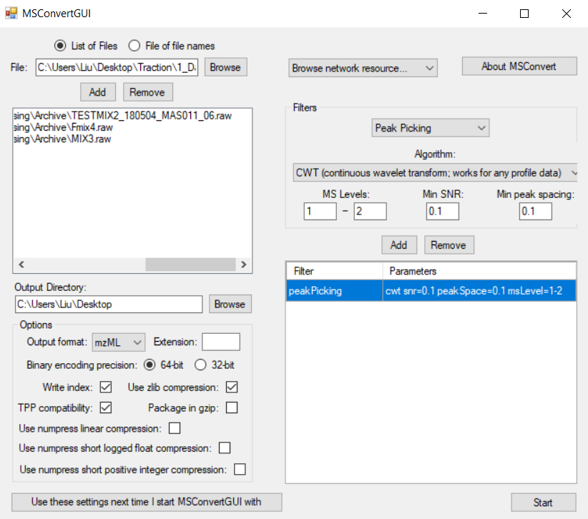
1. Browse and add raw LC-MS files.
v
v
v
v
2. If your data is in profile mode, you need to apply peak picking for both MS1 and MS2 scans. We recommend Vendor algorithms for all data formats except for Waters’.
2. Please choose CWT algorithm to centroid Waters data file. Please use default parameters.
3. Define output format and output directory.
4

Slide 4
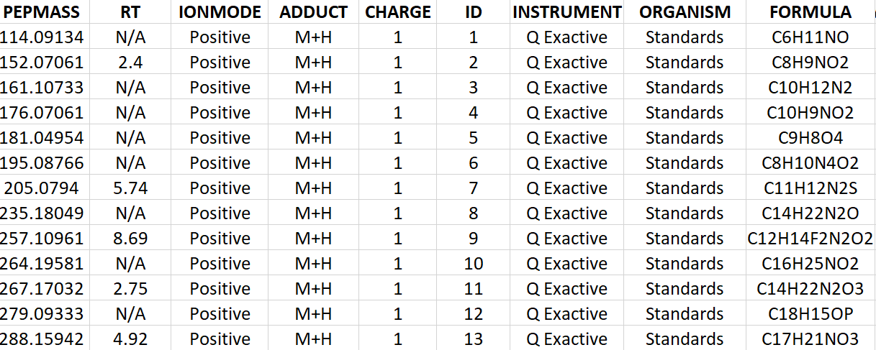
Retention time (in minute) of metabolic features to be found, please put it to N/A if unknown. MergeION will detect all isomers.
Precursor ion adduct type, one of "M+H","M+Na","M+K","M-H“, "M+Cl"
A unique identifier for targeted compounds in spectral library, number or character
Charge number,
Please keep the value at 1
"Positive"
or "Negative"
Precursor m/z to be found in chromatograms
The first six columns of the metadata are mandatory. Column names and their order must not be changed !
Rest of columns are optional

Slide 5
Necessary
Rest of columns are optional
Mass and RT of MS1 features detected by MZMine, used to pick up MS2 scans
Area of MS1 features found by MZMine
A unique identifier for targeted features in the spectral database
Adduct grouping by the meRgeION process_mzmine function
% relative to main compound and fold change calculated from area

Slide 6
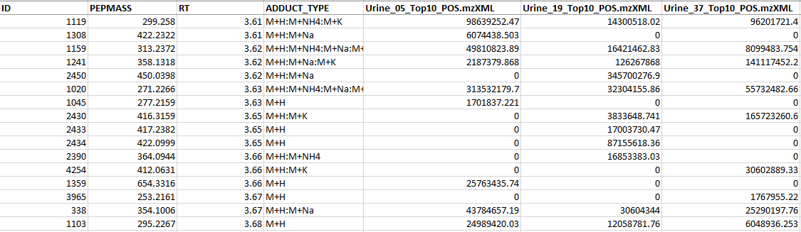
A unique identifier for targeted features in the spectral database
Adduct grouping by the meRgeION process_mzmine function
Necessary
Rest of columns are optional
…
Mass and RT of MS1 features detected by MZMine, used to pick up MS2 scans

Slide 7
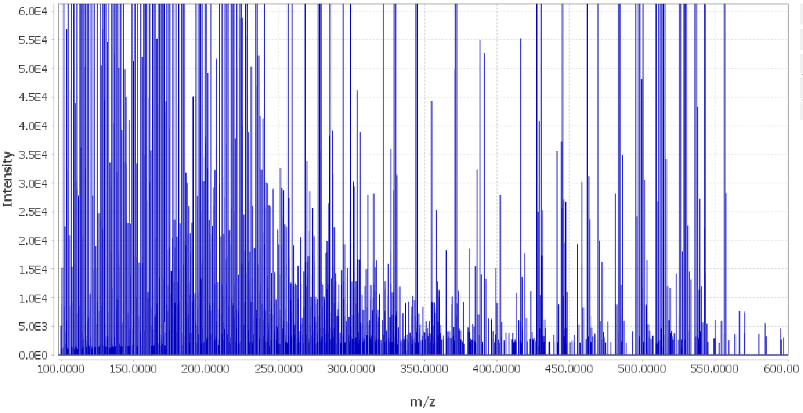
Baseline ≈ 1000

Slide 8
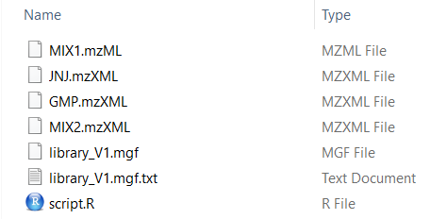
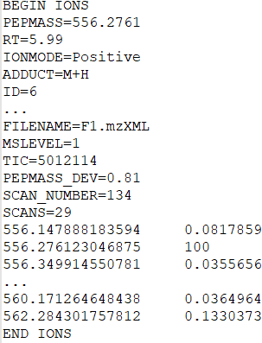
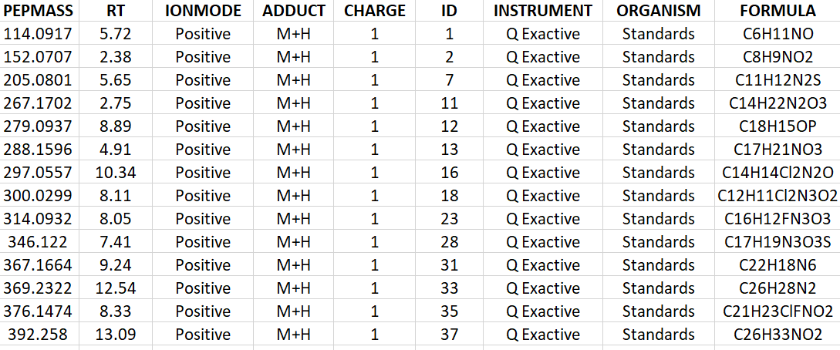
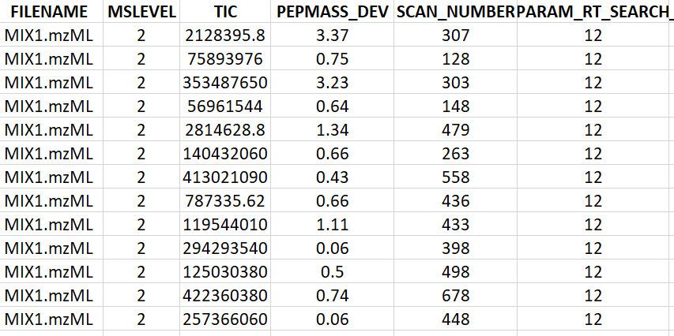
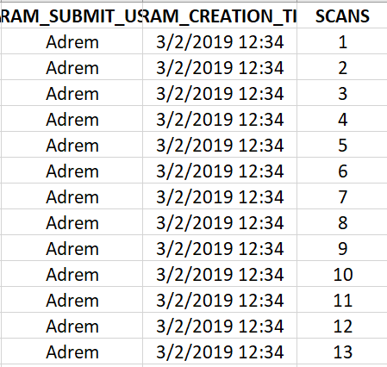
Example of a “scan”
Metadata
GNPS-style
spectral library file
Spectra data
Following metadata columns are appended or updated:
Actual value detected
Metadata
Following metadata columns are added:
Chromatogram information
Search parameters
…
User information

Slide 9
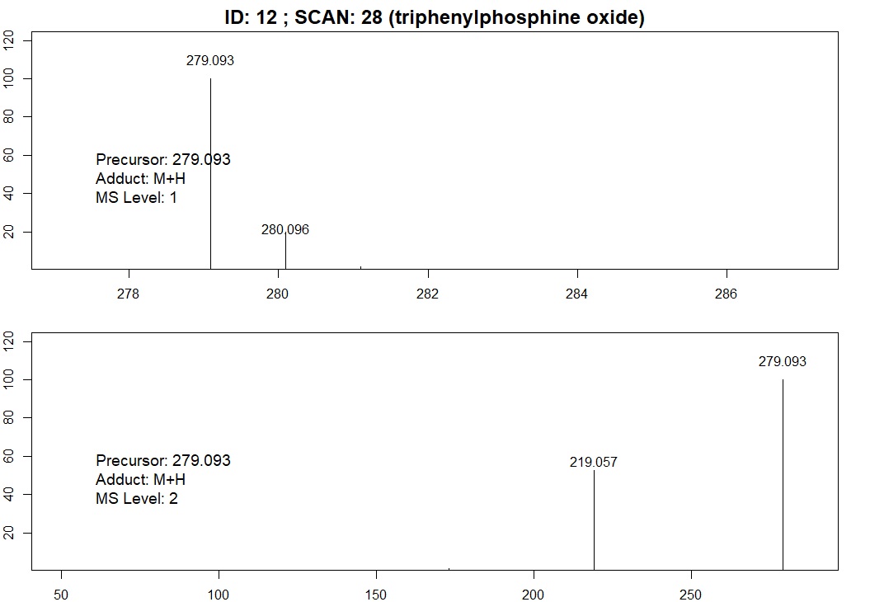

Slide 10
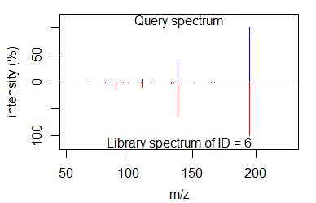

Slide 11
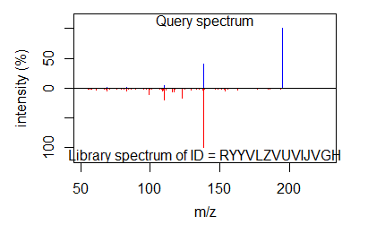
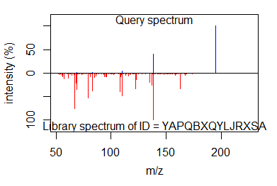
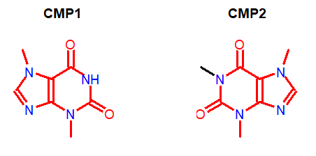

Slide 12
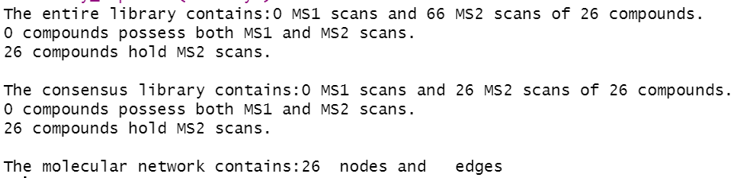
No MS1 scan was extracted since the goal is library search and MS2-based networking
Total number of MS2 scans. Each feature was fragmented in multiple files
A unique consensus scan was generated for each input feature
Not yet generated

Slide 13
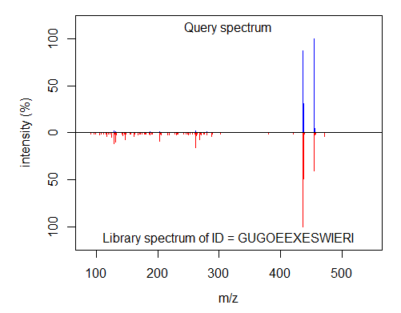
Query spectrum extracted from experimental data based on Terfenadine m/z
Reference spectra of Terfenadine labeled by its Inchikey

Slide 14
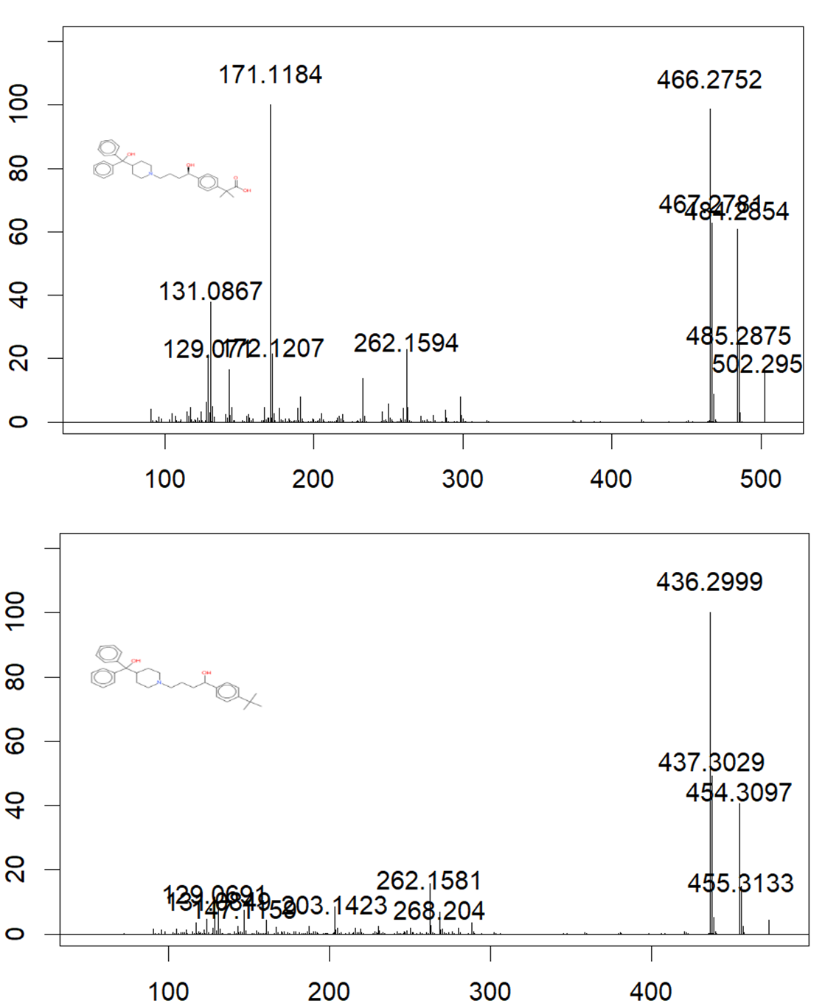

Slide 15
