Slide 1
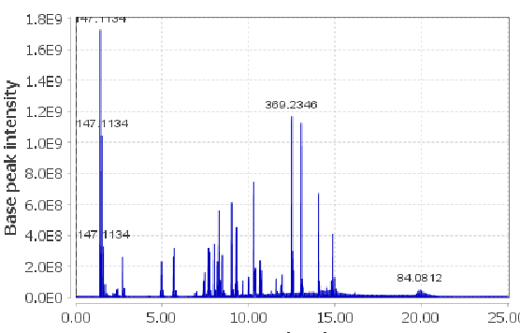
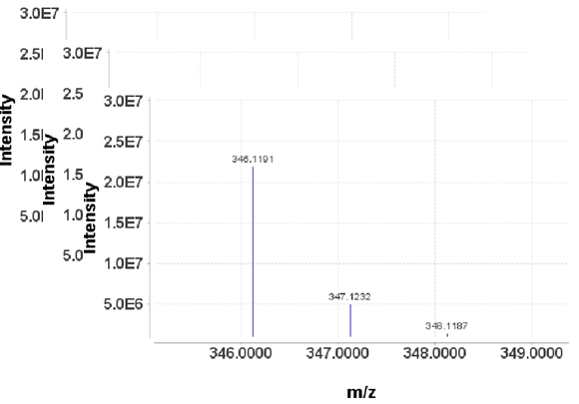
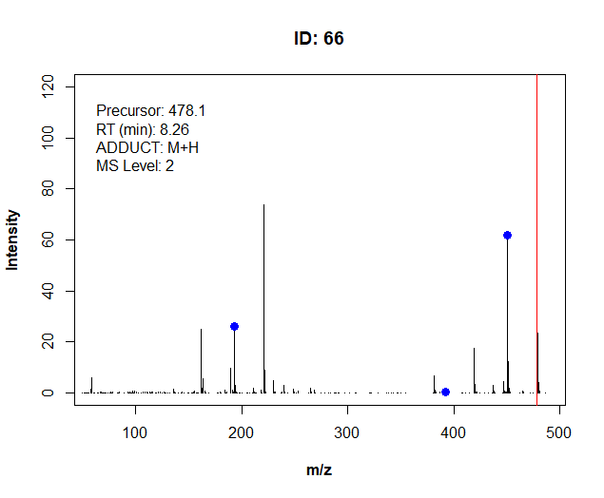
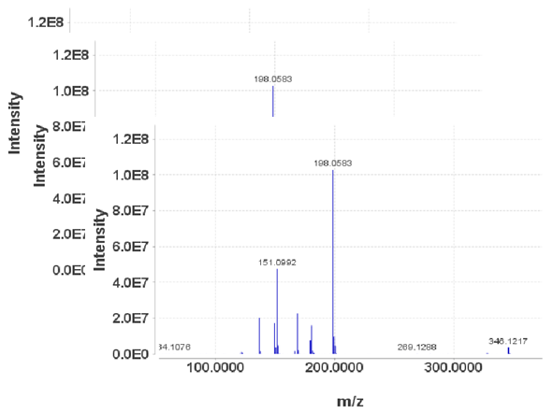
process_library()
In-house library
Search & plot
Extract MS1
LC-MS/MS Thermo
Water
Bruker
…
mzML
Centroid mode
mzML
(Centroid)
library_generator ()
Merged spectral library
MSConvertGUI
or vendor software
Extract MS2
CSI_FingerID_writer()
MSFinder_writer()
MetFrag_writer()
Targeted exact mass
Targeted retention time
Feature ID
Ion mode
Adduct type
…
Metadata
(.csv)
(Previous library .mgf)
Smart algorithms
Batch processing
Adapted formats

Slide 2


library_manager()
Query one or more metadata
simple fragment search
Meta_editor()
Searching for adduct and multi-charged
Search_param
Remove records
Update metadata
Library_visualizer()
Input
MSConvert ()
Docker (Ronald)
library_
generator ()
LC-MS/MS Thermo
Water
Bruker
…
Previous
library
mzML
Centroid mode
mz(X)ML
(Centroid)
MS1+MS2
Ouput Library
Spectra_compare()
Updated metadata
Library_reporter()
Nb of compounds
Class prediction
Update history
Metadata_sum
Targeted mass
Targeted rt
D-NUM ID
JNJ ID
Ion mode
…
Basic metadata
(.csv)
Struc_retrieval()
Rate project (Ronald)
Smiles/INCHI
Input
Devco

Slide 3
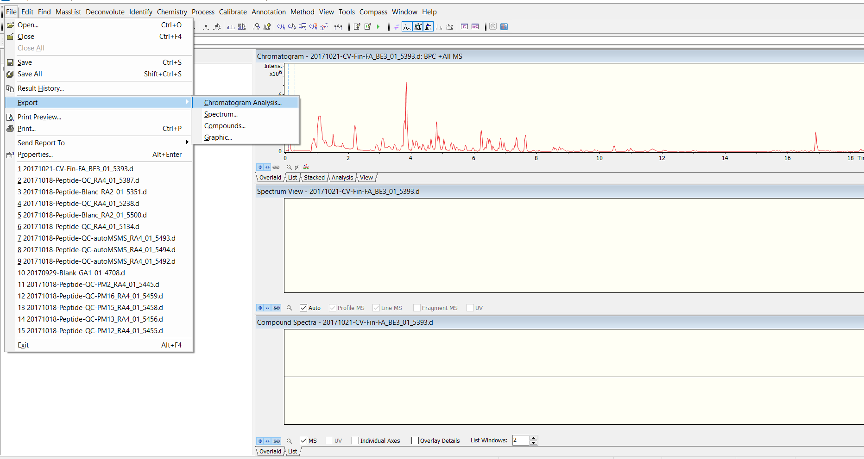
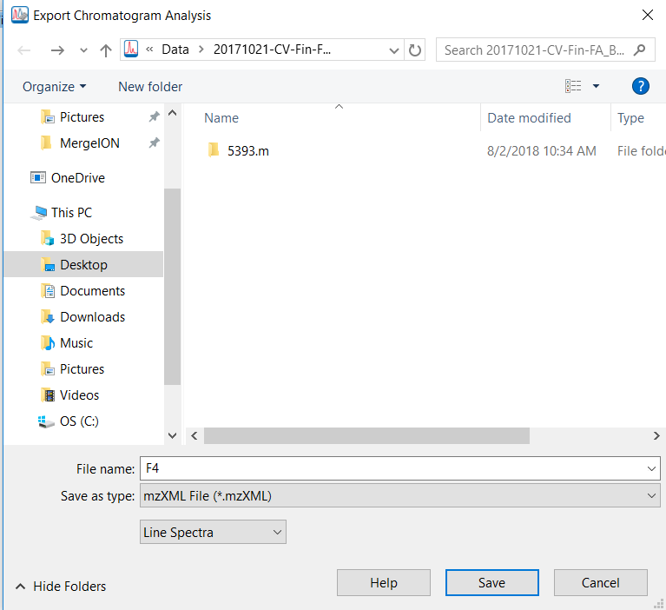
(Line spectra = Centroid-mode)

Slide 4
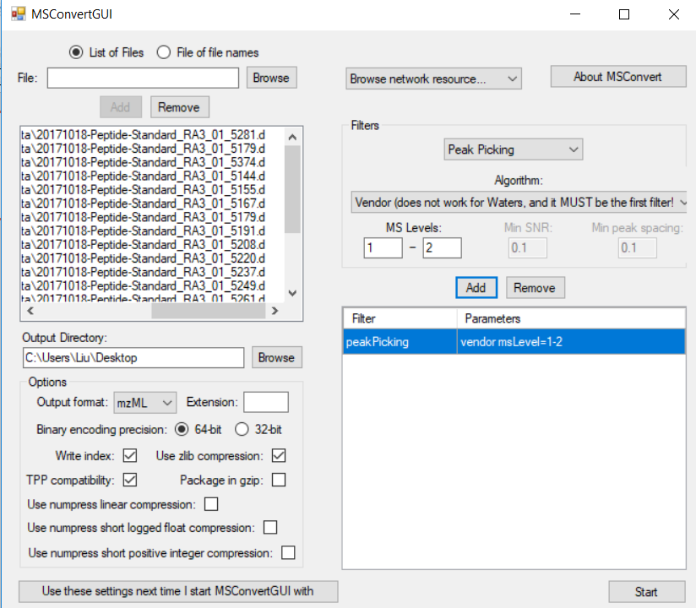
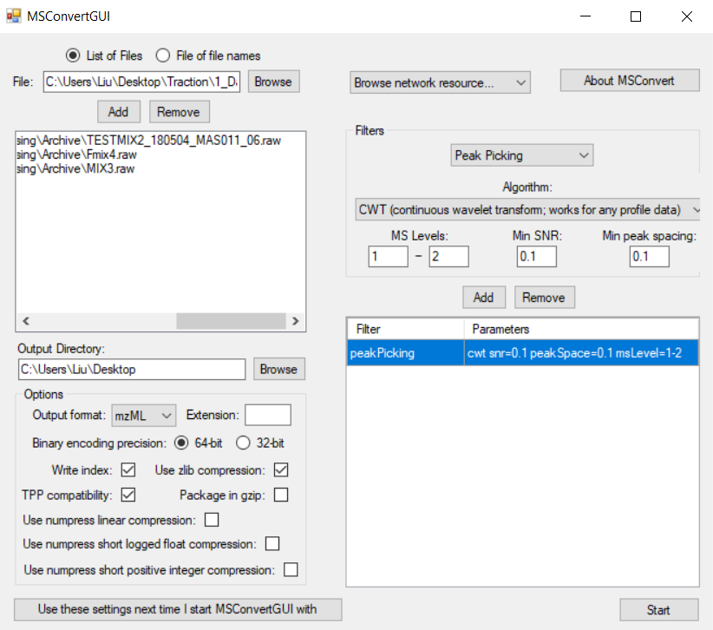
1. Browse and add raw LC-MS files.
v
v
v
v
2. If your data is in profile mode, you need to apply peak picking for both MS1 and MS2 scans. We recommend Vendor algorithms for all data formats except for Waters’.
2. Please choose CWT algorithm to centroid Waters data file. Please use default parameters.
3. Define output format and output directory.
4

Slide 5
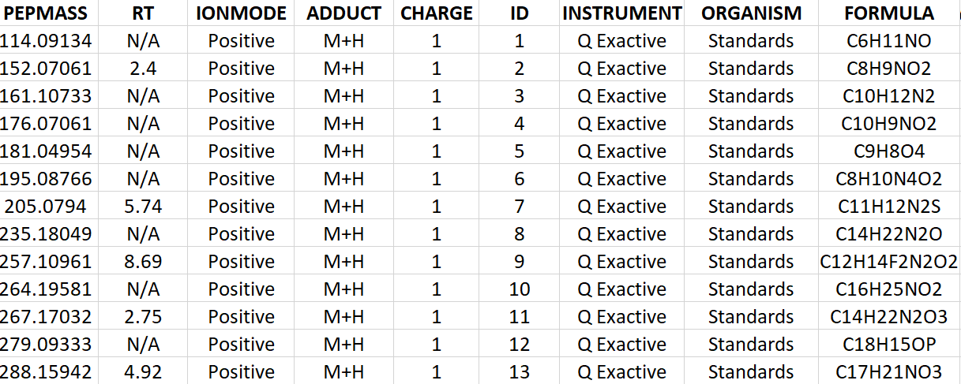
Retention time (in minute) of metabolic features to be found, please put it to N/A if unknown. MergeION will detect all isomers.
Precursor ion adduct type, one of "M+H","M+Na","M+K","M-H“, "M+Cl"
A unique identifier for targeted compounds in spectral library, number or character
Charge number,
Please keep the value at 1
"Positive"
or "Negative"
Precursor m/z to be found in chromatograms
The first six columns of the metadata are mandatory. Column names and their order must not be changed !
Rest of columns are optional

Slide 6
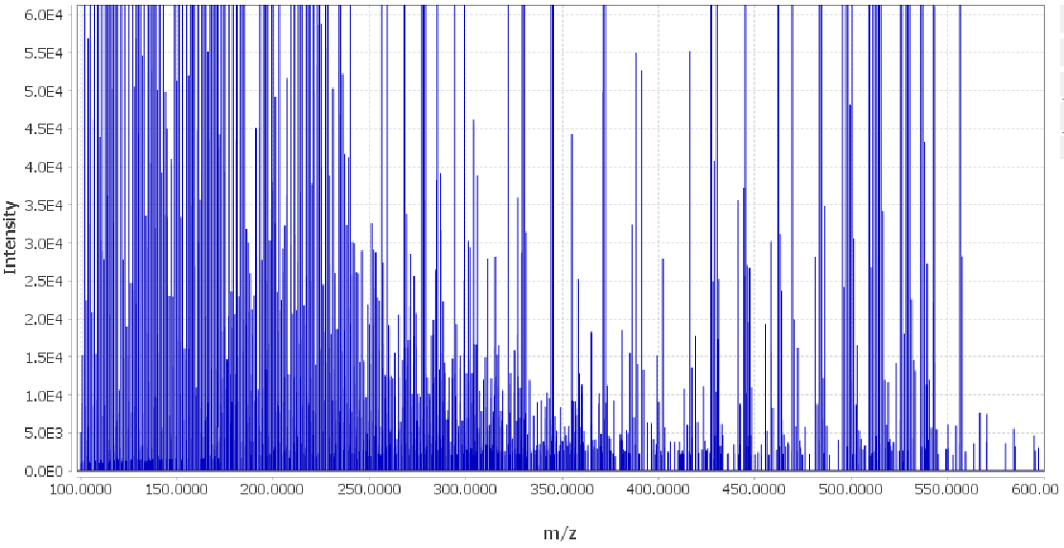
Baseline ≈ 1000

Slide 7
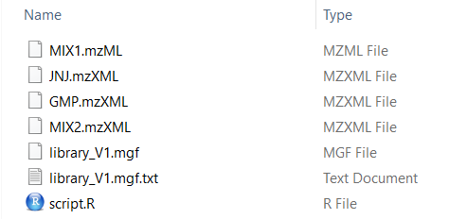
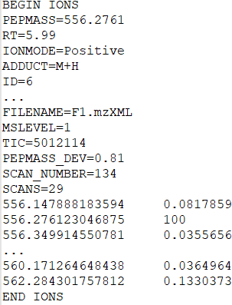
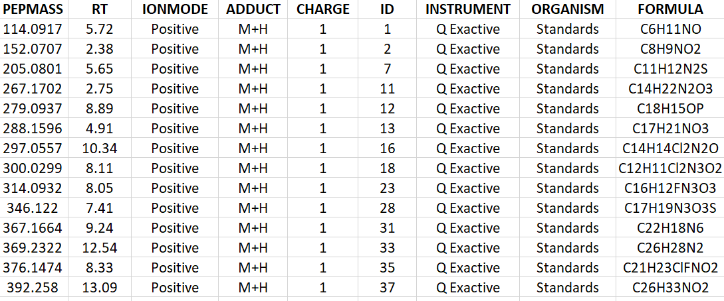
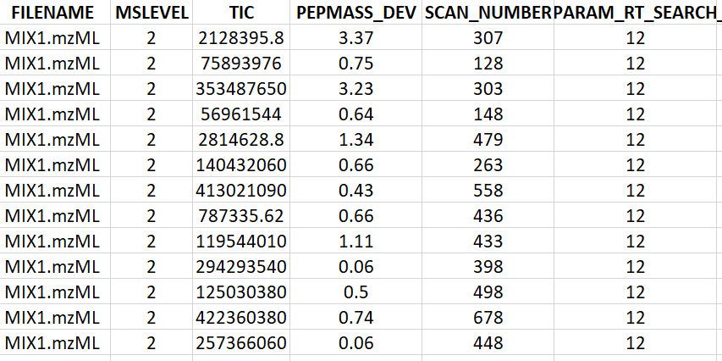
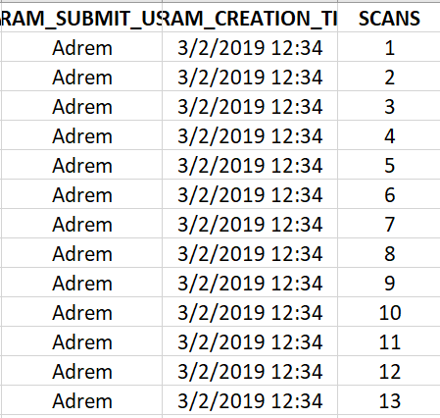
Example of a “scan”
Metadata
GNPS-style
spectral library file
Spectra data
Following metadata columns are appended or updated:
Actual value detected
Metadata
Following metadata columns are added:
Chromatogram information
Search parameters
…
User information

Slide 8
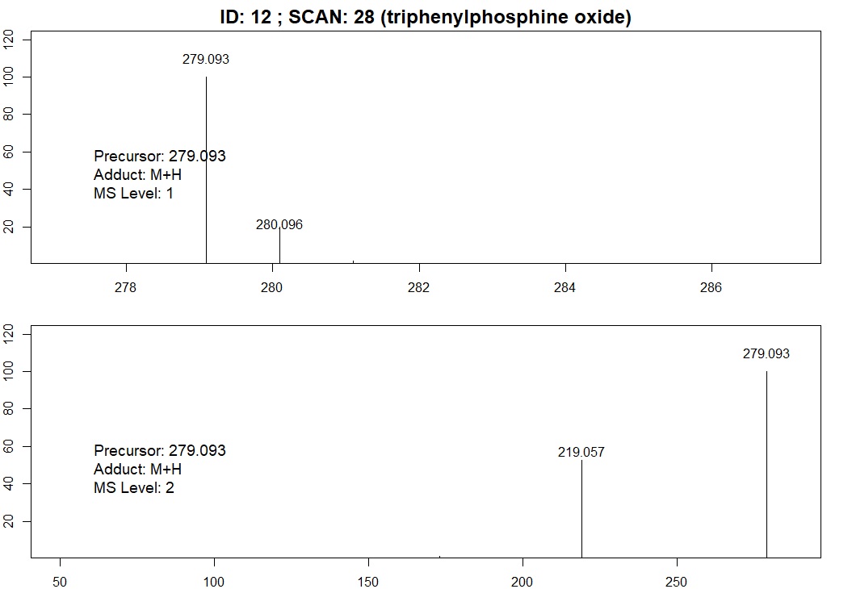

Slide 9
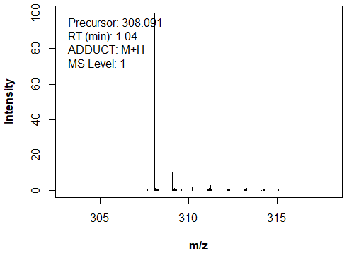
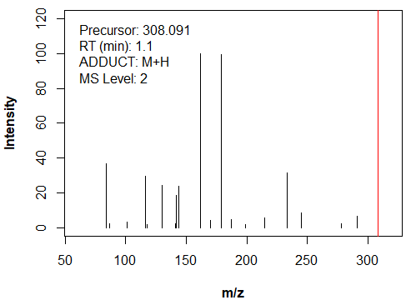
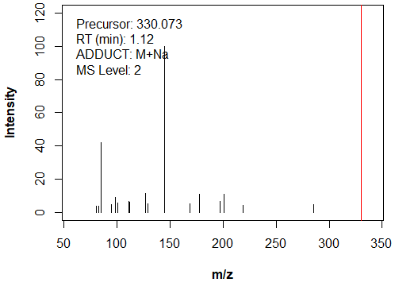

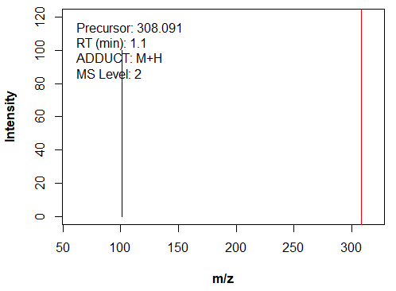
ID = 28
MS1 scan is the same in library2, library2_2 or library2_3 !
library2
library2
library2_2
library2_3

Slide 10
m/z and intensity of matched query fragments

