Slide 1
Tech gist of the week Prototype Chains
Daniel Marchena

Slide 2
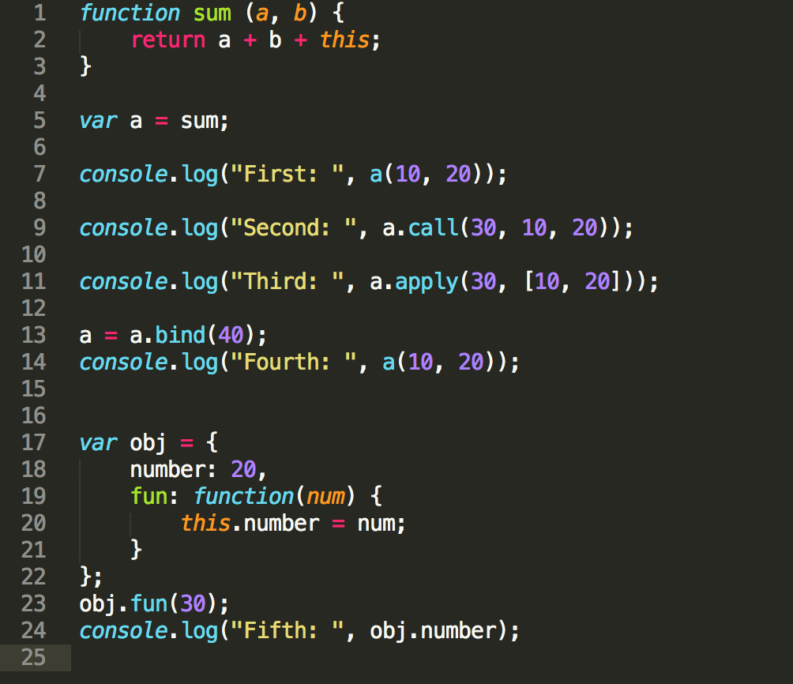
Remember?

Slide 3
What is it?
Make objects resemble other objects.
Why?
Sometimes we want two objects to have all the same properties, either to save memory or to avoid code duplication

Slide 4
What to do?
Copy all the properties from one object to the other?
Nop, let`s be more economical. We will direct the failed lookups of an object to another one.

Slide 5
Time to code!

Slide 6
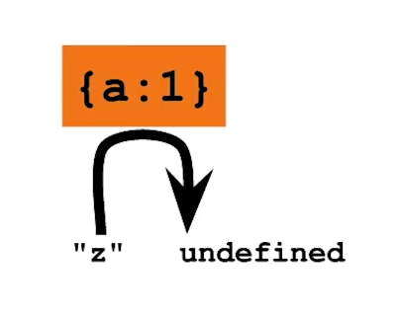
basicPropertyLookup.js

Slide 7
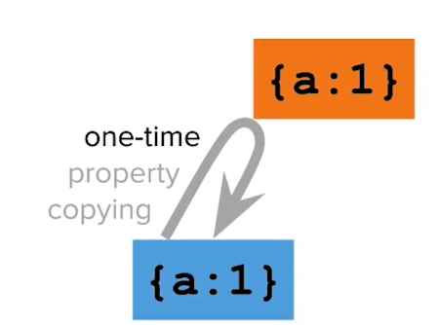
basicPropertyLookup.js

Slide 8
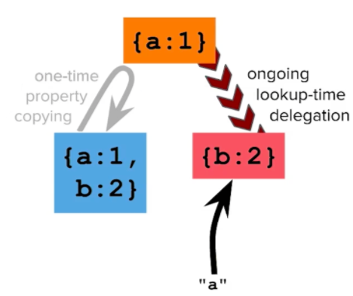
basicPropertyLookup.js

Slide 9
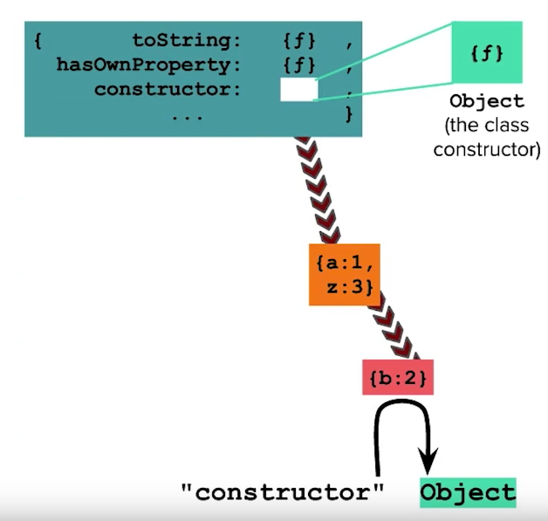
basicPropertyLookup.js

Slide 10
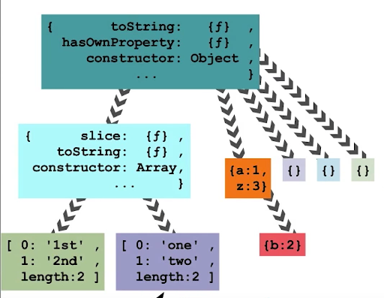
basicPropertyLookup.js

Slide 11
https://github.com/danielmapar/JSOO/tree/master/gists/week3

