Slide 1
Tech gist of the week The parameter this
Daniel Marchena

Slide 2
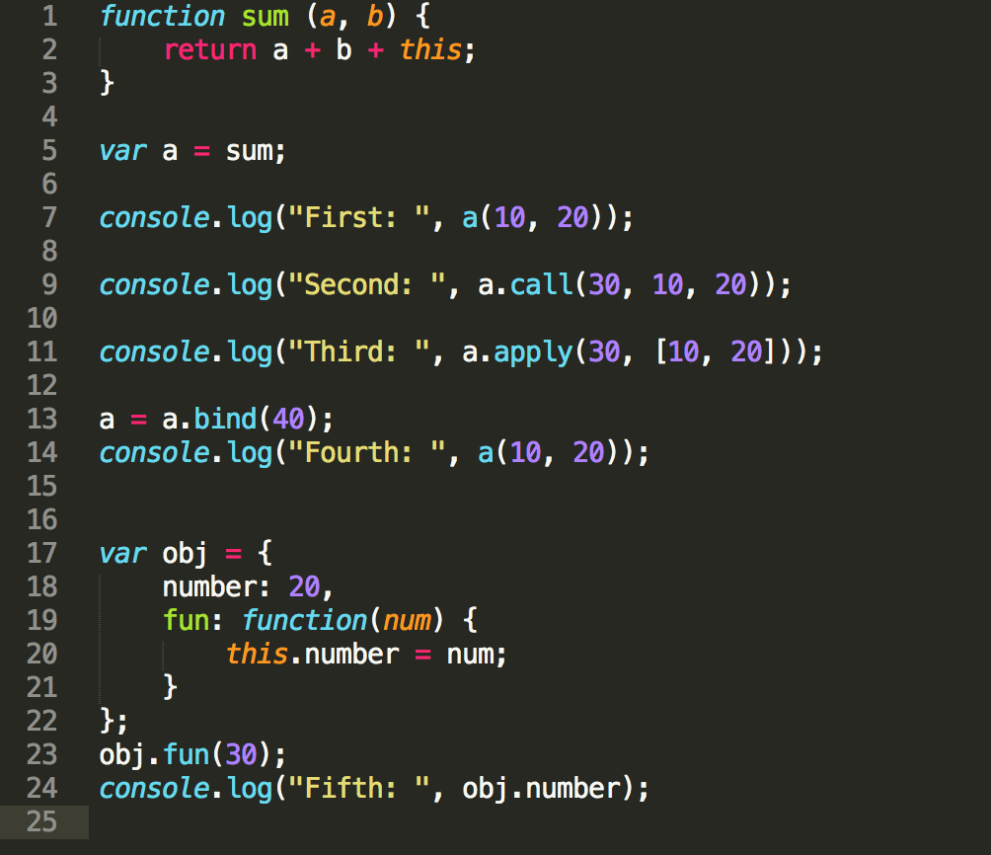
Remember?

Slide 3
What is “this” in other languages?
Dynamically refer to the current object/instance.

Slide 4
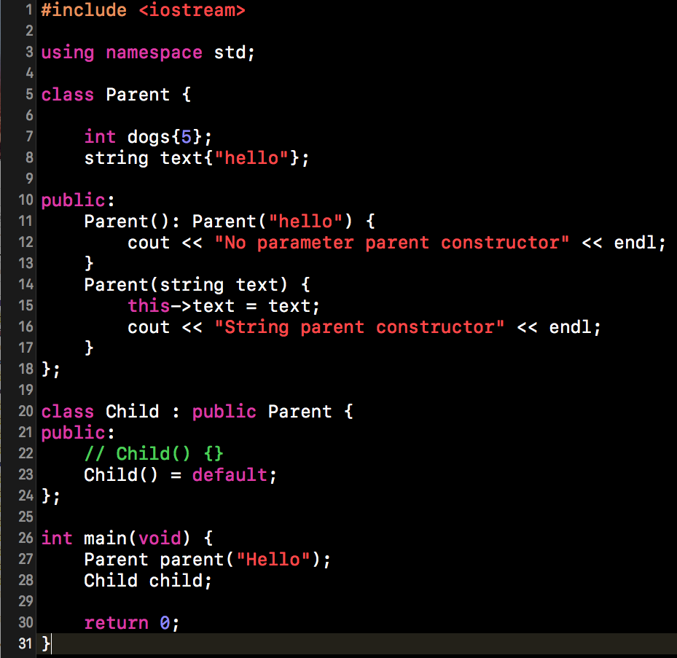

Slide 5
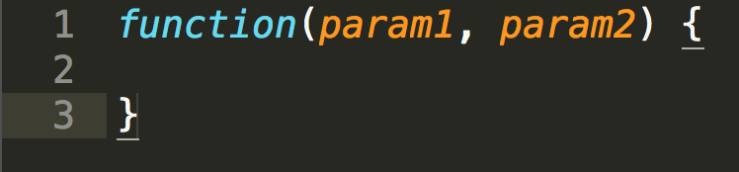
What the is the parameter this in JS?
The parameter this is like any other function parameter
There is two major differences between a regular parameter and the parameter this:
You don’t get to pick the name for the parameter this
You bind values to the parameter this a bit differently
Their 5 different ways to do it (we will explore that)

Slide 6
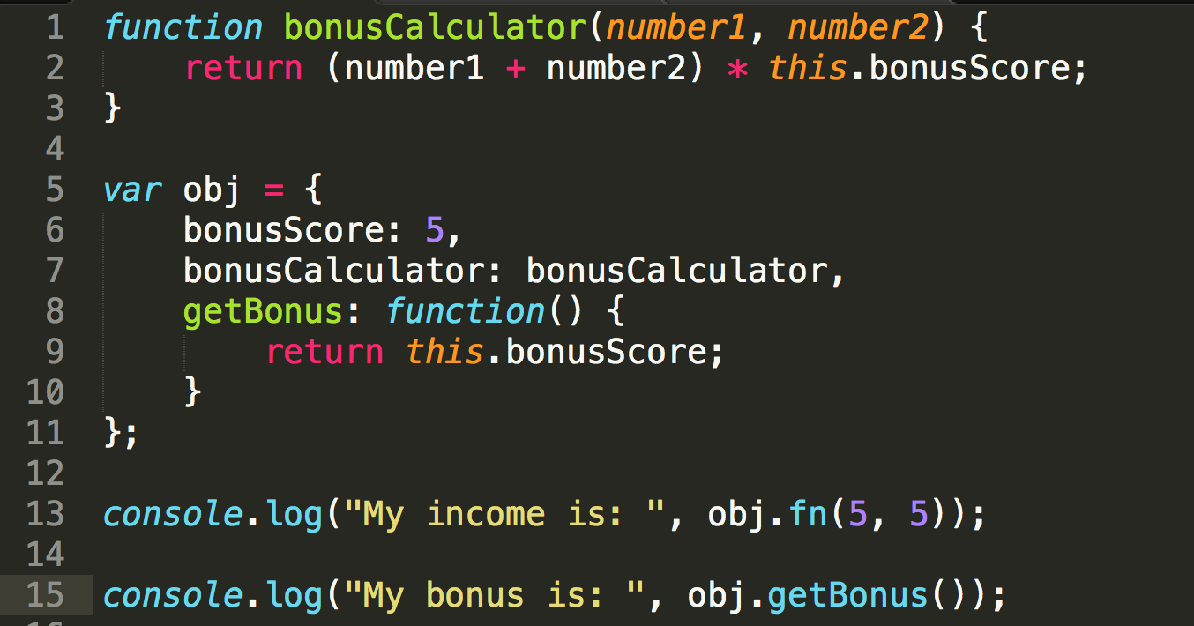
Parameter this binded directly to object

Slide 7
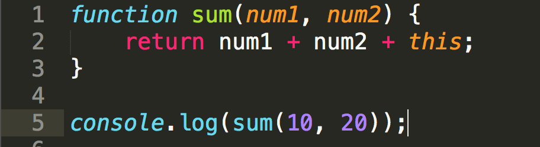
Parameter this binded global object

Slide 8
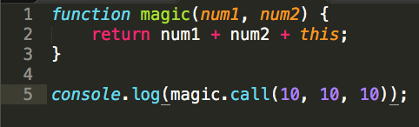
Parameter this binded using .call

Slide 9
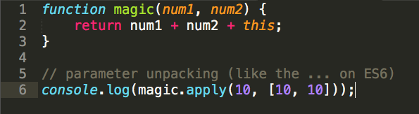
Parameter this binded using .apply

Slide 10
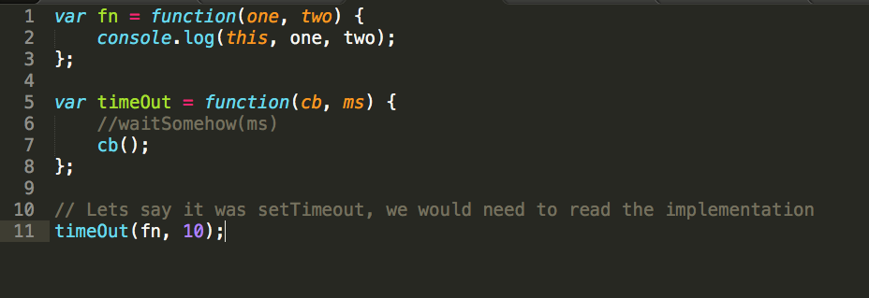
Parameter this and callbacks
http://stackoverflow.com/questions/11605917/this-vs-scope-in-angularjs-controllers

Slide 11
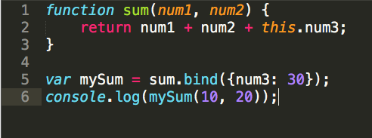
Parameter this using bind

Slide 12
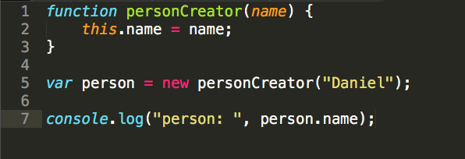
Parameter this and the new keyword
This will get clear next talk

Slide 13
Back to the quiz ☺

Slide 14
https://github.com/danielmapar/JSOO/tree/master/gists/week2

