Slide 1

Welcome
TPL & Message Pumps
webinar
Notes:
A warm welcome to part II webinar in the async webinar series.
Today we talk about the task parallel library and message pumps

Slide 2
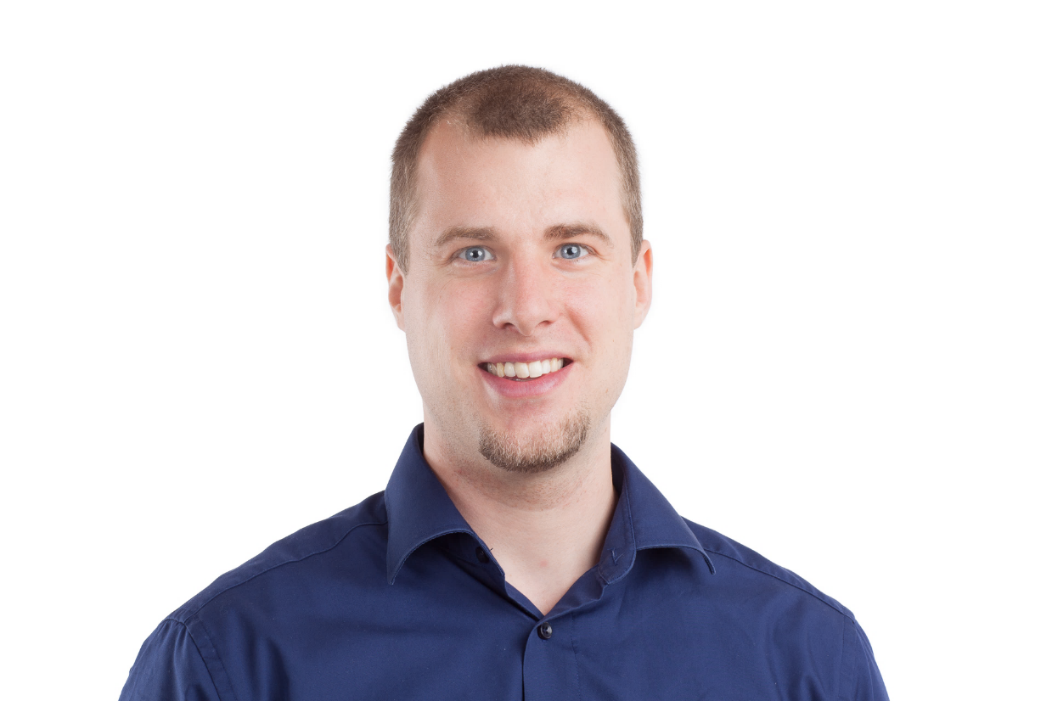
Solution Architect
Enthusiastic Software Engineer
Microsoft MVP for systems integration
@danielmarbach
particular.net/blog
planetgeek.ch
Notes:
I’m Daniel, Solution Architect…
I live in central Switzerland. If you want to know more about me listen to episode 77 of developer on fire
You can reach me on twitter under @danielmarbach
I blog on the particular blog and on my personal blog
Subscribe after this webinar

Slide 3
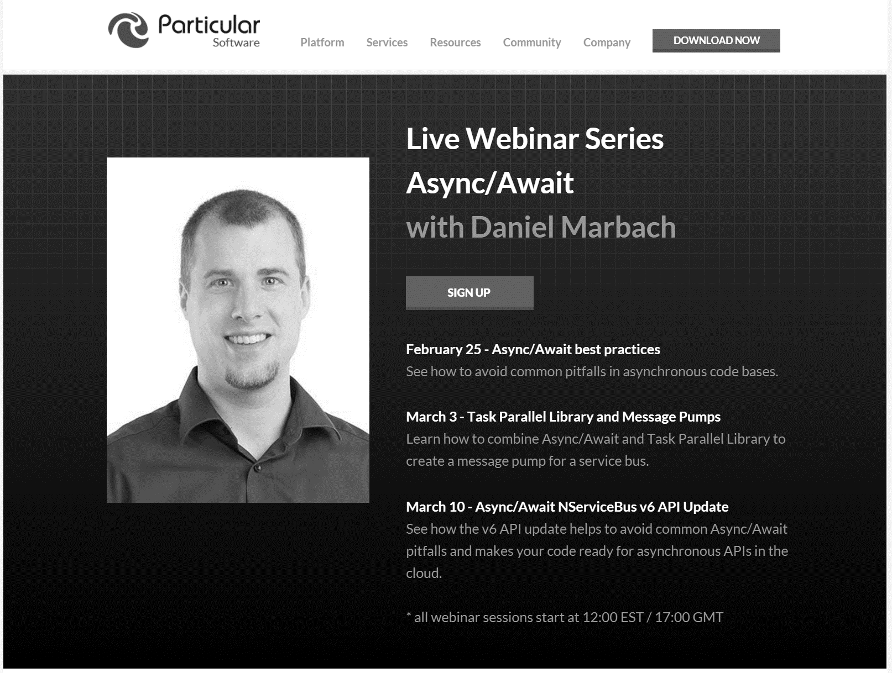
particular.net/async-await-webinar-series
Next
Notes:
In the next webinar we will dive deeper and write a message pump for a service bus which combines async/await with TPL
We’ll learn where TPL contains unpleasant surprises and how we can work around those
Join again, invite your friends and learn to apply more than just the basics of async/await

Slide 4
Slides, Links…
github.com/danielmarbach/03-03-2016-AsyncWebinar
Notes:
Questions that can be answered in blog posts

Slide 5
Q & A
await
Notes:
Reduces christmas tree programming to code which looks much

Slide 6
Thanks
Notes:
Thank you very much for listening and see you next time

