Slide 1

Welcome
TPL & Message Pumps
webinar
Notes:
A warm welcome to part II webinar in the async webinar series.
Today we talk about the task parallel library and message pumps

Slide 2

Solution Architect
Enthusiastic Software Engineer
Microsoft MVP for systems integration
@danielmarbach
particular.net/blog
planetgeek.ch
Notes:
I’m Daniel, Solution Architect…
I live in central Switzerland. If you want to know more about me listen to episode 77 of developer on fire
You can reach me on twitter under @danielmarbach
I blog on the particular blog and on my personal blog
Subscribe after this webinar

Slide 3
Goals
Combine async/await with the TPL
Throttling your concurrent operations
Graceful shutdowns
target
Notes:
Deal with non-true asynchronous code paths
Avoid unpleasant surprises when combining Async/Await with the Task Parallel Library
Achieve "graceful" shutdowns by applying cancellation to asynchronous operations
Achieve throttling with your concurrent operations without needless blocking

Slide 4
The Pump
Code
WrapUp
Notes:
This webinar is divided into three parts
The pump
Code and WrapUp including Q&A

Slide 5
The Pump
Code
WrapUp
Notes:
This webinar is divided into three parts
The pump
Code and WrapUp including Q&A

Slide 6


Your code
Message Pump
Queue

Slide 7
The Pump
Code
WrapUp
Notes:
Now we set the baseline with the terminologies. Let’s dive into code.

Slide 8
Demo
await

Slide 9

Semaphore
gated

Slide 10
Demo
await

Slide 11
The Pump
Code
WrapUp

Slide 12
Prefer Task.Run over Factory.StartNew Use CancellationToken to cancel operations inside tasks
Use SemaphoreSlim to throttle instead of a custom TaskScheduler
Recap
reminder

Slide 13
Recap
Don’t use LongRunning or AttachToParent for Tasks with async operations
Non-blocking all the way, to maximize throughput
reminder

Slide 14
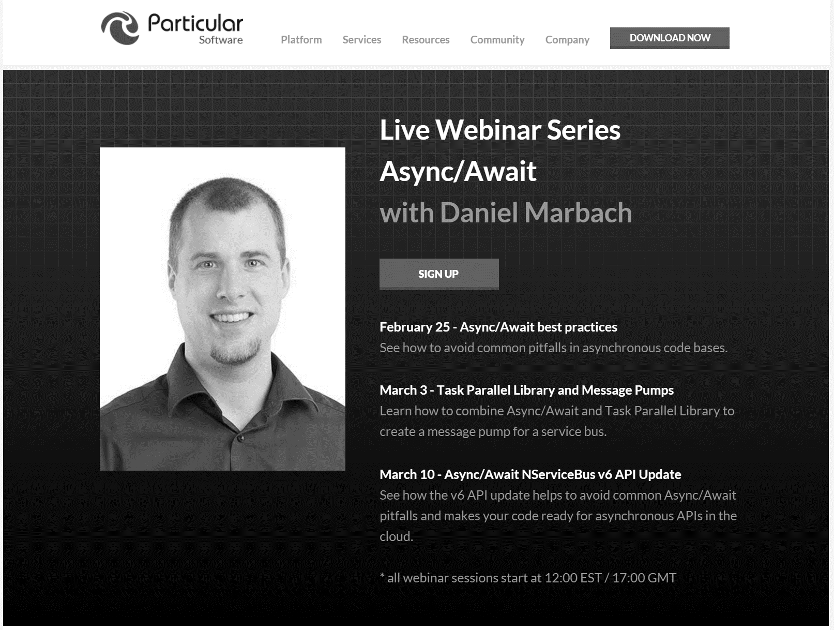
particular.net/async-await-webinar-series
Next
Notes:
In the next webinar we will dive deeper and write a message pump for a service bus which combines async/await with TPL
We’ll learn where TPL contains unpleasant surprises and how we can work around those
Join again, invite your friends and learn to apply more than just the basics of async/await

Slide 15
Slides, Links…
github.com/danielmarbach/03-03-2016-AsyncWebinar
Notes:
Questions that can be answered in blog posts

Slide 16
Q & A
await
Notes:
Reduces christmas tree programming to code which looks much

Slide 17
Thanks
Notes:
Thank you very much for listening and see you next time

