Slide 1
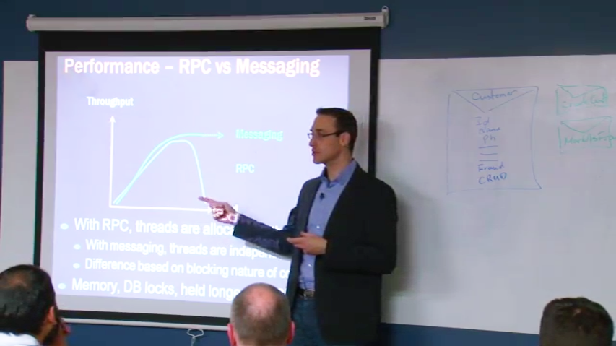

Thank you
Learn to design better systems
Get access to 2 full days of Udi Dahan's Advanced Distributed Systems Design video course.
Sign up here:
http://go.particular.net/Anzcoders
Access code: LZRAIT
Expiration date: 9/6/2015

