Slide 1
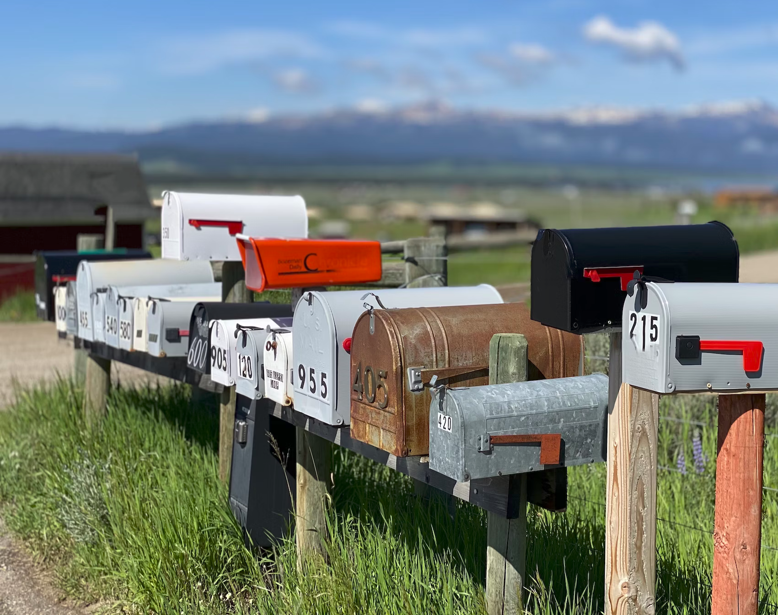
Navigating through the Azure Messaging (over)choice
daniel.marbach@particular.net
Notes:
A warm welcome from my side
Today we are going to look into three different services. Azure Service Bus, Event Hubs and Event Grid. The focus on this talk is to show you robust and reliable code patterns to use these services and teach you crucial knowledge about these services to be successful in your projects. These three services are the building blocks for buidling scalable and reliable distributed systems on top of Azure.
The samples and code snippets are deliberately kept to the essence to not distract too much from the essential Azure .NET SDK code. Throughout the talk I‘ll be showing you code in the IDE and run samples in the console locally. I‘ll do a mixture of showing things in the portal but there is also a fair amount of things I have already setup to save you from watching me doing the boring setup. Please let me know in case the fonts are too small otherwise I will just pretend everything is fine ;) All the code and the infrastructure bicep templates are available in the github repository I‘ll share at the end.
I‘ll do my best to cover the most important things throughout the talk but I also want to highlight that many of those Services have many knobs and dials that would allow me talking about an single service for multiple hours. Should you have questions about the service that my presentation wasn‘t able to cover I‘m happy to be available throughout the conference, via LinkedIn, Bluesky or the email address above. I have also added a few business cards to the edges of the stage should in case you‘d want to keep the business card as a reminder.
Let‘s get started with Azure Service Bus

Slide 2
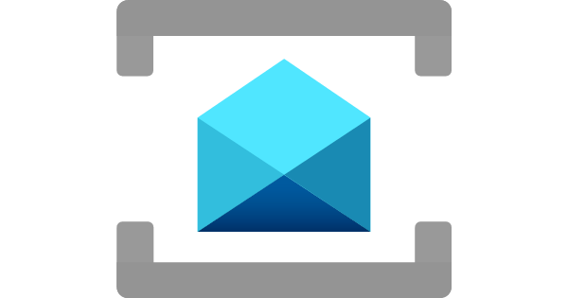
Azure Service Bus
Notes:
Type: Message, Event distribution (within the enterprise). Single message is the information carrier
When to use: Order processing and financial transaction
Error handling: Individual messages can be individually processed several times, put on hold, or marked as processed
Service Bus is a fully managed enterprise message broker with message queues and publish-subscribe topics. The service is intended for enterprise applications that require transactions, ordering, duplicate detection, and instantaneous consistency. Service Bus enables cloud-native applications to provide reliable state transition management for business processes. When handling high-value messages that can't be lost or duplicated, use Azure Service Bus. This service also facilitates highly secure communication across hybrid cloud solutions and can connect existing on-premises systems to cloud solutions.
- Very cheap consumption-based pricing model (Standard), 12 cents per hour, roughly 10 USD a month as a base price with some operations included
- Shared-resources model
- Capacity-based pricing model (Premium), 90 cents per hour, roughly 700 USD a month per messaging unit. No operation based charges
- Isolated-resources model

Slide 3
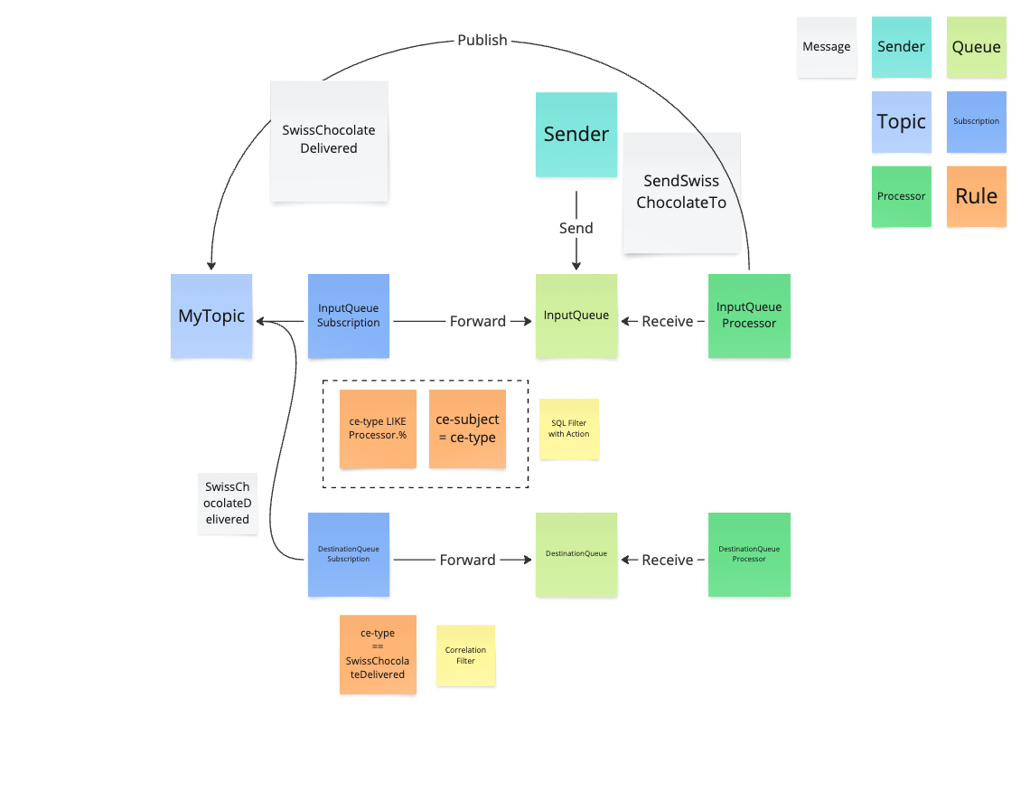

Slide 4
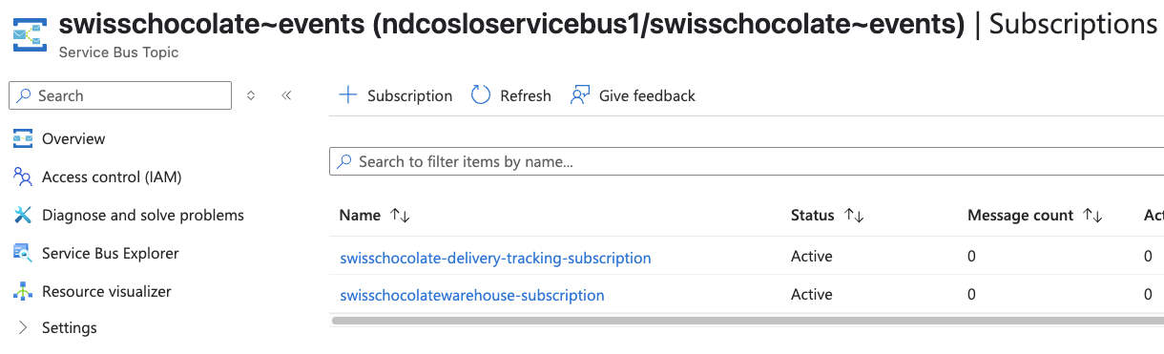

Slide 5
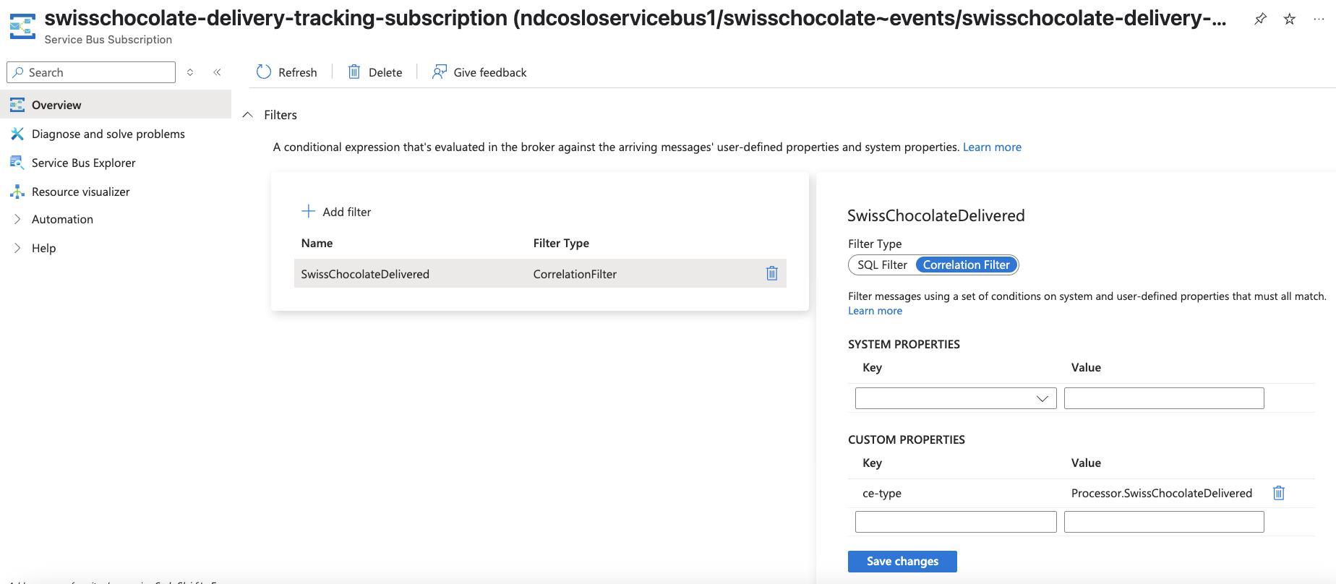

Slide 6
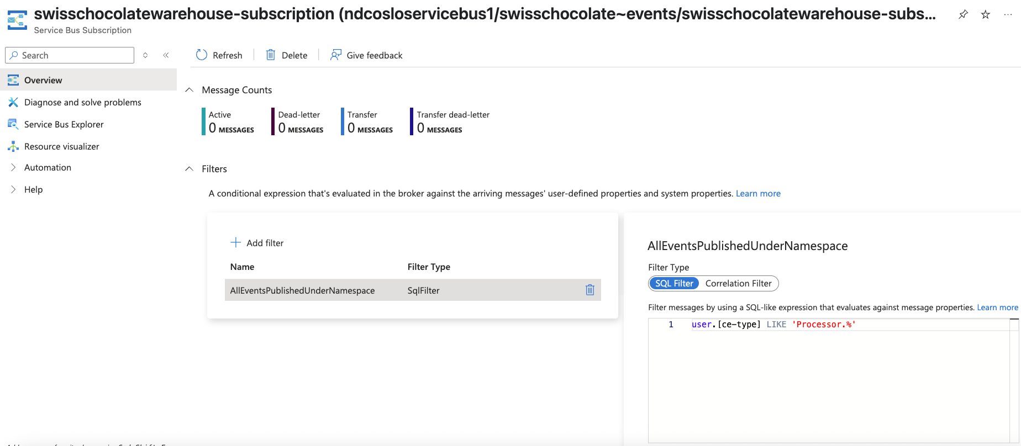

Slide 7

Notes:
Processor

Slide 8
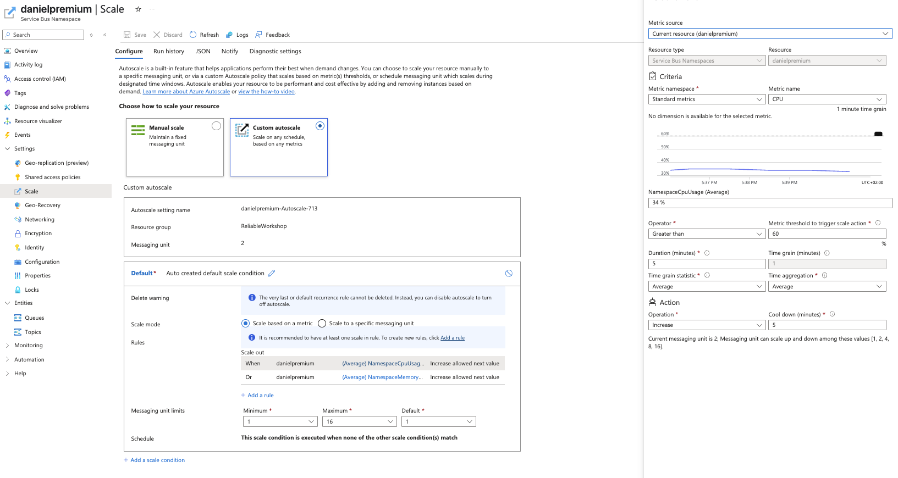


Slide 9
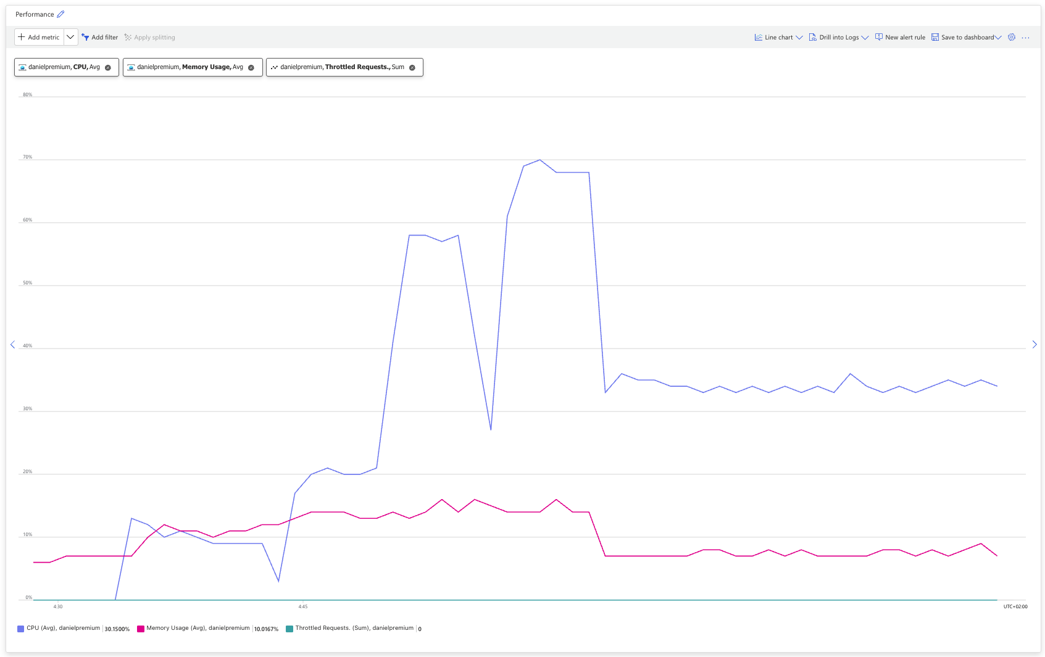
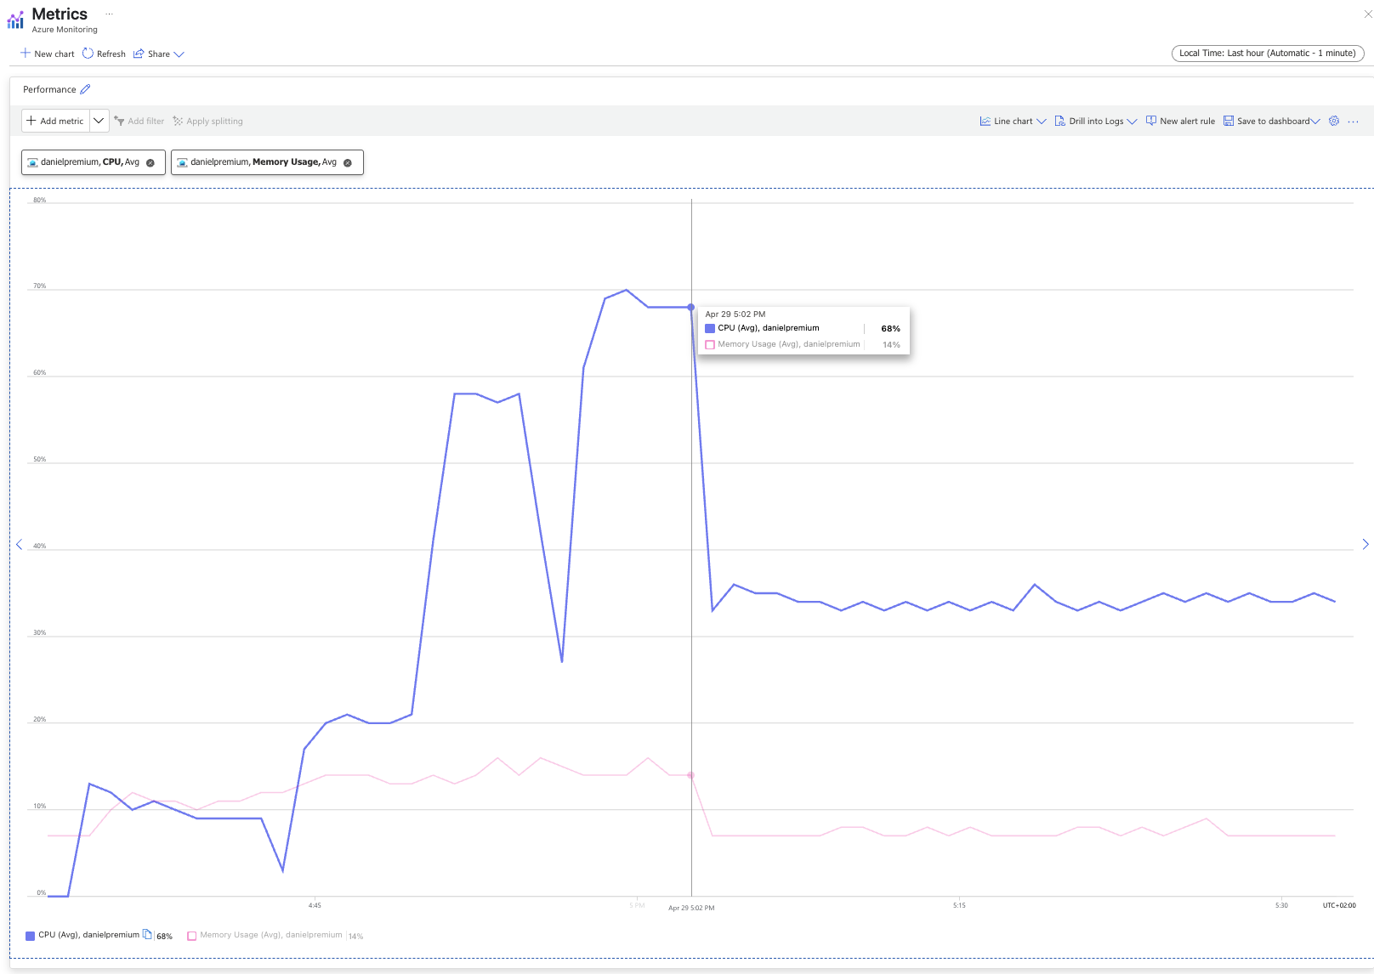
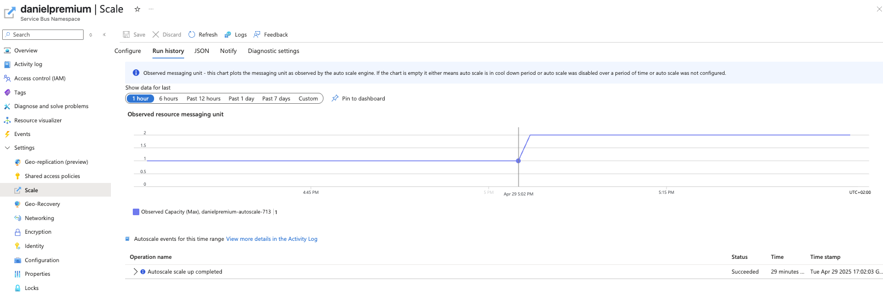
Finally!
redeploy
redeploy
redeploy

Slide 10
Notes:
RBAC

Slide 11
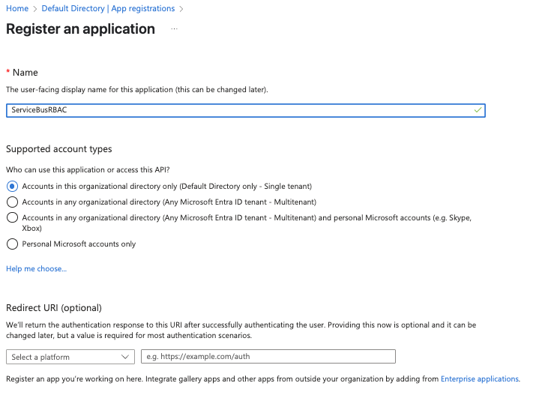

Slide 12
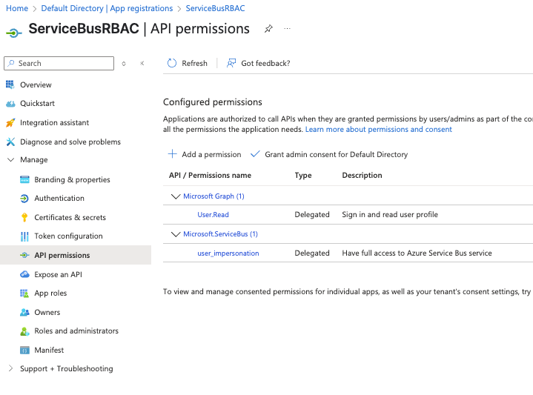

Slide 13
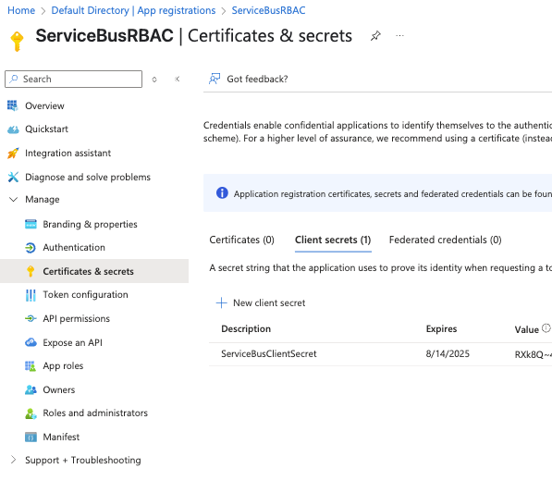

Slide 14
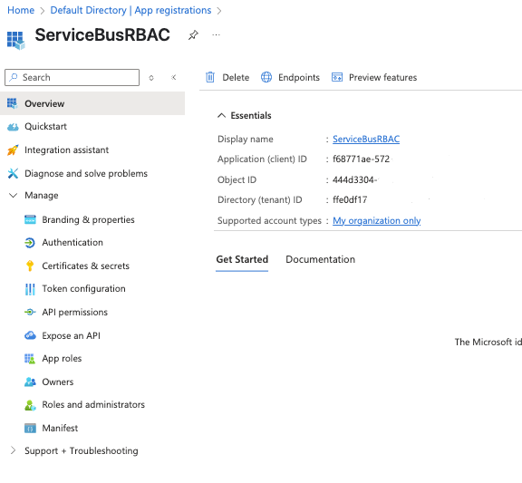

Slide 15
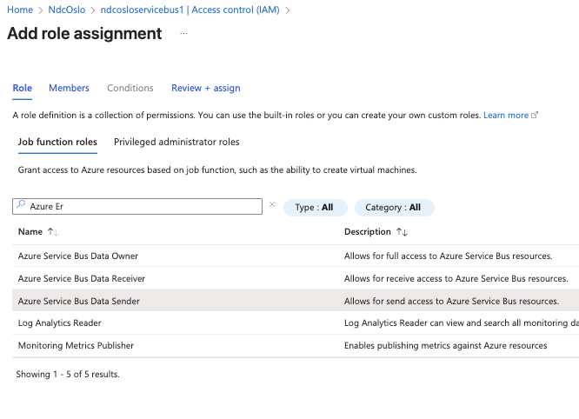

Slide 16
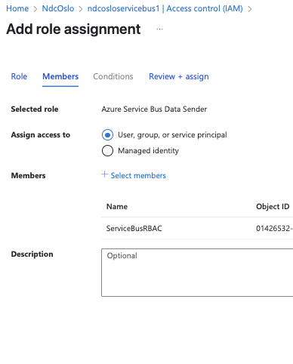

Slide 17
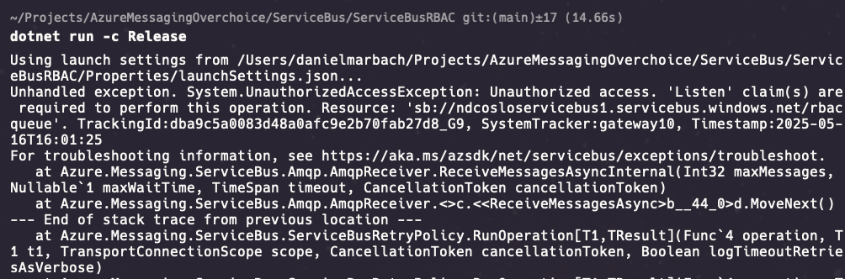

Slide 18
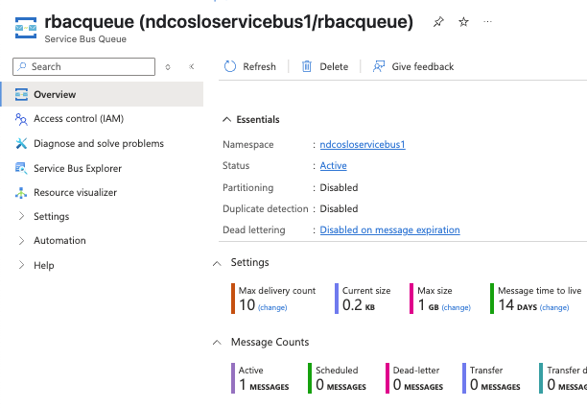

Slide 19
Notes:
Session

Slide 20
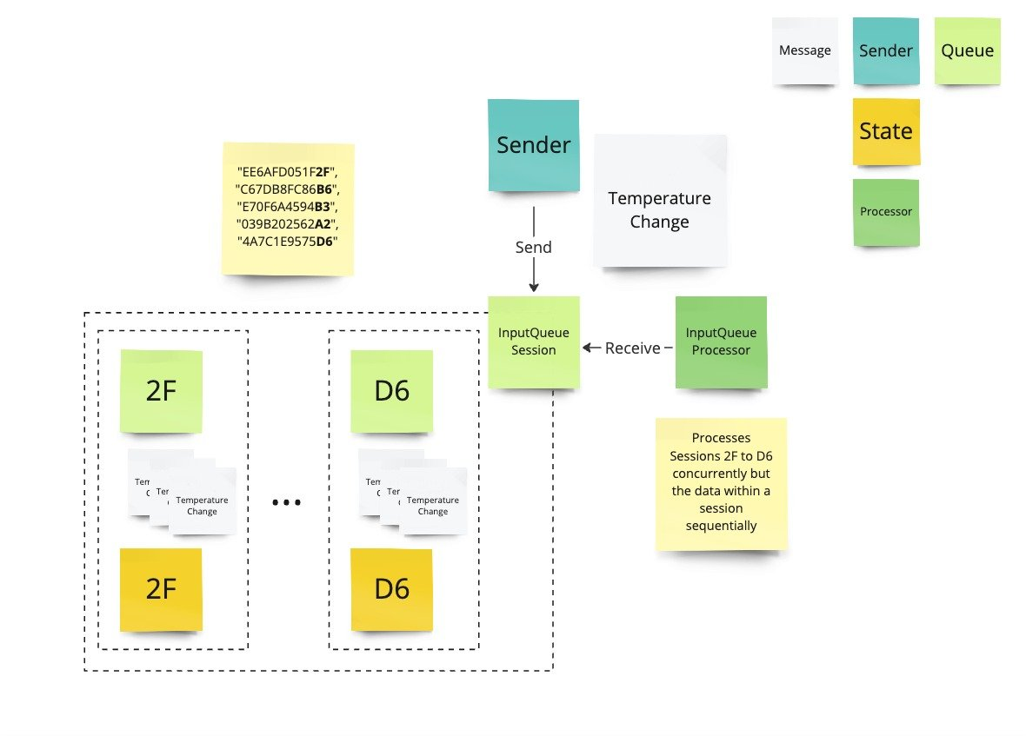

Slide 21
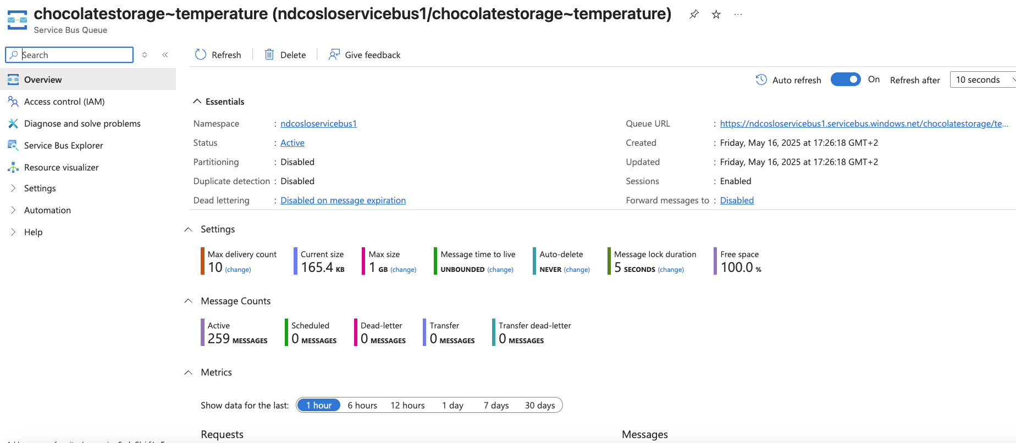

Slide 22
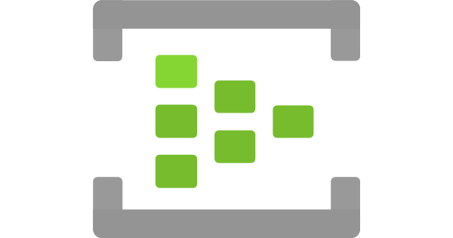
Azure Event Hubs
Notes:
Purpose: Big data pipeline, realtime event-processing and data-distribution
Type: Event streaming (series). The series of event is the information carrier
When to use: Telemetry and distributed data streaming
Error handling: Read the log stream again from a certain offset or skip the offset. Tombstone certain records and move them to a dedicated stream.
Azure Event Hubs is a big data streaming platform and event ingestion service. It can receive and process millions of events per second. It facilitates the capture, retention, and replay of telemetry and event stream data. The data can come from many concurrent sources. Event Hubs allows telemetry and event data to be made available to various stream-processing infrastructures and analytics services. It's available either as data streams or bundled event batches. This service provides a single solution that enables rapid data retrieval for real-time processing, and repeated replay of stored raw data. It can capture the streaming data into a file for processing and analysis.
Azure Event Hubs is widely adopted in industries that produce high volumes of streaming data. The automotive sector, for example, frequently uses Event Hubs for connected vehicle telemetry. Other common applications include IoT telemetry from devices such as elevators, coffee machines (e.g., Thermoplan), and real-time data replication scenarios.
Event Hubs is also commonly used alongside tools like Kafka and Debezium to implement change data capture (CDC), support outbox patterns, and enable the decoupling of monolithic databases into modular, event-driven components. It is particularly suited for high-throughput, append-only, time-ordered event ingestion.
- Azure Event Hubs Standard (40 MB/sec ingress)
- 1TU = min(1000 msg/s, 1MB/s in), min(2000 msg/s, 2MB/s out), 3 cents per hour per throughput unit, 3 cents per hour per 1 million operations
- Shared-resource Model
- Capacity and consumption-based pricing
- Azure Event Hubs Premium (120 MB/sec ingress)
- 1PU = ~5-10MB/sec throughput, 1,25 USD per hour per premium unit
- Isolated-Resource Model
- Capacity based pricing. No consumption charges
- Azure Event Hubs Dedicated, 120MB/sec ingress (>4 GB/sec in prod)
- Capacity unit 6,4 USD per hour per capacity unit, operations included
- 8 CU required for AZ
- Dedicated-Resource Model
- Same as premium but fully isolated cluster

Slide 23
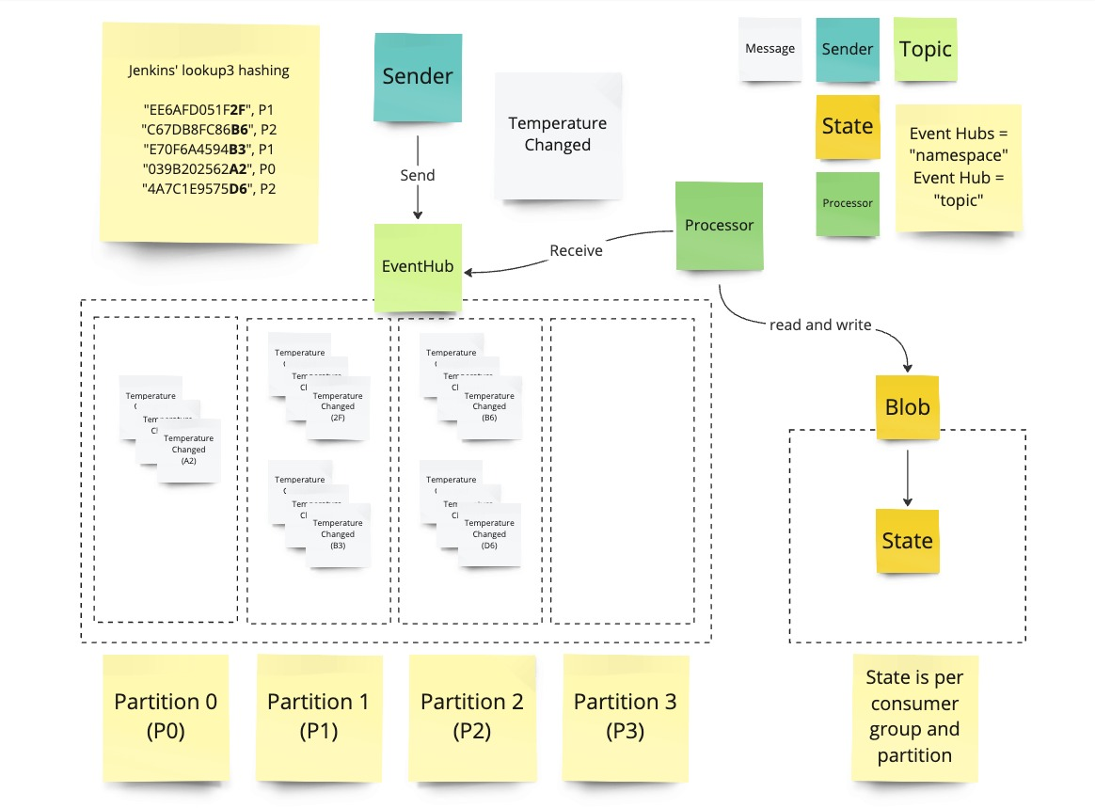

Slide 24
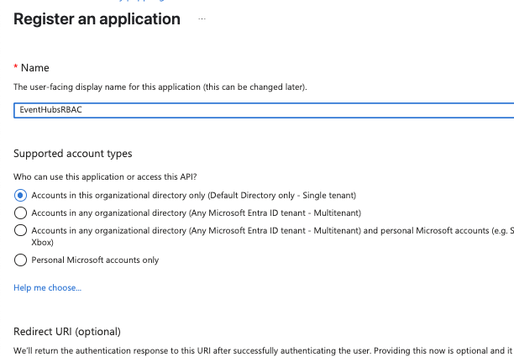

Slide 25
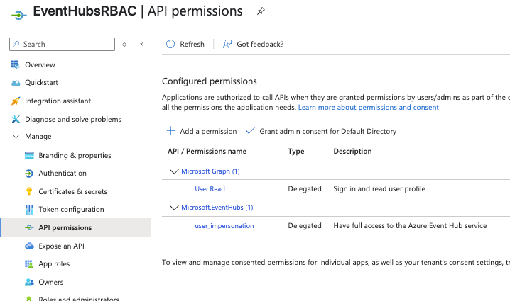

Slide 26
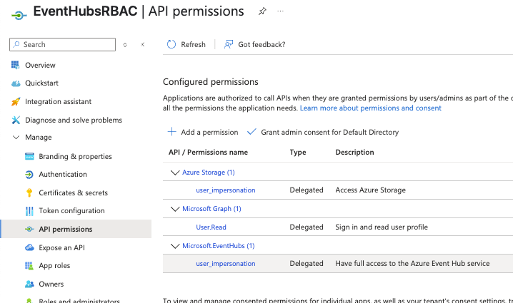

Slide 27
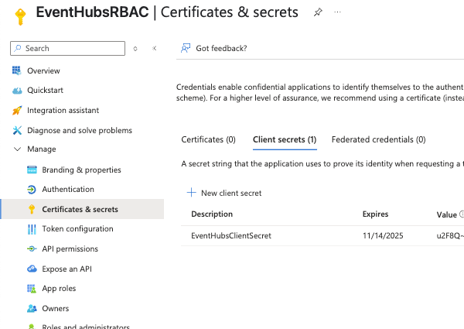

Slide 28
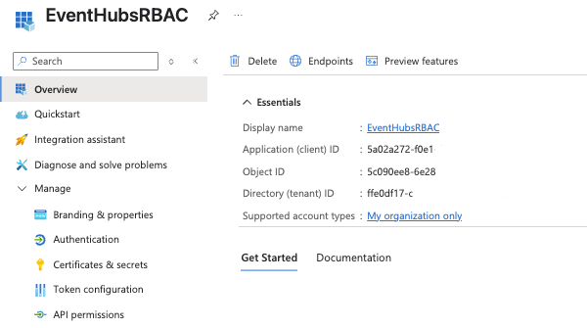

Slide 29
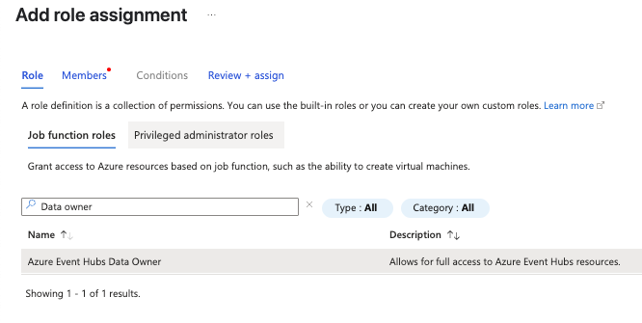
Notes:
On Event Hubs IAM

Slide 30
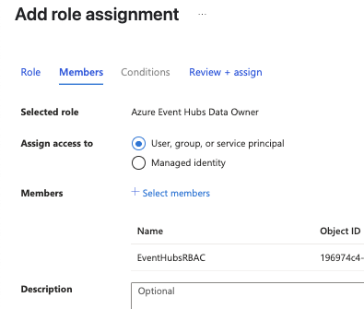

Slide 31
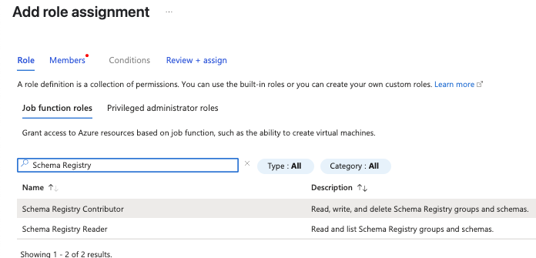

Slide 32
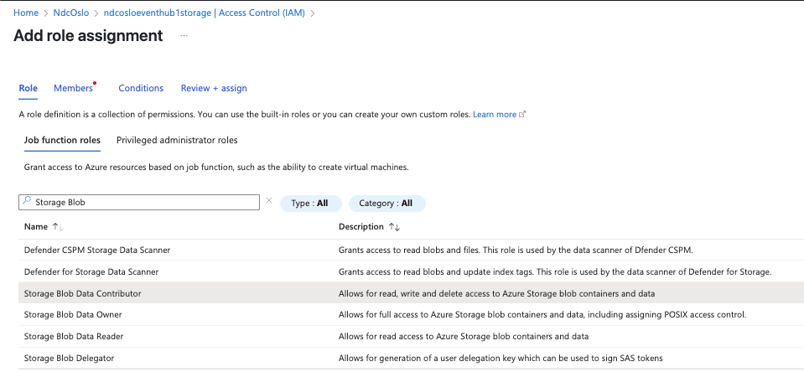

Slide 33
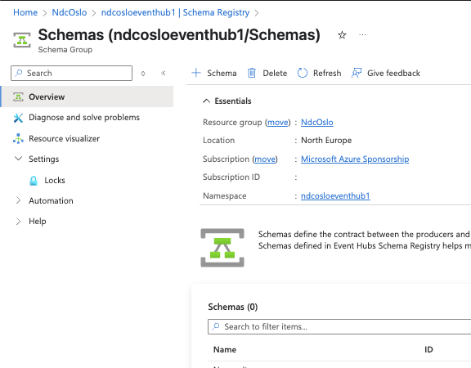

Slide 34
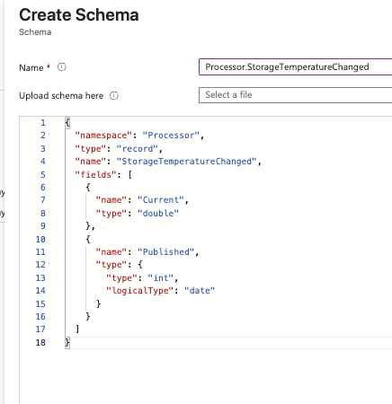

Slide 35
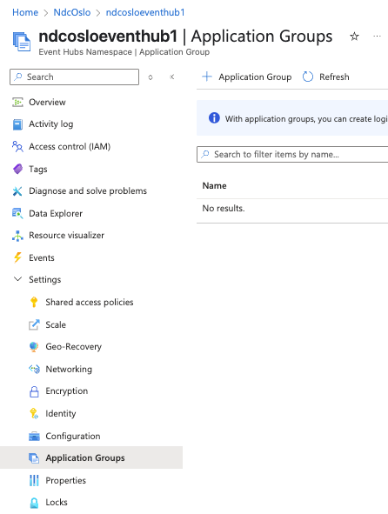

Slide 36
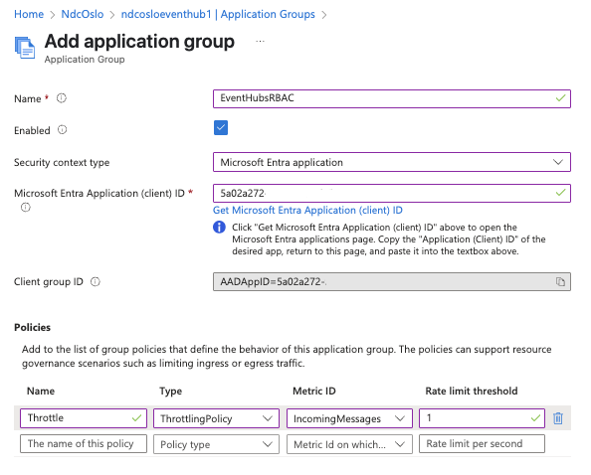

Slide 37
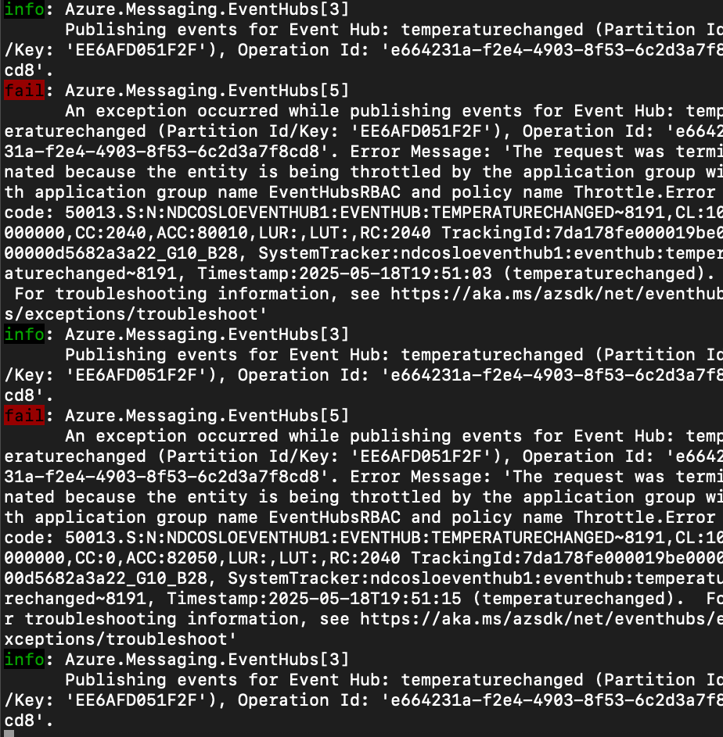

Slide 39
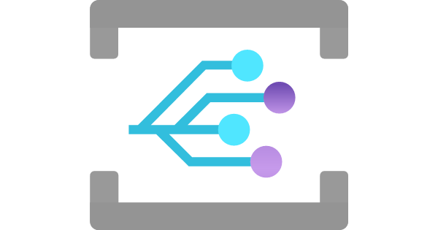
Azure Event Grid
Notes:
Azure Event Grid is a highly scalable, fully managed Pub Sub message distribution service that offers flexible message consumption patterns using the Message Queueing Telemetry Transport (MQTT) and HTTP protocols. With Azure Event Grid, you can build data pipelines with device data, integrate applications, and build event-driven serverless architectures.
The service provides an eventing backbone that enables event-driven and reactive programming. It uses the publish-subscribe model. Publishers emit events, but have no expectation about how the events are handled. Subscribers decide on which events they want to handle.
Event Grid is deeply integrated with other Azure services and can be integrated with third-party services. It simplifies event consumption and lowers costs by eliminating the need for constant polling. Event Grid efficiently and reliably routes events from Azure and non-Azure resources. It distributes the events to registered subscriber endpoints. The event message has the information you need to react to changes in services and applications.
- 4 cents per throughput unit per hour
- 6 cents per million events (1 Million included)

Slide 40
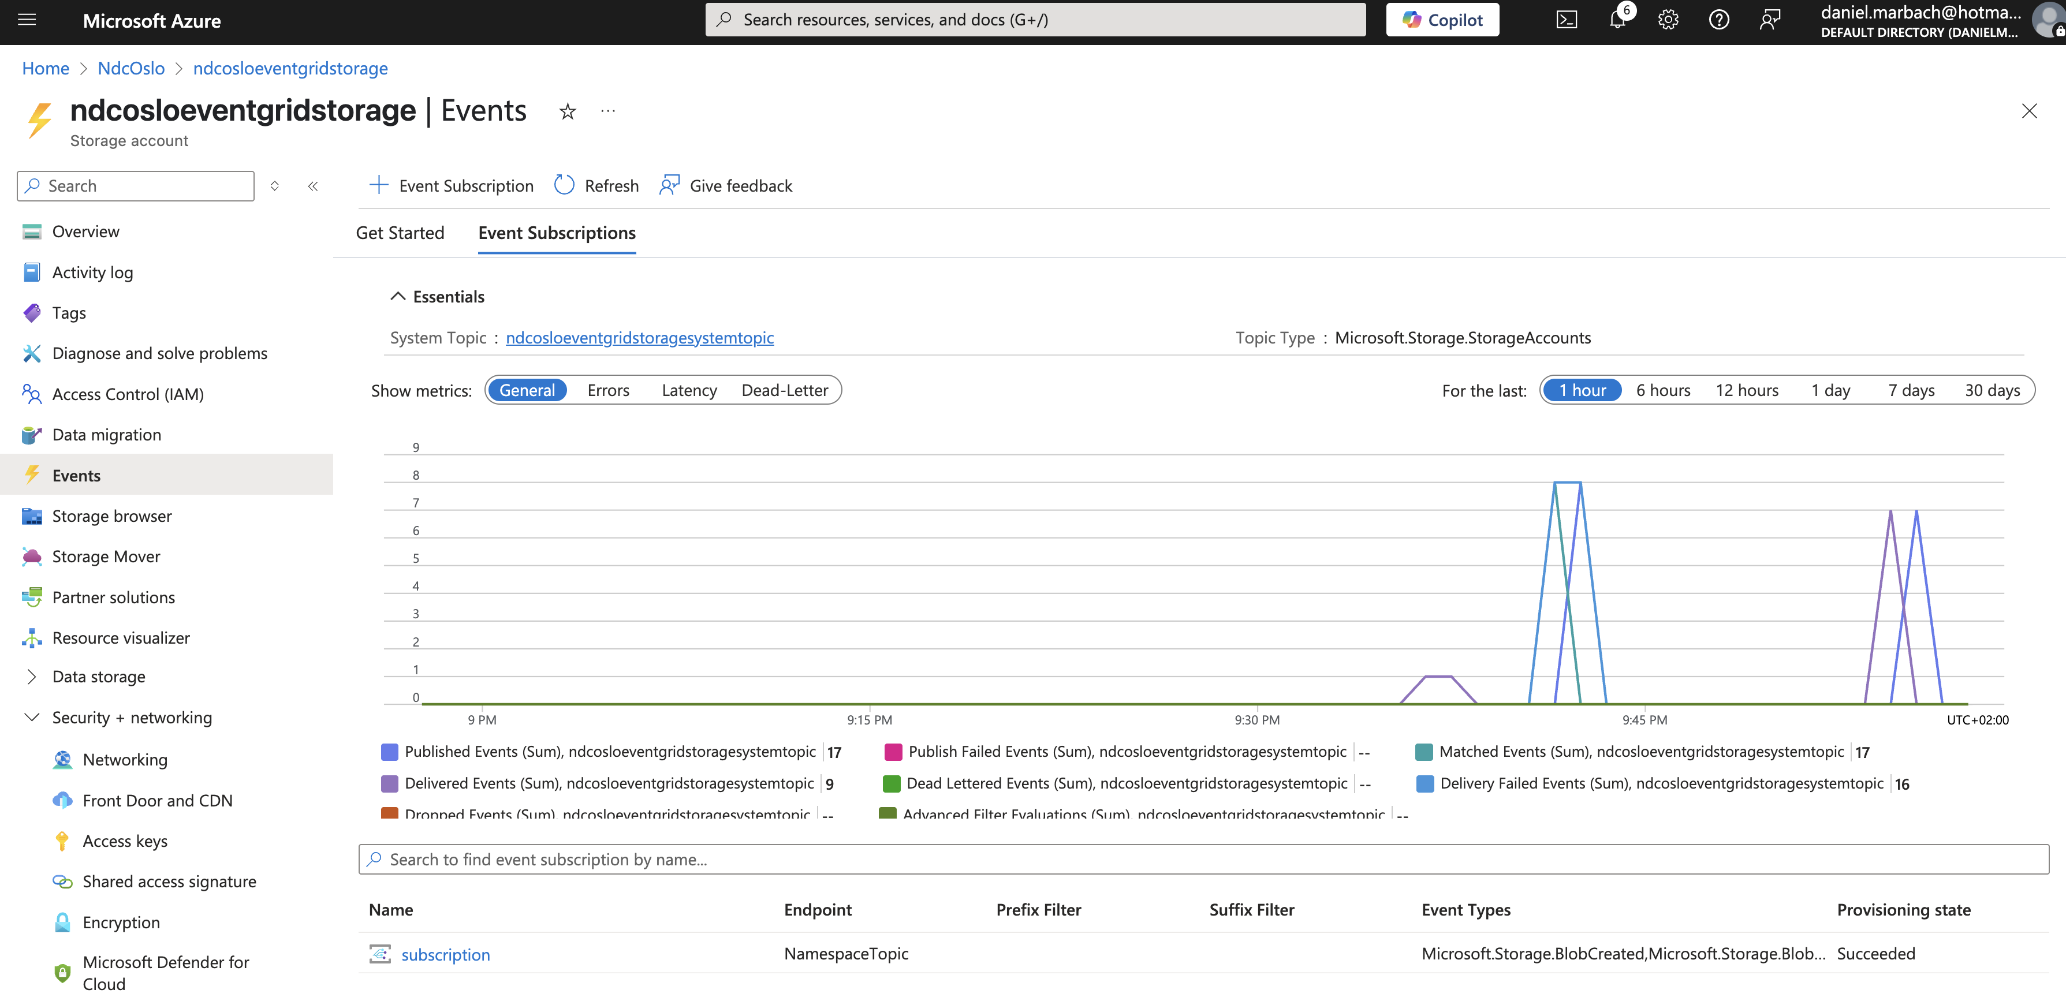

Slide 41
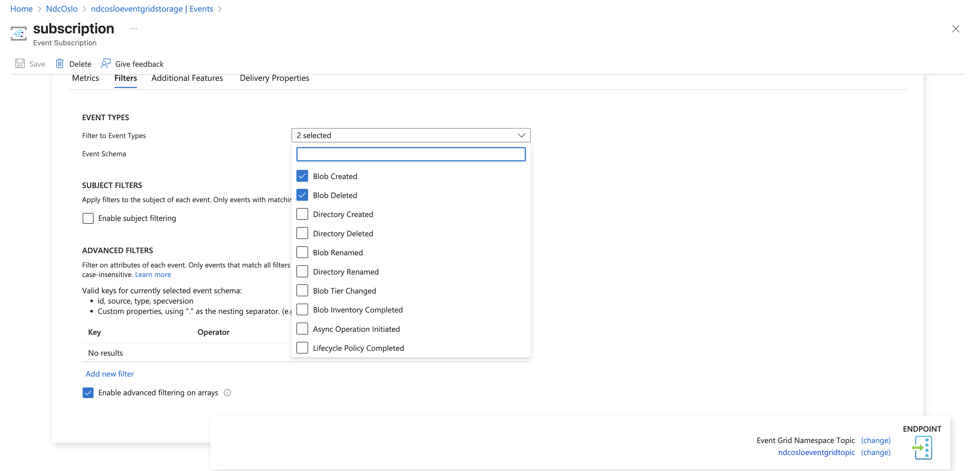

Slide 42
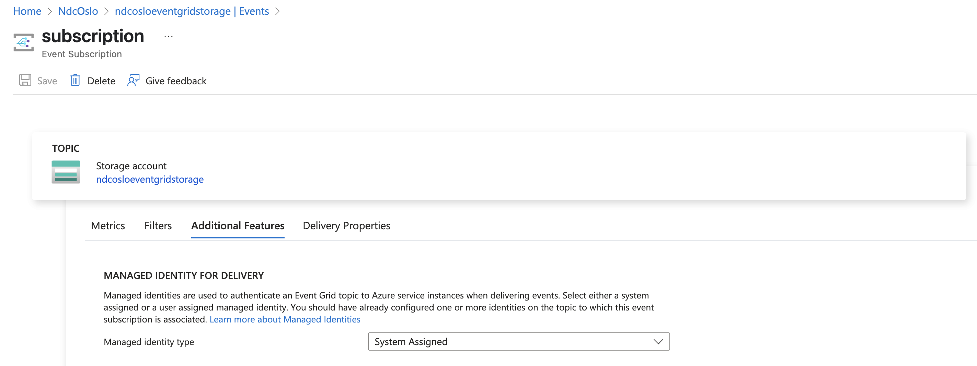

Slide 43
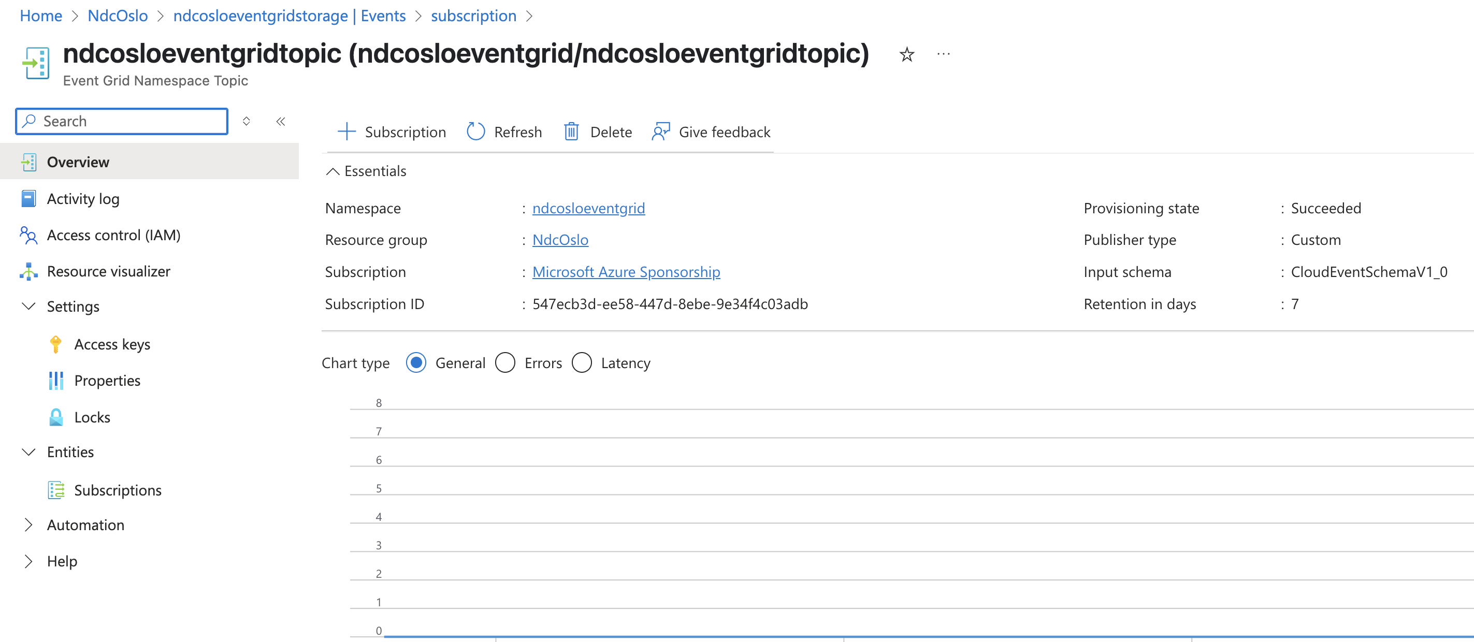

Slide 44
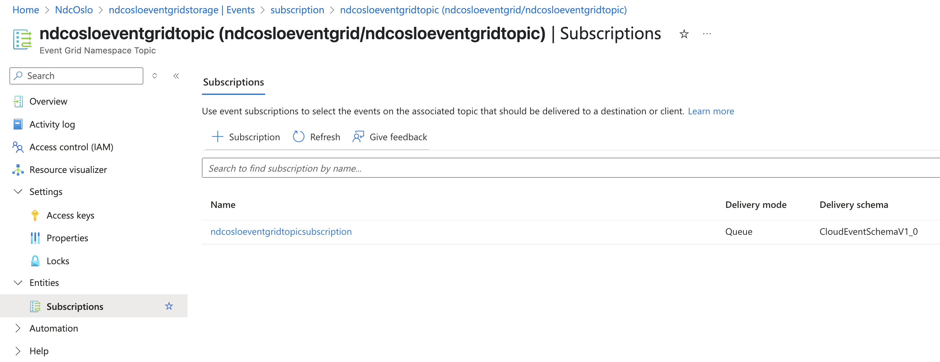

Slide 45
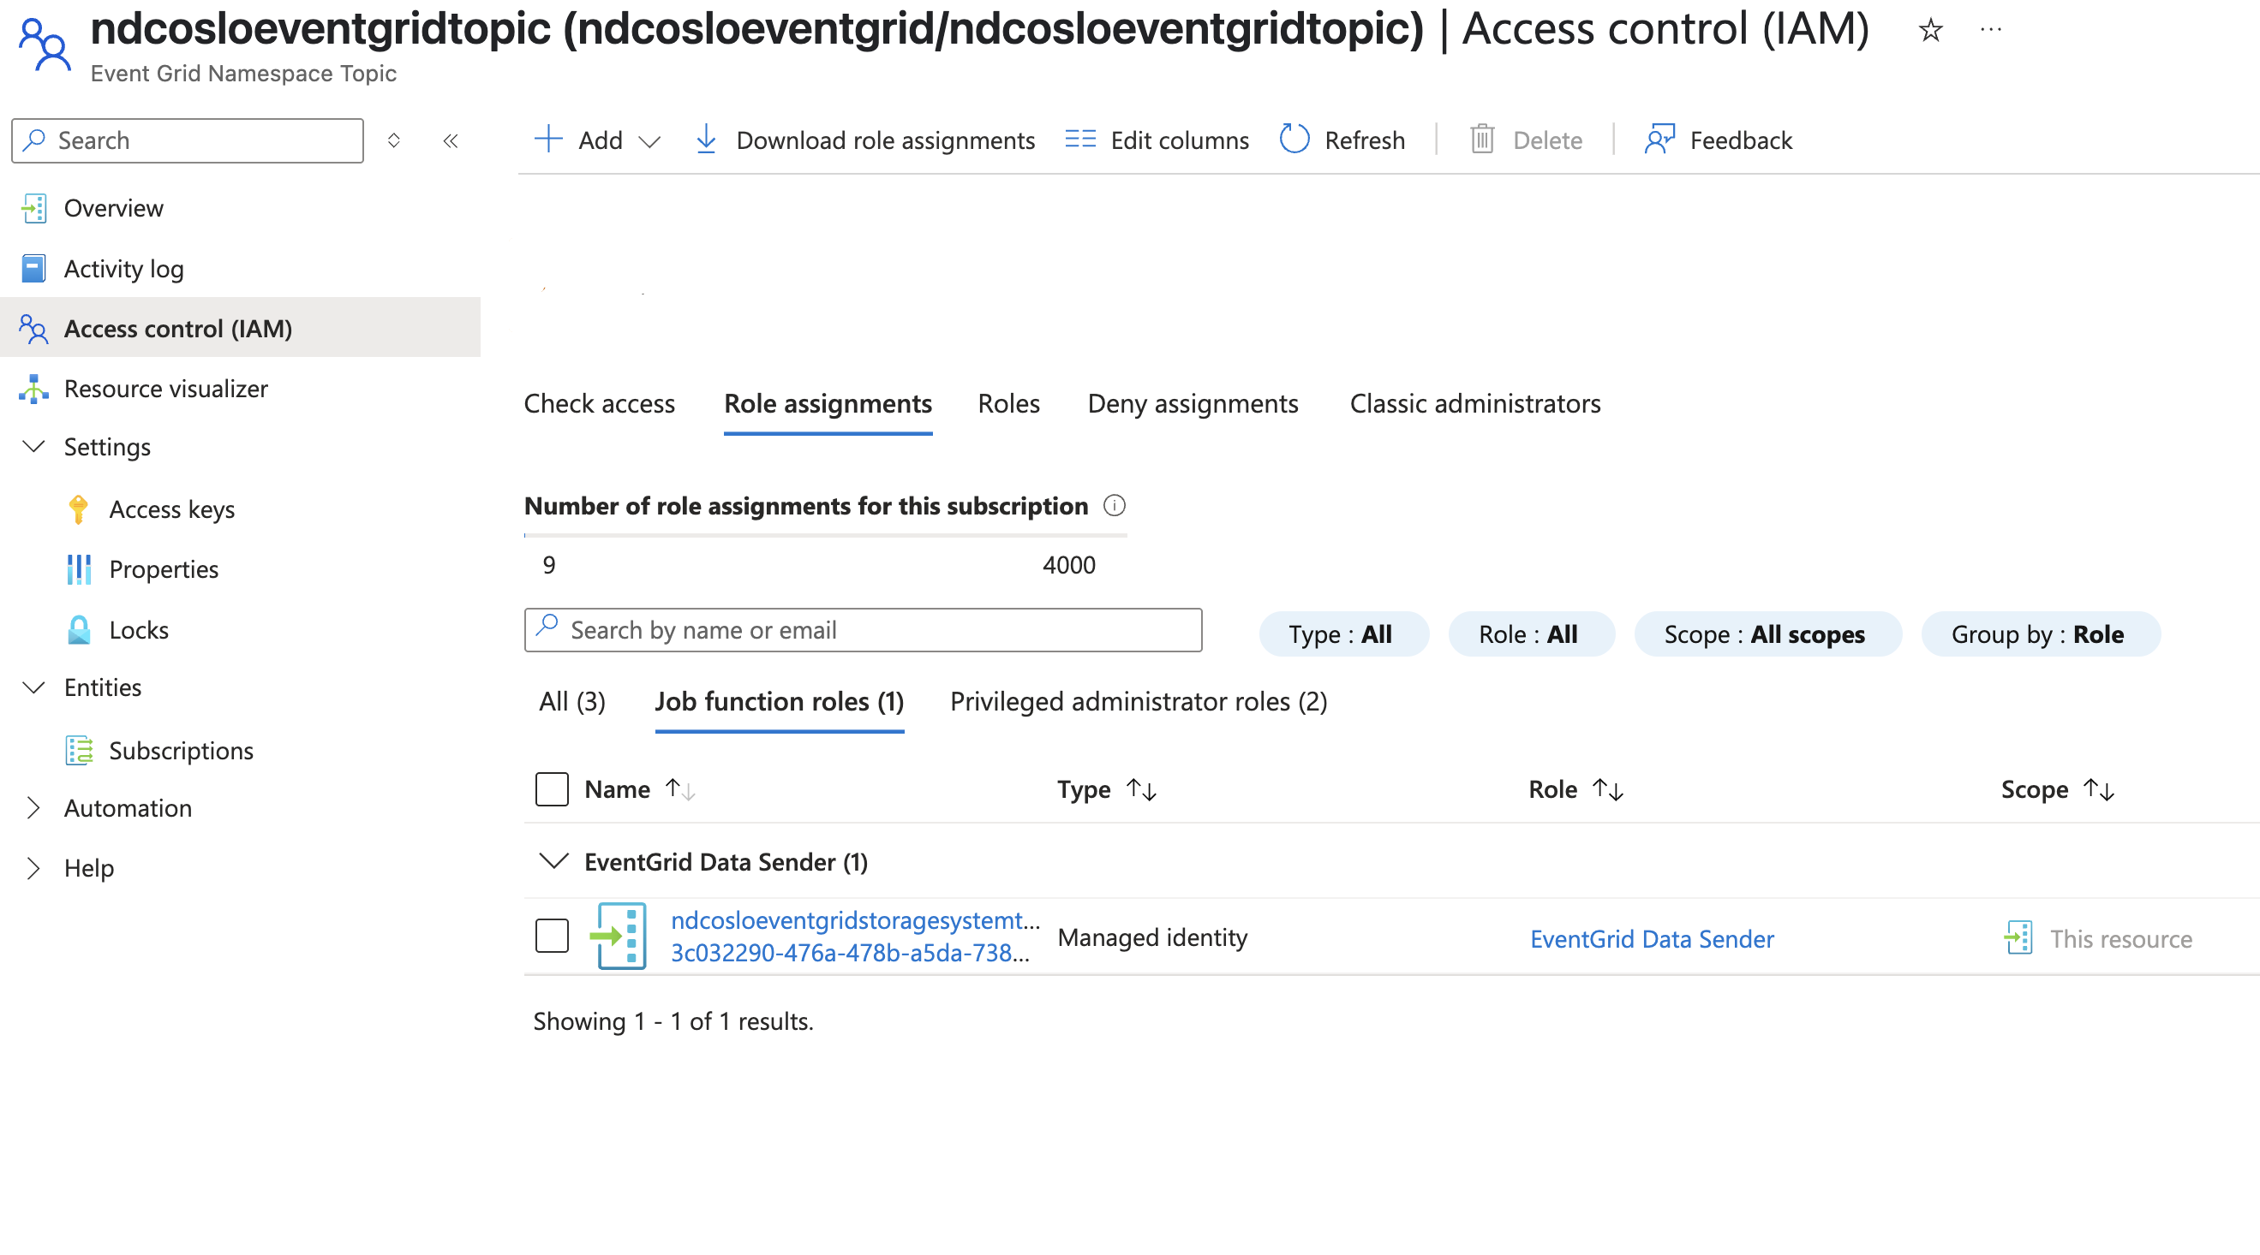

Slide 47
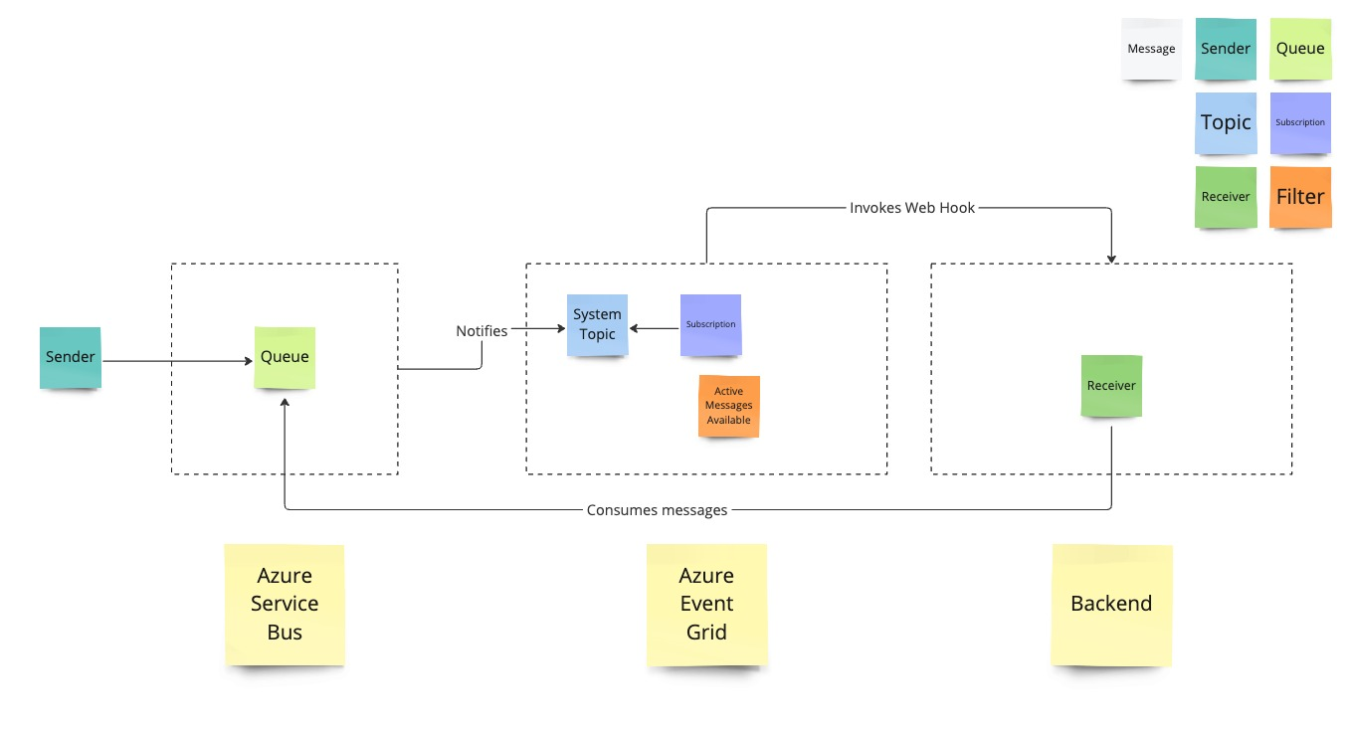

Slide 48
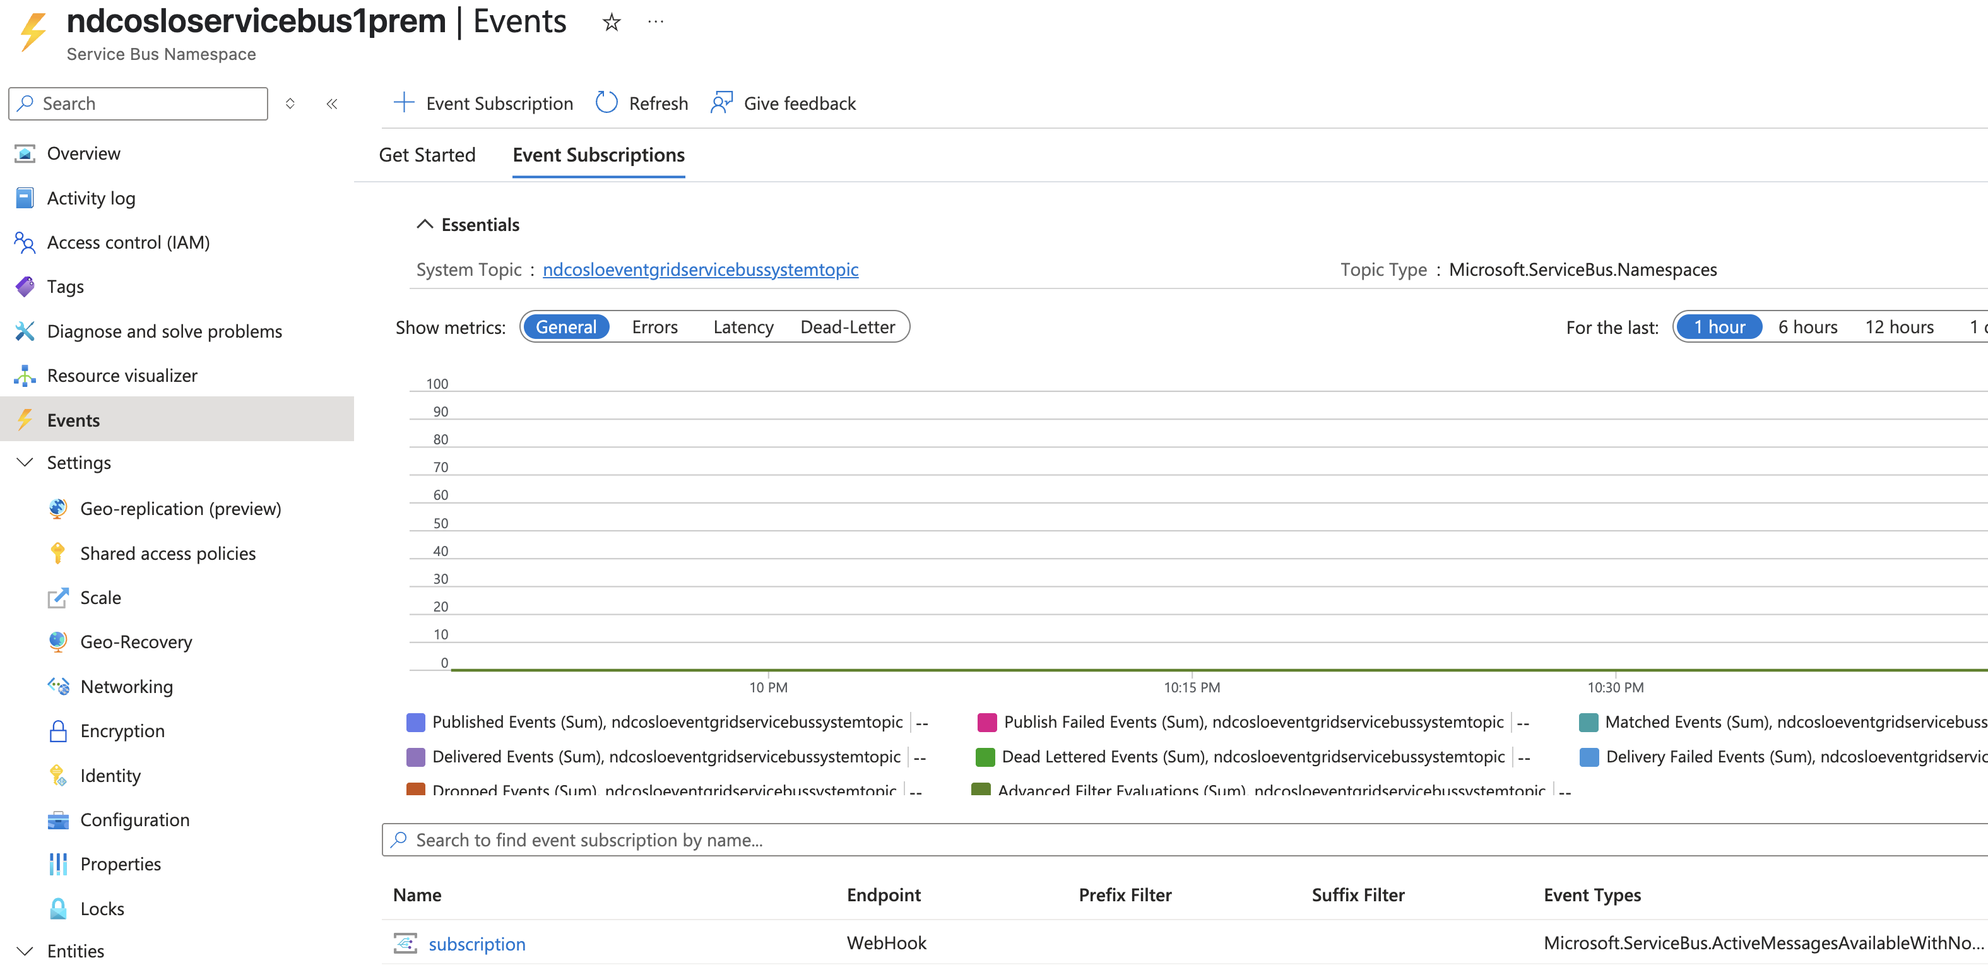

Slide 49
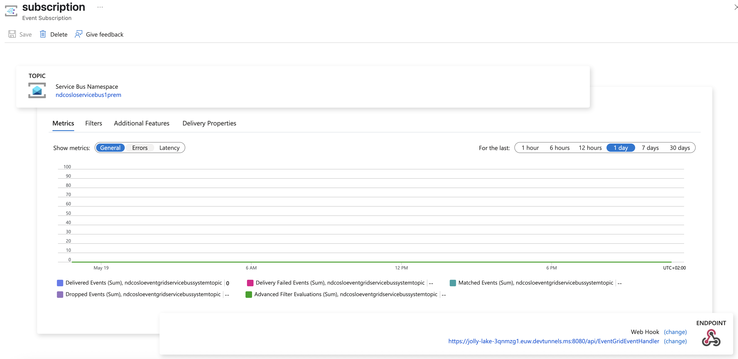

Slide 50
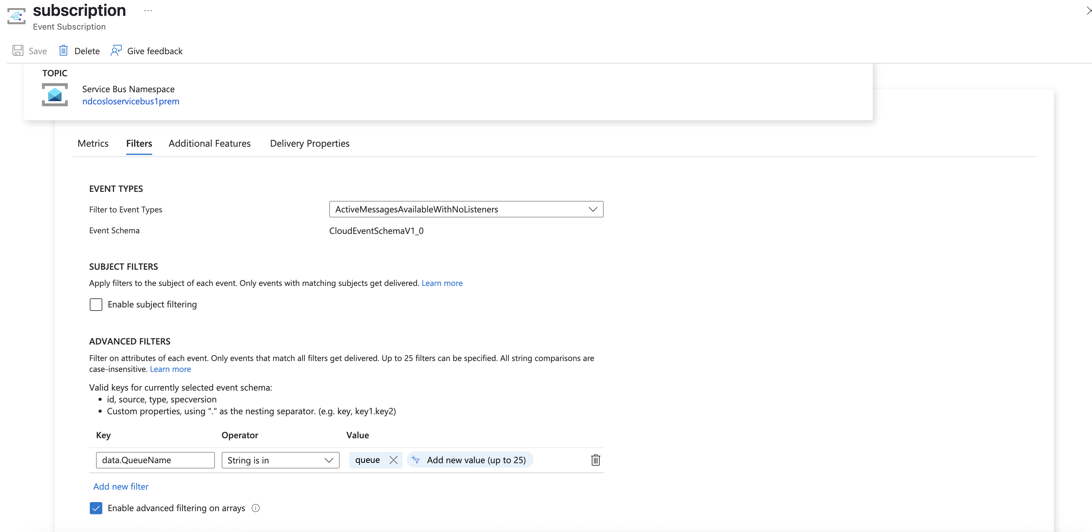

Slide 51
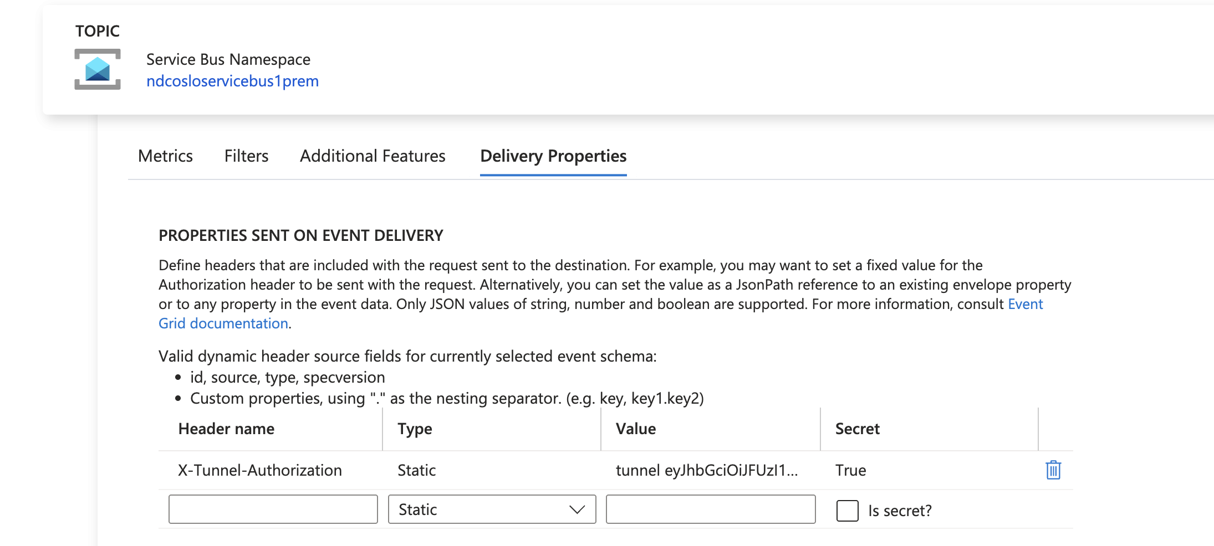

Slide 52
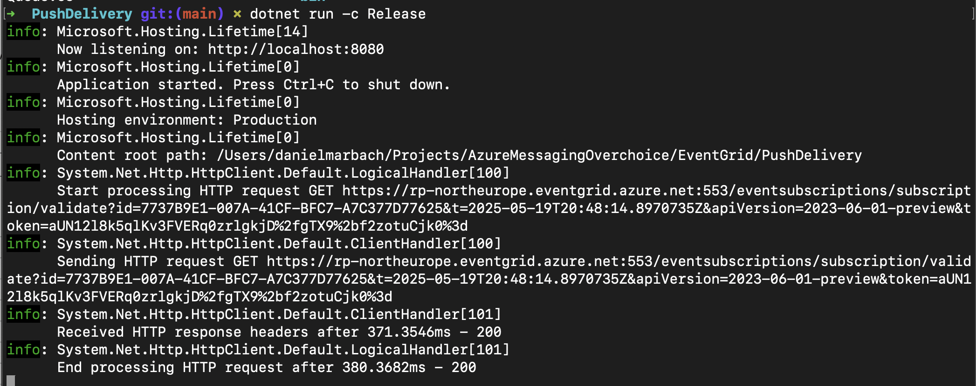

Slide 54
Serverless
Streaming Data
Enterprise
Segment | Eventing PubSub | Streaming | Enterprise Messaging
Product | Event Grid | Event Hubs | Service Bus
What do you care about | Communication between apps / orgs Individual message Push and pull semantics Filtering and routing Pay as you go Fan out | Many messages in a Stream (think in MBs) Ease of use and operation Low cost Fan in Strict ordering Kafka compliant Works with other tools | Instantaneous consistency Strict ordering JMS Non-repudiation & Security Geo-Replication & Availability Rich features (de-dupe, scheduling, etc.)
What you care less about | Ordering of messaging Instantaneous consistency | Individual message semantics Server-side cursor Only Once | Cost Simplicity
Focus point | Reliable fan out push at massive scale | High scale distributed log | Highly indexed full featured message broker
Notes:
Service Composition: Event Grid, Service Bus, and Event Hub can be composed for flexible use cases.
Event Emission and Quick Reaction:
Service Bus and Event Hub emit events to Event Grid when queues or subscriptions activate after idle periods.
Event Grid triggers functions to spin up job processors, saving resources when messages are sporadic or high-value but infrequent.
Event Hub Capture Integration: Event Hub emits Grid events when a Capture package is stored in Azure Storage, triggering functions for processing or moving the package.
Routing Grid Events to Service Bus or Event Hubs:
Events can be routed into Service Bus queues or topics for scenarios requiring:
Hybrid Cloud Solutions: On-premises services can monitor Azure Storage via Service Bus queues.
Costly or Long-Running Processing: Service Bus allows for extended processing time without risking event acknowledgment failures.
Statistical Analysis with Event Hubs:
Grid events can be selectively routed to Event Hubs for analytics.
Event Hub Capture provides an archival solution for Grid events, enabling easy integration with analytics channels.

Slide 55

Use all of them
Notes:
Because use cases often overlap, Service Bus, Event Hub, and Event Grid can be composed.
First, both Service Bus and Event Hub can emit events to Event Grid, enabling applications to react to changes efficiently. For example, when a queue or subscription receives a message after being idle, it emits a Grid event. This can trigger a function to spin up a processor, ideal for infrequent but high-value messages—saving resources by only running services when needed. Similarly, Event Hub emits a Grid event when a Capture package lands in Azure Storage, which can trigger processing or transfer functions.
Second, Event Grid can route events into Service Bus or Event Hubs. For instance, an on-premises service in a hybrid setup can listen on a Service Bus queue subscribed to Azure Storage events, enabling it to react to new files. This model is useful for time/resource-intensive or failure-prone processing, since Service Bus supports longer processing durations with message locks.
Event Grid events can also be selectively routed to Event Hubs for analytics or archival via Event Hub Capture—no extra code required.

Slide 56
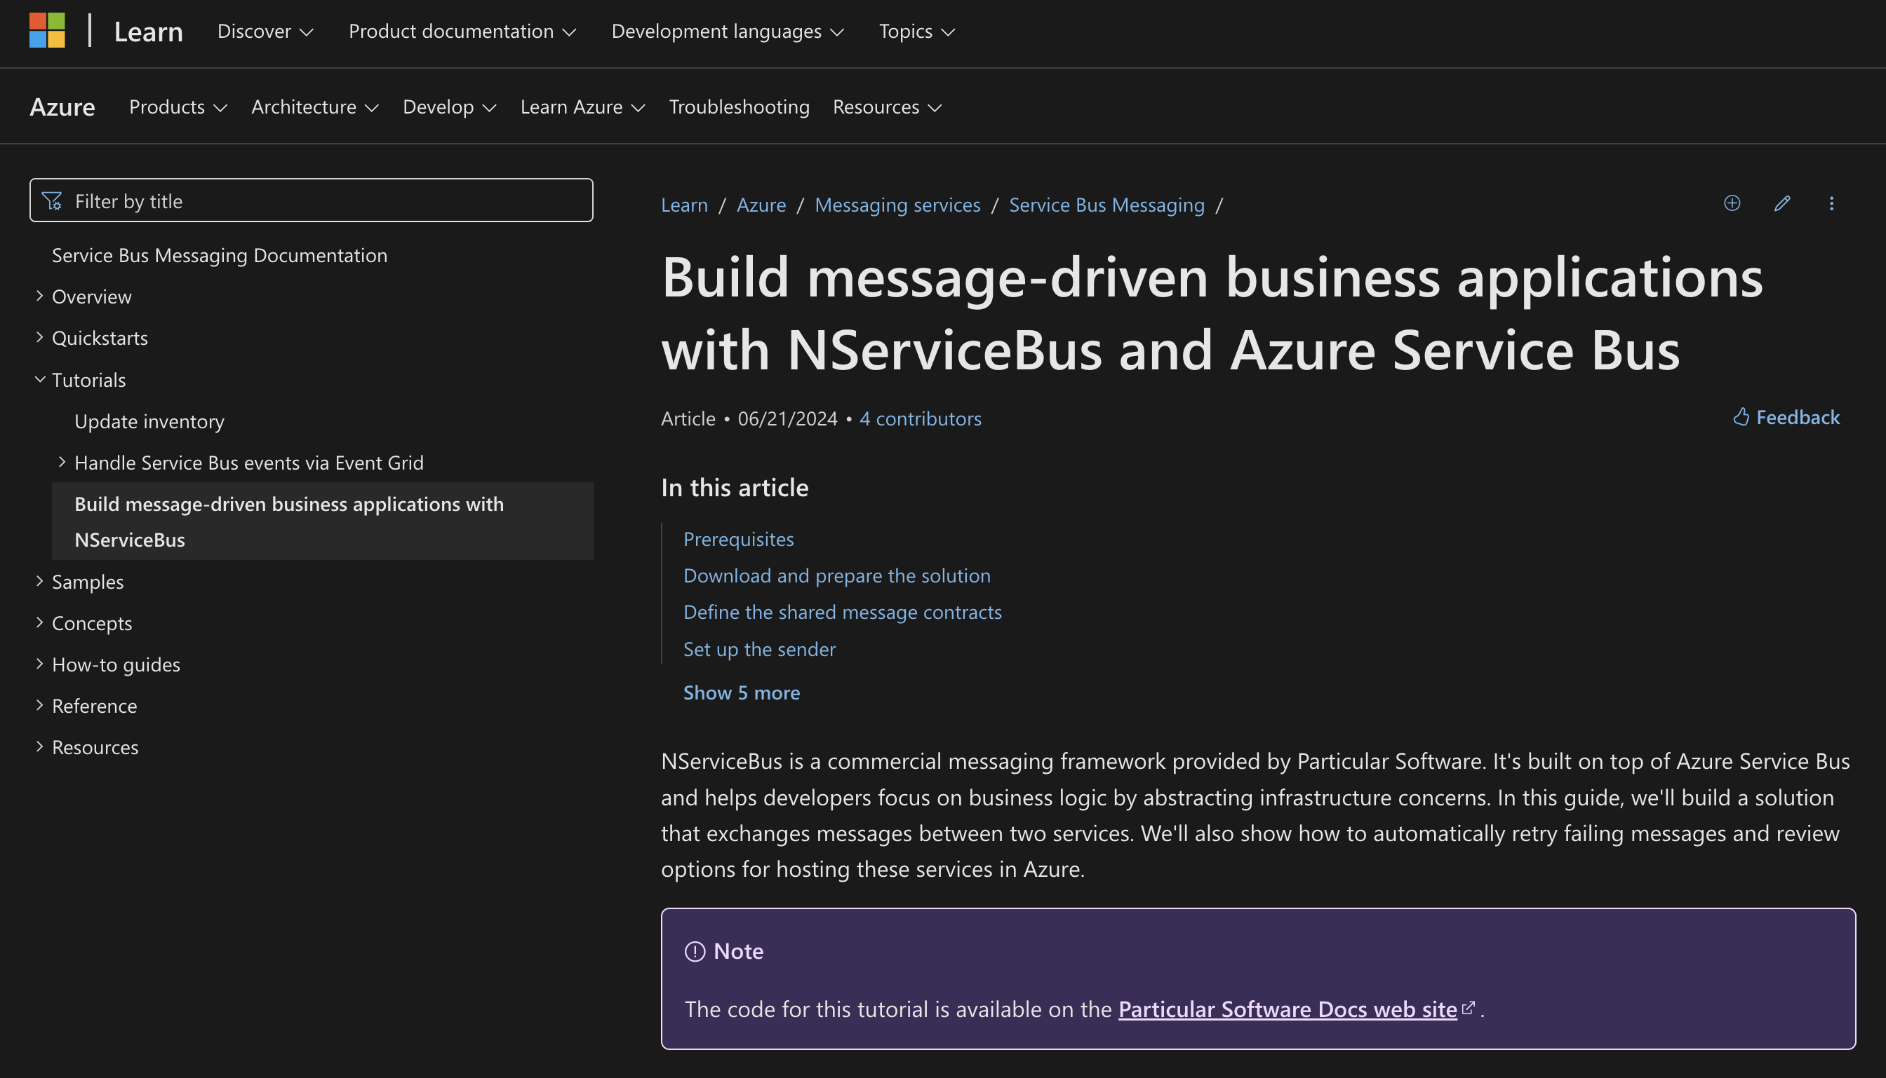

go.particular.net/ ndc-oslo-2025-azure-apps

Slide 57

github.com/danielmarbach/ AzureMessagingOverchoice

Slide 58
Navigating through the Azure Messaging (over)choice
daniel.marbach@particular.net

