Slide 1

Deep Dive with Azure Service Bus
@danielmarbach

Slide 2




Events
Messages
Event Grid
Event Hubs
Storage Queues
Service Bus
Cross cloud reactive eventing
Big data streaming
Simple task queues
Enterprise messaging
Notes:
Event Grid
Eventing backplane that enables event-driven reactive programming
Event consumption of Azure and Non-azure resources
The event message has the information you need to react to changes in services and applications
Event Grid isn't a data pipeline, and doesn't deliver the actual object that was updated.
Reactive programming, events are discrete facts
Event Hubs
Azure Event Hubs is a big data pipeline
For telemetry and event stream data (capture, retain and replay)
Low latency, capable of receiving and processing millions of events per second
Events are streamed in order
Azure Storage Queues
Introduced first, backed by Azure Storage
Allows to store large volumes of messages
Lightweight messages, simple durable task queues
64 KB messages
Azure Service Bus
Traditional enterprise applications that require rich messaging semantics
Reliable state transition management for business processes
Enables hybrid cloud solutions
Receive messages without polling
Richer application semantics like
FIFO
Deduplication
Transactional behavior and atomicity
Compliance with AMQP
Richer semantics like queues, topics and subscriptions, batching on send
communication backbone for many sophisticated cloud solutions
Event
Lightweight notification of condition or state change
Discrete units or parts of a series (time ordered and interrelated)
Actionable, no contract between publisher and subscriber
Message
Raw data to be produced by a consumer
Contains data that triggered the pipeline
Expectations in form of a contract
Can be used together. Let’s focus on ASB for now

Slide 3
Tiers
Basic
Standard
Premium
Consumption (Operation)
Resource (MsgUnit)
Notes:
Basic
Shared capacity
256 KB messages
Only queues
5 cents per million operations
Standard
Shared capacity
256 KB messages
Queues and Topics
9.80 CHF per 12.5 million operations
Queues and Topics default 1 GB size (max 5 GB), with partitioning this can go to 80 GB with 16 partitions
Premium (recommended)
Dedicated capacity
1024 KB messages
Message operations unlimited
679 CHF per month
You can purchase 1, 2, 4 or 8 messaging units for each Service Bus Premium namespace. A single workload or entity can span multiple messaging units and the number of messaging units can be changed at will.
No partitioned queues and topics but 80 GB queues and topics
No express entities

Slide 4


Slide 5
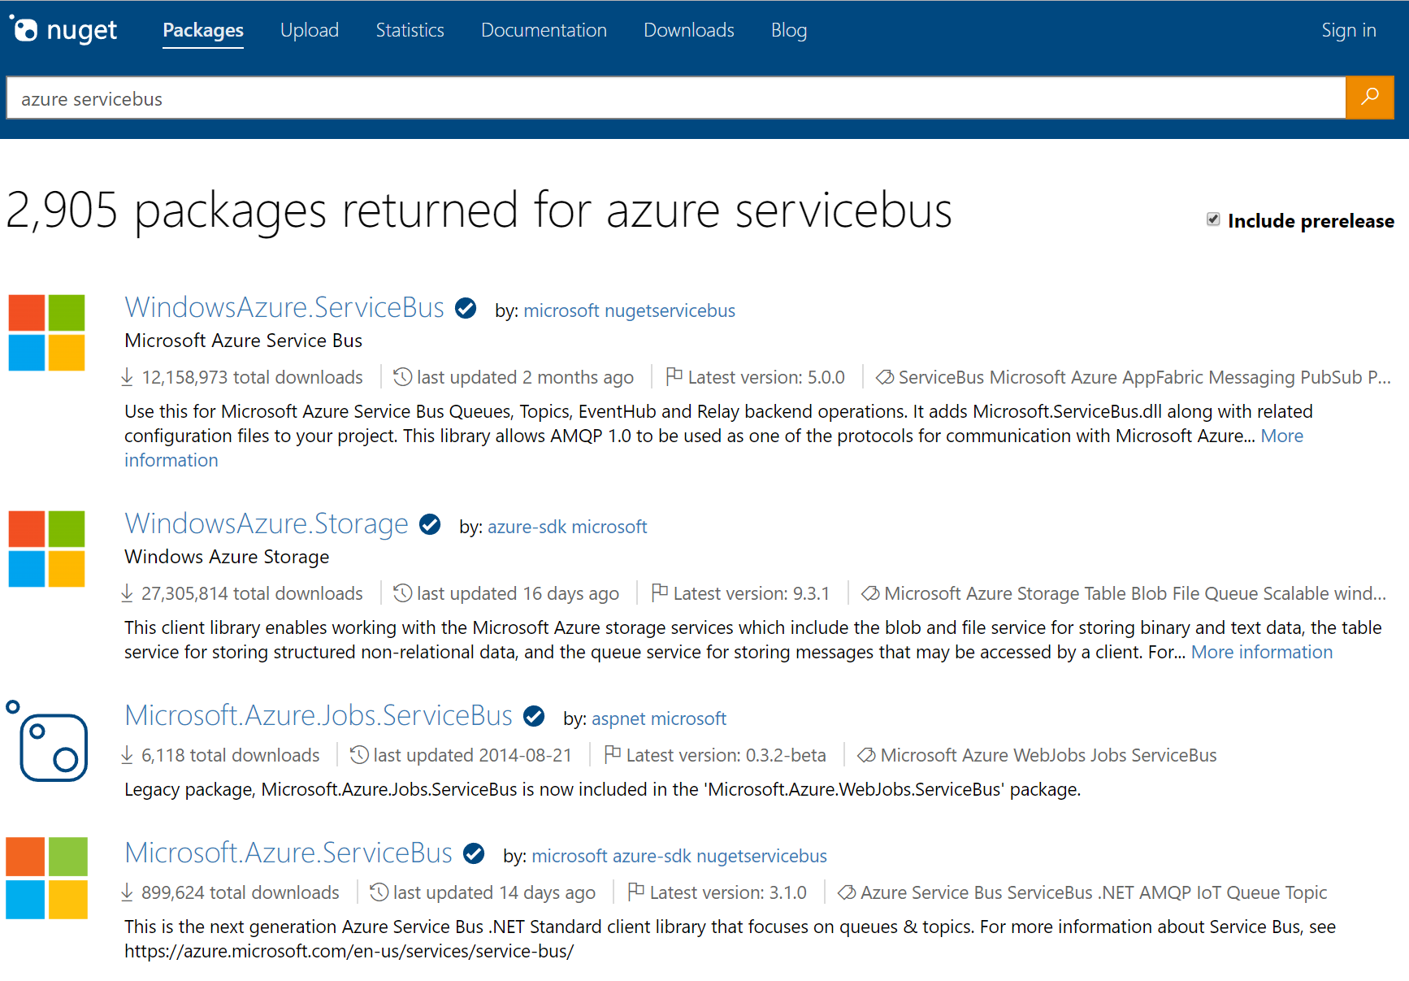
Notes:
A few months a go the picture looked liked the following

Slide 6

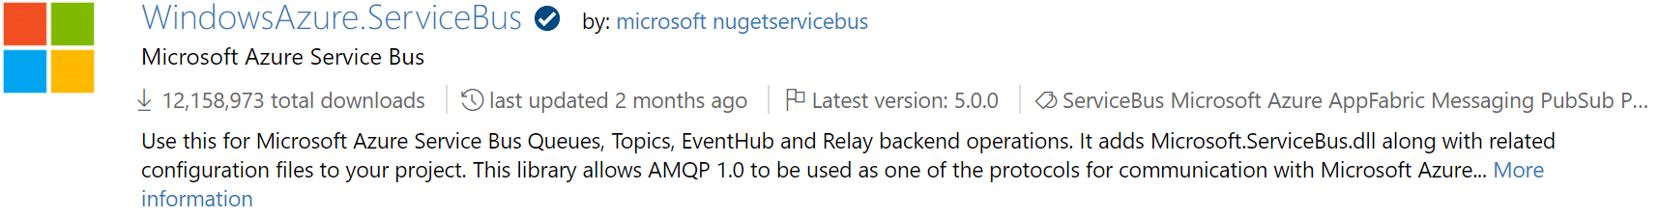
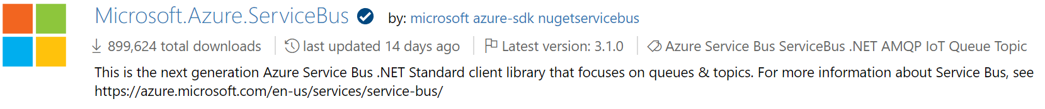
1
2

Slide 7

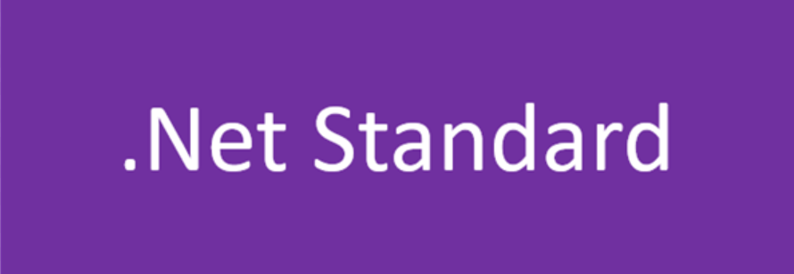


Microsoft.Azure.ServiceBus
WindowsAzure.ServiceBus

Slide 8
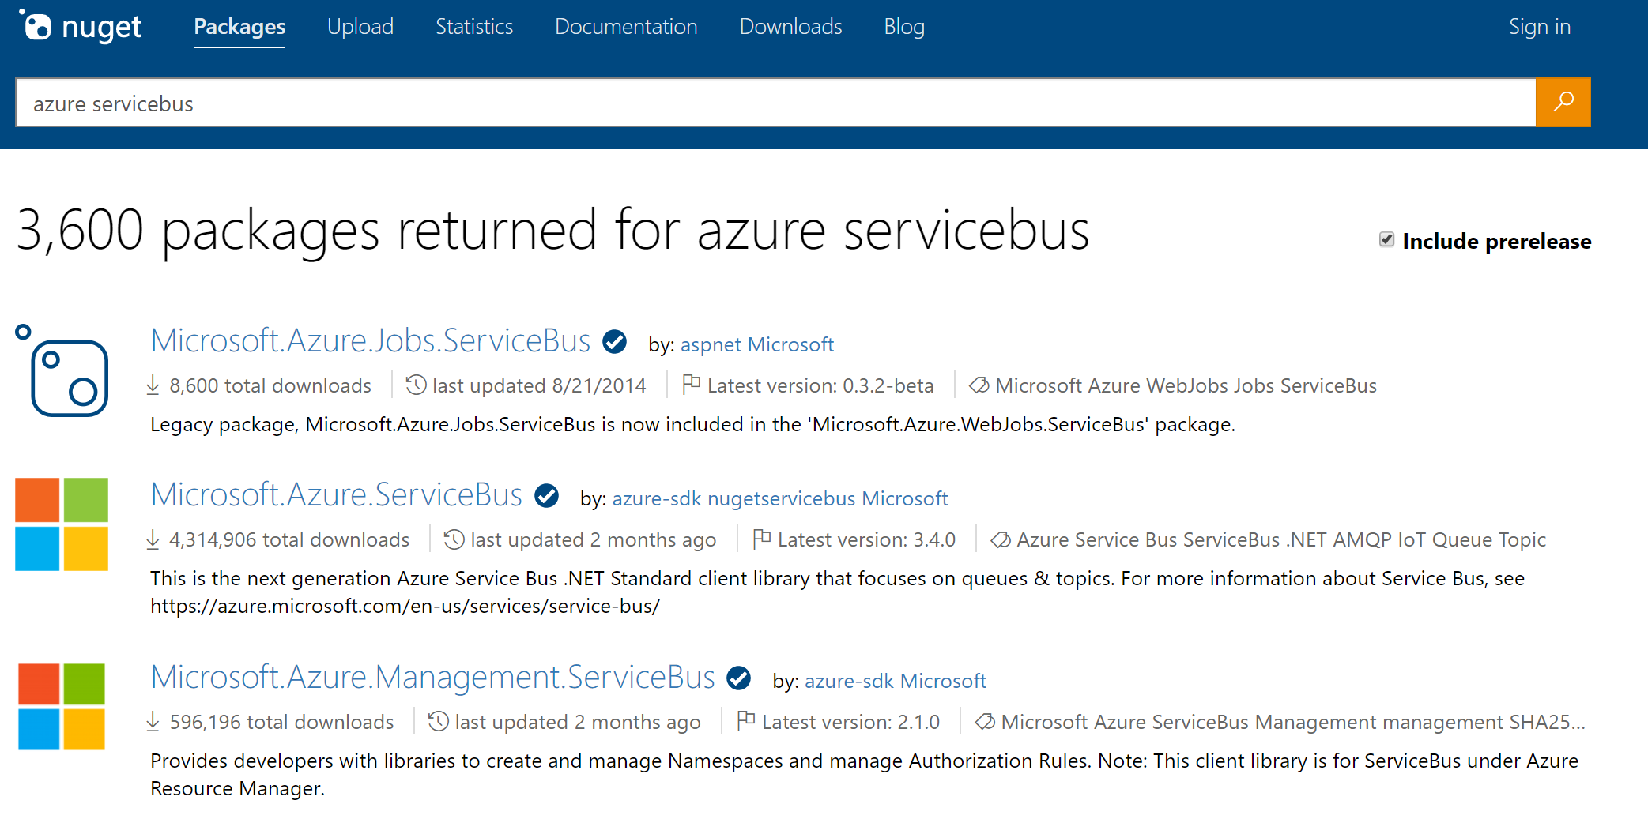

Slide 9

github.com/azure/azure-sdk-for-net
https://octodex.github.com/octobiwan
Notes:
A new mondo repo home

Slide 10
AMQP 1.0
Notes:
AMQP + WebSockets
On the broker side, the new client is speaking AMQP 1.0 and no more SBMP protocol.
Meaning interoperability and less constraints (number of concurrent connections: 1K vs 5K)

Slide 11
Send
Notes:
Sending a message -> MessagingEntityNotFoundException -> tooling
QueuClient.SendAsync

Slide 12
Receive
Notes:
How do we receive? There are two options available
MessageReceiver.ReceiveAsync(message) is fragile requires to do manual heavy lifting such as concurrency etc. Also hard to understand
Use message handlers instead
MessageHandlerOptions
Exception handler with ExceptionReceiveContext
AutoComplete (defaults to true)
MaxConcurrentCalls (defaults to one)
MaxAutoRenewDuration (defaults to 5mins)
Talk about PeekLock and ReceiveAndDelete
What’s the right way? If you need to process incoming messages one by one and don’t want to build message pump logic, MessageHandler is a good option.
If batching is important, manual receive is a better option.

Slide 13
QueueClient
TopicClient
SubscriptionClient
MessageSender
MessageReceiver
Notes:
Sender and Receiver are abstract types that are allow to send and receive from topics and queues

Slide 14
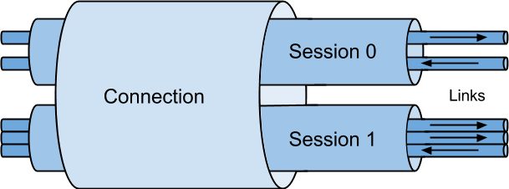
Notes:
No matter what way you’ll be connecting to the broker to send and receive messages, there’s something to keep in mind – connections

Slide 15
Connections
Notes:
netstat -na | find "5671“
Demo

Slide 16
Scheduling
Notes:
Demo
So when a message is scheduled, how can it be received earlier or cancelled?
To retrieve a specific message, SequenceNumber is required. But we got no sequence number until a message is received.
A bit of a chicken and an egg situation.
To solve this, we could peek for a message to find out its sequence number and retrieve it. Works for a single scheduled message, not when there are multiple ones…
That’s why scheduling using a client / message sender is a better option.

Slide 17
Expiry
Notes:
If messages need to be marked as short lived it is possible to give it a TimeToLive. TimeToLive can be set on the message or on the entity. Setting a longer TTL on the message than on the entity adjusts the TTL to the entity TTL.
Where does the message go?
By default messages will be discarded that exceeded the time to live. It is possible to set QueueDescription.EnableDeadLetteringOnMessageExpiration or SubscriptionDescription.EnableDeadLetteringOnMessageExpiration and then they will be deadlettered

Slide 18
Deadlettering
Notes:
Reasons for deadlettering
Exceeded TimeToLive
Exceeded MaxDeliveryCount
Errors while processing subscription rules when SubscriptionDescription.EnableDeadLetteringOnFilterEvaluationExceptions is set
In Forwarding or SendVia scenarios which we’ll talk about later
Every queue has essentially 4 queues
queue
queue/$DeadLetterQueue
queue/$Transfer
queue/$Transfer/$DeadLetterQueue

Slide 19
Forwarding
Notes:
Messages will be sent to the transfer dead-letter queue under the following conditions:
- A message passes through more than 4 queues or topics that are chained together.
- The destination queue or topic is disabled or deleted.
The destination queue or topic exceeds the maximum entity size.
Very powerful in combination with subscriptions to build hierarchies.
Service Bus bills one operation for each forwarded message.

Slide 20
Pub/Sub
Notes:
In contrast to queues, in which each message is processed by a single consumer, topics and subscriptions provide a one-to-many form of communication, in a publish/subscribe pattern. Useful for scaling to large numbers of recipients, each published message is made available to each subscription registered with the topic.
Senders only knows Topics
Receivers only know about Subscriptions
Subscriptions have Filters (rules) and Actions
Rules evaluated using OR logic

Slide 21
Sender
topic
Rule
Rule
Subscription1
Subscription2
Notes:
Messages are sent to a topic and delivered to one or more associated subscriptions, depending on filter rules that can be set on a per-subscription basis. The subscriptions can use additional filters to restrict the messages that they want to receive. Messages are sent to a topic in the same way they are sent to a queue, but messages are not received from the topic directly. Instead, they are received from subscriptions. A topic subscription resembles a virtual queue that receives copies of the messages that are sent to the topic. Messages are received from a subscription identically to the way they are received from a queue.

Slide 22
Boolean Filter
Rule
SQL Filter
Filter
Correlation Filter
Action
Notes:
Boolean filters - The TrueFilter and FalseFilter either cause all arriving messages (true) or none of the arriving messages (false) to be selected for the subscription.
SQL Filters - A SqlFilter holds a SQL-like conditional expression that is evaluated in the broker against the arriving messages' user-defined properties and system properties. All system properties must be prefixed with sys. in the conditional expression. The SQL-language subset for filter conditions tests for the existence of properties (EXISTS), as well as for null-values (IS NULL), logical NOT/AND/OR, relational operators, simple numeric arithmetic, and simple text pattern matching with LIKE.
Correlation Filters - A CorrelationFilter holds a set of conditions that are matched against one or more of an arriving message's user and system properties. A common use is to match against the CorrelationId property, but the application can also choose to match against ContentType, Label, MessageId, ReplyTo, ReplyToSessionId, SessionId, To, and any user-defined properties. A match exists when an arriving message's value for a property is equal to the value specified in the correlation filter. For string expressions, the comparison is case-sensitive. When specifying multiple match properties, the filter combines them as a logical AND condition, meaning for the filter to match, all conditions must match.
Actions: With SQL filter conditions, you can define an action that can annotate the message by adding, removing, or replacing properties and their values. The action uses a SQL-like expression that loosely leans on the SQL UPDATE statement syntax. The action is performed on the message after it has been matched and before the message is selected into the subscription. The changes to the message properties are private to the message copied into the subscription.

Slide 23
Favor Correlation filter over SQL filter
Notes:
All filters evaluate message properties. Filters cannot evaluate the message body.
Complex filter rules require processing capacity. In particular, the use of SQL filter rules results in lower overall message throughput at the subscription, topic, and namespace level. Whenever possible, applications should choose correlation filters over SQL-like filters, since they are much more efficient in processing and therefore have less impact on throughput.

Slide 24
Subscriptions are virtual queues and subscribers need to receive from them
Notes:
Unless you combine pubsub with forwarding to create rich topologies!

Slide 25
Topologies

Slide 26
topic
Rule
Rule
Subscription1
Subscription2
ForwardTo
ForwardTo
Queue

Slide 27
Atomic Sends
Notes:
Unlike a batch, we have a group of messages to send, but not all messages are available as at the same time.
We’d like to send messages in a transactional manner, ensuring that either all messages are sent successfully or they all rolled back

Slide 28
Batching

Slide 29
Upgrade to premium tier
Use ServiceBus.AttachmentPlugin
Notes:
Use Attachment plugin to reduce messages size
Premium tier – bring a bigger gun

Slide 30
Send Via
Notes:
In scenarios where a transactional processing is required for an incoming message that would generate some outgoing messages, the incoming and outgoing messages should all succeed or rollback. Failure to do so would either create duplicate processing (failure to complete the incoming message) or ghost messages (failure to revert the outgoing messages).

Slide 31
Incoming
Outgoing1
Transfer
Outgoing2
Notes:
Similar to shipping something from one point (source) to another point (destination), your package might go through straight to the destination and instead, might go through an intermediary.
The idea behind Send-via is to create an atomic operation between an incoming message and the outgoing messages.

Slide 32
TransferDLQ
Notes:
Reasons for deadlettering
Exceeded TimeToLive
Exceeded MaxDeliveryCount
Errors while processing subscription rules when SubscriptionDescription.EnableDeadLetteringOnFilterEvaluationExceptions is set
In Forwarding or SendVia scenarios which we’ll talk about later
Every queue has essentially 4 queues
queue
queue/$DeadLetterQueue
queue/$Transfer
queue/$Transfer/$DeadLetterQueue

Slide 33
Sessions
Notes:
A session acts in many ways like a sub queue.
Sessions provide concurrent de-multiplexing of interleaved message streams while preserving and guaranteeing ordered delivery.

Slide 34
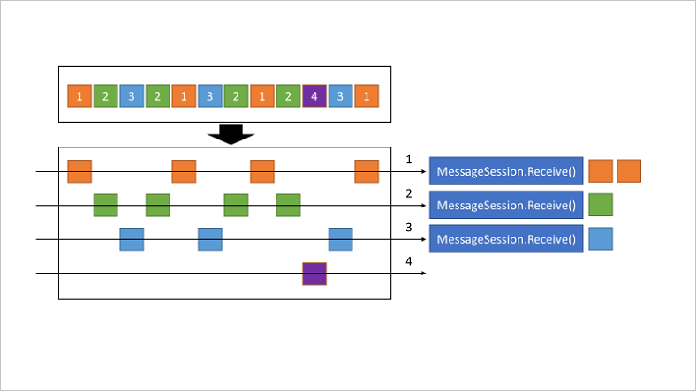
Notes:
When the MessageSession object is accepted and while it is held by a client, that client holds an exclusive lock on all messages with that session's SessionId that exist in the queue or subscription, and also on all messages with that SessionId that still arrive while the session is held.
The lock is released when Close or CloseAsync are called, or when the lock expires in cases in which the application is unable to perform the close operation. The session lock should be treated like an exclusive lock on a file, meaning that the application should close the session as soon as it no longer needs it and/or does not expect any further messages.
When multiple concurrent receivers pull from the queue, the messages belonging to a particular session are dispatched to the specific receiver that currently holds the lock for that session. With that operation, an interleaved message stream residing in one queue or subscription is cleanly de-multiplexed to different receivers and those receivers can also live on different client machines, since the lock management happens service-side, inside Service Bus.
The previous illustration shows three concurrent session receivers. One Session with SessionId = 4 has no active, owning client, which means that no messages are delivered from this specific session. A session acts in many ways like a sub queue.
The session lock held by the session receiver is an umbrella for the message locks used by the peek-lock settlement mode. A receiver cannot have two messages concurrently "in flight," but the messages must be processed in order. A new message can only be obtained when the prior message has been completed or dead-lettered. Abandoning a message causes the same message to be served again with the next receive operation.
Session state is - limited to the maximum message size

Slide 35
Dedup
Notes:
Duplicate detection takes the doubt out of these situations by enabling the sender resend the same message, and the queue or topic discards any duplicate copies. For application controlled message ids
The duplicate detection time history defaults to 30 seconds for queues and topics, with a maximum value of seven days.
Enabling duplicate detection and the size of the window directly impact the queue (and topic) throughput, since all recorded message-ids must be matched against the newly submitted message identifier.
Keeping the window small means that fewer message-ids must be retained and matched, and throughput is impacted less. For high throughput entities that require duplicate detection, you should keep the window as small as possible.

Slide 36
Plugins

Slide 37
Thanks
Notes:
Thanks

Slide 38
Slides, Links…
github.com/danielmarbach/AzureServiceBus.DeepDive

Slide 39
Q & A

Slide 40

Software Engineer
Microsoft MVP
@danielmarbach
particular.net/blog
planetgeek.ch

Slide 41
Thanks
Notes:
Thank you very much for listening and see you next time

