Slide 1

Knock. Knock. Who’s there?
A message from the future
Notes:
Sometimes there are days I wish I could turn back time and undo some things to pretend they never happened. Almost like git rebase for time.
Unfortunately we all understand quite early in our life’s that time is constantly flowing in one direction and there is no turning back.
1927 a British astronomer called Arthur Eddington came up with a concept called “arrow of time”. The concept he posited described the time as unidirectional or asymmetric or always flowing in one obvious direction.

Slide 2
Frontend
Backend
Database
ASP.NET CORE
Front
Back
Storage
Orders
Read / Write
HTTP
ADO.NET
Notes:
Demo 1

Slide 3
Thanks
Notes:
Thanks

Slide 4
Slides, Links…
github.com/danielmarbach/KnockKnock

Slide 5
Q & A

Slide 6
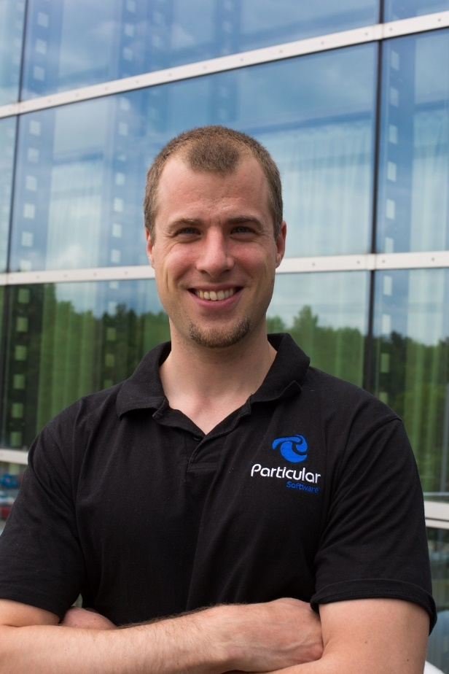
Software Engineer
Enthusiastic Software Engineer
Microsoft MVP
@danielmarbach
particular.net/blog
planetgeek.ch
Notes:
I’m Daniel, Solution Engineer…
I live in central Switzerland. If you want to know more about me listen to episode 77 of developer on fire
You can reach me on twitter under @danielmarbach
I blog on the particular blog and on my personal blog
I’m the lead behind the asyncification of NServiceBus and the ecosystem around it
I regularly contribute back ideas and code changes to asyncify the .NET OSS libraries and frameworks out there. So far I contributed to Entity Framework, RabbitMQ, Marten, MassTransit, Quartz.NET and many more

Slide 7
Thanks
Notes:
Thank you very much for listening and see you next time

