Slide 1

Do it yourself. A message pump
that kicks ass

Slide 2
DMZ
Backend
DB Cluster
WCF Services
Windows Service
Front
Back
Storage
Refund / Query
Read / Write
RPC
ADO.NET
Notes:
Story: We lost maintenance windows because our legacy application had to fulfill invoice refund requests from webshops 24 hours and seven days a week. Web clients were constantly sending us refunds and hammering our APIs for state changes (polling was the thing at the time and we got the impression PHP developers think the more they poll the higher the chance that their requests go through ;) )

Slide 3
The RPC callstack of
do
m
o
Notes:
Because of the RPC call chain when ever the latency between the DB cluster and the backend was slow or there was a concurrent update on a row those effects rippled through the callstack to the issuer of the call, which is the front-end.
Furthermore on every request from the front-end a new database transaction was created and when many operations were pending those transactions sometimes rolled back or slowed down the order processing
The temporal and special coupling introduced was horrible. The latency of the storage layer directly influenced the customer facing latency.
SLA couldn’t be fulfilled
Orders got lest when the client of the request stopped retrying
Orders could not be throttled and worst the actual order intent was difficult to find in WCF callstack exception logs

Slide 4
praise the lords of
messaging
Notes:
Praise the lords of messaging
We realized invoice refunds is a perfect domain to apply messaging to

Slide 5
DB Cluster
DMZ
Backend
WCF Services
Front
Windows Service
Back
Storage
Read / Write
ADO.NET
Query
Cache
Subscriber
Refund
Refunded
Messaging Cluster
Queues
Notes:
We can give the refunding client an immediate fake state and send a message to the legacy system
While the legacy system was processing refunds it could fire events and the demilitarized zone could subscribe to those messages and update the front-end cache
The webshop clients could ask for state as much as they wanted we didn’t bother anymore
Decoupling especially temporal
Awesome scaling
Throttling
Retries and business transactions to stateful middletier
Intent capturing request as messages
Reactive
Attention: Be careful to not implement a distributed cache invalidation on top of messaging. Use a distributed cache instead
Fully bought into messaging the next hard decision had to be taken:

Slide 6
Make
or
Buy
Notes:
Make or buy
TLDR: We went for buy in this project but in another project I was part of we didn’t. After all building a messaging library can’t be that hard right? Let me walk you through the challenges we’ll faced in building a robust messaging library

Slide 7
DB Cluster
DMZ
Backend
WCF Services
Front
Windows Service
Sending
Back
Storage
Read / Write
Receiving Publishing
ADO.NET
Query
Cache
Subscriber
Refund
Refunded
Messaging Cluster
Queues
Notes:
What basic features do we expect from the messaging middleware
Sending messages – Mapping a business intent to a message, hopefully a command
Receiving – Getting a message out of the queue, dispatch businesslogic and eventually publish more messages, hopefully an event
Super simple isn’t it? Let’s see some code!

Slide 8
Building the
pump

Slide 9
Placeholder
Notes:
We showed the basic bits send and receive as well as tx
But what about delayed delivery, scaleout, competing consumer, state management, runtime configuration for routing to adjust to topology changes, pub/sub, retries

Slide 10
Placeholder
Notes:
But now you have this dist systems mess. How the heck do you know what is going on
How to troubleshoot
How to monitor
How to visualize
How to determine whether the consumers are coping with the load

Slide 11
Goals

Slide 12
Premise

Slide 13
Recap

Slide 14
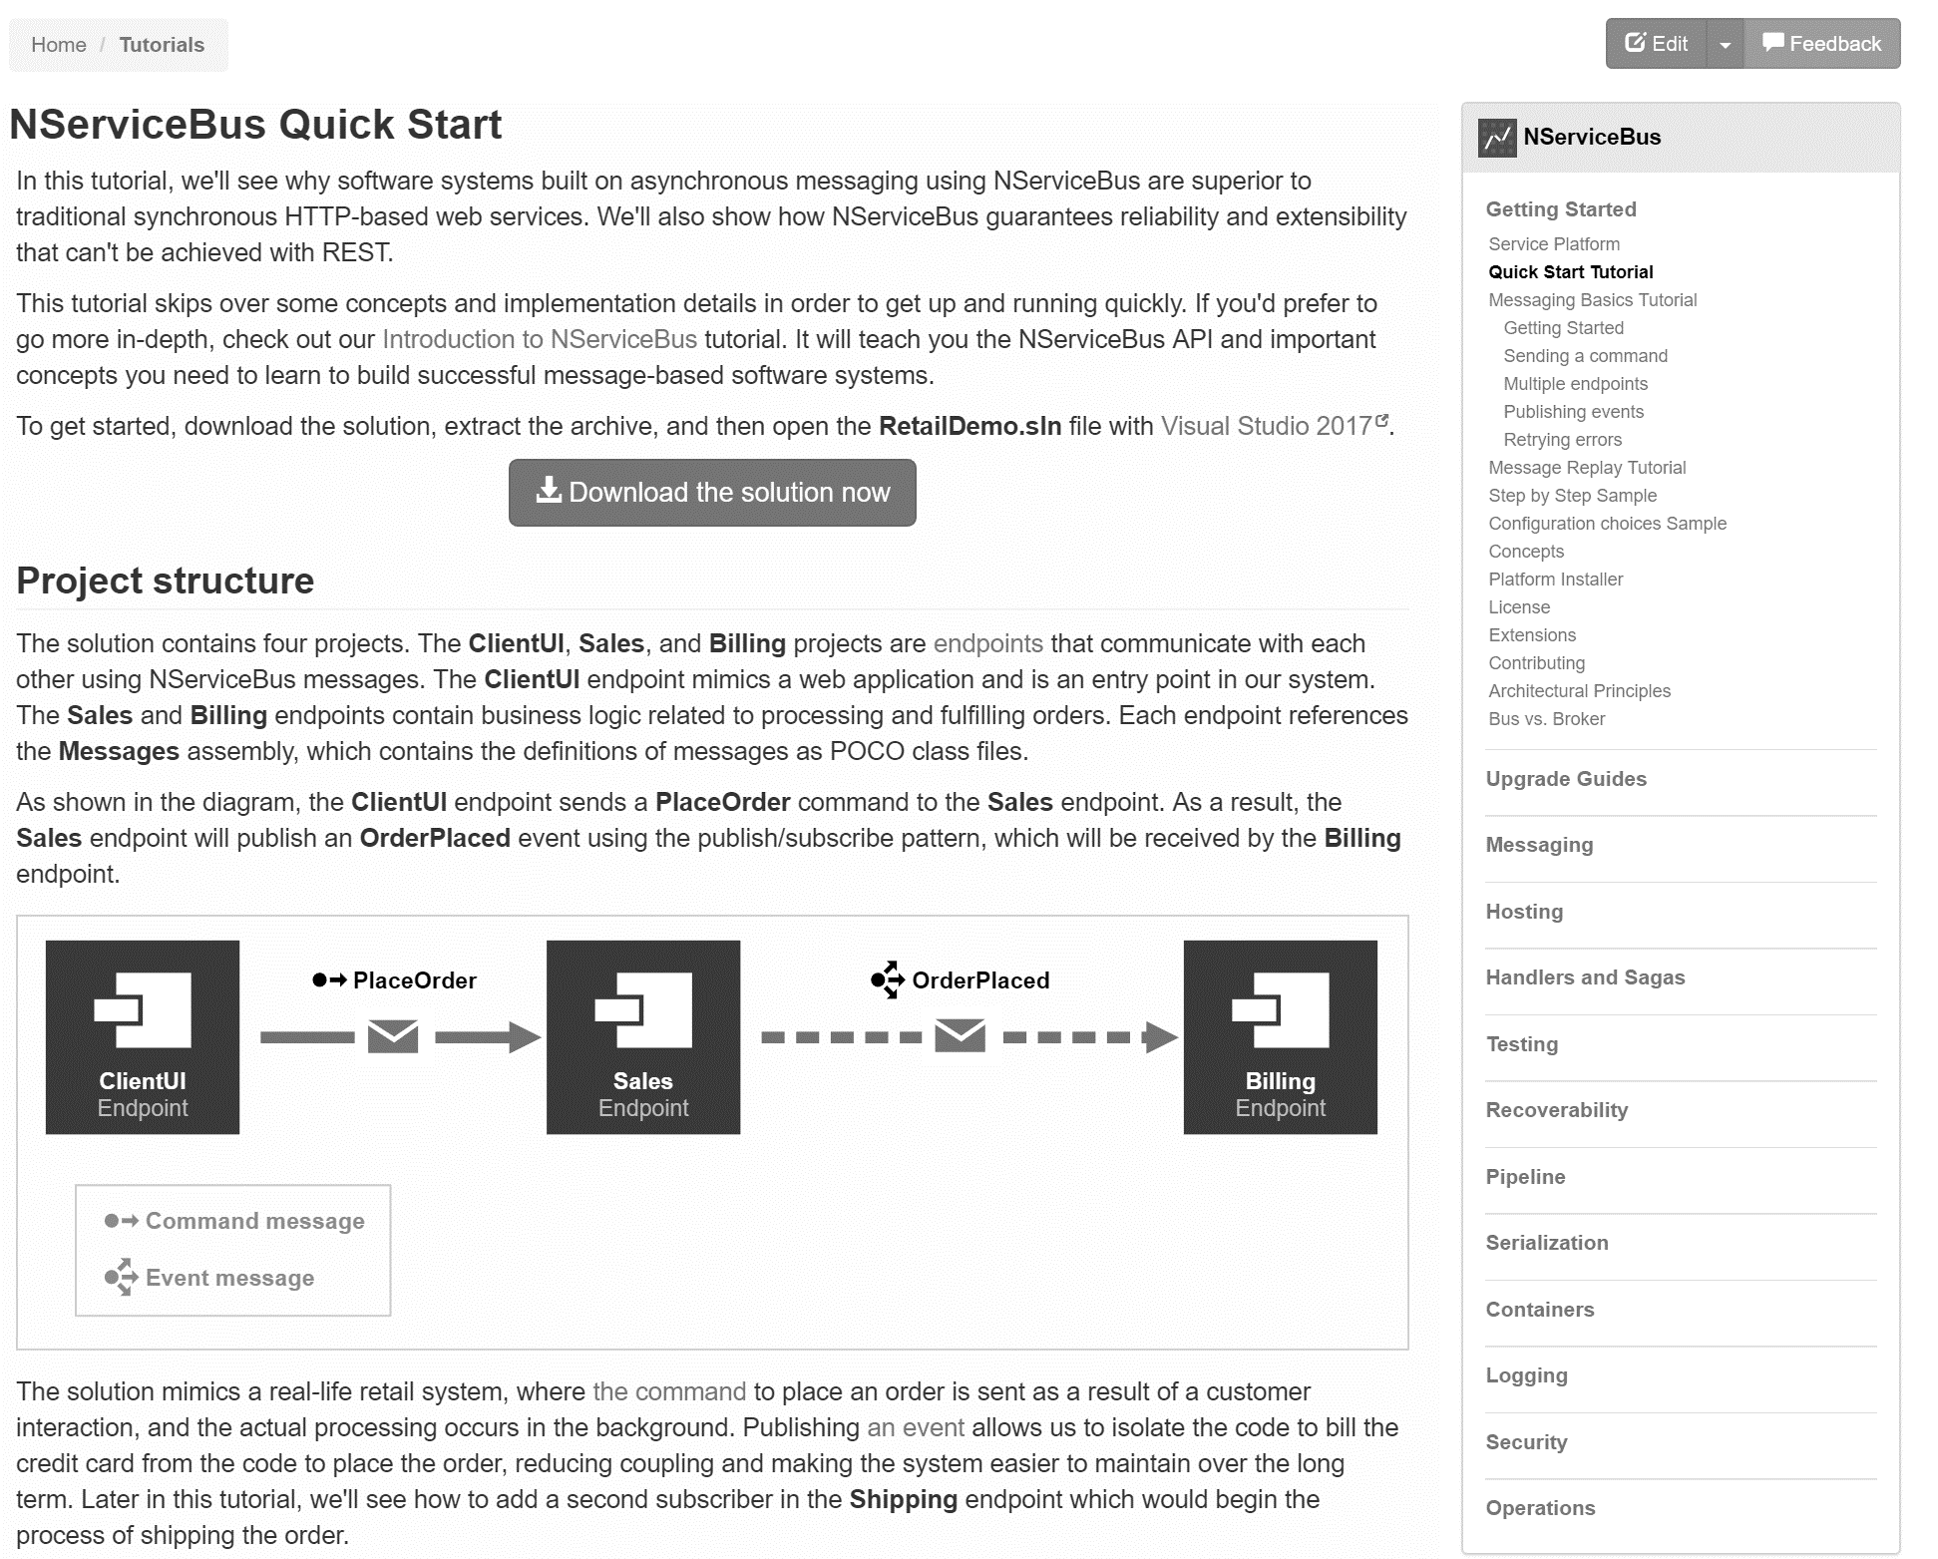
docs.particular.net/ tutorials/quickstart

Slide 15
Slides, Links…
github.com/danielmarbach/MessagePump

Slide 16
Q & A

Slide 17
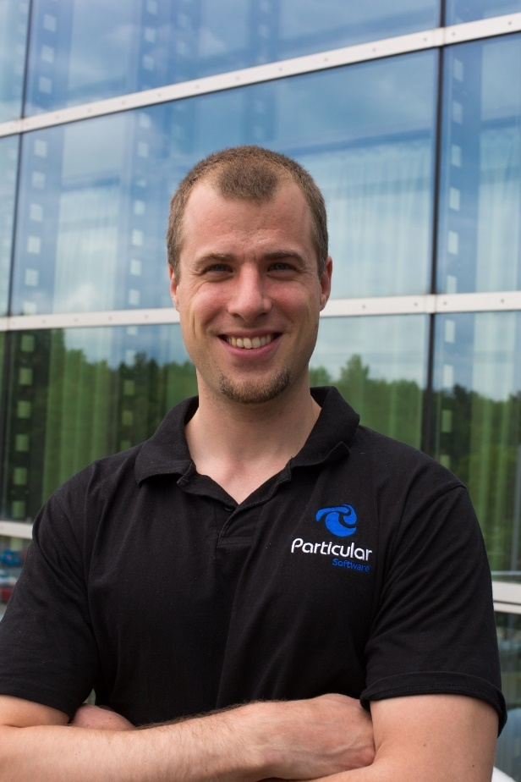
Software Engineer
Enthusiastic Software Engineer
Microsoft MVP
@danielmarbach
particular.net/blog
planetgeek.ch
Notes:
I’m Daniel, Solution Engineer…
I live in central Switzerland. If you want to know more about me listen to episode 77 of developer on fire
You can reach me on twitter under @danielmarbach
I blog on the particular blog and on my personal blog
I’m the lead behind the asyncification of NServiceBus and the ecosystem around it
I regularly contribute back ideas and code changes to asyncify the .NET OSS libraries and frameworks out there. So far I contributed to Entity Framework, RabbitMQ, Marten, MassTransit, Quartz.NET and many more

Slide 18
Thanks
Notes:
Thank you very much for listening and see you next time

