Slide 1

Welcome
1 Company / 50 employees
10
11
in 17 time zones

Slide 2
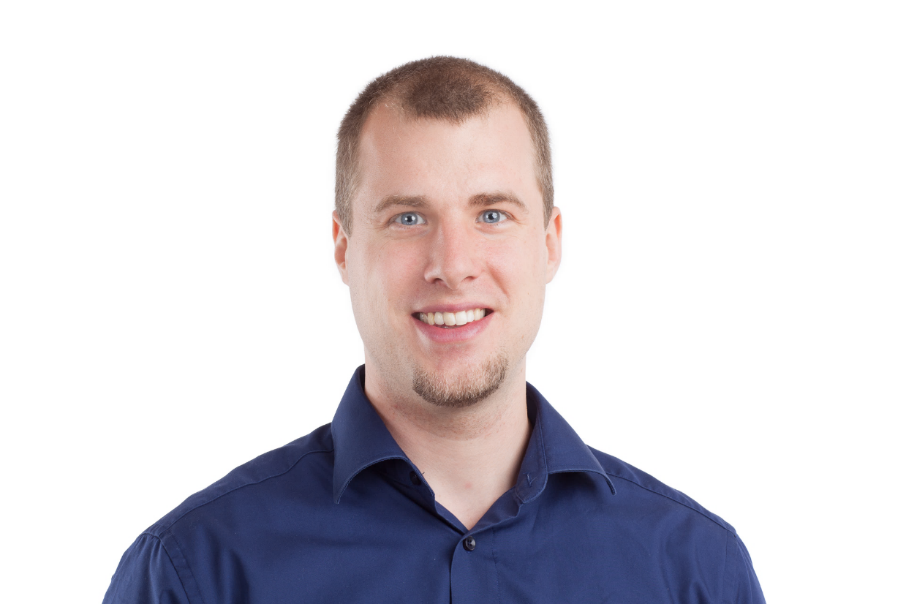
Solution Architect
Enthusiastic Software Engineer
Microsoft Azure MVP
@danielmarbach
particular.net/blog
planetgeek.ch
Notes:
I’m Daniel, Solution Architect…
I live in central Switzerland. If you want to know more about me listen to episode 77 of developer on fire
You can reach me on twitter under @danielmarbach
I blog on the particular blog and on my personal blog
4 «products» and a Platform
Consulting
Support
Spread over 17 time zones
Fully «Dispersed»

Slide 3
Intro
Process
WrapUp
Notes:
This webinar is divided into three parts
Terminology
Code and WrapUp including Q&A

Slide 4
remote
Wherever
you want
Notes:
Everbody is remote and remote only. No one is special, not even the CEO

Slide 5
freedom
Whenever
you want
Notes:
We work whenever we want, we have free working hours and the right to cancel meetings at any time.

Slide 6
vacation
How much
you like
Notes:
Free-time off policy. When you need a break from work, then take it.

Slide 7
life / work balance
However
you prefer
Notes:
Organize your work around your private life. Sometimes shit just hits the fan. Maintaining a good life work balance is crucial. Work / Employers etc. comes and goes. What remains is most important; Your family.

Slide 8
Whatever
your decision
you want
Notes:
Decide on your own what to work on. When you enjoy your work then you make an impact.

Slide 9
sounds like
Chaos

Slide 10
;)
Almost
Notes:
Before we dive deeper what we do let’s make a step back and see what classical companies do.

Slide 11
Experience says
Most of the wrong decisions were made by a single individual

Slide 12
Experience says
Authority and strict rules
generate submission and adaption

Slide 13
Experience says
Matrices bring people
to cheat the system

Slide 14
this is
Chaos
pure
Notes:
People lost purpose, everybody looks after their own joy and salary. The company is reigned with fear and anger. People move on. Gärtchendenken. Innovation and Incubation cannot happen because you are not empowered.
Can we look at a company from a different angle then the organizational chart one? What are the fundamental building blocks for a successful company which treats its most precious good, the human beings, well?
To be able to successful we need a maxim

Slide 15
fail small, learn big
Notes:
Keep in mind that these ideas should follow the fail small, learn big maxim - meaning that they can be tried in some small capacity with minimal risk. Think of them like experiments where the only failure is a failure to learn.
There is no such thing as a "right decision". You will not be criticized for taking a decision that results in a negative or less than optimal outcome - nor will you be celebrated for positive outcomes. Outcomes are at least half chance.
You are ultimately accountable for good decision making - for following this process and using your best judgment as to when you need to deviate from the process.
This forces us to break down things into small units of work
The CEO doesn’t make many decision any more. Just makes sure we follow the process
and a process with Pillars

Slide 16
Organizational Roles
Values
Strategies
A place to collaborate
Notes:
The Core Values which keeps us together including a Code of Conduct
Of course Trust is also a big aspect
A place where we collaborate (Zoom.us, Github and Slack, if we can we try to avoid emails)
Strategies that allow us to focus a predefined areas and define how we collaborate about what
Organizational roles to keep things together in sanity
That’s the secret folks, now go home ;)

Slide 17
Intro
Process
WrapUp

Slide 18
how do I know I fit the
culture?

Slide 19
Values

Slide 20
Motivated
We live up to being
Responsible
Mature
Notes:
We are Responsible:
Able and committed to taking tasks to completion
See the big picture, preventing things from falling between the cracks
Have the judgment to decide what needs to be done well now vs. that which can be improved later
We are Motivated:
Have a “can do” attitude / are self-starters / show initiative
Enjoy learning and trying new things, even outside of our specialty
Are willing to fail small in order to learn big, celebrating success and communicating our learnings from "failure"
Deal well with change, adapting quickly to changing circumstances
next

Slide 21
Motivated
We live up to being
Responsible
Mature
Notes:
We are Mature:
Willingly sharing knowledge and helping others
Understand our limitations and know when to ask for help
Respectful to everyone (customers, co-workers, and partners)
Communicate articulately and effectively, both online and offline
Support group decisions even when we disagree (not passive-aggressive)
You have to believe in the values and live up to them

Slide 22
“Treat colleagues with respect. Make eye contact.
Give honest feedback.”
Starr-Hollow Coast Guard Alaska
Notes:
Just Culture aus der Medizin
„Neulich merkte ich nach einem Einsatz, dass meine Taschenlampe kaputt war“, sagt Starr-Hollow. „Ich hatte sie vor dem Abflug nicht kontrolliert. Niemand wusste von dem Fehler. Trotzdem sprach ich im Debriefing darüber. Das Zugeben eines Fehlers erleichtert dein Gewissen. Und die Kollegen werden daran erinnert, ihre eigenen Taschenlampen zu prüfen.“
Just Culture sei ein phänomenales ­System, um in jedem Job besser zu werden, sagt Starr-Hollow: „Stell dir vor, du verärgerst einen Kunden, weil du in einer E-Mail die falsche Anrede verwendest. Verschweigst du den Fehler, passiert er vielleicht auch deinen Kollegen. Teilst du ihn, profitiert das ganze Team von deinem Erkenntnisgewinn.“
Nurtures an environment where failing is acceptable.

Slide 23
Mentoring / Coaching
1 : 1
Fostering Peer Feedback
Notes:
Are we there yet? Noooo! Observe and Tell. Jump on a call as soon as possible
We do that by pointing back to our values. That is the foundation!

Slide 24
Collaborate

Slide 25
A change is just a Pull Request away

Slide 26
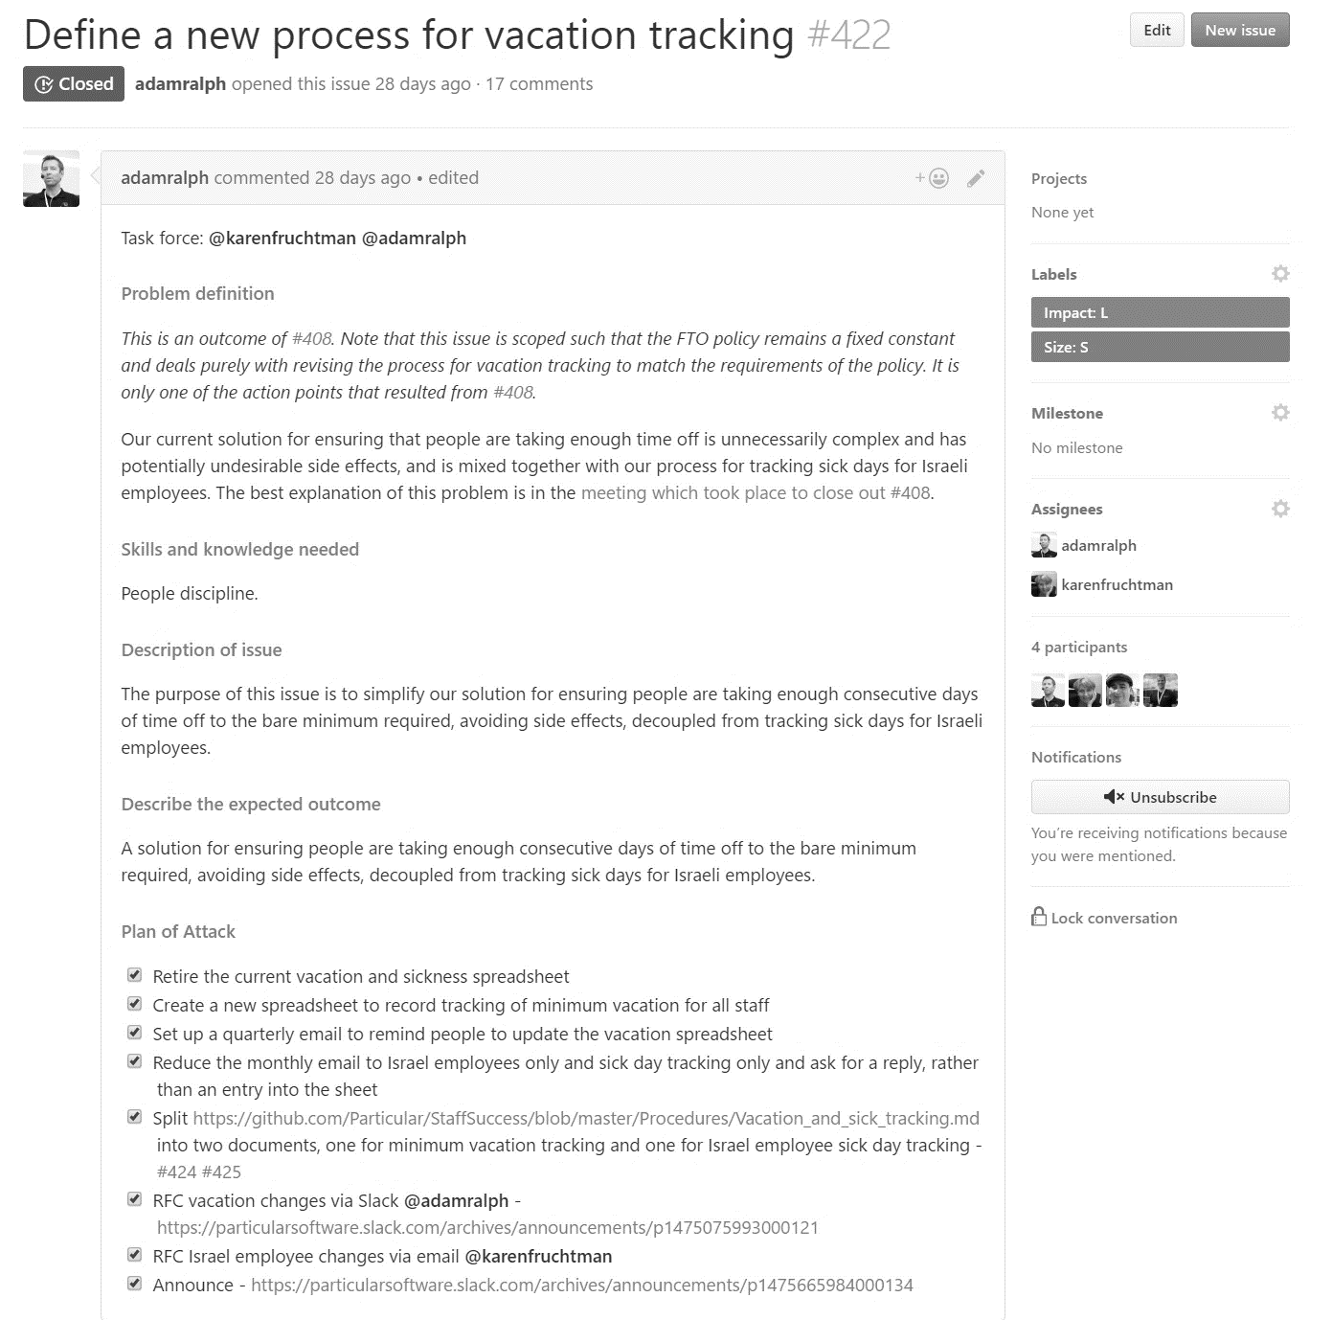
Issue
Notes:
Someone raises an issue (issues are cheap)
A squad responsible for the strategy prioritizes it
prioritzing issues
defining processes
making sure issues are clearly defined
ensuring good decision-making practices are followed (reference needed)
documenting and communicating decisions
continually improving processes.
Setting and following timelines (in the case of projects).
When it is next in line a task force is formed
The way work or tasks are performed in Particular is usually not by a single person but rather by a group of people working in a "task force". Ideally, the people in a taskforce will bring a diverse set of skills and knowledge from multiple disciplines.
Unlike normal teams, a task force comes together for a specific task and disbands once that task is complete.
We don’t need a role to achieve something, skills are the requirement.
We need the right skills to fail small and learn big
Business (Marketing…), People (Softskills), Domain (What), Solution (How)

Slide 27
Issue
Notes:
Someone raises an issue (issues are cheap)
When it is next in line a task force is formed
The way work or tasks are performed in Particular is usually not by a single person but rather by a group of people working in a "task force". Ideally, the people in a taskforce will bring a diverse set of skills and knowledge from multiple disciplines.
Unlike normal teams, a task force comes together for a specific task and disbands once that task is complete.
We don’t need a role to achieve something, skills are the requirement.
We need the right skills to fail small and learn big
Business (Marketing…), People (Softskills), Domain (What), Solution (How)

Slide 28
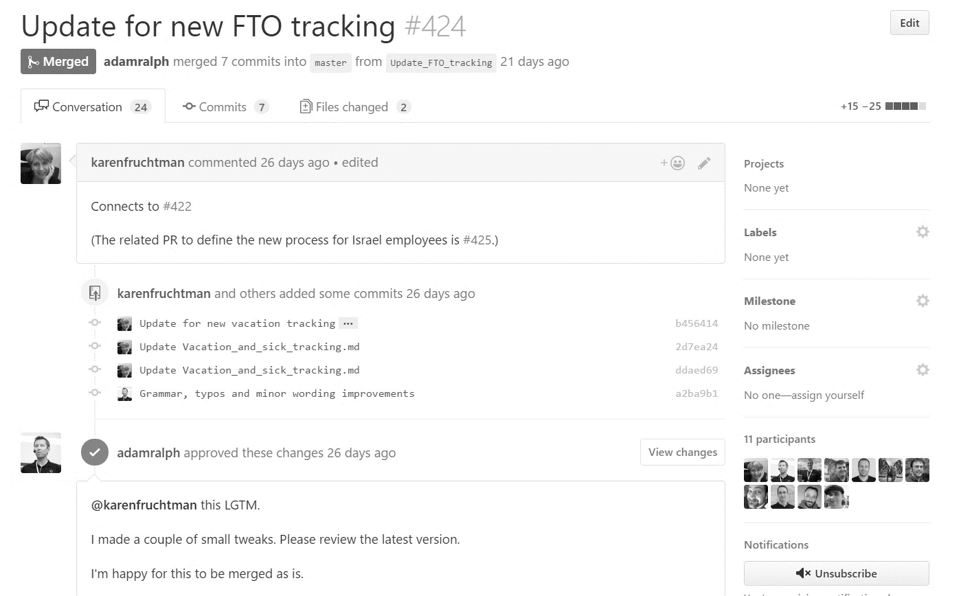
Pull Request
Notes:
The Task Force raises the change as a PR against our internal markdown files
When it is at a certain stage the invite everyone to an RFC

Slide 29
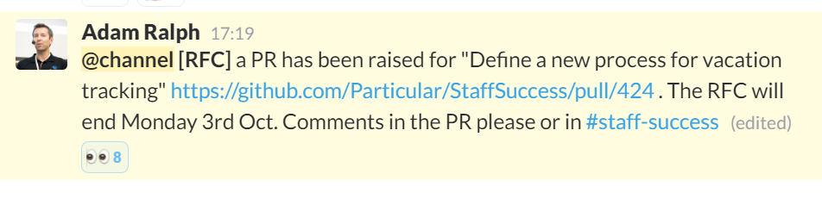
Request for Comments
Notes:
Anyone can make comments and suggest changes but the Task Force is responsible to make the decision. Any employee can stop the line BUT it requires to understand the process the TF went through and have really good arguments why it can’t be done like proposed
Taskforce give the company the opportunity to have a closer look at the change outlined if something fell between the cracks and the opportunity to influence a decision but the TF has the final decision and decides in the name of the whole company. Nobody has the right to finger point against the TF when the decision is made. If you are opinionated about something then you’d better join the TF in advance.
This forces the TF to write down everything and also record the meetings. Employees are empowered. The transparency is high.

Slide 30




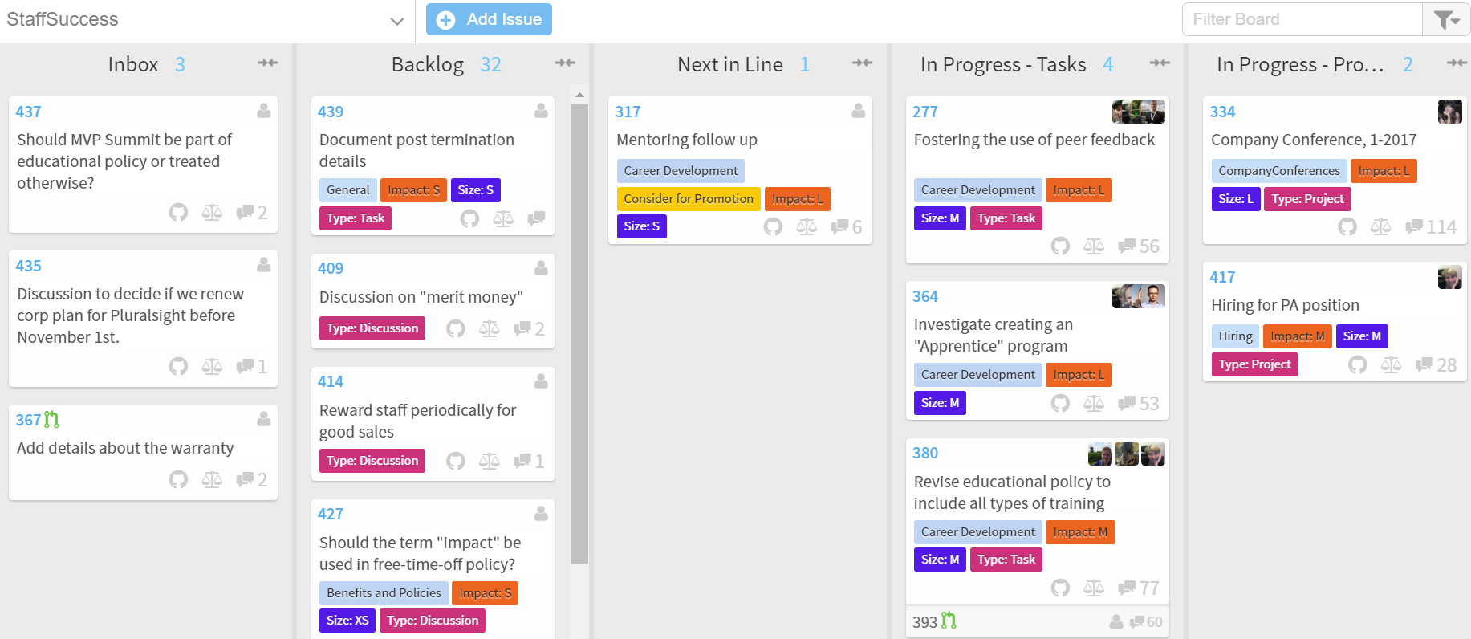
Notes:
And we meet “twice” a year

Slide 31
so I can work on
Anything?

Slide 32
Really?

Slide 33
;)
Almost

Slide 34
Strategies

Slide 35
Customer Success
Developer Education
Platform Dev
Collaboration
Staff Success
Notes:
Collaboration
Decision Making
Cross-Strategy Collaboration (based on expertise in various disciplines. Legal and financial oversight and compliance are here.)
Meetings previously part of "Internal Communications" (including "Ask Udi" and Town Halls)
Online Chat
Distributed reference material management
Distributed work item tracking
Developer Education
Story Production
Events
Training (including ADSD and Enterprise Dev with NSB, and online training in the future)
Online campaigns
Accounts Payable/Receivable (for this area of strategy)
Ecosystem and Community (Partner & Champs)
Marketing website
Customer Success
Inbound Sales (as we don't do outbound)
RFI/RFP
Customer Onboarding
Accounts Receivable (for this area of strategy)
Support previously part of "Developer success"
Technical Account Management previously spread over "Account Management" and "Developer success"
Professional Services Offerings
Startup licenses
Renewals
(Links to high level metrics to be added.)
Platform Development
Bug triage/fixing previously part of "Feature Development"
Features previously part of "Feature Development"
Documentation
Vision
Customer Success Collaboration (for impact assessment and customer communication)
Developer Education Collaboration (for stories)
Accounts Payable (for this area of strategy)
(Links to high level metrics to be added.)
Staff Success
Sourcing
Interviewing
Onboarding
Company Conferences previously "Company Meeting" as its own process and duplicated as part of "Internal Communications"
Compensation previously part of "Staff Rewards and Policies"
Benefits and Policies previously part of "Staff Rewards and Policies"
Career Development previously "Coaching and Development"
Payroll
Accounts Payable (for this area of strategy)

Slide 36
Customer Success
Developer Education
Platform Dev
Collaboration
Staff Success
Notes:
Customer Success
Inbound Sales (as we don't do outbound)
RFI/RFP
Customer Onboarding
Accounts Receivable (for this area of strategy)
Support previously part of "Developer success"
Technical Account Management previously spread over "Account Management" and "Developer success"
Professional Services Offerings
Startup licenses
Renewals
Platform Development
Bug triage/fixing previously part of "Feature Development"
Features previously part of "Feature Development"
Documentation
Vision
Customer Success Collaboration (for impact assessment and customer communication)
Developer Education Collaboration (for stories)
Accounts Payable (for this area of strategy)
(Links to high level metrics to be added.)
Staff Success
Sourcing
Interviewing
Onboarding
Company Conferences previously "Company Meeting" as its own process and duplicated as part of "Internal Communications"
Compensation previously part of "Staff Rewards and Policies"
Benefits and Policies previously part of "Staff Rewards and Policies"
Career Development previously "Coaching and Development"
Payroll
Accounts Payable (for this area of strategy)

Slide 37
Roles

Slide 38

Guild
http://www.iowabeer.org/
Notes:
A guild is a cross-company community of interest - people that want to share knowledge, skills, and tools.
Examples of guilds might include:
Functional programming
Presentation techniques
People from across the company can take part in whichever and as many guilds as they like.

Slide 39
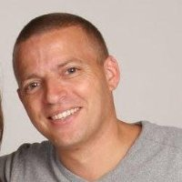
Mentor
https://www.linkedin.com/in/willie-levy-7690b51
Notes:
A mentor is anyone in the organization who a staff member trusts to give them good advice.
This is a confidential relationship, focused more on values and behaviors than skills.
The mentor is a non-judgmental sounding board, and there are no repercussions from anything shared during discussions.
Mentors use coaching skills to guide decision making. Rather than solving problems, mentors guide us to solve a problem ourselves. The focus of the guidance is on improvement, not on aligning with the company goals. mentors need to focus on the individual's needs, not the organization's.
next

Slide 40
Mentor
https://www.linkedin.com/in/willie-levy-7690b51
Notes:
a current frustration in the organization
an interpersonal conflict
a project where we are blocked
prioritization problems
work/life balance issues
professional and personal development

Slide 41
there are more
Notes:
Facilitator, OnBoarding Buddy, Specialist…
You can wear different heads depending on your interests

Slide 42
Metrics

Slide 43
so everything is
perfect?

Slide 44
;)
Almost

Slide 45
Challenges

Slide 46
You have to engage
Notes:
You have to be active, you spend energy, you have to be motivated and embrace the challenge
Help others, the big picture counts
Nobody makes the decision for you, you have to be part of the decision
No boss will tell you what to do and why

Slide 47
There is no ladder to climb
Notes:
There is no “I’m the Rockstar that’s why I get promoted”

Slide 48
Communication is f… hard
Notes:
Written communication is freaking hard and there can be a lot of missunderstanding

Slide 49
Change never ends
Notes:
Personal, organizational and process change is never over. This can be tiring

Slide 50
but
Hey!

Slide 51
I love
challenges!

Slide 52
Pattern
Build It
WrapUp

Slide 53
Slides, Links…
github.com/danielmarbach/RemoteWorking
Notes:
Questions that can be answered in blog posts

Slide 54
Q & A

Slide 55
Thanks
Notes:
Thank you very much for listening and see you next time

