Slide 1

Welcome
1 Company / 45 employees
10
11
in 15 time zones
Notes:
Herzlich Willkommen zum Thema
Eine Firma, 45 Mitarbeiter in 15 Zeitzonen,
Ich muss schon mal gestehen, dass ich mit den Zeitzonen etwas übertrieben habe um hoffentlich mehr Leute in meinen Talk zu locken. Es sind eigentlich nur 10 obwohl Adam Ralph wird die nächsten 6 Monate viel herumreisen. Es könnten also auch mal 11 Zeitzonen sein.
Übrigens es gibt ein Slack Plugin für die die Slack benutzen, dass kann man ins Slack laden und dann sieht man die Zeitzonen der Mitarbeiter, das sieht dann bei uns so aus

Slide 2
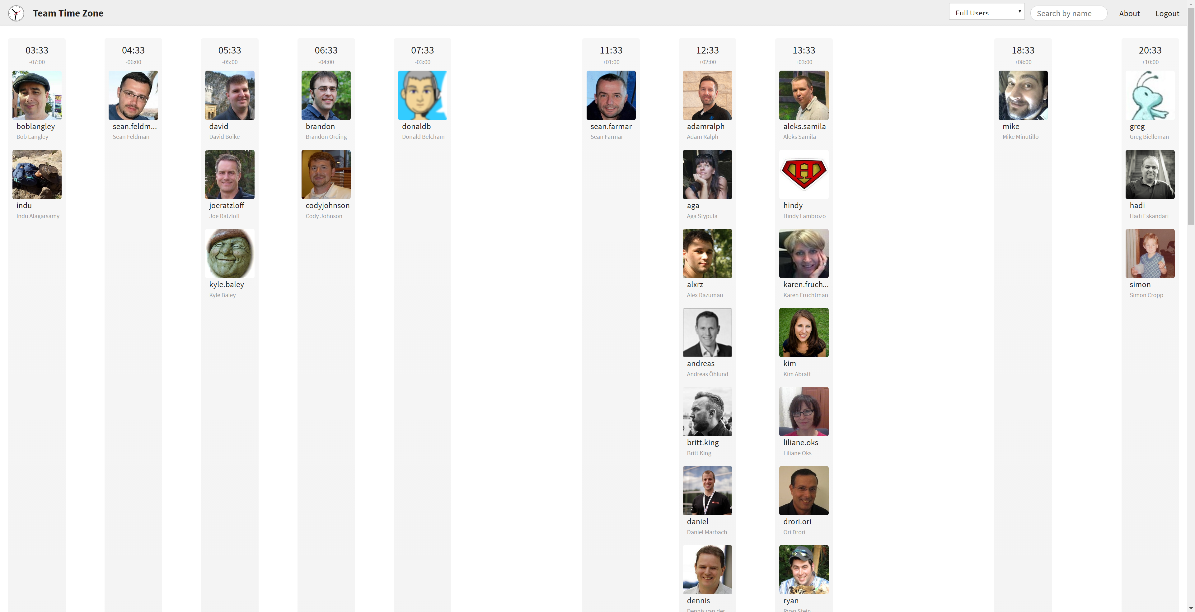
That’s me ☺
https://teamtime.zone/
Notes:
Der Screenshot zeigt ein Teil meines Team, und das bin ich, [CLICK]
Ich arbeite von der Schweiz aus unter dem rechtlichen Konstrukt tracelight GmbH als Contractor für Particular Software
Als Software Engineer bin ich mitverantwortlich für
4 «products» and a Platform for over 1000 customers world wide being used by tens of thousands developers
Und das
Consulting
Support
Warum zerstreute Firma? Firma von Udi Dahan gegründet, er realisierte nur eine zerstreute Firma kann 24/7 den Support und die Entwicklung der Platform gewährleisten auf deren unsere Kunden ihre Mission Critical Systeme aufbauen
Ich liebe Remote Working den es erlaub mir, [CLICK]

Slide 3
remote
Wherever
you want
Notes:
Ich kann arbeiten wo ich will.
Alle meine Arbeitskollegen sich auch Remote
Sogar der CEO ist Remote
Ich habe keinen Nachteil gegenüber den anderen den wir sind nur Remote

Slide 4
freedom
Whenever
you want
Notes:
Ich kann arbeiten wann ich will
Ich habe absolute freiheit
Die geht soweit dass ich keine fixe Arbeitszeiten oder Mindeststunden habe
Ich kann jederzeit an einem Meeting nicht teilnehmen

Slide 5
vacation
How much
you like
Notes:
Ich kann soviel arbeiten wie ich will
Wir haben eine Freetime off policy.
Wen immer ich das Gefühl habe ich brauche eine Pause gönne ich mir die
Komme dann Frisch und erholt zurück
Voller Energie und Elan

Slide 6
life / work balance
However
you prefer
Notes:
Ich kann meine Life / Work balance oder wie ich immer sage Wife / Work balance (Schicksal wenn man verheiratet ist ;) )
D.h. ich kann meine Arbeit rund um mein Privatleben organisieren.
“Sometimes shit hits the fan”
Das passiert jedem einmal im Leben
Beispiel Rücken meiner Frau, Tot der Frau eines Arbeitskollegen
Wie wichtig dass das Privatleben und seine Freunde sind
Manchmal hört man dann “ja aber dann bist du nicht am arbeiten”, ja genau! Genau die Zeit für mich ermöglicht Raum für Kreativität und Veränderung

Slide 7
Whatever
your decision
you want
Notes:
Ich kann auch tun was ich will. Es ist meine Entscheidung an was ich arbeite. Keine Manager die mir sagen was ich zu tun habe. Ich arbeite an Dingen bei denen ich Wert generieren kann.

Slide 8
sounds like
Chaos
Notes:
Das tönt wie Chaos

Slide 9
;)
Almost
Notes:
Ja manchmal ist es Chaos aber bevor ich weiter darauf eingehe was wir tun um das Chaos zu kontrollieren mache ich ein Schritt zurück und analysiere aus meiner Erfahrung wie traditionelle Firmen arbeiten.

Slide 10
Experience says
Most of the wrong decisions were made by a single individual

Slide 11
Experience says
Authority and strict rules
generate submission and adaption

Slide 12
Experience says
Matrices bring people
to cheat the system

Slide 13
this is
Chaos
pure
Notes:
People lost purpose, everybody looks after their own joy and salary. The company is reigned with fear and anger. People move on. Gärtchendenken. Innovation and Incubation cannot happen because you are not empowered.
Can we look at a company from a different angle then the organizational chart one? What are the fundamental building blocks for a successful company which treats its most precious good, the human beings, well?
To be able to successful we need a maxim

Slide 14
fail small, learn big
Notes:
Keep in mind that these ideas should follow the fail small, learn big maxim - meaning that they can be tried in some small capacity with minimal risk. Think of them like experiments where the only failure is a failure to learn.
There is no such thing as a "right decision". You will not be criticized for taking a decision that results in a negative or less than optimal outcome - nor will you be celebrated for positive outcomes. Outcomes are at least half chance.
You are ultimately accountable for good decision making - for following this process and using your best judgment as to when you need to deviate from the process.
This forces us to break down things into small units of work
The CEO doesn’t make many decision any more. Just makes sure we follow the process
and a process with Pillars

Slide 15
Organizational Roles
Values
Strategies
A place to collaborate
Notes:
The Core Values which keeps us together including a Code of Conduct
Of course Trust is also a big aspect
A place where we collaborate (Zoom.us, Github and Slack, if we can we try to avoid emails)
Strategies that allow us to focus a predefined areas and define how we collaborate about what
Organizational roles to keep things together in sanity
That’s the secret folks, now go home ;)

Slide 16
how do I know I fit the
culture?

Slide 17
Values

Slide 18
Motivated
We live up to being
Responsible
Mature
Notes:
We are Responsible:
Able and committed to taking tasks to completion
See the big picture, preventing things from falling between the cracks
Have the judgment to decide what needs to be done well now vs. that which can be improved later
We are Motivated:
Have a “can do” attitude / are self-starters / show initiative
Enjoy learning and trying new things, even outside of our specialty
Are willing to fail small in order to learn big, celebrating success and communicating our learnings from "failure"
Deal well with change, adapting quickly to changing circumstances
next

Slide 19
Motivated
We live up to being
Responsible
Mature
Notes:
We are Mature:
Willingly sharing knowledge and helping others
Understand our limitations and know when to ask for help
Respectful to everyone (customers, co-workers, and partners)
Communicate articulately and effectively, both online and offline
Support group decisions even when we disagree (not passive-aggressive)
You have to believe in the values and live up to them

Slide 20
“Treat colleagues with respect. Make eye contact.
Give honest feedback.”
Starr-Hollow Coast Guard Alaska
Notes:
Just Culture aus der Medizin
„Neulich merkte ich nach einem Einsatz, dass meine Taschenlampe kaputt war“, sagt Starr-Hollow. „Ich hatte sie vor dem Abflug nicht kontrolliert. Niemand wusste von dem Fehler. Trotzdem sprach ich im Debriefing darüber. Das Zugeben eines Fehlers erleichtert dein Gewissen. Und die Kollegen werden daran erinnert, ihre eigenen Taschenlampen zu prüfen.“
Just Culture sei ein phänomenales ­System, um in jedem Job besser zu werden, sagt Starr-Hollow: „Stell dir vor, du verärgerst einen Kunden, weil du in einer E-Mail die falsche Anrede verwendest. Verschweigst du den Fehler, passiert er vielleicht auch deinen Kollegen. Teilst du ihn, profitiert das ganze Team von deinem Erkenntnisgewinn.“
Nurtures an environment where failing is acceptable.

Slide 21
Mentoring / Coaching
1 : 1
Fostering Peer Feedback
Notes:
Are we there yet? Noooo! Observe and Tell. Jump on a call as soon as possible
We do that by pointing back to our values. That is the foundation!

Slide 22
Collaborate

Slide 23
A change is just a Pull Request away

Slide 24
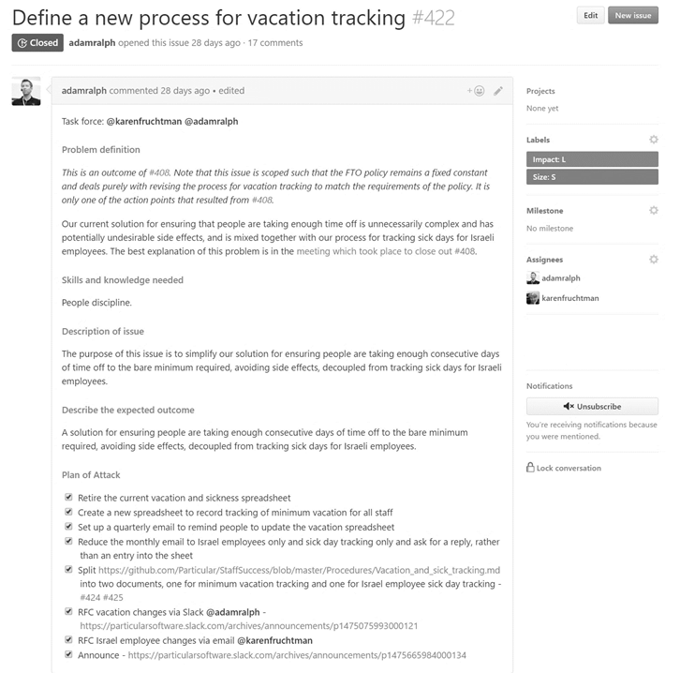
Issue
Notes:
Someone raises an issue (issues are cheap)
A squad responsible for the strategy prioritizes it
prioritzing issues
defining processes
making sure issues are clearly defined
ensuring good decision-making practices are followed (reference needed)
documenting and communicating decisions
continually improving processes.
Setting and following timelines (in the case of projects).

Slide 25
Issue
Notes:
Someone raises an issue (issues are cheap)
When it is next in line a task force is formed
The way work or tasks are performed in Particular is usually not by a single person but rather by a group of people working in a "task force". Ideally, the people in a taskforce will bring a diverse set of skills and knowledge from multiple disciplines.
Unlike normal teams, a task force comes together for a specific task and disbands once that task is complete.
We don’t need a role to achieve something, skills are the requirement.
We need the right skills to fail small and learn big
Business (Marketing…), People (Softskills), Domain (What), Solution (How)

Slide 26
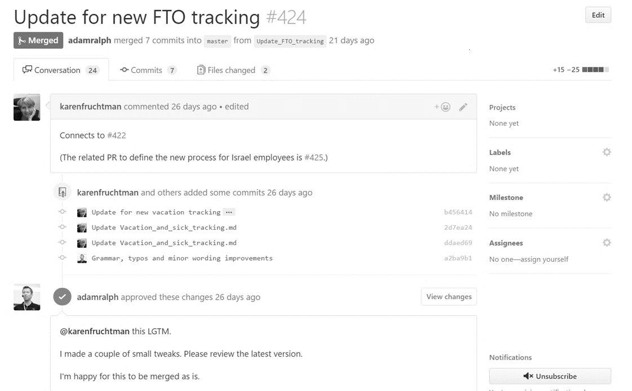
Pull Request
Notes:
The Task Force raises the change as a PR against our internal markdown files
When it is at a certain stage the invite everyone to an RFC

Slide 27
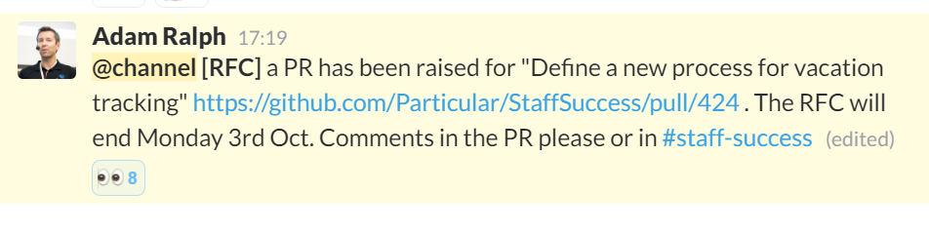
Request for Comments
Notes:
Anyone can make comments and suggest changes but the Task Force is responsible to make the decision. Any employee can stop the line BUT it requires to understand the process the TF went through and have really good arguments why it can’t be done like proposed
Taskforce give the company the opportunity to have a closer look at the change outlined if something fell between the cracks and the opportunity to influence a decision but the TF has the final decision and decides in the name of the whole company. Nobody has the right to finger point against the TF when the decision is made. If you are opinionated about something then you’d better join the TF in advance.
This forces the TF to write down everything and also record the meetings. Employees are empowered. The transparency is high.

Slide 28




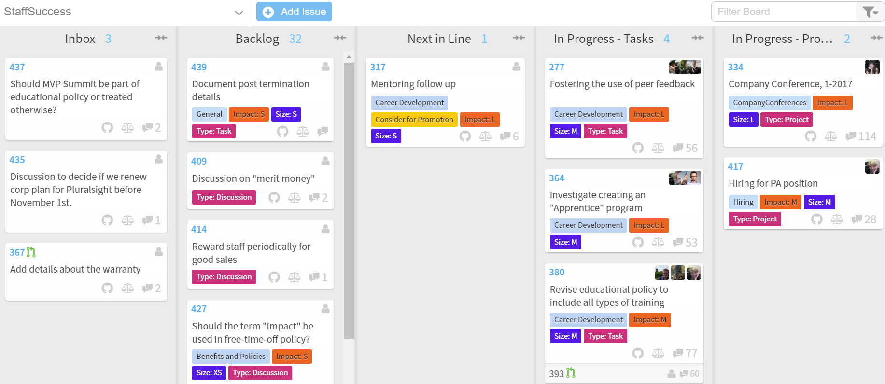
Notes:
And we meet “once to twice” a year physically
We meet every month online in a town hall and in challenge udi
We meet every day within Taskforces over multiple time zones

Slide 29
so I can work on
Anything?

Slide 30
Really?

Slide 31
;)
Almost

Slide 32
Strategies

Slide 33
Customer Success
Developer Education
Platform Dev
Collaboration
Staff Success
Notes:
Collaboration
Decision Making
Cross-Strategy Collaboration (based on expertise in various disciplines. Legal and financial oversight and compliance are here.)
Meetings previously part of "Internal Communications" (including "Ask Udi" and Town Halls)
Online Chat
Distributed reference material management
Distributed work item tracking
Developer Education
Story Production
Events
Training (including ADSD and Enterprise Dev with NSB, and online training in the future)
Online campaigns
Accounts Payable/Receivable (for this area of strategy)
Ecosystem and Community (Partner & Champs)
Marketing website

Slide 34
Customer Success
Developer Education
Platform Dev
Collaboration
Staff Success
Notes:
Customer Success
Inbound Sales (as we don't do outbound)
RFI/RFP
Customer Onboarding
Accounts Receivable (for this area of strategy)
Support previously part of "Developer success"
Technical Account Management previously spread over "Account Management" and "Developer success"
Professional Services Offerings
Startup licenses
Renewals
Platform Development
Bug triage/fixing previously part of "Feature Development"
Features previously part of "Feature Development"
Documentation
Vision
Customer Success Collaboration (for impact assessment and customer communication)
Developer Education Collaboration (for stories)
Accounts Payable (for this area of strategy)
(Links to high level metrics to be added.)
Staff Success
Sourcing
Interviewing
Onboarding
Company Conferences previously "Company Meeting" as its own process and duplicated as part of "Internal Communications"
Compensation previously part of "Staff Rewards and Policies"
Benefits and Policies previously part of "Staff Rewards and Policies"
Career Development previously "Coaching and Development"
Payroll
Accounts Payable (for this area of strategy)

Slide 35
Initiative vs Project
Notes:
Initiative
An initiative is an umbrella task for a large body of work where there is no identifiable end, and issues will be raised as the initiative progresses. It is likely that initiatives become de-activated at some point, and re-activated at a later point when more tasks are identified. One or more small issues can and should be created before an initiative is started to confirm if the initiative is valid.
Project
A project is an umbrella task for a large body of work where this is a specific definition of "done", and most of the issues are identifiable up front. The value delivery for a project is only realized upon completion.

Slide 36
Roles
Notes:
You are not hired for a specific position
You are hired because of your skills and growth opportunities
Your responsibilities are not fixed
There is no job description or title on your business card

Slide 37

Guild
http://www.iowabeer.org/
Notes:
A guild is a cross-company community of interest - people that want to share knowledge, skills, and tools.
Examples of guilds might include:
Functional programming
Presentation techniques
People from across the company can take part in whichever and as many guilds as they like.

Slide 38
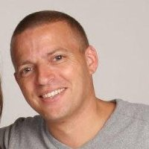
Mentor
https://www.linkedin.com/in/willie-levy-7690b51
Notes:
A mentor is anyone in the organization who a staff member trusts to give them good advice.
This is a confidential relationship, focused more on values and behaviors than skills.
The mentor is a non-judgmental sounding board, and there are no repercussions from anything shared during discussions.
Mentors use coaching skills to guide decision making. Rather than solving problems, mentors guide us to solve a problem ourselves. The focus of the guidance is on improvement, not on aligning with the company goals. mentors need to focus on the individual's needs, not the organization's.
next

Slide 39
Mentor
https://www.linkedin.com/in/willie-levy-7690b51
Notes:
a current frustration in the organization
an interpersonal conflict
a project where we are blocked
prioritization problems
work/life balance issues
professional and personal development

Slide 40
there are more
Notes:
Facilitator, OnBoarding Buddy, Specialist…
You can wear different heads depending on your interests

Slide 41
Decisions

Slide 42
as a group
Notes:
Do we have a sufficiently broad set of disciplines involved to understand all of the ramifications of the decision being discussed?
Do we have people with sufficient depth of expertise to help quantify risk?
Does the issue related to this decision affect other strategies? (collaboration)
Have we chosen the one person accountable for the decision?

Slide 43
now, later or..
never
Notes:
Is now the right time to make this decision?
What is the "last responsible moment" for deciding?
Has that moment already passed?
Should we start taking action even though we're unsure what is the best approach?
Has the issue related to the decision reached a state where the Task force should set a time line for the decision?

Slide 44
important or urgent
Notes:
What assumptions do we assume are true?
What data do we have supporting those assumptions?
What if our assumptions turn out to be false?
What preventative measures can we take?

Slide 45
consensus in a
Task Force
Notes:
Important from a TF perspective, not for the whole company
Sometimes people in the group can't seem to agree on a course of action.
When that occurs, it's likely that the difference in opinion is not actually about the proposed solution but rather about which properties of the problem we're trying to optimize for.
In these cases, stop the discussion and pull in the necessary people to clarify the relative priority of those properties - for example, time to market vs. maintainability.

Slide 46
Metrics

Slide 47
so everything is
transparent?

Slide 48
Finance
even
Notes:
From The company is in a bad situation and all non-essential spending will immediately cease.
To We have a strong cash position, with a healthy forecast, and we are in a position to invest in our growth.
There is a financial projection for the year and a monthly update
Financial decision making is transparent
Every policy that impacts finance can be adjusted to the financial status of the company

Slide 49
but nothing that would
harm your
personal rights
Notes:
Facilitator, OnBoarding Buddy, Specialist…
You can wear different heads depending on your interests

Slide 50
so everything is
perfect?

Slide 51
;)
Almost

Slide 52
Challenges

Slide 53
You have to engage
Notes:
You have to be active, you spend energy, you have to be motivated and embrace the challenge
Help others, the big picture counts
Nobody makes the decision for you, you have to be part of the decision
No boss will tell you what to do and why

Slide 54
There is no ladder to climb
Notes:
There is no “I’m the Rockstar that’s why I get promoted”

Slide 55
Communication is f… hard
Notes:
Written communication is freaking hard and there can be a lot of missunderstanding

Slide 56
Change never ends
Notes:
Personal, organizational and process change is never over. This can be tiring

Slide 57
but
Hey!

Slide 58
I love
challenges!

Slide 59
Slides, Links…
github.com/danielmarbach/RemoteWorking
Notes:
Questions that can be answered in blog posts

Slide 60
Q & A

Slide 61
Thanks
@danielmarbach
particular.net/blog
planetgeek.ch

