Slide 1

Welcome
Async / Await
Chain of Responsibility
Notes:
A warm welcome to my talk about the chain of responsibility principle applied in IO bound domains with async/await

Slide 2
Pattern
Build it
WrapUp
Notes:
This webinar is divided into three parts
Terminology
Code and WrapUp including Q&A

Slide 3
Pattern
Build It
WrapUp

Slide 4
appBuilder.Use(async (ctx, next) =>
{
// do some things here
await next();
// or here
});
OWIN
Notes:
Who has used OWIN before and written that type of code?

Slide 5
ASP.NET Core Middleware
public class Startup {
public void Configure(IApplicationBuilder app) {
app.Use(async (context, next) =>
{
// do some things here
await next.Invoke();
// or here
});
}
}
Notes:
// Do work that doesn't write to the Response.
await next.Invoke();
// Do logging or other work that doesn't write to the Response.
Chain multiple request delegates together with Use. The next parameter represents the next delegate in the pipeline. You can short-circuit the pipeline by not calling the next parameter. You can typically perform actions both before and after the next delegate, as the following example demonstrates:

Slide 6
ASP.NET Core Filters
class ActionFilter : IAsyncActionFilter {
public async Task OnActionExecutionAsync( ActionExecutionContext context, ActionExecutionDelegate next)
{
// do some things here
var resultContext = await next();
// or here
}
}
Notes:
Who has used WebApi action filters before and written that type of code?
These are all variations of the so called Chain of Responsibility pattern

Slide 7
Goals
Chain of Responsibility
target
Notes:
In this talk I’m going to show you how to implement an asynchronous chain of responsibility similar to what you’ll find in popular frameworks like OWIN, WebAPI, MVC and so on. I’m a firm believer that it is crucial to have deep knowledge of the technology, framework or library you are using. If you understand how your infrastructure is composed together and behaves during runtime it is simpler to reason about your application code and in case it fails in production you’ll be quicker to find the problem and eventually a solution to your problem

Slide 8
Client
Link Element
Link Element
Link Element
Link Element
Notes:
You'll find different variations of the pattern in frameworks and middleware like OWIN, FubuMVC, Express.js, Action Filters, and more. They usually share a common approach to the chain of responsibility implementation: nesting functions inside functions.
There is a potentially variable number of "handler" or “link element" or "node" objects, and a stream of requests that must be handled. Need to efficiently process the requests without hard-wiring handler relationships and precedence, or request-to-handler mappings.

Slide 9
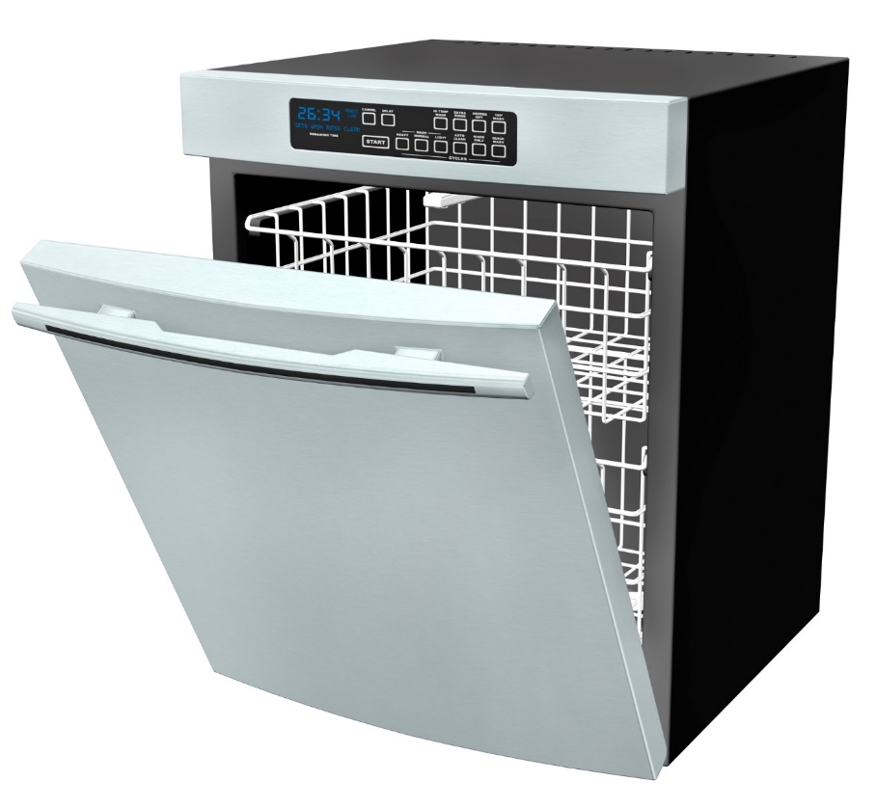
husband
wife
son
Notes:
In our house, cleaning out the dishwasher is a shared chore. My son starts the unloading process by removing a dish or utensil from the dishwasher. If he can put it away, then he does. If the proper location for the dish is out of his reach, then he passes it to his mother. She then goes through the same process; put the dish away if she can, or pass it off to the next person in line, which is me. When I get handed a dish I will put it away and, since I'm 6'4" (1.92m) tall, I can reach all of our cupboard space, which means that the process ends with me.
Next slide

Slide 10
husband
wife
son
Notes:
In our kitchen, the handing off of work can be thought of as an implementation of the chain of responsibility pattern. Each person in the family is a link in that chain. The chain of responsibility starts with my son removing a dish from the dishwasher and ends execution with me.
Each person in our kitchen has a clearly defined set of questions that they ask themselves to determine if they should put the dish away or hand it off to the next process. With these clearly defined questions, each person, or link, has a well-encapsulated set of rules that they apply as they deal with each dish.

Slide 11
static void Person(Action next)
{
// Implementation
next(); // Implementation
}
Notes:
The process of unloading our dishwasher is, at its heart, a chain of responsibility. At our house, we have three steps in the chain and our output is an empty dishwasher. With this in mind, let's explore the code representation of our dishwasher-unloading chain so that we can see the chain and its links. A single person, a link in the chain, can be represented as just a method.
(click)
The method Person above has a single parameter called next of type Action. The Action type is a delegate that can point to any method returning void and accepting zero parameters. Passing in the delegate allows us to compose multiple individual elements together into a chain of responsibility.

Slide 12
public void ManualDishwasherUnloading()
{
Son(() => Wife(() => Husband(() => Done())));
}

Slide 13
Demo
Notes:
Let’s build this thing
ManualDishwasherUnloading

Slide 14
next()
Son
next()
Wife
next()
Husband
Notes:
Recap

Slide 15
cumbersome
Notes:
Of course, complex method-chaining like we've shown in ManualDishwasherUnloading isn't something we'd enjoy manually writing repeatedly. By itself, the code isn't complex. As the method chain grows, visualizing and understanding it becomes more and more difficult. Changing or adding to a large chaining sequence becomes a process that can easily introduce errors or create unintended side effects.
Luckily, there's an even more flexible and maintainable way of building a chain of responsibility.

Slide 16
Demo
Notes:
How do we write a more generic version that is more composable
Let’s build this thing
- Also show exception filter, use file templates auto-*
- Show the callstack and explain how it gets bigger and bigger the more element we have in the list

Slide 17
static void IgnoreDishStillWetException(Action next))
{
try {
next();
}
catch(DishStillWetException) { }
}
Notes:
This type of generic approach is probably overkill if all we want to do is compose four methods together. But as you introduce more links in the chain, the generic approach quickly begins to shine. For example, say you want to surround link with a wrapper that filters out exceptions or performs some other cross-cutting behavior.
It was easy to add IgnoreDishStillWetException before any step in the chain of responsibility when it is needed. As long as the cross-cutting behavior implements the same pattern as Action, you can create and add new links to the chain of responsibility.

Slide 18
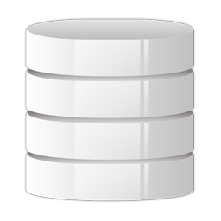

Message Pump
Your Code
PickMessageFrom Transport
DetermineCodeTo Execute
Queue
RetryOnFailure
Deserialize Message
Notes:
Handling a message from a queue can also be implemented as a chain of responsibility.
Each operation, such as picking up the message from the transport of choice, can be thought of as a link in the message-handling chain. Because the chain is stored in a List, links can be added, removed, or reordered. You can make those changes at design time, or at runtime. There is a lot of flexibility in this chain of responsibility.

Slide 19
Pattern
Build It
WrapUp

Slide 20
Demo
await
Notes:
With the analogy of my family and me emptying the dishwasher, we saw how to conceptualize the chain of responsibility and its links as a simple chain of function calls wrapped in each other in a nested fashion. We have also seen that a message handling pipeline is, in itself, a chain of responsibility.
But while these chains are flexible, they are also very linear. As I showed in my previous presentation, Async/Await: The die is cast, the domain of message handling is primarily focused on IO-intensive work, and the answer to IO-heavy workloads is a task-based API combined with the async/await keywords.
So, what would happen if we used async/await on each of the links in the chain of responsibility?
Let’s build this thing!
Manual and Automatic, show retrier with async-auto-1
Show object version
YourDools

Slide 21
Your Code
PickMessageFrom Transport
...
RetryOnFailure
Deserialize Message
DetermineCodeTo Execute
Where to place links?

Slide 22
Physical
Logical
Your Code
PickMessageFrom Transport
...
RetryOnFailure
Deserialize Message
DetermineCodeTo Execute
Stages

Slide 23
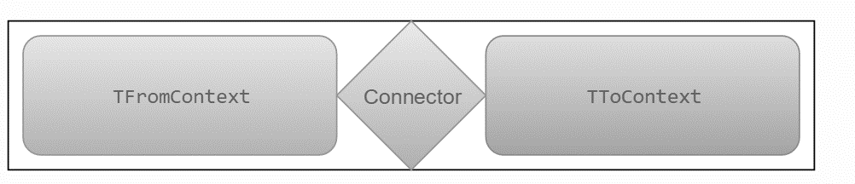
Stage Connector

Slide 24
Demo
await
missing ConfigureAwait(false) ;)
Notes:
Let’s dig this thing!
AsyncDollsWithStateTyped

Slide 25
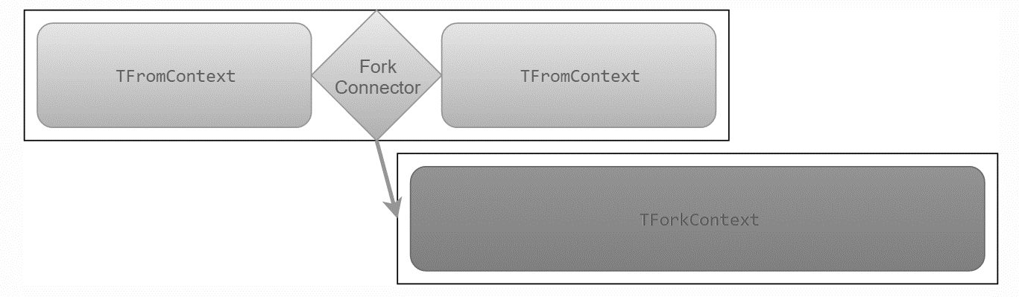
Fork Connector

Slide 26

Stage Fork Connector

Slide 27
Tree of Responsibility
Keep calm and let your head explode

Slide 28
The need for
speed
speed
speed

Slide 29
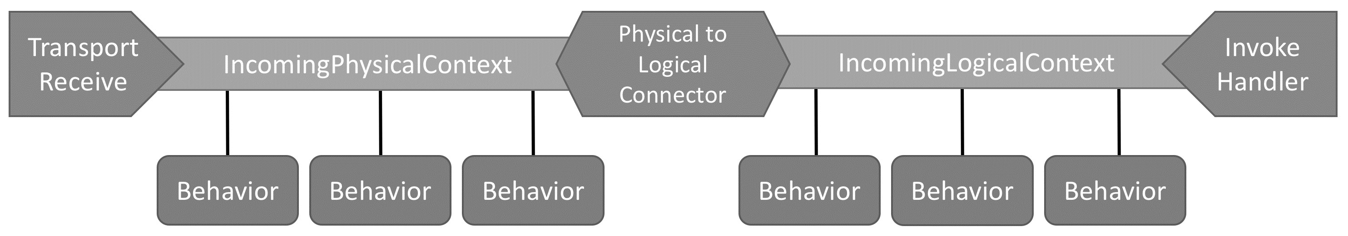

Slide 30
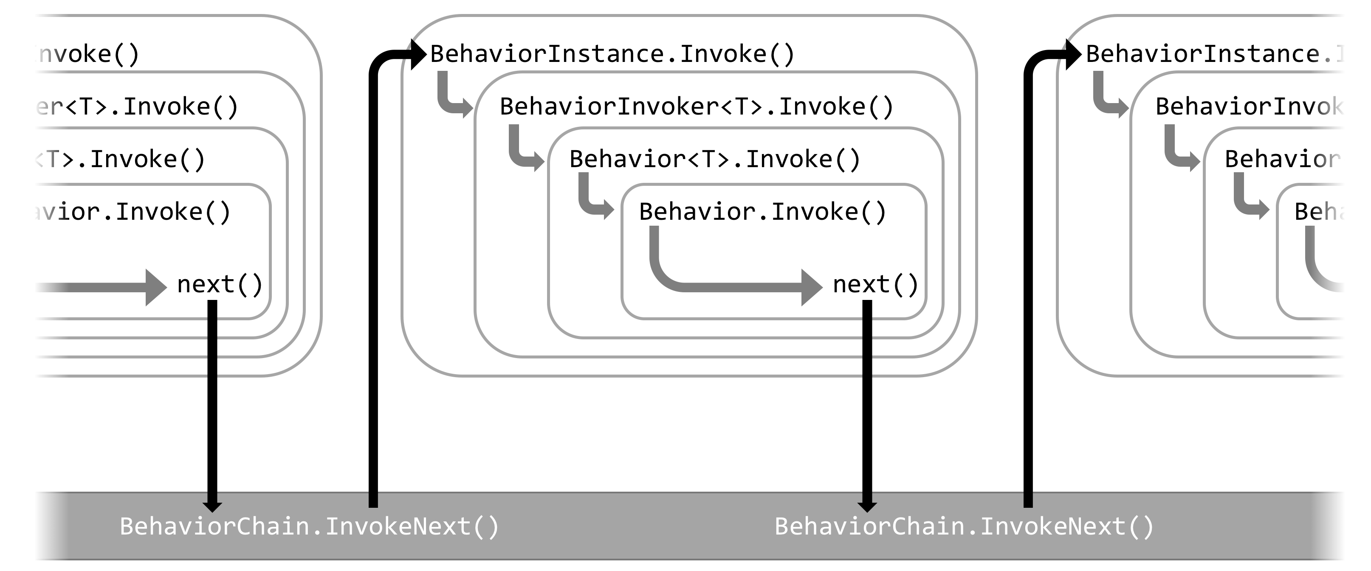

Slide 31
What if we write this code by hand?

Slide 32
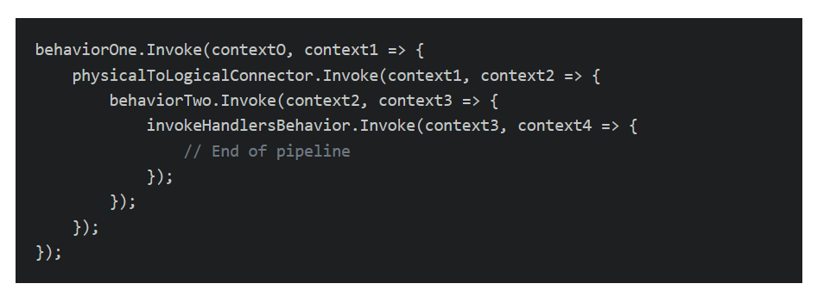
Notes:
Switch to code when time

Slide 33
Expression Trees
go.particular.net/expressions
Notes:
A real-life call stack, based on an example of the outgoing message call stack when publishing a message, was reduced from 113 lines to approximately 30 lines for a 73% improvement in call stack depth compared to the non-optimized version. With no infrastructure overhead, the change results in a dramatic size reduction for error messages, as well as call stacks that are easier to read and debug.
There was up to 10X faster pipeline execution for the cases where no exceptions were thrown and the pipeline completed successfully.
There was up to 5X faster exception handling, even in cases where an exception is thrown at the deepest level of the call stack. When an exception is thrown, it matters quite a bit how deep in the pipeline it's thrown from. An exception thrown earlier in the pipeline will not have to bubble up as far and will be handled even faster.
We saw a 94% reduction in Gen 0 garbage creation with the dramatic reduction in calls and allocated objects.

Slide 34
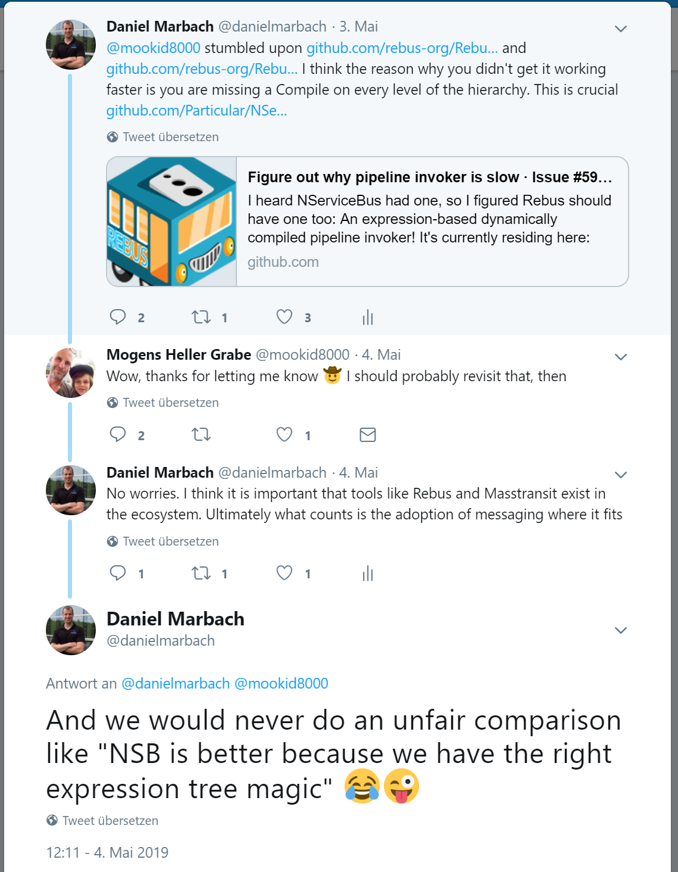

Slide 35
Pattern
Build It
WrapUp

Slide 36
Is Async all the way
Uses the chain of responsibility pattern heavily
NSB v6+
particular.net/blog/async-await-its-time
docs.particular.net/nservicebus/pipeline/customizing-v6
Notes:
But how does this relate to the yet to be release NServiceBus Version 6

Slide 37
Chain of Responsibility or Russian Dolls
is a flextensible pattern ideally suited to build robust IO bound pipelines
Recap
The pattern is used in many OSS projects
reminder
Know it, learn it, love it *
Probably copyrighted by the .NET Rocks guys ;)*

Slide 38
Thanks
Notes:
Thank you very much for listening and see you next time

Slide 39
Slides, Links…
github.com/danielmarbach/async-dolls
Notes:
Questions that can be answered in blog posts

Slide 40
Q & A
await

Slide 41

Software Engineer
Microsoft MVP
@danielmarbach
particular.net/blog
planetgeek.ch
Notes:
I’m Daniel, Solution Engineer…
I live in central Switzerland. If you want to know more about me listen to episode 77 of developer on fire
You can reach me on twitter under @danielmarbach
I blog on the particular blog and on my personal blog
I’m the lead behind the asyncification of NServiceBus and the ecosystem around it
I regularly contribute back ideas and code changes to asyncify the .NET OSS libraries and frameworks out there. So far I contributed to Entity Framework, RabbitMQ, Marten, MassTransit, Quartz.NET and many more

Slide 42
Thanks
Notes:
Thank you very much for listening and see you next time

