Slide 1

Welcome
Workshop
Chain of Responsibility
Notes:
A warm welcome to my talk about the chain of responsibility principle applied in IO bound demains with async/await

Slide 2

Solution Architect
Enthusiastic Software Engineer
Microsoft Azure MVP
@danielmarbach
particular.net/blog
planetgeek.ch
Notes:
I’m Daniel, Solution Architect…
I live in central Switzerland. If you want to know more about me listen to episode 77 of developer on fire
You can reach me on twitter under @danielmarbach
I blog on the particular blog and on my personal blog
Subscribe after this webinar

Slide 3
Pattern
Build It
WrapUp
Notes:
Who has used NancyFX Before and After Module Hooks?
Who has used FubuMVC behaviors?

Slide 4
appBuilder.Use(async (ctx, next) =>
{
// do some things here
await next();
// or here
});
OWIN
Notes:
Who has used OWIN before and written that type of code?

Slide 5
class FilterOutInvalidOperationException : IActionFilter {
public bool AllowMultiple { get; }
public async Task<HttpResponseMessage> ExecuteActionFilterAsync(HttpActionContext actionContext, CancellationToken cancellationToken, Func<Task<HttpResponseMessage>> continuation) {
try {
var response = await continuation();
return response;
} catch (InvalidOperationException) {
}
return new HttpResponseMessage();
}
}
WebApi
Notes:
Who has used WebApi action filters before and written that type of code?
These are all variations of the so called Chain of Responsibility pattern

Slide 6
Goals
Chain of Responsibility
target
Notes:
In this talk I’m going to show you how to implement an asynchronous chain of responsibility similar to what you’ll find in popular frameworks like OWIN, WebAPI, MVC and so on. I’m a firm believer that it is crucial to have deep knowledge of the technology, framework or library you are using. If you understand how your infrastructure is composed together and behaves during runtime it is simpler to reason about your application code and in case it fails in production you’ll be quicker to find the problem and eventually a solution to your problem

Slide 7
Client
Link Element
Link Element
Link Element
Link Element
Notes:
You'll find different variations of the pattern in frameworks and middleware like OWIN, FubuMVC, Express.js, Action Filters, and more. They usually share a common approach to the chain of responsibility implementation: nesting functions inside functions.
There is a potentially variable number of "handler" or “link element" or "node" objects, and a stream of requests that must be handled. Need to efficiently process the requests without hard-wiring handler relationships and precedence, or request-to-handler mappings.

Slide 8
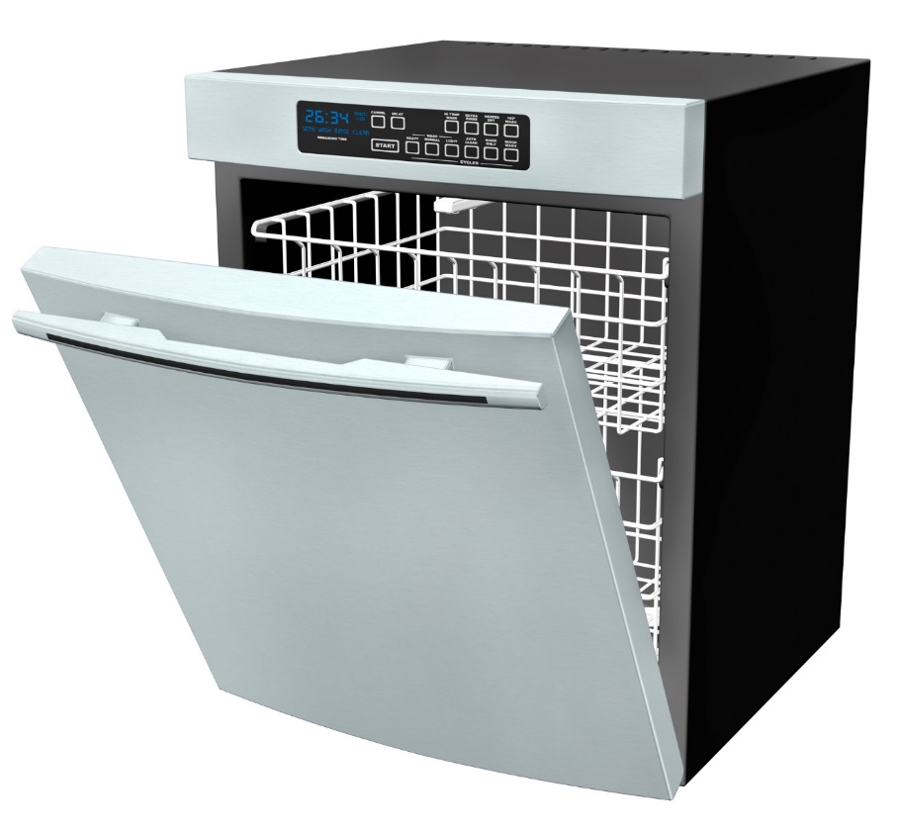
husband
wife
son
Notes:
In our house, cleaning out the dishwasher is a shared chore. My son starts the unloading process by removing a dish or utensil from the dishwasher. If he can put it away, then he does. If the proper location for the dish is out of his reach, then he passes it to his mother. She then goes through the same process; put the dish away if she can, or pass it off to the next person in line, which is me. When I get handed a dish I will put it away and, since I'm 6'4" (1.92m) tall, I can reach all of our cupboard space, which means that the process ends with me.
Next slide

Slide 9
husband
wife
son
Notes:
In our kitchen, the handing off of work can be thought of as an implementation of the chain of responsibility pattern. Each person in the family is a link in that chain. The chain of responsibility starts with my son removing a dish from the dishwasher and ends execution with me.
Each person in our kitchen has a clearly defined set of questions that they ask themselves to determine if they should put the dish away or hand it off to the next process. With these clearly defined questions, each person, or link, has a well-encapsulated set of rules that they apply as they deal with each dish.

Slide 10
static void Person(Action next)
{
// Implementation
next();
}
Notes:
The process of unloading our dishwasher is, at its heart, a chain of responsibility. At our house, we have three steps in the chain and our output is an empty dishwasher. With this in mind, let's explore the code representation of our dishwasher-unloading chain so that we can see the chain and its links. A single person, a link in the chain, can be represented as just a method.
(click)
The method Person above has a single parameter called next of type Action. The Action type is a delegate that can point to any method returning void and accepting zero parameters. Passing in the delegate allows us to compose multiple individual elements together into a chain of responsibility.

Slide 11
public void ManualDishwasherUnloading()
{
Son(() => Wife(() => Husband(() => Done())));
}

Slide 12
Coding time
Exercise 1
Notes:
Let’s build this thing

Slide 13
next()
Son
next()
Wife
next()
Husband
Notes:
Recap

Slide 14
cumbersome
Notes:
Of course, complex method-chaining like we've shown in ManualDishwasherUnloading isn't something we'd enjoy manually writing repeatedly. By itself, the code isn't complex. As the method chain grows, visualizing and understanding it becomes more and more difficult. Changing or adding to a large chaining sequence becomes a process that can easily introduce errors or create unintended side effects.
Luckily, there's an even more flexible and maintainable way of building a chain of responsibility.

Slide 15
Coding time
Exercise 2
Notes:
Let’s build this thing

Slide 16
static void IgnoreDishStillWetException(Action next))
{
try {
next();
}
catch(DishStillWetException) { }
}
Notes:
This type of generic approach is probably overkill if all we want to do is compose four methods together. But as you introduce more links in the chain, the generic approach quickly begins to shine. For example, say you want to surround link with a wrapper that filters out exceptions or performs some other cross-cutting behavior.
It's easy to add IgnoreDishStillWetException before any step in the chain of responsibility when it is needed. As long as the cross-cutting behavior implements the same pattern as Action, you can create and add new links to the chain of responsibility.

Slide 17
Coding time
Exercise 3
Notes:
Let’s build this thing

Slide 18
Task
await IoBoundMethod(); static async Task IoBoundMethod() {
using (var stream = new FileStream(...))
using (var writer = new StreamWriter(stream)) {
await writer.WriteLineAsync("42");
...
}
}
IO-bound
Notes:
The laundry machine
So the state of the task representing the laundry machine would be running, not running, completed
The outcome should be clean clothes
I can late start the machine with a timer, or the machine can decide to run a health check before the process starts
It is also possible that because of failures the machine never starts
Or even more likely my wife cancels the process because yet again I’ve chosen the wrong temperature
The CPU-bound task

Slide 19
Task
Parallel.For(0, 1000, CpuBoundMethod);
Parallel.ForEach(Enumerable.Range(1000, 2000), CpuBoundMethod);
await Task.Run(() => CpuBoundMethod(2001));
await Task.Factory.StartNew(() => CpuBoundMethod(2002));
CPU-bound
Notes:
Can be compared to me doing the laundry manually
No matter whether the task is IO or CPU bound, Threads are the workers responsible for getting Tasks done that are scheduled
But with CPU bound tasks the worker thread is blocked
So that means a thread can only handle one CPU-bound task at a time
In contrast
A thread can handle multiple IO-bound tasks concurrently

Slide 20
try {
AvoidAsyncVoid();
}
catch (InvalidOperationException e) { }
await Task.Delay(100);
static async void AvoidAsyncVoid() {
await Task.Delay(10);
throw new InvalidOperationException("Gotcha!"); }
Avoid
async void

Slide 21
Delay(15);
static void Delay(int milliseconds) {
DelayAsync(milliseconds).Wait();
}
static async Task DelayAsync(int milliseconds) {
await Task.Delay(milliseconds);
}
Don’t mix
blocking & async

Slide 22
Use Task.Run, Factory.StartNew for CPU-bound work Use Task directly for IO-bound work
Use async Task instead of async void
Recap
reminder

Slide 23
Recap
Libraries and frameworks should use ConfigureAwait(false)
Async all the way, don’t mix blocking and asynchronous code
reminder

Slide 24
Coding time
Exercise 4-6
Notes:
With the analogy of my family and me emptying the dishwasher, we saw how to conceptualize the chain of responsibility and its links as a simple chain of function calls wrapped in each other in a nested fashion. We have also seen that a message handling pipeline is, in itself, a chain of responsibility.
But while these chains are flexible, they are also very linear. As I showed in my previous presentation, Async/Await: The die is cast, the domain of message handling is primarily focused on IO-intensive work, and the answer to IO-heavy workloads is a task-based API combined with the async/await keywords.
So, what would happen if we used async/await on each of the links in the chain of responsibility?
Let’s build this thing!

Slide 25
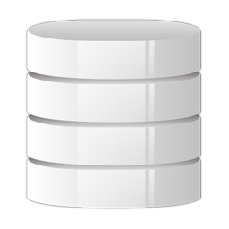

Retries
Message Pump
Your Code
PickMessageFrom Transport
DetermineCodeTo Execute
Queue
RetryOnFailure
Deserialize Message
Notes:
Handling a message from a queue can also be implemented as a chain of responsibility.
Each operation, such as picking up the message from the transport of choice, can be thought of as a link in the message-handling chain. Because the chain is stored in a List, links can be added, removed, or reordered. You can make those changes at design time, or at runtime. There is a lot of flexibility in this chain of responsibility.
Retries

Slide 26
Coding time
Exercise 7

Slide 27
Object
Message Pump
Your Code
PickMessageFrom Transport
DetermineCodeTo Execute
Queue
RetryOnFailure
Deserialize Message
Notes:
We previously did a functional version by using delegates and a heapload of Func<Func<Func>>> let’s lift this thing up into the OO world

Slide 28
Coding time
Exercise 8-9
Notes:
We previously did a functional version by using delegates and a heapload of Func<Func<Func>>> let’s lift this thing up into the OO world

Slide 29
State
Message Pump
Your Code
PickMessageFrom Transport
DetermineCodeTo Execute
Queue
RetryOnFailure
Deserialize Message
Notes:
How do we bring state into it

Slide 30
Coding time
Exercise 10
Notes:
Let’s float state into it

Slide 31
Your Code
PickMessageFrom Transport
...
RetryOnFailure
Deserialize Message
DetermineCodeTo Execute
Where to place links?

Slide 32
Physical
Logical
Your Code
PickMessageFrom Transport
...
RetryOnFailure
Deserialize Message
DetermineCodeTo Execute
Stages

Slide 33
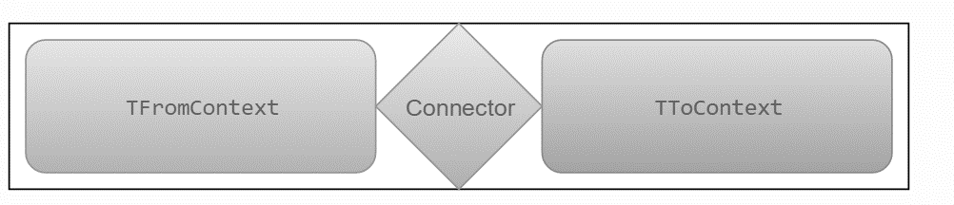
Stage Connector

Slide 34
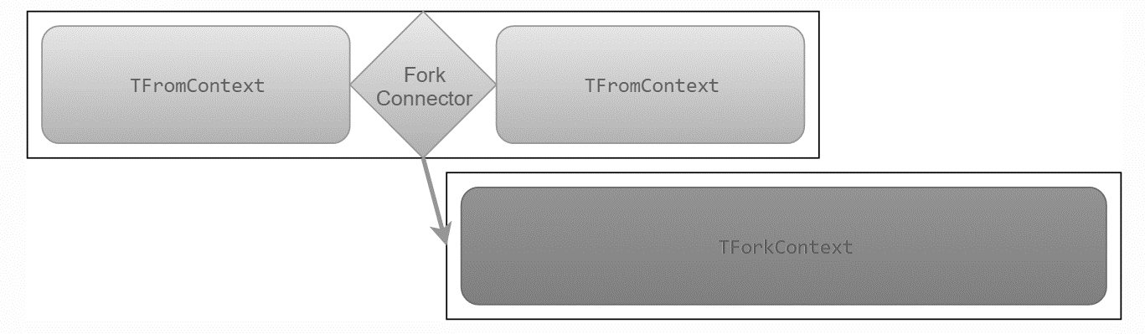
Fork Connector

Slide 35

Stage Fork Connector

Slide 36
Tree of Responsibility
Keep calm and let your head explode

Slide 37
Pattern
Build It
WrapUp

Slide 38
Will be Async all the way
Uses the chain of responsibility pattern heavily
NSB v6
particular.net/blog/async-await-its-time
docs.particular.net/nservicebus/pipeline/customizing-v6
Notes:
But how does this relate to the yet to be release NServiceBus Version 6

Slide 39
Chain of Responsibility or Russian Dolls
is a flextensible pattern ideally suited to build robust IO bound pipelines
Recap
The pattern is used in many OSS projects
reminder
Know it, learn it, love it *
Probably copyrighted by the .NET Rocks guys ;)*

Slide 40
Slides, Links…
github.com/danielmarbach/async-dolls
github.com/danielmarbach/dwx16.async-chain
Notes:
Questions that can be answered in blog posts

Slide 41
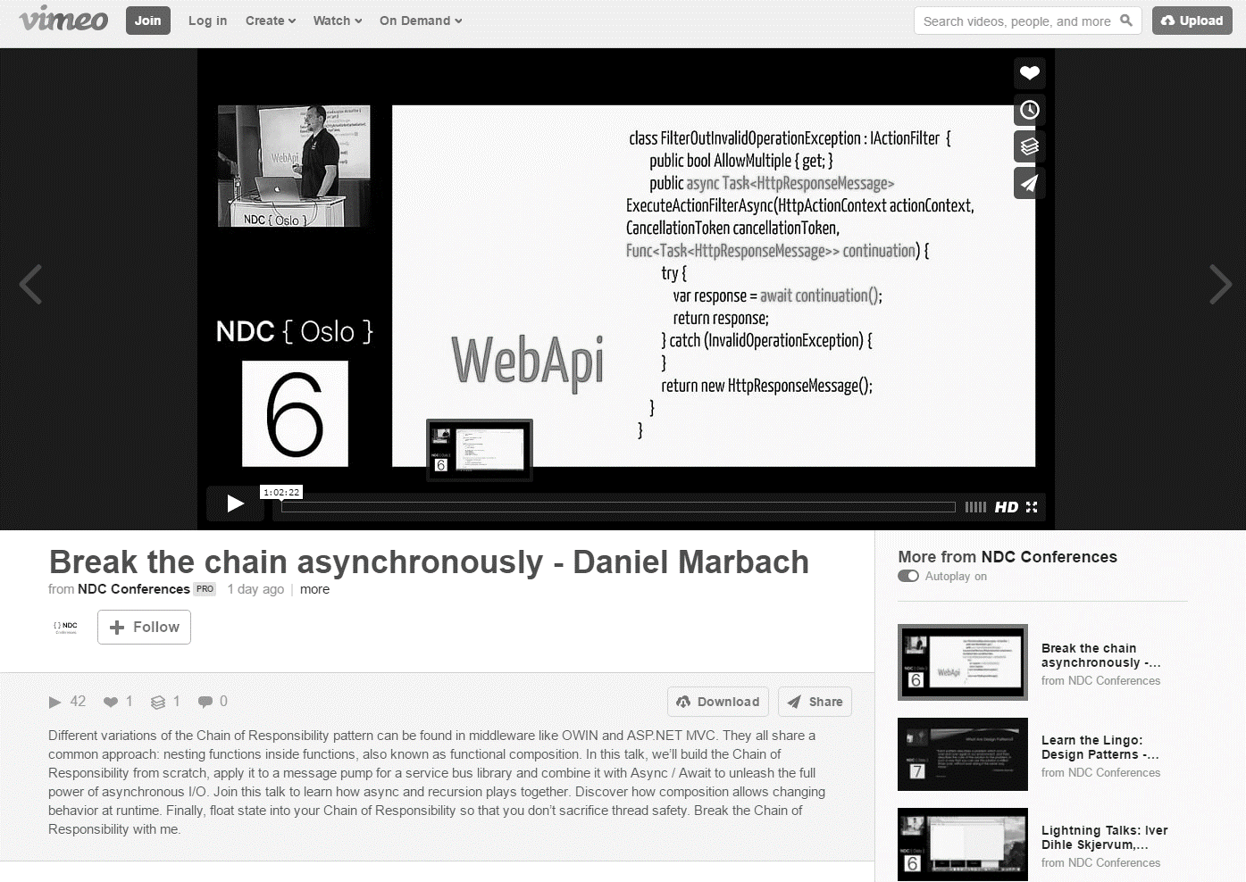
vimeo.com/171319725

Slide 42
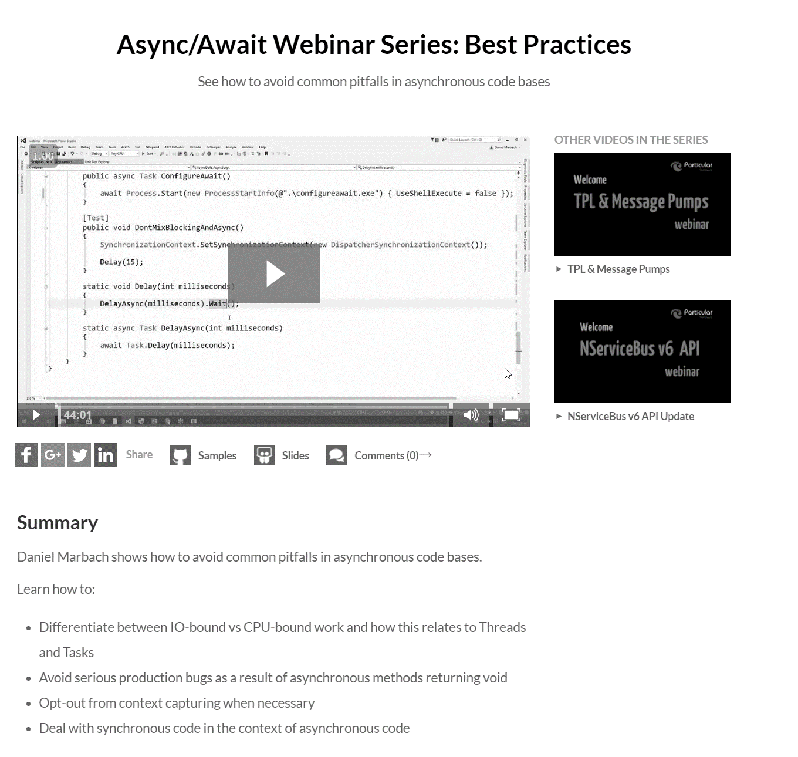
go.particular.net/async-await

Slide 43
Q & A
await

Slide 44
Thanks
Notes:
Thank you very much for listening and see you next time

