Slide 1
CSM 357 Human-Computer Interaction lecture 2: The Human
Rose-Mary Owusuaa Mensah Gyening

Slide 2
The Human
Humans are limited in their capacity to process information. This has important implications for design.
Information is received and responses given via a number of input and output channels:
– visual channel
– auditory channel
– haptic channel
– movement

Slide 3
The Human
The human, the user, is, after all, the one whom computer systems are designed to assist. The requirements of the user should therefore be our topmost priority.
In order to design something for someone, we need to understand their capabilities and limitations.
We need to know if there are things that they will find difficult or, even, impossible.
It will also help us to know what people find easy and how we can help them to do difficult things

Slide 4
The Human
This lecture looks at aspects of cognitive psychology which have a bearing on the use of computer systems:
how humans perceive the world around them,
how they store and process information and solve problems,
and how they physically manipulate objects.

Slide 5
INPUT–OUTPUT CHANNELS
A person’s interaction with the outside world occurs through information being received and sent: input and output.
In an interaction with a computer, the user receives information that is output by the computer, and responds by providing input to the computer

Slide 6
INPUT–OUTPUT CHANNELS
There are five major senses: sight, hearing, touch, taste and smell.
Of these, the first three are the most important to HCI.
Taste and smell do not currently play a significant role in HCI, and it is not clear whether they could be exploited at all in general computer systems, although they could have a role to play in more specialized systems (smells to give warning of malfunction, for example) or in augmented reality systems.
However, vision, hearing and touch are central.
Notes:
An effector is an organ that acts in response to stimulus

Slide 7
INPUT–OUTPUT CHANNELS
Similarly there are a number of effectors, including the limbs, fingers, eyes, head and vocal system.
In the interaction with the computer, the fingers play the primary role, through typing or mouse control,
with some use of voice,
and eye,
head
and body position.
Notes:
An effector is an organ that acts in response to stimulus

Slide 8
INPUT–OUTPUT CHANNELS: Vision, hearing and touch
Imagine using a personal computer (PC) with a mouse and a keyboard. The application you are using has a graphical interface, with menus, icons and windows.
In your interaction with this system, you receive information primarily by sight, from what appears on the screen.

Slide 9
INPUT–OUTPUT CHANNELS: Vision, hearing and touch
However, you may also receive information by ear:
1. for example, the computer may ‘beep’ at you if you make a mistake or to draw attention to something,
2. or there may be a voice commentary in a multimedia presentation.

Slide 10
INPUT–OUTPUT CHANNELS :Vision, hearing and touch
Touch plays a part too in that you will feel the keys moving (also hearing the ‘click’) or the orientation of the mouse, which provides vital feedback about what you have done. You yourself send information to the computer using your hands, either by hitting keys or moving the mouse.

Slide 11
INPUT–OUTPUT CHANNELS
In this section, we are considering the role and limitations of the three primary senses and also motor control in interaction

Slide 12
Vision
Human vision is a highly complex activity with a range of physical and perceptual limitations, yet it is the primary source of information for the average person.

Slide 13
Vision
We can roughly divide visual perception into two stages:
the physical reception of the stimulus from the outside world,
and the processing and interpretation of that stimulus
NB: Visual perception refers to the brain’s ability to make sense of what the eye sees.
This is not the same as visual acuity which refers to how clearly a person sees. So a person can have good visual acuity and still have problems with visual perception processing

Slide 14
The Eye - physical reception
the physical properties of the eye and the visual system mean that there are certain things that cannot be seen by the human;
However, the interpretative capabilities of visual processing allow images to be constructed from incomplete information.

Slide 15
The Eye - physical reception
We need to understand both stages as both influence what can and cannot be perceived visually by a human being, which in turn directly affects the way that we design computer systems.
We will begin by looking at the eye as a physical receptor, and then go on to consider the processing involved in basic vision.

Slide 16
The eye as a physical receptor
Vision begins with light. The eye has a mechanism for receiving light and transforming it into electrical energy.
Light is reflected from objects in the world and their image is focused upside down on the back of the eye.
The receptors in the eye transform it into electrical signals which are passed to the brain.

Slide 17
The eye as a physical receptor
The eye has a number of important components
The cornea and lens at the front of the eye focus the light into a sharp image on the back of the eye, the retina.
The retina is light sensitive and contains two types of photoreceptor: rods and cones.

Slide 18
The eye as a physical receptor
Rods are highly sensitive to light and therefore allow us to see under a low level of illumination
Cones are the second type of receptor in the eye. They are less sensitive to light than the rods and can therefore tolerate more light.
There are three types of cone, each sensitive to a different wavelength of light.
This allows color vision

Slide 19
Visual Perception
Understanding the basic construction of the eye goes some way to explaining the physical mechanisms of vision but visual perception is more than this.
The information received by the visual apparatus must be filtered and passed to processing elements which allow us to recognize coherent scenes, disambiguate relative distances and differentiate color.
We have to look a little more closely at how we perceive size and depth, brightness and color, each of which is crucial to the design of effective visual interfaces.

Slide 20
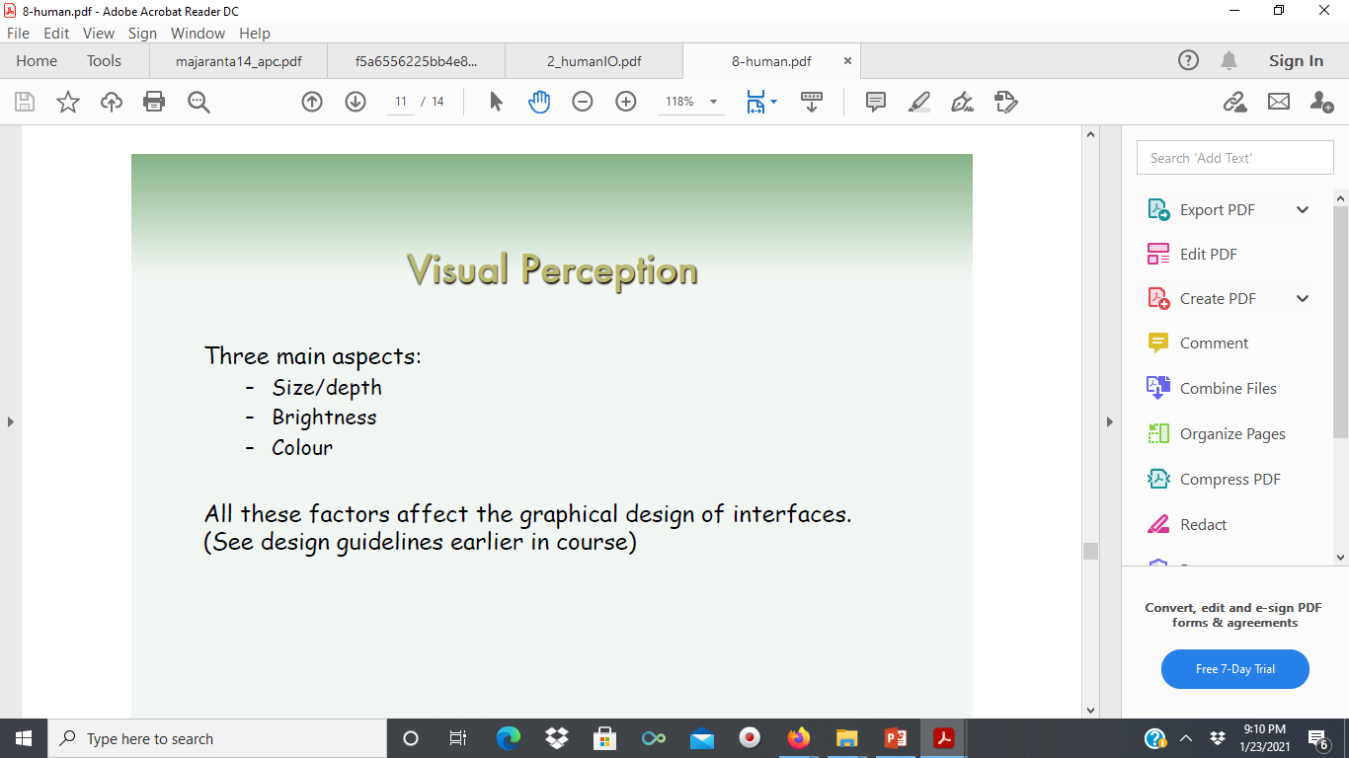

Slide 21
1. Perceiving size and depth
So how does the eye perceive size, depth and relative distances? To understand this, we must consider how the image appears on the retina.
reflected light from the object forms an upside-down image on the retina.
The size of that image is specified as a visual angle.

Slide 22
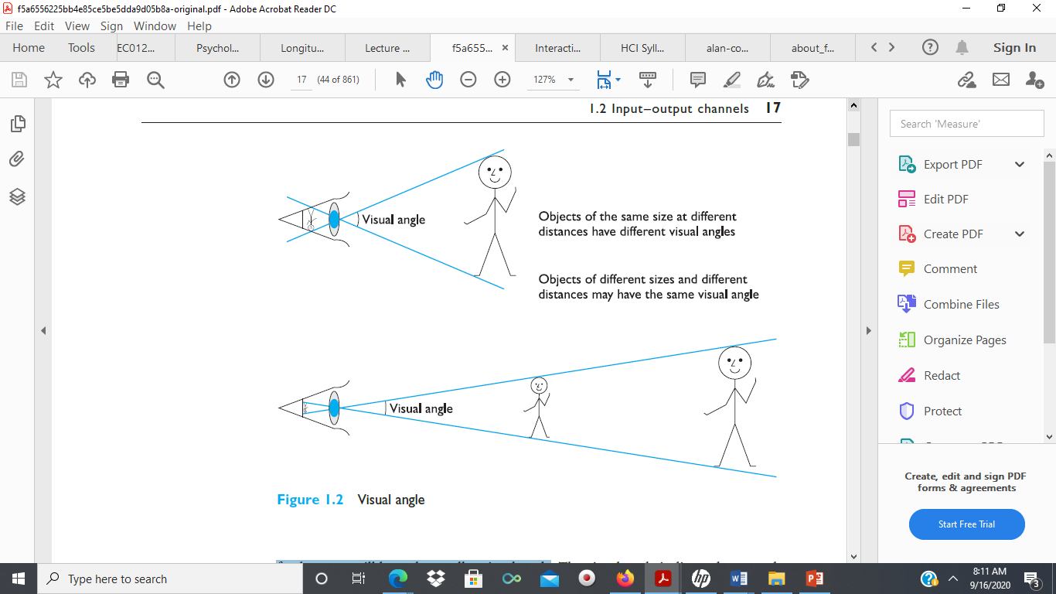
Visual angle
If we were to draw a line from the top of the object to a central point on the front of the eye and a second line from the bottom of the object to the same point, the visual angle of the object is the angle between these two lines.
Visual angle is affected by both:
the size of the object
and its distance from the eye.
The visual angle measurement is given in either
degrees or minutes of arc,

Slide 23
Visual angle
Therefore if two objects are at the same distance, the larger one will have the larger visual angle.
Similarly, if two objects of the same size are placed at different distances from the eye, the furthest one will have the smaller visual angle. Why?

Slide 24
Visual angle

Slide 25
Visual Angle and Perception of size
In fact, our perception of an object’s size remains constant even if its visual angle changes.
E.g: So a person’s height is perceived as constant even if they move further from you.
This is the law of size constancy, and it indicates that our perception of size relies on factors other than the visual angle.
One of these factors is our perception of depth.

Slide 26
2. Perception of Brightness
The second aspect of visual perception is the perception of brightness.
Brightness is in fact a subjective reaction to levels of light.
It is affected by luminance which is the amount of light emitted by an object.
The luminance of an object is dependent on the amount of light falling on the object’s surface and its reflective properties

Slide 27
3. Perceiving color
The third factor that we need to consider is perception of color.
Color is usually regarded as being made up of three components:
hue,
intensity and
saturation.
.

Slide 28
3. Perceiving color
Hue is just another word for color. Simply put: Each position around the color wheel represents a different hue.
Hue is determined by the spectral wavelength of the light.
Blues have short wavelengths,
greens medium
and reds long.
Approximately 150 different hues can be discriminated by the average person.

Slide 29
Perceiving color
Intensity is the brightness of the color, and
saturation is the amount of whiteness in the color.
By varying these two (intensity and saturation), we can perceive in the region of 7 million different colours.

Slide 30
Perceiving color
The eye perceives color because the cones are sensitive to light of different wavelengths.
There are three different types of cone, each sensitive to a different color (blue, green and red).

Slide 31
Perceiving color
However, the number of colours that can be identified by an individual without training is far fewer (in the region of 10).
around 8% of males and 1% of females suffer from color blindness, most commonly being unable to discriminate between red and green.

Slide 32
The capabilities and limitations of visual processing
Visual processing involves the transformation and interpretation of a complete image, from the light that is thrown onto the retina
This ability to interpret and exploit our expectations can be used to resolve ambiguity.
For example, consider the image shown in Figure 1 What do you perceive?
Now consider Figure 2 and Figure 3

Slide 33
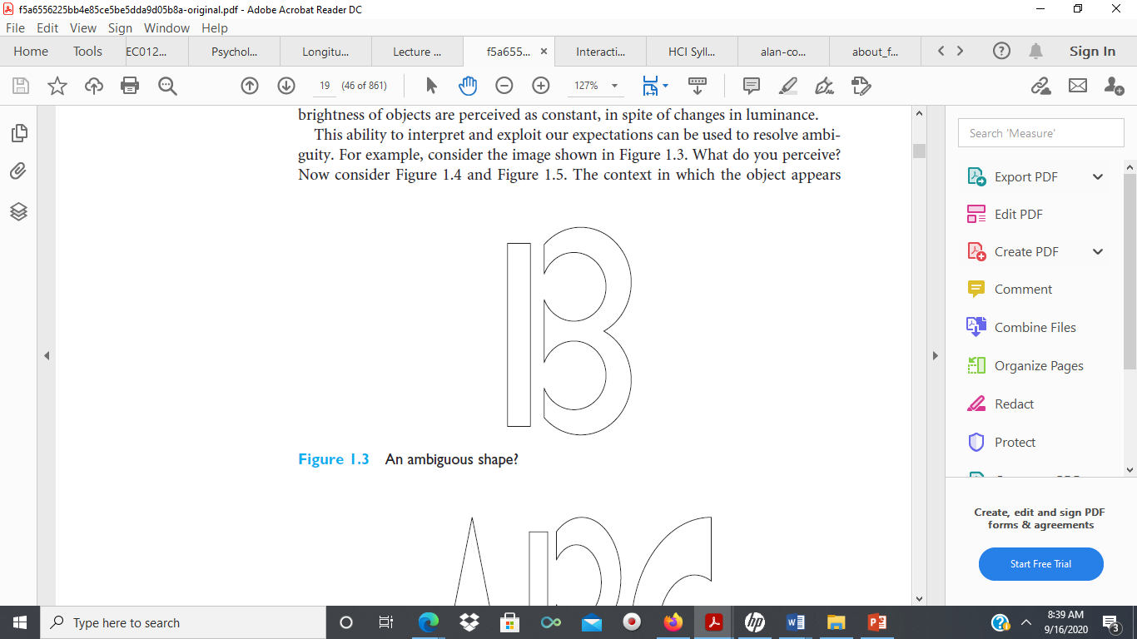
This ability to interpret and exploit our expectations can be used to resolve ambiguity. consider the image shown in Figure 1
Figure 1: What do you perceive?

Slide 34
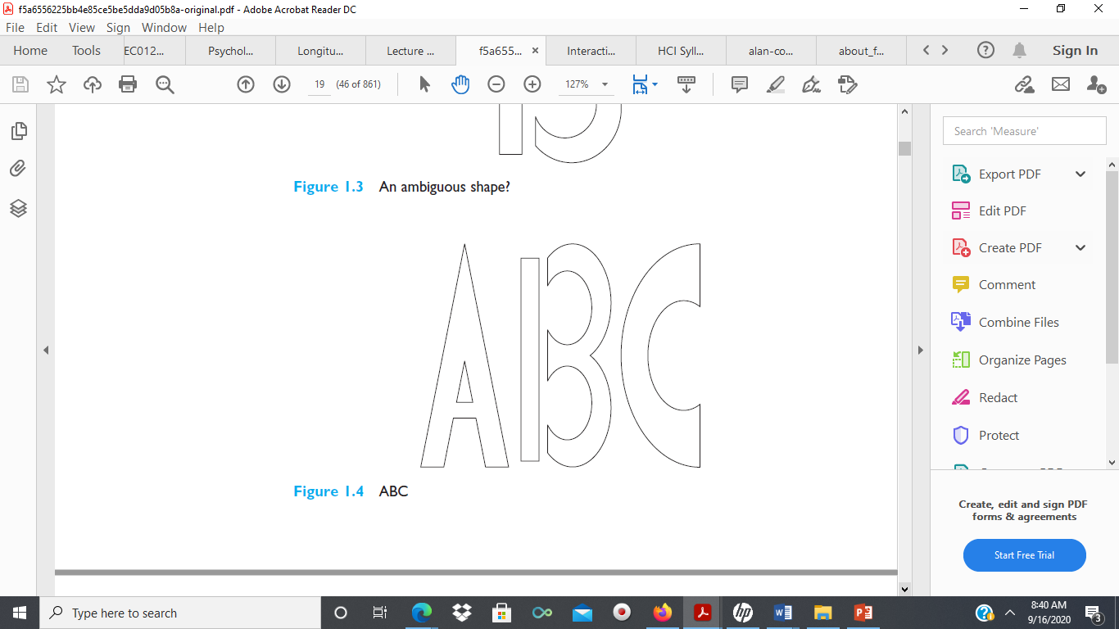
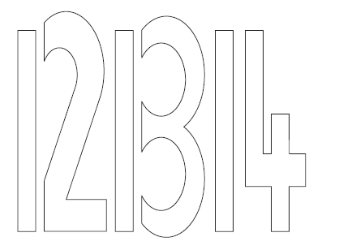
What do you perceive?
Figures 2 and 3: What do you perceive?

Slide 35
Optical Illusion
The context in which the object appears allows our expectations to clearly disambiguate the interpretation of the object, as either a B or a 13.
However, it can also create optical illusions.
For example, consider Figure 4

Slide 36
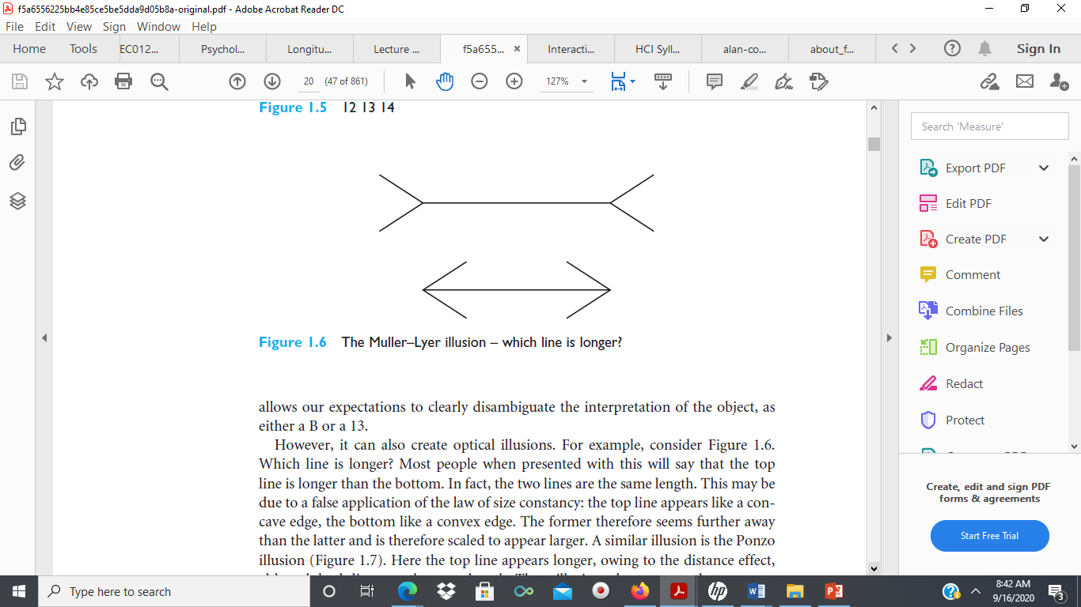
Figure 4: Which line is longer?

Slide 37
Optical Illusion
Most people when presented with this will say that the top line is longer than the bottom.
In fact, the two lines are the same length.
This may be due to a false application of the law of size constancy
the top line appears like a concave edge, the bottom like a convex edge. The former therefore seems further away than the latter and is therefore scaled to appear larger.
A similar illusion is the Ponzo illusion (Figure 5). Here the top line appears longer, owing to the distance effect although both lines are the same length.
These illusions demonstrate that our perception of size is not completely reliable.

Slide 38
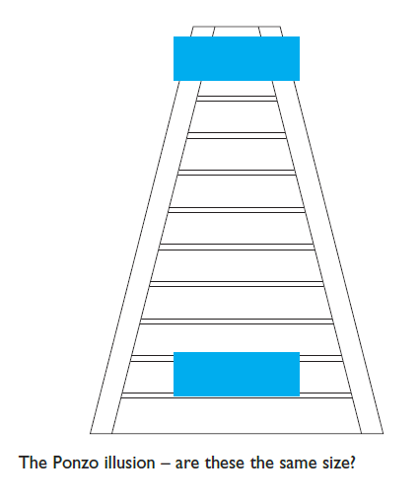
Ponzo illusion
Figure 5

Slide 39
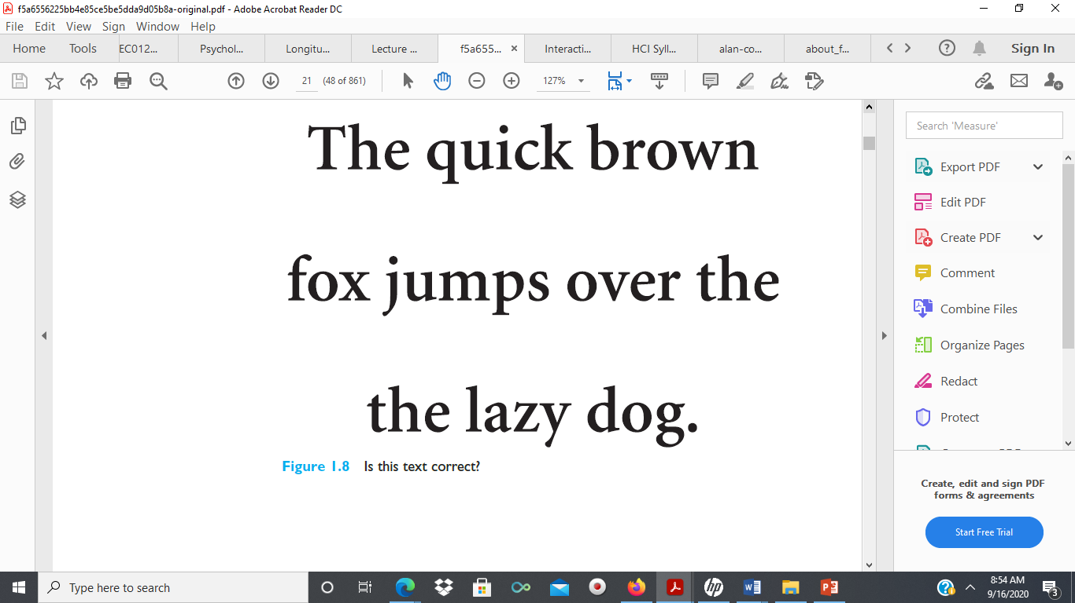
Proofreading illusion
Another illusion created by our expectations compensating an image is the proofreading illusion.
Read the text in Figure 6 quickly. What does it say?
Most people reading this rapidly will read it correctly, although closer inspection shows that the word ‘the’ is repeated in the second and third line.
These are just a few examples of how the visual system compensates and sometimes overcompensates, to allow us to perceive the world around us.
Figure 6: Is this text correct?

Slide 40
Assignment
The human eye has quite a number of limitations. Explain any three of these and discuss how and why these limitations should be taken into consideration when designing visual interfaces

Slide 41
Hearing
The sense of hearing is often considered secondary to sight, but we tend to underestimate the amount of information that we receive through our ears.
Close your eyes for a moment and listen. What sounds can you hear? Where are they coming from? What or who is making them?
When I sit at my desk I can hear cars passing on the road outside, I can also tell where the sounds are coming from, and estimate how far away they are.
So from the sounds I hear, I can tell that a car is passing on a particular road near my office, and which direction it is travelling in.
The auditory system can convey a lot of information about our environment.

Slide 42
Sound
sound can convey a remarkable amount of information.
It is underestimated for its potential in interface design, usually being confined to warning sounds and notifications.
The exception is multimedia, which may include music, voice commentary and sound effects.
However, the ear can differentiate quite subtle sound changes and can recognize familiar sounds without concentrating attention on the sound source.
This suggests that sound could be used more extensively in interface design, to convey information about the system state

Slide 43
Discussion
Suggest ideas for an interface which uses the properties of sound effectively.

Slide 44
HCI: Speech Sounds
Speech sounds can obviously be used to convey information.
This is useful not only for the visually impaired but also for any application where the user’s attention has to be divided
for example, power plant control, flight control

Slide 45
HCI: Non-speech sounds
Uses of non-speech sounds include the following:
Attention – to attract the user’s attention to a critical situation or to the end of a process, for example.
Status information – continuous background sounds can be used to convey status
information. For example, monitoring the progress of a process (without the need for visual attention).
Confirmation – a sound associated with an action to confirm that the action has been carried out. For example, associating a sound with deleting a file.
Navigation – using changing sound to indicate where the user is in a system

Slide 46
Touch
The third and last of the senses that we will consider is touch or haptic perception.
Although this sense is often viewed as less important than sight or hearing, imagine life without it.
Touch provides us with vital information about our environment.

Slide 47
Touch
It tells us when we touch something hot or cold, and can therefore act as a warning.
It also provides us with feedback when we attempt to lift an object
Touch is therefore an important means of feedback, and should be utilized in HCI

Slide 48
Touch
Also, we should be aware that, although for the average person, haptic perception is a secondary source of information, for those whose other senses are impaired, it may be vitally important.
For such users, interfaces such as braille may be the primary source of information in the interaction.
We should not therefore underestimate the importance of touch

Slide 49
Movement
we need to consider motor control and how the way we move affects our interaction with computers
Movement time is dependent largely on the physical characteristics of the subjects: eg. their age and fitness
A second measure of motor skill is accuracy. One question that we should ask is whether speed of reaction results in reduced accuracy.
This is dependent on the task and the user.
Can you give any examples?

Slide 50
Movement
Speed and accuracy of movement are important considerations in the design of interactive systems, primarily in terms of the time taken to move to a particular target on a screen. The target may be a button, a menu item or an icon
The time taken to hit a target is a function of the size of the target and the distance that has to be moved.
This is formalized in Fitts’ law.

Slide 51
Group presentation
Discuss the implications of Fitts’ law in design and HCI

Slide 52
Fitts’ Law and HCI
Fitts’ law states that the amount of time required for a person to move a pointer (e.g., mouse cursor) to a target area is a function of the distance to the target divided by the size of the target.
Thus, the longer the distance and the smaller the target’s size, the longer it takes
Source:https://www.interaction-design.org/literature/topics/fitts-law

Slide 53
Fitts’ Law and HCI
Fitts’ law is widely applied in user experience (UX) and user interface (UI) design.
For example, this law influenced the convention of making interactive buttons large (especially on finger-operated mobile devices)
—smaller buttons are more difficult (and time-consuming) to click.
Likewise, the distance between a user’s task/attention area and the task-related button should be kept as short as possible.
Source:https://www.interaction-design.org/literature/topics/fitts-law

Slide 54
Fitts’ Law and HCI
There are many variations of the Fitts’ law formula, which have varying constants, but they are all very similar.
One common form is
Movement time = a + b log2(distance/size + 1)
where a and b are empirically determined constants.
This affects the type of target we design. Since users will find it more difficult to manipulate small objects, targets should generally be as large as possible and the distance to be moved as small as possible.

Slide 55
Human factors in HCI
humans have similar capabilities and limitations and that we can therefore make generalizations. To an extent this is true
Notwithstanding this, we should remember that, although we share processes in common, humans, and therefore users, are not all the same.
We should be aware of individual differences so that we can account for them as far as possible within our designs.

Slide 56
Human factors in HCI
These differences may be long term, such as sex, physical capabilities and intellectual capabilities.
Others are shorter term and include the effect of stress or fatigue on the user. Still others change through time, such as age.

Slide 57
Human factors in HCI
It is useful to consider, for any design decision, if there are likely to be users within the target group who will be adversely affected by our decision.
At the extremes, a decision may exclude a section of the user population.
For example, the current emphasis on visual interfaces excludes those who are visually impaired, unless the design also makes use of the other sensory channels

Slide 58
Memory
ACTIVITY 4.2
Try to remember the birthdays of all the members of your family and closest friends.
How many can you remember? Then try to describe the image/graphic of the latest app you downloaded.
Comment
It is likely that you remembered the image, the colors, and the name of the app you downloaded much better than the birthdays of your family and friends—most people now rely on
Facebook or other online app to remind them about such special dates.

Slide 59
Memory
People are good at remembering visual cues about things, for example, the color of items, the location of objects (for example, a book being on the top shelf), and marks on an object (like a scratch on a watch, a chip on a cup, and so on).
In contrast, people find other kinds of information persistently difficult to learn and remember, especially arbitrary material like phone numbers.

Slide 60
Memory Load and Passwords
Phone, online, and mobile banking allow customers to carry out financial transactions, such as paying bills and checking the balance of their accounts, at their convenience.
One of the problems confronting banks that provide these capabilities, however, is how to manage security concerns, especially preventing fraudulent transactions.
One solution has been to develop rigorous security measures whereby customers must provide multiple pieces of information before gaining access to their accounts.
This is called multifactor authentication (MFA).

Slide 61
Memory loads and Passwords
The method requires a user to provide two or more pieces of evidence that only they know, such as the following:
• Their ZIP code or postal code
• Their mother’s maiden name
• Their birthplace
• The last school they attended

Slide 62
Memory loads and Passwords
• The first school they attended
• A password of between five and ten letters
• A memorable address (not their home)
• A memorable date (not their birthday)

Slide 63
Memory loads and Passwords
This requirement to remember and recall such information puts a big memory load on customers.
Some people find such a procedure quite nerve-racking and are prone to forget certain pieces of information.
As a coping strategy, they write down their details on a sheet of paper.

Slide 64
Memory loads and Passwords
Having such an external representation at hand makes it much easier for them to read off the necessary information rather than having to recall it from memory.
However, it also makes them vulnerable to the fraud the banks are trying to prevent should anyone else get ahold of that piece of paper!
Software companies have also developed password managers to help reduce memory load.

Slide 65
Discussion
How can banks overcome the problem of providing a secure system while making the memory load easier for people wanting to use online and mobile phone banking?

Slide 66
Comments
Advances in computer vision and biometrics technology means that it is now possible to replace the need for passwords to be typed in each time.
For example, facial and touch ID can be configured on newer smartphones to enable password-free mobile banking.
Once these are set up, a user simply needs to put their face in front of their phone’s camera or their finger on the fingerprint sensor.
These alternative approaches put the onus on the phone to recognize and authenticate the person rather than the person having to learn and remember a password.

Slide 67
Memory: Design Implications
• Reduce cognitive load by avoiding long and complicated procedures for carrying out tasks.
• Design interfaces that promote recognition rather than recall by using familiar interaction patterns, menus, icons, and consistently placed objects.

Slide 68
THANK YOU

