Slide 1


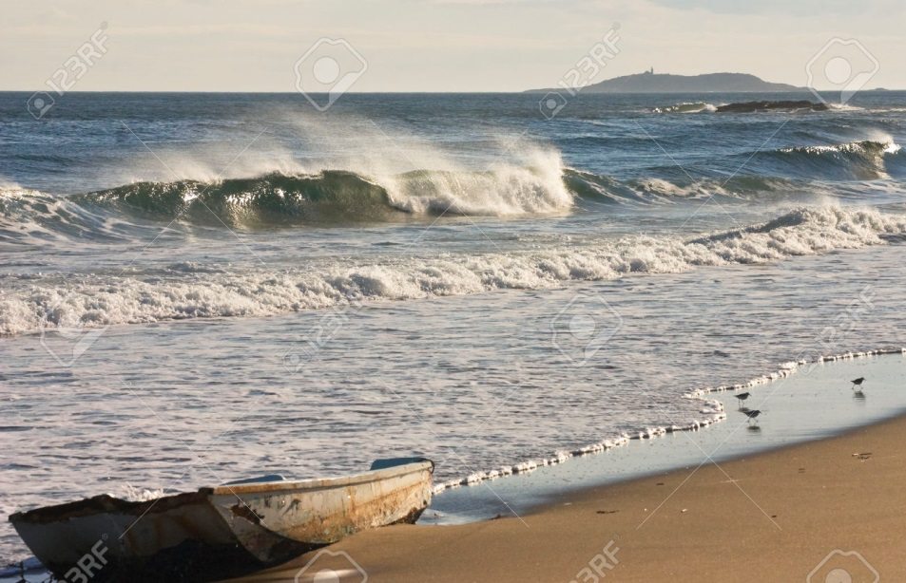

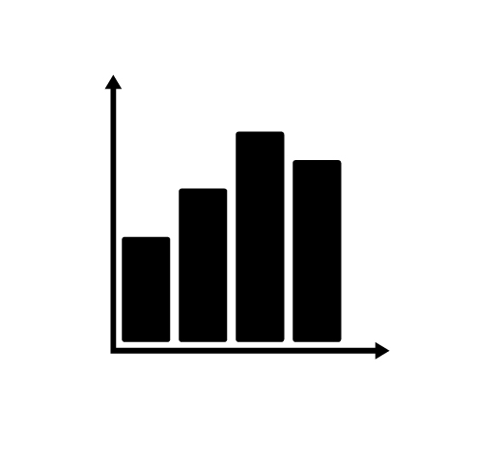

Reinforcement Learning Applied to the Shoals Marine Laboratory Smart Grid Daniel Mattson, Dr. Marek Petrik Department of Computer Science, University of New Hampshire, Durham, NH 03824
Abstract
Value Function Approximations
Results
Motivation:
The Shoals Marine Laboratory (SML) is a remote lab with an isolated power grid.
The island’s goal is to solely use renewable energy, with a diesel generator as backup.
Minimizing generator use and maximizing battery longevity is a complex task because of unpredictable environments and electricity demand.
Reinforcement learning (RL) can be applied to this problem to improve generator usage beyond the intuitive policy the SML currently uses.
Different underlying RL models are compared and evaluated in this project, with the _____ approximation providing the best results.
Image #1 Sub-Title Here
Image #2 Sub-Title Here
List your results text here
Image #1 Caption Here
Image #2 Caption Here
Reinforcement Learning
Policy Evaluations
Conclusions
RL is a machine learning technique where an intelligent agent takes actions in an environment to maximize its notion of cumulative reward.
The environment is modeled as a set of possible states and actions, and the agent receives a reward for each action it performs.
Chart #1 Sub-Title Here
Chart #2 Sub-Title Here
List your conclusions text here.
Chart #1 Caption Here
Chart #2 Caption Here
Data and Modeling
Acknowledgements
All data used in this project was taken from the public SML website.
Key variables to consider were the energy produced by solar, wind, and the generators on the island, along with the power usage from the battery storage.
Graph #1 Sub-Title Here
Graph #2 Sub-Title Here
Acknowledgement text here
References
List your references here.
Graph #1 Caption Here
Graph #2 Caption Here

