Slide 1

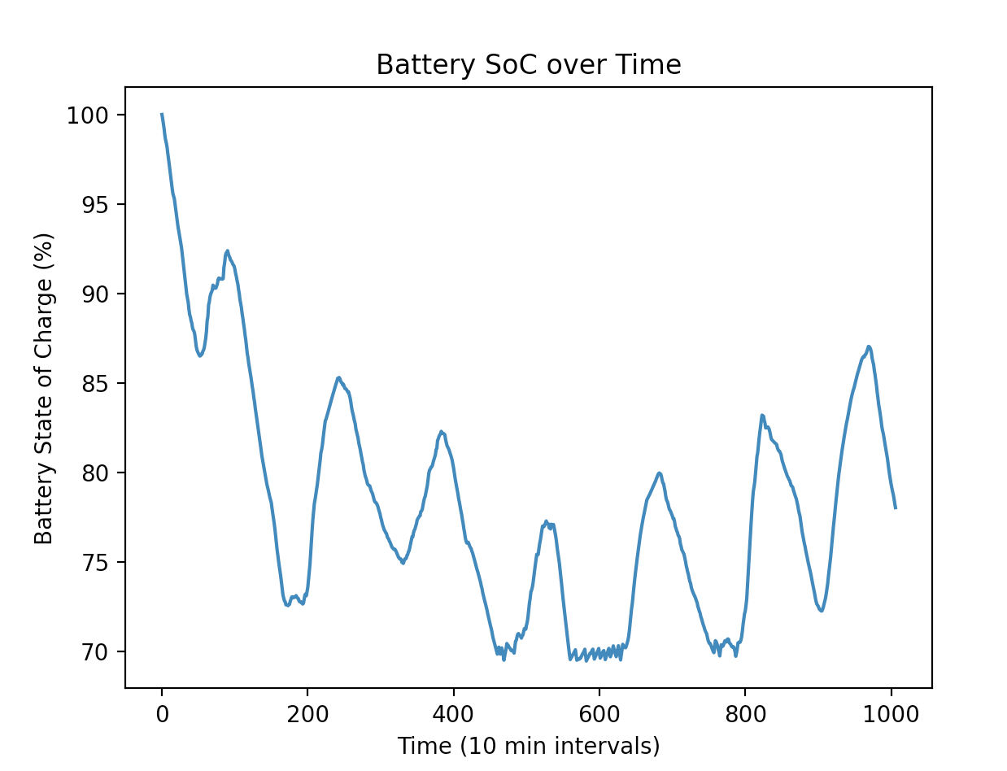
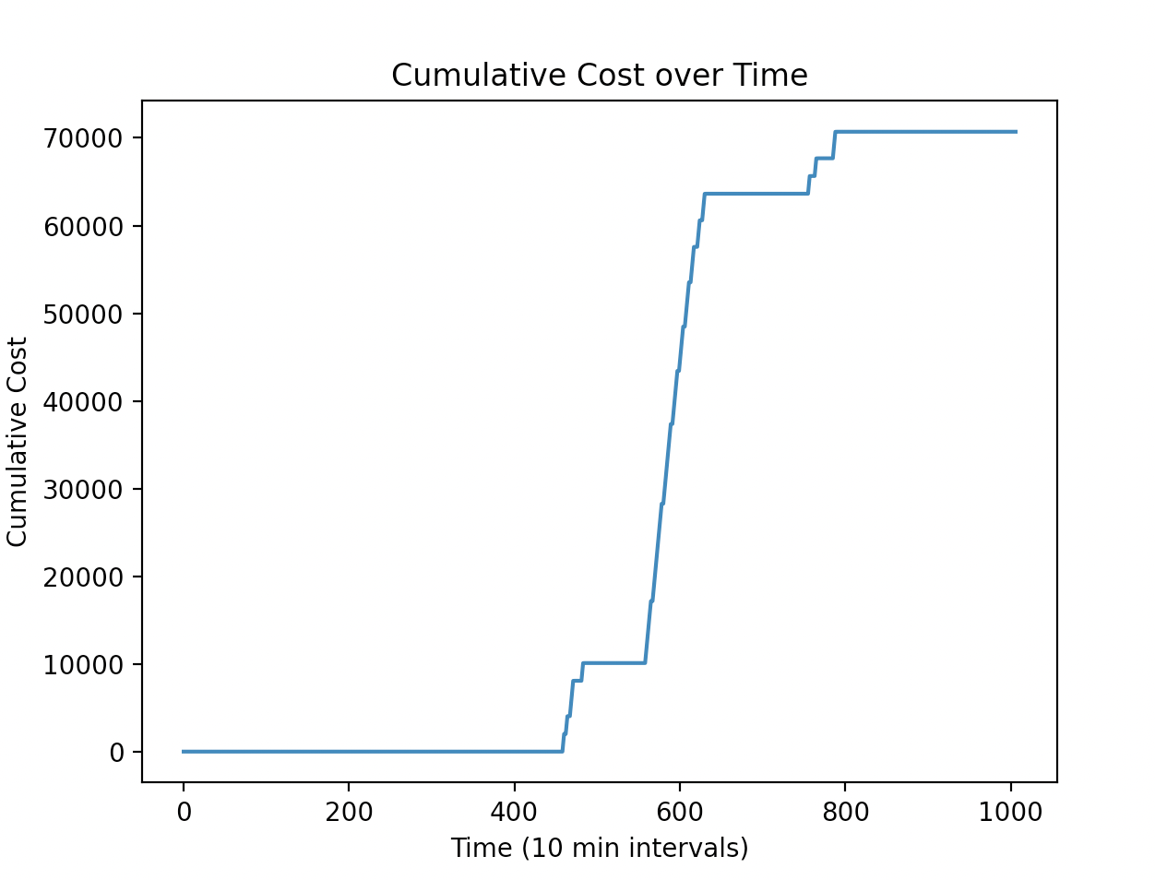
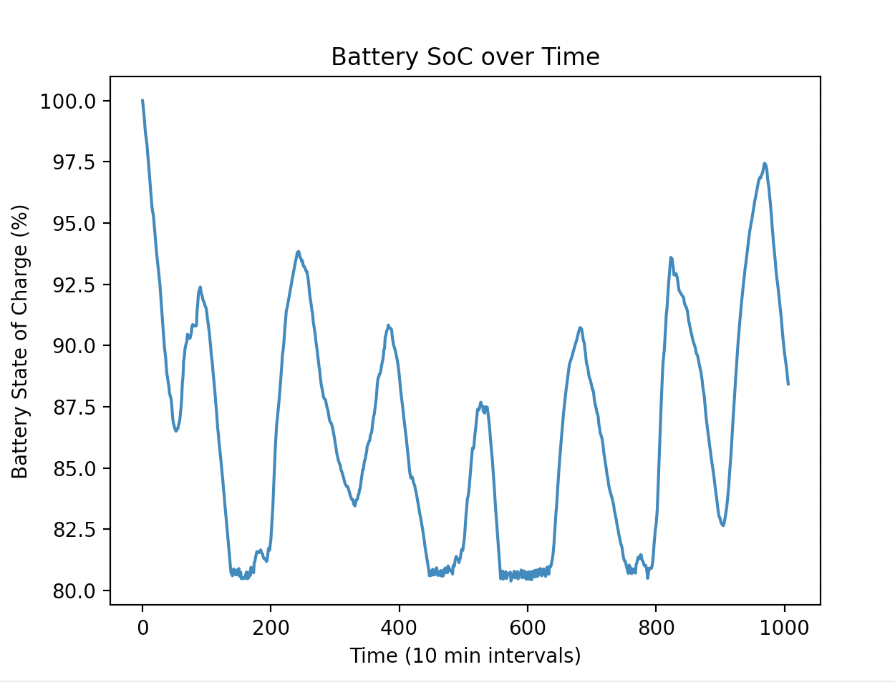
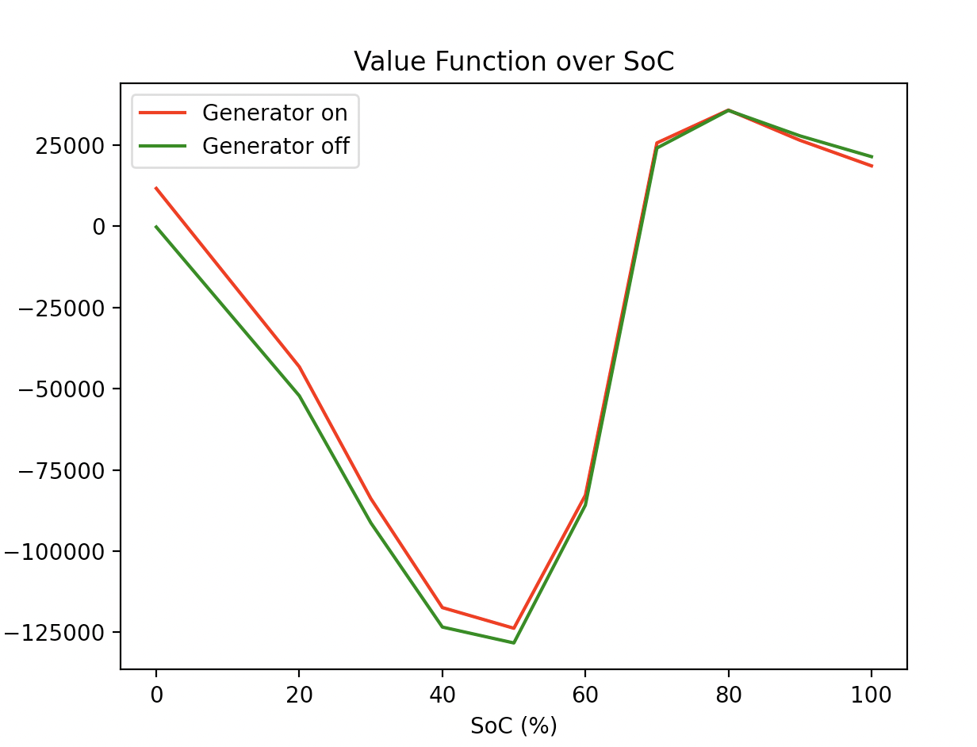
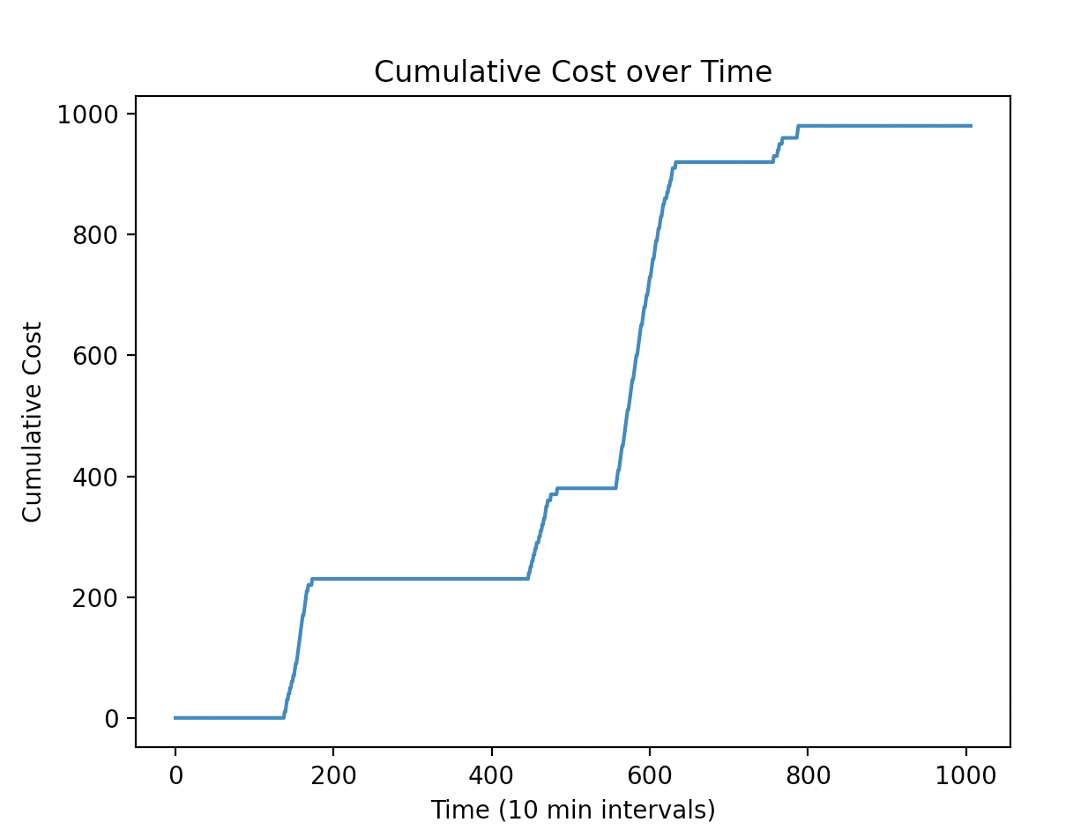
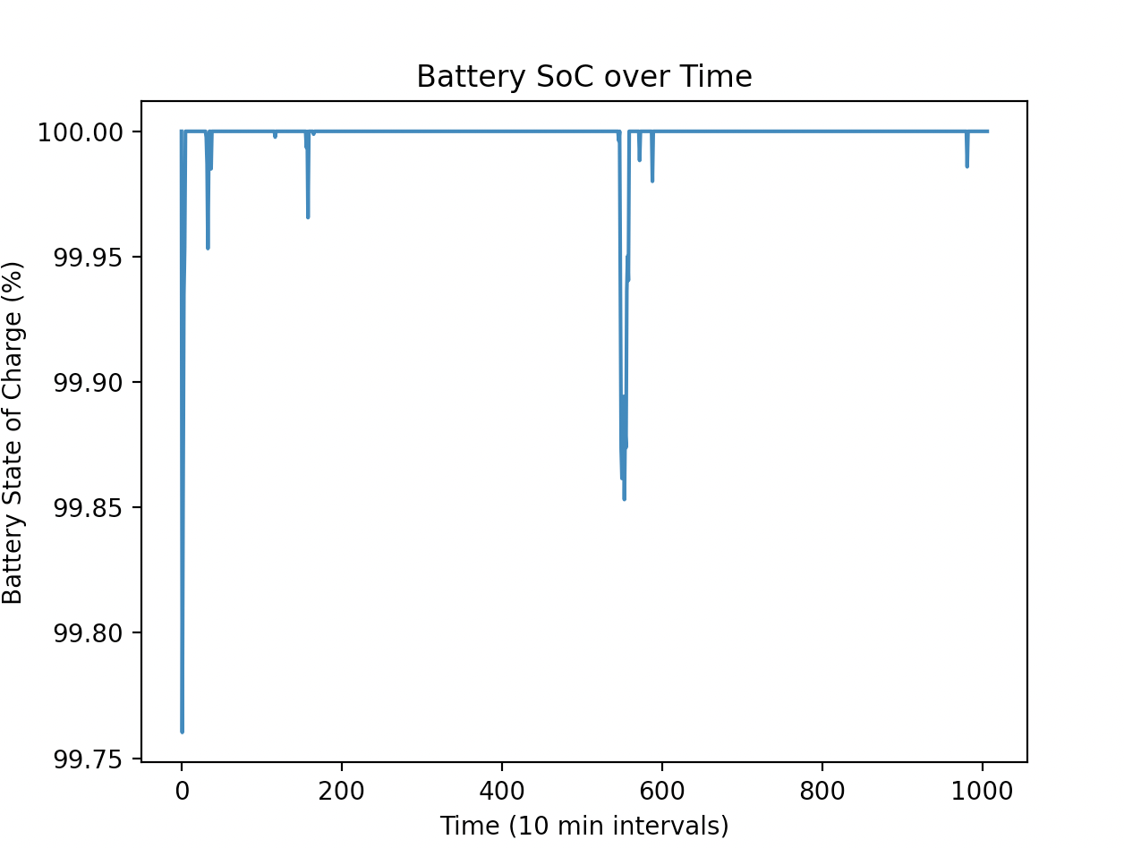
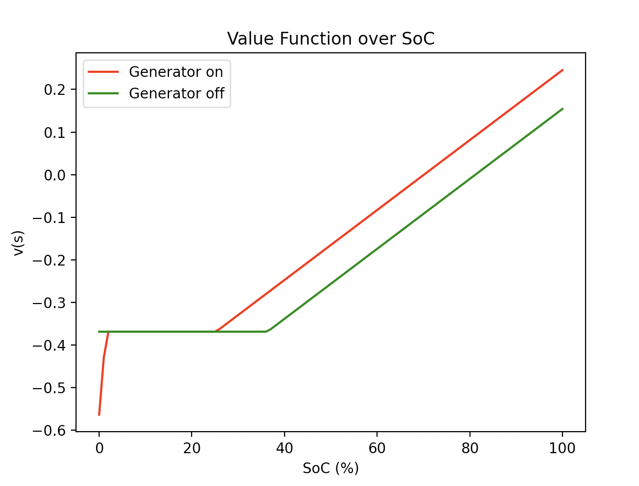
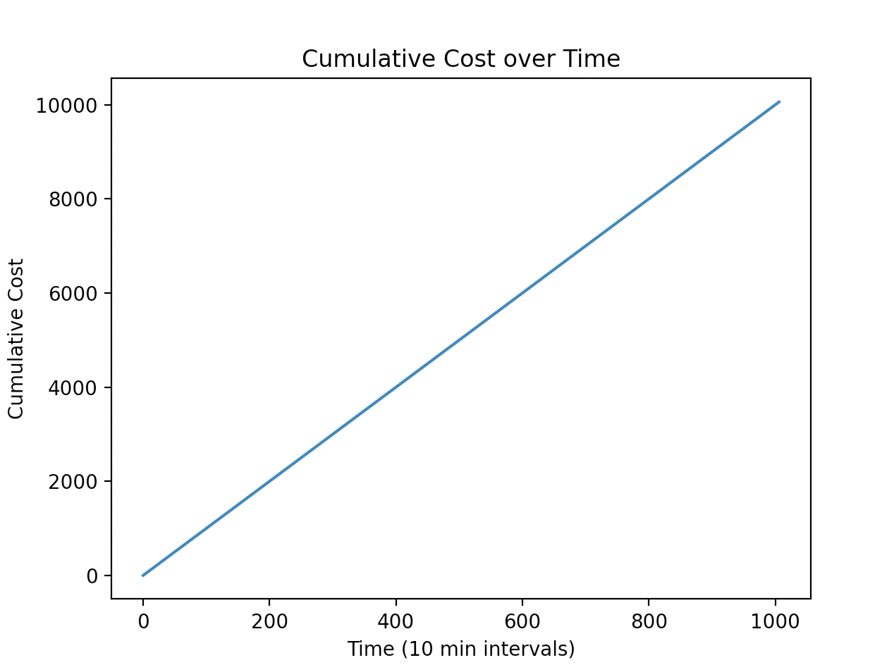
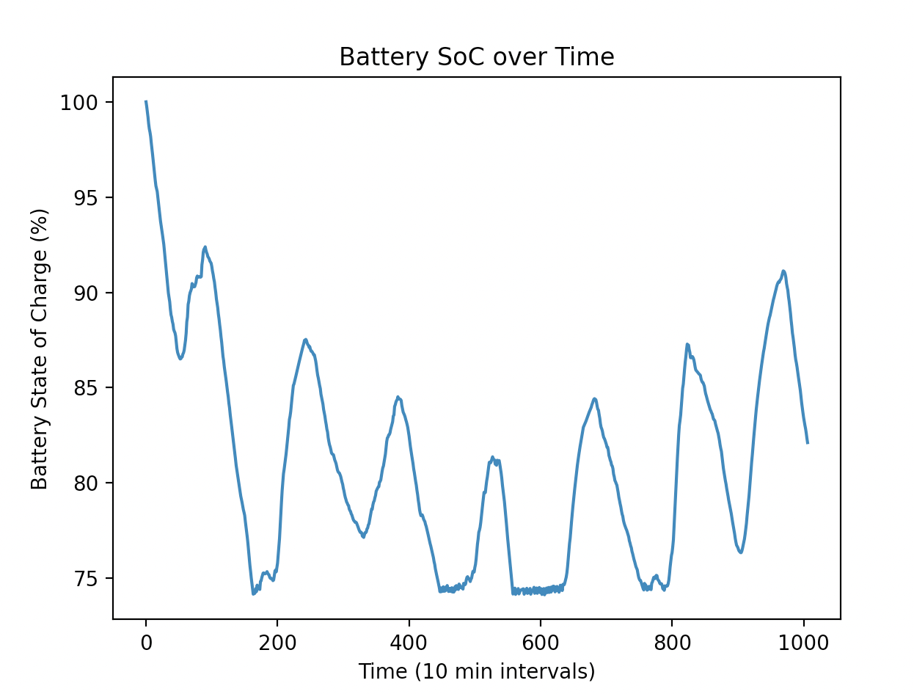
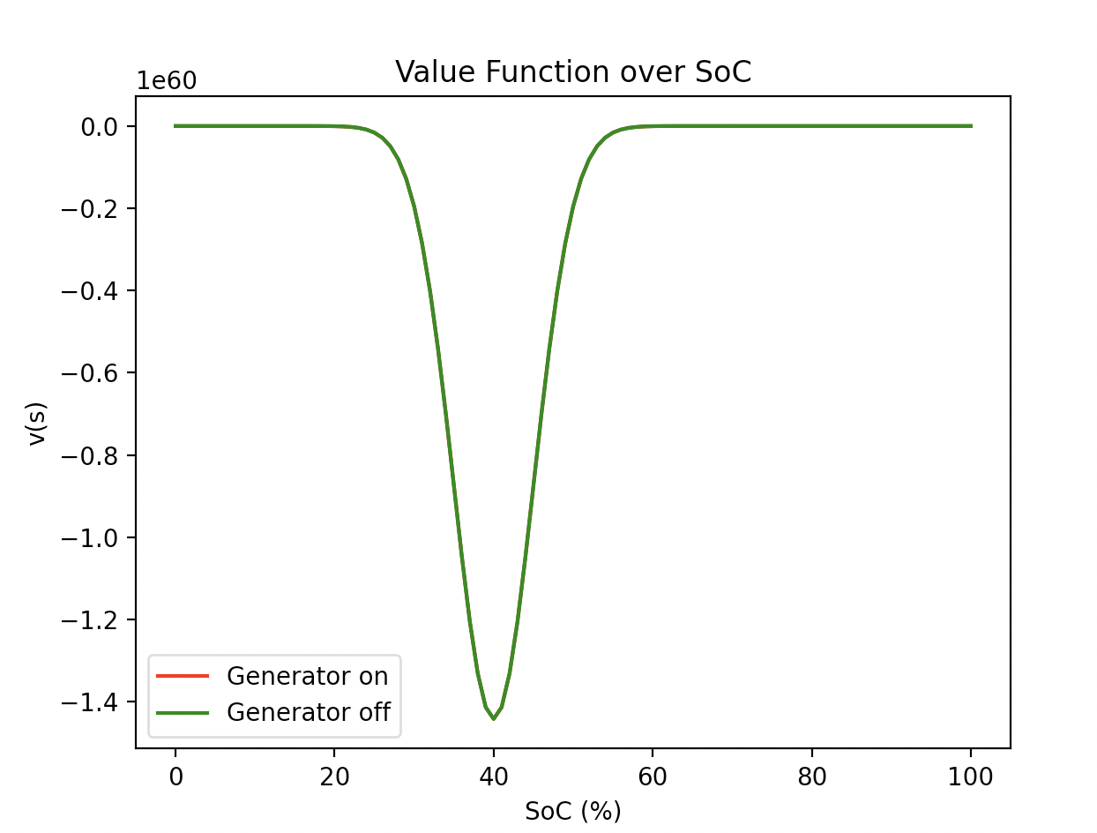
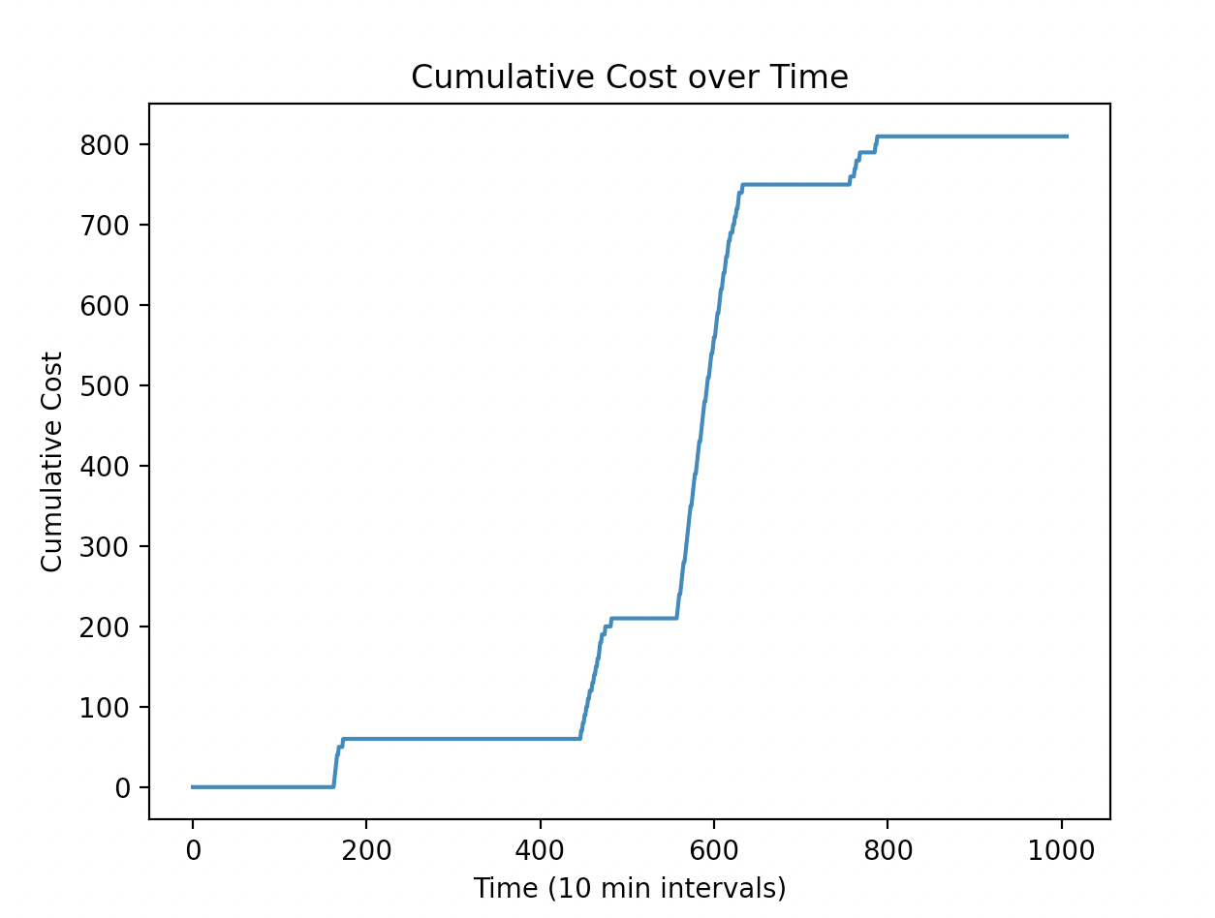
Reinforcement Learning Applied to the Shoals Marine Laboratory Smart Grid Daniel Mattson Advisor: Dr. Marek Petrik Department of Computer Science, University of New Hampshire, Durham, NH 03824
Abstract
What the SML Currently Uses
Results
The Shoals Marine Laboratory (SML) is a remote island lab with an isolated power grid.
The island’s goal is to solely use renewable energy, with a diesel generator as backup.
Minimizing generator use and maximizing battery longevity is a complex task because of unpredictable environments and electricity demand.
Reinforcement learning (RL) can be applied to this problem to improve generator usage beyond the naive policy the SML currently uses.
Different underlying RL models are compared and evaluated in this project, with the linear spline approximation providing the best results.
Run the generator when under 70% charge
The value functions produced by all model types generally trend upward with higher charge, which is expected.
The high values for lower charge seen in splines and RBFs could be explained by a lack of training data in that region.
The neural network was only trained on 1 day of data due to long training times.
With a larger training set or adjustments to the structure of the neural net better results are possible.
The linear spline has the most correct approximation, matching the intuition of the problem.
In the simulation, the linear spline approximation beats the naive policy currently used by the SML.
Value Function Approximations
Reinforcement Learning
Linear Spline
Fit using 1 week of data
RL is a machine learning technique where an intelligent agent takes actions in an environment to maximize its notion of cumulative reward.
The environment is modeled as a set of possible states and actions, and the agent receives a reward for each action it performs.
The value function is used to quantify the perceived value of a state and is what the agent uses to choose actions. The goal is to be in states with high value.
Approximating the value function is the primary problem that must be solved to choose an optimal action.
Conclusions
Neural Network
Trained on 1 day of data
The linear spline model performed the best out of all models in simulations.
RL was effective when applied to optimizing SML smart grid operation.
Total “cost” was significantly reduced.
Future work:
Expand model to use predictions of future power demand and generation, time of year (season or week number) as inputs.
Include a reward for having surplus energy in model.
Data and Modeling
Radial Basis Function
All data used in this project was taken from the public SML website.
Key variables to consider were the energy produced by solar, wind, and the generators on the island, along with the power usage from the battery storage.
Fitted value iteration was used to approximate the value function using different features.
Models using a neural net, linear spline, cubic spline, and radial basis functions were compared.
Fit using 1 week of data
References
SML Data: https://sustainablesml.org/pages/systemList.php
A. Ghasemi, A. Shojaeighadikolaei, K. Jones, M. Hashemi, A. G. Bardas and R. Ahmadi, "A Multi-Agent Deep Reinforcement Learning Approach for a Distributed Energy Marketplace in Smart Grids," 2020 IEEE International Conference on Communications, Control, and Computing Technologies for Smart Grids (SmartGridComm), 2020, pp. 1-6, doi: 10.1109/SmartGridComm47815.2020.9302981.
Y. Wan, J. Qin, X. Yu, T. Yang and Y. Kang, "Price-Based Residential Demand Response Management in Smart Grids: A Reinforcement Learning-Based Approach," in IEEE/CAA Journal of Automatica Sinica, vol. 9, no. 1, pp. 123-134, January 2022, doi: 10.1109/JAS.2021.1004287.

